Slide 1
Innominds Hackathon {Machine Learning}
[Solution Tracer]
Team Name : Mind_Innovators
Team Members :
T Poornith Sundar
G Lavanya
Hemant Kumar G

Slide 2

About Me
My name is Thota Poornith Sundar, and I’m currently a B.tech third year student. I enjoy coding. My specialization is in “Networking & Cyber Security”. I like to do as many projects as I could to build up my knowledge and add it up in my resume. I like to participate in all types of hackathon competitions to gain knowledge from the industry persons and to improve my perspective view towards a problem. My interests include playing mobile games, creating basic webpages and windows applications using Java etc.,.

Slide 3
About Me
My name is Ganta Lavanya, and I’m currently a B.tech third year student. I like to do as many projects as I could to build up my knowledge. I am doing specialization in “Data Analytics” in my college. My interests include playing mobile games, working in IOT projects etc.,. I would like to improve my confidence and innovative skills by participating in these types of hackathons.

Slide 4
About Me
My name is Hemant Kumar Gahlot, and I’m currently a B.tech third year student. I am doing specialization in “Networking & Cyber Security” in my college. My interests include working in IOT projects, group discussions about project solutions etc.,. I would like to improve my job opportunity for getting hired in the companies by participating in these types of hackathons.

Slide 5
Core Idea
Explain the given problem statement in your words
The problem statement is given as to create a application that can handle the resolution ( solution ) for the tickets from the given user manuals and previous handled tickets.
The interaction between the user and the database is to be maintained by the user interface ( UI ).
The application should be user friendly and tech friendly ( i.e.,. User and tech support agents both can use the application ).

Slide 6
Implementation Overview
Explain the solution submitted in your words
We firstly converted the user manuals data into html files to extract the data based on the styling order.
After the extraction of data, the questions and answers are made into separate lists and those lists are appended into new SampleOutput1 and SampleOutput2 File.
Sample Input File is then concatenated with the Sample Output File and data is stored in SampleOutput.xlsx file.
Now a GUI application is made with a list box and entry box where user can type the keyword in entry box and particular word containing question comes into the list box.
By selecting the question in the list box and clicking on CHECK button, the resolution for the particular question is shown in the Result box.
Pg 1

Slide 7
Implementation Overview
Explain the solution submitted in your words
If the query is not there in the list, click on “Problem not listed.?” button. (Pc : Make sure internet is connected)
Now enter your gmail username(full address) and gmail password and query that is not listed. Click on SUBMIT button.
If your gmail account allows a low secure app to access the account, the mail is sent.
Or else a mail is sent to your gmail id to allow the less secure app to access your account. Again send the query now to send to the admin.
Pg 2

Slide 8
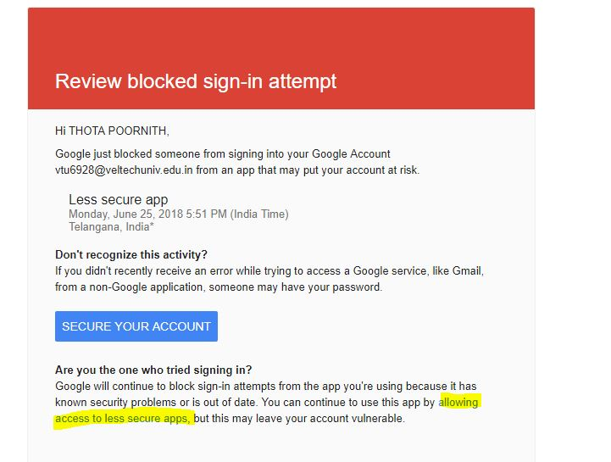
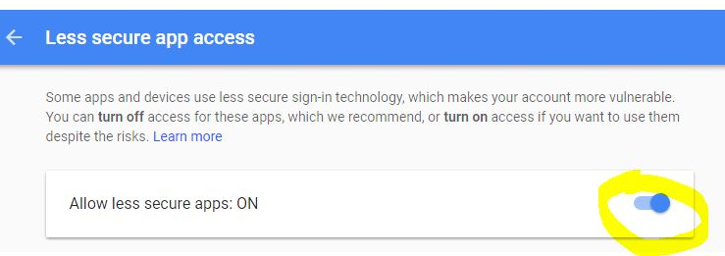
Gmail settings
Click on the highlighted link to allow the less secure app access

Slide 9
Technology/Tool/Components used
Explain the Technologies, Languages used in your solution.
We used Python Programming because it is rich in its library functions for machine learning projects. I used libraries like tkinter, pandas, textwrap, xlrd, os, mammoth, time, re, docx2txt.
Tkinter : it consists of GUI components to create a user interface for the user.
Pandas : to do the manipulations of data in any type of files.
Textwrap : to clear the null values and repeated values in the list of data.
Xlrd : used to read the excel files.
Os : to get the system location path.
Pg 1

Slide 10
Technology/Tool/Components used
Explain the Technologies, Languages used in your solution.
Mammoth : converts docx to html.
Time : for sleep function.
Re : to remove the html tags for the data.
Docx2txt : converts docx to text file and takes data as list with unicode-8 format.
Pg 2

Slide 11
Architecture overview
Explain the Architecture you followed in your solution
In each manual, the type of font or text used is different. The most common point in all the manuals is the styling used to differentiate questions and answers.
So I converted each document into an html file and with the help of styling tags, I classified the data into questions list and answers list in the SampleOutput.xlsx file
But to get the SampleOutput.xlsx file , I created 3 different codes for 3 manuals to convert to list and all the 3 excel files are at last concatenated with the previous tickets excel and SampleOutput.xlsx file is created.
Now final application is made by using the SampleOutput.xlsx file by reading the questions into the list box and entry box is made as auto suggestion for user simplicity.
The resolution or solution is got from the SampleOutput.xlsx file and printed down. If the query is not present, he/she can send that query to the admin for clarification.

Slide 12
Elaboration of the usage
How does your application work.
The problem statement is typed in the entry box. The suggestion questions present in the excel with the matching keywords are shown in list box.
Select the required problem and click on check button. The answer is shown in the text box below the buttons.
If needed to check other problem, click clear button and then type query in entry box.
If the problem is not listed, click on problem not listed button. It gives a window asking for Gmail id , Gmail password, and the query.
Pg 1

Slide 13
Elaboration of the usage
How does your application work.
For first time users, type the required fields and click submit button. Check the mail inbox. As the application is not google allowed app, we need to allow the less secure application access. Follow Slide 6 for allowing the access. Again send the query with mail id and password as asked in the window. Now the message is sent.
For next time users, directly type mail id, password and query and click submit. Mail is sent to admin.
Pg 2

Slide 14
Number of Output Questions Working
In the output sheet we provided how many questions are showing the correct answers and what are those.
21 out of 23 questions given in Sample Output file are giving the correct answers. They are:
Login Page is not getting displayed
Login Page Down
Login Page not opening
Login Page is not showing up.
Login credetials are not working.
Forgot the password, can you please reset the password for me.
Password expired.
FW: Myspace Login Issue
Please reset mypassword.It is expired.
Account got locked, because of 3 wrong attempts os password.
Could you please reset the password Account locked. Not able to login
Create new account and share the username and password
New Account is needed for a new joinee.
Pg 1

Slide 15
Number of Output Questions Working
In the output sheet we provided how many questions are showing the correct answers and what are those.
New Account Creation for user Tom.
Needs permission wifi access to laptop
Wifi access needed.
Need to connect to Wifi.
Unable to connect to Internet
How can I Delete Internet Cookies
Not able to send and receive emails
Volume Icon is not showing in right corner
Pg 2

Slide 16
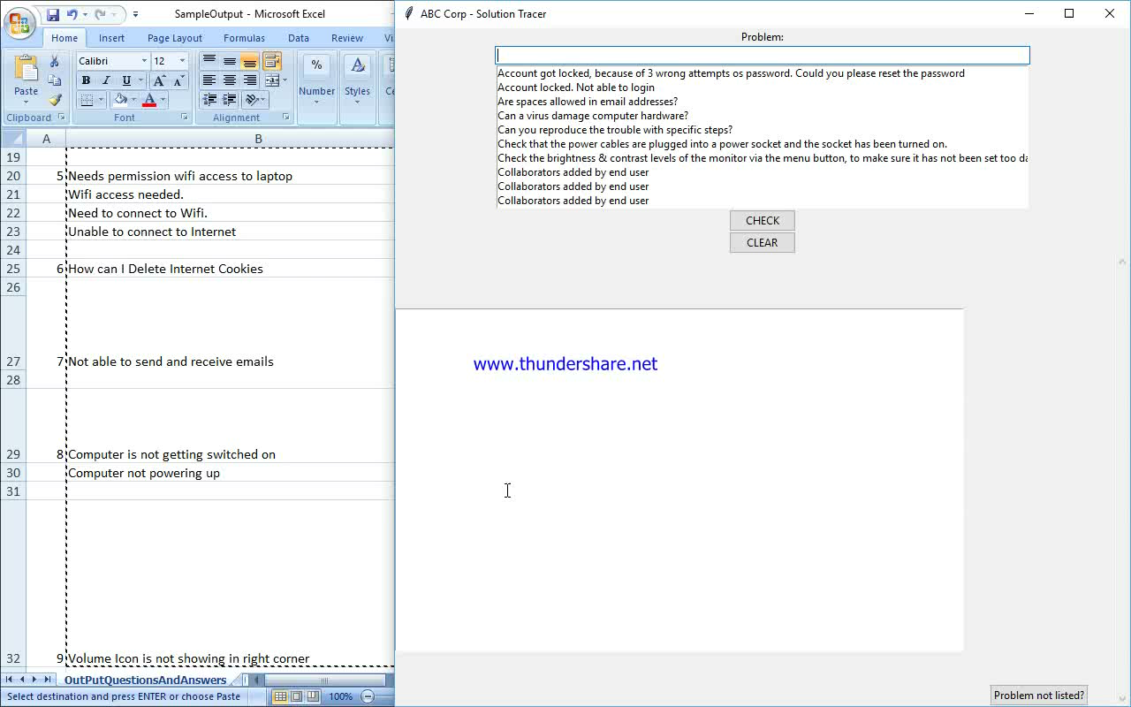
Prototype Demo
Add a video link of the workable solution. Please cover as many output scenario’s as you can show from the output excel provided. (Mandatory)

Slide 17
Source Code
GIT Link and Compile Instructions, Solution Hosted URL
GIT URL: https://github.com/poornithsundar/Solution_tracer.git
Compile Instructions: Firstly open the readme.txt file to understand the compilation process.

Slide 18
Completeness
Mark the area’s which have been completed and tested. They will be a part of the evaluation parameters.
Area | Description
Performance – How did you measure the performance of this system. | By checking the outputs given by the program and checking it in the manual, the performance is calculated. It gives approximately 80% - 90% accurate results.
Usability – How usable is your solution | It is user-friendly and tech agents friendly application to retrieve the solution for the problem ticket.
Completeness – What has been completed. | Resolution of the tickets or problems from the manual and the missing queries are sent through the mail to the admin.
Pending – What are the items which are pending | Changing the GUI Application into a CHATBOT application to make the interaction easy and nice lookup for the application

Slide 19
Possible Improvement
Any Improvements you want to add?
We want to add 2 improvements to the application. They are:
Changing the application into an interactive chatbot app to make the application look stylish and neat and user-friendly easy accessable.
Making the application a google trusted application in terms of security for avoiding the gmail complexity of allowing less secure application toggle.

Slide 20


