Slide 1

THE UNIVERSITY OF HONG KONG
Custom-Designed Machine Learning Algorithms:
A Plug-and-Play Framework for Diverse Applications
in Trading and Finance
COMP 7409 Machine Learning in Trading and Finance – Group 7
Nov.9, 2023
Notes:
名字可以再讨论下？ - lsh

Slide 2
1
Introduction
Framework
Live Demo
Conclusion and Future work
2
CONTENT
3
4

Slide 3
1 Introduction

Slide 4
1 Introduction
1.1 Background and Motivation
Strong demand for data-driven decisions in finance
Existing machine learning tools lack domain-specific features and solutions
Code-intensive or highly encapsulated
We aim at:
Providing finance industry with customized tools
Eliminating the need for complex coding and streamlining the entire data-to-algorithm process
Offering a highly interpretable set of machine learning algorithms and resources for beginners
Notes:
might add one motivation: existing tools either are code-intensive to process the data before apply to the algorithms, or are highly encapsulated and hard for us to understand the data flow. - lsh

Slide 5
1 Introduction
1.2 Our Project Achievements
We've built a Python machine learning framework designed specifically for the finance industry:
Categorized financial data into 5 major groups
Implemented 10 efficient machine learning algorithms
Optimized approach to provide multiple actionable machine learning algorithms for each type of financial problems

Slide 6
2 Framework

Slide 7
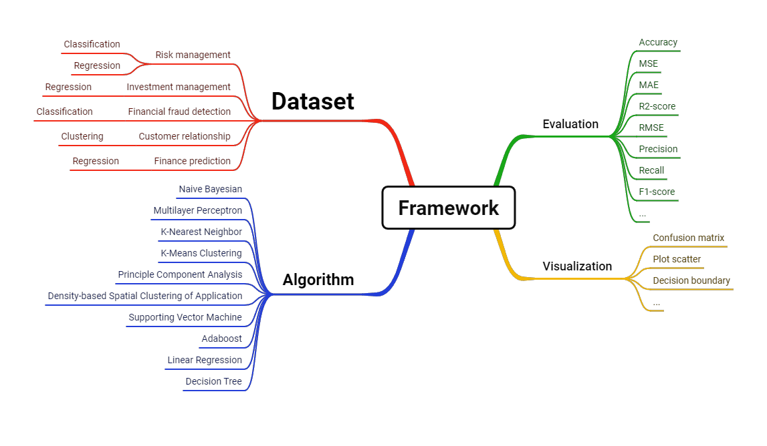
Diverse financial applications and respective algorithms with rich evaluation and visulization methods.
Notes:
Market Risk Prediction: Predicting Fluctuations in Financial Markets to help investor make wise decisions.
Market trends prediction: Predict price trends for stocks, commodities and other assets
Credit card fraud detection: Identify fraud in credit card transactions
Customer churn prediction: predict which customers will be lost and take steps to maintain customer relationships
Profit prediction: Predict future profitability based on historical data and market trends

Slide 8
Pipeline details based on the framework.

Slide 9
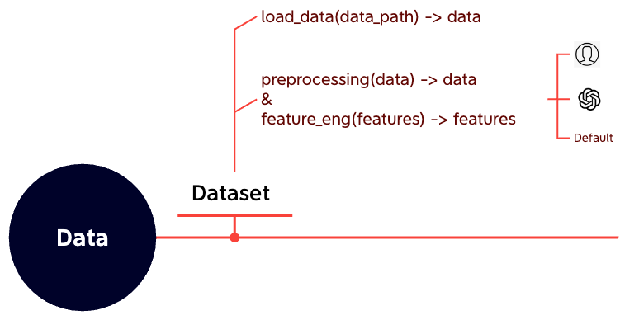
Flexible data preprocessing and feature engineering with three plugable coding module - AI-based, human-written and default.
Notes:
Given a data, e.g. boston house price data, dataset handle all the stuff about data, include loading the csv, preprocessing like normalization, handling missing values, etc,
picking out the important features, etc.

Slide 10
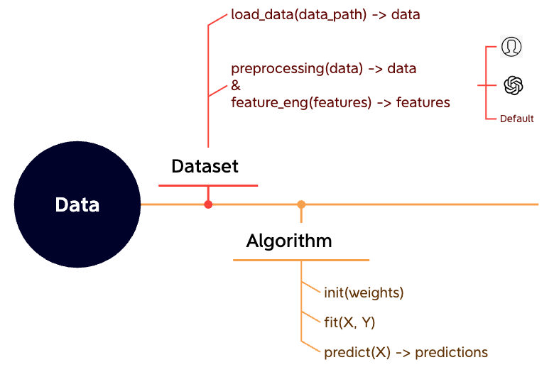
Model training and predicting.
Notes:
responsible for model training and predicting. in this part, a model is first initialized, then when passed with training data with X as input and Y as target, we train the model in a fit function and update the weights. algorithm also have predict function which take any data object as input and predict the label.

Slide 11
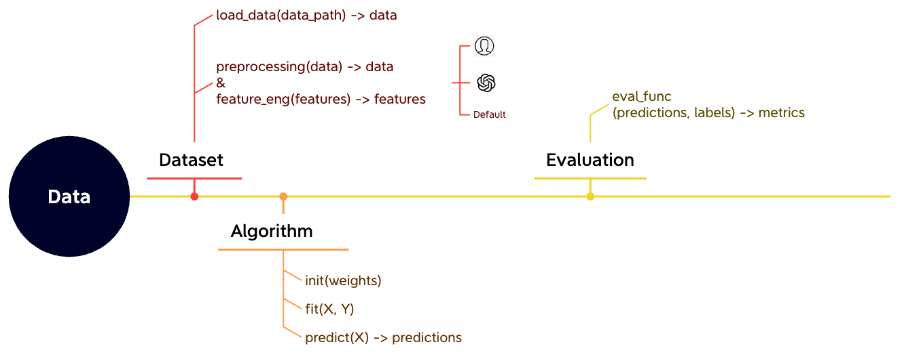
Diverse evaluation metrics on the dataset with trained model.

Slide 12
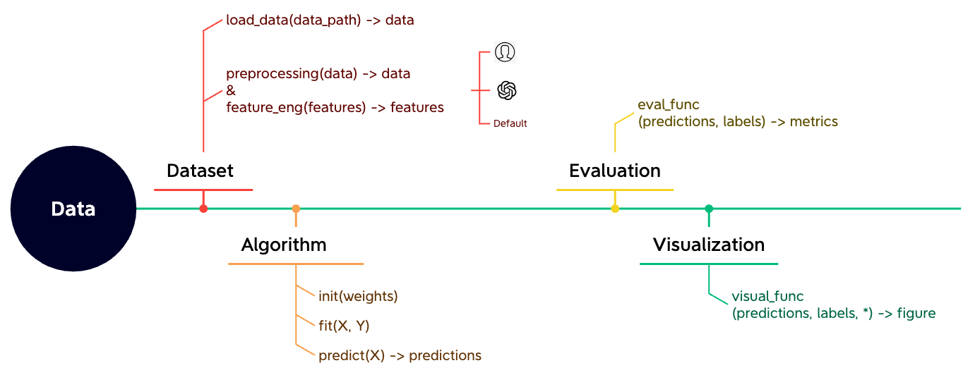
Diverse visualization methods to show the evaluation results.

Slide 13
3 Live Demo
Notes:
The demo will show how we use SVM algorithm to predict the netflix stock profit in our framework, which is a finance prediction task

Slide 14
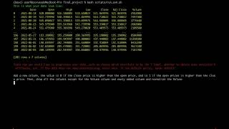

Slide 15
4 Conclusion and Future work

Slide 16
4 Conclusion and Future work
Classification of Machine Learning Problems in Finance
We categorize the common machine learning problems in finance into the following five categories:
Financial fraud detection
Customer relationship management
Financial forecast
Risk management
Investment and Asset Management

Slide 17
4 Conclusion and Future work
4.1 Financial fraud detection
(Classification) Credit card fraud detection
(Classification) Malicious transaction detection
Dataset: Credit Card Fraud Detection Dataset 2023
Algorithms: k-Nearest Neighbor
The K-nearest neighbors (KNN) algorithm applied to classify credit card fraud dataset achieved an accuracy of 78.9%. With precision values of 74.2% for identifying non-fraudulent transactions and 86.0% for detecting fraudulent transactions, the algorithm demonstrates good performance in accurately predicting both classes. The recall values of 88.9% for non-fraudulent transactions and 68.9% for fraudulent transactions indicate that the algorithm effectively captures a high proportion of both classes. Overall, the KNN algorithm shows promising performance in accurately classifying credit card fraud, with balanced precision and recall values.

Slide 18
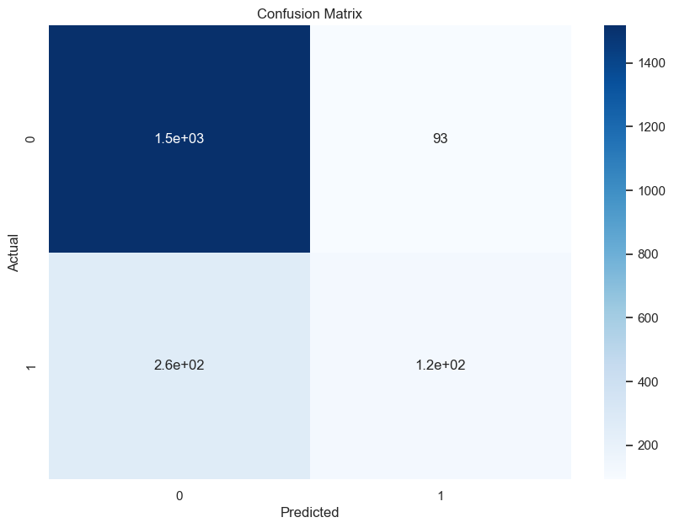
4 Conclusion and Future work
4.2 Customer relationship management
(Classification) Customer Segmentation
(Classification) Churn prediction
Dataset: Credit Card Customer Churn Prediction
Algorithms: Naive Bayes
The Naive Bayes algorithm for predicting customer churn achieved an accuracy of 82.1%, with precision values of 85.1% for non-churned customers and 57.3% for churned customers. However, the recall values were 94.2% for non-churned customers and 32.1% for churned customers, indicating room for improvement in accurately identifying churned customers.
Notes:
add one future work: adaptive evaluation to free us from writing codes for task-specific evaluation, e.g. binding algorithms with evaluation - lsh

Slide 19
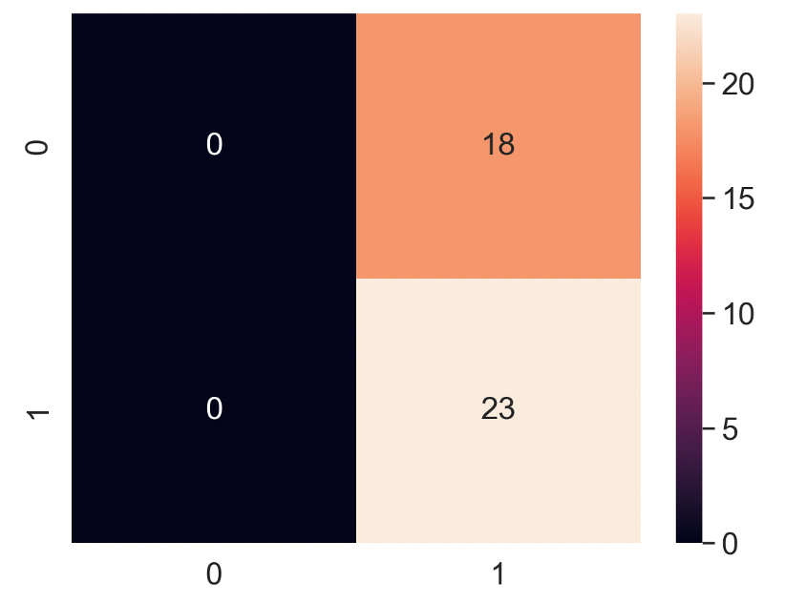
4 Conclusion and Future work
4.3 Financial forecast
(Regression/Classification) Profit forecasting
(Regression) Financial Statement Analysis
Dataset: Stock Price of Netflix
Algorithms: SVM
Given history volumns, predict if a stock’s open price is higher or lower than the close price. The label is 0 if the close price is higher than the open price, and is 1 if the open price is higher than the close price. Predictions were 56% accurate. However, all predictions are label 1, might be overfitted.
Notes:
add one future work: adaptive evaluation to free us from writing codes for task-specific evaluation, e.g. binding algorithms with evaluation - lsh

Slide 20
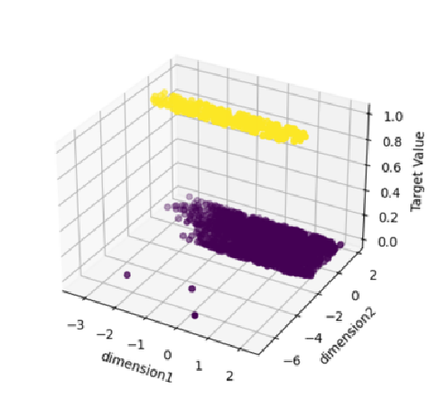
4 Conclusion and Future work
4.4 Risk Management
(Classification) Credit score
(Return) Market Risk
(Classification/Regression) Credit Risk
Dataset: creditcard_2023
Algorithms: Principal Component Analysis(PCA)
The Silhouette Coefficent is 0.1366, indicating that the data after principal component analysis (PCA) has a certain degree of clustering structure.
The two principal components together retained approximately 81.44% of the total variance, providing a fairly good dimensional compression of the original data.

Slide 21
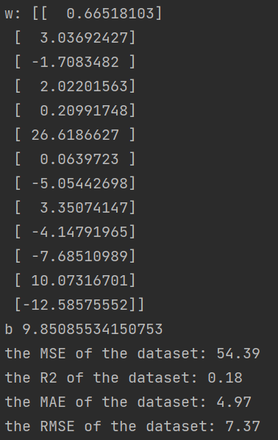
4 Conclusion and Future work
4.5 Investment and Asset Management
(Regression) Portfolio optimization
(Regression) Predicting Market Trends
Dataset: boston_house_prices
Algorithms: Linear Regression
This output provides a prediction model based on this dataset.
Meanwhile, it gives 4 evaluation function.
Mse=54.39 MAE=4.97 RMSE=7.37 R2=0.18
These four evaluation functions indicate that the predicted results are very close to real data, and the model performs well

Slide 22

Conclusion with Numbers
1 group
5 members
10 algorithms
15 datasets
Tens of thousands of lines of code
Millions of Financial Scenarios
Infinite possibilities!

Slide 23
Team Member & Work Distribution
Liu Zhengze (Team Leader):
Algorithm implementation
Data preprocessing &&Evaluation
Report writing
Chen Rui:
Algorithm implementation
Data preprocessing & Evaluation
Dataset collection
Chen Xingnuo:
Algorithm implementation
Data preprocessing & Evaluation
Dataset collection
Liang Shihao:
Algorithm implementation
Framework implementation
Report writing
Zhong Ruohan:
Algorithm implementation
Framework implementation
Data preprocessing &Evaluation

Slide 24
Thanks for your listening!
project codes

