Slide 1

ALY 6010 Probability Theory and Introductory Statistics Final Project Presentation Fall 2023
Prof. Ji-Young Yun
Group 6
Poorva Joshi, Yash Gokhale, Krishna Mohan, Rohit Gupta

Slide 2
Agenda
Dataset
Libraries Installed
Data Cleaning
Bar Plot
Histogram
Box Plot
Two-Sample T-test
Correlation
Heatmap
Regression
Prediction

Slide 3
Dataset
The dataset specifically explores awards received by companies in two states, Georgia and Tennessee.
The dataset is sourced from the US Seed Foundation and encompasses 30 attributes.
It provides a comprehensive view of awards received by companies across various categories and subcategories.
The project's primary objective is to conduct an exploratory data analysis and hypothesis testing on government awards data.

Slide 4
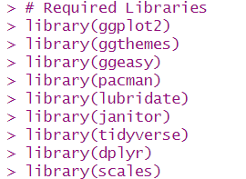
Libraries Installed
Together, these libraries offer a wide range of capabilities for managing packages, analyzing data, visualizing data, and working with date-time data in R.

Slide 5
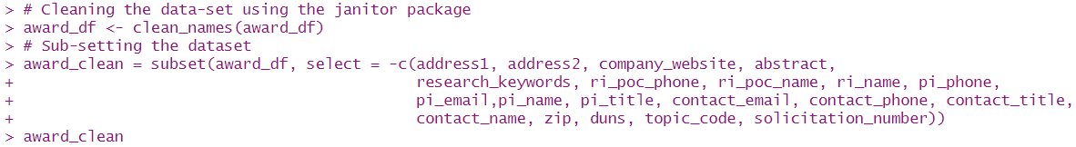
Data Cleaning
The “clean_names” function is part of the janitor package in R. It is used to clean and standardize column names in a data frame.
The “subset()” is used for filtering rows from a data frame based on specified conditions, providing a convenient way to create a subset of the original data.

Slide 6
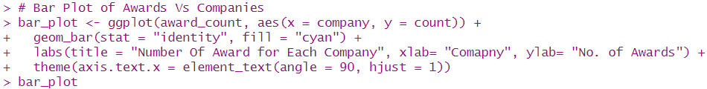
Bar Plot
This R code uses the ggplot2 package to create a bar plot “(bar_plot)” visualizing the number of awards received by each company.
The x-axis represents company names, and the y-axis shows the corresponding count of awards.

Slide 7
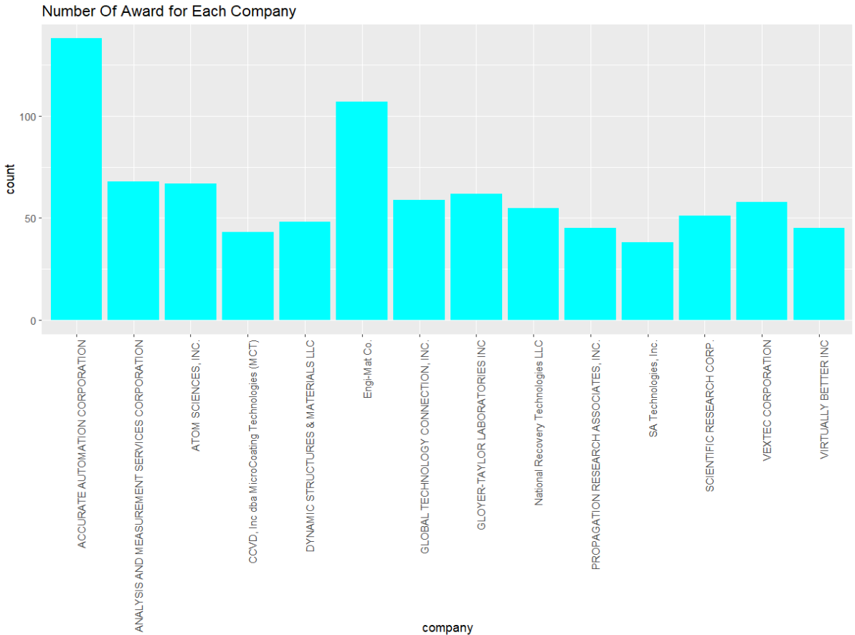
Bar Plot- contd.

Slide 8
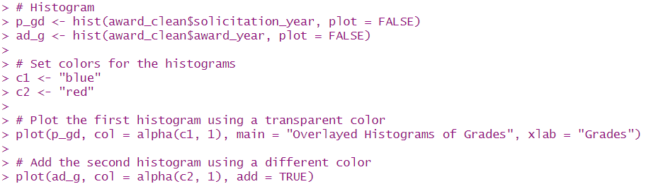
Histogram
The code utilizes the hist() function to create histograms for two variables:
award_clean$solicitation_year = solicitation years
award_clean$award_year = award years

Slide 9
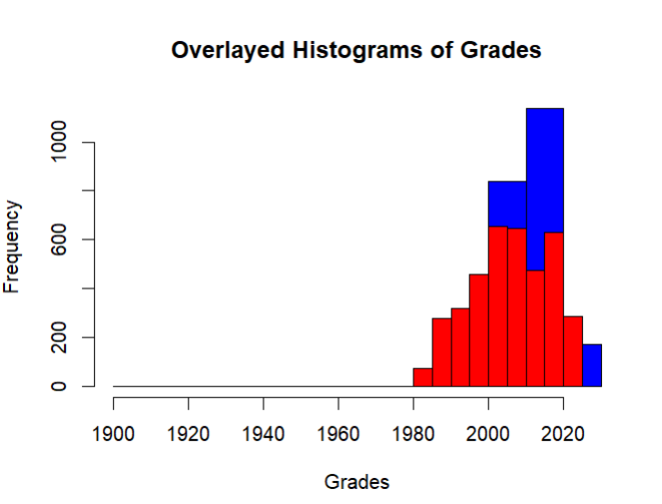
Histogram- contd.
The resulting plot, called the Overlayed Histogram, makes it possible to compare the distributions of the two variables directly in one plot.

Slide 10
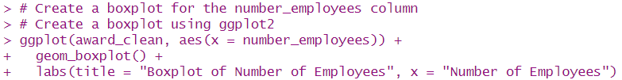
Box Plot
The Boxplot graphically represents the 5-point summary.
It also helps us to identify the outliers and understand the overall pattern of the data.

Slide 11
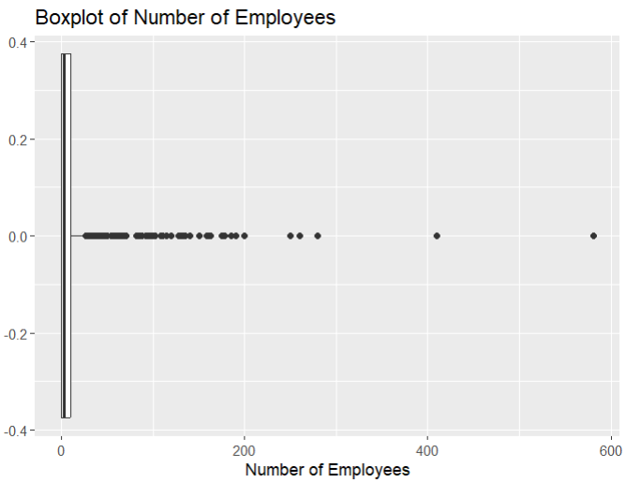
Box Plot- contd.

Slide 12
Two-Sample T-Test
Do the company owners with socially disadvantaged backgrounds get more award money than the ones who are not socially disadvantaged? (GA, TN)
Null Hypothesis → The difference of means between award amounts for the companies with socially disadvantaged backgrounds and advantaged backgrounds is zero.
Alternative Hypothesis → The difference of means between award amounts for the companies with socially disadvantaged backgrounds and advantaged backgrounds is not zero.

Slide 13
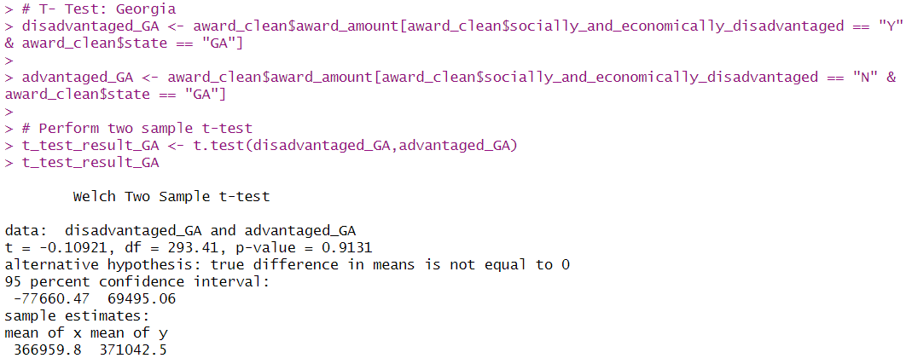
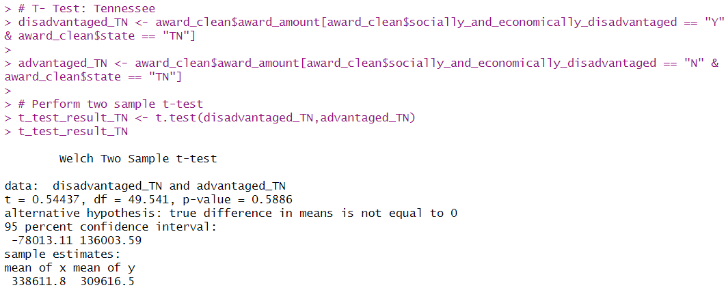
Two-Sample T-Test
Notes:
Georgia: The mean award amount for socially and economically disadvantaged groups ($366,959.8) is slightly lower than that of non-disadvantaged groups ($371,042.5). However, the difference is not statistically significant (p-value = 0.9131, which is higher than the typical significance level of 0.05).
Tennessee: In contrast, the mean award amount for socially and economically disadvantaged groups ($338,611.8) is higher than that of non-disadvantaged groups ($309,616.5). Again, similar to Georgia, the observed difference is not statistically significant (p-value = 0.5886).

Slide 14
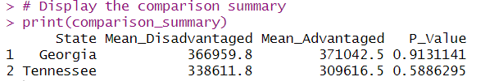
Two-Sample T-Test
Both Georgia and Tennessee exhibit similar patterns regarding award amounts for disadvantaged and non-disadvantaged groups.
In both cases, there isn't enough statistical evidence to support a significant distinction between the award amounts received by these groups.
Notes:
In both Georgia and Tennessee, the p-values obtained from the t-tests are relatively high (above the typical significance level of 0.05). This suggests that there isn't enough evidence to conclude that there is a statistically significant difference in award amounts between socially and economically disadvantaged and non-disadvantaged groups within each state.

Slide 15

Correlation
The positive value demonstrates that there is a positive correlation between the award year and the award amount.
The value also suggests that there is relatively weak correlation.

Slide 16
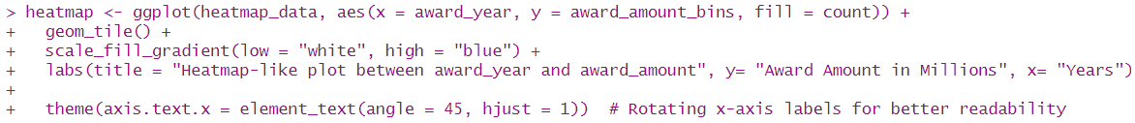
Heat Map
Utilizing ggplot2, a heatmap plot is generated, visualizing the relationship between “award_year” and discretized “award_amount”.
The resulting visualization, which shows how rewards are distributed across various amounts and how they have changed over time, helps to spot patterns and trends over time.

Slide 17
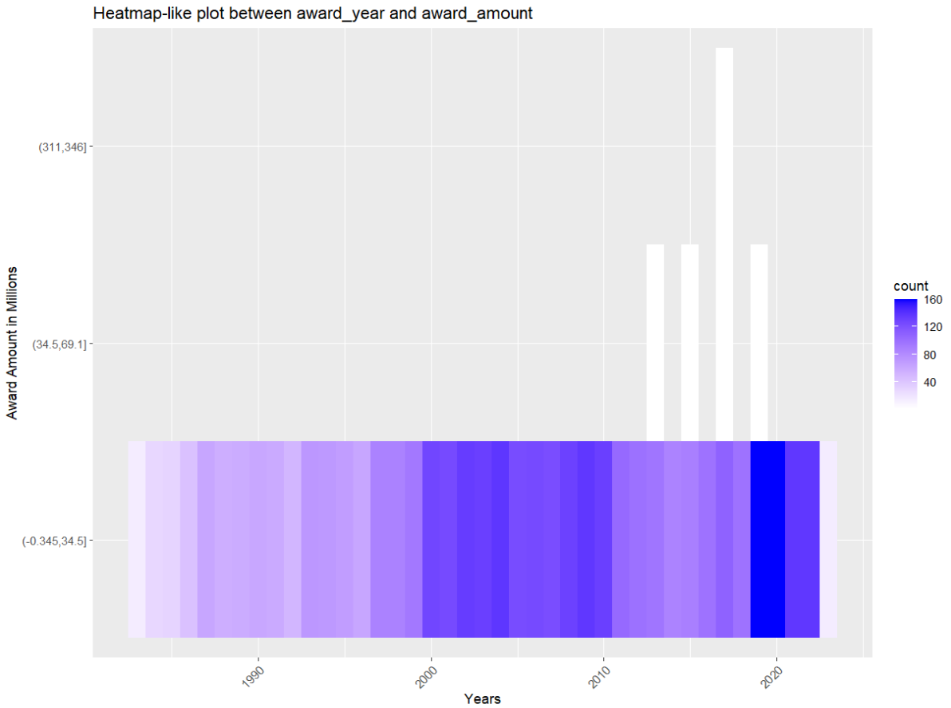
Heat Map- contd.

Slide 18
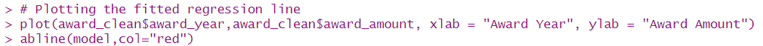
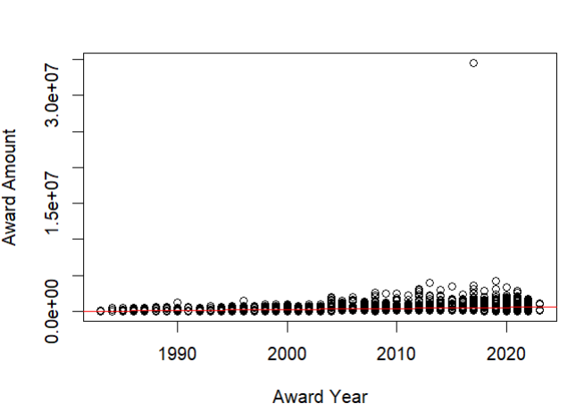
Regression
The purpose of the regression line is to visually represent the estimated linear relationship between the two variables. The line is fitted based on the coefficients obtained from the linear regression model.

Slide 19
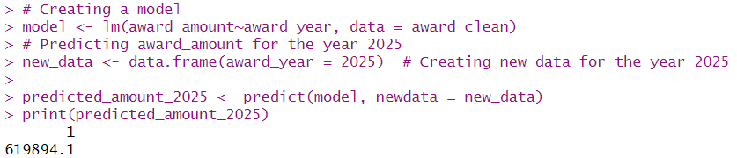
Prediction
The linear regression model “lm()” which was built predicts “award_amount” based on “award_year” using the “award_clean” dataset.
The model is then used to predict the award amount for the year 2025, yielding an estimated amount of approximately $619,894.10.

Slide 20
Conclusion
The mean for the award amount for the state of GA is more than that of TN.
The t-test suggests that there is no significant difference between the award amount for the socially disadvantaged and advantaged across the states.
ALY6010 allowed us to cover a diverse range of statistical analyses, data visualizations, and predictive modeling tasks on the given dataset.

Slide 21

THANK YOU!

