Slide 1
Implementation Phase-2 on: AUTOCOMAPANION– AI-Powered Trip Planner & Smart Document Manager
JSS MAHAVIDYAPEETHA JSS SCIENCE AND TECHNOLOGY UNIVERSITY, MYSURU – 570 006 Department of computer applications
Guided by:
MS. KAVYA S R
Assistant Professor
JSS STU, Mysuru
Submitted by:
POORVA BR (01JST23UBC067)
MANASA KM (01JST23UBC053)
LALITHA LAKSHMI HM (01JST23UBC044)

Slide 2
Introduction
AutoCompanion is a smart vehicle assistant mobile application designed to simplify vehicle management and travel planning.
The application integrates OCR technology, Artificial Intelligence, and cloud services to automate everyday vehicle-related tasks.
It enables users to scan, store, and track vehicle documents such as insurance, RC, DL, and PUC.
AutoCompanion provides an AI-based tour planner that generates structured and budget-aware travel itineraries.

Slide 3
Problem Statement
Owners often miss insurance, service, and PUC renewals.
No centralized platform for vehicle documents.
Lack of smart features like AI planning, reminders, and GPS tracking.
Manual tracking of maintenance and expenses is error-prone.
Monitoring vehicle health, location, and performance is difficult.

Slide 4
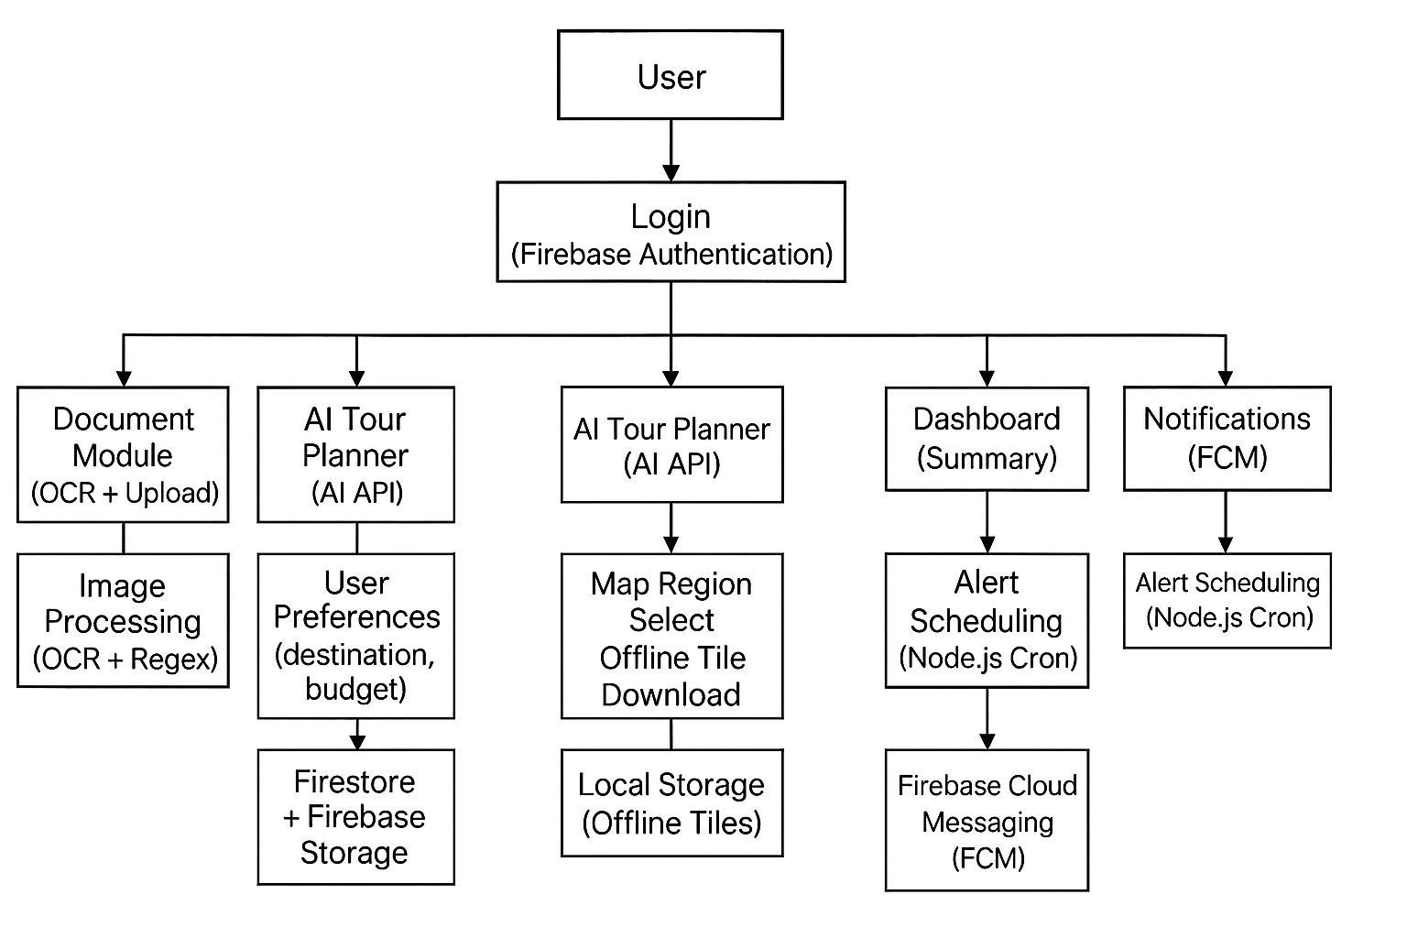
Architectural Diagram

Slide 5
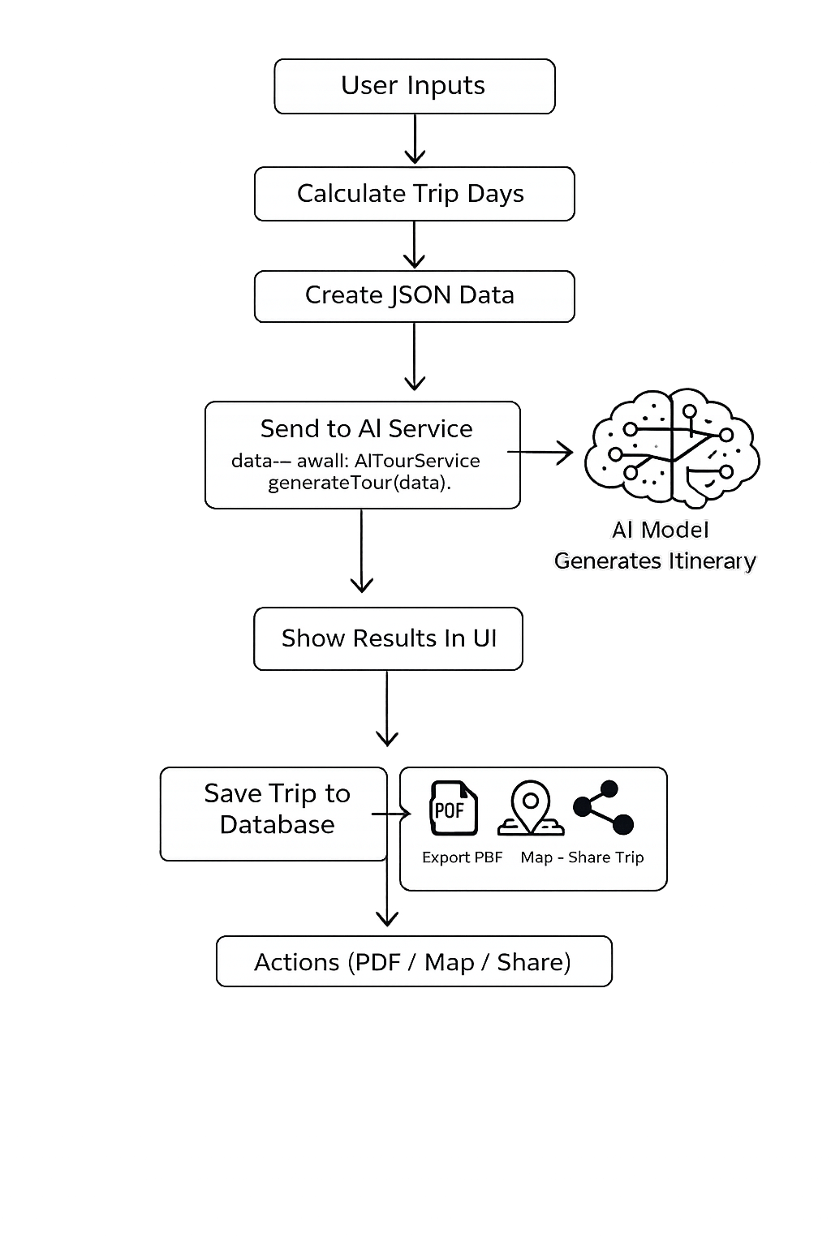
AI-Driven Tour Planning Workflow
Step 1: Start
Step 2: Accept user inputs
(Start location, Destination, Travel dates, Budget, Interests)
Step 3: Calculate total trip days
Step 4: Create structured JSON data from inputs
Step 5: Send JSON data to AI services
(Preparing and forwarding input for Transformer-based AI processing)
Step 6: AI model processes the prompt and generates itinerary
(Using a Transformer-based autoregressive algorithm)
Step 7: Display itinerary in UI
Step 8: Store itinerary in database (Supabase)
Step 9: Enable user actions
(PDF, Map, Share)
Step 10: End

Slide 6
AI-Driven Tour Planning Algorithm
Algorithm Used: Transformer-Based Autoregressive Model
This algorithm is used to automatically generate a personalized travel itinerary based on user inputs.
It enables the system to convert raw trip details into a clear, human-readable tour plan.
Key Features:
Uses a Transformer neural network (Gemini AI)
Generates the itinerary word by word using next-token prediction
Understands destination, number of days, budget, and user interests
Produces a structured and context-aware travel itinerary
Creates a meaningful tour plan step by step
Code Used:
response = model.generate_content(build_prompt(data))

Slide 7
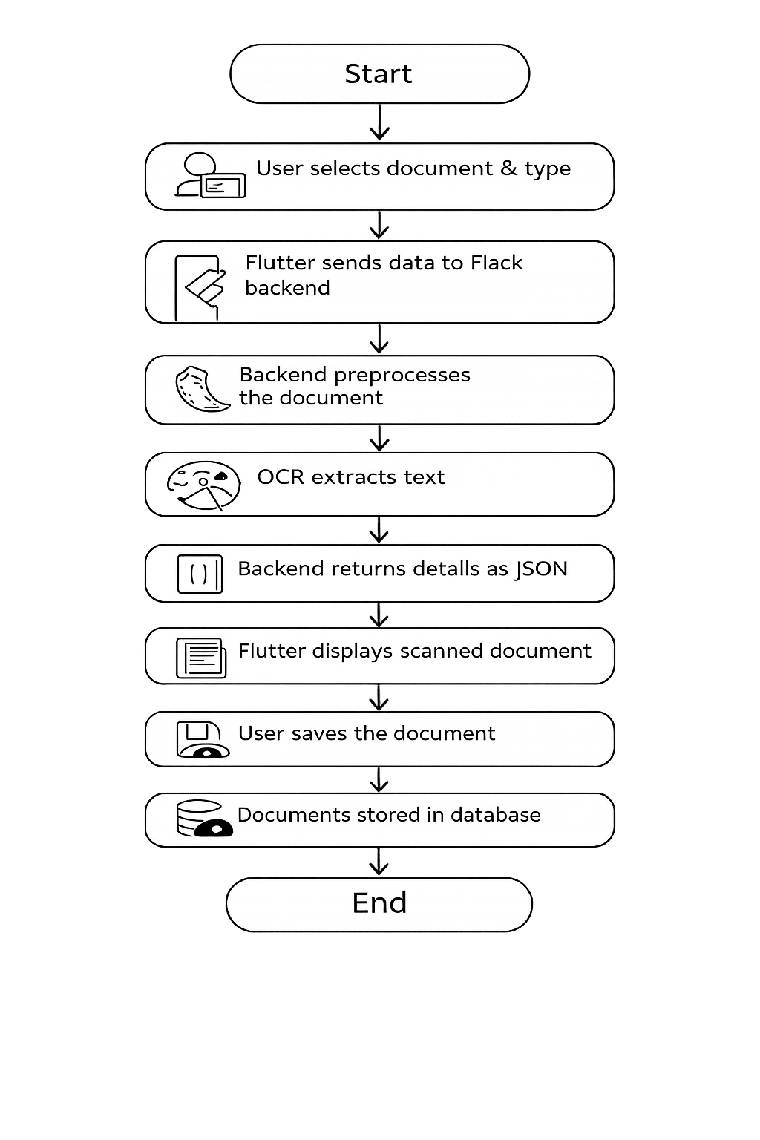
OCR Document Scan Workflow
Step 1: Start
Step 2: User selects document image and document type
Step 3: Flutter sends document data to Flask backend
Step 4: Backend preprocesses the document image
(Image preprocessing – Computer Vision algorithm)
Step 5: OCR is performed to extract text
(Tesseract LSTM-based OCR algorithm)
Step 6: Text is normalized and cleaned
(Rule-based NLP algorithm)
Step 7: Expiry date and document number are detected using regex patterns
(Regex-based information extraction algorithm)
Step 8: Backend returns extracted details as JSON
Step 9: Flutter displays scanned document details
Step 10: User saves the document
Step 11: Document image and metadata are stored in database
Step 12: End

Slide 8
OCR Document Scan Algorithm
Algorithm Used:
These algorithms work together to automatically extract important details from scanned documents.They improve image quality, recognize text, clean noisy data, and extract required information accurately.
1. Image Preprocessing – CV (Computer Vision)
image=cv2.resize(image,None,fx=2.5,fy=2.5)
gray=cv2.cvtColor(image,cv2.COLOR_BGR2GRAY)
thresh=cv2.adaptiveThreshold(gray,255,
cv2.ADAPTIVE_THRESH_GAUSSIAN_C,cv2.THRESH_BINARY,31,11)
2. Tesseract LSTM-based OCR (Optical Character Recognition)
text=pytesseract.image_to_string(image,"--oem 3 --psm 11 -l eng")
3. Rule-based NLP (Natural Language Processing)
text=text.lower()
text=re.sub(r"\s+"," ",text)
4. Regex-based IE (Information Extraction)
re.search(r"(valid till|expiry date).*",text,re.I)

Slide 9
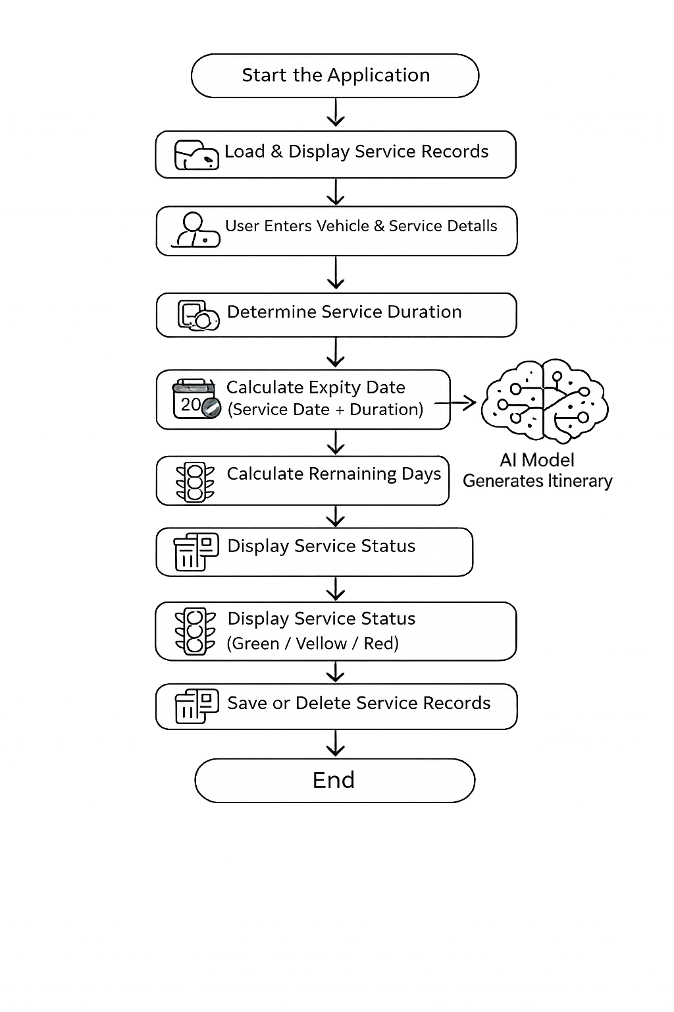
Service And Maintainence Workflow
Step 1: Start the application.
Step 2: Load vehicle service records from the database.
(CRUD Operations Algorithm – Read)
Step 3: Display service records on the screen.
Step 4: User enters vehicle name, service type, and service date.
(Data Validation Algorithm)
Step 5: Get service duration based on selected service type.
(Rule-Based Decision Algorithm)
Step 6: Calculate expiry date = Service date + Service duration.
(Temporal / Date Arithmetic Algorithm)
Step 7: Save service details into the database.
(CRUD Operations Algorithm – Create)
Step 8: Calculate remaining days = Expiry date − Current date.
(Time Interval Computation Algorithm)
Step 9: Display status color (Green >30 days, Yellow =30 days, Red <30 days).
(Rule-Based Classification Algorithm)
Step 10: Allow user to delete service records.
(CRUD Operations Algorithm – Delete)
Step 11: Stop.

Slide 10
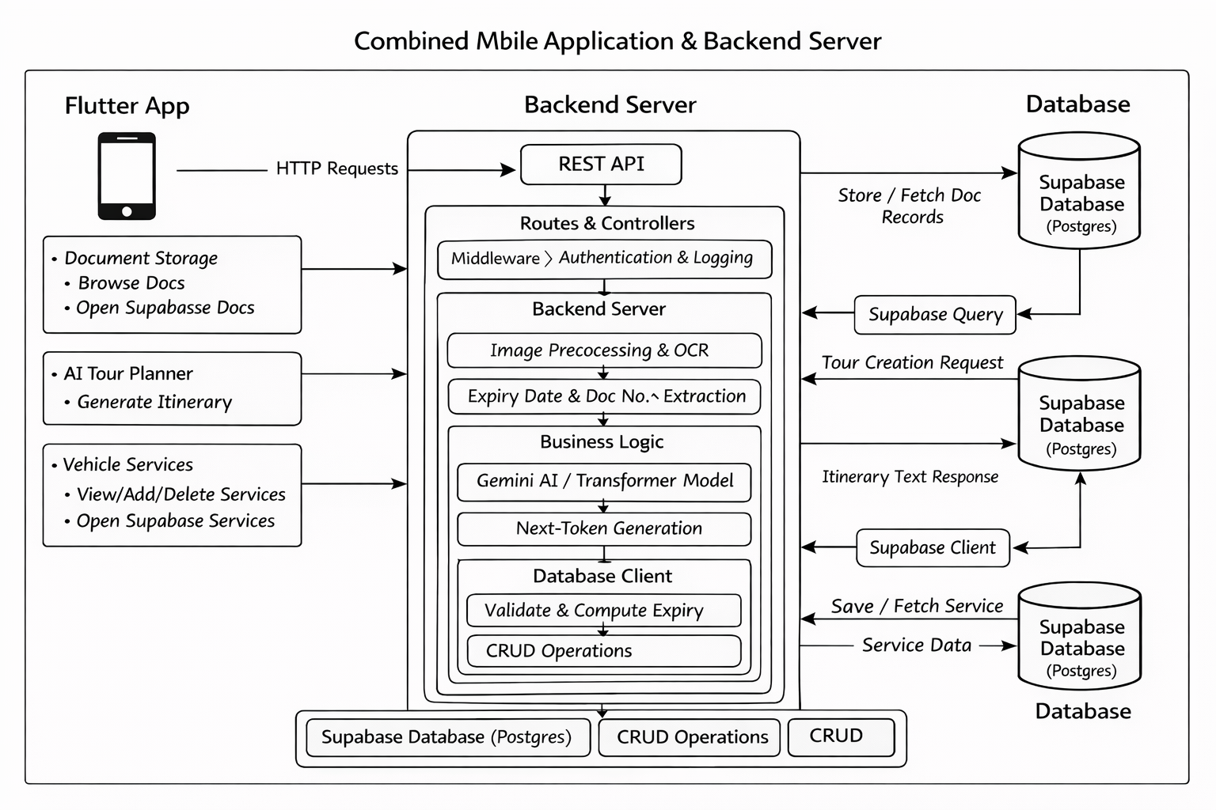
Dataflow Diagram

Slide 11
Thank you

