Slide 1
NSAF AND S/S PROJECT T2 AIM : EDGE DETECTION USING CANNYEDGE METHOD
GROUP NO. 16
GROUP MEMBERS:
Pranali Gaikwad MIS: 111807067
Poorval Wanere MIS:111807077
Raj Murumkar MIS:111807075
Ananya Popat MIS:111813060

Slide 2

WHAT IS A DIGITAL IMAGE AND HOW IT IS STORED?
A digital image is a picture which contains a fixed number of rows and columns of pixels.
Typically ,the pixels are stored in a computer memory as a raster map,2D array of small integers. These values are often transmitted or stored in compressed form.

Slide 3
THE CANNYEDGE APPROACH FOR EDGE DETECTION :
INPUT IMAGE
GAUSSIAN FILTER
VERTICAL AND HORIZANTAL EDGE DETECTION USING SOBEL OPERATOR
.
.
EDGE DIRECTION (THETA) MAPPING
NON MAXIMUM SUPRESSION
.
THRESHOLDING
OUTPUT IMAGE WITH BORDERS DETECTED,

Slide 4
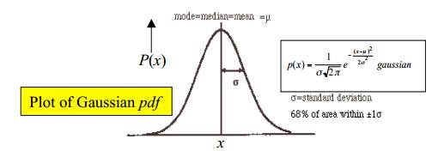
Use of Gaussian Filter in Canny edge
The Gaussian smoothing in the Canny edge detector fulfills two purposes: First, it can be used to control the amount of detail that appears in the edge image and Second, it can be used to suppress noise. All the edges have been detected and almost all of the noise has been removed.
Gaussian functions are widely used in signal processing to define gaussian filters and for image processing.

Slide 5
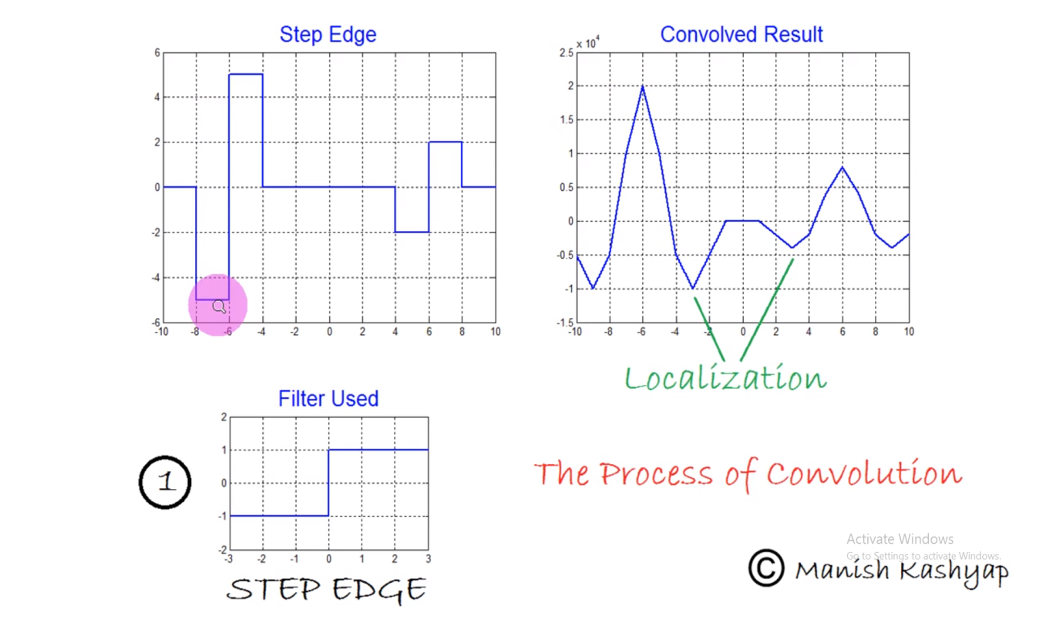
Convolution In Gaussian Filter
Convolution is a simple mathematical operation which is fundamental to many common image processing operators .
Convolution provides a way of multiplying 2 arrays of numbers generally of different sizes but of the same dimensionality to produce a third array of numbers with same dimensionality.

Slide 6
USE OF SOBEL X/SOBEL Y FILTERS
The sobel operator or sobel filter is used in image processing and computer vision particularly within edge detection algorithms where it creates an image emphasising edges.
Sobel operator is used to detect two kinds of edges in an image :vertical direction and horizontal direction.
When we use a Sobel X filter , only the Y coordinates of the image are displayed and while Sobel Y filter is used only the X coordinates are displayed.

Slide 7
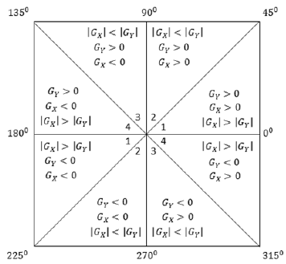
USE OF SOBEL X/SOBEL Y FILTERS
An edge direction falling in each color region will be set to a specific angle values, for instance θ in [0°, 22.5°] or [157.5°, 180°] maps to 0°.

Slide 8
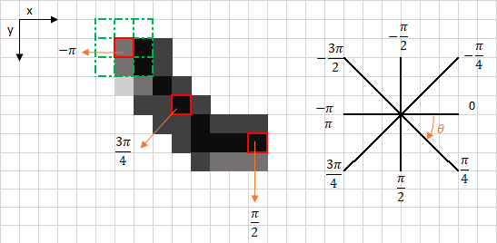
Theta Calculations and Mapping
The edge direction angle is rounded to one of four angles representing vertical , horizontal and two diagonals(0,45,90,135 degrees).

Slide 9
NON MAXIMUM SUPRESSION
Non-maximum suppression is an edge thinning technique
Non-maximum suppression is applied to find "the largest" edge. After applying gradient calculation, the edge extracted from the gradient value is still quite blurred.
Thus non-maximum suppression can help to suppress all the gradient values (by setting them to 0) except the local maxima, which indicate locations with the sharpest change of intensity value.

Slide 10
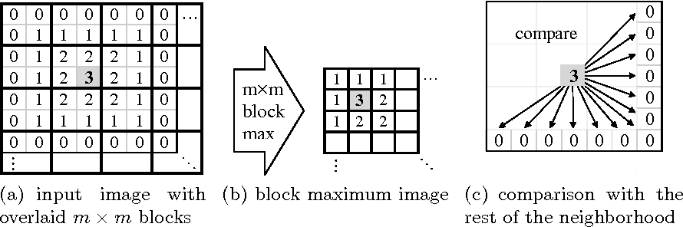
HOW NON MAXIMUM SUPRESSION WORKS ?
Compare the edge strength of the current pixel with the edge strength of the pixel in the positive and negative
If the edge strength of the current pixel is the largest compared to the other pixels in the mask with the same direction (e.g., a pixel that is pointing in the y-direction will be compared to the pixel above and below it in the vertical axis), the value will be preserved. Otherwise, the value will be suppressed.

Slide 11
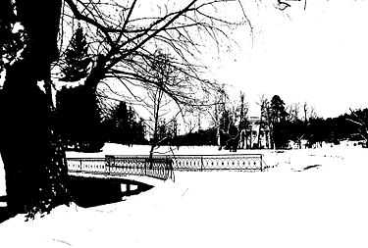
THRESHOLDING AND RESULTANT IMAGE
The thresholding method replaces each pixel in an image with a black pixel if the image intensity I i,j is less than some fixed constant T (that is, Ii , j < T ), or a white pixel if the image intensity is greater than that constant. In the example image on the right, this results in the dark tree becoming completely black, and the white snow becoming completely white. Thus converting image to binary.

Slide 12
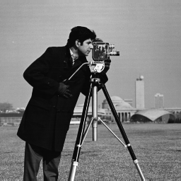

THRESHOLDING AND RESULTANT IMAGE
Original image
Resultant image
Processing using Cannyedge method

Slide 13
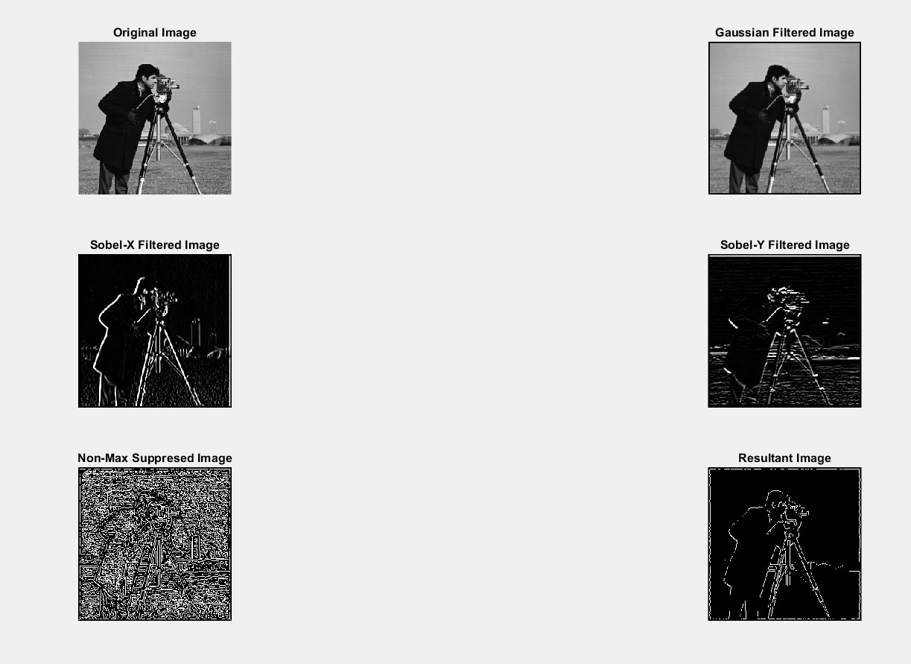

Slide 14
APPLICATIONS OF EDGE DETECTION:
COMPUTER VISION
POST PROCESSING ON IMAGE
OBJECT DETECTION
FINGERPRINT
SATELLITE IMAGES
MEDICAL SCIENCE

Slide 15
WHAT WE LEARNT……
Canny Edge Detection is a technique to extract useful structural information from different vision objects and dramatically reduced the amount of data to be processed.
Here,we learnt use of gaussian filter in image processing for removing noise signals from image.
We got an insight into an area where convolution is used.
We also learnt basics of Matlab here.

Slide 16
Thank you

