Slide 1

Telco Customer
Churn Prediction
From churn probability to a clear retention action.

Slide 2
02
Problem Statement
REVENUE LEAK
Churn is visible
only after the loss.
PREDICT → EXPLAIN → RETAIN
• Detect likely churners early
• Prioritize proactive retention
• Explain every model decision
Manual identification is slow, inconsistent, and difficult to scale.

Slide 3
03
Project Objectives
01
02
03
04
05
Predict
Stratify
Explain
Scale
Report
Likelihood of customer churn
Low, Medium, or High risk
Main factors per prediction
Single and batch analysis
Downloadable business follow-up

Slide 4
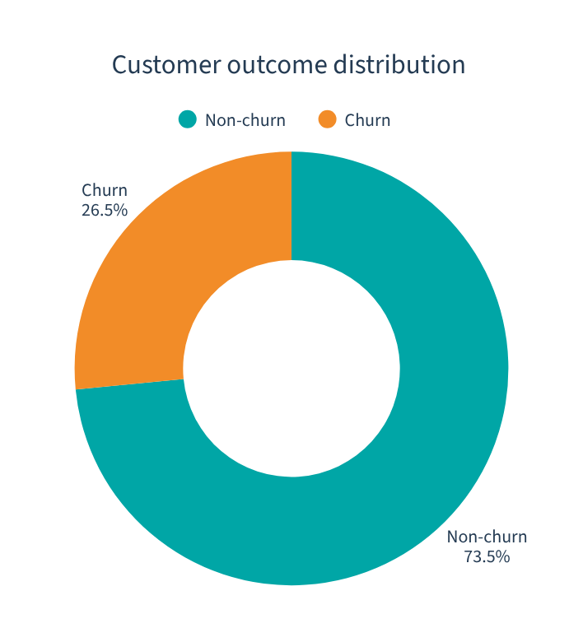
04
Dataset
7,043
customers • 21 columns
19 predictors
Tenure • contract • monthly charges
Internet • payment • support services
TARGET / CHURN: YES OR NO

Slide 5
05
Deep Learning Workflow
Customer
Data
Validation
Preprocessing
Neural
Network
Churn
Probability
Risk
Level
SHAP
Explanation
Retention
Action
RAW INPUT
MODEL & DECISION ENGINE
ACTIONABLE OUTPUT

Slide 6
06
Data Preprocessing
01 Median imputation
19
30
Missing TotalCharges
raw features
model features
02 Mode imputation
Categorical gaps
03 Standardization
Numeric features
04 One-hot encoding
Categorical features

Slide 7
07
Model Architecture
INPUT
30 features
DENSE
64 • ReLU
DENSE
32 • ReLU
DENSE
16 • ReLU
OUTPUT
Sigmoid
Batch Normalization + Dropout after each hidden layer
ADAM OPTIMIZER • BINARY CROSS-ENTROPY • EARLY STOPPING

Slide 8
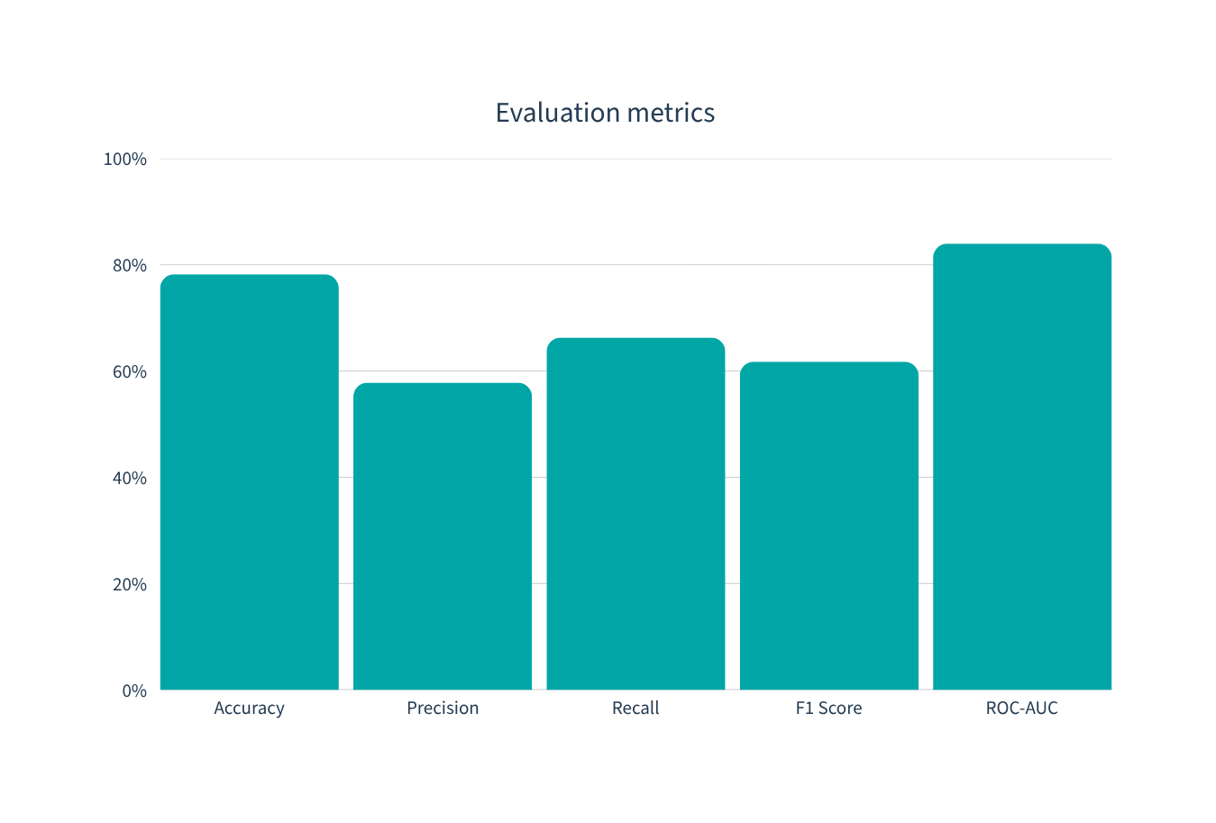
08
Model Performance
66.31%
RECALL
Missing a real churner is costlier than a false alarm.
ROC-AUC 83.97%

Slide 9
09
Risk Classification
LOW RISK
MEDIUM RISK
HIGH RISK
< 0.30
0.30 – < 0.60
≥ 0.60
Monitor
Engage
Act now
PREDICTED CHURN THRESHOLD = 0.45

Slide 10
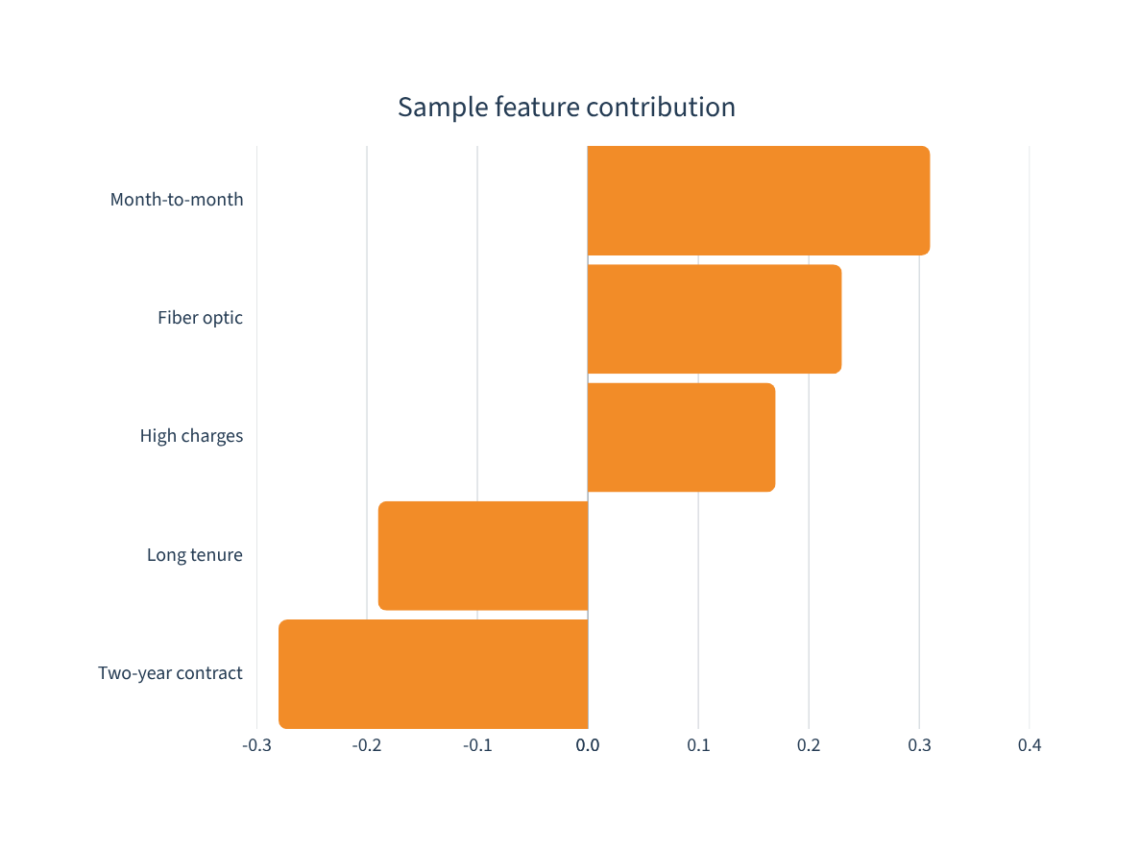
10
Explainable AI With SHAP
WHY?
+ increases churn likelihood
− supports customer retention
DeepExplainer
KernelExplainer fallback

Slide 11
11
Application Architecture & Features
Streamlit
Frontend
Flask
REST API
Preprocessor +
TensorFlow
SHAP
Explainer
1 Single customer prediction
2 Batch CSV scoring
3 Risk ranking dashboard
4 Interactive charts
5 CSV + HTML reports
6 SHAP Assistant Q&A

Slide 12
12
Conclusion & Future Scope
Predict. Explain. Prioritize.
NEXT
01 Real-time CRM integration
02 Automated retention recommendations
03 Monitoring, retraining & live testing
An explainable DNN turns churn probability into focused retention action.
66.31%
83.97%
RECALL
ROC-AUC

