Slide 1
Predicting Eligibility for The Challenge
IBM HACKATHON PROJECT
Presented By:
Student name : Poorvi Mathur
College Name & Department : JECRC Foundation (AI&DS)

Slide 2
OUTLINE
Problem Statement
Technology used
Wow factor
End users
Result
Conclusion
Git-hub Link
Future scope
IBM Certifications

Slide 3
Problem Statement
Problem statement 34 - Predicting Eligibility for The Challenge: using Machine Learning The National Social Assistance Program (NSAP) is a flagship social security and welfare program by the Government of India. It aims to provide financial assistance to the elderly, widows, and persons with disabilities belonging to below-poverty-line (BPL) households. The program consists of several sub-schemes, each with specific eligibility criteria. Manually verifying applications and assigning the correct scheme can be a time consuming and error-prone process. Delays or incorrect allocation can prevent deserving individuals from receiving timely financial aid. Your task is to design, build, and evaluate a multi-class classification model that can accurately predict the most appropriate NSAP scheme for an applicant based on their demographic and socio-economic data. The goal is to create a reliable tool that could assist government agencies in quickly and accurately categorizing applicants, ensuring that benefits are delivered to the right people efficiently.

Slide 4
Technology used
IBM cloud lite services
Watsonx.ai Studio
Jupyter Notebook
Python libraries
IBM Granite model

Slide 5
IBM cloud services used
IBM Cloud Watsonx AI Studio
IBM Cloud Watsonx AI runtime
IBM Cloud Agent Lab
IBM Jupyter Notebook
IBM Granite foundation model

Slide 6
Wow factors
This model serves as a vital tool that helps government agencies move from reactive policy to proactive, data-driven strategy, ensuring resources reach the right people more efficiently.
Unique features:
Predictive Resource Planning: Anticipates future scheme needs by location and time.
Actionable Policy Insights: Explains the reasons behind predictions to inform policy decisions.
Automated Data Auditing: Flags data anomalies for quality control and investigation.
Targeted Recommendations: Suggests which schemes to prioritize to increase program impact.

Slide 7
End users
The end users of this model would be government officials and policymakers working within the National Social Assistance Program (NSAP) and related social welfare departments.
District and State-Level Administrators
Data Analysts and Auditors
Policymakers at the National Level

Slide 8
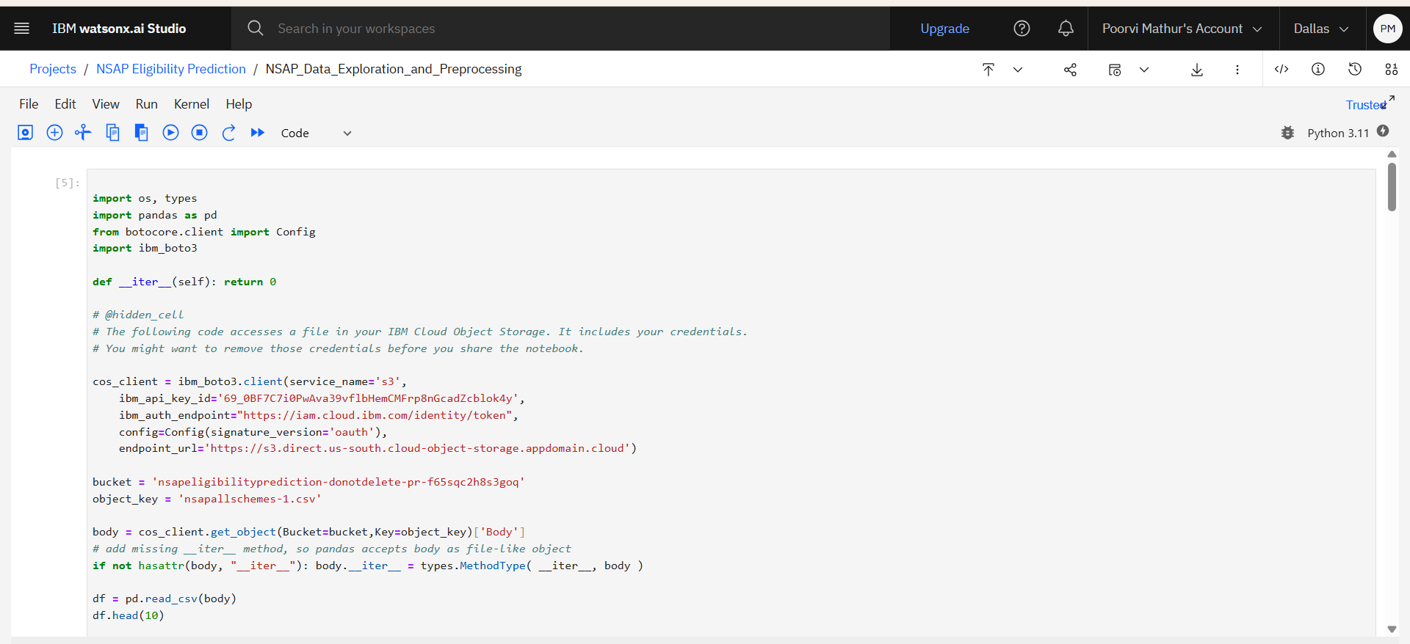
Results

Slide 9
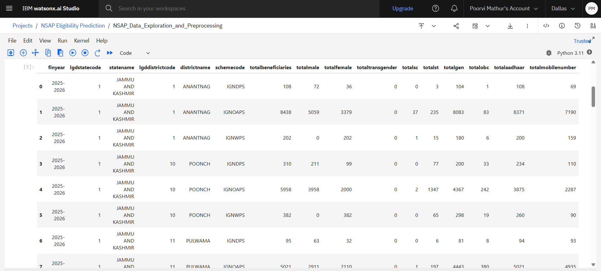
Results

Slide 10
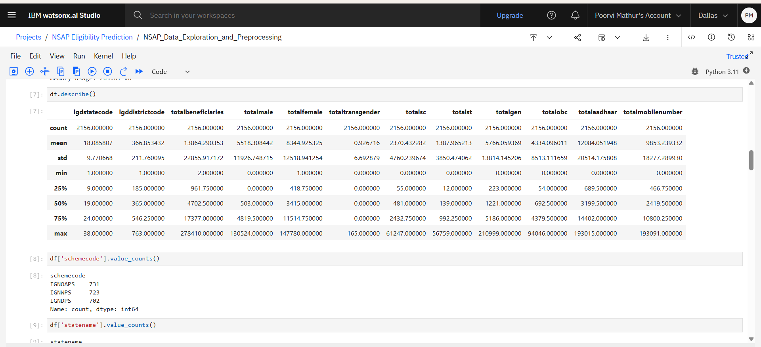
Results

Slide 11
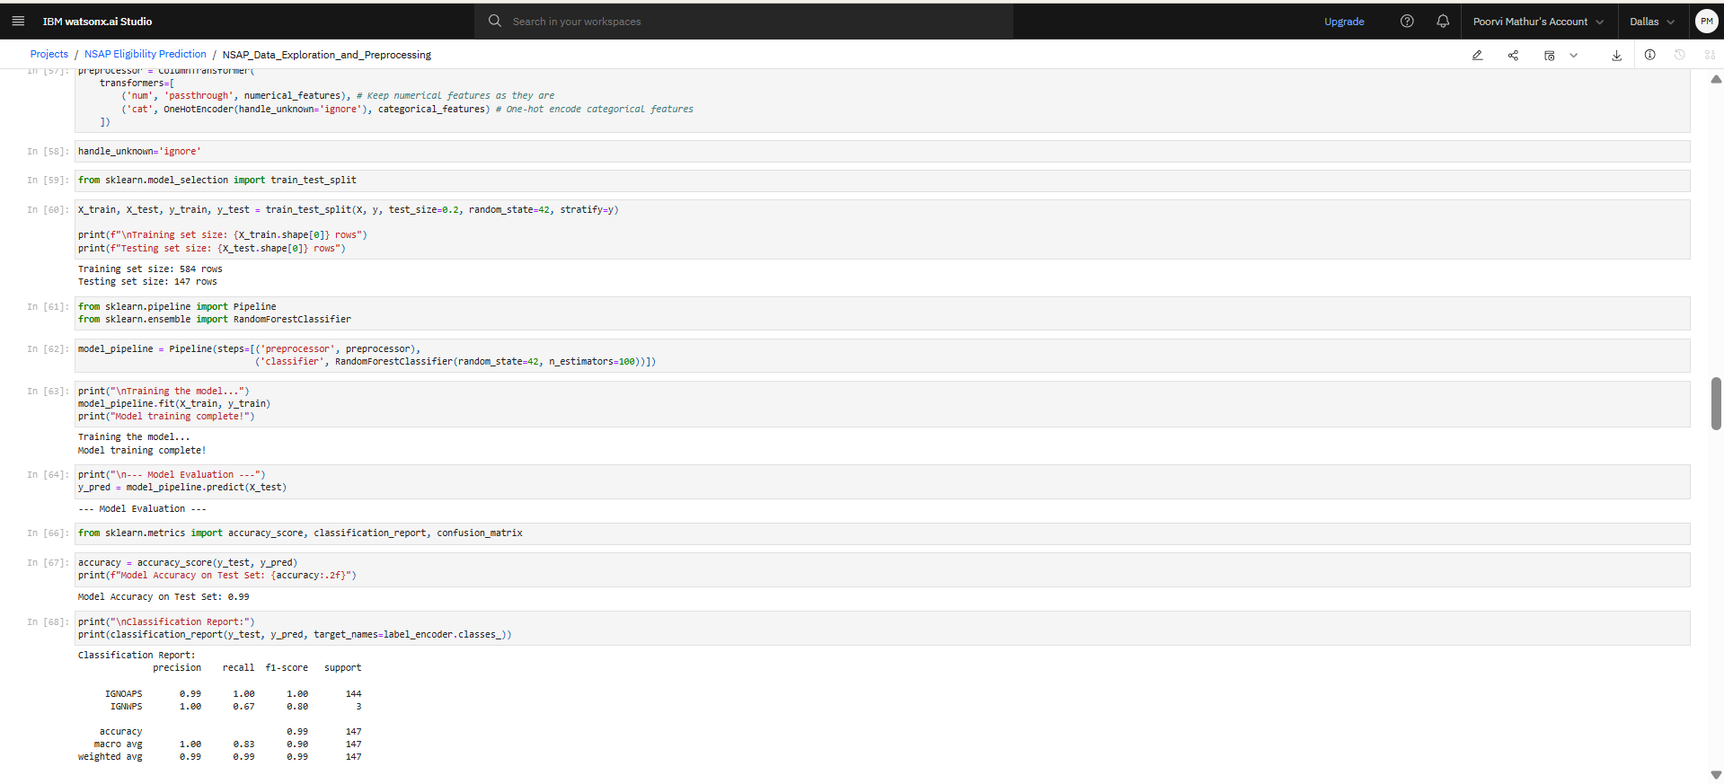
Results

Slide 12
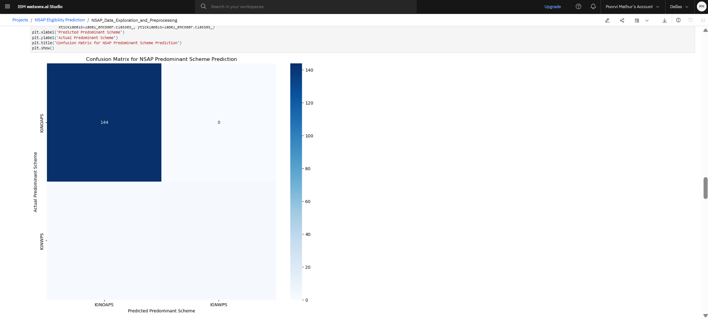
Results

Slide 13
Conclusion
Problem: Predicted the predominant NSAP scheme for a district using an aggregated dataset.
Solution: Developed a robust machine learning model using Python and IBM Watson Studio, covering the entire data science workflow.
Impact: The model provides a practical tool for government agencies to make data-driven decisions, improving resource planning and program efficiency.

Slide 14
GitHub Link
https://github.com/poorvi-mathur/NSAP_PREDICTION.git

Slide 15
Future scope
Individual Eligibility Prediction
Geospatial Integration
Real-Time Analytics
Causal Inference
Time-Series Forecasting
Enhanced AI Capabilities

Slide 16
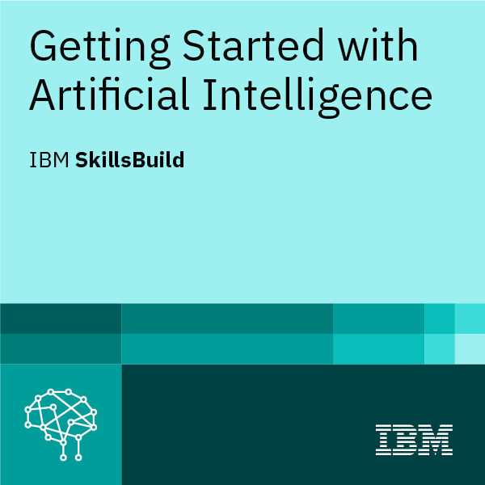
IBM Certifications

Slide 17
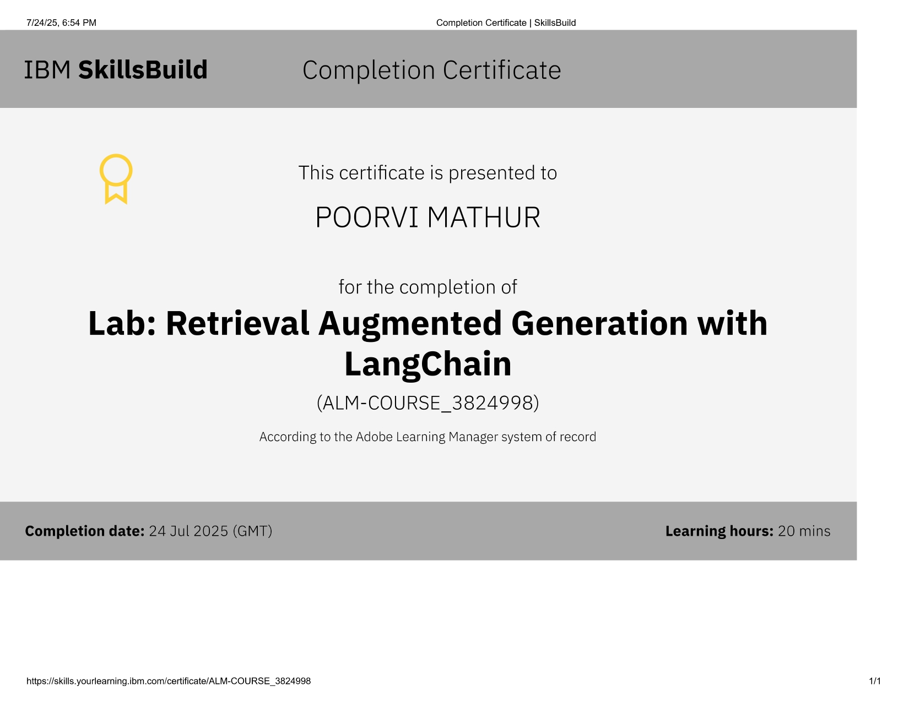
RAG LAB certificate

Slide 18
THANK YOU

