Slide 1
Forecasting Access to Safely Managed Drinking Water
Linear Regression vs Random Forest vs Transformer on 158 countries, 2000-2024
Poorvi Goyal (2430010343) Batch D
Bhoomi Kothari (2430010325) Batch D
Notes:
Introduce the project: predicting next-year water access per country.

Slide 2
Predict next year's water access
158
3,873
25
countries
country-year rows
years (2000-2024)
Target: % of population using safely managed drinking water (WHO)
Inputs: last 5 years of water access, urban population, unemployment (World Bank)
Notes:
Data sources: WHO GHO for water; World Bank for urban population and unemployment.

Slide 3
Method
1
2
3
4
Clean & merge
5-year windows
Time split
Three models
Country totals, reshape World Bank tables, join on country-year
Consecutive years only; predict the next year
Train to 2018, validate 2019-20, test 2021-24
Linear, Random Forest, Transformer
Scalers are fit on training data only, so nothing from the future leaks in.
Notes:
Explain the time-based split: no shuffling, so the test set is genuinely the future.

Slide 4
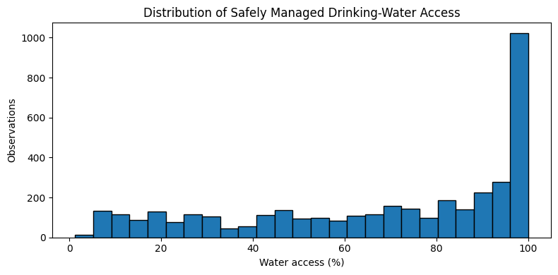
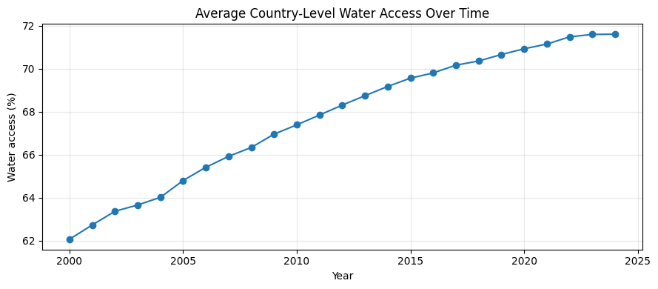
Access rises with urbanisation
Correlation with water access: urban population 0.67, unemployment 0.17
Missing data: urban population 6%, unemployment 15%
Notes:
Distribution is skewed to high access; average access trends upward over time.

Slide 5
Linear Regression wins
0.087
best MAE (% points)
Transformer MAE 0.434
Random Forest MAE 0.401
Repeat-last-year MAE 0.322
Notes:
All R2 values exceed 0.999, so compare MAE/RMSE and the naive baseline instead.

Slide 6
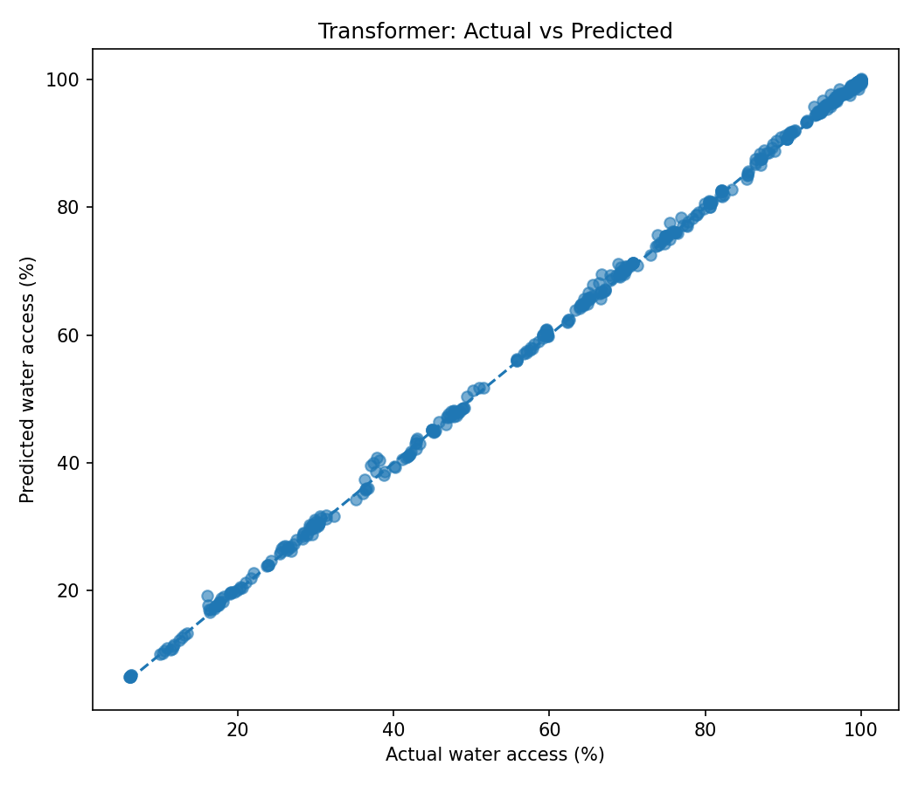
Transformer: actual vs predicted
Predictions sit on the diagonal across the full 6-100% range.
522 test predictions, 2021-2024.
But last year's value already explains most of this, so a tight fit is expected.

Slide 7
Findings and limitations
What worked
Limitations
Leak-free time-based evaluation
Simple linear model is accurate and cheap
Reproducible script and documented repo
Only 3 features
15% of rows lose unemployment data
Transformer needs more data to pay off

Slide 8
Next steps
Add features: income, health spend, rainfall
Forecast several years ahead, not one
Benchmark against the repeat-last-year baseline in every report
Deploy as a small web demo

