Slide 1
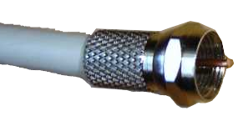
Two-wire transmission lines
Outline:
  What is the purpose of this study?
  What and how was done in the study?
  What are possible future directions for the study?
Gianfranco Scordino
Ponomarenko-Timofeev Aleksei

Slide 2
Why study it?
Two-wire transmission lines are most common today
Have a simple structure
Therefore there are not so many dependencies for the parameters
However, due to the first point, this topic is of great interest and is not extremely complex as a result

Slide 3
What we get from this study
Understanding of how parameters of the line affect it's characteristics
Can we use analytical formula in case parameters of the line are equal to certain value?
Basic skills of using simulation software
(COMSOL, for instance), although that was not the main point of the study

Slide 4
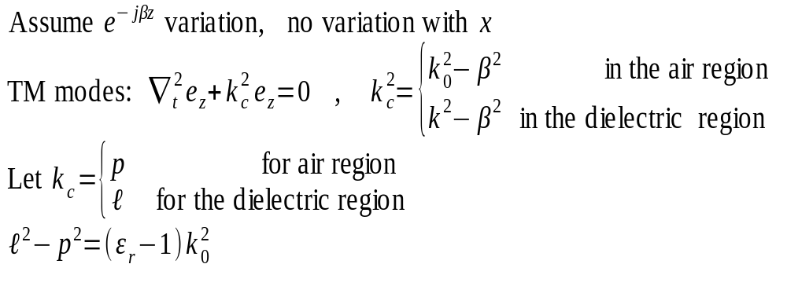
Parallel plate transmission line, theory

Slide 5
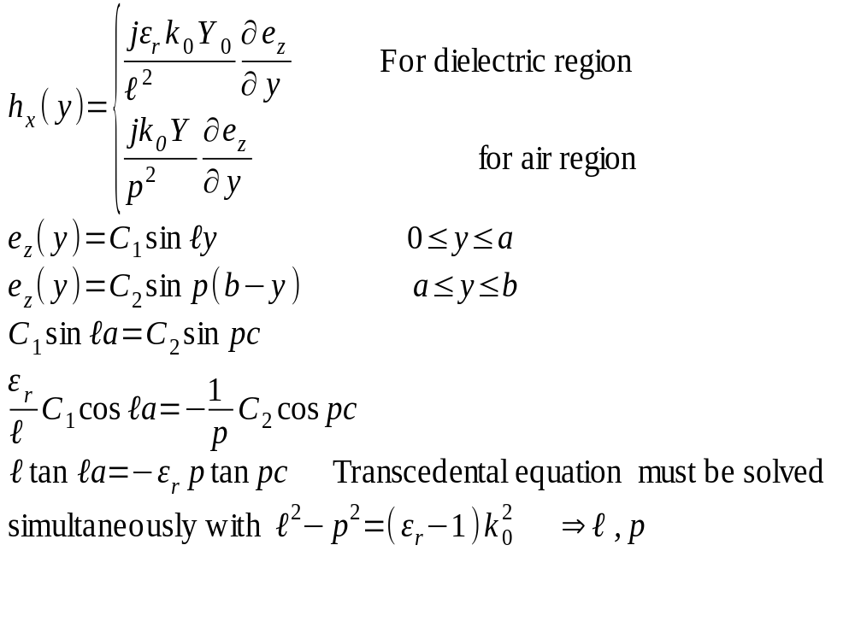

Slide 6
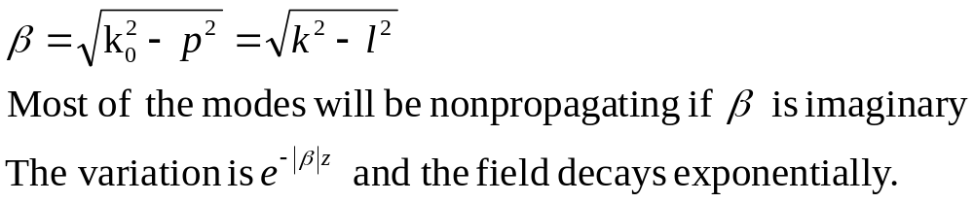
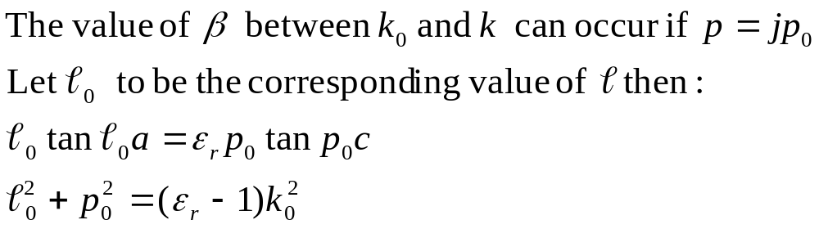

Slide 7
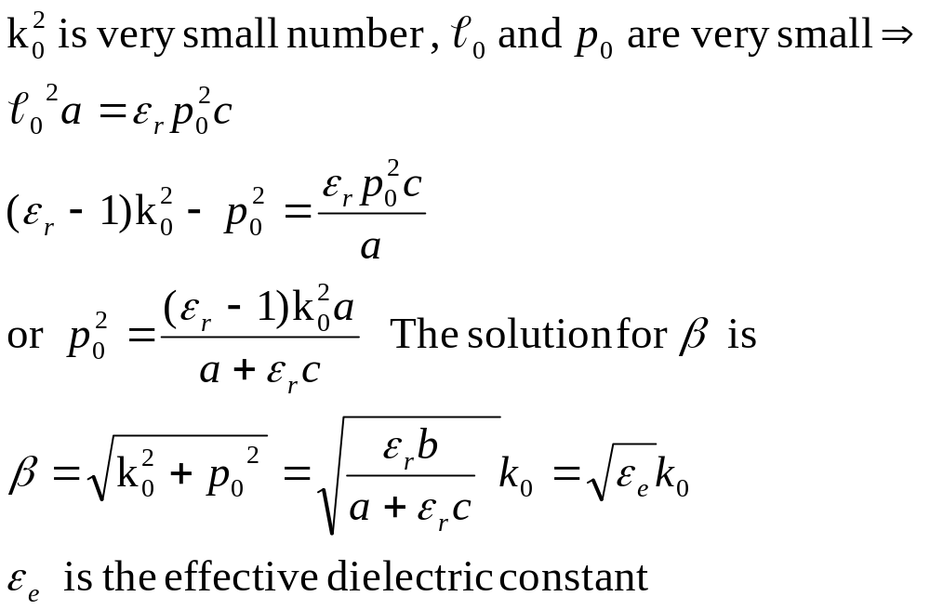
Low Frequency Solution
When the frequency is low,

Slide 8
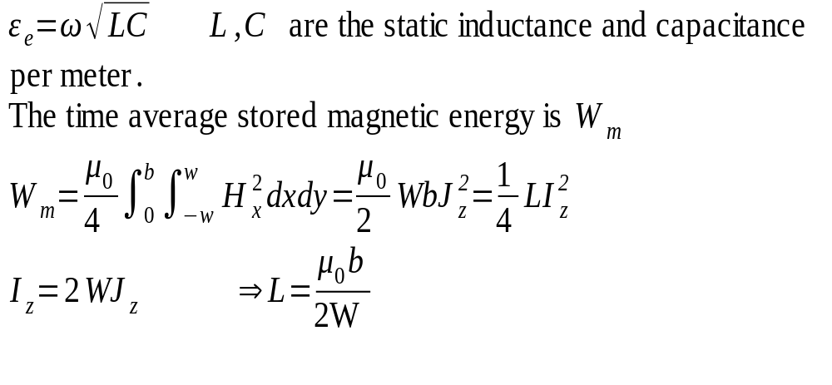
y
b
x
-W
W

Slide 9
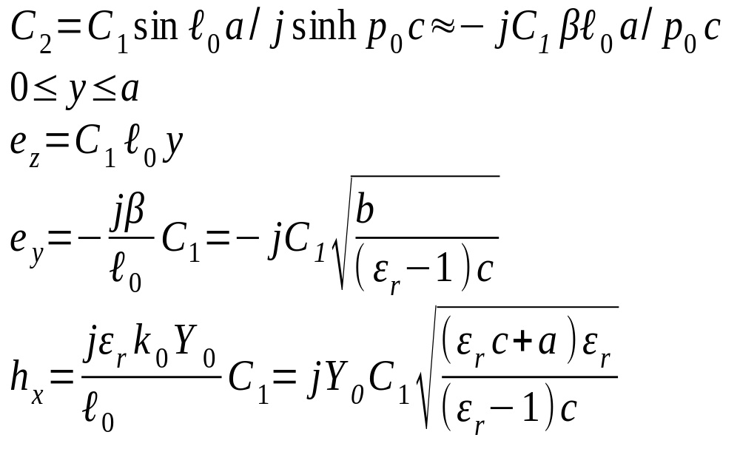
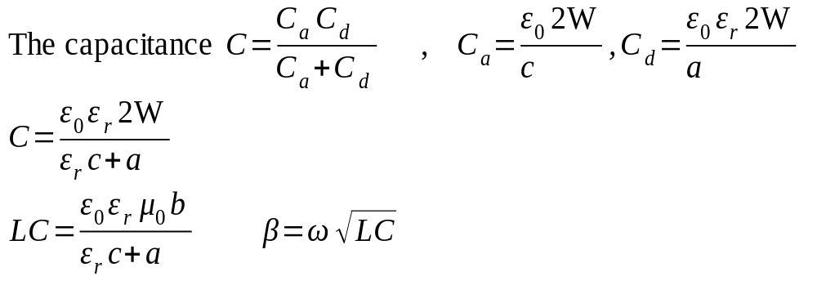

Slide 10
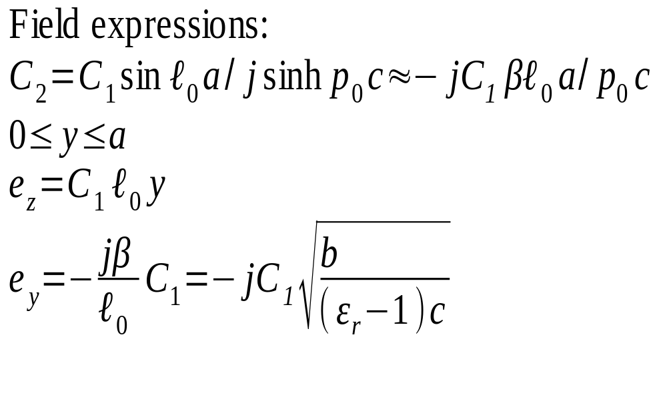

Slide 11
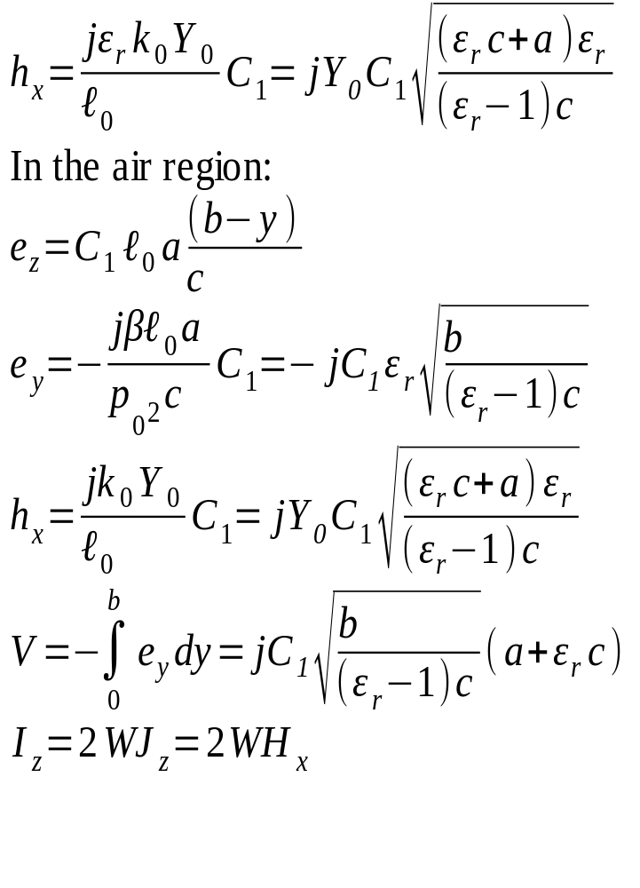

Slide 12

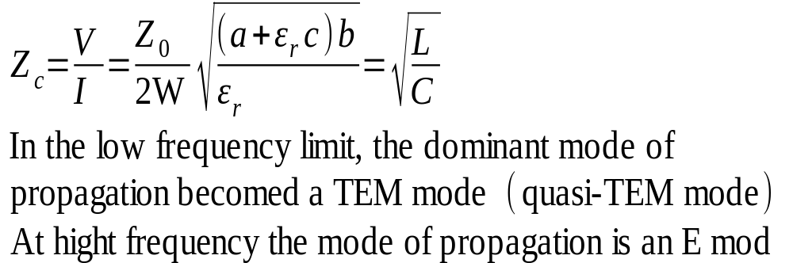

Slide 13
Example:
Two plate transmission line
Problems:
  Plates are infinitely thin
  Simulation mesh might get very big
Solutions:
  Define boundaries of inner square (or rectangle) as conductors
  Pick appropriate size by trial and error, so that the simualtion results do not change drastically, compared with previous values

Slide 14
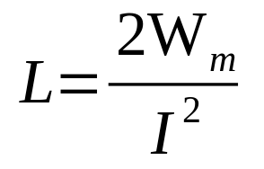
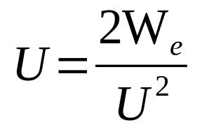
Calculating impedance
We need L and C of the line
  They are the part of the energy equations
  Calculate them using these equations:
Optimization: set 1 for current and voltage in the simulation parameters

Slide 15
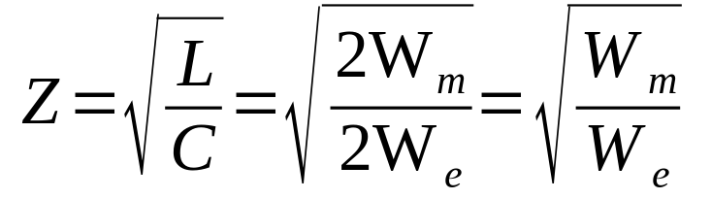
Calculating impedance...
The only step that is left now is:
Then we can calculate the analytical function and compare the plots of two solutions
In the formula above we consider I = 1A and U = 1V

Slide 16
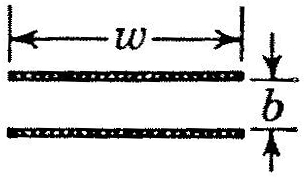
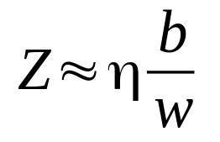
Two parallel plates
Consider following:
  We have two infinitely thin plates of width w
  They are separated by b meters of insulator
  Let insulator be air
  How impedance of such structure can be calculated?
  Analytic formula:
Fig. 1: Cross section of the line

Slide 17
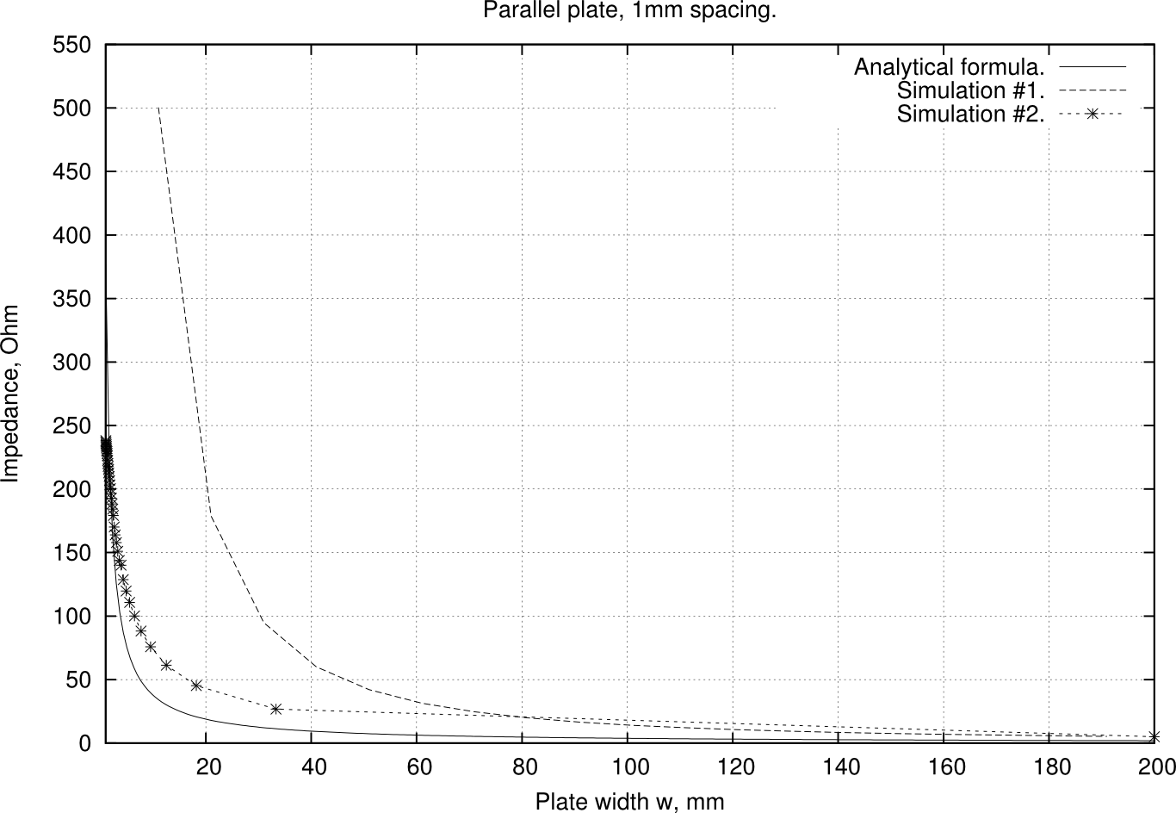
Calculation results

Slide 18
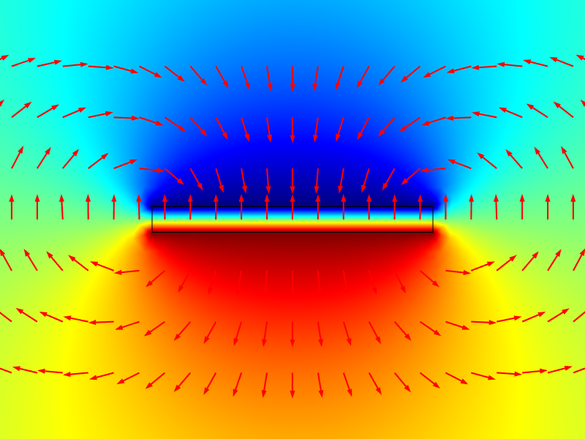
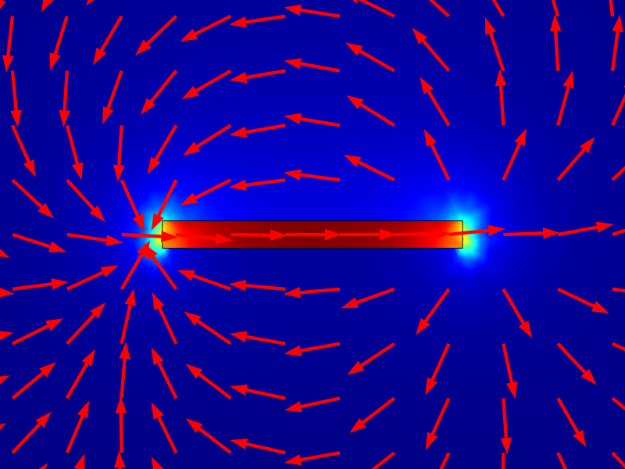
Simulation screens
Fig. 2: Electric potential and its density in the two plate transmission line.
Fig. 3: Magnetic flux and its density in the two plate transmission line.

Slide 19
Some conclusions on case
It can be seen from plot that the analytical formula is not always correct
The bigger the plate width gets, the more accurate our estimation becomes
The analytical formula approaches values of simulation, meaning that the error is decreasing and consequently getting closer to actual value

Slide 20
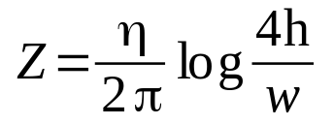
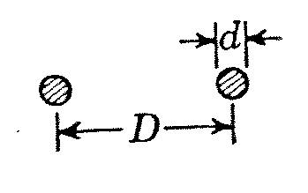
Wire above groung plane
Consider the following:
An infinite charged plane
A cable of diameter d above that plane
Distance from center of the cable to the surface of the plane is h.
Analytical formula for the impedance:
Fig. 4: Cross section of the line

Slide 21
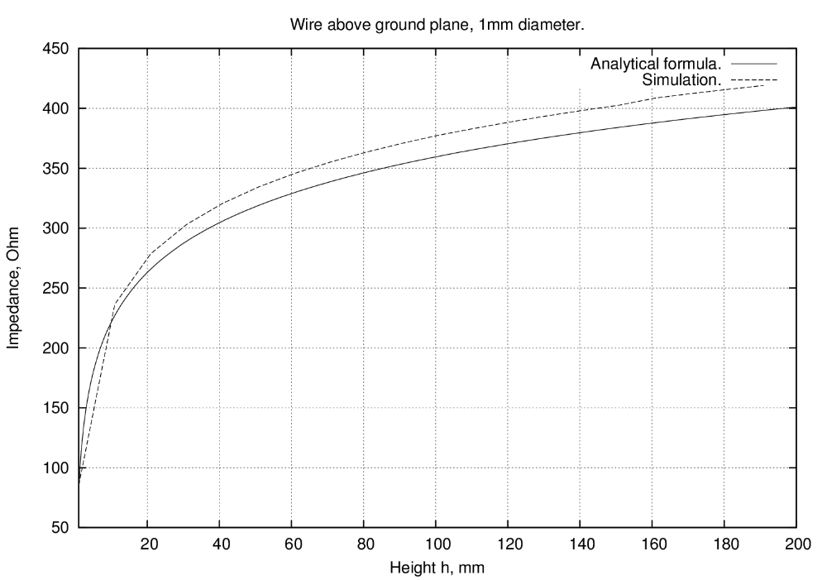
Simulation and analytical solution

Slide 22
Future directions
Fix simulations that were done improperly
Make a proper report
Reviev other cases (Shielded pair, for instance)
Review different dielectrics (polyethylene, rubber)

Slide 23
COMSOL TIME
Show some parts of the models in COMSOL
Questions?

