Slide 1
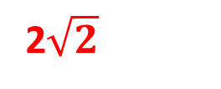


Alice
Bob
CHSH Score
λ
λ
Classical
2
Quantum
2$\sqrt{2}$
c
λ
λ
Classical +
Communication
4

Slide 2







$$\vec{x}$$
$$\vec{y}$$
$$c=f_{\vec{λ_{1}}\text{ , }\vec{λ_{2}}}(\vec{x})$$
$\vec{λ_{1}}$ , $\vec{λ_{2}}$
$\vec{λ_{1}}$ , $\vec{λ_{2}}$
$$a$$
$$b$$

Slide 3
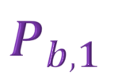










I
A
A
B
A
B
$$A_{0}$$
$$A_{1}$$
c
$$B_{0}$$
$$B_{1}$$
$$P_{a,1}$$
$$P_{b,0}$$
$$P_{a,0}$$
$$P_{b,1}$$
$$c$$
$$P_{0}$$
$$P_{1}$$
P

Slide 4
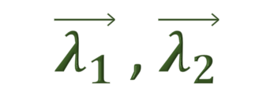
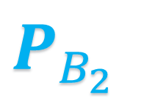


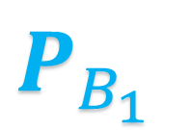







$$\vec{x}$$
$\vec{λ_{1}}$ , $\vec{λ_{2}}$
$$\vec{y}$$
$$A_{1}$$
$$A_{2}$$
c
$$B_{1}$$
$$B_{2}$$
$$P_{A_{1}}$$
$$P_{A_{2}}$$
$$ρ$$
$$P_{B_{1}}$$
$$P_{B_{2}}$$

Slide 5




$$x$$
$$y$$
c
λ
λ
$$a$$
$$b$$

Slide 6
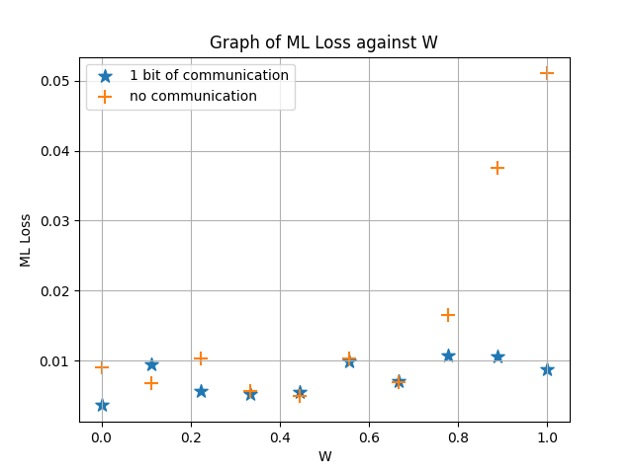


$S≤2$
$S>2$

