Slide 1
L
R
2
1
Y2
Y2
Y
3
4
Y
Y1
Y1
A
B
C
X1
X2
X3
X3
X2
X1
X
X

Slide 2
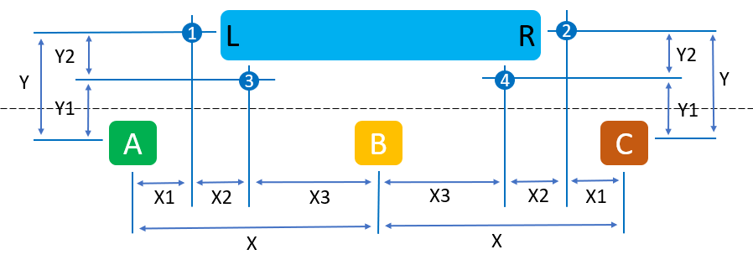
Initial Autonomous Mode
Determine: Robot Location, Drop-off Location
1
2
3
4
1
↑ Y, → X1
→ (X+X3+ X2), ↑ Y, turn ←
→ (X1 + X2), ↑ Y1
→ (X + X3), ↑ Y1
← (X3 + X2), ↑ Y, turn →
→ (X3 + X2), ↑ Y, turn ←
← X3, ↑ Y1
→ X3, ↑ Y1
← (X + X3 + X2), ↑ Y, turn →
↑ Y, ← X1
←(X + X3), ↑ Y1
← (X1 + X2), ↑ Y1
Drop off block
Second autonomous mode (pick up/drop off second block)
Start teleop

