Slide 1

AIRLINES ONTIME ARRIVAL PREDICTION
Submitted by
POOVARAGAVAN SELVARAJ

Slide 2
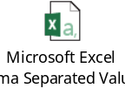
Below are the steps performed to analyze top 10 carrier with highest & lowest delay time
Scope:
Selected every 100th record from year 2002,2005,2006,2007,2008 as Training dataset
(Attached CombinedYears_100.csv)
Selected 105th record from year 2002,2005,2006,2007,2008 as Testing dataset
(Attached CombinedYears_105.csv)
Selected 110th record from year 2002,2005,2006,2007,2008 as Test dataset to verify the accuracy of the model.
(Attached CombinedYears_110.csv)
Loaded into Hadoop as CombinedYears_100, CombinedYears_105, CombinedYears_110 tables respectively.
Created a New Column OnTime and populated the values for each table as per below logic,
  “Y” if the record has a value of zero in the ArrDelay column
  “N” if the record has a non-zero value in the ArrDelay column
Create a various classification analytics model, train and test the model and observe the results.
Tools used: Hadoop, Microsoft Excel and Rapid Miner, RStudio

Slide 3
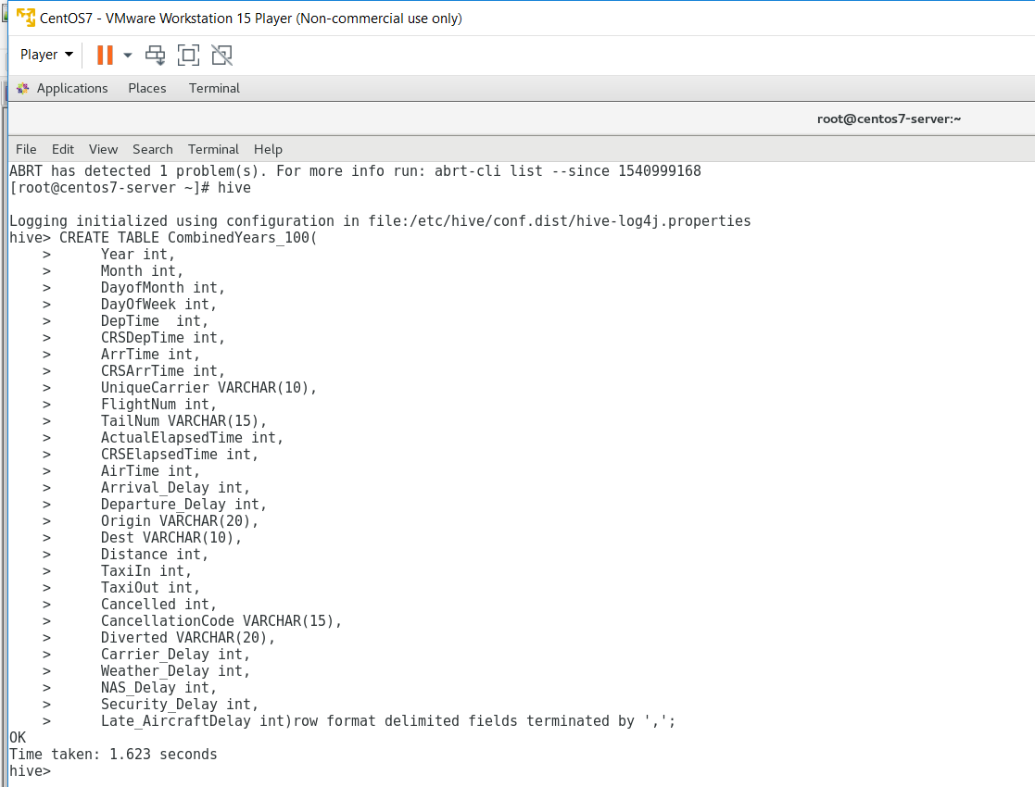
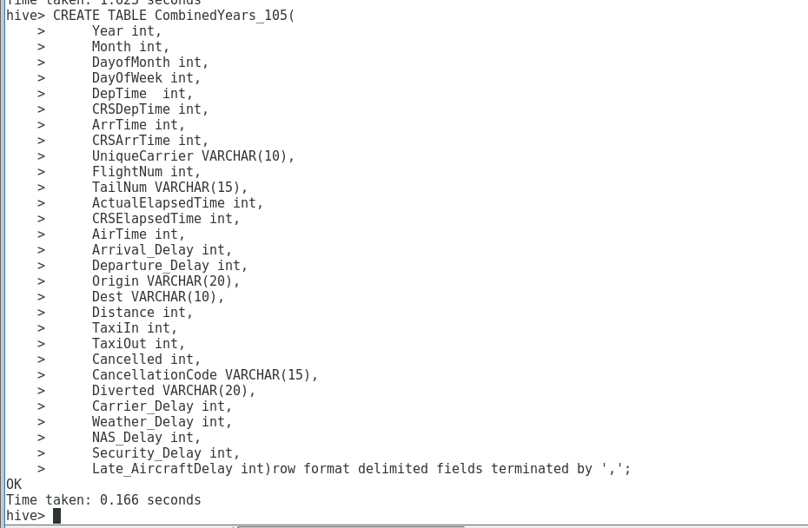
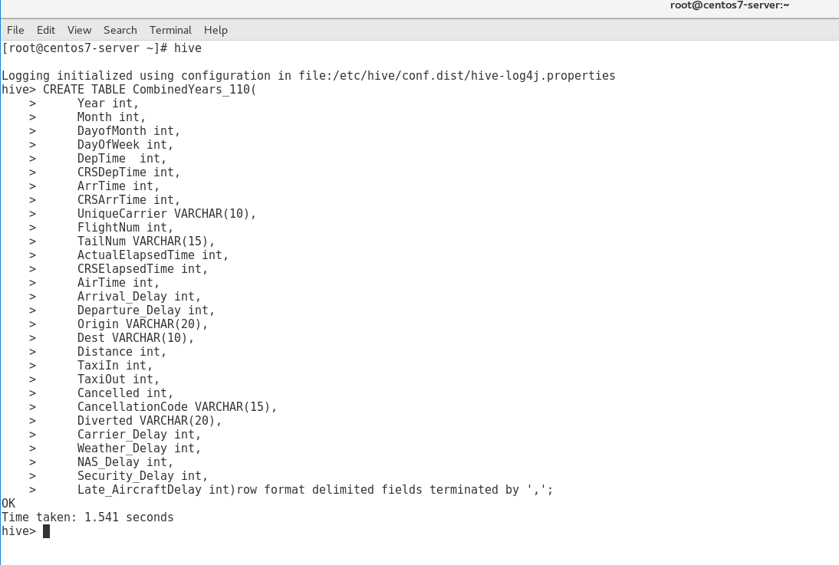
Creating table in Hadoop as shown below,

Slide 4
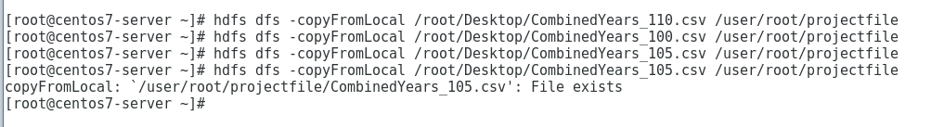

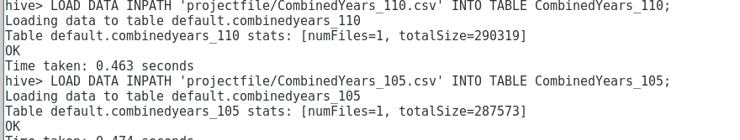
Copying the Combined Years file from Local to HDFS projectfile directory

Slide 5
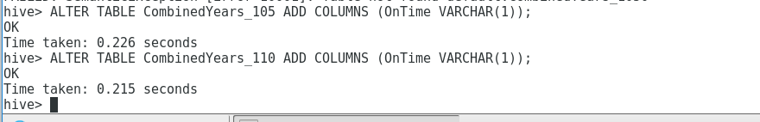
Adding the New column OnTime in Combined Years table as shown below,

Slide 6
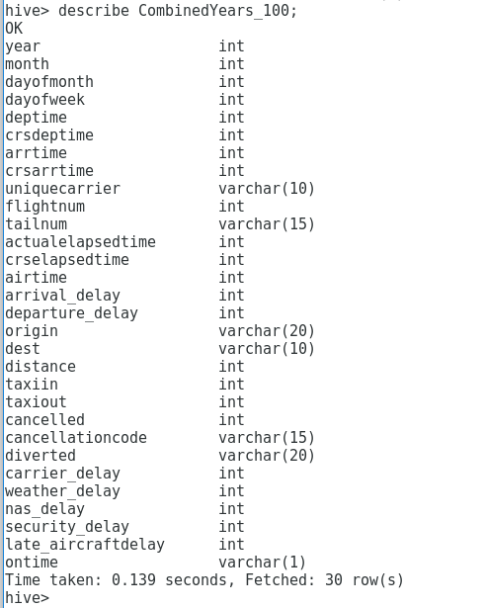
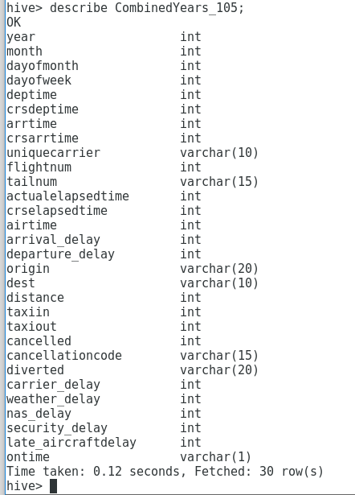
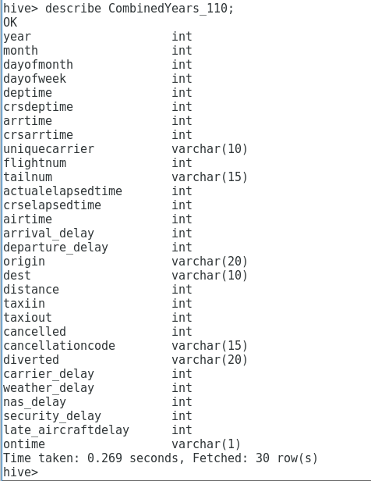
Tables with OnTime column as shown below,
When we try to update the values based on the logic given, we couldn’t update it as Hadoop version which we have is not supporting Update feature in Hive

Slide 7

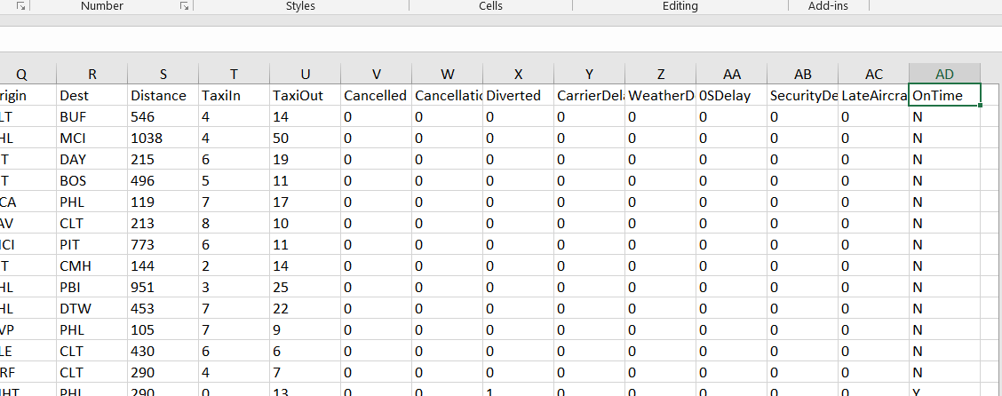
We have updated OnTime values for combined years manually through Excel as shown below,

Slide 8
Data Preprocessing/Cleaning:
Total of 56 records with ArrivalTime, AirTime, DepDelay and ActualElapsedTime NA are removed.
TaxiIN, TaxiOut, Carrier Delay, Weather Delay, NAS Delay, Security Delay and Late aircraft Delay attributes with values NA are replaced with 0.
We choose to put 0 because, 80% of records with the above attributes have a value 0.

Slide 9
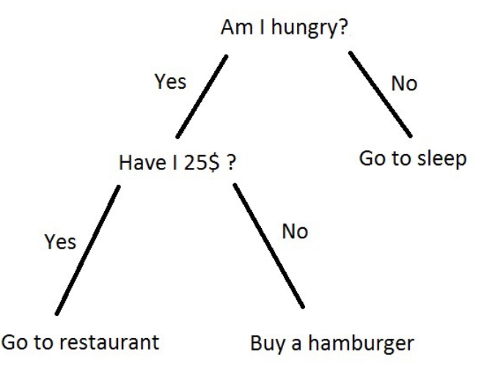
Model selection:
Logistic regression
Analysis to conduct when the dependent variable is (binary).
Logistic regression is a predictive analysis.
Logistic regression is used to describe data and to explain the relationship between one dependent binary variable.
Decision Tree
Graph that uses a branching method to illustrate every possible outcome of a decision.
Naïve Bayes
It is a classification technique based on Bayes’ Theorem with an assumption of independence among predictors. In simple terms, a Naive Bayes classifier assumes that the presence of a particular feature in a class is unrelated to the presence of any other feature.

Slide 10
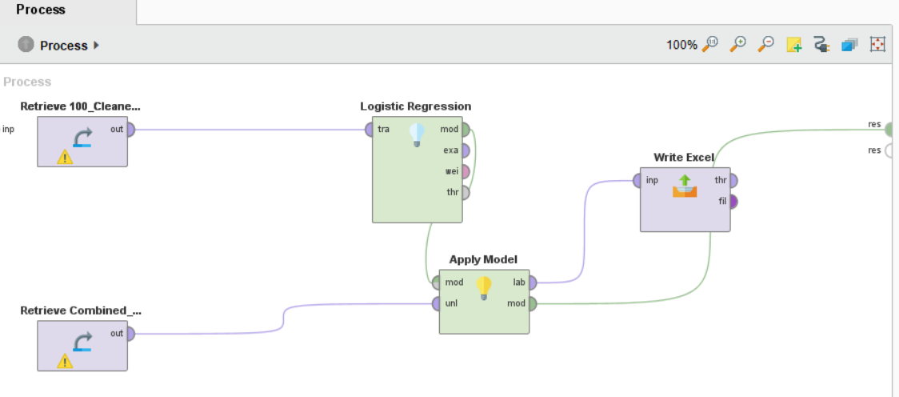
Logistic Regression with all attributes selected:

Slide 11
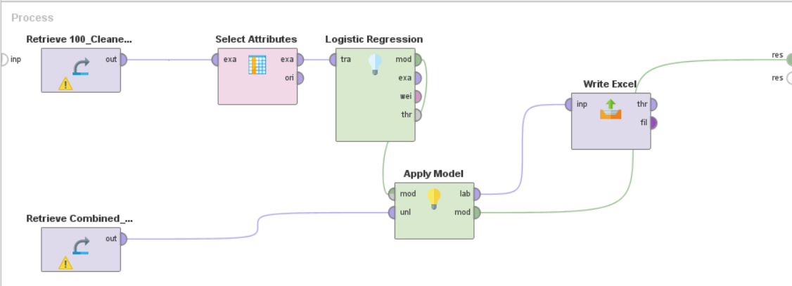
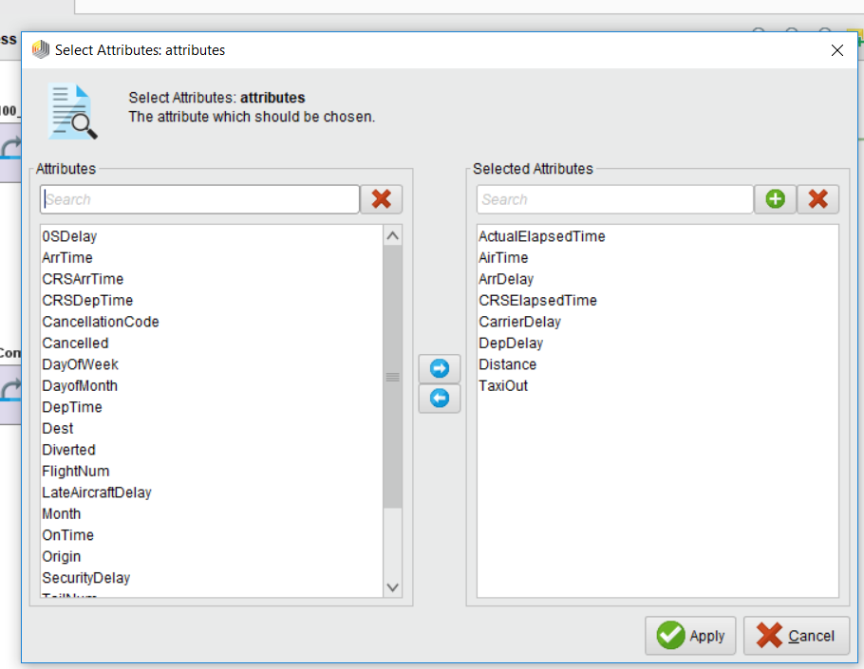
Logistic Regression with selected attributes selected:

Slide 12
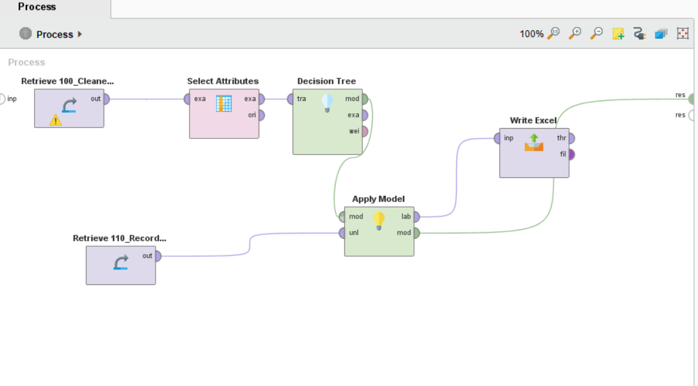
Decision Tree Regression with selected attributes selected:

Slide 13
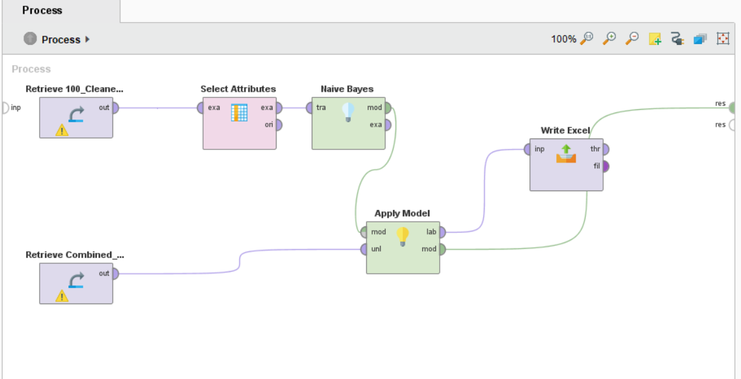
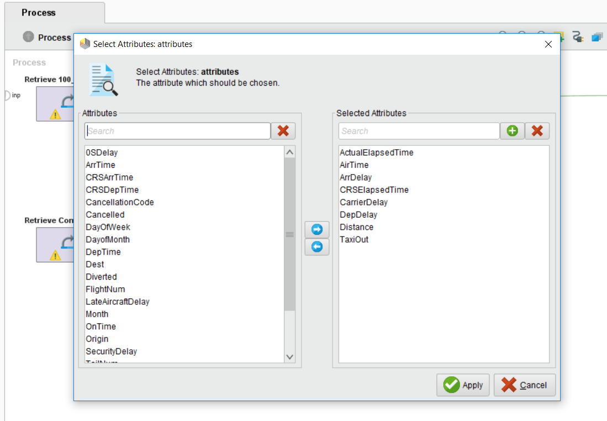
Naïve Bayes Model

Slide 14
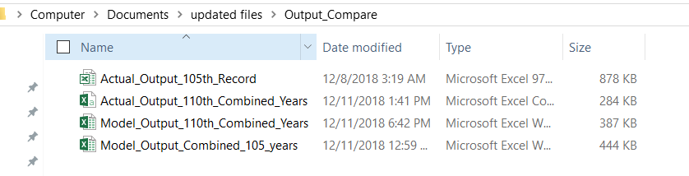
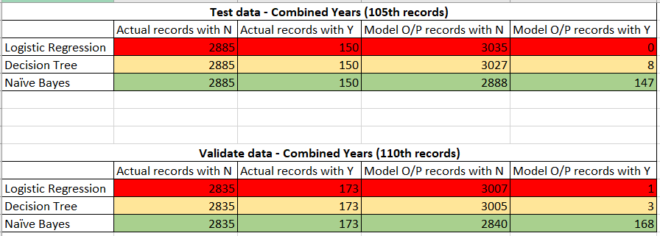
Conclusion:
It is very clear that Naïve Bayes model outperformed while comparing with other models. The model output is consistent in both Testing and Validation steps.

