Slide 1
Carrier delay time Analysis PHASE I – Team red
POOVARAGAVAN SELVARAJ

Slide 2
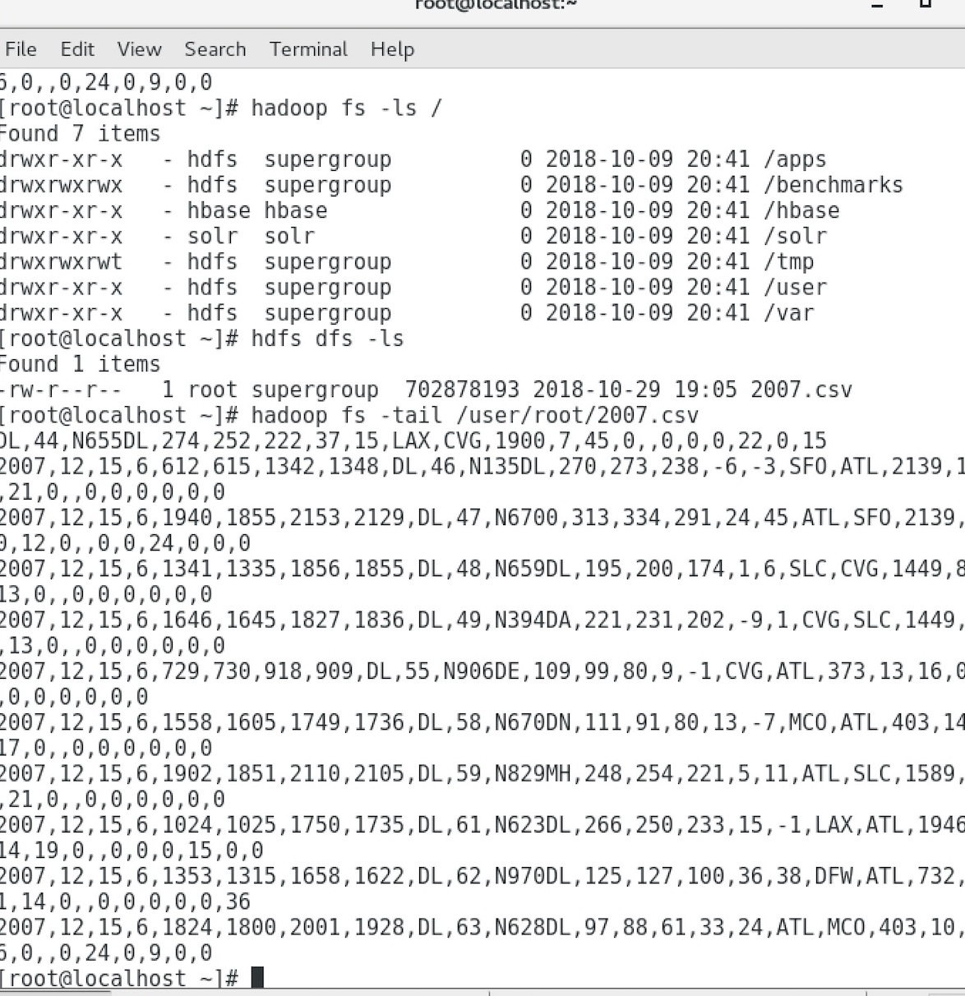
Step 1: Download the 2007.csv and copy the data to Hadoop. Step 2: Created pig script to fetch 10 carriers with highest and lowest delay time

Slide 3
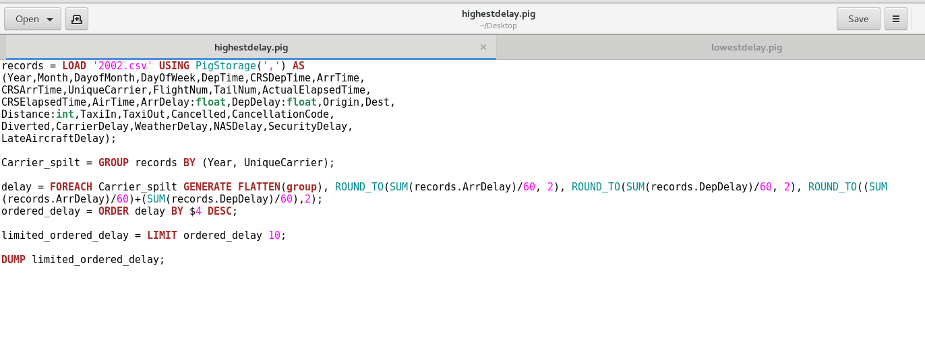
Using PIG SCRIPT:

Slide 4
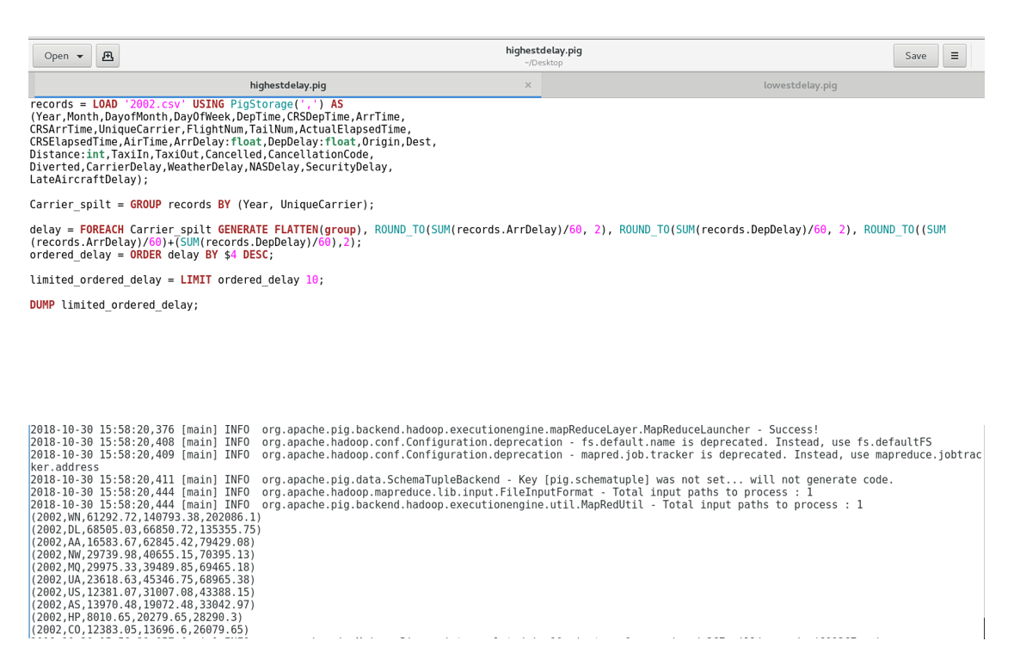
Records with highest delay time shown below

Slide 5
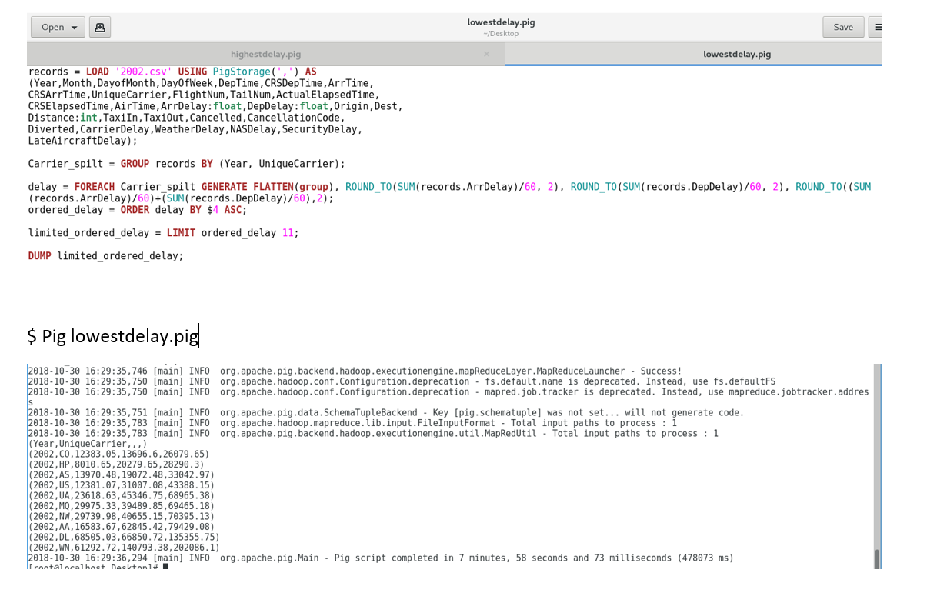
Records with Lowest delay time shown below

Slide 6
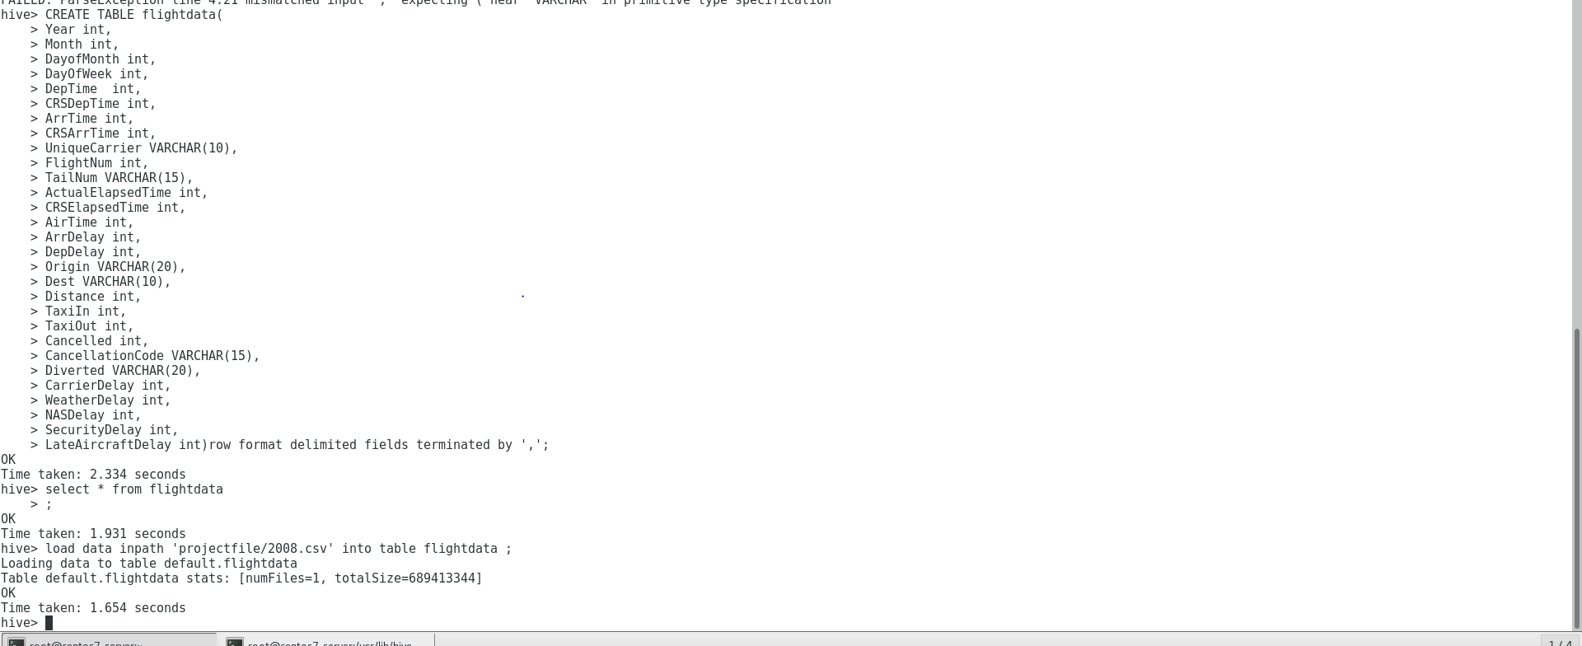
Hive:
Created table flightdata; loaded 2008.csv to flightdata

Slide 7
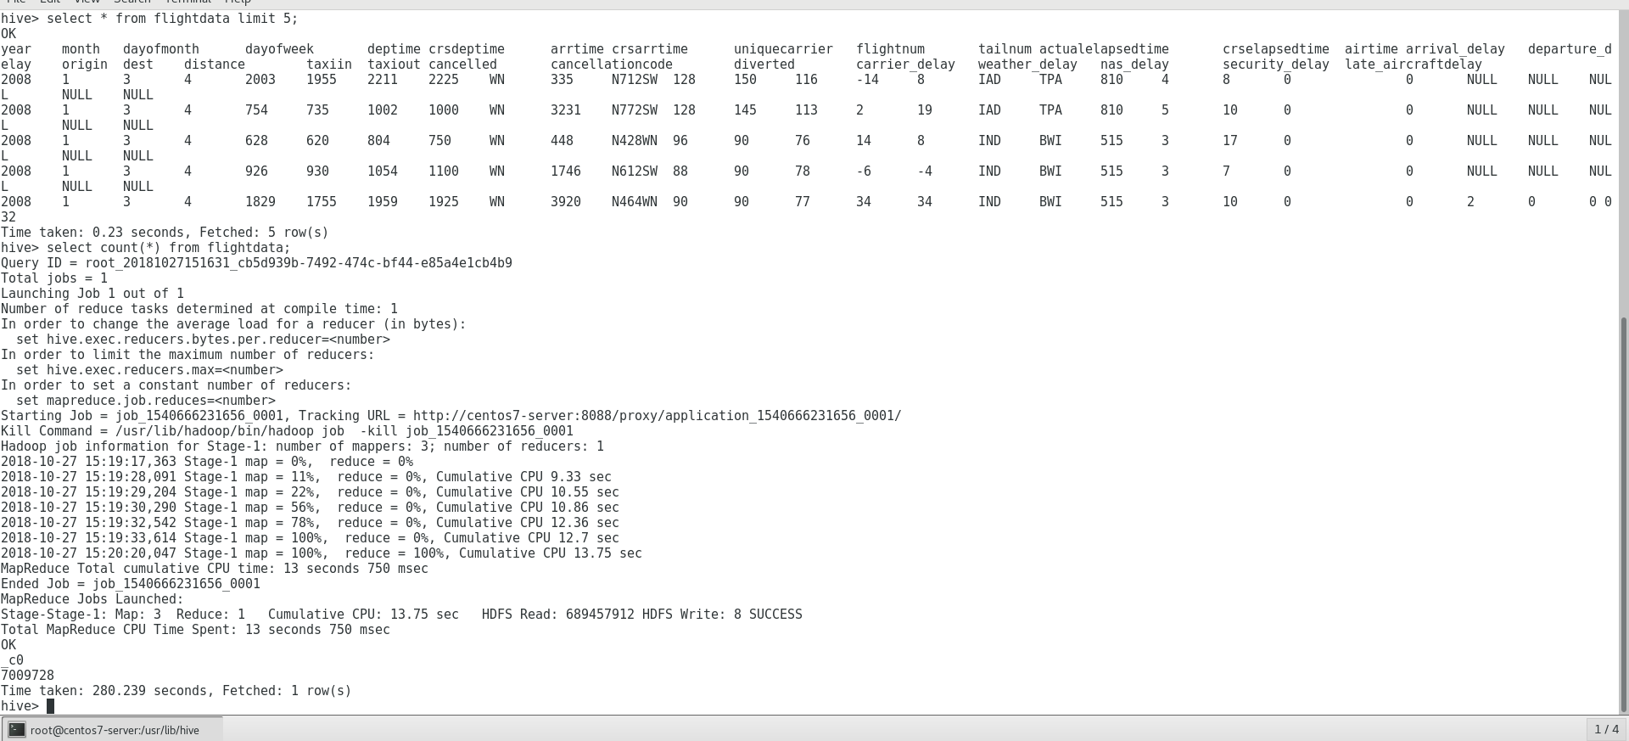
Viewing the first 5 records of the loaded table and identifying the total number of records in the dataset which is 7009728 records

Slide 8
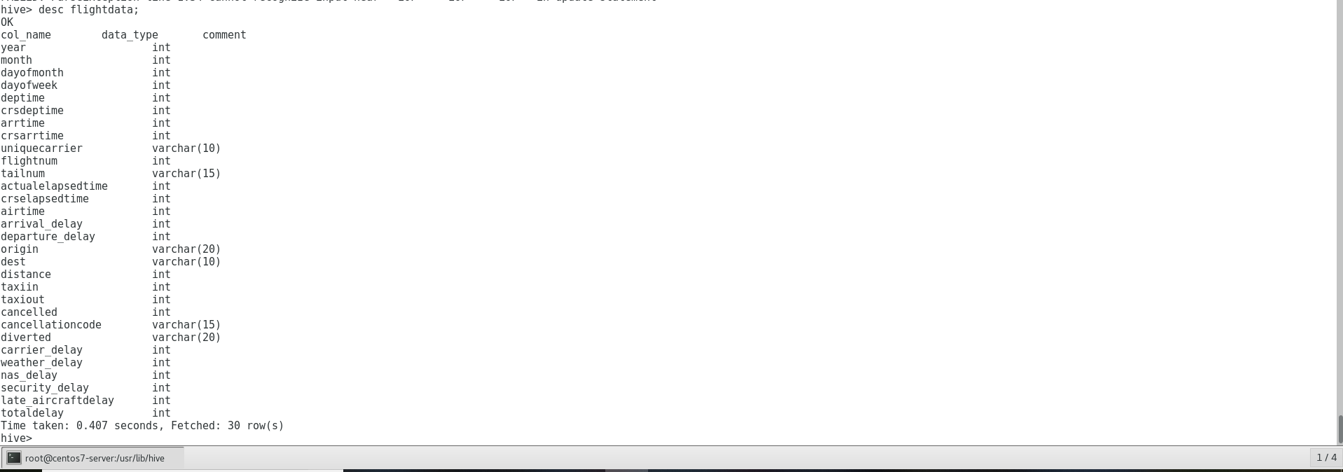
Adding new column Total delay to flightdata table shown below,
Describing the table to see the no of variables in flightdata

Slide 9
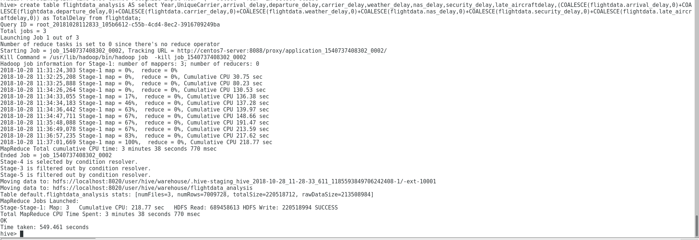
Created a new table flightdata_analysis with only required variables for analysis and also calculated Totaldelay for all the records
Created table carriers and loaded carriers.csv as shown below

Slide 10
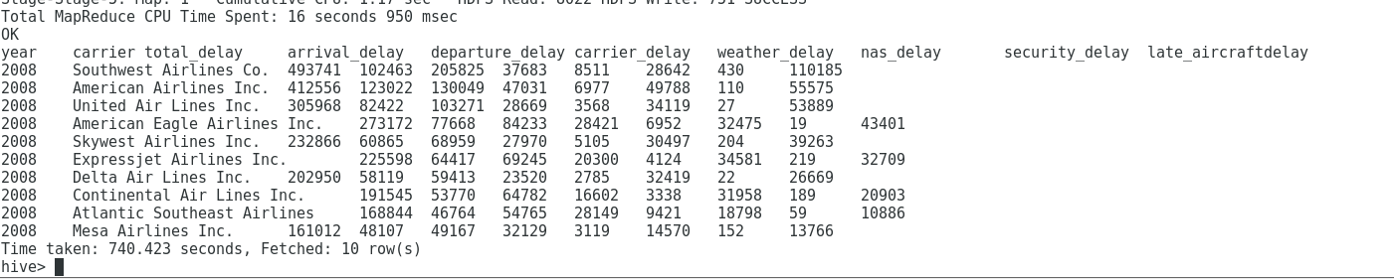
Hive Query to get carriers with highest delay time
Carriers with Highest delay time in hours

Slide 11
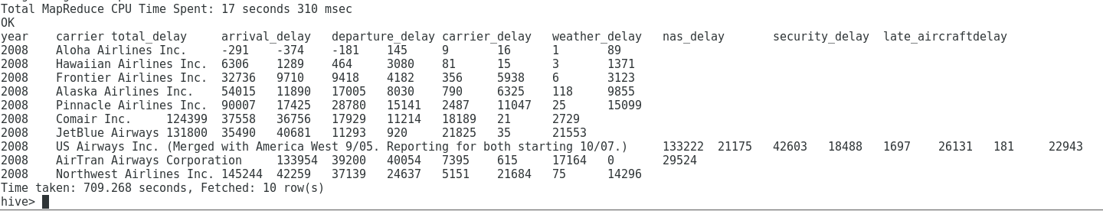
Hive Query to get carriers with lowest delay time
Carriers with Lowest delay time in hours

