Slide 1
Numbers & Date

Slide 2
Number literals
A variable of type number holds a number, either an integer or a floating-point number.

Slide 3
Integer literals
Integer literals can be expressed in:
Decimal: begins with a digit 1 to 9 (not 0), e.g., 123 or -456,
Octal: begins with a digit 0, e.g., 0123 or -0456,
Hexadecimal: begins with 0x (or 0X), e.g., 0xA1B2 or -0XA1B2.
Binary: begins with 0b (or 0B), e.g., 0b10011100 or -0B11001100. [Binary may not be supported in some browsers.]

Slide 4
Floating-point literals
JavaScript also provides some special number literals:
infinity: e.g., 1/0
-infinity: e.g., -1/0
NaN (Not-a-Number): e.g., 0/0, or converting the string 'Hello' to a number.

Slide 5
Number Object
Built-in Number object has properties for numerical constants, such as maximum value, not-a-number, and infinity.

Slide 6
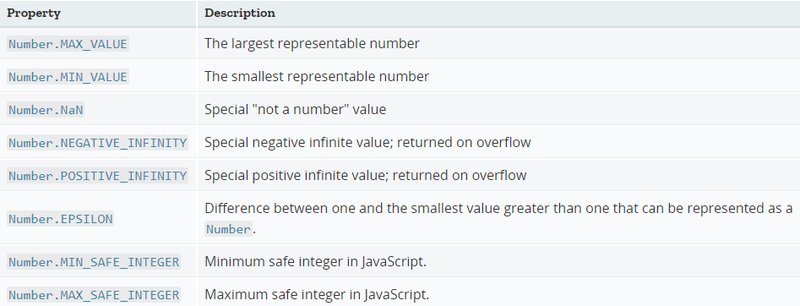
Number Object

Slide 7
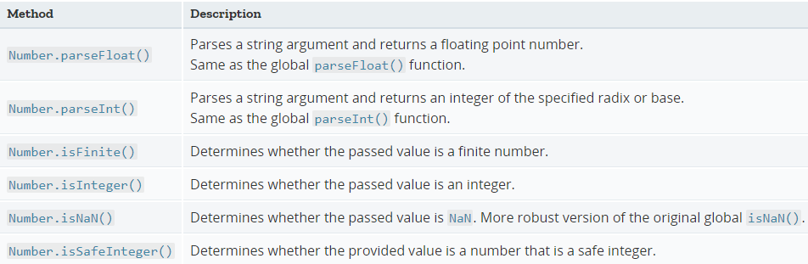
Number Methods

Slide 8
Math Object
The built-in Math object has properties and methods for mathematical constants and functions.
Example
Math.sin(5.16)

Slide 9
String Literals
A string is a sequence of characters enclosed within a pair of single quotes or double quotes (e.g., "Hello", 'world', "5566", '3.1416')
You can use an escape sequence to represent special characters (such as \n for new-line, \t for tab, and \uhhhh for Unicode character); and to resolve conflict (e.g., \", \', \\).
JavaScript is dynamically-type, and performs type conversion automatically.
When a string value is used in arithmetic operations (such as subtraction or multiplication), JavaScript runtime automatically converts the string to a number if it represents a valid number; or a special number called NaN (not-a-number) otherwise.

Slide 10
'+' : Addition or Concatenation?
If both the operands to a '+' operator are numbers, it performs the usual numeric addition.
However, if one (or both) of the operand is a string, the '+' operator is overloaded to perform string concatenation. The other operand will be converted to a string, if necessary.
Example:
console.log(11 + 22); // gives Number 33 (usual addition)
console.log('11' + '22'); // gives string 1122 (concatenation)
console.log('11' + 22); // gives string 1122 (concatenation)
console.log('Hello' + 22); // gives string Hello22(concatenation)

Slide 11
Built-in Functions
To convert a numeric string to a number, you could use the built-in functions parseInt() or parseFloat(), which returns a number if conversion is successful; or NaN otherwise.
Example
var magic = "11"; // string
console.log(magic + 22); // string concatenation - string "1122"
console.log(parseInt(magic) + 22); // Addition - number 33
console.log(parseInt(magic) + "22"); // string "1122"
console.log(parseInt(magic) + parseFloat("22.33")); // Addition -33.33
console.log(parseInt("abc")); // NaN
Number() also works on Object such as Date,
Example
console.log(new Date(2015, 5, 1, 12, 34, 56));

Slide 12
Date Object : Constructors
new Date(): constructs a Date object with the current date and time.
new Date(dateTimeStr): constructs a Date object with the given date-time string in an acceptable form (e.g., "Month, day, year, hours:minutes:seconds").
new Date(year, Month, day): where month is 0-11 for Jan to Dec.
new Date(year, Month, day, hours, minutes, seconds, milliseconds)

Slide 13
Date Object Methods
getDate(), setDate(), getMonth(), setMonth(), getFullYear(), setFullYear(): get/set the date (1-31), month (0-11 for Jan to Dec), year (4-digit year).
getDay(): get the day of the week (0-6 for Sunday to Saturday).
getHours(), setHours(), getMinutes(), setMinutes(), getSeconds(), setSeconds(): get/set the hours/minutes/seconds.
getTime(), setTime(): get/set the number of milliseconds since January 1, 1970, 00:00:00.

Slide 14
Regular Expression
JavaScript” is said to match this regular expression.
Thus, this regular expression allows us to detect strings containing this particular string of text.
Syntax

Slide 15
Syntax
First of all, a caret (^) may be used to indicate the beginning of the string, while a dollar sign ($) is used to mark the end
To remove the special meaning of a character, prefix it with a backslash \$\@
Square brackets may be used to define a set of characters that may match [a – z]

Slide 16
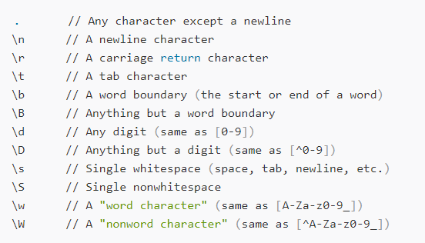
Regular Expression

Slide 17
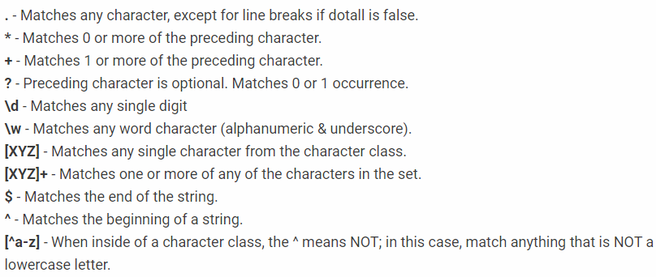
Quantifiers

Slide 18
RegEx : test()
var username = ‘JavaScript';
alert(/[A-Z a-z_-]+/.test(username)); // returns true

Slide 19
RegEx : split()
var str = 'this is my string';
alert(str.split(/\s/)); // alerts "this, is, my, string"

Slide 20
RegEx : replace()
var someString = 'Hello, World';
someString = someString.replace(/World/, 'Universe');
alert(someString); // alerts "Hello, Universe"

Slide 21
RegEx : match()
var name = 'JavaScript';
alert(name.match(/a/c)[1]); // alerts“a & c“

Slide 22
Splitting an Email Address
var email = ‘javascript@gmail.com';
alert(email.replace(/([a-z\d_-]+)@([a-z\d_-]+)\.[a-z]{2,4}/ig, '$1, $2'));

Slide 23
Functions
A function (also known as a method) is a self-contained piece of code that performs a particular "function", then returns a value. You can recognise a function by its format — it's a piece of descriptive text, followed by open and close brackets.
Function syntax
function function_name(parameter1)
{
// Insert Line of Code
}
Arugument
Function_name(value);

Slide 24
Calling functions
<head>
<script src=“fileName.js"></script>
</head>

Slide 25
JSON
JSON is a human-readable text format that facilitates data interchange between different programming languages.
JSON stores data in objects and arrays. The JSON syntax reflects how these are defined.

Slide 26
JSON vs XML
JSON is a data interchange format. Its purpose is to faciliate structured data interchange. It achieves this by directly representing objects, arrays, numbers, strings, and booleans that are often present in the source environment and the destination.

Slide 27
JSON vs XML
XML on the other hand, is a markup language. XML's purpose is document markup. Although XML can be easy to learn for the purpose of data interchange, there's a lot more to learn if you want to become proficient in using XML as a markup language. For example, you'll need to learn things like, how to create a document type definition, how to use XSLT to transform XML documents into another form, and how to query XML documents using XPath.

Slide 28
Basic Constructs
There four basic and built-in data types in JSON. They are strings, numbers, booleans (i.e true and false) and null. Besides, there are two data types which are structured - objects and arrays.
Objects are wrapped within '{' and '}'. Arrays are enclosed by '[' and ']'. Objects are a list of label-value pairs. Arrays are list of values.
Both objects and arrays can be nested.
strings, numbers, booleans (i.e true and false) and null can be used as values.

Slide 29
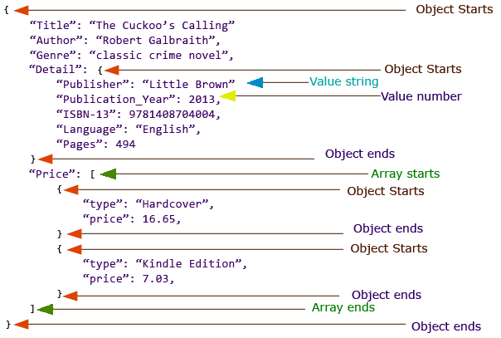
Example

Slide 30
Syntax
A JSON object is an unordered set of name/value pairs inserted between {}(curly braces).
A JSON array is an ordered collection of values. It allows you to provide a list of values.
A JSON array begins with [ (left bracket) and ends with ] (right bracket). Its values are separated by , (comma).
Simply adding whitespace doesn't have any impact on the data.
eval() is not recommended because your application for read JSON

Slide 31
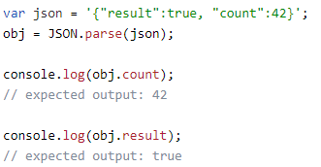
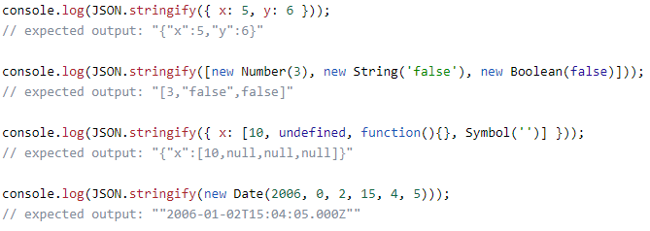
JSON Data Reading

Slide 32
Strict Mode

Slide 33
BOM – Browser Object Model

Slide 34
Window Event

Slide 35
window object represents the browser's frame or window, in which the webpage is contained
window object is a Global Object, hence its name need not be used to access its properties and methods.
window object's open() method is used to open windows and close using close() method

Slide 36
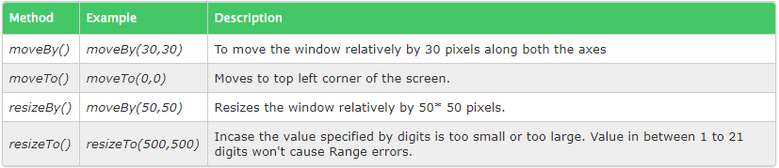
Moving and Resizing a Window

Slide 37
Screen
screen object is get information about the user's display and number of color pixels available on it.
This object is has no programmatic use; it used purely to get information about the client's screen capabilities such as width, height , color-depth etc
history object methods back() , forward() and go() are used to tell the browser to naviagte to specified URL in history.
The methods back() and forward() have the same effect as the browser's back and forward button.
The method go() is used to navigate to a URL in history relative to the current document.A positive value is used to move forward in the history while a negative value is used to move backwards.

Slide 38
Location
window object property of location is used to access the URL of the document currently loaded in the window and also provides information about the general navigation functionality of the document.
Location.property;

Slide 39
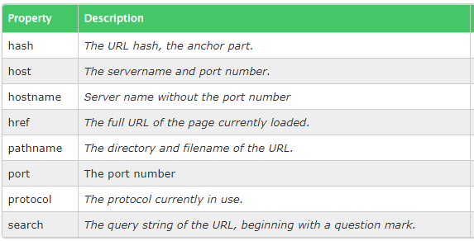
Location Properties

Slide 40
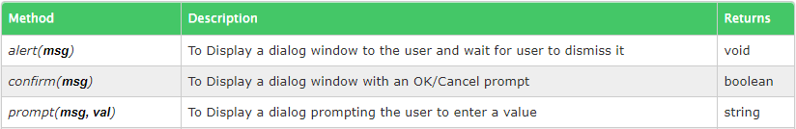
Browser can invoke system dialogs to display to the user using methods alert() , confirm() , prompt()

Slide 41
Cookie
To store small amounts of user specific information on User's Machine.

Slide 42
Properties of a JavaScript Cookie
Cookies comprises of text in form of name/value pairs, commonly also called as "crumbs“
Cookies are attached to specific domain, and when set it is sent along with all requests to the same domain which created it, ensuring that the information within these cookies are available only to approved domains.
Cookies are stored on client's machine and hence to disallow it from occupying too much space, there exists an upper limit to number of cookies per domain, this upper limit varies from browser to browser.
Internet Explorer and Firefox: Maximum of 50 cookies per domain.
Opera: Maximum of 30 cookies per domain.
Safari & Google Chrome: No limit of cookies per domain.
When the number of cookies exceeds the maximum limit, the browser begins to eliminate old cookies using the least recently used (LRU) method, thus vacating space for new cookies.
There is also a size upper limit for cookies, its around 4KB(4096 bytes), this size upperlimit is applicable to all cookies for a domain, and not per cookie. Any cookie exceeding this size upperlimit gets dropped.
Cookies can be turned off and completely removed from the hard disk. Eg: for Firefox browser visit Tools => Options => Privacy where you have the option to block all cookies from any websites. Similarly all other browsers have a such options within their privacy settings.

Slide 43
Attributes of JavaScript Cookies
name = value; [expires=date]; [path=path]; [domain=domainname]; [secure]
Javascript Cookies: Functions escape() and unescape()
escape() and unescape() are built-in and used for encoding and decoding purposes.
escape() function is used to encode the characters that are not text or numbers into the hexadecimal equivalent of their character in Latin-1 character set, preceding with a character %.
unescape() function is used while retrieving the cookie, it converts the encoded data to plain text.

Slide 44
DOM
Document Object Model (DOM) is a programming interface for HTML and XML documents.
It represents the page so that programs can change the document structure, style, and content.
The DOM represents the document as nodes and objects. That way, programming languages can connect to the page.

Slide 45
DOM and JavaScript
API (HTML or XML page) = DOM + JS (scripting language)

Slide 46
Access the DOM?
<script> element or included in the web page by means of a script loading instruction–you can immediately begin using the API for the document or window elements to manipulate the document itself or to get at the children of that document, which are the various elements in the web page.

Slide 47
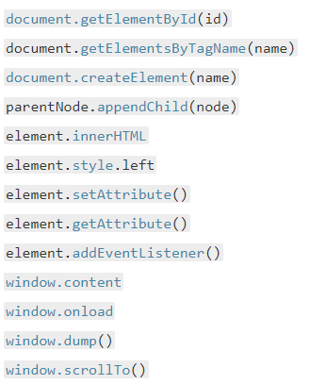
Most commonly-used interfaces

Slide 48
Document Selector
document.getElementById(id_string)
document.getElementById(id_string)
document.getElementsByClassName("class_values")
document.getElementsByName("name_value")

Slide 49
Document Selector using CSS
document.querySelector(css_selector)
document.querySelectorAll(css_selector)

Slide 50
DOM: Create/Insert HTML Element
document.createElement
insertAdjacentElement
appendChild
insertBefore

Slide 51
DOM Events
Events
GUI elements are actionable. These actions are called events. For example, a button can be pressed, menu item can be selected, check box can be clicked, window can be resized or scrolled.
Browser keeps track of events. For example, when a button is pressed, browser knows, and will invoke the “event”.
Event Handler
For each event, the programer (you) need to attach to it a function, so that when the event happens, the function runs, as a response. This function is called the “event handler”, for that event.
Here's a example of JavaScript code that attaches a function to a event named “click”, of a button element.

Slide 52
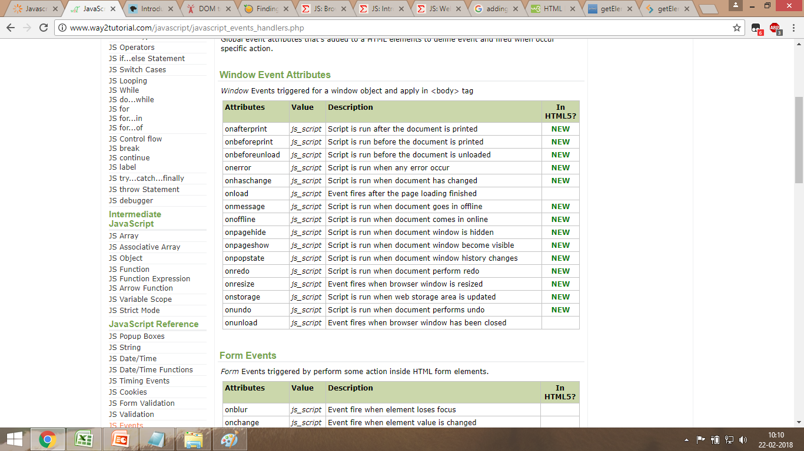
Window Events

Slide 53
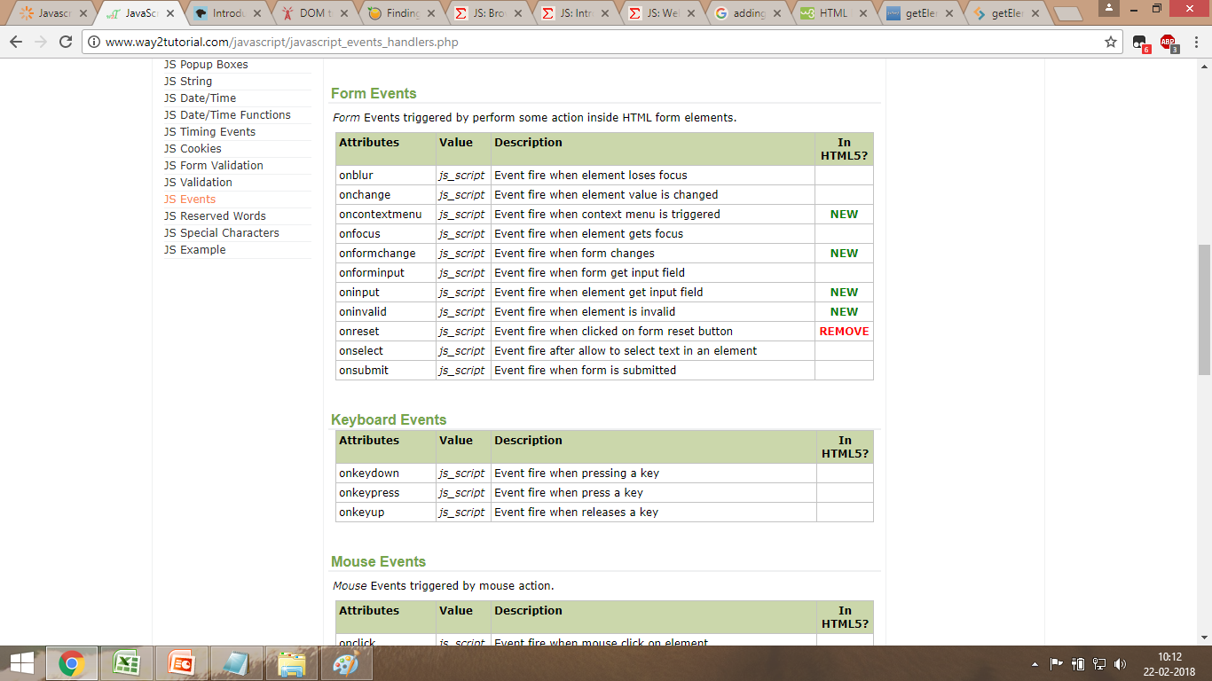
Form Events

Slide 54
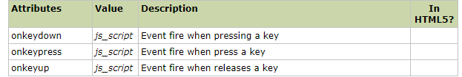
Keyboard Events

Slide 55
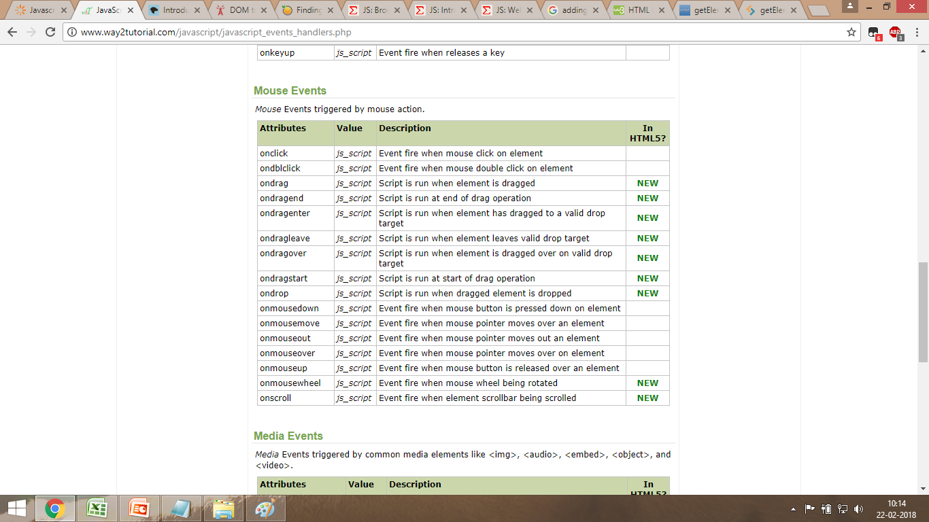
Mouse Events

Slide 56
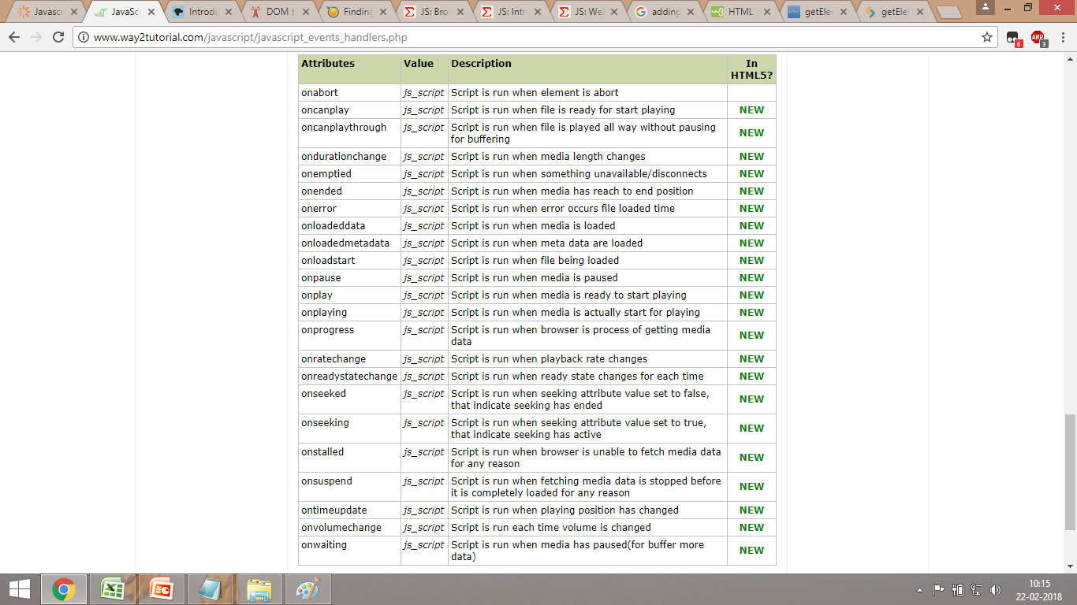
Media Events

Slide 57
AJAX

Slide 58
AJAX Technologies
JavaScript
Loosely typed scripting language.
JavaScript function is called when an event occurs in a page.
Glue for the whole AJAX operation.
DOM
API for accessing and manipulating structured documents.
Represents the structure of XML and HTML documents.
CSS
Allows for a clear separation of the presentation style from the content and may be changed programmatically by JavaScript
XMLHttpRequest
JavaScript object that performs asynchronous interaction with the server.

Slide 59
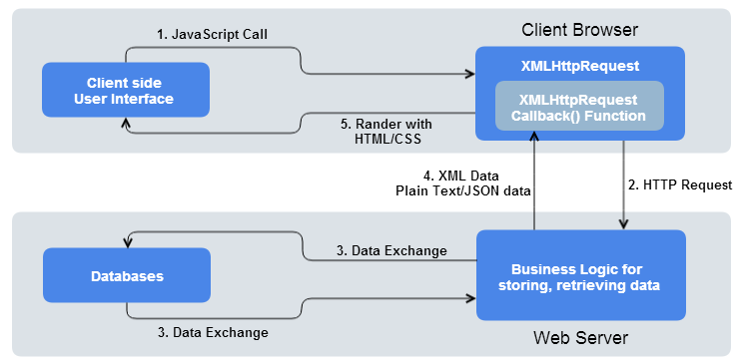
WorkFlow

Slide 60
Cross Browser
//Create AJAX Using XMLHttpRequest
var ajaxRequest = new XMLHttpRequest();
// Browser Support action
// Opera 8.0+, Firefox, Safari
ajaxRequest = new XMLHttpRequest();
//Internet Explorer
ajaxRequest = new ActiveXObject(“param");
Param = Microsoft.XMLHTTP/ Msxml2.XMLHTTP

Slide 61
AJAX Action
Define instance of this XMLHttpRequest object
var xhr = new XMLHttpRequest();
Initialize open() method
open( "method", "URL" [ , asynchronous_flag [ , "username" [ , "password" ] ] ] )
Request send using send() method
variable.send
onreadystatechange
Before you calling send method, Using onreadystatechange event to set callback (handler) function to be executed when the status of the request changes

Slide 62
XMLHttpRequest Methods
setRequestHeader("label", "value");
Open();
Variable. abort();
getResponseHeader(header_name);
getAllResponseHeaders();

Slide 63
XMLHttpRequest Properties
onreadystatechange
An event handler for an event that fires at every state change.
readyState
The readyState property defines the current state of the XMLHttpRequest object.
UNSENT=>0,
OPENED=>1,
HEADERS_RECEIVED=>2,
LOADING=>3,
DONE=>4

Slide 64
Ready state response properties
Status
statuscode, statusText
responseText/XML/Body
responseText, responseXML, responseBody

