Slide 1
JavaScript
HTML is for content and
CSS is for presentation,
JavaScript is for interactivity.

Slide 2
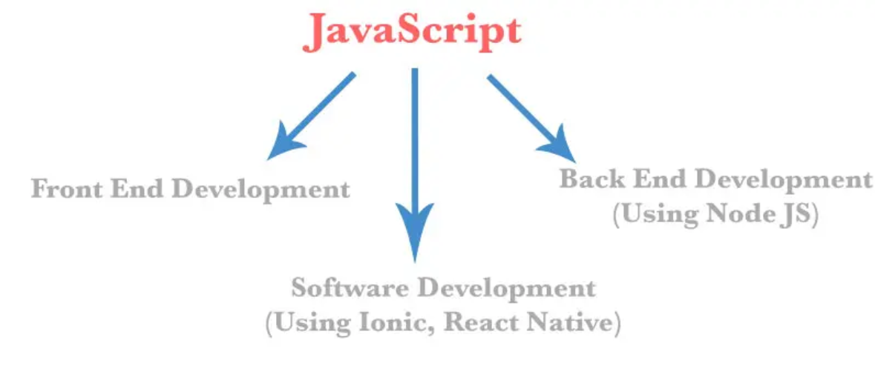
Why you should learn JS in 2022?

Slide 3
JavaScript Facts
Javascript is the only client side programming language for web browser used on 98% websites for frontend and 2% for backend(Node JS).
JavaScript can add interactions to website .
Javascript is Object Based language with prototype inheritance model for OOPS.
Javascript is Case Sensitive.
Javascript can put dynamic content into a webpage using DOM Manipulation and get data from both frontend or backend.
Javascript can react to events like Mouse Click, mouse hover, mouse out, form submit etc known as JavaScript Events.
Javascript can validate form data.
Javascript can detect user's browser and operating system using navigator Object.
Javascript can be used to create cookies.
Javascript can add animation to a webpage JS timing functions.
Javascript can detect user physical location using HTML5 Geolocation API.
Javascript can also be used to draw shapes, graphs, create animations and games development using HTML5 Canvas.
At present, Javascript has lot of libraries and framework, exp JQuery, Angular JS, React JS, Backbone JS etc, thus making Javascript more popular.
Javascript can also be used in developing server side application using Node JS.

Slide 4
JavaScript Engines
JavaScript Engines are the computer programs used to interpret or compile JavaScript into machine code. JavaScript was primarily developed for browser environment only, but non-browser environments are also using JavaScript now, like Node JS, Deno and Bun.

Slide 5
JavaScript Engines
JavaScript Engine | Browser | Other Environments
Chrome V8 | Google Chrome, Chromium, Brave, Microsoft Edge ( Jan 2020 onwards ) | Node JS, Deno
SpiderMonkey | Firefox, Netscape Navigator | MongoDB 3.2 and above, Adobe Acrobat and Reader, CouchDB
JavaScriptCore | Safari | Bun
Chakra ( deprecated ) | Internet Explorer, Edge

Slide 6
How to write JavaScript Code
Internal Javascript
<script> document.body.textContent="Hello Javascript"; </script>
External Javascript
<script src="custom.js"></script>
Inline Javascript
<button onclick="alert('Hello JS')">Check</button>

Slide 7
Important terms in JavaScript
Object
Anything which has property and method is called an object. Like a car is an object. Car can have properties like power, engine and methods like run, reverse. To access property or method of object, use dot (.) or brackets [].

Slide 8
Important terms in JavaScript
Functions
Functions are first class objects in javascript used to store multiple statements to reuse code.
Functions are called or invoked using parenthesis ().

Slide 9
Important terms in JavaScript
Operators
Operators are symbols used in programme to perform mathematical or logical operations.
For example + is used to add numbers, = is used to assign values.

Slide 10
JavaScript Dialog Box
JavaScript supports three dialog box. These dialog boxes are build in functions of window object. Three dialog box in javascript are alert, prompt and confirm.
alert
prompt
confirm

Slide 11
JavaScript Comments
Comments are used to write explanations, hints, and to stop execution of code. JavaScript use two comments syntax. One is Single line comment, and second is Multi-line comment.
Always prefer Multi-line comments in javascript for production. Single line comments in javascript are good for development purpose. But in production, they can create errors after JS Minification.
In HTML5, type="text/javascript" and language attributes from script tag has been deprecated. So we can write javascript code directly in script tag without any attribute.

Slide 12
Variables in JavaScript
A variable is the storage area used to store any value in memory.
Strict Mode
"use strict" string is used to follow strict mode. In strict mode, var is compulsory, but in sloppy mode, we can also create variables without var keyword.
It is recommended to use strict mode for faster Compilation and to avoid runtime errors.

Slide 13
Variables in JavaScript
let and Const block scope
let is used to declare temporary values with block scope, inside {} . Whereas const is used to declare permanent values, which can't be change. Like value of pi, e, G and other constants.
Scope of var is global or local.
const is used to declared immutable values

Slide 14
Data Types in JavaScript
Data Types in javascript means the type of data stored in a variable.
typeof operator in javascript is used to check data type of a variable.
Primitive Data Types
string, numbers, boolean, undefined and null.
Reference Data Types
Reference are data types based on primitive. Like Array, Object and Functions.
Everything is JavaScript is either a primitive datatype or Object.
Even Arrays and Functions are objects, but they are build-in objects.

Slide 15
Primitive data types
Primitive Data Type | Meaning
var x="HELLO" | string
var x="3" | string
var x='3' | string
var x; | undefined
var x=undefined; | undefined
var x=null; | null
var x=3; | number
var x=3.5 | number
var x=2n | BigInt
var x=Symbol('a') | Symbol
var x=true | Boolean
var x=false; | Boolean

Slide 16
Reference Data Type
Reference Data Type | Meaning
let month=[ "Jan", "Feb", "Mar" ]; | Array
let user={ name : "ABC", age : 22 }; | Object
var x=function(x,y){ return x+y;}; | Function Expression
function sum(x,y){ return x+y;} | Function Declaration
var x=new Date(); | Date
var x=/^[0-9]{6}$/; | Regex

Slide 17
Operators
Javascript Operators are used to assign, add, subtract, compare data. JavaScript is having arithmetic, logical, assignment and comparison operators.
JavaScript has both binary and unary operator including one ternary operator (conditional operator).

Slide 18
Type of Operators in Javascript
Arithmetic Operators
Logical Operaors
Assignment Operators
Comparision Operators

Slide 19
Functions
Function is a set of code, that is defined once and can be called n number of times.
A function can be reused, thus they are also used to avoid repetition of code.
Function are reference datatype in javascript.
Function includes multiple statements to perform task.
A function can take input and then return output.
Functions are one of the major building blocks in JavaScript.
Function can be both User Defined and Pre-defined ( like alert, print, close, open etc ).

Slide 20
Why JavaScript Functions are first class objects?
Functions can be assigned to variables.
Functions can have properties and methods.
Functions can return functions (High order function).
Functions can have callbacks (High order function).
Functions can be easily reused.
To invoke a function, we can use events like click, hover, submit, focus, mousemove etc, or just call by function name followed by parentheses.

Slide 21
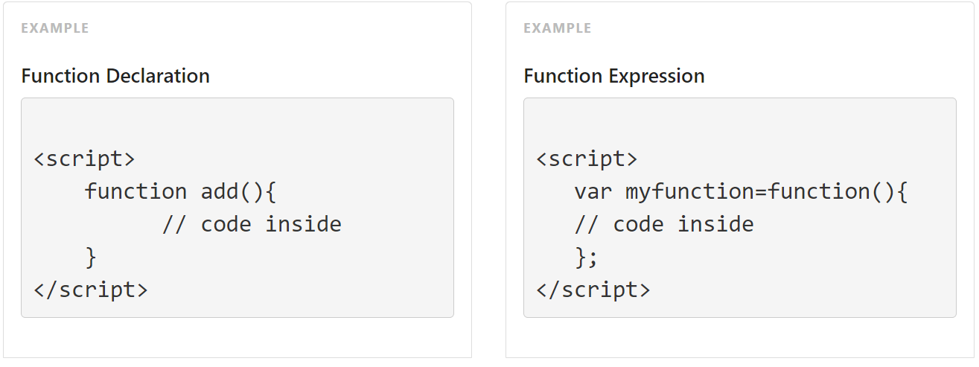
JavaScript Function Declaration

Slide 22
Call a Function
To call a function in javascript, use function name followed by parenthesis.

Slide 23
Arrow Functions
Arrow functions are actually short form of expression functions. To call arrow functions, we have to declare function first and then call.
Arrow functions were introduced in ES6. Its recommended to use function declaration or expression for IE browsers.
var myFunc1=(x,y)=>{ }; // 2 parameters
var myFunc2=(x)=>{ }; // 1 parameter
var myFunc3=x=>{ }; // 1 parameter

Slide 24
this keyword in functions
this keyword in JavaScript refers to current object. In a function, this keywords value depends upon how the function is called.
For any function, this keyword is window object, but in strict mode, this keyword is undefined.
For Events, this keyword is element on which event is triggered.

Slide 25
Note
Its better to use JavaScript Objects to declare properties and methods instead of functions.
var user={
"name":"abc", "year":2012, "location":"Noida"
}

Slide 26
Exception Handling using try catch
For error handling or exception handling in javascript, we can use try catch.
It is compulsory to handle runtime errors in javascript. Errors can block the whole code.
Forms of try statement
try ... catch
try ... finally
try ... catch...finally

Slide 27
Exception Handling using try catch
For error handling or exception handling in javascript, we can use try catch.
It is compulsory to handle runtime errors in javascript. Errors can block the whole code.
Forms of try statement
try ... catch
try ... finally
try ... catch...finally

Slide 28
Exception Handling using try catch
try
try is a code block used to wrap exceptions.
throw
throw block is used to throw exceptions.
throw can send a string error message, or error object.
Catch
catch statement is used to catch the error thrown by try block.
Error Object
We can also error object to handle runtime errors.
finally
finally block is used after catch block. finally block will always execute whether an error occurs or not.

Slide 29
Document Object Model or DOM
DOM is a Browser API to get, change and update the HTML Elements or attributes on runtime in a browser window.
We can see these changes in browser inspect, but not in source code.
DOM is a Tree Like Structure of HTML Document, with connected nodes, as shown below.
Everything in a webpage page is treated as a node,
To access DOM Element, or Elements, document or window.document keyword is used

Slide 30
DOM Methods
Document
document.write
getting elements
getElementById
getElementsByTagName
getElementsByClassName
querySelector
querySelectorAll
createElement

Slide 31
Javascript Events
Events are the techniques used by a user to interact with webpage, like mouse click, mouse hover, key press, keyup, right click, drag touch etc. Javascript can handle Keyboard based events, mouse based events and Touch Based events. A fully interactive website is not possible without JS Events.
Touch based events are also supported in javascript after ES5(2011).

Slide 32
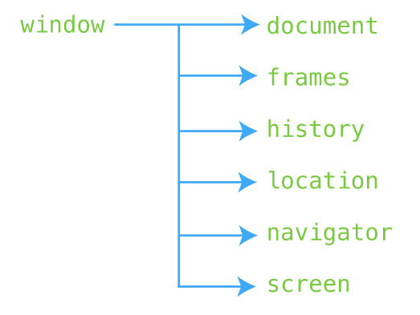
Browser Object Model (BOM)
The BOM is a tree-like hierarchy of objects, each with useful access properties and methods. Essentially, this object allows you to talk with your user's browser.

Slide 33
BOM - Window
Window – understand the window object.
Alert – display an alert dialog.
Confirm – display a modal dialog with a question.
Prompt – prompt the user to input some text.
setTimeout – set a timer and execute a callback function once the timer expires.
setInterval – execute a callback function repeatedly with a fixed delay between each call.

Slide 34
BOM - Location
Location – manipulate the location of a document via the location object.
Get query string parameters – learn how to retrieve query string parameters.
Redirect to a new URL – show you how to redirect to a new URL using JavaScript

Slide 35
BOM - Navigator
Navigator – query the information and capabilities of the browser using the navigator object.
window.navigator.userAgent

Slide 36
BOM - Screen
Screen – get the information about the screen on which the browser is running by using the screen object.
window.screen

Slide 37
BOM - History
History – manage the web browser’s history stack with the history object.
The window.history object allows you to access the history stack of the browser.
To navigate to a URL in the history, you use the back(), forward(), and go() methods.
The history.length returns the number of URLs in the history stack.

Slide 38
Regular Expression
The Regular Expression or regex in short is a build in JS Object used to Test and Match strings. This can check characters in strings and also their sequence. One of the main use of Regular Expression is to test password strength.

Slide 39
RegExp Object
To build a regular expression pattern, javascript use build in regexp object using new Constructor Object or by using literal notation. We will prefer using literal notation as it is short.
new RegExp
In constructor form, new RegExp is used to create regexp and pattern is stored inside.
var pattern=new RegExp('\s'); // pattern for white space

Slide 40
Form Validation
JavaScript Form Validation is the process of validating form data on submit.
This includes validation of inputs, select, radio buttons, checkbox, file, textarea etc.
Validating form data on client side is very important.

