Slide 1
Module 3

Slide 2
HTML5 Stack
Html5 is the combination of three web technologies
HTML → to build webpage structure
CSS → to enhance look and feel( presentation layer)
Javascript → to add functionality to HTML elements.

Slide 3
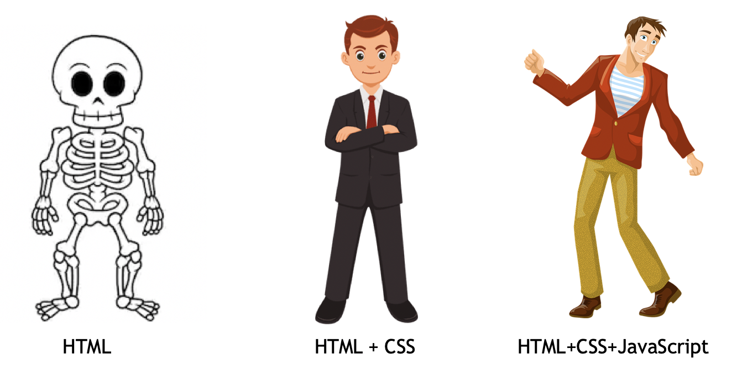
HTML5 -> HTML + CSS + JS

Slide 4
HTML Headings
HTML offers six levels of heading tags, <h1> through <h6>; the lower the heading level number, the greater its importance — therefore <h1> tag defines the most important heading, whereas the <h6> tag defines the least important heading in the document.

Slide 5
Paragraphs
Creating Paragraphs
Paragraph element is used to publish text on the web pages.
Paragraphs are defined with the <p> tag.
Creating Line Breaks
The <br> tag is used to insert a line break on the web page.
Creating Horizontal Rules
You can use the <hr> tag to create horizontal rules or lines to visually separate content sections on a web page. Like <br>, the <hr> tag is also an empty element.

Slide 6
Paragraphs
Managing White Spaces
Insert &nbsp; for creating extra consecutive spaces
Defining Preformatted Text
you can use the <pre> tag to display spaces, tabs, line breaks, etc. exactly as written in the HTML file.
It is very helpful in presenting text where spaces and line breaks are important like poem or code.

Slide 7
Links
A link or hyperlink is a connection from one web resource to another.
Links allow users to move seamlessly from one page to another, on any server anywhere in the world.
Links are specified in HTML using the <a> tag.
A link or hyperlink could be a word, group of words, or image.

Slide 8
Links
Setting the Targets for Links
The target attribute tells the browser where to open the linked document. There are four defined targets, and each target name starts with an underscore(_) character:
_blank — Opens the linked document in a new window or tab.
_parent — Opens the linked document in the parent window.
_self — Opens the linked document in the same window or tab as the source document. This is the default, hence it is not necessary to explicitly specify this value.
_top — Opens the linked document in the full browser window.

Slide 9
Text Formatting
<strong> and <b> tag
<em> and <i> tag
Formatting Quotations -> <blockquote>
Showing Abbreviations -> <abbr>
Contact Addresses -> <address>

Slide 10
Images
<img> tag is used to insert images in the HTML documents.
Using the HTML5 Picture Element
HTML5 has introduced the <picture> tag that allows you to define multiple versions of an image to target different types of devices.
<picture> element contains zero or more <source> elements, each referring to different image source, and one <img> element at the end.
Also each <source> element has the media attribute which specifies a media condition (similar to the media query) that is used by the browser to determine when a particular source should be used.

Slide 11
Tables
HTML table allows you to arrange data into rows and columns. They are commonly used to display tabular data like product listings, customer's details, financial reports, and so on.
You can create a table using the <table> element. Inside the <table> element, you can use the <tr> elements to create rows, and to create columns inside a row you can use the <td> elements. You can also define a cell as a header for a group of table cells using the <th> element.

Slide 12
Lists
Unordered list — Used to create a list of related items, in no particular order.
Ordered list — Used to create a list of related items, in a specific order.
Description list — Used to create a list of terms and their descriptions.
The description list is created using <dl> element. The <dl> element is used in conjunction with the <dt> element which specify a term, and the <dd> element which specify the term's definition.

Slide 13
Forms
HTML Forms are required to collect different kinds of user inputs, such as contact details like name, email address, phone numbers, or details like credit card information, etc.

Slide 14
iFrame
An iframe or inline frame is used to display external objects including other web pages within a web page.
An iframe pretty much acts like a mini web browser within a web browser.
<iframe src="hello.html"></iframe>

Slide 15
DOCTYPE
A Document Type Declaration, or DOCTYPE for short, is an instruction to the web browser about the version of markup language in which a web page is written.

Slide 16
Layout
Warning: The method used for creating layout in the above example is not wrong, but it's not recommended. Avoid tables and inline styles for creating layouts. Layouts created using tables often rendered very slowly. Tables should only be used to display tabular data.
Tip: Better web page layouts can be created by using the DIV elements and CSS. You can change the layout of all the pages of your website by editing just one CSS file.

Slide 17
Layout
Tag | Description
<header> | Represents the header of a document or a section.
<footer> | Represents the footer of a document or a section.
<nav> | Represents a section of navigation links.
<section> | Represents a section of a document, such as header, footer etc.
<article> | Represents an article, blog post, or other self-contained unit of information.
<aside> | Represents some content loosely related to the page content.

Slide 18
Head
<head>
<style>
<meta>
<script>
<link>

Slide 19
meta
<meta> tags are typically used to provide structured metadata such as a document's keywords, description, author name, character encoding, and other metadata.

Slide 20
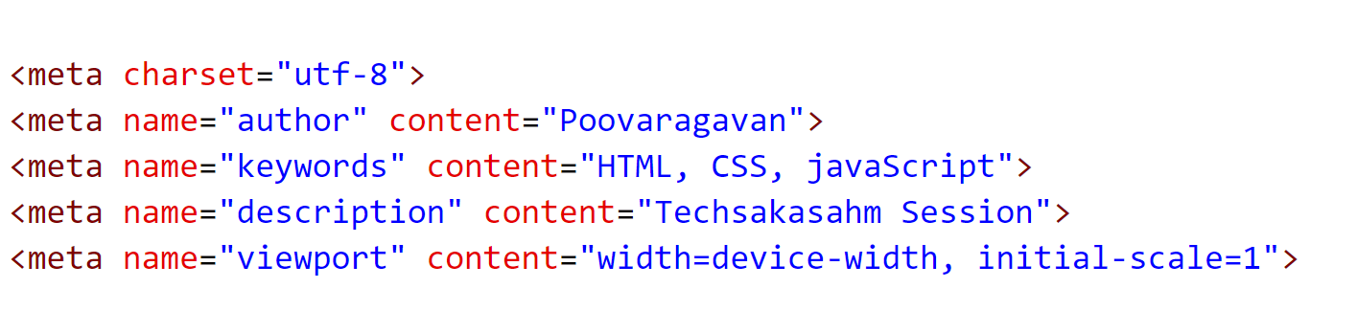
meta

Slide 21
Entitites
HTML entities to display special characters and symbols.
Using &
<p>&#12854;</p>

Slide 22
HTML5 Input Types
HTML5 introduces several new <input> types like email, date, time, color, range, and so on. to improve the user experience and to make the forms more interactive.

Slide 23
Audio & Video

Slide 24
Geolocation
Finding a Visitor's Coordinates
Getting the position information of the site visitor using the HTML5 geolocation API is fairly simple.
It utilizes the three methods that are packed into the navigator.geolocation object — getCurrentPosition(), watchPosition() and clearWatch().

Slide 25
CSS3

Slide 26
CSS
HTML can only build webpage structure, CSS can style HTML.
CSS Advantage
By using a single style sheet or css file for entire site, a web designer can apply styles across whole site while updating a single css file.

Slide 27
Why CSS ??
CSS Save Lots of Time
Easy Maintenance
Pages Load Faster
Superior Styles to HTML
Multiple Device Compatibility

Slide 28
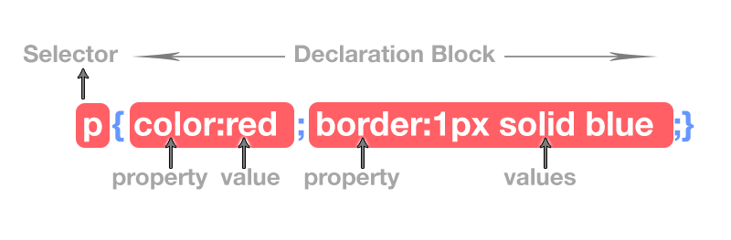
CSS Code

Slide 29
Type of css
CSS Type | Explanation
Internal CSS | CSS Code is written inside <style> tag in head. Recommended for single page only.
External CSS | CSS code is written in separate file with .css extension and <link> element is used to attach external css with html document. Used for multipage websites.
Inline CSS | CSS code is written inside html tag directly, in style attribute.

Slide 30
CSS Color

Slide 31
CSS Background
background-color
background-image
background-repeat
background-attachment
background-position
background-color: #f0e68c;
background-image: url("images/smiley.png");
background-repeat: no-repeat;
background-attachment: fixed;
background-position: 250px 25px;

Slide 32
Font
Choosing the right font and style is very crucial for the readability of text on a page.
font-family, font-style, font-weight, font-size, and font-variant.

Slide 33
Length Units
Unit | Description
in | inches – 1in is equal to 2.54cm.
cm | centimeters.
mm | millimeters.
pt | points – In CSS, one point is defined as 1/72 inch (0.353mm).
pc | picas – 1pc is equal to 12pt.
px | pixel units – 1px is equal to 0.75pt.

Slide 34
CSS Text
CSS provides several properties that allows you to define various text styles such as color, alignment, spacing, decoration, transformation, etc. very easily and effectively.
The commonly used text properties are: text-align, text-decoration, text-transform, text-indent, line-height, letter-spacing, word-spacing

Slide 35
CSS Link
A link has four different states
a:link — define styles for normal or unvisited links.
a:visited — define styles for links that the user has already visited.
a:hover — define styles for a link when the user place the mouse pointer over it.
a:active — define styles for links when they are being clicked.

Slide 36
CSS List
list-style-type,
list-style-image, and
list-style-position

Slide 37
CSS Tables
CSS border property is the best way to define the borders for the tables.

Slide 38
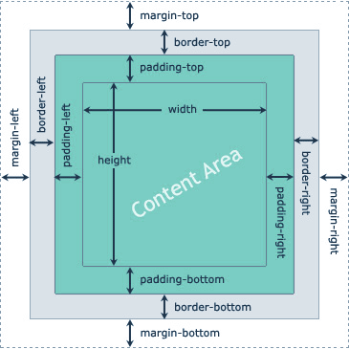
CSS Box Model
How elements are visually laid out on the web pages.
Every box has a content area and optional surrounding padding, border, and margin areas.

Slide 39
CSS padding properties allow you to set the spacing between the content of an element and its border (or the edge of the element's box, if it has no defined border).
CSS => padding-top, padding-right, padding-bottom, and the padding-left

Slide 40
CSS border properties allow you to define the border area of an element's box.
Borders appear directly between the margin and padding of an element.

Slide 41
The CSS margin properties allow you to set the spacing around the border of an element's box (or the edge of the element's box, if it has no defined border).
An element's margin is not affected by its background-color, it is always transparent.
margin-top, margin-right, margin-bottom and margin-left.

Slide 42
2D Transforms
With CSS3 2D transform feature you can perform basic transform manipulations such as move, rotate, scale and skew on elements in a two-dimensional space.
transform: translate(200px, 50px);
transform: rotate(30deg);

Slide 43
3D Transforms
transform: rotate3d(0, 1, 0, 60deg);
transform: scale3d(1, 1, 2) rotate3d(1, 0, 0, 60deg);

