Slide 1

Revolutionizing IMDb Scores: Innovative Design for Predictive Accuracy

Slide 2

Introduction
Welcome to the presentation on Revolutionizing IMDb Scores: Innovative Design for Predictive Accuracy. In this session, we will explore the challenges with current IMDb scoring system and propose a new approach to enhance accuracy and reliability. Join us on this journey to revolutionize movie ratings and make informed decisions.

Slide 3

Current IMDb Scoring System
The current IMDb scoring system relies heavily on user ratings and reviews.
However, it has limitations due to
subjectivity and bias. Users often rate movies based on personal preferences, leading to inconsistencies. Additionally, manipulation of scores by certain groups affects the overall accuracy. We need a more reliable and objective approach to evaluate movie quality.

Slide 4
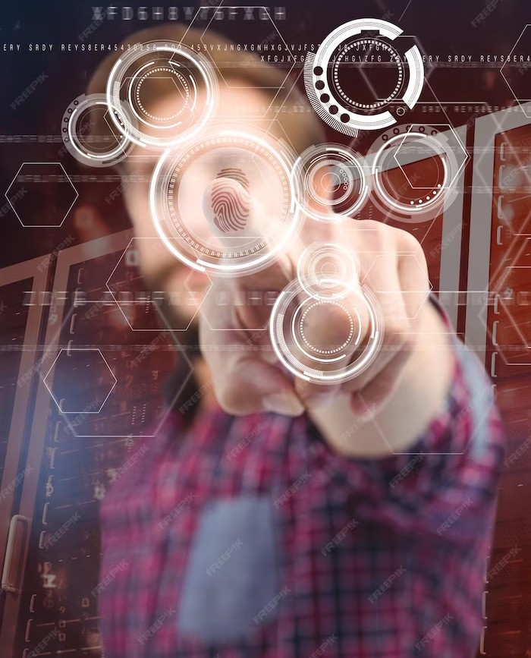
Introducing Predictive Accuracy
Our proposed approach focuses on predictive accuracy. By leveraging machine learning algorithms and data analysis, we aim to develop a model that can accurately predict movie ratings. This will provide users with more reliable information and help them make informed decisions before watching a movie.

Slide 5

Data Collection and Analysis
To achieve predictive accuracy, we will collect and analyze various movie- related data including genre, cast, crew, release date, and user demographics.
By combining this data with historical ratings, we can identify patterns and factors that contribute to movie success. This comprehensive analysis will enable
us to build a robust predictive model.

Slide 6

Machine Learning Model
Our proposed machine learning model will be trained using the collected data. By considering various features and their impact on ratings, the model will learn to predict IMDb scores accurately. The model will continuously update and improve itself as new data becomes available, ensuring its reliability and adaptability.

Slide 7


Enhancing User E perience
With the new design, users will have a more enhanced experience on IMDb. The predictive accuracy will provide them with personalized movie recommendations based on their preferences, increasing the likelihood of enjoying the movies they watch. Users can also explore diverse genres and discover hidden gems that align with their taste.

Slide 8

Industry Impact
The revolutionized IMDb scoring system will have a signiﬁcant impact on the movie industry. Filmmakers will receive more accurate feedback on their work, allowing them to make necessary improvements and increase audience satisfaction. Studios can make informed decisions on movie investments, reducing ﬁnancial risks.
Overall, the industry will beneﬁt from a
more reliable and objective evaluation system.

Slide 9

Challenges and Considerations
Implementing a new scoring system comes with challenges. We need to address concerns regarding privacy and data security.
Transparency in the algorithm is crucial to gain user trust. Additionally, we must ensure the model remains unbiased and fair in its predictions, avoiding any discrimination or favoritism.

Slide 10

Future Developments
The future holds exciting possibilities for IMDb scores. We envision incorporating natural language processing to analyze user reviews and sentiments, providing a more holistic evaluation. Collaborations with streaming platforms can enable real- time ratings and recommendations.
Continuous advancements in technology will pave the way for further
innovation in movie ratings.

Slide 11
Conclusion
In conclusion, revolutionizing IMDb scores through innovative design and predictive accuracy will transform the way we evaluate movies. By leveraging machine learning and data analysis, we can provide users with reliable information and enhance their movie-watching experience. Let's embrace this journey of change and create a more informed and enjoyable movie ecosystem.

