Slide 1
Ecommerce Customer Retention And Activation
Poovarasi Vijayan

Slide 2
Introduction
Customer satisfaction has emerged as one of the most important factors that guarantee the success of online store; it has been posited as a key stimulant of purchase, repurchase intentions and customer loyalty.
A comprehensive review of the literature, theories and models have been carried out to propose the models for customer activation and customer retention.
Five major factors that contributed to the success of an e-commerce store have been identified as: service quality, system quality, information quality, trust and net benefit.
The research furthermore investigated the factors that influence the online customers repeat purchase intention. The combination of both utilitarian value and hedonistic values are needed to affect the repeat purchase intention (loyalty) positively.

Slide 3
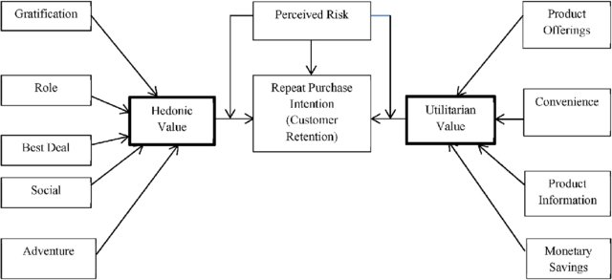
Introduction

Slide 4
Dataset
The data is collected from Indian Online Shoppers which has data such as age, gender, how long customers shop online, number of purchase, how they access internet, what is the payment options they use, how ease they access page, how often they abond cart, what is the loading speed of the page, is it value for money, how they recommend to their friends and neighbours along with other data.
Result of these data indicate the e-retail success factors, which are very much critical for customer satisfaction.

Slide 5
Exploratory Data Analysis
With this dataset I have performed the below analysis (after null value removal)
Univarient Analysis: Uni means ‘one’ which is simplest form of analyzing data. Analyzing each variables separately.
Multivarient Analysis: Analysis is made with more than one data.
Correlation : It is the measure of relationship between two variables
Outliers: outliers are values within a dataset that vary greatly from the others—they're either much larger, or significantly smaller. Outliers may indicate variabilities in a measurement, experimental errors, or a novelty.
Skewness: Measure of symmetric or asymmetric distribution.

Slide 6
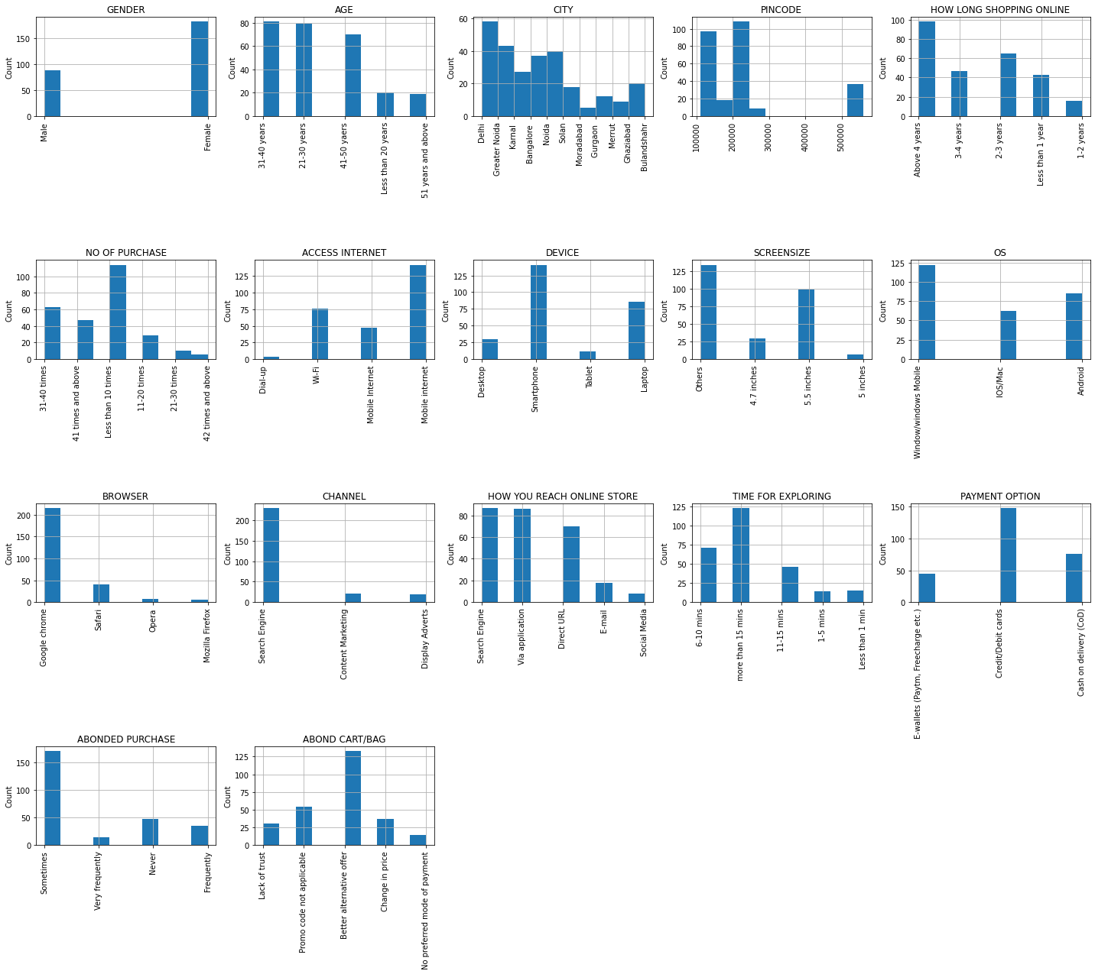
Customer Preference Data Analysis:

Slide 7
Key Observations:
Female online buyers are more than male and mostly in the age group of 21-30 & 31-40 years.
Delhi has highest online shoppers compared to other cities.
Many are doing online shopping for more than 4 years.
More people purchased less than 10 times in a year.
Mostly internet is accessed through mobile data in smartphones and all type of screen types are used.
Among desktop users Windows OS is used in most cases and among Mobile users android devices is used mostly than ios.
Google browser is most frequently used browser.

Slide 8
Key Observations:
Many are reaching online stores via search engine and applications followed by direct url
Exploring of products is done in less than 15 minutes.
Online payment is done via debit/credit cards compared to other platforms.
Sometimes abonding products from cart happens due to other better alternatives.

Slide 9
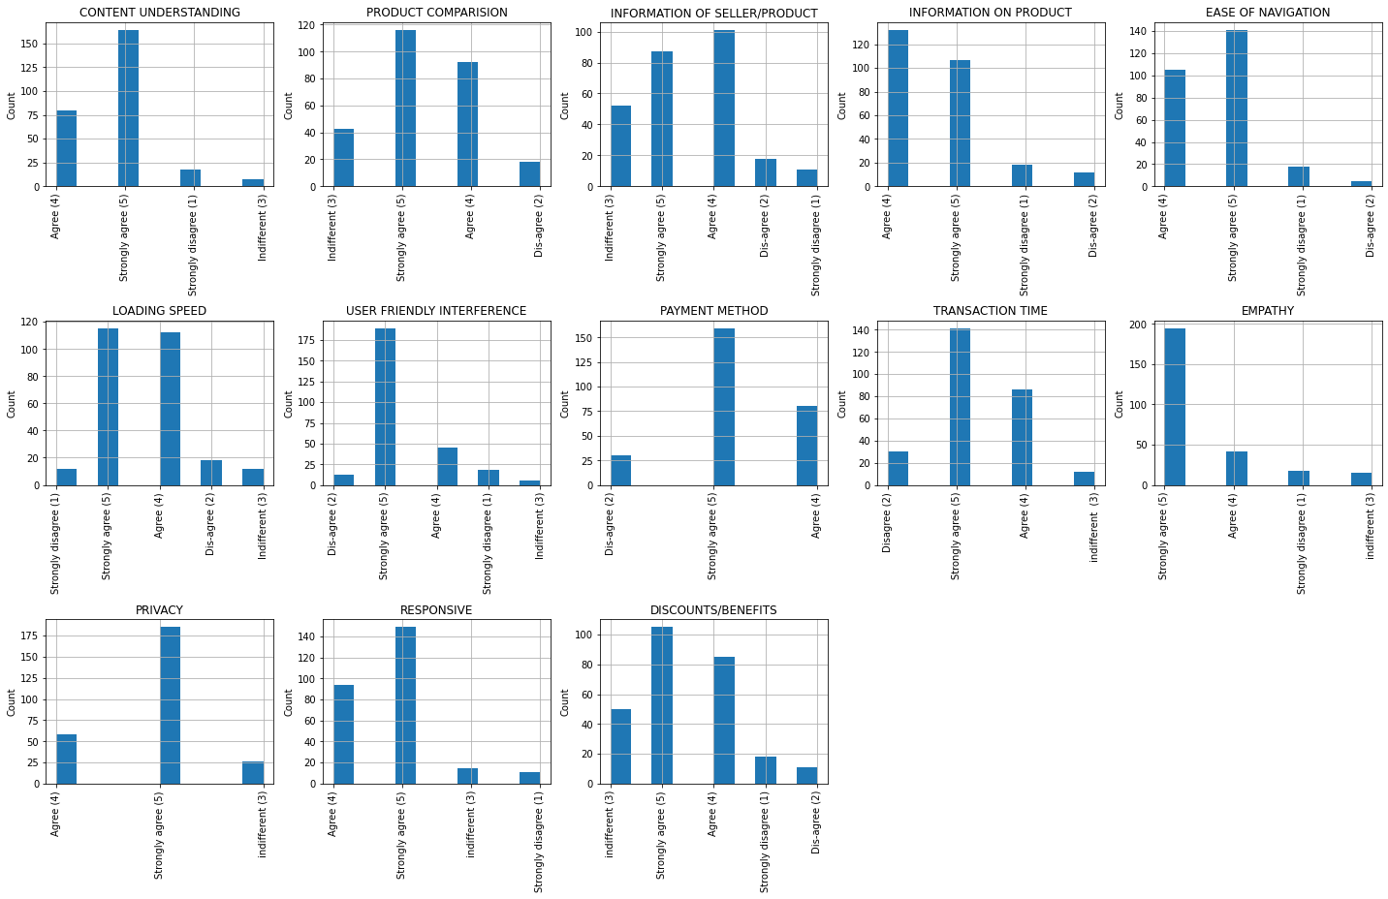
E commerce Data Analysis:

Slide 10
Key Observation
Based on ratings customers has given highest rating/Strongly recommended for
CONTENT UNDERSTANDING
PRODUCT COMPARISION
EASE OF NAVIGATION
LOADING SPEED
USER FRIENDLY INTERFERENCE
PAYMENT METHOD
TRANSACTION TIME
EMPATHY
PRIVACY
RESPONSE
DISCOUNTS/BENEFITS
Below two needs improvement
INFORMATION OF SELLER/PRODUCT
INFORMATION OF PRODUCT

Slide 11
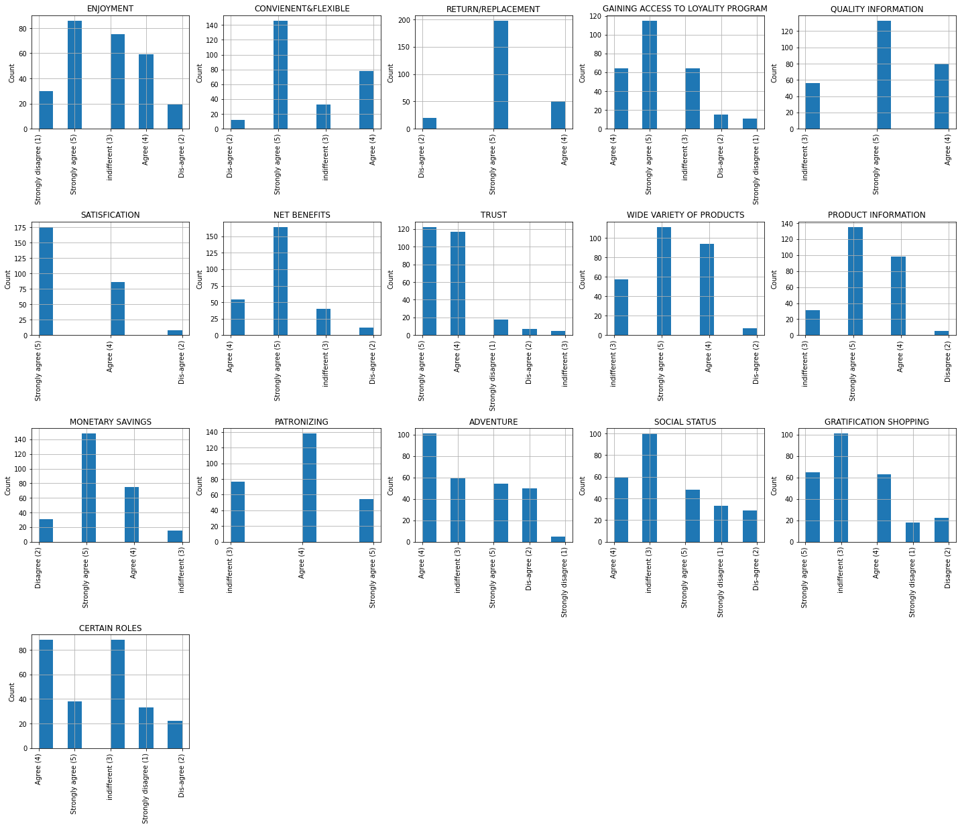
E commerce Data Analysis:

Slide 12
Key Observations:
Customers has strongly agreed for
'SOCIAL STATUS’ , 'GRATIFICATION SHOPPING’ , 'CERTAIN ROLES' shows indifference.
'PATRONIZING’ , 'CERTAIN ROLES’ , 'ADVENTURE' shows agree
ENJOYMENT | 'GAINING ACCESS TO LOYALTY PROGRAM | 'WIDE VARIETY OF PRODUCT
'CONVIENENT/FLEXIBLE | 'QUALITY INFORMATION | 'NET BENEFITS
'RUTURN/REPLACEMENT | 'SATISFACTION | 'TRUST
'PRODUCT INFORMATION | 'MONETARY SAVINGS

Slide 13
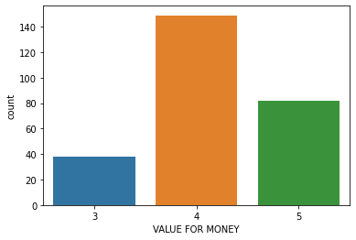
VALUE FOR MONEY
Here mostly all customers agree that the product bought are Value for money.

Slide 14
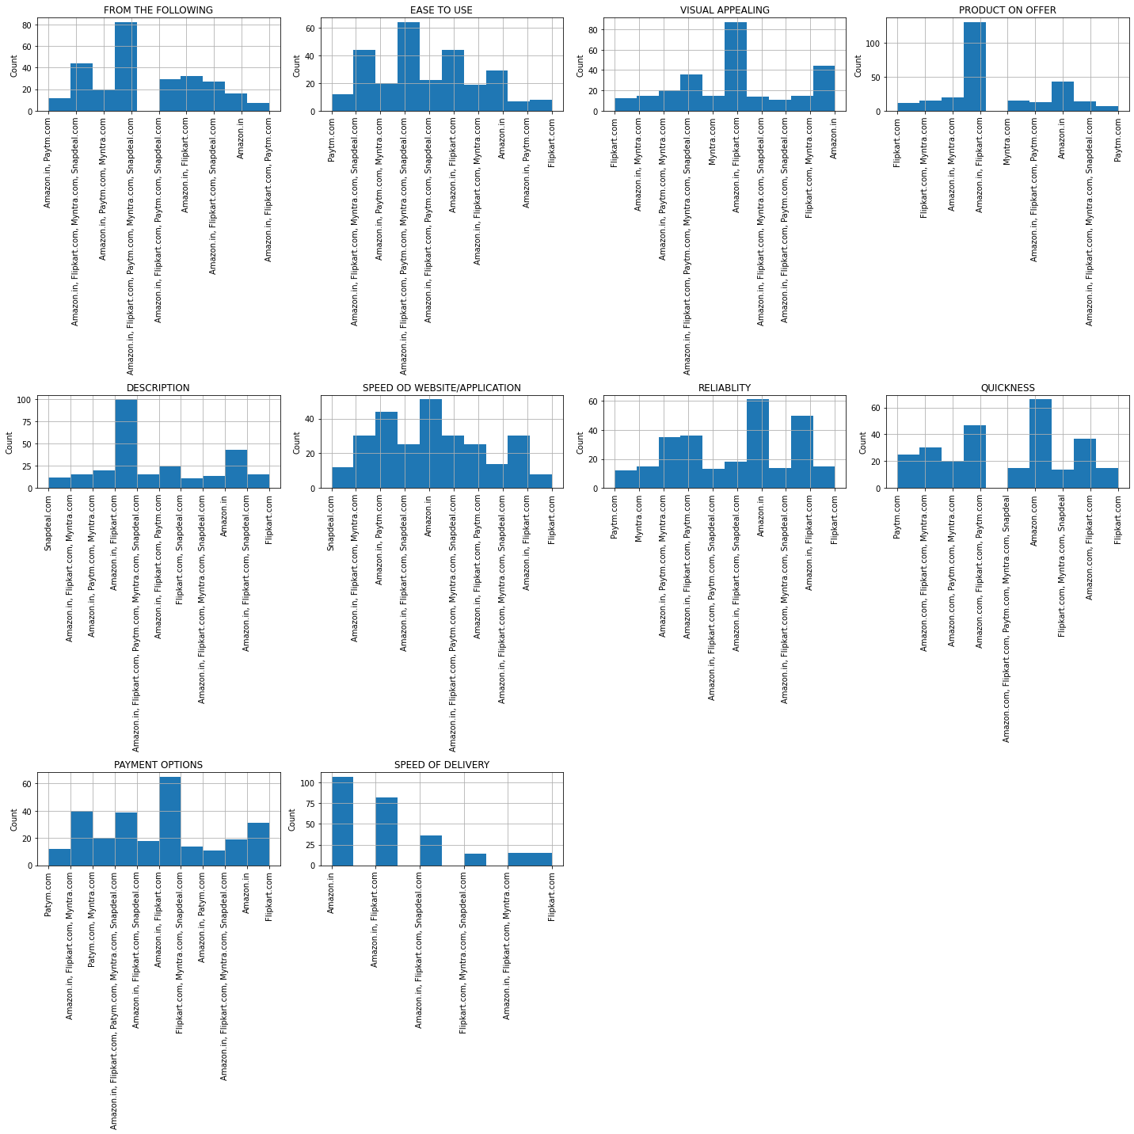
Website data

Slide 15
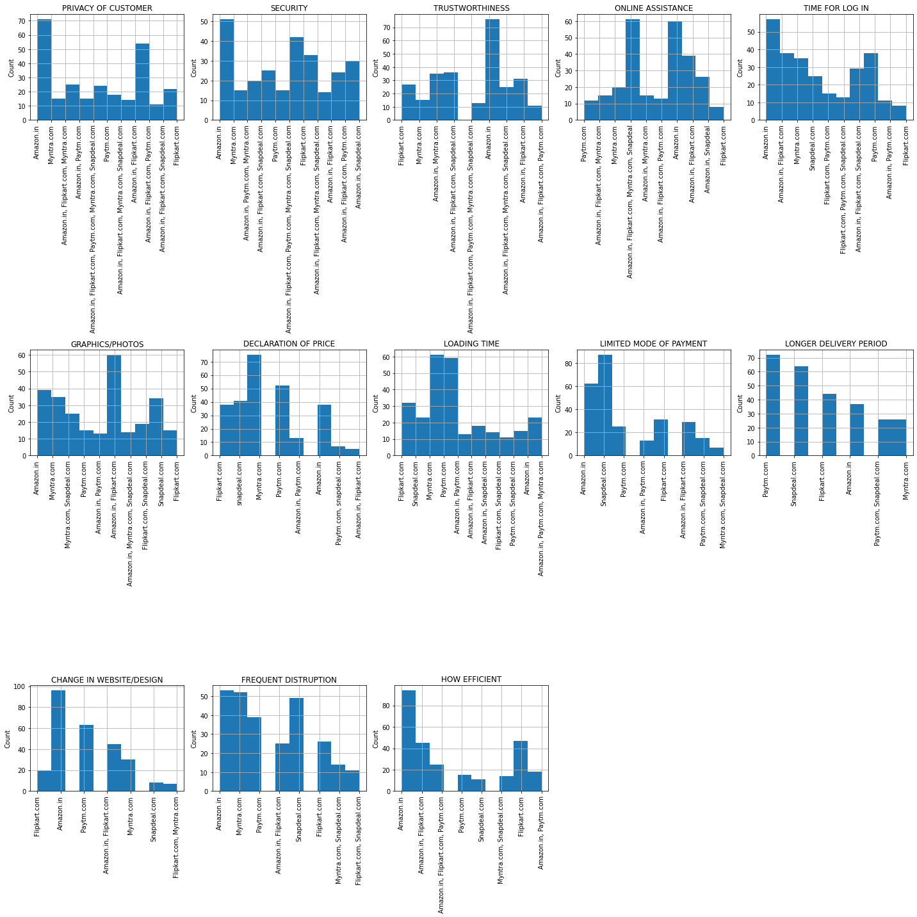
Website data:

Slide 16
Key Observations:
Most of customers go with Amazon for EASE TO USE, VISUAL APPEARING, PRODUCT ON OFFER, DESCRIPTION, SPEED, RELIABILITY, QUICKNESS, PAYMENT OPTIONS, DELIVERY SPEED followed by Flipkart, Myntra, Paytm
In PRIVACY, TRUTHWORTHINESS, SECURITY, ONLINE ASSISTANCE, TIME FOR LOG IN, GRAPHICS, HOW EFFICIENT, FREQUENT DISTRUPTION, CHANGE IN WEBSITE Amazon tops the list followed by Flipkart.
Snapdeal has 'limited mode of payment' followed by Amazon and Flipkart.
Myntra, Paytm takes more time to load.
Paytm, Snapdeal has longer delivery time.

Slide 17
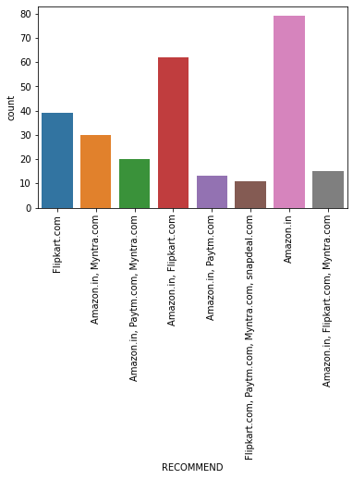
RECOMMENDED WEBSITE:
It is seen that mostly amazon is used and recommended website, followed by Flipkart and Myntra

Slide 18
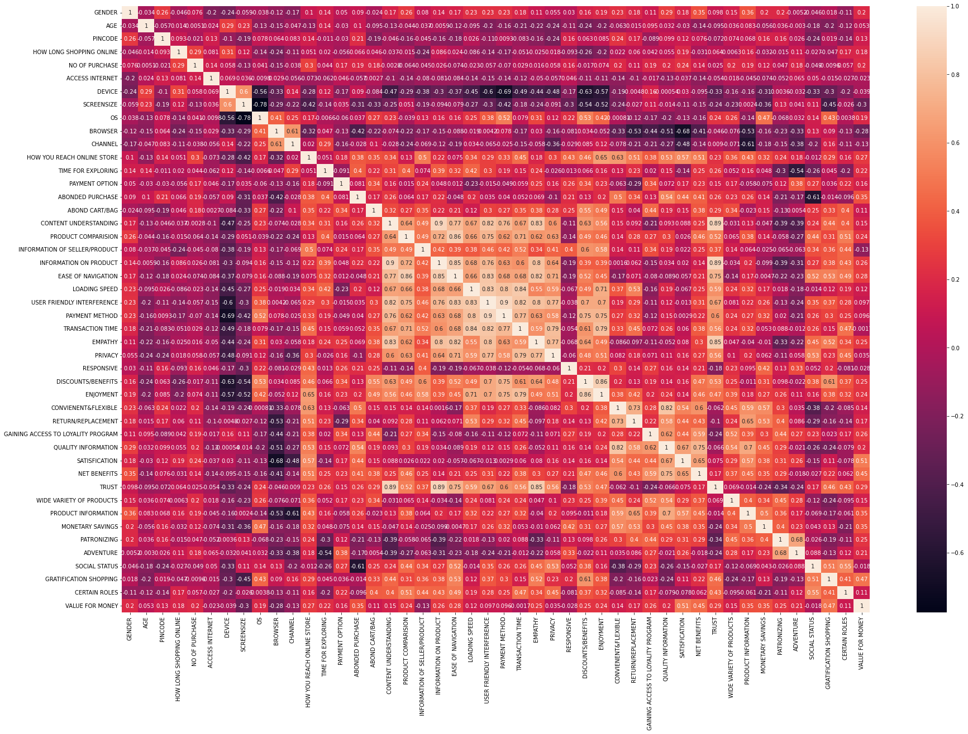
Correlation:

Slide 19
Key Observations:
Here we can find that 'OS' and 'SCREEN SIZE' column is highly correlated with each other.
Mostly all data have positive correlation with 'VALUE FOR MONEY'
These observation says that customers are more interested in faster delivery and ease of access product details over other factors which also makes the customers to purchase again from the same vendor.

Slide 20
Conclusion:
Based on the data we can conclude that with ease of internet facility most of customers trust ecommerce sites because they have good price, product offers, easy return policy, ease usage of website.
Customers also recommend few sites to their friends based on the value of the website.

