Slide 1
Flight Ticket Price Prediction
Submitted by,
Poovarasi Vijayan

Slide 2
Content:
Introduction
Problem Statement
Insights of the project
Analytical Problem Facing
EDA
Visualizations
Data Pre Processing and Feature Engineering
Model Development and Evaluation
Conclusion

Slide 3
Introduction:
Airline industry is one of the most sophisticated in its use of dynamic pricing strategies to maximize revenue, based on proprietary algorithms and hidden variables. That is why the airline companies use complex algorithms to calculate the flight ticket prices.
There are several different factors on which the price of the flight ticket depends. The seller has information about all the factors, but buyers are able to access limited information only which is not enough to predict the airfare prices.

Slide 4
Problem Statement:
Flight ticket prices can be something hard to guess, today we might see a price, check out the price of the same flight tomorrow, it will be a different story. We might have often heard travellers saying that flight ticket prices are so unpredictable.
Anyone who has booked a flight ticket knows how unexpectedly the prices vary. The cheapest available ticket on a given flight gets more and less expensive over time. This usually happens as an attempt to maximize revenue based on –
1. Time of purchase patterns (making sure last-minute purchases are expensive).
2. Keeping the flight as full as they want it (raising prices on a flight which is filling up in order to reduce sales and hold back inventory for those expensive last-minute expensive purchases).
Here we are trying to help the buyers to understand the price of the flight tickets by deploying machine learning models. These models would help the sellers/buyers to understand the flight ticket prices in market and accordingly they would be able to book their tickets.

Slide 5
Business Goal:
The main aim of this project is to predict the price of flight tickets based on various features. The purpose of this project is to study the factors which influence the fluctuations in the airfare prices and how they are related to the change in the prices. Then using this information, build a system that can help buyers whether to buy a ticket or not. So that Machine Learning model is deployed for flight ticket price prediction and analysis. This model will provide the approximate selling price for the flight tickets based on different features.

Slide 6
Insights of Project:
As per the requirement of our client, data is scraped from www.easemytrip.com, which is one of the platforms to book flight tickets. This project was built with a aim of gaining insights about various factors affecting the price of flight. This project is more about data exploration, feature engineering and pre-processing of data.
The goal of this project is to build an application which can predict the price of flight tickets with the help of the features available. In long term this would allow people to better explain and review their purchase in this digital world.

Slide 7
Analytical Problem Facing:
Analytic problem framing involves translating the business problem into terms that can be addressed analytically via data and modeling. Analytic problem framing is the antithesis of merely working with the ready-to-hand data and seeing what comes of it, hoping for something insightful.

Slide 8
Exploratory data analysis
In flight ticket price prediction problem data is scrapped using webscraping selenium from www.easemytrip.com website.
First, the analysis is started with importing the data, this dataset had few Null values in target column, so null values is dropped and unnecessary columns which does not contribute for the target variable is also dropped.
Once data is cleaned outliers and skewness are checked, if present they are removed then in Data Pre-processing, Standard Scaler is used to standardize the data and by using VIF, multicollinearity is removed.

Slide 9
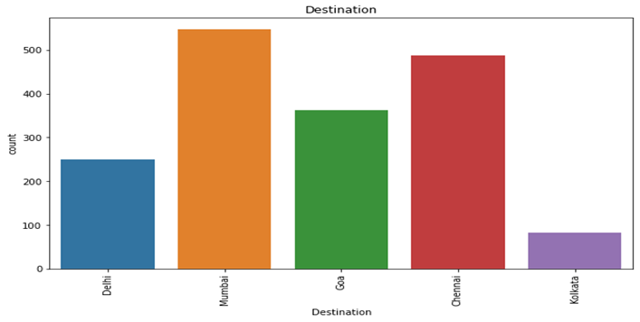
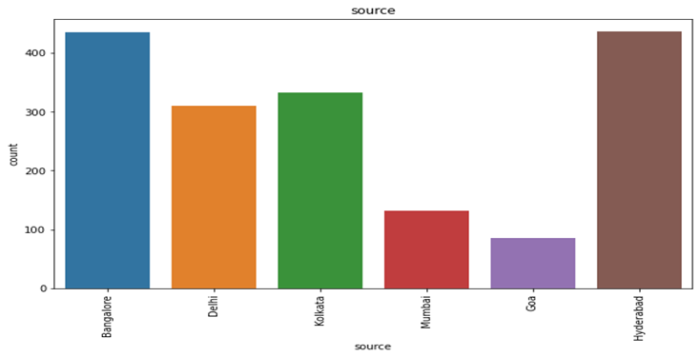
Visualization:
Many people travel to Mumbai and Chennai followed by Goa.
Source is mostly in Bangalore followed by Hyderabad.

Slide 10
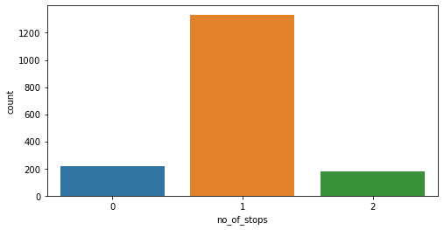
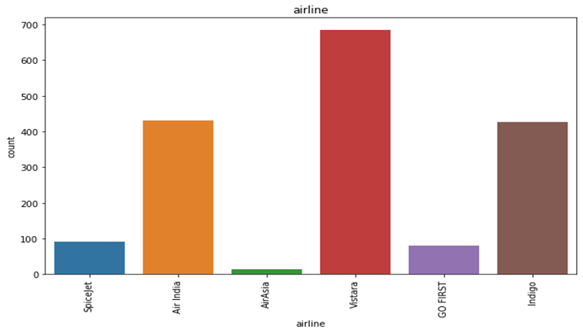
Cont.
Vistara is mostly prefered airlines followed by AirIndia and Indigo
Our dataset contains many one stop airplanes compared to non-stop.

Slide 11
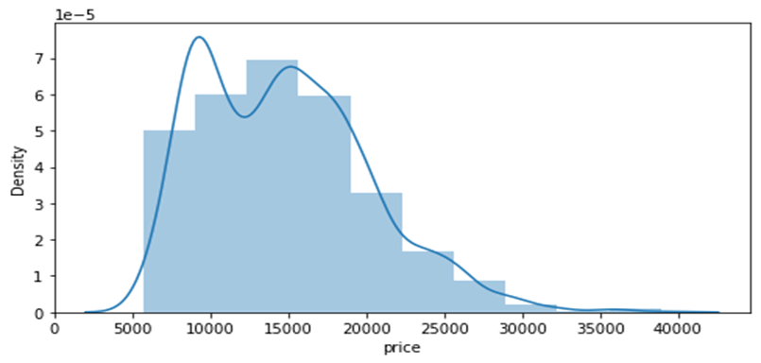
Visualization of Numerical data:
1. Mostly the price ranges from 5000 to 20000 and it extends upto 40000

Slide 12
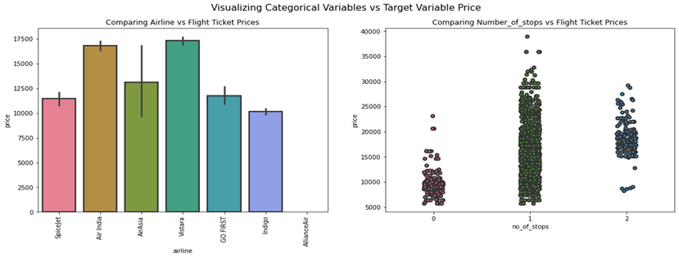
Bivarient Analysis
Airline vs Price: From the bar plot we can notice "Vistara" and "Air India" airlines have highest ticket prices compared to other airlines.
Number_of_stops vs Price: From the strip plot we can notice the flights which have 1 stop between source and destination have highest ticket prices compared to others.

Slide 13
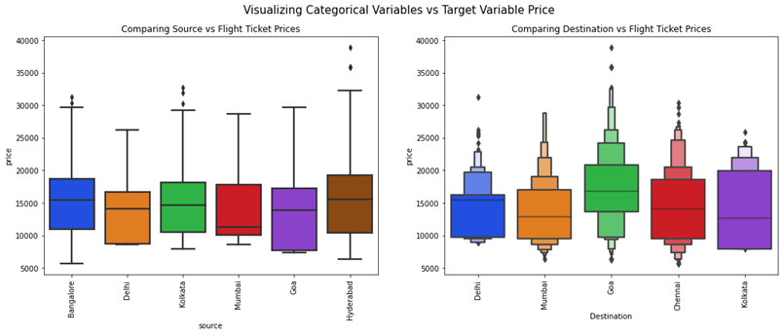
Cont.
Source vs Price : From the box plot we can observe the flights from Hyderabad are having somewhat higher prices compared to other sources.
Destination vs Price: From the boxen plot we can notice that the flights travelling to Goa have higher flight ticket prices.

Slide 14
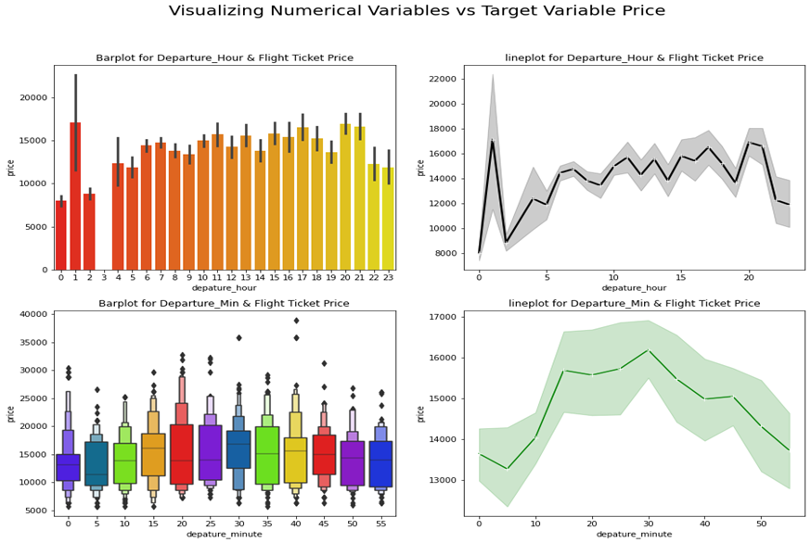
Cont.
Departure_Hour vs Price: From the bar plot and line plot we can see that there are some flights departing in the early morning 1 AM having most expensive ticket prices compared to late morning flights. We can also observe the flight ticket prices are higher during afternoon (may fluctuate) and it decreases in the evening.
Departure_Min vs Price: The boxen plot and line plot gives there is no significant difference between price and departure min.

Slide 15
Data Pre-Processing and Feature Engineering:
In Machine Learning, data pre-processing refers to the process of cleaning and organising raw data in order to make it appropriate for creating and training Machine Learning models.
In other words, anytime data is received from various sources, it is collected in raw format, which makes analysis impossible. Data pre-processing is a crucial stage in Machine Learning since the quality of data and the relevant information that can be cleaned from it has a direct impact on our model's capacity to learn; consequently, we must pre-process our data before feeding it into our model.
As a result, it is the first and most important stage in developing a machine learning model. Some of the techniques used in this project are listed below:
Started with importing the required libraries and then the train dataset which is in excel.
As the dataset contains 9 variables. Then the information of the columns are observed carefully.

Slide 16
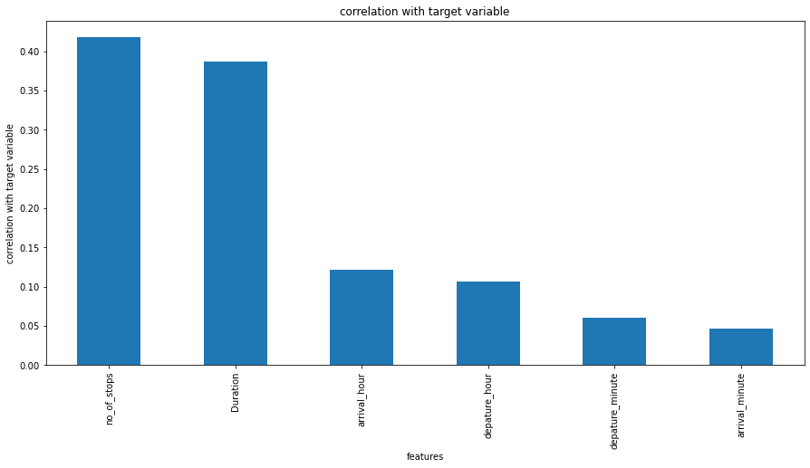
Correlation:
corr() is used to find the pairwise correlation of all columns in the dataframe.
In this project correlation is done with target variable ‘Price’, by which we can observe that Number_of_stops, Duration is highly positively correlated with target column. As number of stops and duration decreases ticket price also increases.

Slide 17
Outliers:
An outlier is an observation that lies an abnormal distance from other values in a random sample from a population.
In this project mostly all columns contains outliers which is visualized in next slide.
These Outliers are removed by Z-Score.

Slide 18
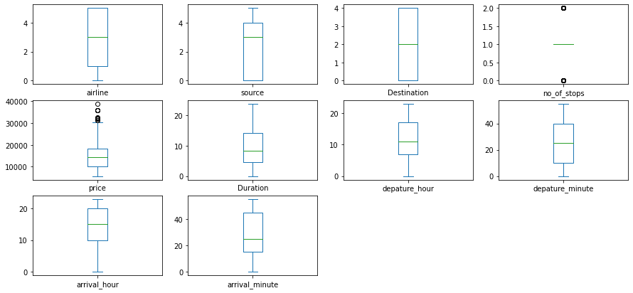
Outliers are present in ‘no_of_stops’ column

Slide 19
Skewness:
Skewness refers to a distortion or asymmetry that deviates from the symmetrical bell curve, or normal distribution, in a set of data.
Keeping skew values +/- 0.5 we can find that most columns have more value of skew.
Here in this project, power transform method is used to remove skewness and to get high accuracy of the model.

Slide 20
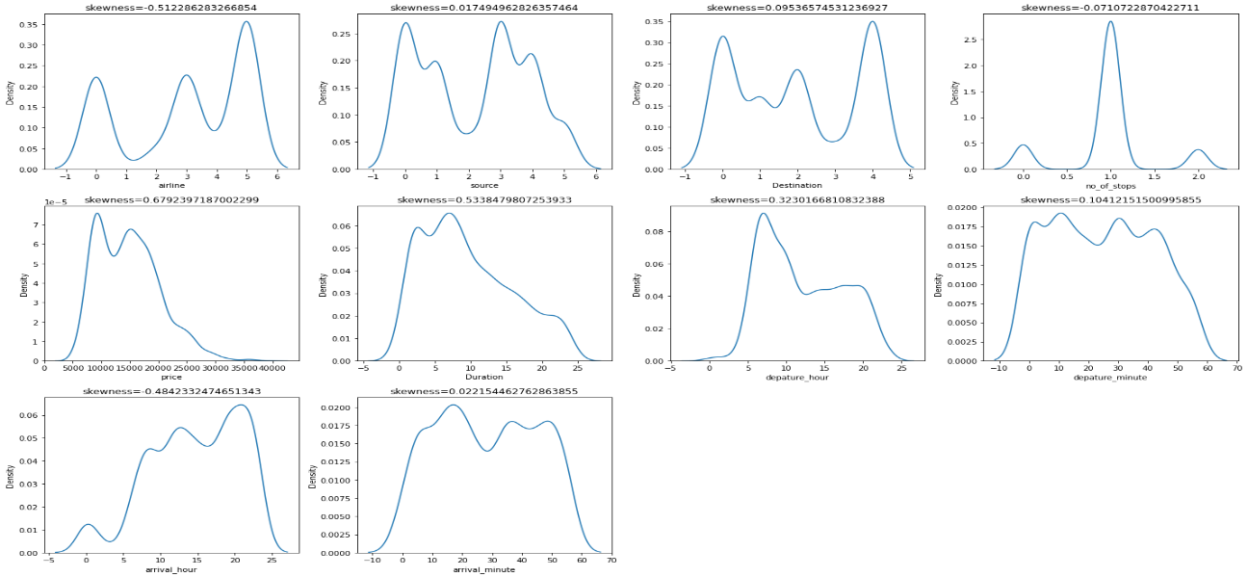
Keeping +/- 0.5 as skew value skewness, all columns values is below this.

Slide 21
Cont.
Outliers and Skewness is checked and removed in order to avoid bias while model building.
Standard Scaler is used for data standardization and VIF is used to check Multicolinearity is checked to find if any data variable is correlated with each other and it is removed.
Once all these processes are done then data is ready for model building where various Machine Learning models is used to check the accuracy of data.

Slide 22
Model Development and Evaluation
The approaches followed in this project are
Find the best random state of a model.
Use all the other models to find accuracy score, mean squared error, mean absolute error and r2 score.
Then find Cross Validation of all models to find the best accuracy, which is the least difference between r2 score and cv score.
With the best model accuracy, we need to do hyper tuning using GridSearchCV.
Then finally saving the best model and by keeping this we need to predict the ticket Price of test dataset.

Slide 23
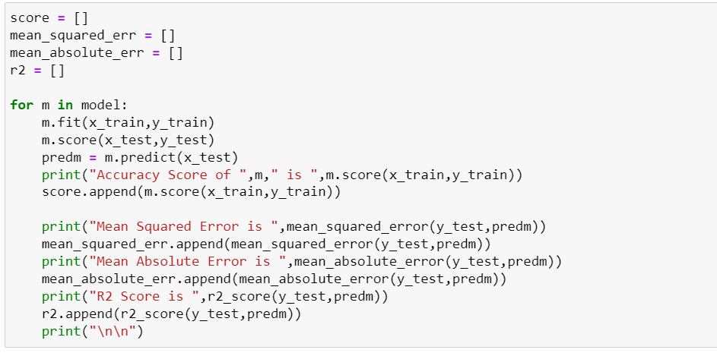
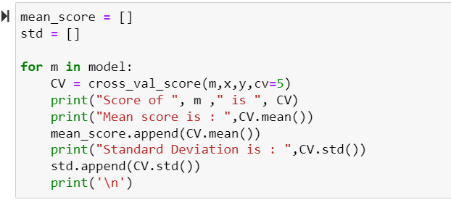
Here accuracy score,r2_score, mse , cv is checked for all models and final model is selected.

Slide 24
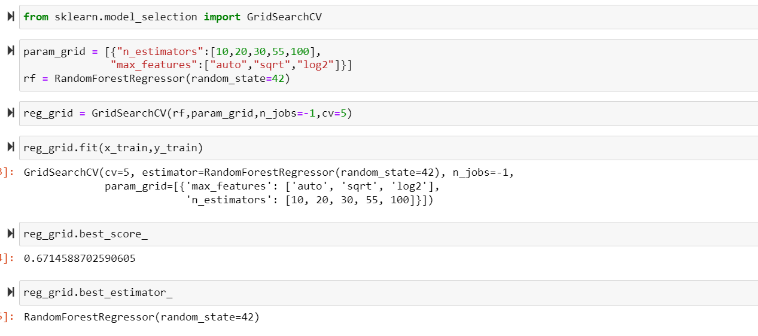
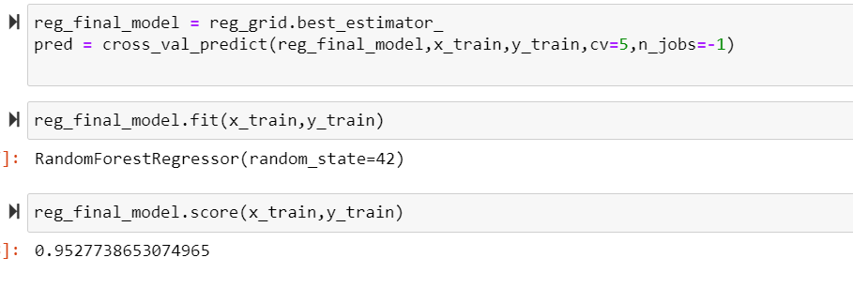
HyperTuning:
Hypertuning is done to improve model accuracy for RandomForestRegressor. By which we improved our accuracy to 95 percent.

Slide 25
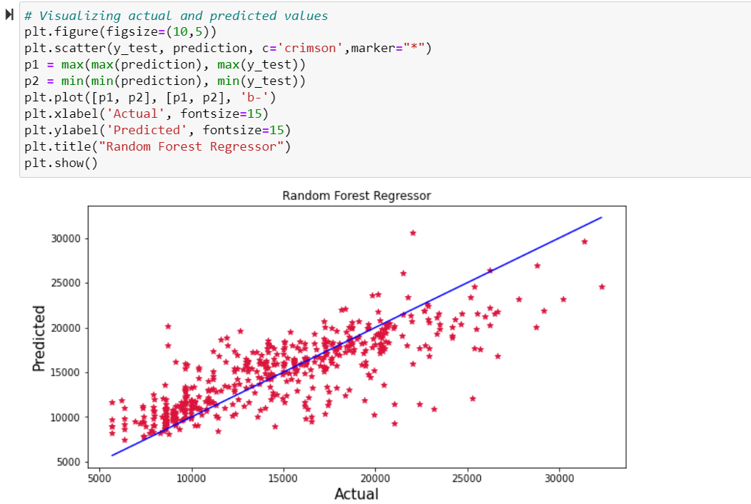
Conclusion:
The graph shows how our final model is mapping. The plot gives the linear relation between predicted and actual price of the flight tickets. The blue line is the best fitting line which gives the actual values/data and red dots gives the predicted values/data.

Slide 26
Conclusion:
The Flight ticket price goes up and down and there is no fixed time. Some flights have early morning and day flights with expensive flight ticket price and mid night ticket price with cheap price. The last-minute flights are expensive. Indigo and SpiceJet have almost same cost of ticket price.
Finally, our aim was achieved by predicting the flight ticket price and built flight price evaluation model that could help the buyers to understand the future flight ticket prices.

