Slide 1
Malignant Comment Project
Submitted by,
Poovarasi Vijayan

Slide 2
Content:
Introduction
Problem Statement
Insights of the project
Analytical Problem Facing
EDA
Visualizations
Data Pre Processing and Feature Engineering
Model Development and Evaluation
Conclusion

Slide 3
Introduction:
In the past few years its seen that the cases related to social media hatred have increased exponentially. The social media is turning into a dark venomous pit for people now a days. Online hate is the result of difference in opinion, race, religion, occupation, nationality etc. In social media the people spreading or involved in such kind of activities uses filthy languages, aggression, images etc. to offend and gravely hurt the person on the other side. This is one of the major concerns now. The result of such activities can be dangerous. It gives mental trauma to the victims making their lives miserable.
People who are not well aware of mental health online hate or cyber bullying become life threatening for them. Such cases are also at rise. It is also taking its toll on religions. Each and every day we can see an incident of fighting between people of different communities or religions due to offensive social media posts. Online hate, described as abusive language, aggression, cyberbullying, hatefulness, insults, personal attacks, provocation, racism, sexism, threats, or toxicity has been identified as a major threat on online social media platforms. These kinds of activities must be checked for a better future.

Slide 4
Problem Statement:
The proliferation of social media enables people to express their opinions widely online. However, at the same time, this has resulted in the emergence of conflict and hate, making online environments uninviting for users. Although researchers have found that hate is a problem across multiple platforms, there is a lack of models for online hate detection.
Online hate, described as abusive language, aggression, cyberbullying, hatefulness and many others has been identified as a major threat on online social media platforms. Social media platforms are the most prominent grounds for such toxic behaviour.
There has been a remarkable increase in the cases of cyberbullying and trolls on various social media platforms. Many celebrities and influences are facing backlashes from people and have to come across hateful and offensive comments. This can take a toll on anyone and affect them mentally leading to depression, mental illness, self-hatred and suicidal thoughts.

Slide 5
Problem Statement:
Internet comments are bastions of hatred and vitriol. While online anonymity has provided a new outlet for aggression and hate speech, machine learning can be used to fight it. The problem we sought to solve was the tagging of internet comments that are aggressive towards other users. This means that insults to third parties such as celebrities will be tagged as unoffensive, but “u are an idiot” is clearly offensive.
Our goal is to build a prototype of online hate and abuse comment classifier which can used to classify hate and offensive comments so that it can be controlled and restricted from spreading hatred and cyberbullying.

Slide 6
Business Goal:
To understand the business problem, Our goal is to build a prototype of online hate and abuse comment classifier which can used to classify hate and offensive comments so that it can be controlled and restricted from spreading hatred and cyberbullying.

Slide 7
Insights of Project:
Effective Machine Learning model needs to be created which predicts the ratings based on reviews. The target variable contains 0’s and 1’s, So, here Classification problem with NLP is used.
First, the analysis is started with importing the data, if the dataset contains no null values, continued with data cleaning and pre-processing.
Once this is all done then data is ready for modelling. Modelling is done with Logistic Regression, Random Forest Classifier, Ada Boost Classifier, Gradient Boosting Classifier, Decision Tree Classifier, Extra Tree Classifer. From this the best model is identified and using Cross Validation technique is checked for overfitting and underfitting and Hypertuning is done to increase accuracy. Then, Finally the best model is saved.

Slide 8
Analytical Problem Facing:
Analytic problem framing involves translating the business problem into terms that can be addressed analytically via data and modeling. Analytic problem framing is the antithesis of merely working with the ready-to-hand data and seeing what comes of it, hoping for something insightful.

Slide 9
Exploratory data analysis
In malignant comment prediction project there are 159000 rows in train dataset and 153000 in test dataset and 8 columns.
First, the analysis is started with importing the data, this dataset has no Null values in target column so continued with further analysis and unnecessary columns which does not contribute for the target variable is also dropped.
Once data is cleaned outliers and skewness are checked, if present they are removed then in Data Pre-processing, Standard Scaler is used to standardize the data and by using VIF, multicollinearity is removed.

Slide 10
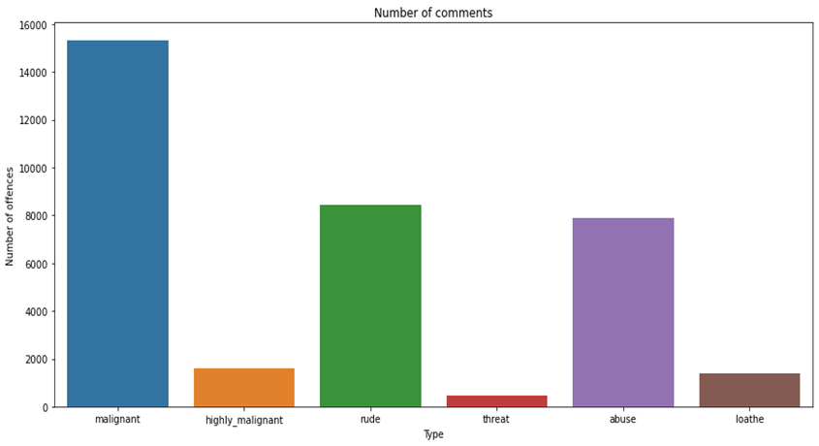
Visualization:
Bar Plot is used to find count of each comment type.
Mostly Malignant comment is used compared to threat and rude.

Slide 11
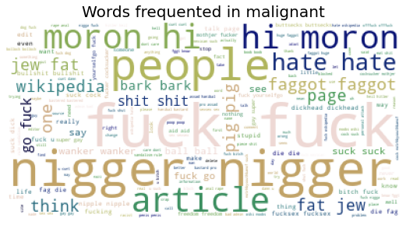
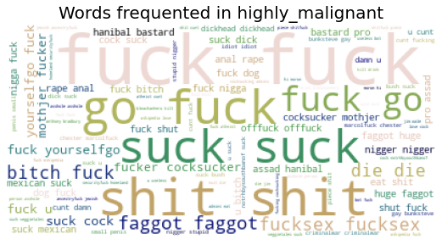
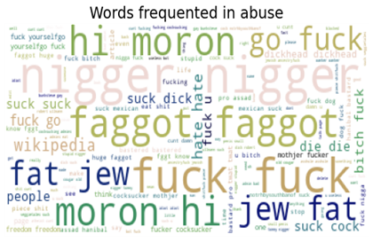
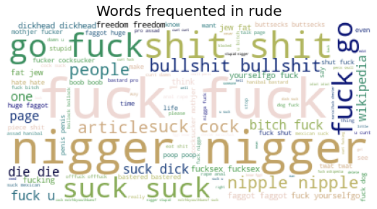
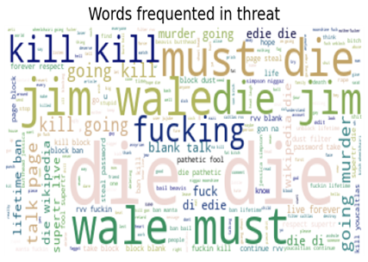
Cont.
These are the most commonly used words in all
comment type.

Slide 12
Data Pre-Processing and Feature Engineering:
In Machine Learning, data pre-processing refers to the process of cleaning and organising raw data in order to make it appropriate for creating and training Machine Learning models.
In other words, anytime data is received from various sources, it is collected in raw format, which makes analysis impossible. Data pre-processing is a crucial stage in Machine Learning since the quality of data and the relevant information that can be cleaned from it has a direct impact on our model's capacity to learn; consequently, we must pre-process our data before feeding it into our model.
As a result, it is the first and most important stage in developing a machine learning model. Some of the techniques used in this project are listed below:
Started with importing the required libraries and then the train dataset which is in csv format.
As the dataset contains 8 variables. Then the information of the columns are observed carefully.

Slide 13
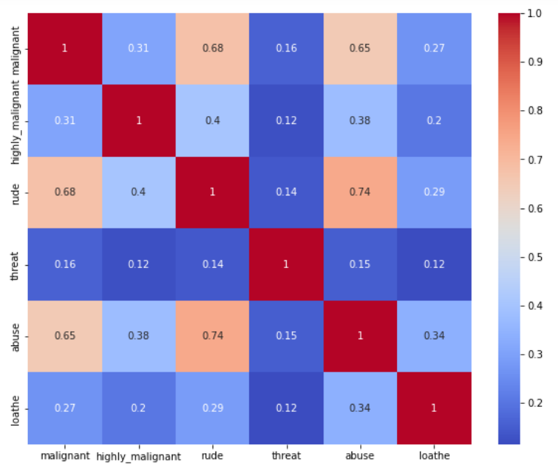
Correlation:
corr() is used to find the pairwise correlation of all columns in the dataframe.

Slide 14
Model Development and Evaluation
The approaches followed in this project are
Find the best random state of a model.
Use all the other models to find accuracy score, confusion_matric, classification_report.
Then find Cross Validation of all models to find the best accuracy.
With the best model accuracy, we need to do hyper tuning using GridSearchCV.
Then finally saving the best model and by keeping this we need to predict the malignant comment of test dataset.

Slide 15
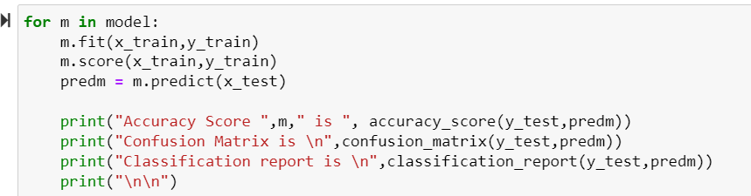
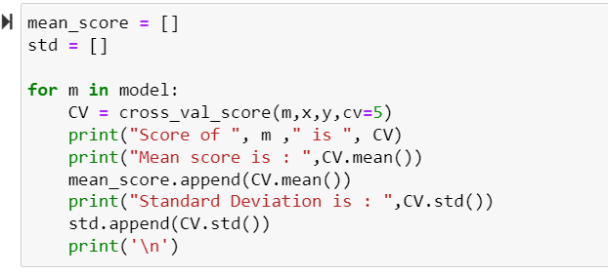
Here accuracy score, confusion matrix, classification report ,cv is checked for all models and final model is selected.

Slide 16
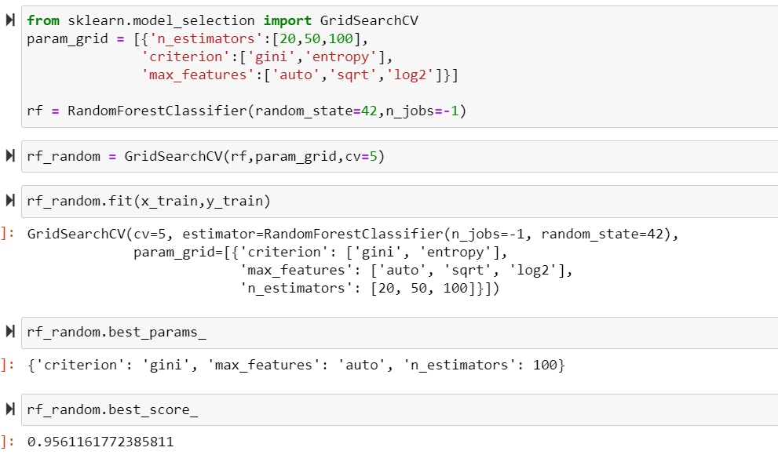
HyperTuning:
Hypertuning is done to improve model accuracy for RandomForestRegressor. By which we improved our accuracy to 95.61 percent.

Slide 17
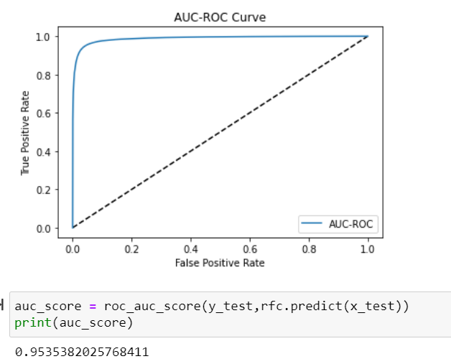
AUC-ROC Curve
With AUC-ROC we get 95.35% accuracy.

Slide 18
Conclusion:
Improvement in computing technology has made it possible to examine social information that cannot previously be captured, processed and analysed. New analytical techniques of machine learning can be used in property research. The power of visualization has helped us in understanding the data by graphical representation it has made me to understand what data is trying to say. Data cleaning is one of the most important steps to remove unrealistic values and stop words. This study is an exploratory attempt to use four machine learning algorithms in estimating malignant comments, and then compare their results.
To conclude, the application of machine learning in malignant classification is still at an early stage. We hope this study has moved a small step ahead in providing some methodological and empirical contributions to crediting institutes, and presenting an alternative approach to the valuation of malignance.

Slide 19
Limitation:
One of the drawbacks is as the dataset is huge it takes more time for model building using different algorithms. Also, this study will not cover all Regression algorithms instead, it is focused on the chosen algorithm, starting from the basic ensemble techniques to the advanced ones.

Slide 20
Thank You

