Slide 1
Types of architectures used to develop an application
Monolithic Architecture
Microservice Architecture

Slide 2
Monolithic Architecture
It is an architecture in which the different modules that belong to an application are packaged into single bundle e.g. shopping.war

Slide 3
Packaging - Monolithic Applications
Product module
Shipping module
Order module
Payment module
Customer module
Security module
Shopping.war

Slide 4
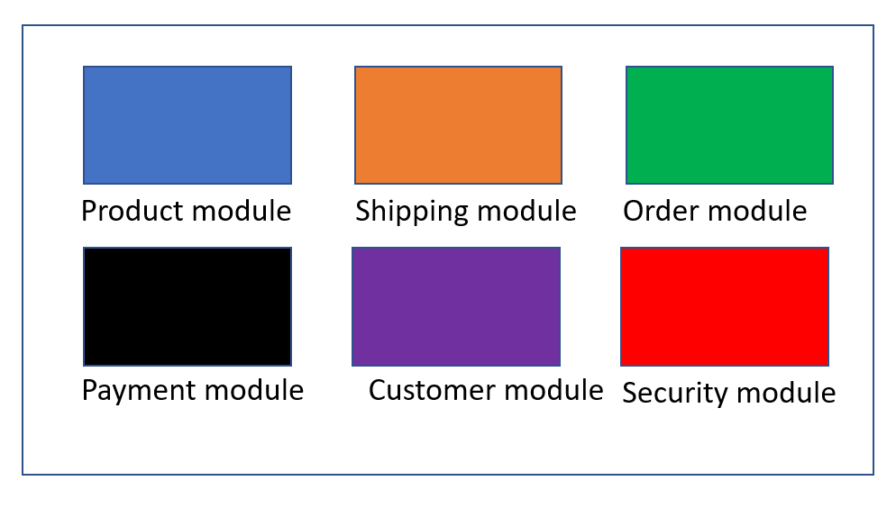
Deploying- Monolithic Applications
Product module
Shipping module
Order module
Server-1
Payment module
Customer module
Security module
Shopping.war

Slide 5
Clients/Server load problem - Monolithic Applications
Server-1
Server client handling capacity is 5 at a time. ALL OK BECAUSE 5 CLIENT REQUESTS AT A TIME

Slide 6
Clients/Server load problem - Monolithic Applications
Server-1
Server client handling capacity is 5 at a time. NO OK. All client beyond 5th client must wait until one of the 5 clients processing is over

Slide 7
Clients/Server load solution- Add extra server and distribute the load
Server-1
Server-2

Slide 8
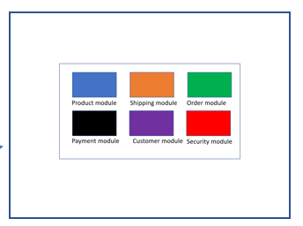
Sometimes too many servers required based on the load
Server
Server
Server
Server
Server
Server

Slide 9
sometimes too few servers too few servers required based on load
Server-1
Server-2
Server-3

Slide 10
Adding servers manually when required and removing servers manually when not required is not an easy task

Slide 11
Add servers even when not required results in more expenses
Building rental cost
IT admin salaries
electricity maintenance
and others

Slide 12
Monolithic apps- advantages
Simple to develop
All modules use same technology
Easy to test
Simple To deploy

Slide 13
Monolithic apps- dis-advantages
Complexity increases as size increases
Big size application slows down the start time
Changes require to understand so many things
Entire application to be deployed on each change
Bug in any module (e.g. memory leak) can potentially bring down the entire process
Adopting new technologies is a barrier Since changes in frameworks or languages will affect an entire application it is extremely expensive in both time and cost.

Slide 14
Microservice Architecture
It is an architecture in which the different modules that belong to an application are packaged as individual bundles

Slide 15
Packaging - Microservice Applications
Product.jar
Shipping.jar
Order.jar
Payment.jar
Customer.jar
Security.jar

Slide 16
Deploying- Microservice Applications
Product.jar
Shipping.jar
Order.jar
Web container such as tomcat
Payment.jar
Customer.jar
Security.jar

Slide 17
Deploying- Microservice Applications
Product.jar
Shipping.jar
Product.jar
Shipping.jar
Payment.jar
Security.jar
Payment.jar
Security.jar
Customer.jar
Order.jar
Customer.jar
Order.jar
CLOUD SERVER SUCH AS AWS

Slide 18
Deploying to cloud - benefits
Scaling up and down is faster and easy
Cost effective
Scaling a specific module is possible
Product.jar
Shipping.jar
Payment.jar
Security.jar
Customer.jar
Order.jar
CLOUD SERVER SUCH AS AWS

Slide 19
Microservice apps- advantages
faster to develop, and much easier to understand and maintain.
It enables each service to be developed independently by a team that is focused on that service
adopting new technologies is easy, since the developers are free to choose whatever technologies make sense for their service
scaled independently

Slide 20
Microservice apps- dis-advantages
Complex maintenance and troubleshooting due to distributed nature.
Complex to test. To test a service we would need to launch that service and any services that it depends upon
Changes across the related modules is tough

Slide 21
Microservice patterns, What are they ?
These are the patterns which define effective solutions to create and manage microservices based applications

Slide 22
A few most commonly used patterns
Service discovery pattern
Circuit breaker pattern
API GATEWAY pattern
Centralized configuration

Slide 23
Service Discovery Pattern, Problem-Solution
Problem:
If microservices scale up and down based on demand and load, then their IP address will be dynamic, which means , Clients code who want to access the service won’t be able to use static IP address of the service they want to call in their code
Solution:
All instances of a service should register their IP address as they are created and de register their IP address as they are destroyed in a server called service registry
Clients will then make a call to service registry. And service registry will then send a call to one of the instances of the service. Which means, client will have a fixed IP address of the SERVICE REGISTRY in their code

Slide 24
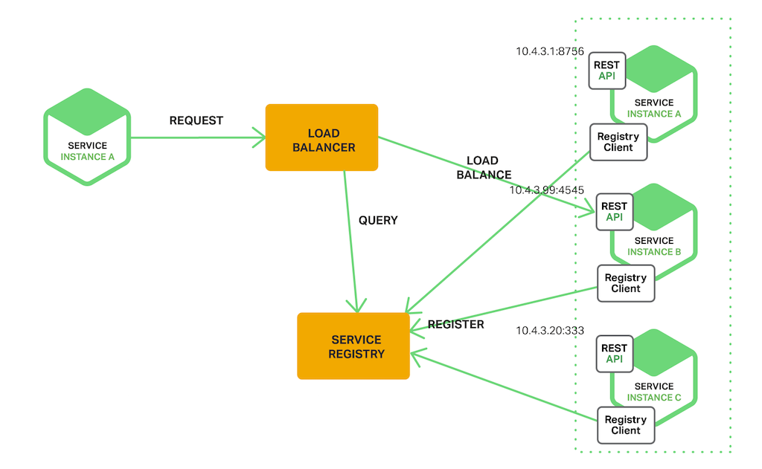

Slide 25
Spring cloud, what is it ?
It is a group of cloud related projects in spring
Spring cloud Netflix, what is it ?
It is a software library from Netflix OSS (open source software) which provides the functionality of various microservice patterns such as service registry, load balancing, and others

Slide 26
Eureka-Server , What is it?
It is a software library from Netflix, which provides the functionality of service discovery registry and server
Eureka server program, what is it?
A program that behaves as a service registry is called eureka server
Eureka client program, what is it?
A program that consumes the services of a service that is registered in eureka server is called eureka client

Slide 27
Working with eureka server?
#1. Create a eureka server app (eureka server program project)
#2. Create the one or more microservices and register their details with eureka server app (eureka client program project)
#3. Invoke one microservice from other microservices (both of which live inside the eureka server app)
Spring cloud Netflix, what is it ?
It is a software library from Netflix OSS (open source software) which provides the functionality of various microservice patterns such as service registry, load balancing, and others

