Slide 1
Efficient Quantum PDE Solvers and Gibbs Samplers on the Continuum via Gevrey Regularity
Pooya Ronagh Pr. Quantum System Architecture | Microsoft Quantum

Slide 2
References for this talk
Gibbs Sampling of Periodic Potentials on a Quantum Computer, arXiv:2210.08104 with Arsalan Motamedi Proceedings of the 41st International Conference on Machine Learning, PMLR 235:36322-36371, 2024
Breaking the Curse of Dimensionality in Quantum PDE Solvers via Gevrey Regularity, arXiv:2608.07893 with Mariia Sobchuk, Xiaoran Li, Grecia Castelazo, Ala Shayeghi
Provable Quantum—Classical Separation for Continuous Gibbs Sampling, arXiv:2608.24527 with Enrico Olivucci, Mariia Sobchuk, Sehmimul Hoque, Jeffrey Hnybida, Kyungho W. Kim, Ala Shayeghi

Slide 3
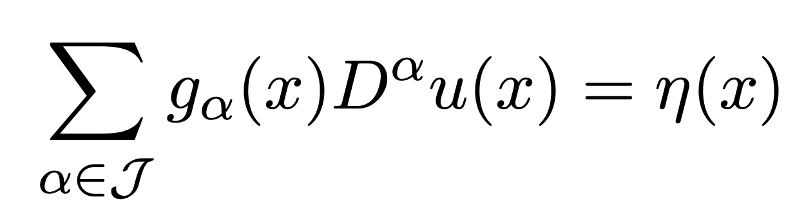
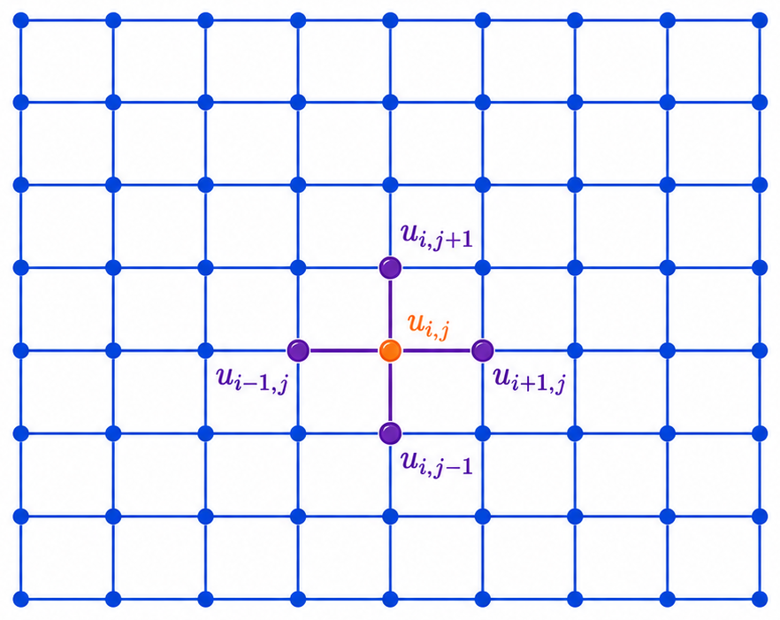
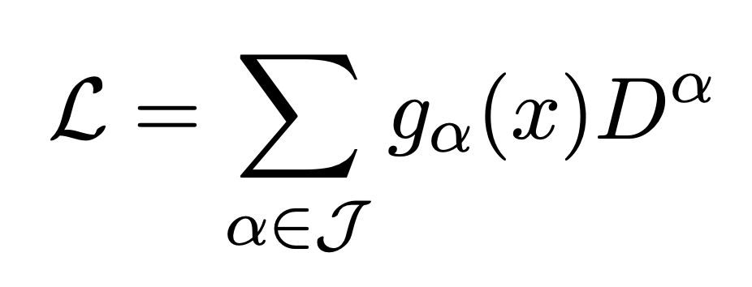
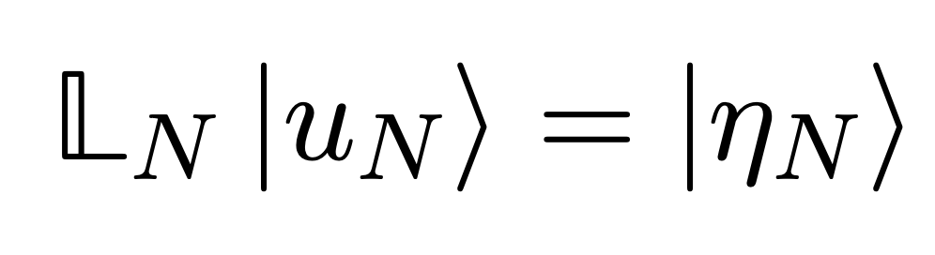

Motivation: solving general linear PDEs on quantum computer
The goal is to linearize the generator and obtain a large linear system:
Problem: Grid cells have to be as small as $1/ε$.
Solution: Hope for a “smooth” behaviour and use planewave basis (i.e., move to the Fourier domain).

Slide 4
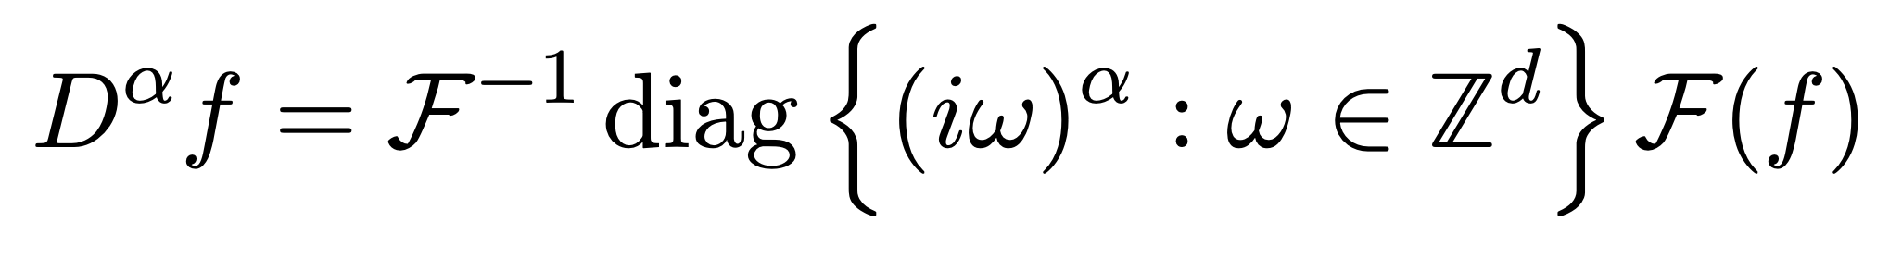
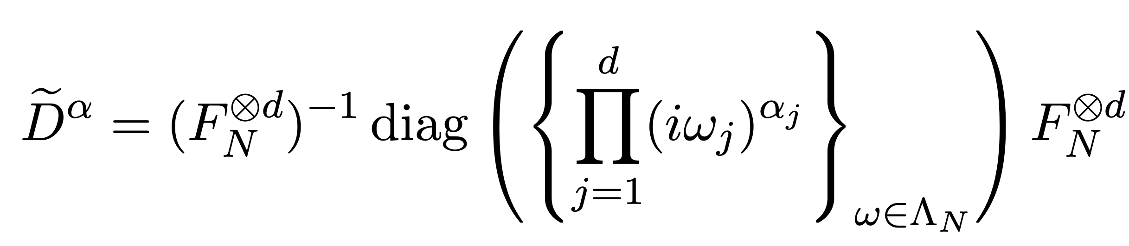
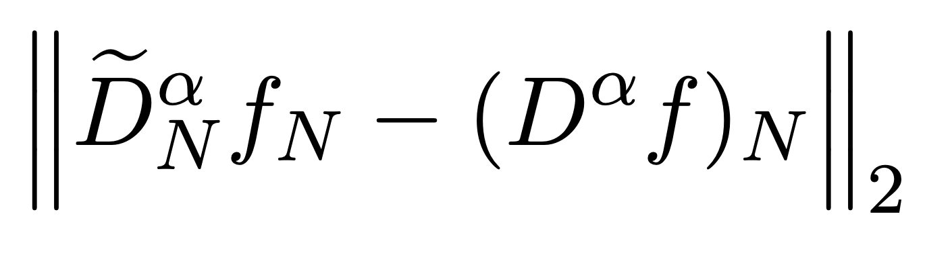
Motivation: solving general linear PDEs on quantum computer
What we wish to do:
What we can actually do:
The burning question: How bad is the truncation error?
🔥

Slide 5
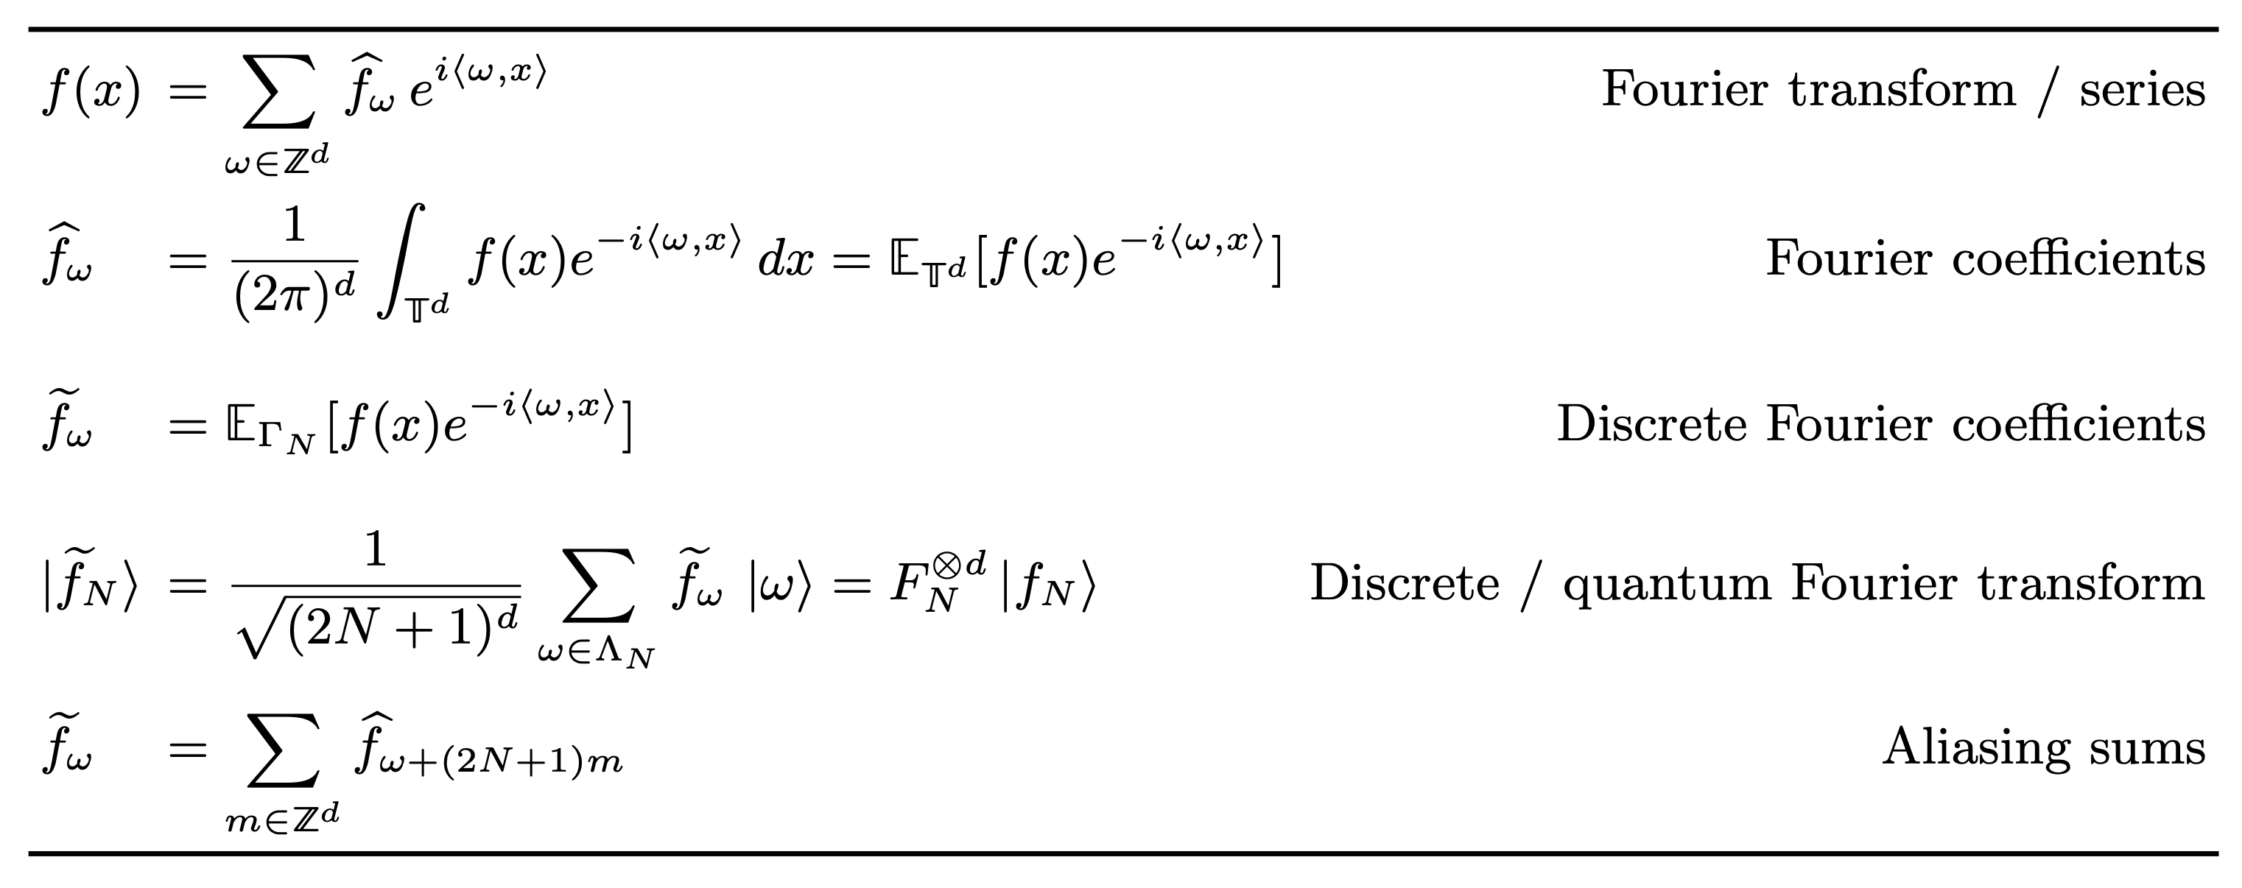
A Fourier analytic crash course
For periodic functions

Slide 6
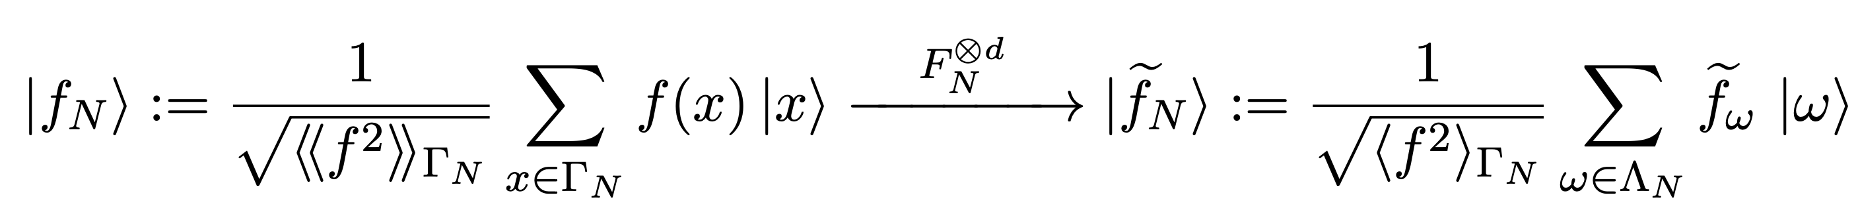
A Fourier analytic crash course

Slide 7
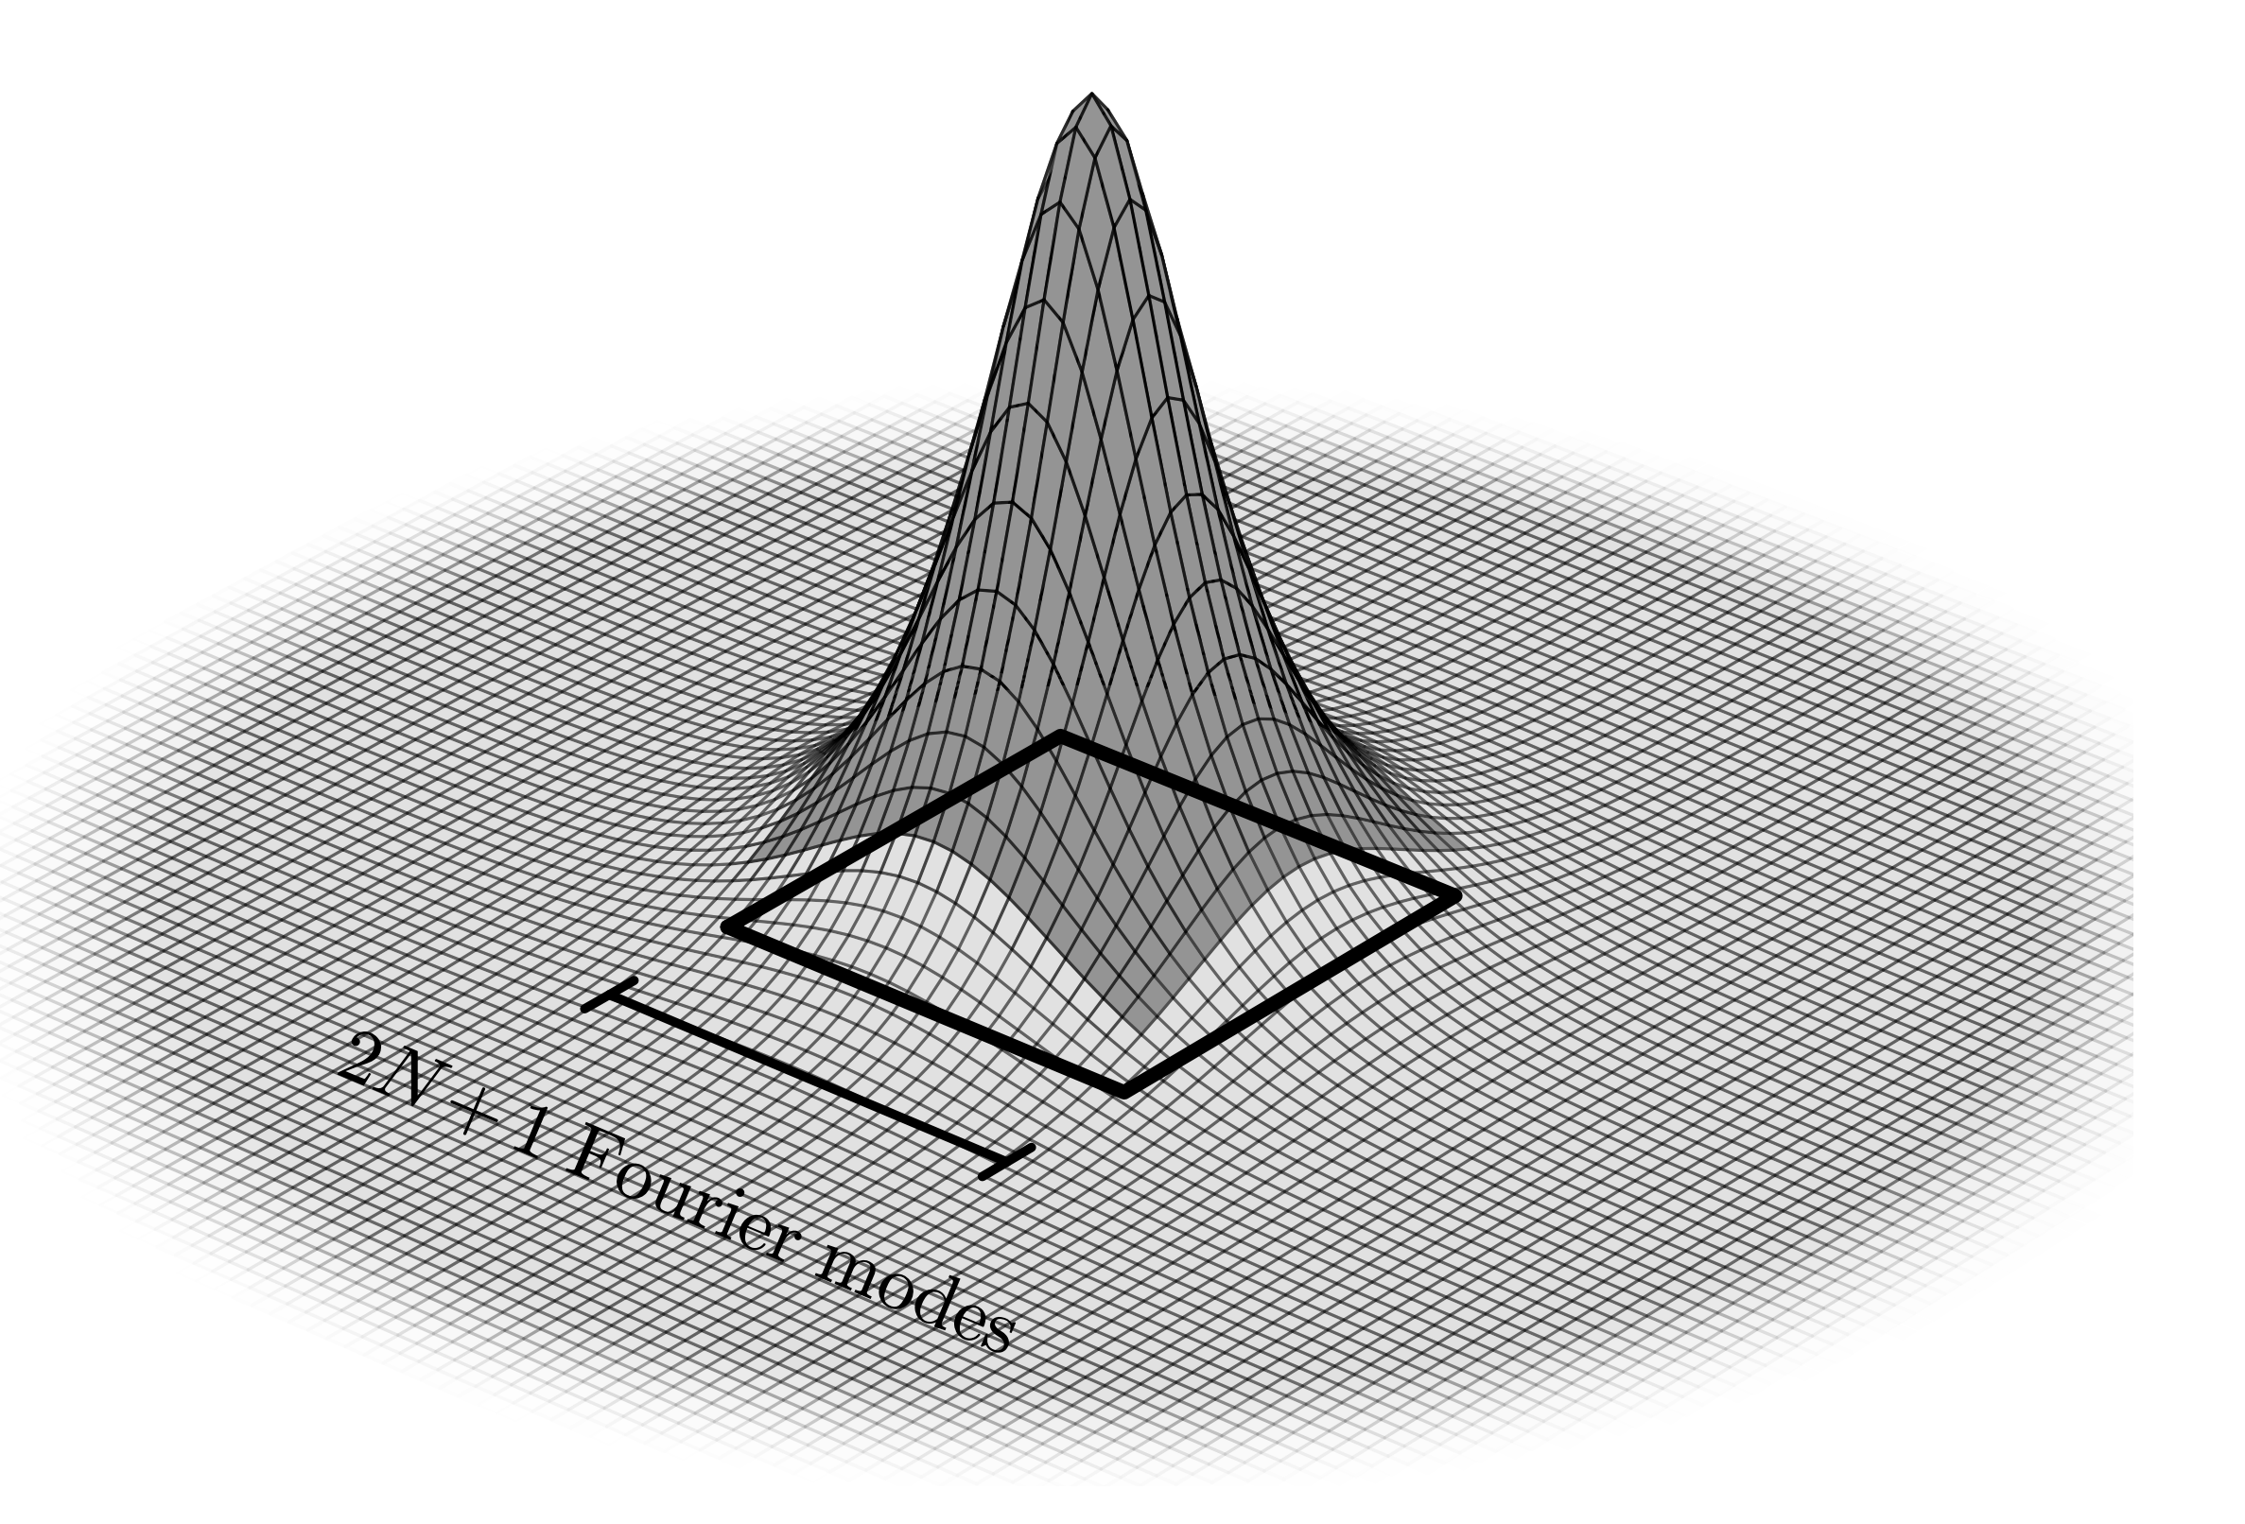





A Fourier analytic crash course
$$ω−(2N+1)$$
$$ω$$
$$ω+(2N+1)$$
$$ω+2(2N+1)$$

Slide 8
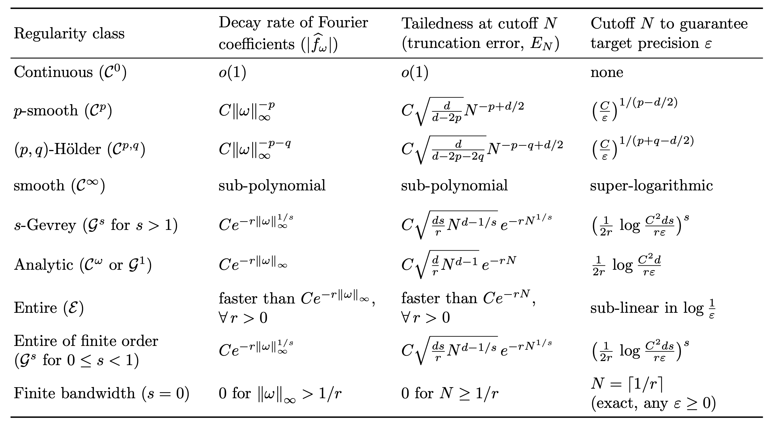
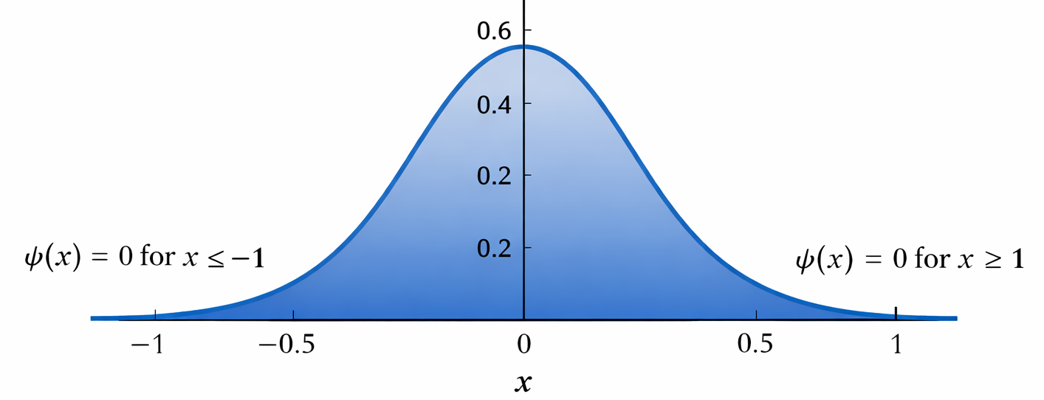
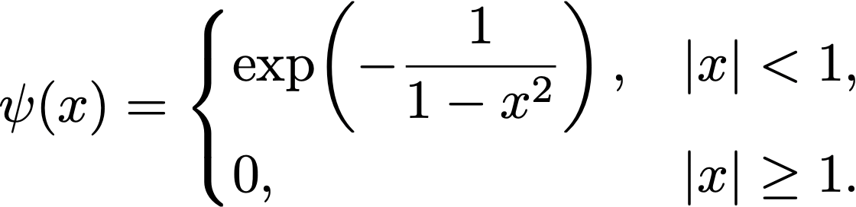

What does analyticity have to do with qubit / gate count?
Motamedi-R 2024: High precision can be achieved in quantum PDE solvers, if the solution to the PDE is periodic and analytic. That is, the query complexity of the algorithm is in $O(polylog\left(1/ε\right))$.
Analytic functions ⇒ Exponentially fast decay of Fourier coefficients
But analyticity is quite limiting.

Slide 9
More smoothness = Faster decay of spectrum

Slide 10
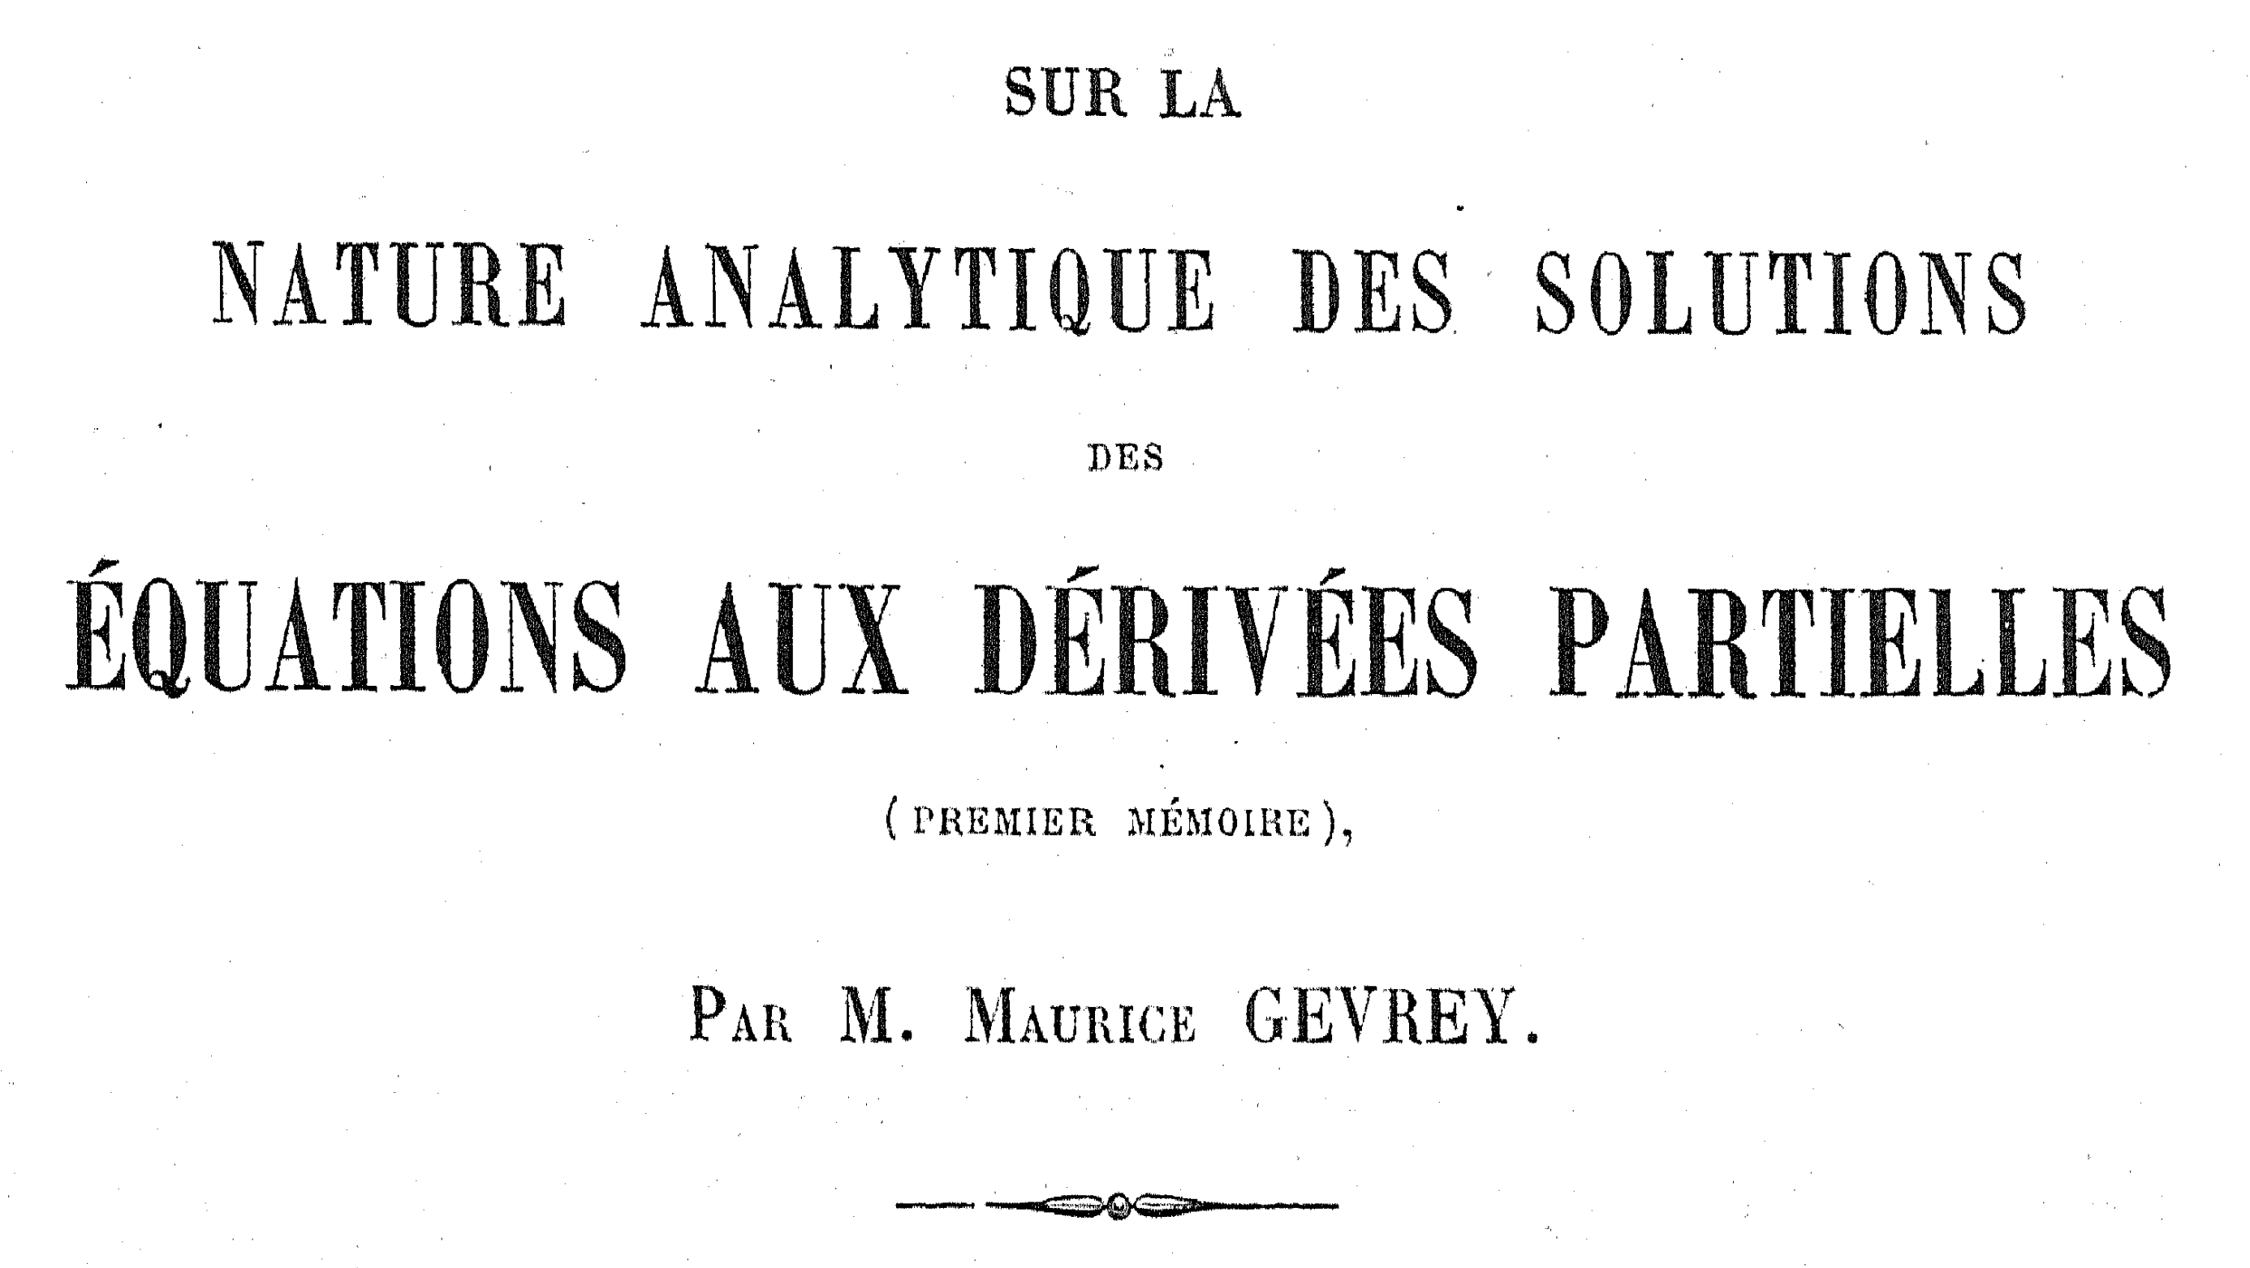
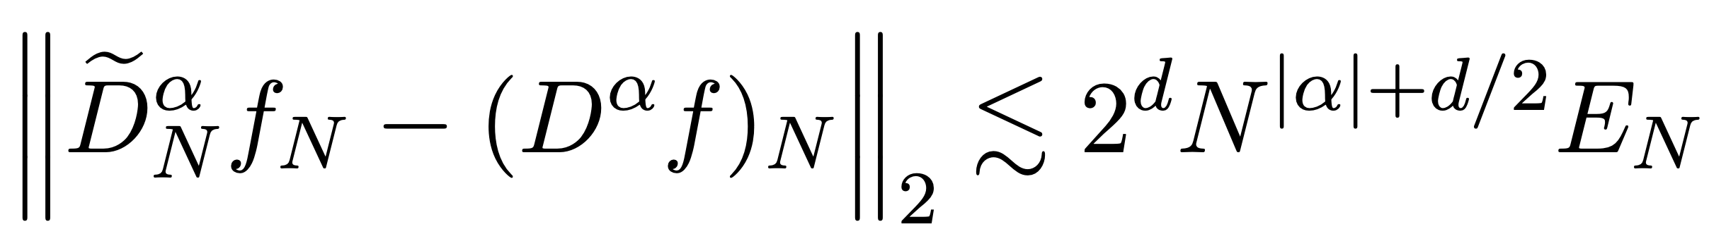
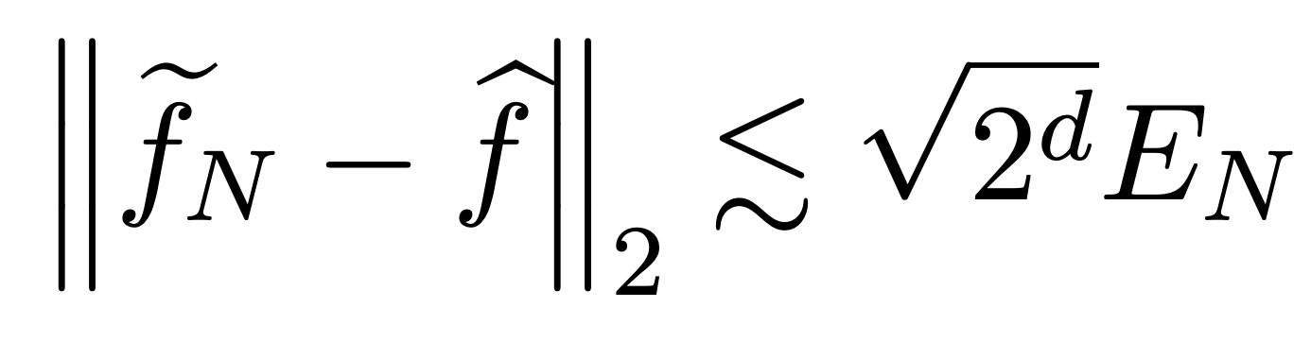
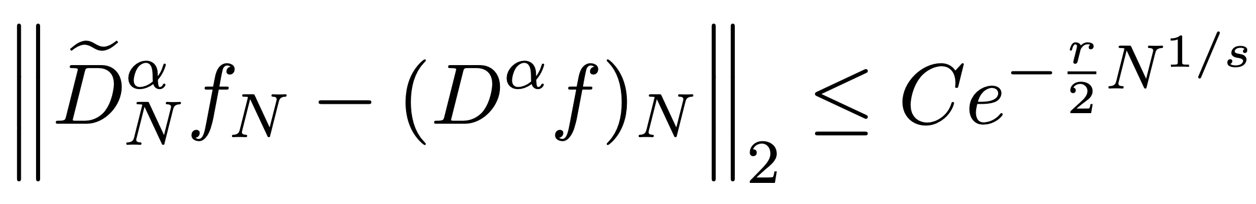
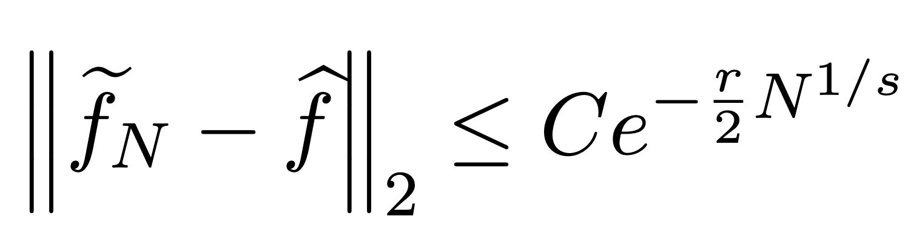
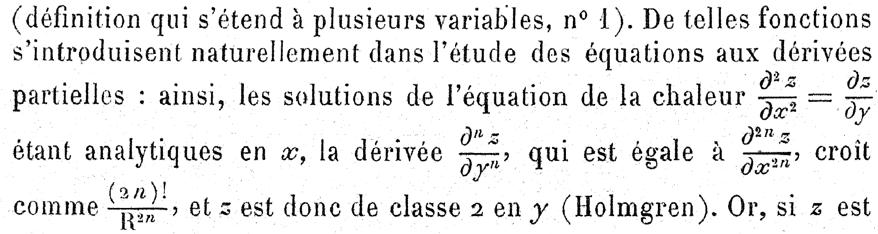

Gevrey regularity and the answer to our burning question
RSLCS26: We show that
which means that for s-Gevrey functions
provided choosing $N≥{\left(\frac{\left(d+\left|α\right|\right)s}{r}\right)}^{s}$.
🔥

Slide 11
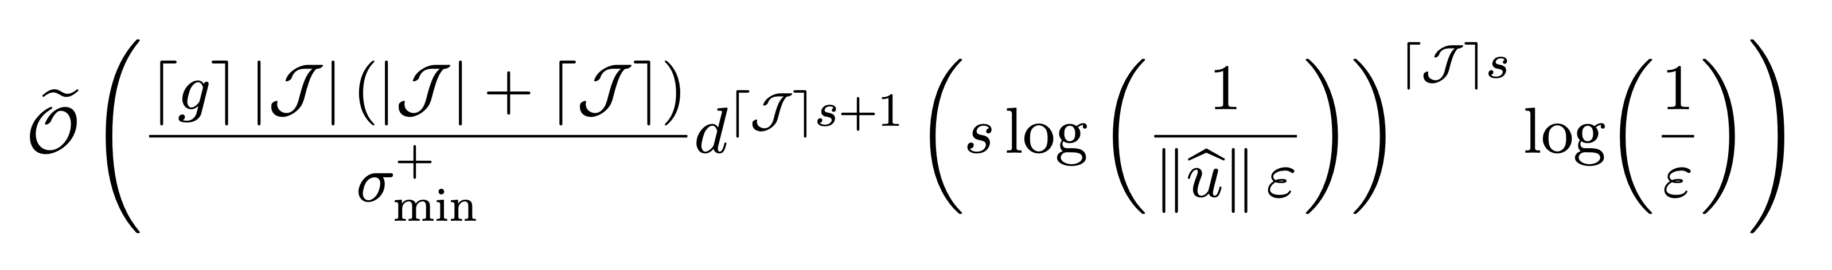
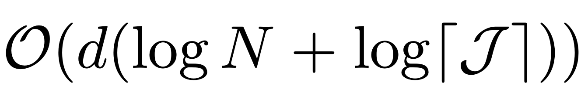
Back to solving the general linear PDE
RSLCS26: If u is s-Gevrey and periodic then QLSA solves the problem using
Total gate count:
Total qubit count:

Slide 12
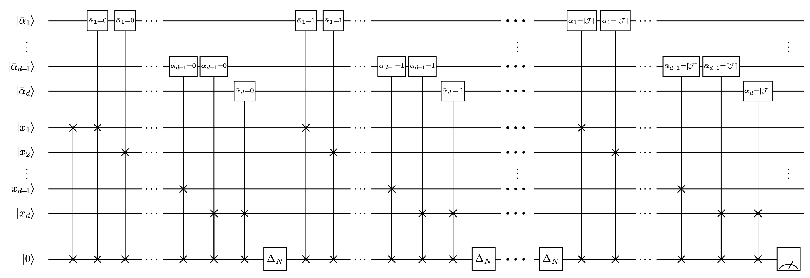
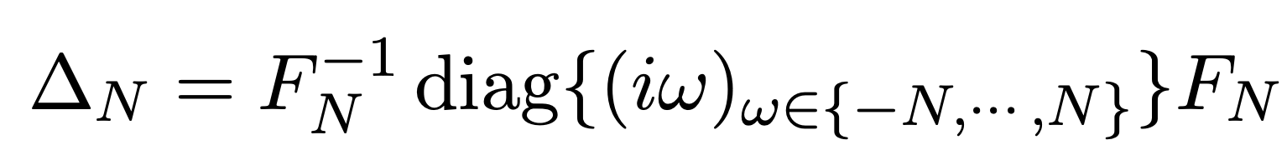
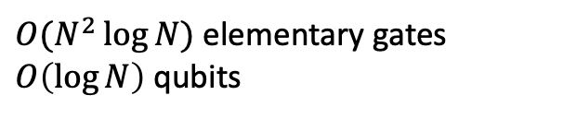
Block encoding of the approximate differentials
$O(N^{2}\log{N})$ elementary gates $O\left(\log{N}\right)$ qubits

Slide 13
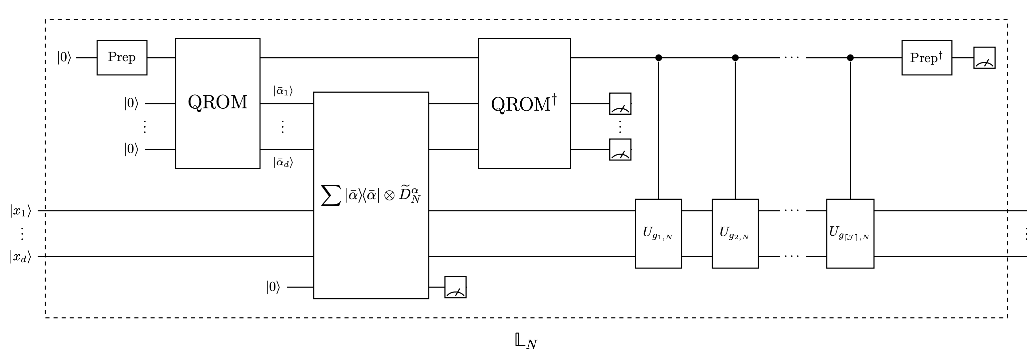
Block encoding of $𝕃_{N}$

Slide 14
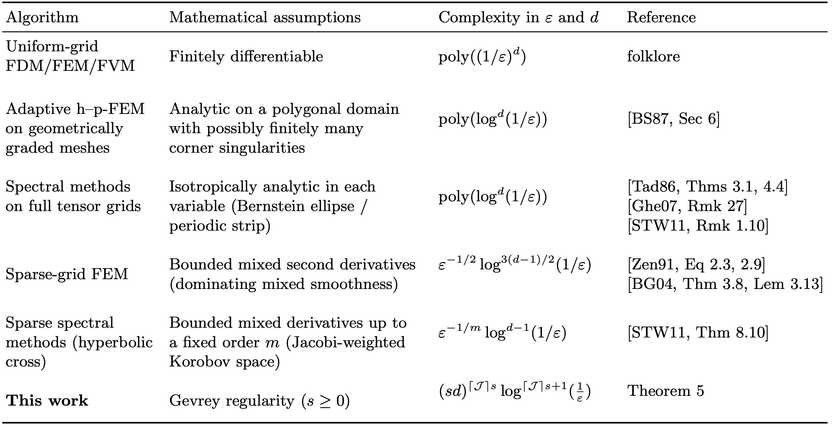
Breaking the curse of dimensionality

Slide 15

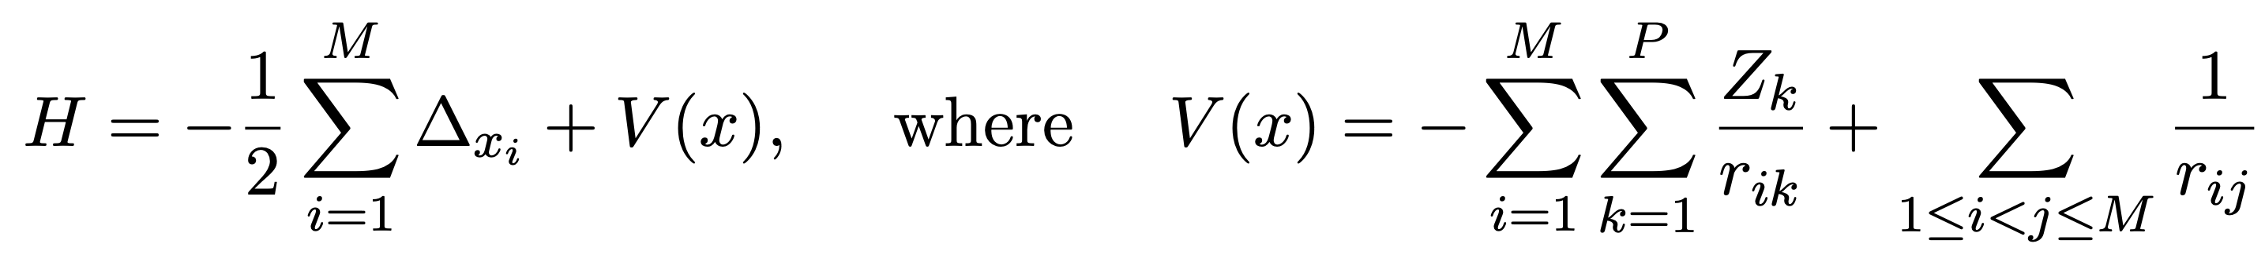
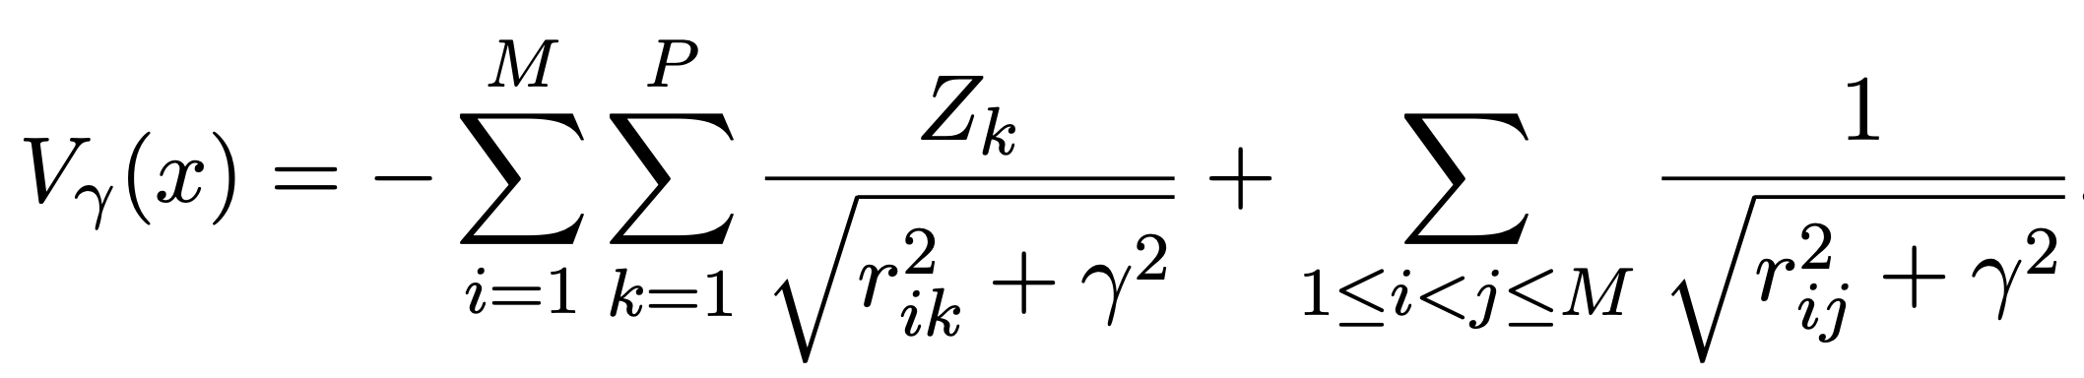
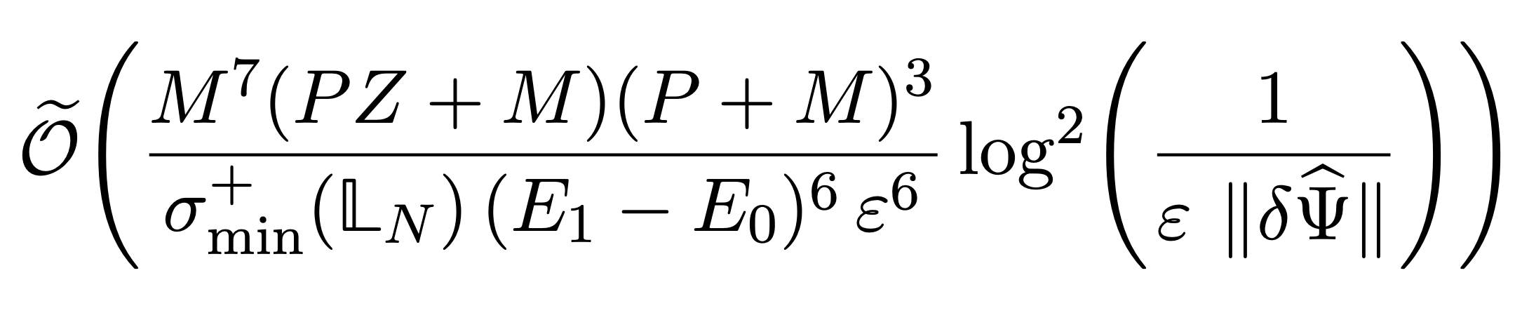

Application 1: Atomistic simulation
Challenge: The solution wavefunction is cuspidal (Kato cusps).
Common practice:
Analytic solution with radius of convergence $∝γ$.
Total gate count:
Total qubit count:

Slide 16
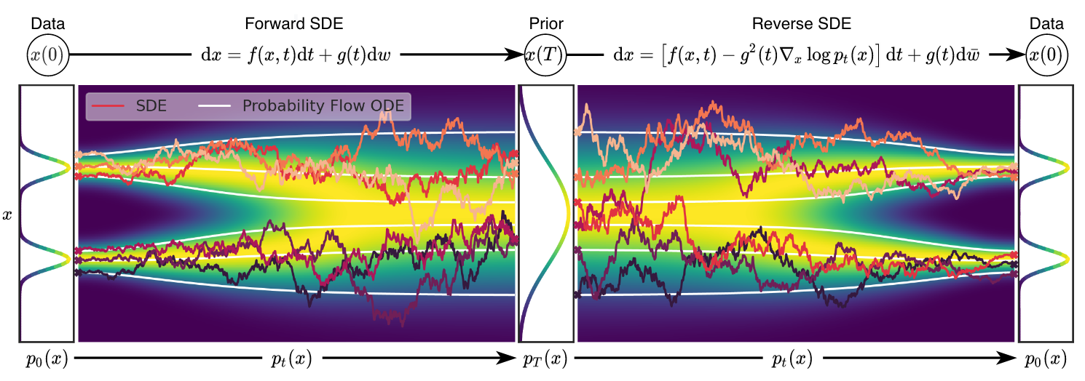
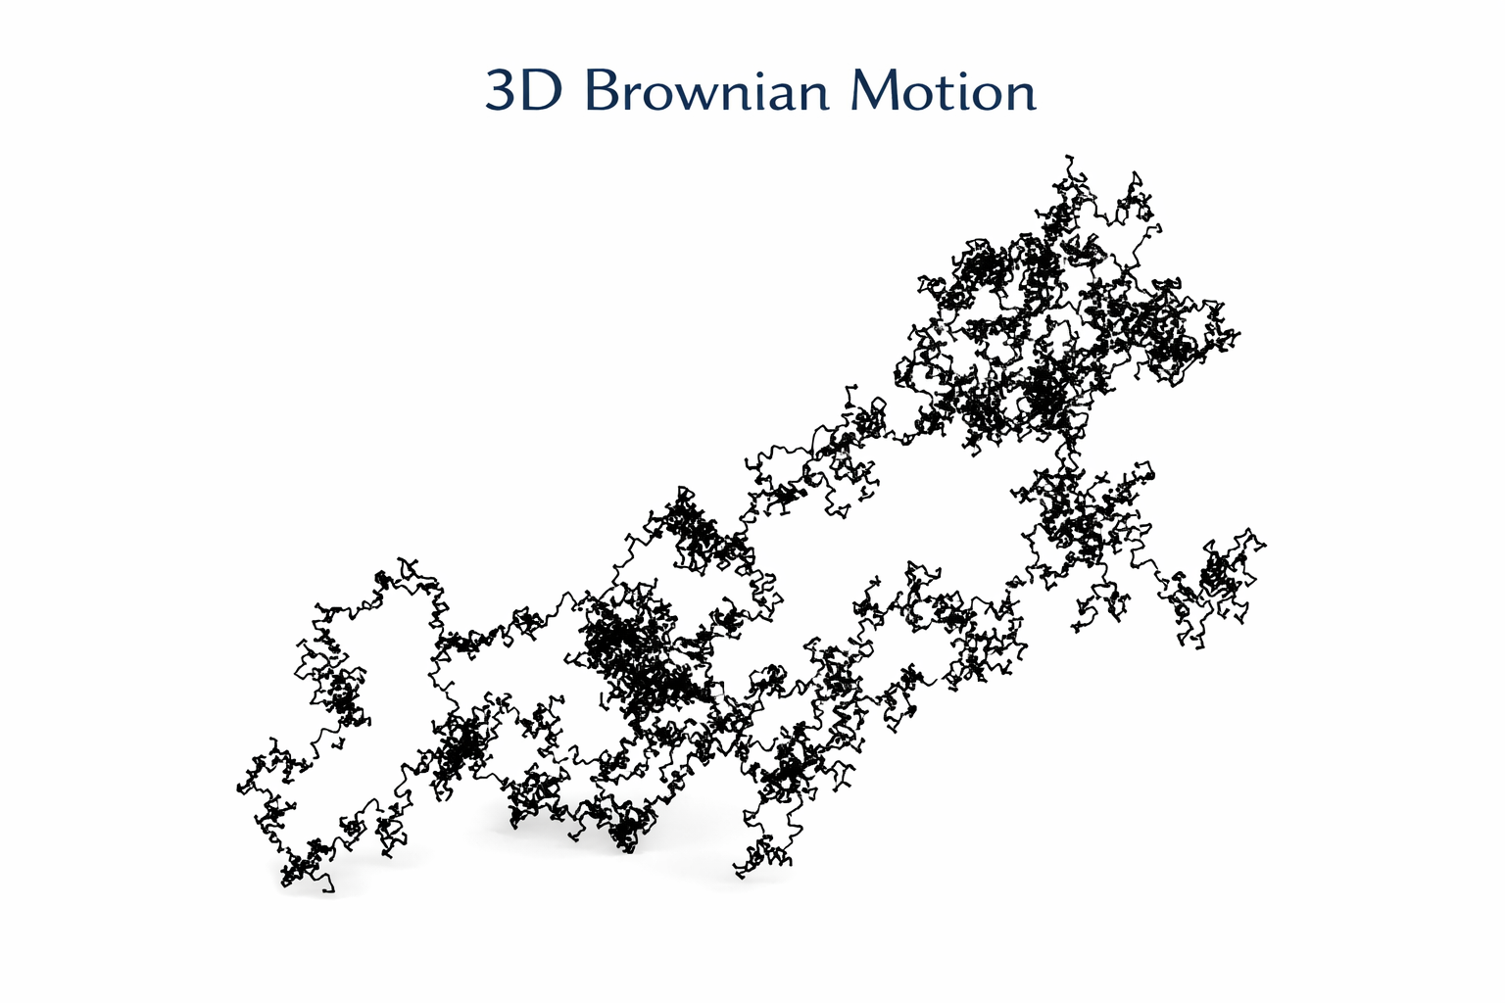
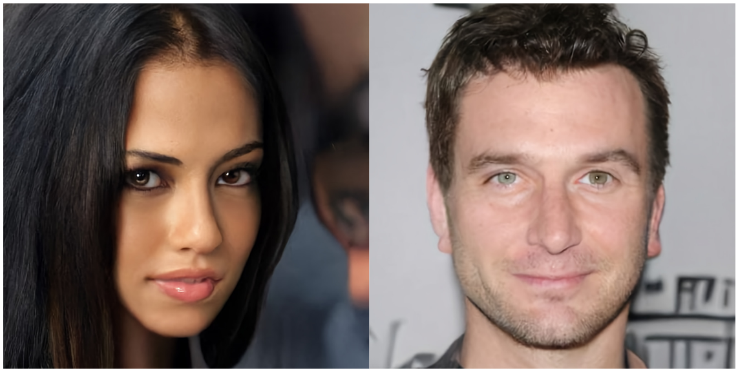

Application 2: Provable separation for quantum Gibbs sampling
Focus: Gibbs sampling on the continuum
Common in ML: Diffusion models and EBMs
Method: Simulating Langevin dynamics
$$dX_{t}=−\frac{1}{2}βσ^{2}∇_{X}E_{θ}\left(X\right) dt+σ dW_{t}.$$

Slide 17
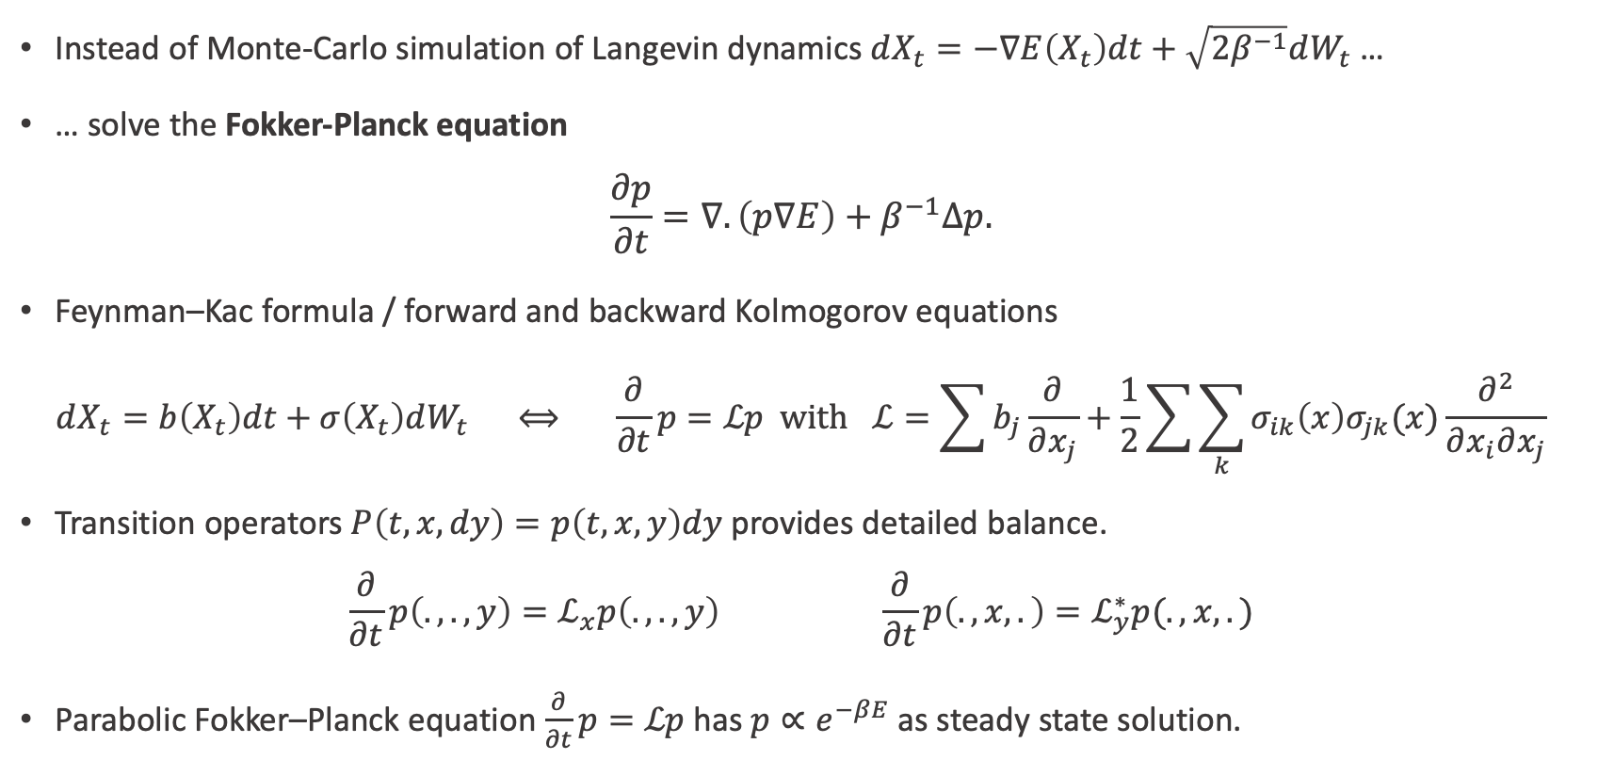
Quantum Gibbs sampling from a PDE
Instead of Monte-Carlo simulation of Langevin dynamics $dX_{t}=−∇E\left(X_{t}\right)dt+\sqrt{2β^{−1}}dW_{t}$ …
… solve the Fokker-Planck equation
$$\frac{∂p}{∂t}=∇.\left(p∇E\right)+β^{−1}Δp.$$
Feynman–Kac formula / forward and backward Kolmogorov equations
$$dX_{t}=b\left(X_{t}\right)dt+σ\left(X_{t}\right)dW_{t} ⟺ \frac{∂}{∂t}p=ℒp with ℒ=\sum{b_{j}\frac{∂}{∂x_{j}}}+\frac{1}{2}\sum{\sum_{k}{σ_{ik}\left(x\right)σ_{jk}(x)}\frac{∂^{2}}{∂x_{i}∂x_{j}}}$$
Transition operators $P\left(t, x, dy\right)=p\left(t, x, y\right)dy$ provides detailed balance.
$$\frac{∂}{∂t}p\left(., ., y\right)=ℒ_{x}p\left(.,.,y\right) \frac{∂}{∂t}p\left(., x, .\right)=ℒ_{y}^{∗}p(., x,.)$$
Parabolic Fokker–Planck equation $\frac{∂}{∂t}p=ℒp$ has $p∝e^{−βE}$ as steady state solution.

Slide 18
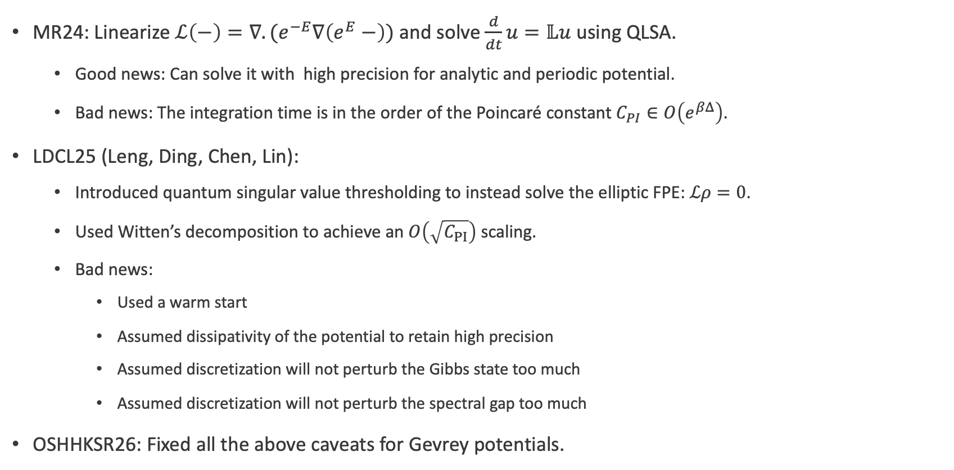
Quantum Gibbs sampling in $O(e^{βΔ/2})$
MR24: Linearize $ℒ\left(−\right)=∇.(e^{−E}∇\left(e^{E}−\right))$ and solve $\frac{d}{dt}u=𝕃u$ using QLSA.
Good news: Can solve it with high precision for analytic and periodic potential.
Bad news: The integration time is in the order of the Poincaré constant $C_{PI}∈O\left(e^{βΔ}\right)$.
LDCL25 (Leng, Ding, Chen, Lin):
Introduced quantum singular value thresholding to instead solve the elliptic FPE: $ℒρ=0$.
Used Witten’s decomposition to achieve an $O\left(\sqrt{C_{PI}}\right)$ scaling.
Bad news:
Used a warm start
Assumed dissipativity of the potential to retain high precision
Assumed discretization will not perturb the Gibbs state too much
Assumed discretization will not perturb the spectral gap too much
OSHHKSR26: Fixed all the above caveats for Gevrey potentials.

Slide 19
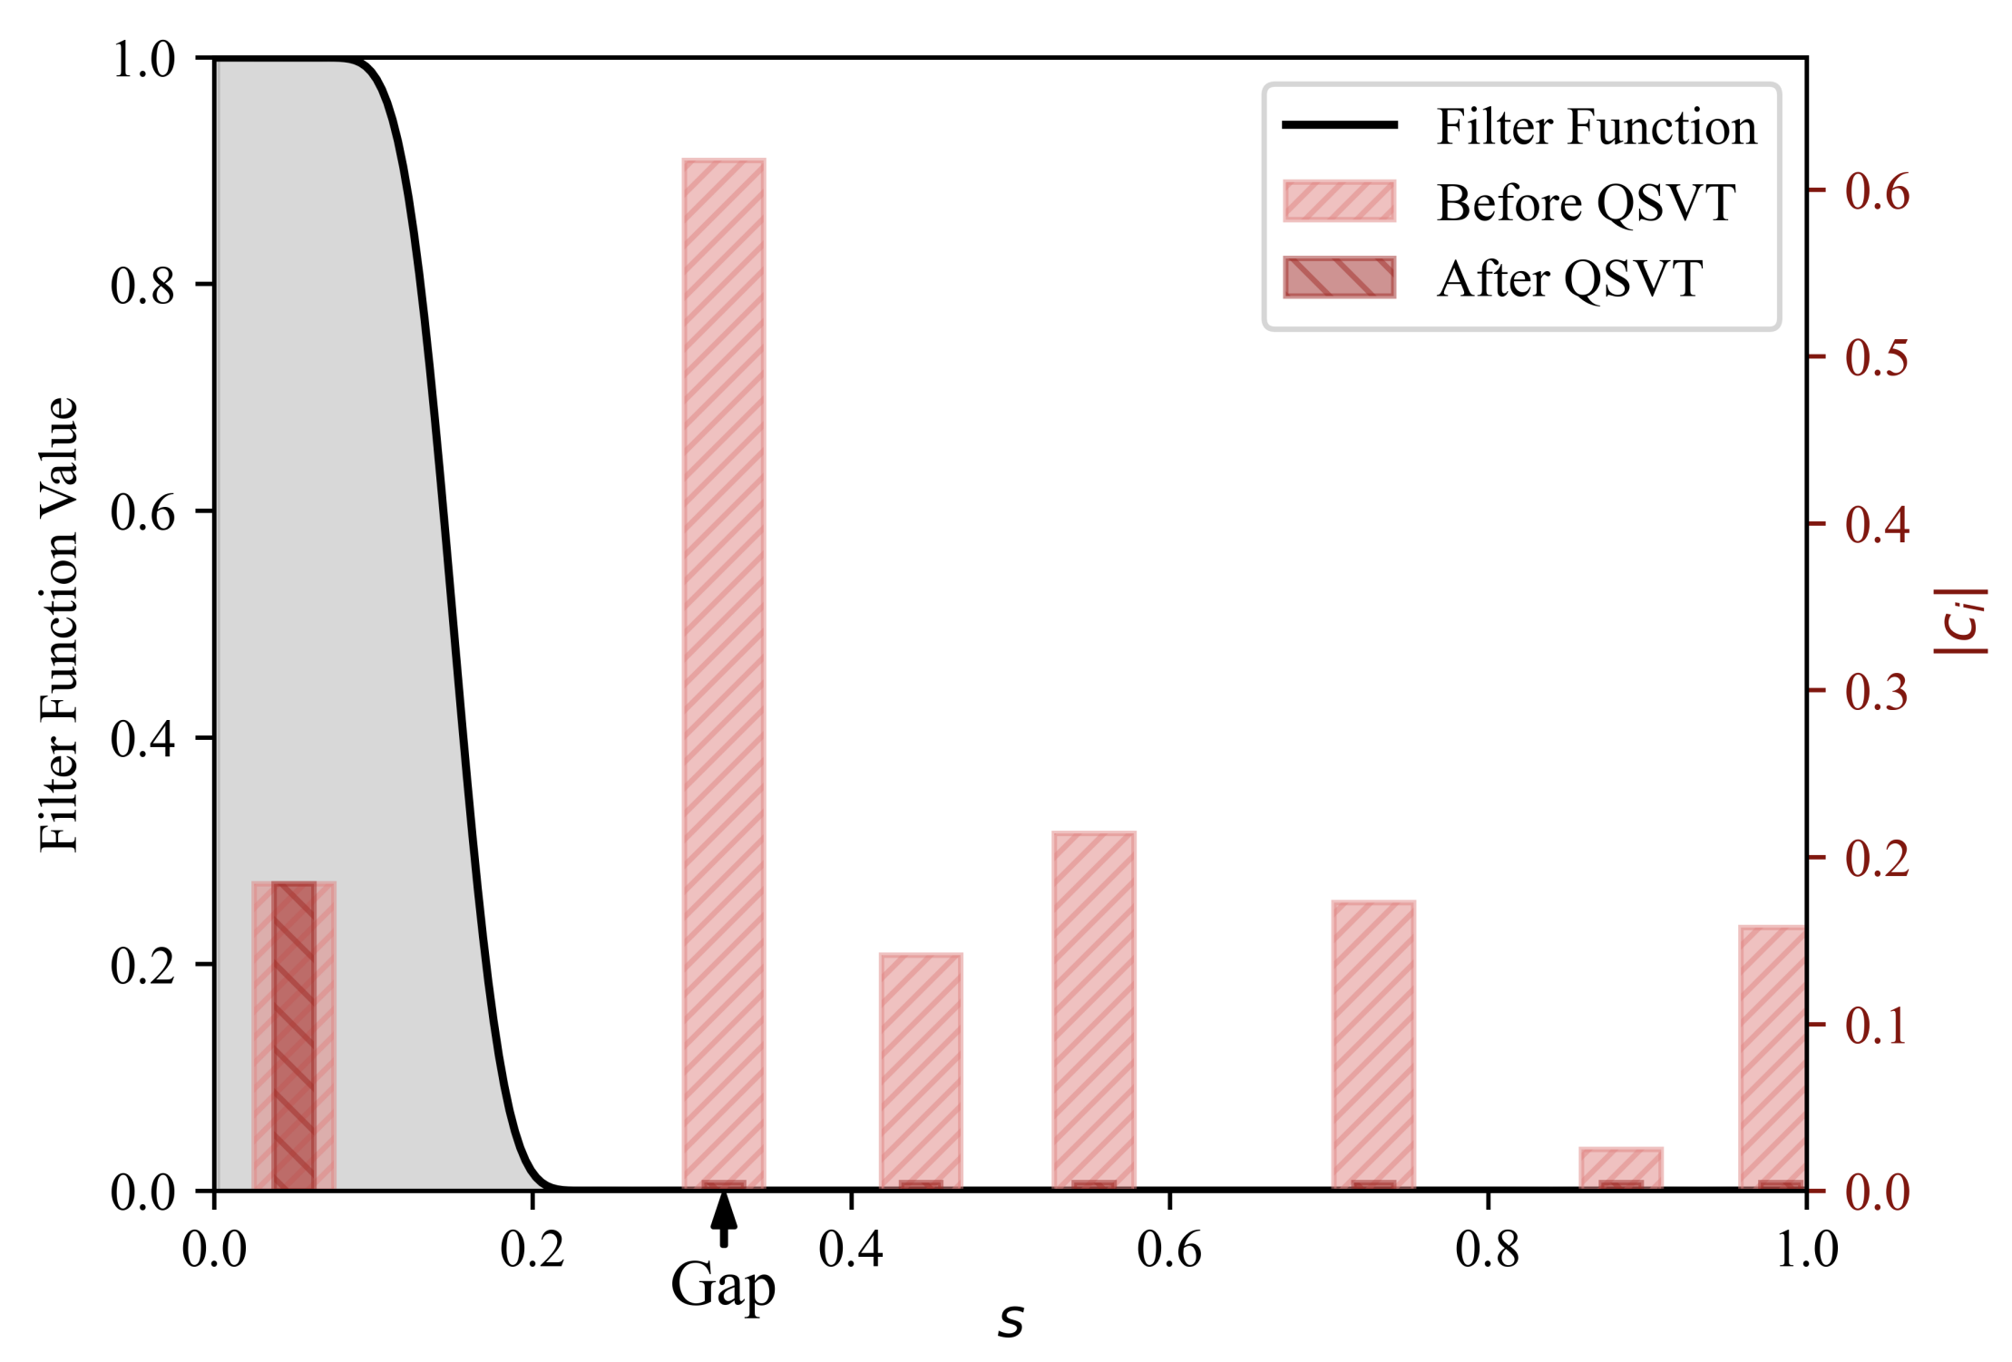
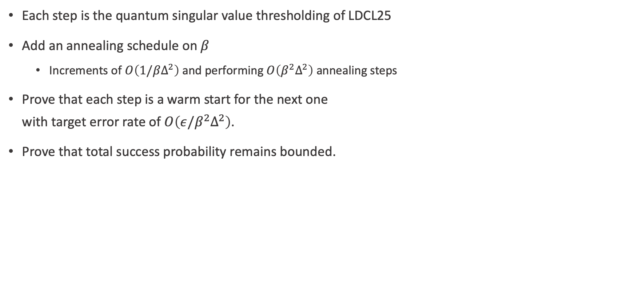
Eliminating the warm start
Each step is the quantum singular value thresholding of LDCL25
Add an annealing schedule on $β$
Increments of $O\left(1/βΔ^{2}\right)$ and performing $O\left(β^{2}Δ^{2}\right)$ annealing steps
Prove that each step is a warm start for the next one with target error rate of $O\left(ε/β^{2}Δ^{2}\right)$.
Prove that total success probability remains bounded.
arXiv 2505.05301

Slide 20
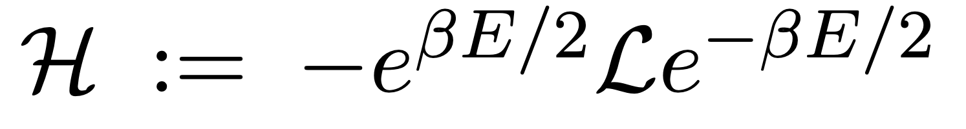
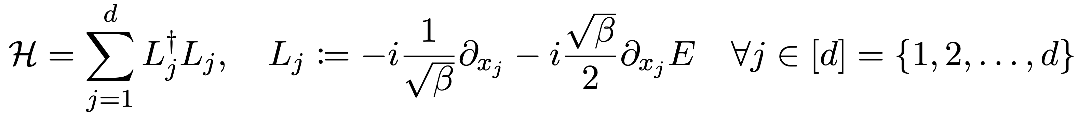
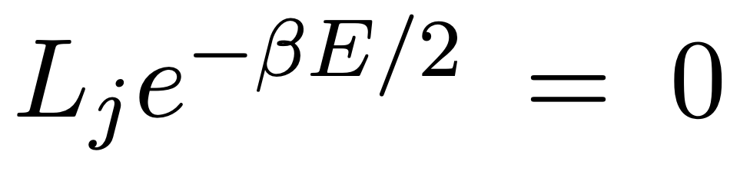
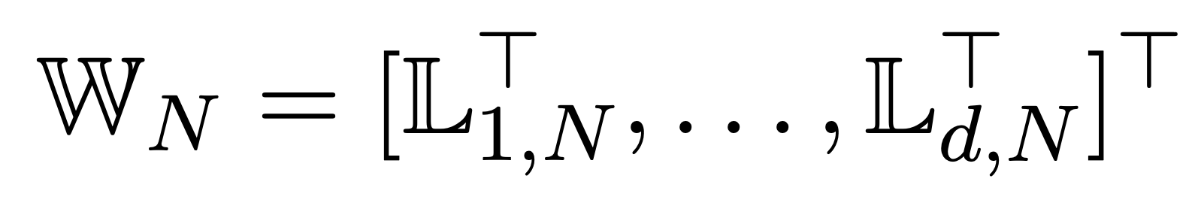
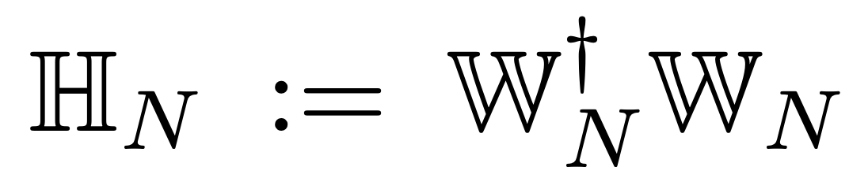
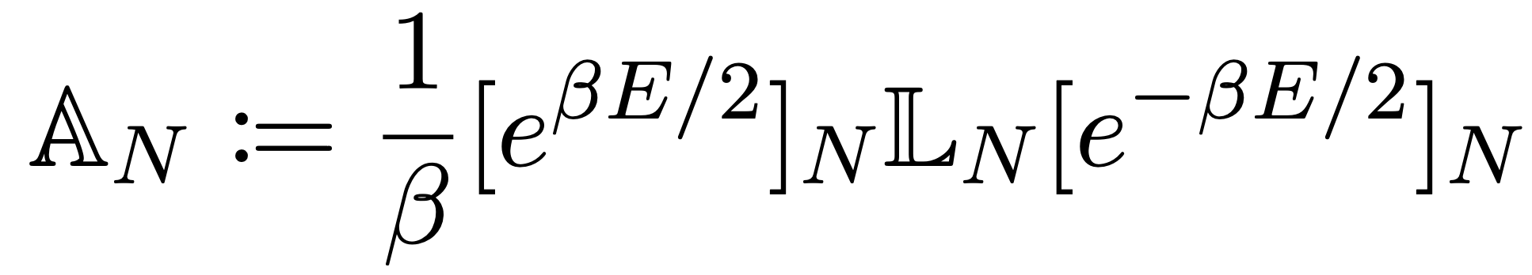
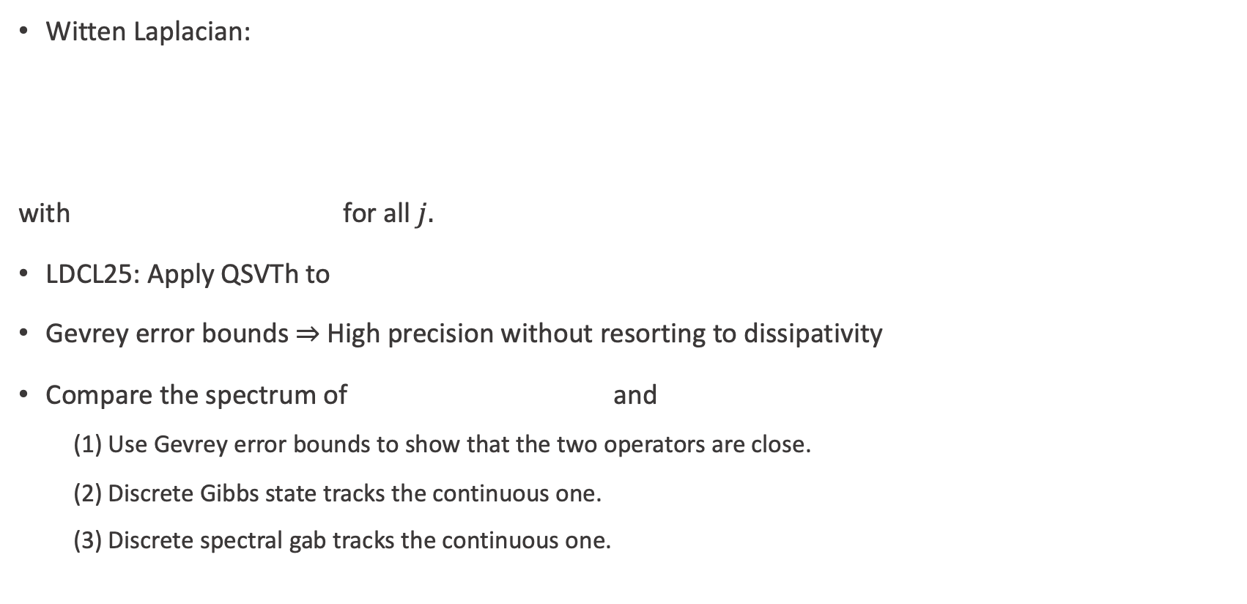
Discrete versus continuous operator
Witten Laplacian:
with for all $j.$
LDCL25: Apply QSVTh to
Gevrey error bounds $⇒$High precision without resorting to dissipativity
Compare the spectrum of and
(1) Use Gevrey error bounds to show that the two operators are close.
(2) Discrete Gibbs state tracks the continuous one.
(3) Discrete spectral gab tracks the continuous one.

Slide 21
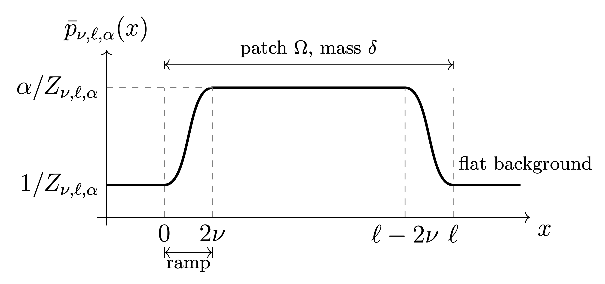
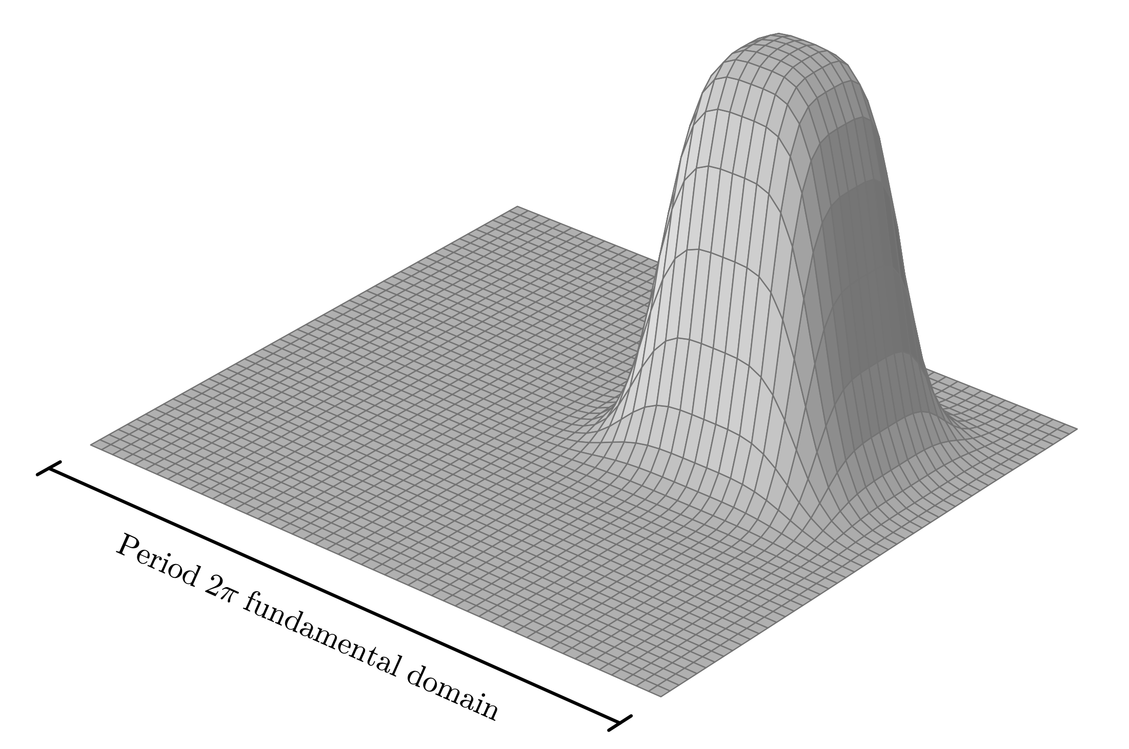

Classical Gibbs sampling in $Ω(e^{βΔ})$
OSHHKSR26: Gevrey potentials can hide $O(e^{βΔ})$ bump functions from classical algorithms.
Comparing the quantum upper-bound and the classical lower bound provides a provable quadratic quantum—classical separation.

Slide 22



Application 3: Force-field molecular dynamics
Force field as a function of torsion angles:

Slide 23
Conclusions
Gevrey smoothness is a natural criteria for efficient quantum computing on continuous functions.
QLSA solves general linear PDEs with periodic boundary conditions with no curse of dimensionality for the Gevrey class.
QSVTh enables high-precision Gibbs sampling for Gevrey potentials.
Gevrey potentials provide quadratically more adversarial examples for any classical algorithms thereby proving a quantum-–classical separation.
Many more applications to yet to be explored: Molecular dynamics, time-dependent PDEs, etc.

Slide 24


Thank you for your attention! pooya.ronagh@uwatelroo.ca

