Slide 1
Association Rules

Slide 2
Association rule mining
Proposed by Agrawal et al in 1993.
It is an important data mining model studied extensively by the database and data mining community.
Assume all data are categorical.
No good algorithm for numeric data.
Initially used for Market Basket Analysis to find how items purchased by customers are related.
Bread → Milk [sup = 5%, conf = 100%]
CS583, Bing Liu, UIC

Slide 3
The model: data
I = {i₁, i₂, …, i_{m}}: a set of items.
Transaction t :
  t a set of items, and t ⊆ I.
Transaction Database T: a set of transactions T = {t₁, t₂, …, t_{n}}.
CS583, Bing Liu, UIC

Slide 4
Transaction data: supermarket data
Market basket transactions:
  t1: {bread, cheese, milk}
  t2: {apple, eggs, salt, yogurt}
  … …
  tn: {biscuit, eggs, milk}
Concepts:
  An item: an item/article in a basket
  I: the set of all items sold in the store
  A transaction: items purchased in a basket; it may have TID (transaction ID)
  A transactional dataset: A set of transactions
CS583, Bing Liu, UIC

Slide 5
The model: rules
A transaction t contains X, a set of items (itemset) in I, if X ⊆ t.
An association rule is an implication of the form:
X → Y, where X, Y ⊂ I, and X ∩Y = ∅
An itemset is a set of items.
  E.g., X = {milk, bread, cereal} is an itemset.
A k-itemset is an itemset with k items.
  E.g., {milk, bread, cereal} is a 3-itemset
CS583, Bing Liu, UIC

Slide 6
Rule strength measures
Support: The rule holds with support sup in T (the transaction data set) if sup% of transactions contain X ∪ Y.
  sup = Pr(X ∪ Y).
Confidence: The rule holds in T with confidence conf if conf% of tranactions that contain X also contain Y.
  conf = Pr(Y | X)
An association rule is a pattern that states when X occurs, Y occurs with certain probability.
CS583, Bing Liu, UIC

Slide 7
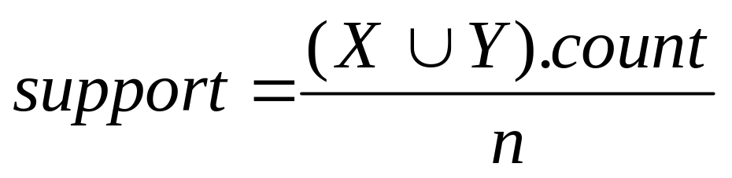
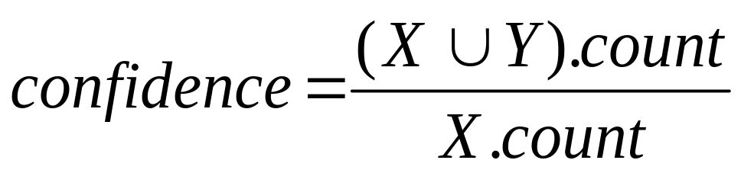
Support and Confidence
Support count: The support count of an itemset X, denoted by X.count, in a data set T is the number of transactions in T that contain X. Assume T has n transactions.
Then,
CS583, Bing Liu, UIC

Slide 8
Goal and key features
Goal: Find all rules that satisfy the user-specified minimum support (minsup) and minimum confidence (minconf).
Key Features
  Completeness: find all rules.
  No target item(s) on the right-hand-side
  Mining with data on hard disk (not in memory)
CS583, Bing Liu, UIC

Slide 9
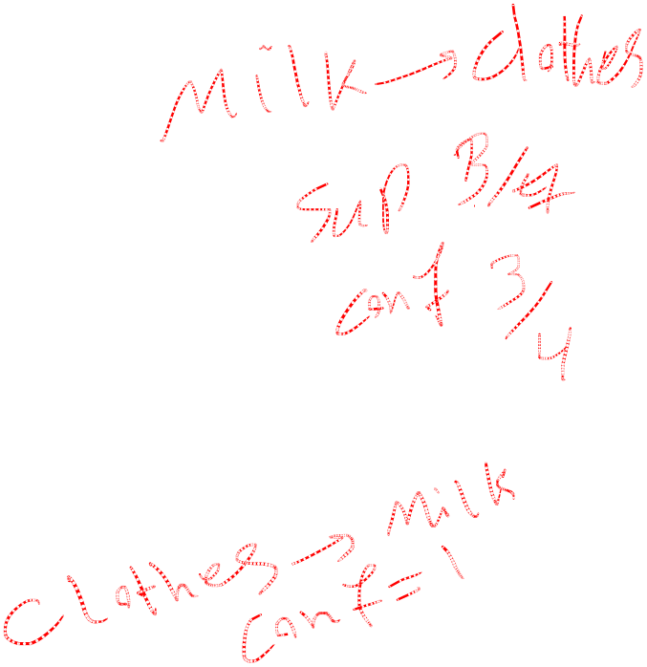
An example
  t1: Beef, Chicken, Milk
  t2: Beef, Cheese
  t3: Cheese, Boots
  t4: Beef, Chicken, Cheese
  t5: Beef, Chicken, Clothes, Cheese, Milk
  t6: Chicken, Clothes, Milk
  t7: Chicken, Milk, Clothes
Transaction data
Assume:
minsup = 30%
minconf = 80%
An example frequent itemset:
{Chicken, Clothes, Milk} [sup = 3/7]
Association rules from the itemset:
Clothes → Milk, Chicken [sup = 3/7, conf = 3/3]
… …
Clothes, Chicken → Milk, [sup = 3/7, conf = 3/3]
CS583, Bing Liu, UIC

Slide 10
Transaction data representation
A simplistic view of shopping baskets,
Some important information not considered. E.g,
  the quantity of each item purchased and
  the price paid.
CS583, Bing Liu, UIC

Slide 11
Many mining algorithms
There are a large number of them!!
They use different strategies and data structures.
Their resulting sets of rules are all the same.
  Given a transaction data set T, and a minimum support and a minimum confident, the set of association rules existing in T is uniquely determined.
Any algorithm should find the same set of rules although their computational efficiencies and memory requirements may be different.
We study only one: the Apriori Algorithm
CS583, Bing Liu, UIC

