Slide 1
Nearest Neighbor Models
Carla P. Gomes
gomes@cs.cornell.edu
Module:
Nearest Neighbor Models
(Reading: Chapter 20.4)

Slide 2
Instance-Based Learning
Idea:
  Similar examples have similar label.
  Classify new examples like similar training examples.
Algorithm:
  Given some new example x for which we need to predict its class y
  Find most similar training examples
  Classify x “like” these most similar examples
Questions:
  How to determine similarity?
  How many similar training examples to consider?
  How to resolve inconsistencies among the training examples?
Notes:
Similar inputs map to similar outputs
If not true => learning is impossible
If true => learning reduces to defining “similar”

Slide 3
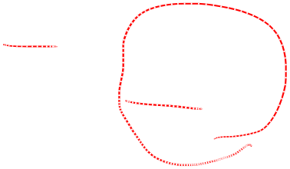
1-Nearest Neighbor
One of the simplest of all machine learning classifiers
Simple idea: label a new point the same as the closest known point
Label it red.

Slide 4
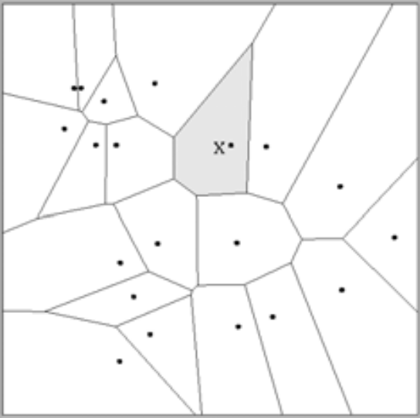
1-Nearest Neighbor
A type of instance-based learning
  Also known as “memory-based” learning
Forms a Voronoi tessellation of the instance space

Slide 5
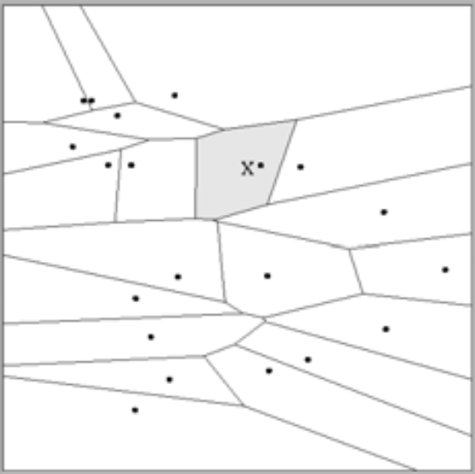
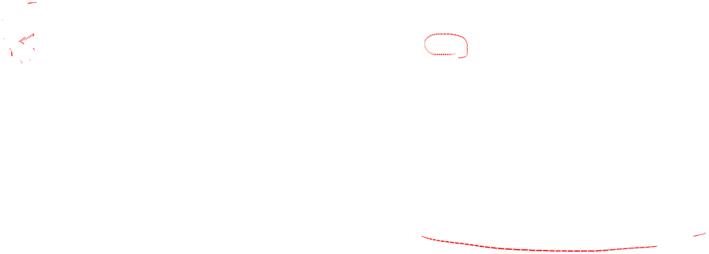
Distance Metrics
Different metrics can change the decision surface
Standard Euclidean distance metric:
  Two-dimensional: Dist(a,b) = sqrt((a₁ – b₁)² + (a₂ – b₂)²)
  Multivariate: Dist(a,b) = sqrt(∑ (a_{i} – b_{i})²)
Dist(a,b) =(a₁ – b₁)² + (a₂ – b₂)²
Dist(a,b) =(a₁ – b₁)² + (3a₂ – 3b₂)²
Adapted from “Instance-Based Learning”
lecture slides by Andrew Moore, CMU.

Slide 6

1-NN’s Aspects as an
Instance-Based Learner:
A distance metric
  Euclidean
  When different units are used for each dimension
    → normalize each dimension by standard deviation
  For discrete data, can use hamming distance
    → D(x1,x2) =number of features on which x1 and x2 differ
  Others (e.g., normal, cosine)
How many nearby neighbors to look at?
  One
How to fit with the local points?
  Just predict the same output as the nearest neighbor.
Adapted from “Instance-Based Learning”
lecture slides by Andrew Moore, CMU.

Slide 7

k – Nearest Neighbor
Generalizes 1-NN to smooth away noise in the labels
A new point is now assigned the most frequent label of its k nearest neighbors
Label it red, when k = 3
Label it blue, when k = 7

Slide 8
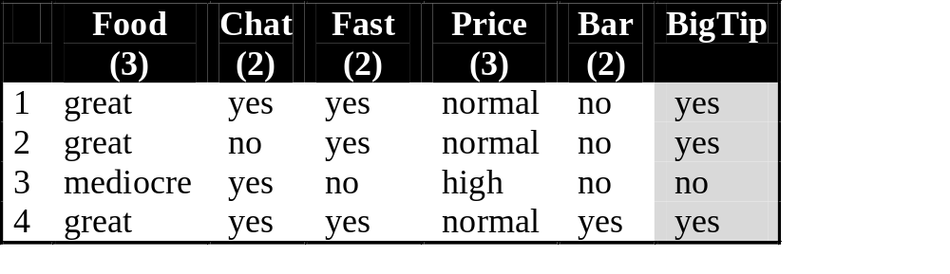
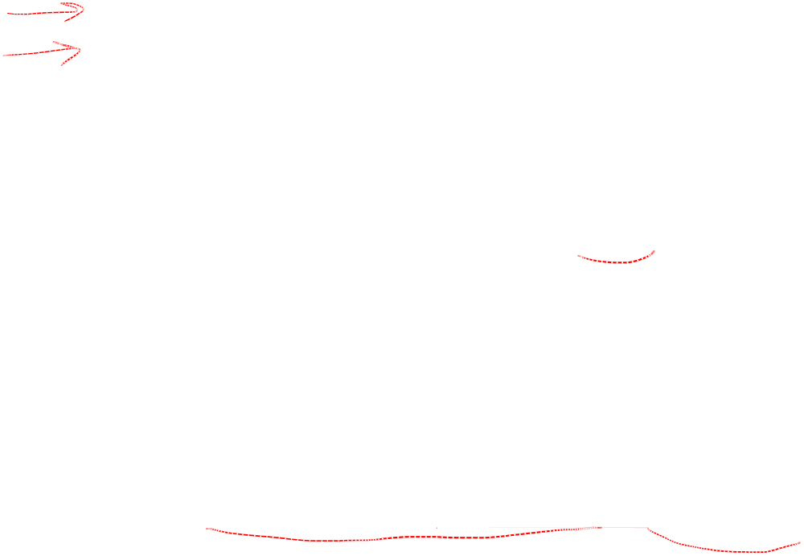
KNN Example
Similarity metric: Number of matching attributes (k=2)
New examples:
  Example 1 (great, no, no, normal, no)
  Example 2 (mediocre, yes, no, normal, no)
Yes
  → most similar: number 2 (1 mismatch, 4 match) → yes
  →Second most similar example: number 1 (2 mismatch, 3 match) → yes
Yes/No
  → Most similar: number 3 (1 mismatch, 4 match) → no
  →Second most similar example: number 1 (2 mismatch, 3 match) → yes
Notes:
Distance metric: Number of matching attributes
Example 1:
Most similar example: number 2 (1 mismatch, 4 match) -> classify yes
Second most similar example: number 1 (2 mismatch, 3 match) -> classify yes
Example 2:
Most similar example: number 3 (1 mismatch, 4 match) -> classify no
Second most similar example: number 1 (2 mismatch, 3 match) -> classify yes/no

Slide 9
Selecting the Number of Neighbors
Increase k:
  Makes KNN less sensitive to noise
Decrease k:
  Allows capturing finer structure of space
➔Pick k not too large, but not too small (depends on data)

Slide 10
Curse-of-Dimensionality
Prediction accuracy can quickly degrade when number of attributes grows.
  Irrelevant attributes easily “swamp” information from relevant attributes
  When many irrelevant attributes, similarity/distance measure becomes less reliable
Remedy
  Try to remove irrelevant attributes in pre-processing step
  Weight attributes differently
  Increase k (but not too much)
Notes:
Prediction accuracy can quickly degrade when number of attributes grows.
Imagine attribute vector (y,r1,r2,r3,…,rN),
first feature always tells the label
r1,..rn take random binary values.
What is the probability that nearest neighbor has same label? P(y=yNN)
Similarity measure is number of mismatches.
Assume we have only two training examples, one for each label. Both training examples have distance N+1 (all bits different)
(-1,+1,-1,+1,-1,+1,…,-1)
(+1,-1,+1,-1,+1,-1,…,+1)
If N=0, then P(y=yNN)=1
If N=2, then P(y=yNN)=3/4
→ need both random attributes to match the wrong examples
(4 outcomes on random attributes, and only one leads to a mistake)
If N=4, then P(y=yNN)=11/16
→ need three random attributes to match the wrong examples
(16 outcomes on random attributes, and 5 lead to a mistake)
If N=100, then P(y=yNN) almost 1/2
→ need N/2+1 random attributes to match the wrong examples
For every random attribute, we need exponentially more training examples.

Slide 11
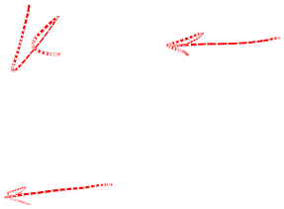
Advantages and Disadvantages of KNN
Need distance/similarity measure and attributes that “match” target function.
For large training sets,
→ Must make a pass through the entire dataset for each classification. This can be prohibitive for large data sets.
Prediction accuracy can quickly degrade when number of attributes grows.
Simple to implement algorithm;
Requires little tuning;
Often performs quite weel!
(Try it first on a new learning problem).
Notes:
Need similarity measure and attributes that “match” target function
predicting a person’s height may depend on different attributes than predicting their IQ

