Slide 1
Machine Learning
Text Categorization
Raymond J. Mooney
University of Texas at Austin

Slide 2
Text Categorization Applications
Web pages
  Recommending
  like classification
Newsgroup/Blog Messages
  Recommending
  spam filtering
  Sentiment analysis for marketing
News articles
  Personalized newspaper
Email messages
  Routing
  Prioritizing
  Folderizing
  spam filtering
  Advertising on Gmail

Slide 3

Text Categorization Methods
Representations of text are very high dimensional (one feature for each word).
Vectors are sparse since most words are rare.
For most text categorization tasks, there are many irrelevant and many relevant features.
Methods that sum evidence from many or all features (e.g. naïve Bayes, KNN, neural-net, SVM) tend to work better than ones that try to isolate just a few relevant features (decision-tree or rule induction).

Slide 4
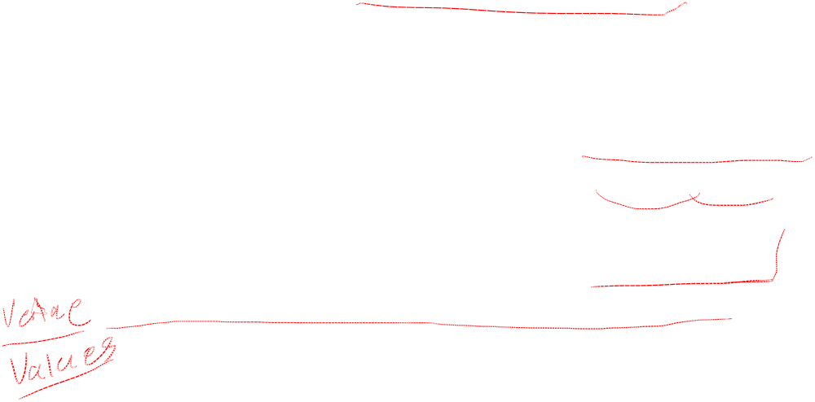
Textual Similarity Metrics
Measuring similarity of two texts is a well-studied problem.
Standard metrics are based on a “bag of words” model of a document that ignores word order and syntactic structure.
May involve removing common “stop words” and stemming to reduce words to their root form.
Vector-space model from Information Retrieval (IR) is the standard approach.
Other metrics (e.g. edit-distance) are also used.

Slide 5
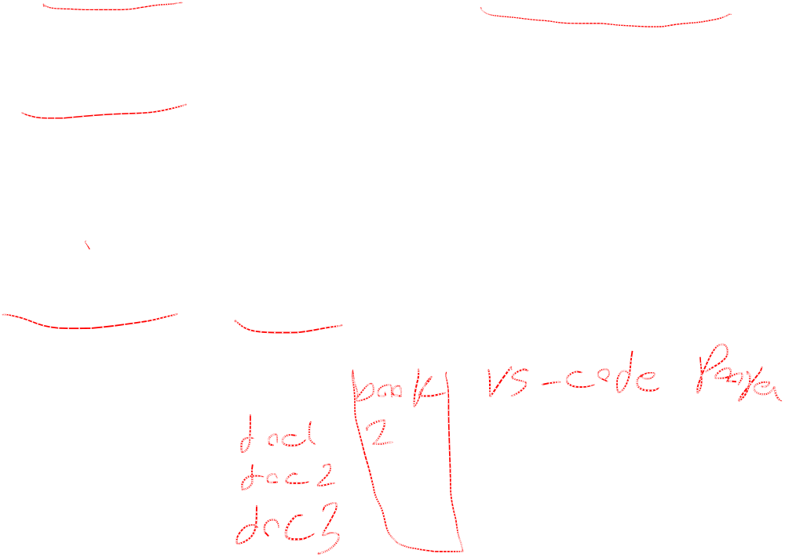
The Vector-Space Model
Assume t distinct terms remain after preprocessing; call them index terms or the vocabulary.
These “orthogonal” terms form a vector space.
  Dimension = t = |vocabulary|
Each term, i, in a document or query, j, is given a real-valued weight, w_{ij.}
Both documents and queries are expressed as t-dimensional vectors:
  d_{j} = (w_{1j}, w_{2j}, …, w_{tj})

Slide 6
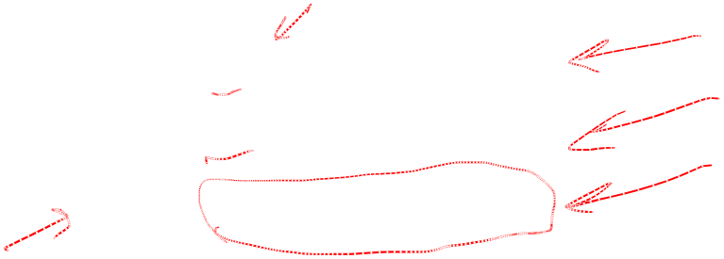
Graphic Representation
Example:
D₁ = 2T₁ + 3T₂ + 5T₃
D₂ = 3T₁ + 7T₂ + T₃
Q = 0T₁ + 0T₂ + 2T₃
T₃
5
D₁ = 2T₁+ 3T₂ + 5T₃
Q = 0T₁ + 0T₂ + 2T₃
2
3
T₁
D₂ = 3T₁ + 7T₂ + T₃
Is D₁ or D₂ more similar to Q?
How to measure the degree of similarity? Distance? Angle? Projection?
7
T₂

Slide 7

Document Collection
A collection of n documents can be represented in the vector space model by a term-document matrix.
An entry in the matrix corresponds to the “weight” of a term in the document; zero means the term has no significance in the document or it simply doesn’t exist in the document.
T₁ T₂ …. T_{t}
D₁ w₁₁ w₂₁ … w_{t1}
D₂ w₁₂ w₂₂ … w_{t2}
: : : :
: : : :
D_{n} w_{1n} w_{2n} … w_{tn}

Slide 8
Term Weights: Term Frequency
More frequent terms in a document are more important, i.e. more indicative of the topic.
  f_{ij} = frequency of term i in document j
May want to normalize term frequency (tf) by dividing by the frequency of the most common term in the document:
  tf_{ij} = f_{ij} / max_{i}{f_{ij}}

Slide 9
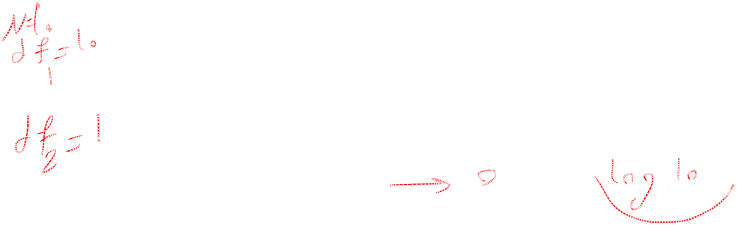
Term Weights: Inverse Document Frequency
Terms that appear in many different documents are less indicative of overall topic.
df _{i} = document frequency of term i
= number of documents containing term i
idf_{i} = inverse document frequency of term i,
= log₂ (N/ df _{i})
(N: total number of documents)
An indication of a term’s discrimination power.
Log used to dampen the effect relative to df.

Slide 10

TF-IDF Weighting
A typical combined term importance indicator is tf-idf weighting:
w_{ij} = tf_{ij} idf_{i} = tf_{ij} log₂ (N/ df_{i})
A term occurring frequently in the document but rarely in the rest of the collection is given high weight.
Many other ways of determining term weights have been proposed.
Experimentally, tf-idf has been found to work well.

Slide 11
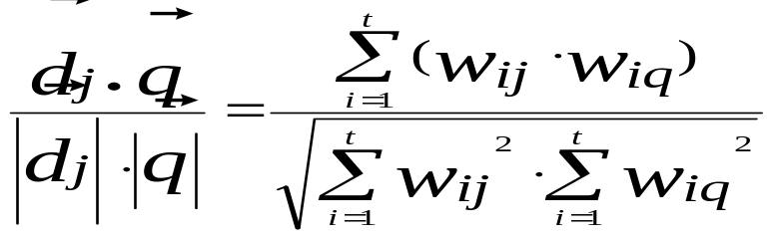
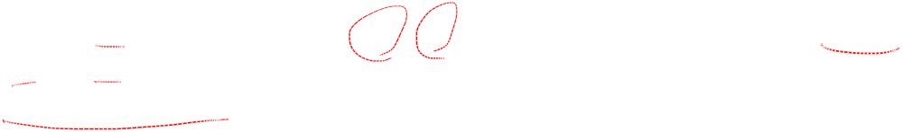
Cosine Similarity Measure
Cosine similarity measures the cosine of the angle between two vectors.
Inner product normalized by the vector lengths.
t₃
θ₁
D₁
Q
CosSim(d_{j}, q) =
θ₂
t₁
t₂
D₂
D₁ = 2T₁ + 3T₂ + 5T₃ CosSim(D₁ , Q) = 10 / √(4+9+25)(0+0+4) = 0.81
D₂ = 3T₁ + 7T₂ + 1T₃ CosSim(D₂ , Q) = 2 / √(9+49+1)(0+0+4) = 0.13
Q = 0T₁ + 0T₂ + 2T₃
D₁ is 6 times better than D₂ using cosine similarity but only 5 times better using inner product.

