Slide 1

SHARIF UNIVERSITY OF TECHNOLOGY
Department of Computer Engineering
Robust Speech Recognition
in Persian Language
Telecom augmentation, dual-stream fusion,
and pseudo-labelled Persian audiobooks
Pouya Fallah Sichani
M.Sc. in Computer Engineering
Supervisor: Dr. Hosein Sameti
POUYA FALLAH SICHANI
1 / 30
Notes:
This thesis studies Persian ASR under telephone and VoIP conditions. I compare improvements from matching training conditions, adding an enhancement-fusion architecture, and expanding training data with pseudo-labelled audiobooks. The largest controlled robustness gain comes from telecom-oriented multi-condition training. The later experiments show smaller and domain-dependent gains.
Sources: /home/mint/MS-Thesis/Thesis/front/info.tex; /home/mint/MS-Thesis/Thesis/front/abstract-eng.tex
Target speaking time: 25 seconds.
Institutional branding: original university logo from Thesis/front/template/images/logo.pdf.

Slide 2
RESEARCH CONTEXT
The mismatch in Persian telephone ASR
01
02
03
Available speech
Target speech
Research objective
General Persian corpora, many short clips, varied recording conditions
Telephone and VoIP with noise, limited bandwidth, codecs and packet loss
Improve real-call recognition using existing speech and unlabelled audio
The test must include real calls that the simulator never generated.
POUYA FALLAH SICHANI
2 / 30
Notes:
Persian training data includes read and spontaneous speech, but does not fully cover real telecom channels. A call can combine environmental noise, bandwidth restriction, codec distortion, gain changes and packet loss. Collecting large quantities of transcribed calls is expensive and privacy-sensitive. The goal is to improve recognition on real calls while monitoring performance on general Persian speech.
Sources: /home/mint/MS-Thesis/Thesis/chapters/introduction.tex; /home/mint/MS-Thesis/Thesis/chapters/preliminaries.tex
Target speaking time: 50 seconds.
Institutional branding: original university logo from Thesis/front/template/images/logo.pdf.

Slide 3
RESEARCH CONTEXT
Research design
Comparison | What changes | Reference
Telecom augmentation | Add degraded speech | Ordinary Whisper-small
Enhancement and fusion | Add dual streams and staged training | Multi-condition Whisper-small
Audiobook data | Add accepted IranSeda clips | Multi-condition Whisper-small
Whisper-small remains the recognizer for the main comparisons.
Whisper Medium and Fast Conformer provide additional context.
POUYA FALLAH SICHANI
3 / 30
Notes:
The ordinary Whisper-small baseline includes original and constructed long examples. The multi-condition baseline adds degraded speech. It becomes the reference for both later comparisons. Fusion changes the system architecture and training schedule. The IranSeda experiment retains the complete multi-condition mixture and adds accepted audiobook clips. Fusion and IranSeda are separate branches. I did not train a combined fusion-plus-IranSeda system.
Sources: /home/mint/MS-Thesis/Thesis/chapters/work.tex
Target speaking time: 55 seconds.
Institutional branding: original university logo from Thesis/front/template/images/logo.pdf.

Slide 4
RESEARCH CONTEXT
A shared Persian training foundation
Base corpus | Training clips | Validation clips
Common Voice Persian 25 | 299,430 | 10,006
FarsSpon, limited subset | 600,672 | 6,044
FLEURS Persian | 3,019 | 362
Mono 16 kHz audio and one Persian text normalizer
Long variants join 2–4 clips within a split, with durations above 5 and at most 20 seconds.
POUYA FALLAH SICHANI
4 / 30
Notes:
The base corpora are Common Voice Persian 25, FarsSpon and FLEURS Persian. All audio uses mono 16 kHz and transcripts share deterministic Persian normalization. Constructed long examples concatenate two to four clips within the same split, with final duration above five and at most twenty seconds. Every main model uses these long variants. Multi-condition training additionally uses two independent degraded variants for each Common Voice clip and its long variant. These counts describe base examples before derived data and IranSeda.
Sources: /home/mint/MS-Thesis/Thesis/chapters/work.tex
Target speaking time: 55 seconds.
Institutional branding: original university logo from Thesis/front/template/images/logo.pdf.

Slide 5
RESEARCH CONTEXT
Evaluation on real calls and general speech
Test set | Examples | Role
AGFarsdat | 10,044 | Real telephone and VoIP
Common Voice Persian 25 | ~10,518 | Crowdsourced general speech
FLEURS Persian | 871 | Read speech across domains
PersianSpeech | 24 | Small supplementary test
Persian Speech Corpus | 391–396 | Studio speech outside training domain
WER = (substitutions + deletions + insertions) / reference words
CER counts characters. Aggregate scores pool counts. Lower is better.
POUYA FALLAH SICHANI
5 / 30
Notes:
WER is substitutions plus deletions plus insertions divided by reference words. CER uses the same calculation over characters. Lower is better. All main systems use greedy decoding and identical Persian normalization. Aggregate metrics pool error counts and reference units rather than average dataset percentages. The paired single-stream comparisons use 21,848 common eligible examples. The thesis lists a 391 to 396 range for Persian Speech Corpus across models, so model-wide rankings require care about eligibility. AGFarsdat is held out from training and model selection.
Sources: /home/mint/MS-Thesis/Thesis/chapters/work.tex; /home/mint/MS-Thesis/Thesis/chapters/results.tex; /home/mint/MS-Thesis/Thesis/chapters/conclusions.tex
Target speaking time: 60 seconds.
Institutional branding: original university logo from Thesis/front/template/images/logo.pdf.

Slide 6
TELECOM AUGMENTATION
Reproducible telecom augmentation
Stage | Implementation
Noise and gain | DEMAND noise, SNR from −5 to 15 dB, gain ±6 dB
Channel and codec | Narrowband / wideband, real codec encode–decode
Network effects | Opus packet loss + PLC, waveform-dropout approximation elsewhere
Aligned output | 16 kHz pair, matched bandwidth target, saved seed and metadata
G.711, GSM, AMR-NB, AMR-WB and Opus cover the implemented codec paths.
POUYA FALLAH SICHANI
6 / 30
Notes:
Four sampled profiles cover clean telephone, noisy telephone, lossy VoIP and mobile wideband. Their weights describe a designed training distribution, not measured operator traffic. Noise and gain changes precede channel filtering and codec processing. FFmpeg round-trips model codec distortion. Native Opus supports packet loss and decoder PLC. Other paths approximate loss through waveform dropouts. The final aligned pair has a shared transcript, compensated delay and a common peak scale. The clean enhancement target has the same bandwidth as its degraded input. Seeds and settings make each example traceable.
Sources: /home/mint/MS-Thesis/Thesis/chapters/work.tex
Target speaking time: 75 seconds.
Institutional branding: original university logo from Thesis/front/template/images/logo.pdf.

Slide 7
TELECOM AUGMENTATION
Synthetic training transfers to real calls
WER (%) on the aggregate evaluation and held-out real calls. Lower is better.
9.83
points lower
on real calls
5.44
points lower overall
POUYA FALLAH SICHANI
7 / 30
Notes:
This is the main robustness result. Multi-condition training lowers aggregate WER by 5.44 percentage points, a 23.4 percent relative reduction. On AGFarsdat, WER falls by 9.83 points, a 27.6 percent relative reduction. AGFarsdat contains real telephone and VoIP recordings and did not participate in training or simulator construction. This is evidence of transfer to the target channel. It does not establish uniform improvement across every general speech dataset.
Sources: /home/mint/MS-Thesis/Thesis/chapters/results.tex
Target speaking time: 70 seconds.
Institutional branding: original university logo from Thesis/front/template/images/logo.pdf.

Slide 8
TELECOM AUGMENTATION
Noise alone leaves part of the gap
Whisper-small training | Aggregate WER | AGFarsdat WER
Ordinary | 23.27% | 35.63%
Noise only | 20.38% | 32.67%
pMCT, clean/noisy segment mixing | 19.21% | 30.01%
Full telecom multi-condition | 17.83% | 25.80%
Lower is better. The full pipeline adds bandwidth, codec and network effects.
POUYA FALLAH SICHANI
8 / 30
Notes:
Both noise-only augmentation and pMCT improve over the ordinary baseline. In the implemented pMCT comparison, aligned clean and noisy examples are divided into one-second pieces, then each piece is selected from either view with equal probability. The full telecom pipeline gives the lowest aggregate and AGFarsdat WER of these augmentation experiments. This supports modelling more than noise. It does not isolate the contribution of each codec or loss mechanism, since those components were not individually ablated.
Sources: /home/mint/MS-Thesis/Thesis/chapters/results.tex
Target speaking time: 55 seconds.
Institutional branding: original university logo from Thesis/front/template/images/logo.pdf.

Slide 9
ENHANCEMENT AND FUSION
Dual-stream enhancement and fusion
01
02
03
Two views
Shared encoding
Learned combination
Original log-Mel and a residual U-Net enhanced view
One Whisper encoder, two passes with shared weights
Bidirectional cross-attention, then a gate per time and feature
Fused = g ⊙ Enhanced′ + (1 − g) ⊙ Original′
POUYA FALLAH SICHANI
9 / 30
Notes:
The hypothesis is that a learned enhanced view may complement the original observation. A residual U-Net modifies 80-band log-Mel features without reconstructing a waveform. Original and enhanced features pass through the same Whisper encoder in two passes with shared parameters. One layer of bidirectional cross-attention with four heads exchanges information between streams. A time-feature gate then combines the outputs before the Whisper decoder. Starting from the multi-condition checkpoint makes the comparison more demanding than starting from ordinary Whisper. The diagram in the appendix contains the complete architecture.
Sources: /home/mint/MS-Thesis/Thesis/chapters/work.tex
Target speaking time: 80 seconds.
Institutional branding: original university logo from Thesis/front/template/images/logo.pdf.

Slide 10
ENHANCEMENT AND FUSION
Three-stage fusion training
Stage | Trainable components | Objective
1. Enhancer warm-up | Enhancer only | 0.5 enhancement + 0.5 feature
2. Frozen recognizer | Enhancer and fusion | ASR + 0.3 enhancement
3. Joint training | All components | ASR + 0.1 enhancement
One epoch per stage. Final learning rates: added modules 10⁻⁴, Whisper 5 × 10⁻⁶.
Fusion changes both architecture and the training schedule.
POUYA FALLAH SICHANI
10 / 30
Notes:
Every stage runs for one epoch. Warm-up trains the enhancer using equal-weight log-Mel reconstruction and encoder-feature matching, while Whisper remains frozen. Stage two trains enhancer and fusion with ASR loss plus 0.3 enhancement loss, again with frozen Whisper. Stage three unfreezes the whole model with ASR loss plus 0.1 enhancement loss. The additional modules use a higher learning rate than Whisper. The last stage includes degraded examples, long examples and a randomly selected 25 percent of clean data. Fusion therefore has extra recognizer training relative to the single-stream baseline.
Sources: /home/mint/MS-Thesis/Thesis/chapters/work.tex
Target speaking time: 50 seconds.
Institutional branding: original university logo from Thesis/front/template/images/logo.pdf.

Slide 11
ENHANCEMENT AND FUSION
Fusion gives a small numerical improvement
System | Aggregate WER | Aggregate CER | AGFarsdat WER
Multi-condition | 17.83% | 7.93% | 25.80%
Dual-stream fusion | 17.64% | 7.85% | 25.37%
Adaptive bridge, independent | 17.74% | 8.00% | 25.84%
Mean enhanced-stream gate weight: 0.6785
Gate weights do not measure independent causal contribution.
Small margins lack confidence intervals and repeated-seed evidence.
POUYA FALLAH SICHANI
11 / 30
Notes:
Fusion lowers aggregate WER from 17.83 to 17.64 percent, a 0.19-point gain, and AGFarsdat WER from 25.80 to 25.37 percent. The independently implemented adaptive bridge combines original and FRCRN-enhanced waveforms before frozen Whisper, rather than encoder representations. It improves aggregate WER slightly but increases CER. Fusion’s mean gate weight for the enhanced stream is 0.6785, with median 0.6930. Because cross-attention already exchanged information, this weight is not a causal contribution estimate. Different enhancers and training schedules prevent isolating the fusion mechanism from the bridge comparison. No significance test establishes reliability of the small margins.
Sources: /home/mint/MS-Thesis/Thesis/chapters/results.tex; /home/mint/MS-Thesis/Thesis/chapters/work.tex
Target speaking time: 65 seconds.
Institutional branding: original university logo from Thesis/front/template/images/logo.pdf.

Slide 12
ENHANCEMENT AND FUSION
Tiny-model ablations support using both views
Whisper Tiny configuration | CV25 WER | AGFarsdat WER
Multi-condition baseline | 74.92% | 76.85%
Bidirectional cross-attention fusion | 57.82% | 63.50%
Gate only, without cross-attention | 62.35% | 65.88%
Original representation only¹ | 64.10% | 69.23%
Enhanced representation only¹ | 63.81% | 69.69%
¹ Inference-time removal from the trained fusion checkpoint. Lower is better.
Separate Tiny experiment. Extra training and unequal capacity limit attribution.
POUYA FALLAH SICHANI
12 / 30
Notes:
These are separate experiments with Whisper Tiny and Common Voice training only. They are not additional rows in the Whisper-small benchmark. Full bidirectional fusion performs best among these variants on both tests. Removing attention or using either stream alone raises WER. The single-view conditions bypass fusion at inference using the same trained checkpoint. They do not represent separately trained single-stream controls. Fusion also receives an extra joint ASR training stage, so the large gap from Tiny’s multi-condition baseline cannot be attributed to architecture alone. Full WER and CER results are in the appendix.
Sources: /home/mint/MS-Thesis/Thesis/chapters/results.tex
Target speaking time: 65 seconds.
Institutional branding: original university logo from Thesis/front/template/images/logo.pdf.

Slide 13
AUDIOBOOK DATA
IranSeda audiobook preparation
01
02
03
Source preparation
Segmentation and transcription
Text preparation
3,777 books, about 6,300 raw hours, 250 hours selected
Silero VAD, 20-second target, Persian-adapted Whisper Medium teacher
Persian normalization, conservative Qwen refinement, quality filtering
The new Whisper-small run retains ordinary, long and degraded speech.
POUYA FALLAH SICHANI
13 / 30
Notes:
The second data direction asks whether additional real Persian speech helps after multi-condition training. The acquisition contains 3,777 audiobooks and approximately 6,300 raw hours. Compute limits motivate processing a selected 250-hour subset. Silero VAD segments audio around natural boundaries, with a twenty-second target, preferred fifteen to twenty-five seconds and a hard twenty-eight-second maximum. Persian-adapted Whisper Medium generates each segment’s transcript. Deterministic normalization precedes conservative Qwen refinement and quality filtering. Accepted clips supplement all original, long and degraded data, rather than replacing any baseline component.
Sources: /home/mint/MS-Thesis/Thesis/chapters/work.tex
Target speaking time: 65 seconds.
Institutional branding: original university logo from Thesis/front/template/images/logo.pdf.

Slide 14
AUDIOBOOK DATA
218.564 hours remain after filtering
Reviewed clips | Accepted | Rejected
44,820 | 39,454 | 5,366
Label safeguards
Leakage control
Retain raw text, preserve numbers, reject uncertain or excessive edits
Split by original book and preserve source identity, times and checksums
Accepted corpus: 218.564 hours from 136 files. Forty operational failures are separate.
POUYA FALLAH SICHANI
14 / 30
Notes:
The selected 250 raw hours must be distinguished from the final accepted corpus. Of 44,820 reviewed clips, 39,454 were accepted and 5,366 rejected. Forty operational failures were tracked separately. Accepted audio totals 218.564 hours from 136 audiobook files. Qwen receives text and context only. It may correct orthography and clearly supported substitutions, but cannot add speech or complete segments. Numeric tokens must remain unchanged. Uncertain or excessive edits are rejected. Raw teacher text and refined text remain separate. Splits operate at book level, not clip level, and provenance preserves source identity, timestamps, hashes and processing settings. There is no human transcription audit that quantifies pseudo-label or LLM correction accuracy.
Sources: /home/mint/MS-Thesis/Thesis/chapters/work.tex; /home/mint/MS-Thesis/Thesis/chapters/conclusions.tex
Target speaking time: 60 seconds.
Institutional branding: original university logo from Thesis/front/template/images/logo.pdf.

Slide 15
AUDIOBOOK DATA
Audiobook gains depend on the test domain
Change in WER versus multi-condition Whisper-small, in percentage points
Negative means improvement. Aggregate WER: 17.83% to 17.22%.
¹ Only 24 test examples. Domain effects require further analysis.
POUYA FALLAH SICHANI
15 / 30
Notes:
Adding IranSeda lowers aggregate WER from 17.83 to 17.22 percent and CER from 7.93 to 7.70 percent. That is a 0.61-point WER reduction when calculated from displayed values. Per-domain changes are more revealing: FLEURS improves by 6.04 points, PersianSpeech by 8.39 points and Persian Speech Corpus by 5.03 points. AGFarsdat worsens by 0.86 points and Common Voice by 0.35 points. PersianSpeech has only 24 examples, so its large change is preliminary. The data improves several general domains but does not add telephone robustness. The experiment does not isolate whether style, recording conditions, label quality or sampling mixture causes this pattern.
Sources: /home/mint/MS-Thesis/Thesis/chapters/results.tex
Target speaking time: 85 seconds.
Institutional branding: original university logo from Thesis/front/template/images/logo.pdf.

Slide 16
RESULTS
Results of the main Whisper-small comparisons
Whisper-small system | Aggregate WER | Aggregate CER | AGFarsdat WER
Ordinary | 23.27% | 10.84% | 35.63%
Multi-condition | 17.83% | 7.93% | 25.80%
Dual-stream fusion | 17.64% | 7.85% | 25.37%
Multi-condition + IranSeda | 17.22% | 7.70% | 26.66%
Lower is better. The lowest aggregate score and the lowest real-call score differ.
POUYA FALLAH SICHANI
16 / 30
Notes:
This table brings the primary comparisons together. Ordinary Whisper-small provides the initial reference. Multi-condition training gives the large reduction in aggregate and real-call errors. Fusion adds a small numerical improvement. Additional IranSeda speech produces the lowest aggregate WER among these Whisper-small systems but a higher AGFarsdat WER than multi-condition or fusion. The ranking depends on the application domain. These are observed values from the completed experiments rather than statistically established model rankings. The complete augmentation and bridge comparisons are in backup slides.
Sources: /home/mint/MS-Thesis/Thesis/chapters/results.tex
Target speaking time: 60 seconds.
Institutional branding: original university logo from Thesis/front/template/images/logo.pdf.

Slide 17
RESULTS
Whisper Medium provides capacity context
Model | Aggregate WER | Aggregate CER | AGFarsdat WER
Small, multi-condition | 17.83% | 7.93% | 25.80%
Small, + IranSeda | 17.22% | 7.70% | 26.66%
Medium, Persian-adapted | 14.36% | 6.68% | 21.99%
Medium is also the pseudo-label teacher.
Changing model capacity prevents a data-only interpretation.
POUYA FALLAH SICHANI
17 / 30
Notes:
Whisper Medium achieved the lowest overall WER and CER of the completed main evaluations. It also served as the pseudo-label teacher. Its aggregate WER is 3.47 percentage points below multi-condition Whisper-small. Its AGFarsdat WER is 21.99 percent. The single-stream models share the same 21,848 eligible examples, but model capacity and training details differ. These numbers give a useful higher-capacity reference and do not identify a data-only or architecture-only causal effect.
Sources: /home/mint/MS-Thesis/Thesis/chapters/results.tex; /home/mint/MS-Thesis/Thesis/chapters/work.tex
Target speaking time: 40 seconds.
Institutional branding: original university logo from Thesis/front/template/images/logo.pdf.

Slide 18
CONCLUSIONS
Research contributions
Reproducible telecom data
Controlled robustness evidence
Aligned pairs with real codec paths and recorded augmentation settings
Large Whisper-small gain on held-out real telephone and VoIP speech
Architecture and data studies
Domain-specific interpretation
Fusion evaluation, Tiny ablations and a curated audiobook corpus
Separate general-speech gains from real-call robustness
POUYA FALLAH SICHANI
18 / 30
Notes:
The contribution is a reproducible experimental framework, alongside the implemented systems and data preparation. It includes deterministic telecom degradation with provenance, evidence of synthetic-to-real transfer, a task-trained dual-stream system evaluated against a strong multi-condition baseline and an independently implemented waveform bridge, plus a curated audiobook corpus. The domain-specific analysis prevents treating lower aggregate WER as universal robustness. Claims of a new universal architecture or state-of-the-art Persian ASR are outside the evidence.
Sources: /home/mint/MS-Thesis/Thesis/chapters/introduction.tex; /home/mint/MS-Thesis/Thesis/chapters/work.tex; /home/mint/MS-Thesis/Thesis/chapters/conclusions.tex
Target speaking time: 40 seconds.
Institutional branding: original university logo from Thesis/front/template/images/logo.pdf.

Slide 19
CONCLUSIONS
Limits and the next experiments
Current limitation | Next experiment
Small margins, single runs | Repeated seeds and paired confidence intervals
Fusion training differs | Match training budget and ablate modules in Whisper-small
Pseudo-labels lack human audit | Audit teacher, Qwen edits and accepted text separately
Domain and deployment uncertainty | Sweep data mixture, report codec/SNR errors and runtime cost
AGFarsdat is private. PersianSpeech has 24 examples. Simulator coverage is incomplete.
POUYA FALLAH SICHANI
19 / 30
Notes:
The most urgent follow-ups test reliability and explain mechanism. Repeated seeds, exact paired eligibility and bootstrap confidence intervals are necessary for small differences. Matched-budget ablations should isolate attention and enhancement at Whisper-small scale. A human audit should compare raw teacher text, Qwen refinements and retained labels. Mixture sweeps and more telephone-like unlabelled speech would test the domain trade-off. Codec- and SNR-specific analyses and measurements of latency, memory and real-time factor remain necessary before deployment decisions. AGFarsdat is private, and PersianSpeech is very small.
Sources: /home/mint/MS-Thesis/Thesis/chapters/results.tex; /home/mint/MS-Thesis/Thesis/chapters/conclusions.tex
Target speaking time: 45 seconds.
Institutional branding: original university logo from Thesis/front/template/images/logo.pdf.

Slide 20
CONCLUSIONS
Telecom-matched training gives the largest gain
Real-call robustness
35.63%
25.80%
to
WER with multi-condition training
Added architecture
Added audiobook speech
Fusion reaches 25.37% real-call WER, a small numerical gain
17.22% aggregate WER, with a 0.86-point real-call regression
Questions
POUYA FALLAH SICHANI
20 / 30
Notes:
The central answer is that matching the training conditions to the target channel yields the largest controlled improvement. Multi-condition training cuts real-call WER from 35.63 to 25.80 percent without changing the Whisper-small architecture. Fusion improves it slightly further, but statistical reliability and runtime value remain open. Audiobooks lower aggregate WER to 17.22 percent while slightly worsening AGFarsdat, showing why data relevance matters alongside volume. Thank you. I am happy to discuss the experimental controls and the domain-specific results.
Sources: /home/mint/MS-Thesis/Thesis/chapters/results.tex; /home/mint/MS-Thesis/Thesis/chapters/conclusions.tex
Target speaking time: 45 seconds.
Institutional branding: original university logo from Thesis/front/template/images/logo.pdf.

Slide 21
SUPPLEMENTARY EVIDENCE
Complete aggregate results
System | WER | CER
Ordinary | 23.27% | 10.84%
Noise only | 20.38% | 9.59%
pMCT | 19.21% | 8.91%
Multi-condition | 17.83% | 7.93%
Dual-stream fusion | 17.64% | 7.85%
Adaptive bridge | 17.74% | 8.00%
Whisper Medium | 14.36% | 6.68%
Multi-condition + IranSeda | 17.22% | 7.70%
Lower is better. Confidence intervals and repeated-seed estimates are unavailable.
POUYA FALLAH SICHANI
21 / 30
Notes:
Reported aggregate scores from the current results table. All methods except Medium use Whisper-small. Adaptive bridge is an independent implementation. Lower is better. Aggregate values pool error counts and reference units.
Sources: /home/mint/MS-Thesis/Thesis/chapters/results.tex
Backup slide. Open during questions only.
Institutional branding: original university logo from Thesis/front/template/images/logo.pdf.

Slide 22
SUPPLEMENTARY EVIDENCE
WER by test domain
System | AG | CV25 | FLEURS | PS¹ | PSC
Ordinary | 35.63 | 11.52 | 21.05 | 34.53 | 30.17
Noise only | 32.67 | 7.86 | 19.26 | 33.57 | 30.47
pMCT | 30.01 | 7.25 | 20.23 | 31.65 | 30.50
Multi-condition | 25.80 | 7.84 | 19.82 | 35.25 | 30.90
Dual-stream fusion | 25.37 | 7.53 | 19.67 | 31.81 | 33.82
Adaptive bridge | 25.84 | 7.63 | 19.73 | 35.09 | 32.32
Whisper Medium | 21.99 | 3.84 | 17.14 | 31.65 | 31.17
Multi-condition + IranSeda | 26.66 | 8.19 | 13.78 | 26.86 | 25.87
All values are %. AG: AGFarsdat. PS: PersianSpeech (24 examples). PSC: Persian Speech Corpus.
POUYA FALLAH SICHANI
22 / 30
Notes:
All WER values are percentages. Lower is better. CV25 means Common Voice Persian 25, PS means PersianSpeech and PSC means Persian Speech Corpus. PersianSpeech has 24 examples. Cross-model eligibility counts vary slightly in PSC. These are the thesis table values, not simple averages of the aggregate scores.
Sources: /home/mint/MS-Thesis/Thesis/chapters/results.tex
Backup slide. Open during questions only.
Institutional branding: original university logo from Thesis/front/template/images/logo.pdf.

Slide 23
SUPPLEMENTARY EVIDENCE
CER by test domain
System | AG | CV25 | FLEURS | PS¹ | PSC
Ordinary | 19.73 | 4.06 | 6.13 | 16.21 | 15.48
Noise only | 17.49 | 3.17 | 5.72 | 14.64 | 15.40
pMCT | 15.98 | 2.79 | 6.15 | 10.57 | 15.13
Multi-condition | 12.62 | 3.22 | 6.36 | 15.62 | 15.22
Dual-stream fusion | 12.39 | 3.13 | 6.29 | 12.95 | 19.95
Adaptive bridge | 12.59 | 3.26 | 6.39 | 15.53 | 17.02
Whisper Medium | 10.92 | 1.65 | 5.42 | 13.99 | 17.29
Multi-condition + IranSeda | 12.96 | 3.29 | 4.09 | 9.82 | 14.16
All values are %. AG: AGFarsdat. PS: PersianSpeech (24 examples). PSC: Persian Speech Corpus.
POUYA FALLAH SICHANI
23 / 30
Notes:
All CER values are percentages. Lower is better. CV25 means Common Voice Persian 25, PS means PersianSpeech and PSC means Persian Speech Corpus. PersianSpeech has 24 examples. Cross-model eligibility counts vary slightly in PSC. These are the thesis table values, not simple averages of the aggregate scores.
Sources: /home/mint/MS-Thesis/Thesis/chapters/results.tex
Backup slide. Open during questions only.
Institutional branding: original university logo from Thesis/front/template/images/logo.pdf.

Slide 24
SUPPLEMENTARY EVIDENCE
Complete Whisper Tiny ablations
Tiny system | CV WER | CV CER | AG WER | AG CER
Multi-condition | 74.92 | 38.03 | 76.85 | 35.04
Bidirectional fusion | 57.82 | 30.57 | 63.50 | 27.02
Gate only | 62.35 | 32.87 | 65.88 | 28.42
Residual cross-attention | 60.26 | 31.90 | 65.48 | 28.35
Original only, inference | 64.10 | 33.21 | 69.23 | 30.39
Enhanced only, inference | 63.81 | 33.05 | 69.69 | 30.73
Bridge, PQ + RI | 74.40 | 37.81 | 76.81 | 34.94
Bridge, PQ only | 74.48 | 37.81 | 76.63 | 34.83
FRCRN enhanced only | 75.90 | 38.79 | 77.67 | 35.53
All values are %. Lower is better. This study has a different scale and training mix.
POUYA FALLAH SICHANI
24 / 30
Notes:
Separate Common Voice-only Tiny study. Original-only and enhanced-only bypass fusion at inference using one final checkpoint. Residual cross-attention, gate-only and full attention have unequal parameter counts. Fusion gets an extra ASR training stage. Adaptive bridge uses frozen FRCRN and frozen Whisper, with either perceptual quality (PQ) or PQ plus recognition information (RI). This is an independent implementation, not an author-code reproduction.
Sources: /home/mint/MS-Thesis/Thesis/chapters/results.tex
Backup slide. Open during questions only.
Institutional branding: original university logo from Thesis/front/template/images/logo.pdf.

Slide 25
SUPPLEMENTARY EVIDENCE
Fast Conformer corroborates a smaller gain
Test set | Ord. WER | MCT WER | Ord. CER | MCT CER
Aggregate | 22.73 | 21.81 | 14.79 | 14.45
AGFarsdat | 31.07 | 30.48 | 14.81 | 14.09
Common Voice | 11.68 | 10.01 | 16.46 | 16.10
FLEURS | 29.22 | 29.40 | 9.94 | 10.22
PersianSpeech | 30.70 | 31.41 | 13.50 | 13.56
Persian Speech Corpus | 33.69 | 33.59 | 12.22 | 12.68
All values are %. Lower is better. Aggregate WER improves by 0.92 points.
POUYA FALLAH SICHANI
25 / 30
Notes:
The within-model comparison is the appropriate control. Ordinary and multi-condition Fast Conformer use the same number of steps and learning settings. Their absolute scores cannot isolate architecture differences relative to Whisper because pretraining, decoder and optimization differ. CER values below are transcribed from the thesis table.
Sources: /home/mint/MS-Thesis/Thesis/chapters/results.tex
Backup slide. Open during questions only.
Institutional branding: original university logo from Thesis/front/template/images/logo.pdf.

Slide 26
SUPPLEMENTARY EVIDENCE
External-model comparison on 100 samples
Model | Aggregate WER | Aggregate CER | AG WER
Chirp 3 | 16.44 | 5.14 | 22.94
GPT-4o Transcribe | 18.55 | 6.94 | 48.62
Small, + IranSeda | 20.72 | 10.72 | 26.61
Whisper Medium | 23.13 | 11.24 | 24.77
Voxtral Small 24B | 26.92 | 10.75 | 45.87
Qwen3-ASR 1.7B | 36.66 | 15.68 | 63.30
Grok STT 1.0 | 40.88 | 23.68 | 67.89
Nemotron 3.5 ASR 0.6B | 98.70 | 80.86 | 104.59
All values are %. Lower is better. Twenty examples per domain. Separate benchmark.
POUYA FALLAH SICHANI
26 / 30
Notes:
This is a completed thesis experiment on 20 randomly selected samples from each of the five datasets, with common normalization. These scores apply only to this fixed 100-sample subset and are not directly comparable to full-test results. Chirp 3 leads this subset. The evidence is supplementary and does not support a global model ranking. Names and scores reproduce the archived experiment rather than current product specifications.
Sources: /home/mint/MS-Thesis/Thesis/chapters/results.tex
Backup slide. Open during questions only.
Institutional branding: original university logo from Thesis/front/template/images/logo.pdf.

Slide 27
SUPPLEMENTARY EVIDENCE
Controls and attribution boundaries
Comparison | Main controls | Remaining boundary
Ordinary vs MCT | Small model, LR, step budget, tests | Composite telecom treatment
MCT vs + IranSeda | Small model, full base mix, steps, tests | Data domain and labels both change
MCT vs fusion | Starting checkpoint and test domains | Extra modules and ASR training
Fusion vs bridge | Test domains, training data family | Enhancer and freezing differ
Small vs Medium | Common single-stream eligible tests | Capacity and training differ
Small runs: learning rate 10⁻⁵, batch 4, gradient accumulation 8.
POUYA FALLAH SICHANI
27 / 30
Notes:
Ordinary, multi-condition and multi-condition plus IranSeda use Whisper-small with the reported same main training settings and step budget. Fusion starts from multi-condition and receives an additional staged training schedule. Bridge freezes both FRCRN and Whisper, so its comparison with fusion is a system-level comparison. Medium changes capacity. Human-labelled tests and common normalization remain fixed. Exact per-model sample eligibility should be reconciled for small cross-system differences.
Sources: /home/mint/MS-Thesis/Thesis/chapters/work.tex; /home/mint/MS-Thesis/Thesis/chapters/results.tex
Backup slide. Open during questions only.
Institutional branding: original university logo from Thesis/front/template/images/logo.pdf.

Slide 28
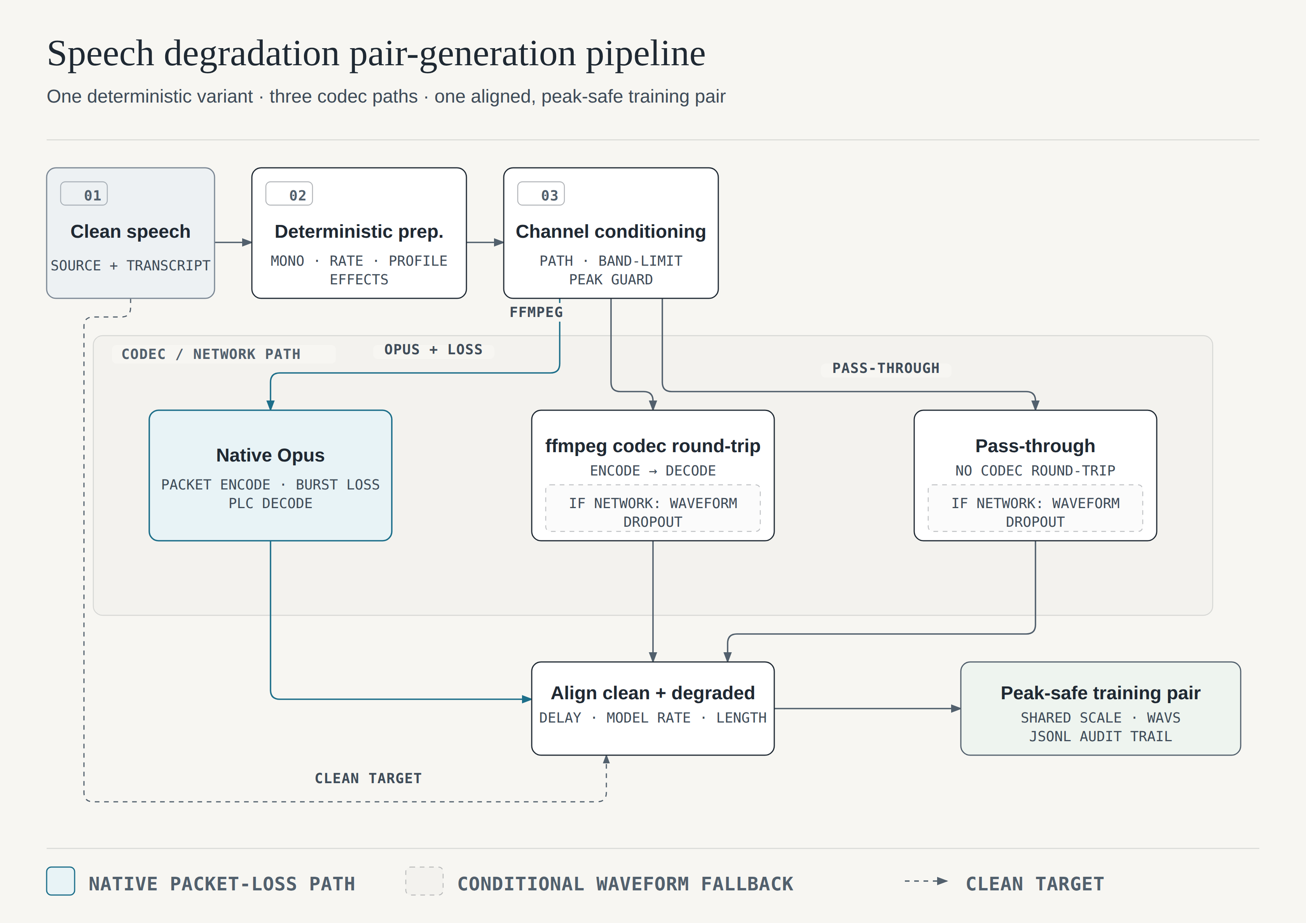
SUPPLEMENTARY EVIDENCE
Telecom simulator architecture
POUYA FALLAH SICHANI
28 / 30
Notes:
Complete source diagram. Native Opus applies packet-level loss and PLC. Other codec paths use real FFmpeg round-trips and optionally approximate network loss through waveform dropout. The aligned clean target has matched bandwidth.
Sources: /home/mint/MS-Thesis/Thesis/chapters/work.tex; /home/mint/MS-Thesis/Thesis/figs/degradation-pipeline-architecture.png
Backup slide. Open during questions only.
Institutional branding: original university logo from Thesis/front/template/images/logo.pdf.

Slide 29
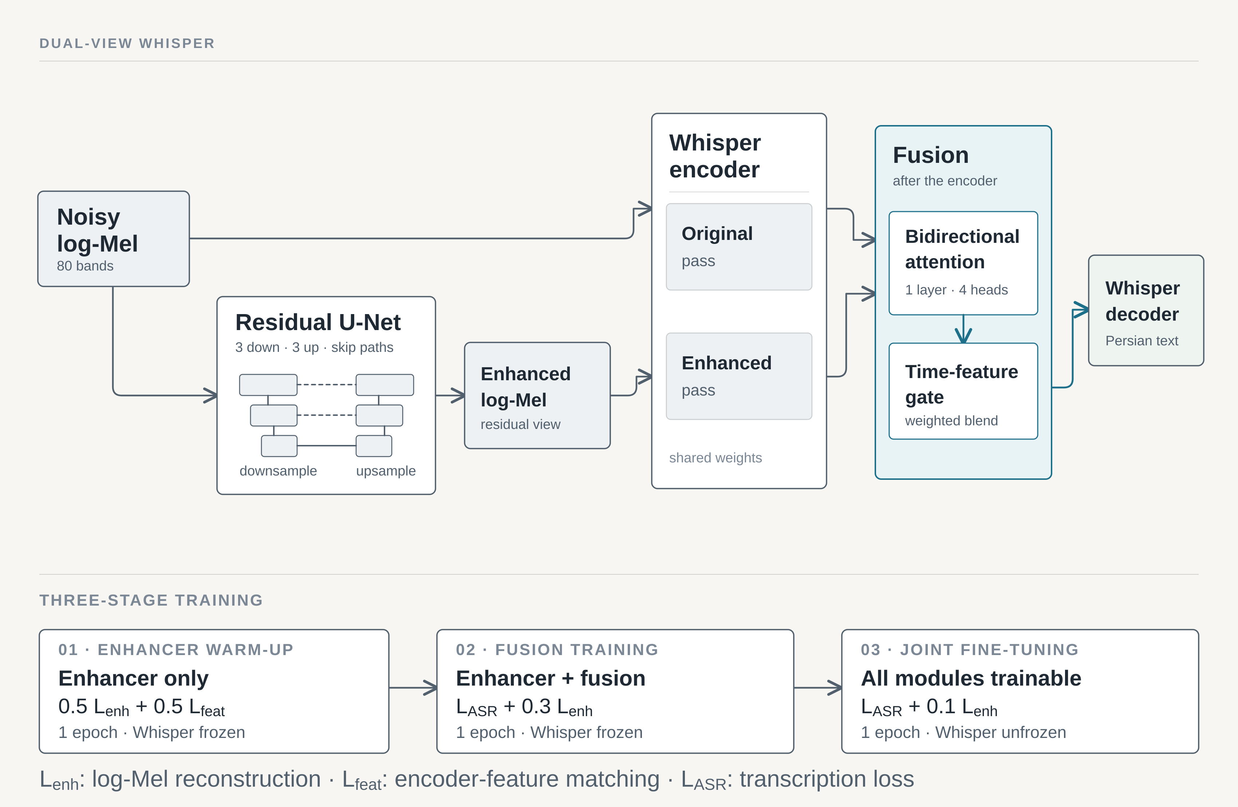
SUPPLEMENTARY EVIDENCE
Fusion architecture and training
POUYA FALLAH SICHANI
29 / 30
Notes:
Complete source diagram. Residual U-Net, shared encoder with two passes, bidirectional attention and a time-feature gate. The lower row gives the three training stages.
Sources: /home/mint/MS-Thesis/Thesis/chapters/work.tex; /home/mint/MS-Thesis/Thesis/figs/fusion-model-architecture-left-to-right.png
Backup slide. Open during questions only.
Institutional branding: original university logo from Thesis/front/template/images/logo.pdf.

Slide 30
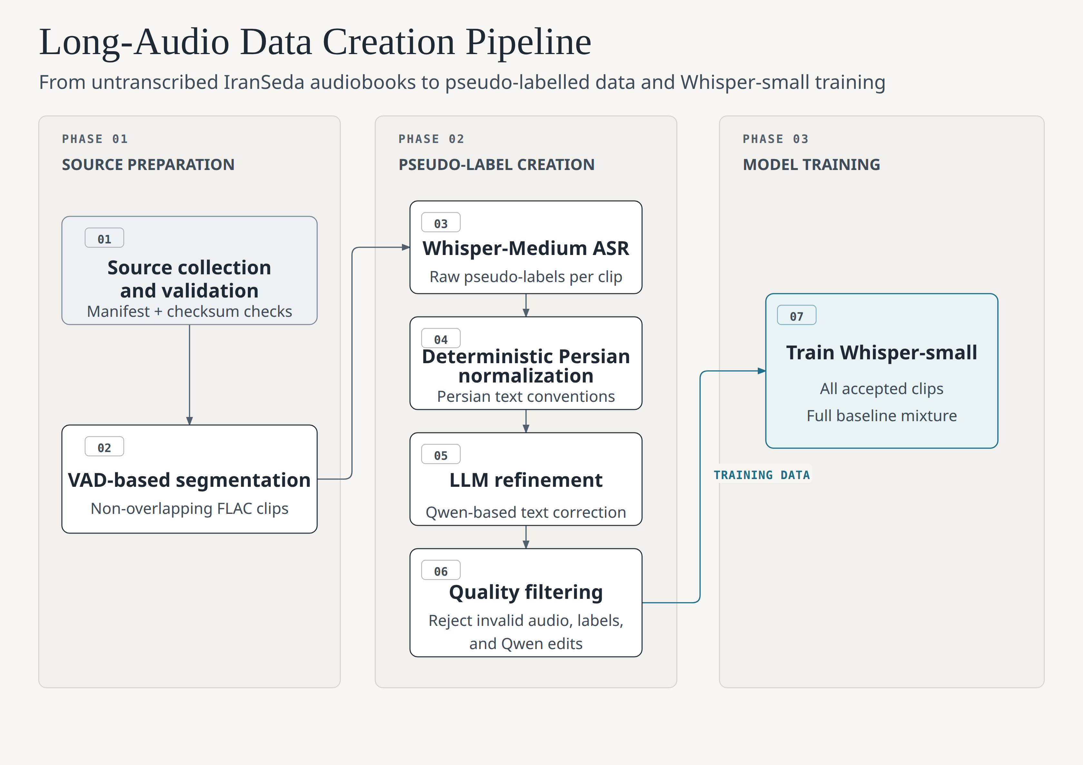
SUPPLEMENTARY EVIDENCE
Long-audio construction pipeline
POUYA FALLAH SICHANI
30 / 30
Notes:
Complete source diagram. Source validation, VAD segmentation, teacher transcription, normalization, constrained Qwen refinement and filtering. Accepted speech adds to the complete baseline mixture.
Sources: /home/mint/MS-Thesis/Thesis/chapters/work.tex; /home/mint/MS-Thesis/Thesis/figs/long-audio-data-creation-pipeline.png
Backup slide. Open during questions only.
Institutional branding: original university logo from Thesis/front/template/images/logo.pdf.

