Slide 1
Robust Speech Recognition in Persian Language
Adapting Whisper-small to Telephone and VoIP Degradations
Pouya Fallah Sichani
M.Sc. Thesis in Computer Engineering · Supervisor: Dr. Hosein Sameti
Sharif University of Technology · February 2026
Notes:
This thesis studies robust Persian automatic speech recognition under telephone and Voice over IP conditions. The central question is whether carefully simulated, traceable telecom degradations can reduce the mismatch between ordinary Persian speech data and real calls—and whether a more complex enhancement-and-fusion model improves further over a strong multi-condition baseline.

Slide 2
The Deployment Mismatch
Models usually see
Real calls may contain
Relatively clean, wideband speech
Environmental noise and gain variation
Short, read utterances
Telephone bandwidth restriction
Public speech corpora
domain shift
Codec artifacts and packet loss
Spontaneous, continuous speech
Takeaway: A Persian ASR model trained mainly on ordinary speech may lose substantial accuracy on real telephone and VoIP audio.
Robust Persian ASR · 2/19
Notes:
ASR accuracy depends not only on language and content, but also on how closely training conditions match deployment. This mismatch is especially important for Persian because public resources are more limited, while collecting and transcribing real calls is expensive and raises privacy and legal concerns. Controlled simulation is therefore attractive, but it must transfer to real—not only synthetic—channels.

Slide 3
Research Questions
Data strategy
Model strategy
1
3
Does adding synthetically degraded speech reduce Whisper-small error relative to ordinary fine-tuning?
Does fusing original and enhanced representations beat both ordinary and multi-condition Whisper?
2
4
Does this benefit transfer to real telephone and VoIP speech without a broad loss on general Persian speech?
Does the learned gate actually use both streams?
The evaluation was designed to allow a negative answer for the proposed fusion architecture.
Robust Persian ASR · 3/19
Notes:
The evaluation was deliberately designed to permit a negative answer for the proposed fusion architecture. The relevant comparison is not merely against ordinary Whisper, but against a simpler model exposed to the same degradation knowledge through multi-condition training.

Slide 4
Proposed Approach at a Glance
1. Unify Persian corpora
2. Generate traceable degradations
3. Train three systems
4. Evaluate synthetic-to-real transfer
Common TSV contract
16 kHz mono audio
Shared text normalization
Aligned clean–degraded pairs
Deterministic seeds
Metadata audit trail
Ordinary Whisper
Multi-condition Whisper
Dual-stream fusion
Five held-out test sets
Real AGFarsdat calls
General-domain checks
data contribution
model comparison
Narrative: domain mismatch → reproducible telecom simulation → three compared systems → results → interpretation and limitations
Robust Persian ASR · 4/19
Notes:
The method operates at three levels: consistent data preparation, reproducible telecom simulation, and model training. The main experimental logic is to first isolate the effect of degraded training data in a controlled single-stream comparison, then test whether a dual-stream enhancement pathway provides additional useful information.

Slide 5
Data: Training Diversity and Held-Out Evaluation
Training and validation
Dataset
Train
Validation
Role
Common Voice Persian 25
299,430
10,006
General speech + degradation source
FarsSpon (restricted)
600,672
6,044
Spontaneous Persian speech
FLEURS Persian
3,019
362
Read speech + domain diversity
Held-out test sets
not generated by our simulator
Test set
Evaluated samples
Main characteristic
AGFarsdat normalized
10,044
Real telephone and VoIP
Common Voice Persian 25
≈10,518
Crowdsourced general speech
FLEURS Persian
871
Multi-domain read speech
PersianSpeech
24
Small public Persian test set
Persian Speech Corpus
391–396
Out-of-domain Persian speech
AGFarsdat is the central application-domain test: real telephone/VoIP speech, not synthetic simulator output.
Robust Persian ASR · 5/19
Notes:
All datasets follow the same TSV contract and audio/text preprocessing. Longer variants were also produced by concatenating two to four clips into 5–20 second examples. AGFarsdat is the most important application-domain test because it contains real telephone and VoIP speech and was not used to generate synthetic training samples. Test counts can vary slightly when references exceed Whisper’s token limit.

Slide 6
Reproducible Paired-Data Generation
Degraded variant A
seed = f(1337, split,
source ID, variant ID)
Saved outputs
Clean
utterance
• new split TSV files
• degraded_to_clean.jsonl
• degradation_metadata.jsonl
• profile, codec, packet loss, delay, SNR, gain
Degraded variant B
independent degradation
same deterministic rule
Time-aligned pairs
Same channel target
Auditable metadata
Clean and degraded waveforms are matched in time and length.
Clean target uses the same channel bandwidth for narrowband paths.
Samples can be reproduced, grouped, and diagnosed by condition.
Robust Persian ASR · 6/19
Notes:
Randomness is controlled per sample, so changing processing order does not change a clip’s degradation. Codec delay is estimated and compensated, and pair lengths are aligned. For narrowband paths, the clean enhancement target is also band-limited; the enhancer is therefore not penalized for failing to reconstruct frequencies fundamentally removed by the channel.

Slide 7
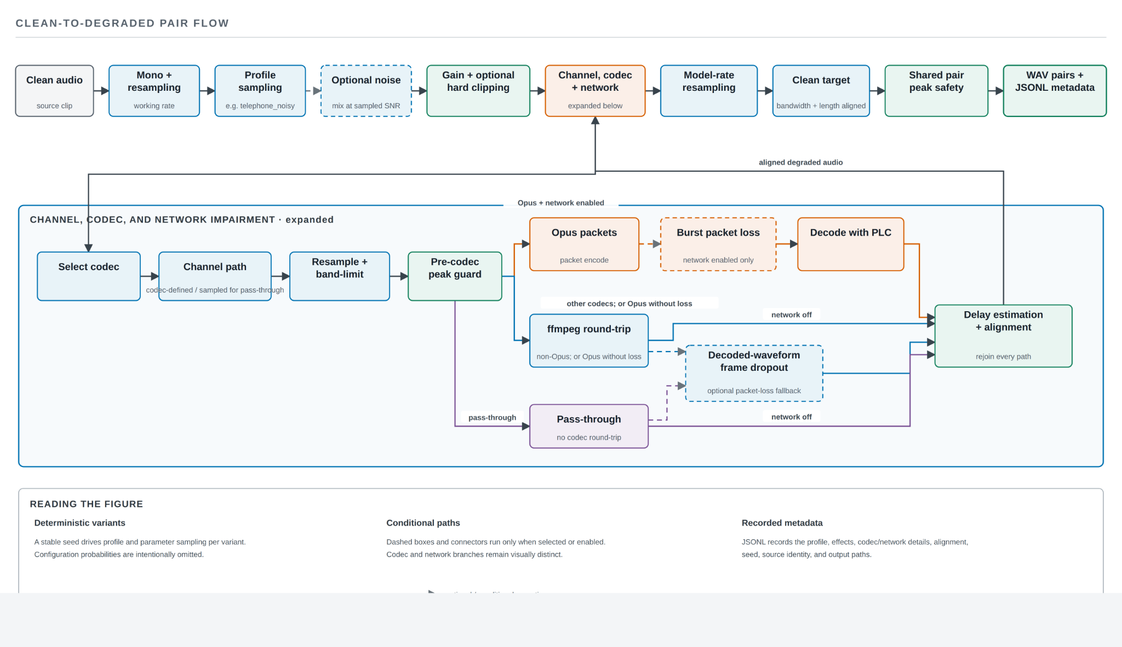
Telecom Degradation Pipeline
real FFmpeg codec round-trips
burst loss + Opus PLC
delay alignment + shared pair normalization
Robust Persian ASR · 7/19
Notes:
The order is intentional: noise and gain occur before channel and codec processing, while network impairment occurs after encoding. Supported codecs include G.711 A-law and μ-law, GSM, AMR-NB, AMR-WB, and narrowband or wideband Opus. Opus packets can be removed before decoding so the decoder’s own packet-loss concealment is exercised. For non-Opus codecs, decoded-waveform frame dropout is explicitly recorded as an approximation rather than exact network simulation.

Slide 8
Three Systems, One Key Controlled Comparison
System
Training input
Added architecture
Main question
Ordinary Whisper
Ordinary Persian + long variants
None
Language adaptation baseline
Multi-condition Whisper
Ordinary + long + degraded variants
None
Effect of degraded training data
Dual-stream fusion
Original and enhanced views
Enhancer + cross-attention + gate
Added value beyond multi-condition training
controlled data comparison
Ordinary vs. Multi-condition
Fusion comparison
Key baseline
Same seed, optimizer, evaluation data, and decoding setup.
Architecture and training schedule change, so the evidence is less tightly controlled.
The simpler multi-condition model is the benchmark the proposed model must beat.
Robust Persian ASR · 8/19
Notes:
Whisper-small was chosen to balance model capacity against the cost of multiple training runs. The ordinary and multi-condition systems are the cleanest causal comparison in the thesis. The fusion model changes both architecture and training schedule, so its comparison is informative but not as tightly controlled.

Slide 9
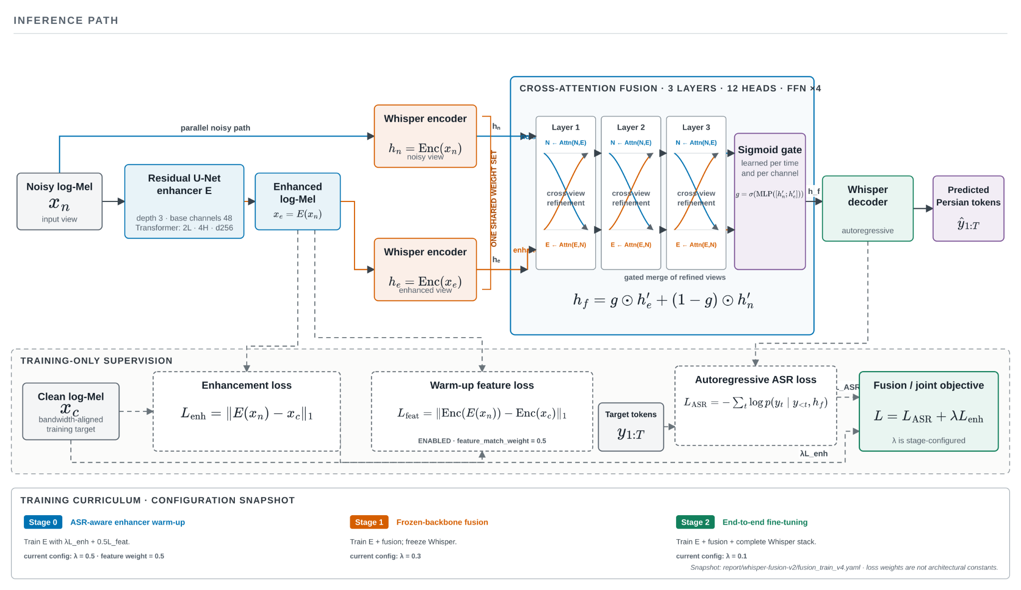
Dual-Stream Enhancement and Fusion
original + enhanced views
bidirectional cross-attention
time–feature sigmoid gate
Robust Persian ASR · 9/19
Notes:
Enhancement can remove noise but may also remove low-energy phonetic cues or introduce artifacts. The architecture therefore keeps the original representation rather than replacing it. Both views pass through a shared encoder, exchange information using bidirectional cross-attention, and are combined by a learned gate that can, in principle, select the more useful view at each time–feature location.

Slide 10
Three-Stage Training Strategy
1. Enhancer warm-up
2. Fusion / Whisper frozen
3. End-to-end joint training
Up to 20k steps
Reconstruction + encoder-feature guidance
Up to 30k steps
Train enhancer and fusion without destabilizing recognizer
Up to 120k steps
Optimize complete ASR system jointly
Whisper frozen
Whisper unlocked
Final run improvements over the first fusion run
Initialize from multi-condition Persian Whisper
Add a two-layer transformer at the enhancer bottleneck
Add encoder-feature matching during warm-up
Increase joint-training ceiling from 50k to 120k steps
Robust Persian ASR · 10/19
Notes:
The final fusion model was not simply a longer copy of the first run: several factors changed simultaneously. Consequently, the improvement between fusion versions cannot be attributed to one component. This distinction matters later when interpreting the development result.

Slide 11
Evaluation Protocol
Error rate
Shared evaluation setup
ER = (S + D + I) / N
WER: substitutions, deletions, and insertions over reference words
CER: the same operations over reference characters
Lower is better; the two metrics expose different error patterns
Greedy decoding and identical Persian text normalization
Five test sets covering general and real telecom speech
Single-stream models: 21,848 identical samples
Fusion model: 21,854 samples — six more, or 0.027% of the total
Caution: small fusion differences must not be presented as conclusive; no confidence intervals or significance tests were computed.
Robust Persian ASR · 11/19
Notes:
The two single-stream runs are fully paired. The fusion aggregate is not perfectly paired because it includes one additional Common Voice and five additional Persian Speech Corpus examples. This is a very small fraction, but it reinforces why small differences involving fusion must not be presented as conclusive. No confidence intervals or significance tests were computed.

Slide 12
Main Result: Multi-Condition Training Wins Overall
Aggregate error across all test sets · lower is better
25
System
WER
CER
WER change
23.27
Ordinary Whisper
23.27%
10.84%
—
20
18.44
17.83
Multi-condition Whisper
17.83%
7.93%
−5.44 pp
15
14.04
Dual-stream fusion
18.44%
14.04%
−4.82 pp
10.84
10
7.93
5
23.4% relative WER reduction
0
Multi-condition vs. ordinary
WER
CER
Ordinary
Multi-condition
Fusion
Key result: multi-condition training reduces WER by 5.44 percentage points and CER by 26.8% relative compared with ordinary Whisper.
Robust Persian ASR · 12/19
Notes:
This is the strongest result of the thesis. Adding degraded speech lowers aggregate WER from 23.27% to 17.83%—5.44 percentage points, or 23.4% relative. Because the single-stream runs use the same evaluation and optimization settings, this provides controlled evidence for multi-condition training. Fusion remains better than ordinary Whisper but is 0.62 percentage points worse than the multi-condition baseline and has substantially worse CER.

Slide 13
Synthetic Degradations Transfer to Real Calls
AGFarsdat: real telephone and VoIP speech · WER, lower is better
System
WER
Abs. change
40
35.63
Ordinary Whisper
35.63%
—
30
Multi-condition Whisper
25.80%
−9.83 pp
25.80
25.38
Dual-stream fusion
25.38%
−10.25 pp
20
27.6% relative WER reduction
10
Multi-condition training transfers to real calls; AGFarsdat was not produced by the simulator.
0
AGFarsdat
Fusion is 0.42 pp lower than multi-condition Whisper, but no statistical test supports a stable advantage.
Ordinary
Multi-condition
Fusion
Robust Persian ASR · 13/19
Notes:
AGFarsdat was not produced by the simulator, so this reduction is evidence that synthetic telecom diversity transferred to a real channel. Fusion achieves the lowest observed WER, but its advantage over multi-condition Whisper is only 0.42 percentage points and was not tested for significance. The defensible conclusion is that fusion preserves the multi-condition model’s target-domain performance with a small numerical improvement—not that it conclusively wins.

Slide 14
Robustness Is Domain-Dependent
WER by test set (%) · lower is better
AGFarsdat
35.6
Test set
Ord.
Multi
Fusion
25.8
AGFarsdat
35.63
25.80
25.38
25.4
Common Voice
11.5
Common Voice
11.52
7.84
9.06
7.8
FLEURS
21.05
19.82
19.61
9.1
21.1
PersianSpeech
34.53
35.25
31.18
FLEURS
19.8
19.6
Persian Speech Corpus
30.17
30.90
35.17
PersianSpeech
34.5
35.3
31.2
PersianSpeech has only n = 24 scored examples, so each sample has a large effect.
Persian Speech Corpus
30.2
30.9
35.2
0
10
20
30
40
Ordinary
Multi
Fusion
Interpretation: telecom robustness does not guarantee uniform cross-domain improvement.
Robust Persian ASR · 14/19
Notes:
Multi-condition training improves strongly on Common Voice and modestly on FLEURS, but not on PersianSpeech or the Persian Speech Corpus. PersianSpeech contains only 24 scored examples, so each sample has a large effect. On the Persian Speech Corpus, ordinary Whisper is best and fusion is worst. These results show that channel robustness and cross-domain generalization are related but not identical problems.

Slide 15
CER Exposes a Fusion Failure Mode
CER by test set (%) · lower is better
Test set
Ordinary
Multi-condition
Fusion
Key anomaly
AGFarsdat
19.73
12.62
12.38
Fusion reaches 9.06% WER but 16.08% CER on Common Voice.
Common Voice
4.06
3.22
16.08
FLEURS
6.13
6.36
6.23
Aggregate CER
Ordinary 10.84% · Multi-condition 7.93% · Fusion 14.04%
PersianSpeech
16.21
15.62
12.91
Persian Speech Corpus
15.48
15.22
21.07
Next diagnosis
Sample-level error decomposition is needed before attributing the cause.
WER alone gives an incomplete assessment: fusion improves or matches target-domain CER but fails badly on Common Voice and the Persian Speech Corpus.
Robust Persian ASR · 15/19
Notes:
Fusion performs competitively on AGFarsdat and PersianSpeech CER, but the aggregate CER is worse than both single-stream systems. The Common Voice divergence is particularly striking. Aggregate files alone cannot determine whether this comes from very long outputs, repeated characters, normalization issues, or another insertion/deletion pattern. Sample-level error decomposition is needed before claiming a cause.

Slide 16
The Learned Gate Collapsed to the Original Stream
Fusion development · lower WER/CER is better
28
Final gate allocation
24.35
21
18.44
99.61% original representation
15.46
14.04
14
0.39% enhanced
7
Gate collapse
0
The final model became more accurate while relying almost entirely on the original stream.
First run
Final run
WER
CER
Run
WER
CER
Enhanced
Original
First run
24.35%
15.46%
0.5154
0.4846
Final run
18.44%
14.04%
0.0039
0.9961
Robust Persian ASR · 16/19
Notes:
The final run improves WER by 5.90 percentage points over the first fusion run, but several changes were made simultaneously, so no single change receives causal credit. The gate’s mean and median are both near the same extreme, suggesting this is not driven by a few outliers. Still, gate weight alone does not prove that the enhancer contributes nothing, because cross-attention can exchange information before gating. Ablation studies are required.

Slide 17
What This Thesis Contributes
1. Traceable telecom data generation
2. Controlled evidence for robust Persian ASR
3. Honest evaluation of dual-stream fusion
Real codec round-trips, bandwidth limits, noise, gain, and packet loss
Multi-condition Whisper is a simple, strong baseline
Competitive target-domain WER, but no aggregate win
Deterministic seeds, aligned pairs, and auditable metadata
Synthetic degradations transfer to real AGFarsdat calls
CER anomaly and gate collapse reported as central findings
Takeaway: In this setting, data design and a fair baseline mattered more than added architectural complexity.
Robust Persian ASR · 17/19
Notes:
The contribution is not only a model. It is a reproducible data workflow, controlled empirical evidence that telecom-oriented augmentation helps Persian ASR, and an evaluation framework that tests a proposed architecture against the stronger baseline it must actually beat. The negative fusion findings narrow the next research questions rather than being hidden.

Slide 18
Limitations and Next Experiments
Current limitations
Highest-priority next experiments
One training seed per main configuration; no confidence intervals
Re-score identical sample lists; bootstrap confidence intervals; run multiple seeds
Fusion evaluation differs by six samples
Ablate original-only, enhanced-only, cross-attention, and forced/fixed gates
No WER/CER breakdown by codec, SNR, packet loss, or clip length
Analyze errors and gate weights by degradation condition
No SI-SDR, PESQ, STOI, listening test, latency, or memory measurements
Measure real-time factor, peak memory, and end-to-end latency
Simulator omits reverberation, echo, jitter, long dropouts, and overlapping speakers
Robust Persian ASR · 18/19
Notes:
The first priority is diagnostic evaluation, not immediate architectural expansion. A paired re-evaluation and confidence intervals would establish which differences are reliable. Ablations can then determine whether the enhanced stream, cross-attention, or gate contributes. Deployment decisions also require computational measurements because fusion runs the Whisper encoder for two views and adds enhancer and attention overhead.

Slide 19
Conclusion
Traceable telecom augmentation + multi-condition training was the most effective approach in the current experiments.
Aggregate WER
Real AGFarsdat WER
23.27% → 17.83%
35.63% → 25.80%
Fusion overall
Final gate
Competitive, but not better overall
99.61% original stream
Best current balance
Multi-condition Whisper-small: accuracy · simplicity · interpretability
Questions?
Robust Persian ASR · 19/19
Notes:
The final conclusion is deliberately simple: for robust Persian ASR under telephone and VoIP degradation, reproducible telecom-oriented augmentation and direct multi-condition training currently offer the strongest overall result. The fusion work remains useful because it produced a competitive model and exposed a concrete gate-collapse problem, but added complexity should be accepted only when it provides repeatable benefit over the strong baseline.

