Slide 1
Introduction to Machine Learning
By: Pooya Darvehei

Slide 2
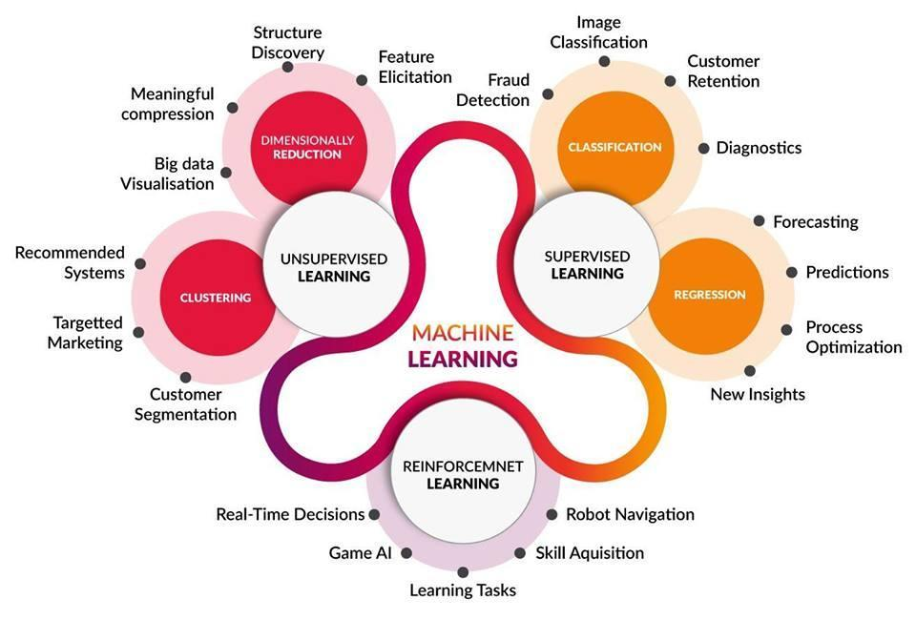

Slide 3
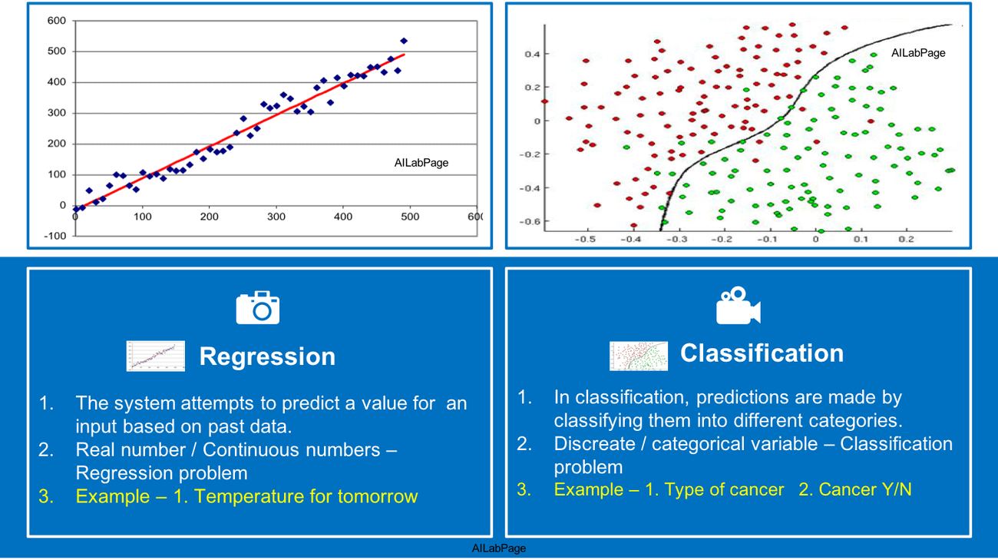
Supervised Learning

Slide 4
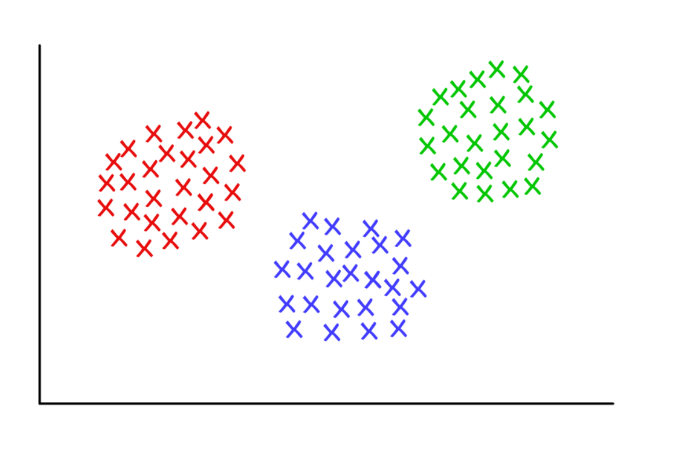
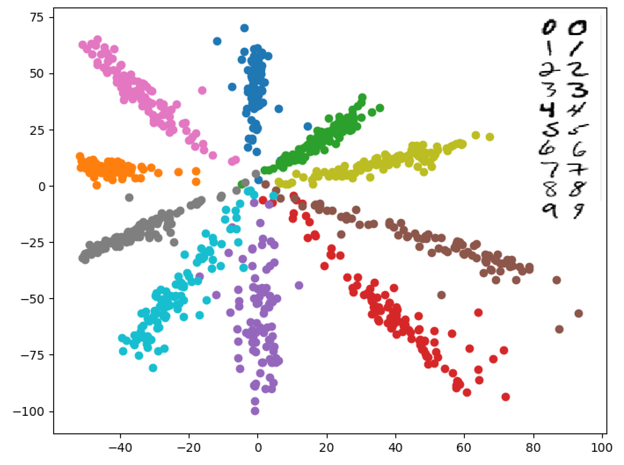
Unsupervised learning

Slide 5
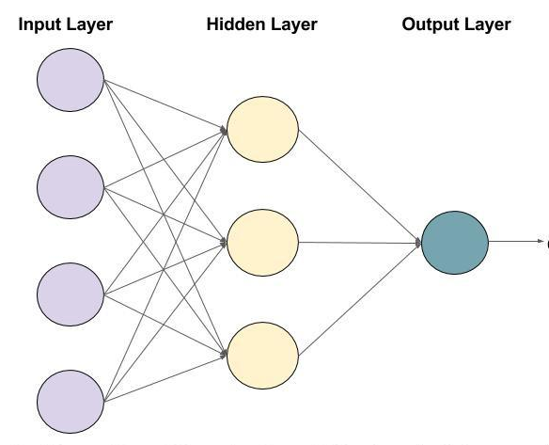
Artificial Neural Networks (ANN)
Inspired by biological neural networks.
The circles are called Neurons.
The arrows are called connections.
Each column of Neurons is called a layer.
Every Connection and Neuron represents a value.

Slide 6
Artificial Neural Networks (ANN)
The value in a Neuron is multiplied by the value of the Connection.
The output of all the connections that enter a Neuron is summed up.
An extra value (biase) is added to the summation.
The result is passed through an activation function.

Slide 7
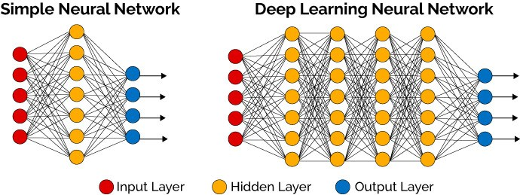
Deep Neural Networks (DNN)

Slide 8

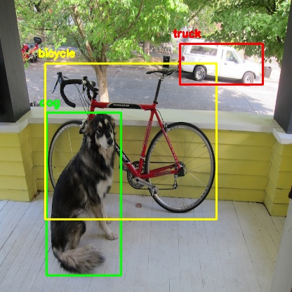
Applications
Tabular data
Computer Vision
Natural Language Processing
Time Series
Reinforcement Learning
Generative models

Slide 9
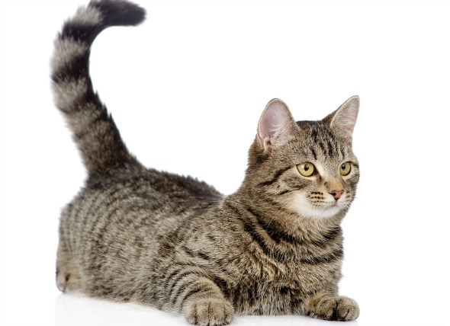
Computer Vision
We want to know the main subject in an image. How can a model do that?
This is one of the first problems computer vision had to deal with.
Image Classification

Slide 10
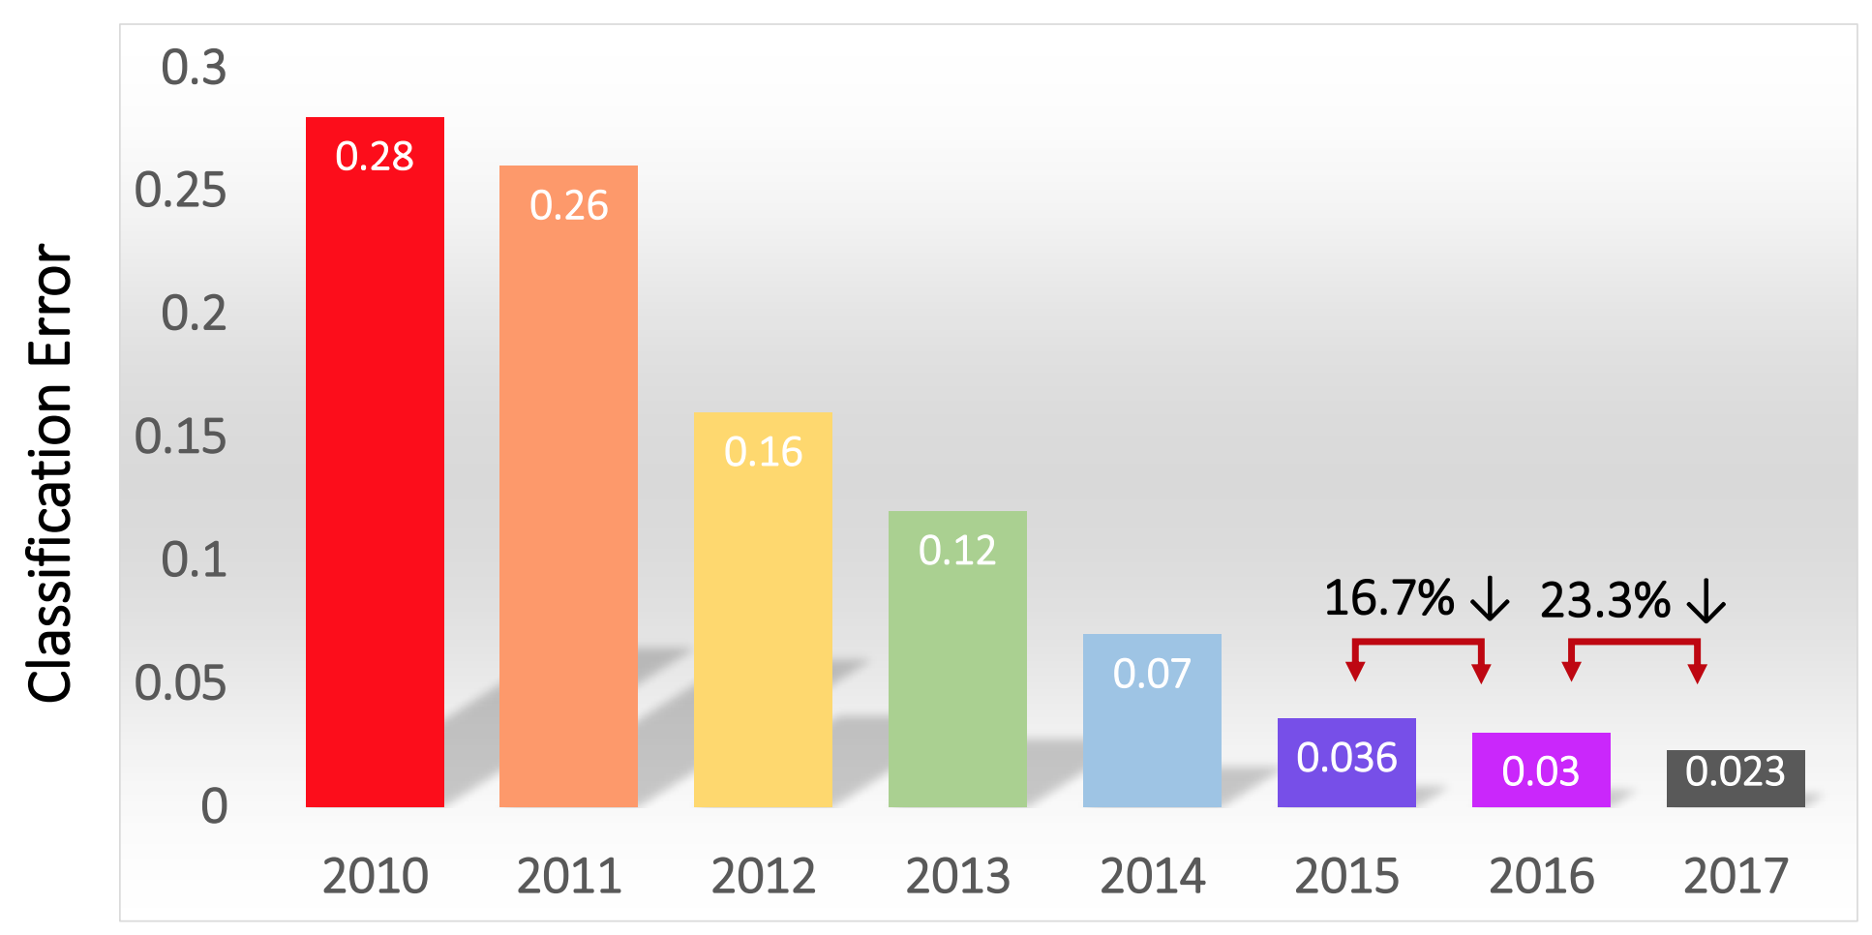
ImageNet Challenge
The goal is to successfully predict the object inside images. They used 1.4 million images of 1000 categories.
In 2012, a deep learning model called AlexNet won the competition.
In 2015, ResNet by Microsoft won the competition beating human performance.

Slide 11
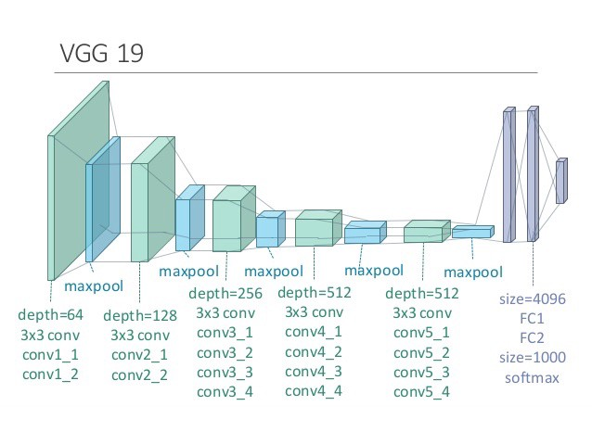
How does it work?
We have multi-layered (deep) neural network.
Each layer extracts specific features from the image.
The final layer uses the extracted features to decide what the main subject in the image is.

Slide 12
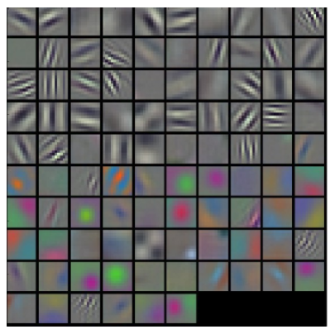
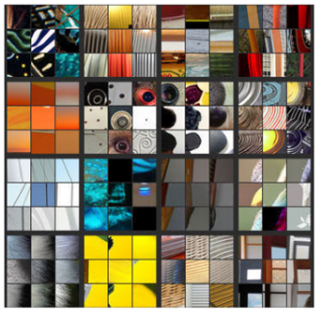
What are the features?

Slide 13
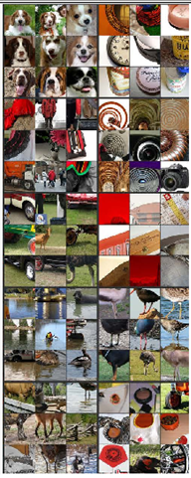
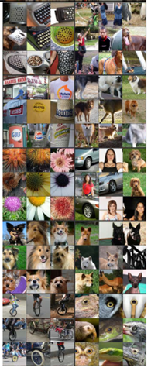
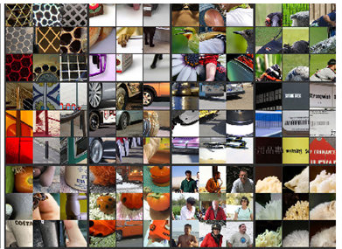
What are the features?

Slide 14
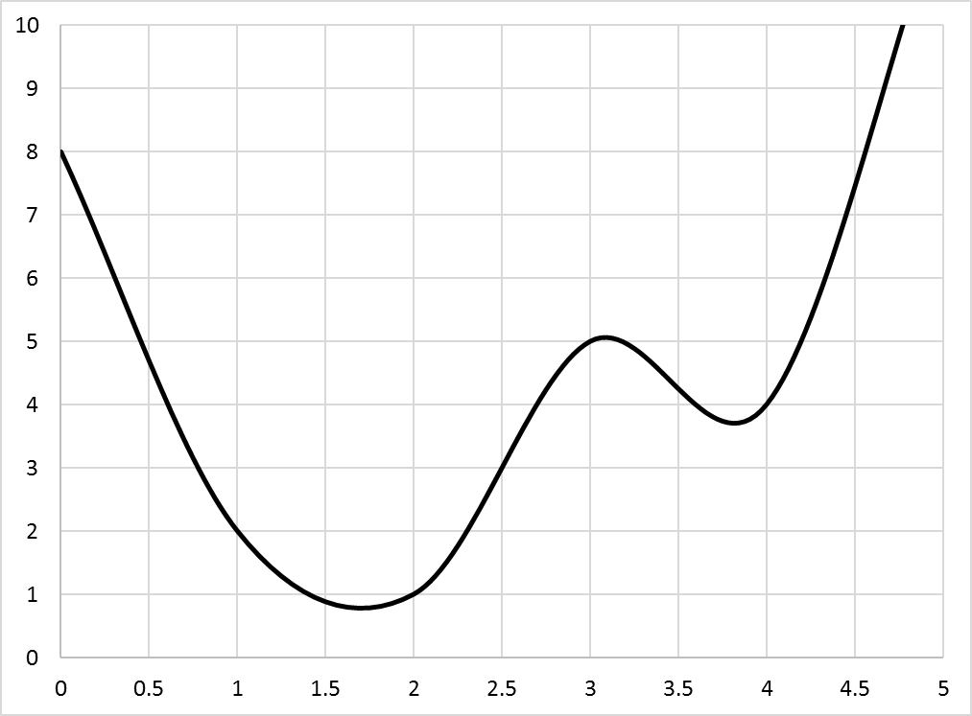
Loss function
It shows us how close the model’s predictions are to the actual value.
We try to find a set of variables (weights) that have the lowest loss.
When we have millions of variables, finding the optimum set becomes challenging.
We use various algorithms (optimisers) to find the best solution.

Slide 15
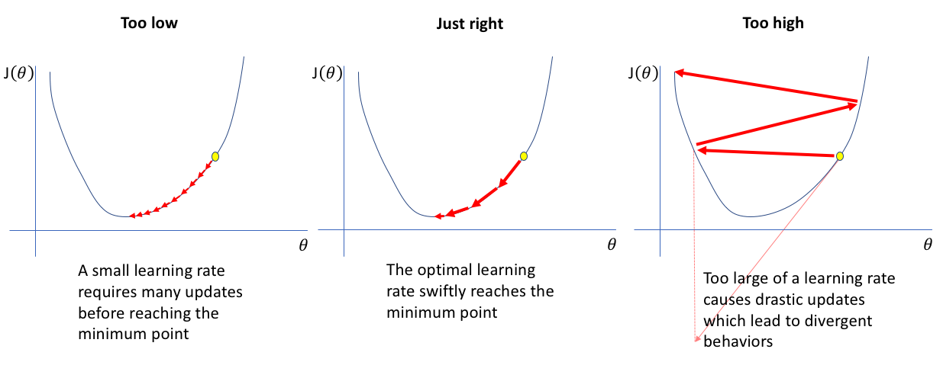
Learning Rate
Learning rate is value which tells the optimiser how fast it should move towards the solution.

