Slide 1




FlightTracker
database project
Gate 1
Arthur Popov
Gate 2
Jakub Samulski
Gate 3
Alina Sukhoverkova

Slide 2



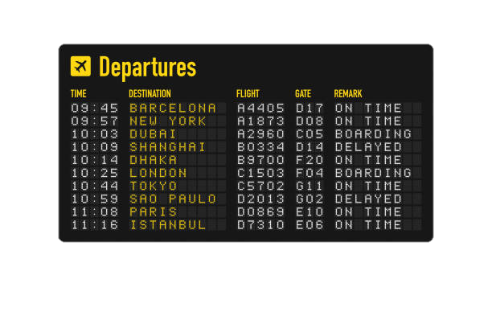


background & objectives
Why this topic?
• Air travel is essential in today's global world
• Millions of flights occur daily
• Reliable systems are needed to track, manage, and analyze flight data
Our Objective
To design a functional, normalized database system that stores, organizes, and queries flight-related data

Slide 3






requirements & features
Main Features:
• Store flight details: time, aircraft, status, airports
• Retrieve airline & aircraft info
• Support detailed search queries (flight number, route, delay status)
Target Users:
• Everyday travelers
• People searching for flights with full info
• Travel apps or price aggregators

Slide 4
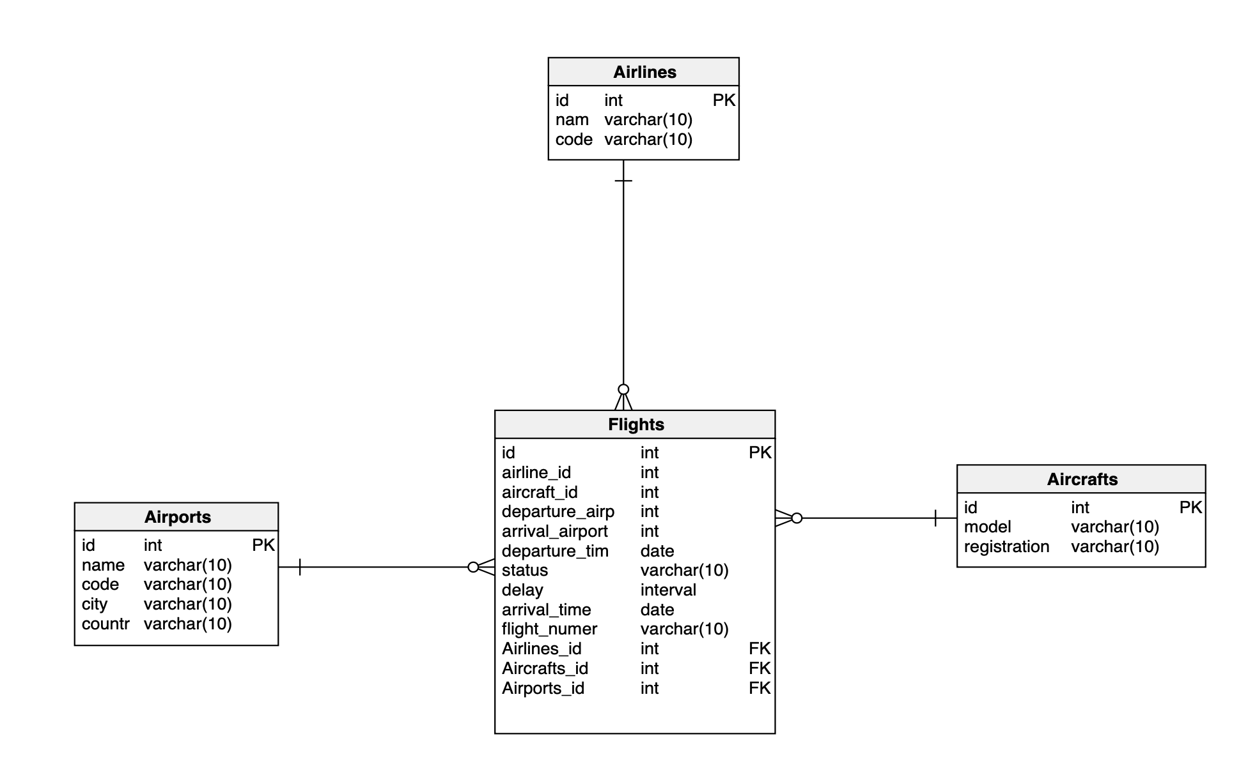
PDM database model
4 main tables:
• Flights is the central entity, referencing Airlines, Aircrafts, and Airports
• Airports are linked twice — as departure and arrival locations
• The schema is normalized and designed to allow flexible querying of flights and related data

Slide 5



Stack
database project
FastAPI
React JS
PostgreSQL

Slide 6

Database

Slide 7
CREATE TABLE Airlines ( id SERIAL PRIMARY KEY, nam VARCHAR(40), code VARCHAR(20) ); CREATE TABLE Aircrafts ( id SERIAL PRIMARY KEY, model VARCHAR(20), registration VARCHAR(20) ); CREATE TABLE Airports ( id SERIAL PRIMARY KEY, name VARCHAR(40), code VARCHAR(20), city VARCHAR(20), country VARCHAR(20) );
Tables
CREATE TABLE Flights ( id SERIAL PRIMARY KEY, airline_id INT REFERENCES Airlines (id), aircraft_id INT REFERENCES Aircrafts (id), departure_airport INT REFERENCES Airports (id), arrival_airport INT REFERENCES Airports (id), departure_time TIMESTAMP, status VARCHAR(20), delay INTERVAL, arrival_time TIMESTAMP, flight_number VARCHAR(20) );

Slide 8
Sequence
CREATE SEQUENCE flight_id_seq START WITH 1000 INCREMENT BY 1 NO MINVALUE NO MAXVALUE CACHE 1; ALTER TABLE Flights ALTER COLUMN id SET DEFAULT nextval('flight_id_seq');

Slide 9
Function
CREATE OR REPLACE FUNCTION get_flight_duration(flight_id INT) RETURNS INTERVAL STABLE AS $$ DECLARE duration INTERVAL; BEGIN SELECT (arrival_time - departure_time + delay) INTO duration FROM Flights WHERE id = flight_id; RETURN duration; END; $$ LANGUAGE plpgsql;

Slide 10
View
CREATE VIEW flight_view AS SELECT f.id AS flight_id, f.flight_number, … f.status, f.delay, get_flight_duration(f.id) AS duration_with_delay FROM Flights f JOIN Airlines a ON f.airline_id = a.id …

Slide 11
Trigger
CREATE OR REPLACE FUNCTION log_flight_status_change() RETURNS TRIGGER AS $$ BEGIN IF OLD.status IS DISTINCT FROM NEW.status THEN INSERT INTO FlightStatusLog(flight_id, old_status, new_status) VALUES (OLD.id, OLD.status, NEW.status); END IF; RETURN NEW; END; $$ LANGUAGE plpgsql; CREATE TRIGGER trg_flight_status_change AFTER UPDATE ON Flights FOR EACH ROW WHEN (OLD.status IS DISTINCT FROM NEW.status) EXECUTE FUNCTION log_flight_status_change();
CREATE TABLE FlightStatusLog ( id SERIAL PRIMARY KEY, flight_id INT, old_status VARCHAR(20), new_status VARCHAR(20), changed_at TIMESTAMP DEFAULT now() );

Slide 12
API

Slide 13
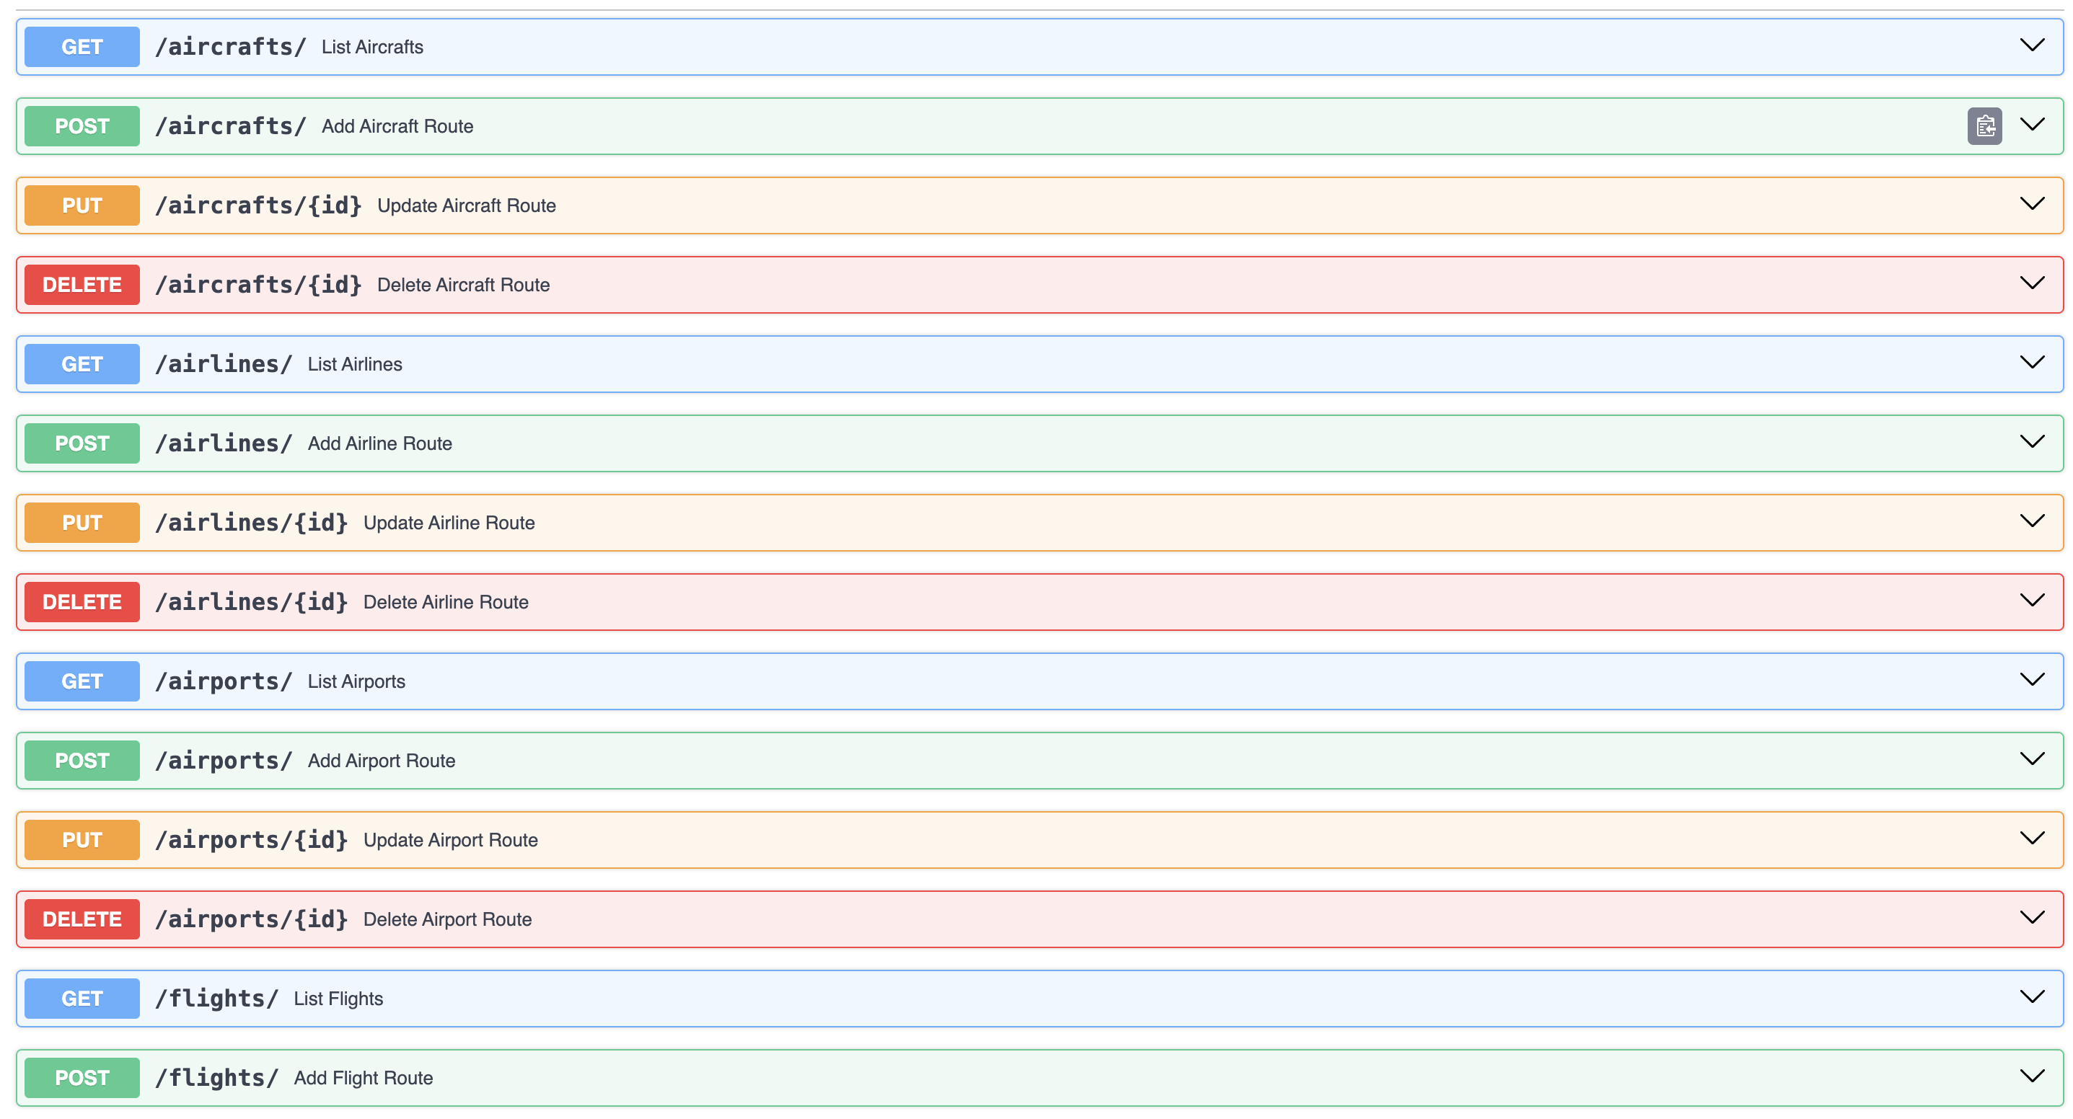

Slide 14
WEB

Slide 15
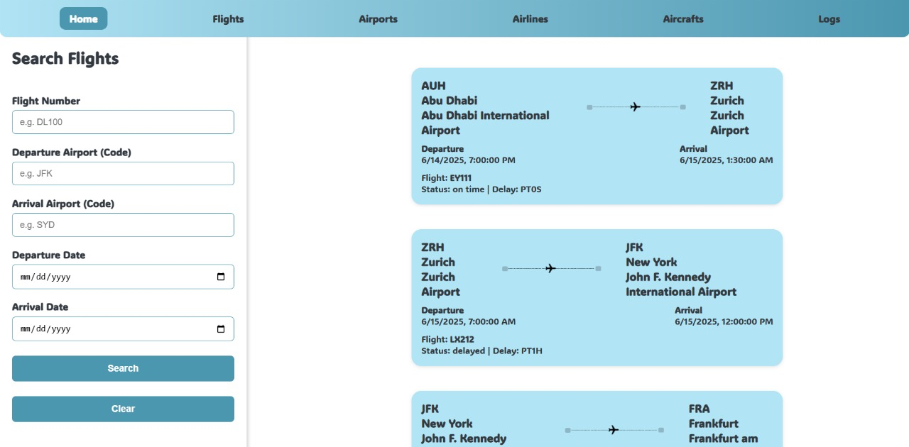

Slide 16
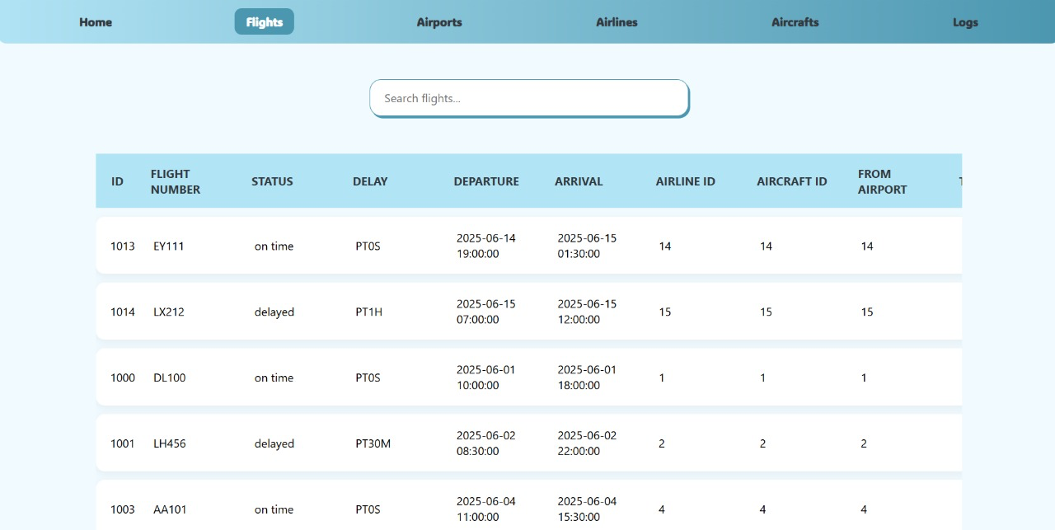

Slide 17
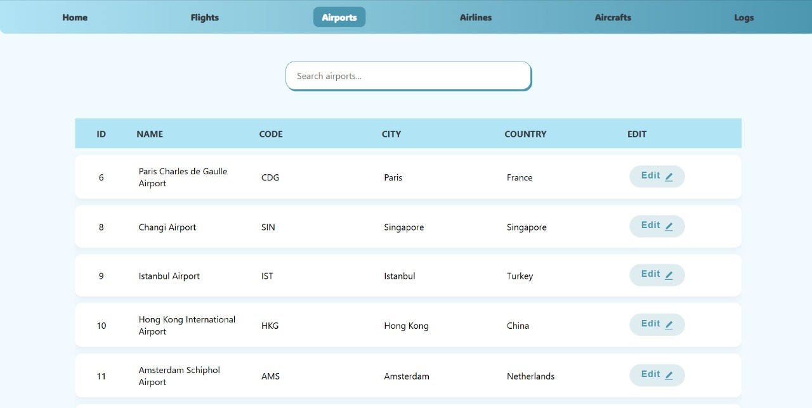

Slide 18
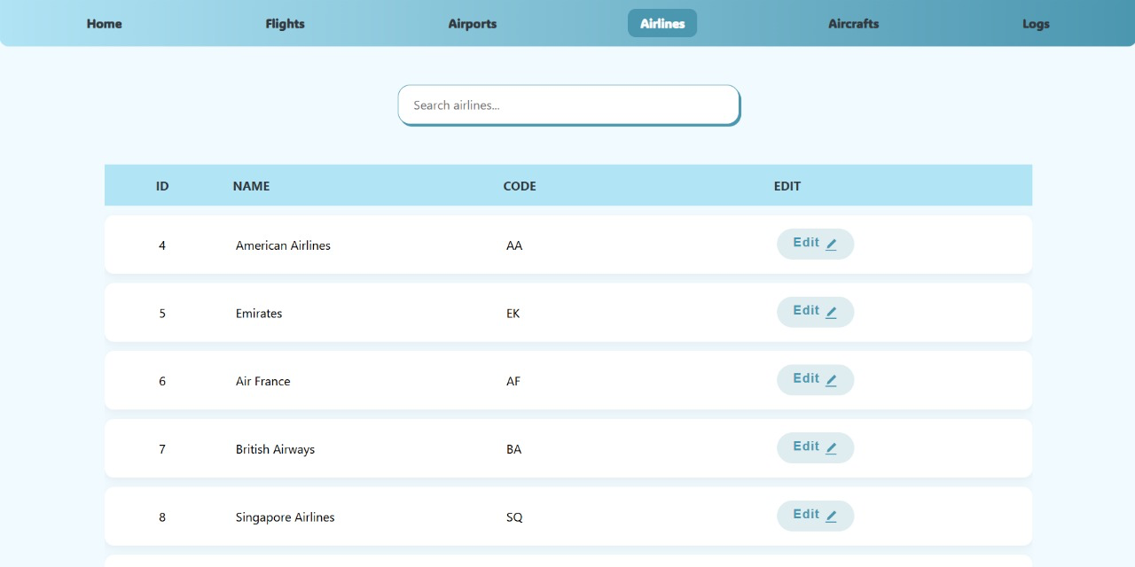

Slide 19
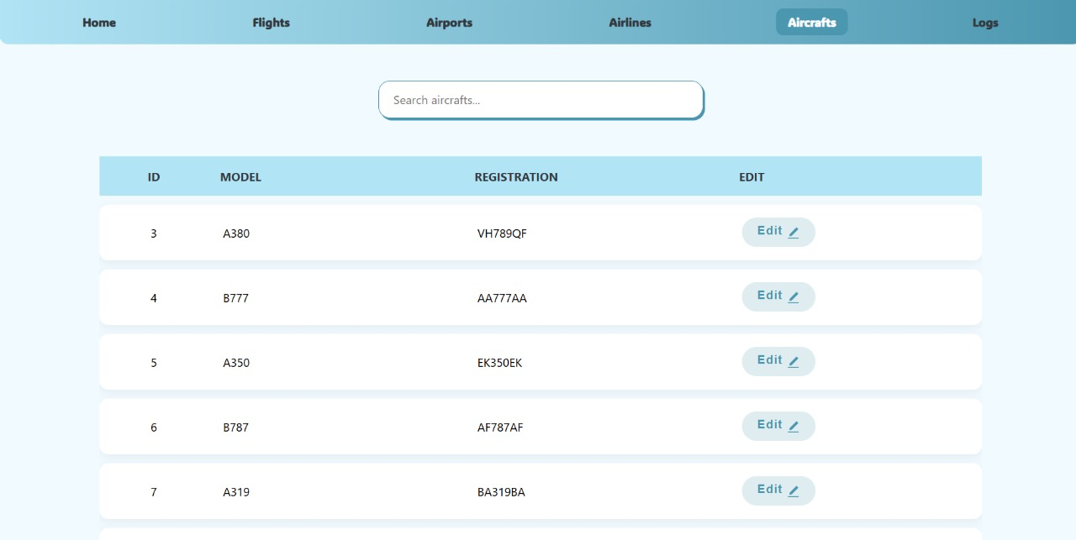

Slide 20
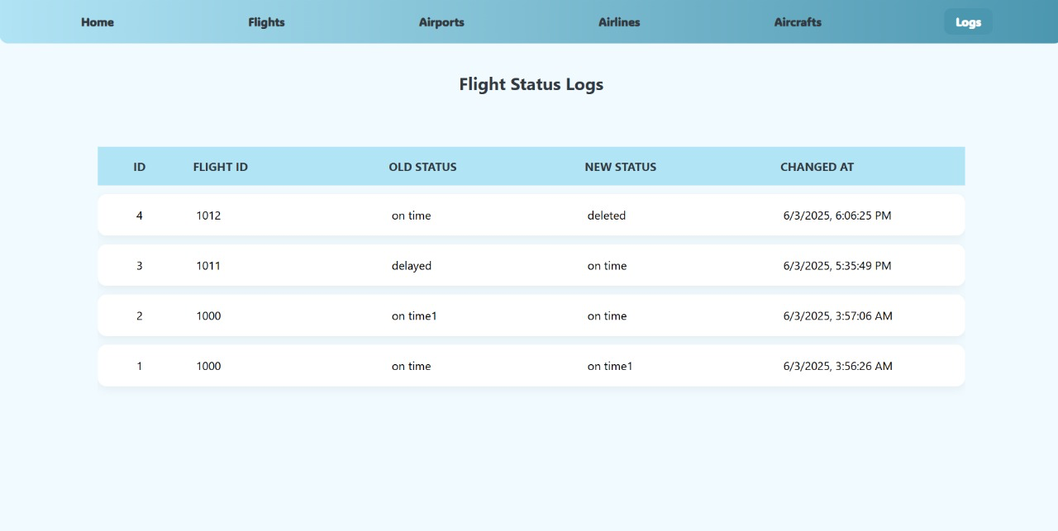

Slide 21
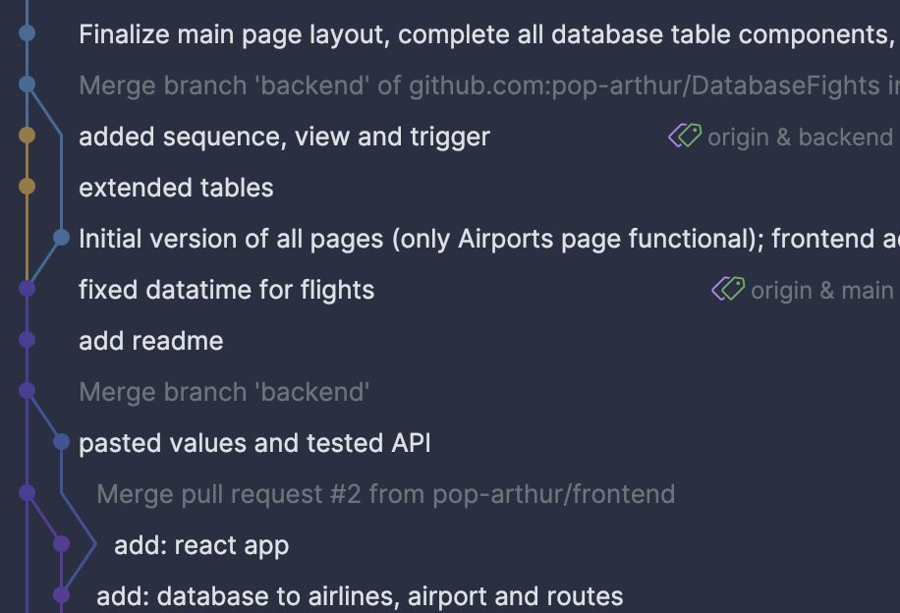
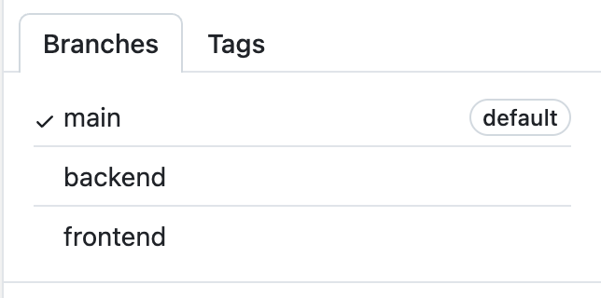
Github
https://github.com/pop-arthur/DatabaseFights

Slide 22
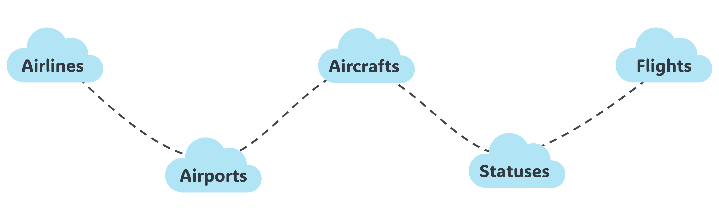
conclusion
• FlightTracker is a clean, well-structured database that connects flights, airlines, airports, aircrafts, and statuses
• Database models show clear relationships and normalized data — ready for real queries and simple app integration
• We’re excited to turn this into a working flight info tool!

Slide 23

goodbye
Thank you!!
We are ready for your questions

