Slide 1




FlightTracker
database project
Gate 1
Arthur Popov
Gate 2
Jakub Samulski
Gate 3
Alina Sukhoverkova

Slide 2



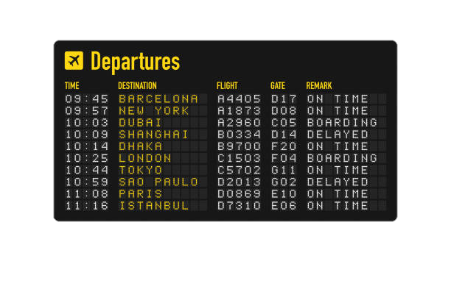


background & objectives
Why this topic?
• Air travel is essential in today's global world
• Millions of flights occur daily
• Reliable systems are needed to track, manage, and analyze flight data
Our Objective
To design a functional, normalized database system that stores, organizes, and queries flight-related data

Slide 3






requirements & features
Main Features:
• Store flight details: time, aircraft, status, airports
• Retrieve airline & aircraft info
• Support detailed search queries (flight number, route, delay status)
Target Users:
• Everyday travelers
• People searching for flights with full info
• Travel apps or price aggregators

Slide 4
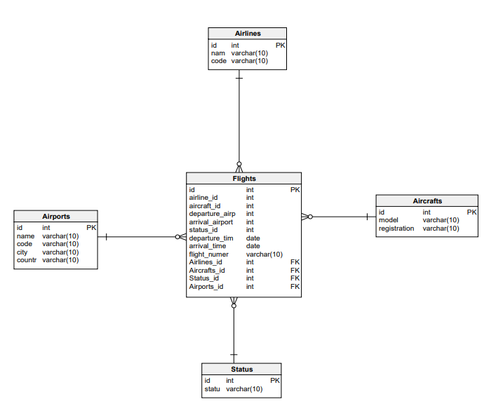
PDM database model
5 main tables:
• Flights is the central entity, referencing Airlines, Aircrafts, Status, and Airports
• Airports are linked twice — as departure and arrival locations
• The schema is normalized and designed to allow flexible querying of flights and related data

Slide 5
database description
Small but realistic simulation of a flight tracking system
Airlines
Aircrafts
Flights
Airports
Statuses
The data is synthetic but follows real-world formats: flight numbers, IATA codes, timestamps
Perfect for testing queries and building a simple app

Slide 6

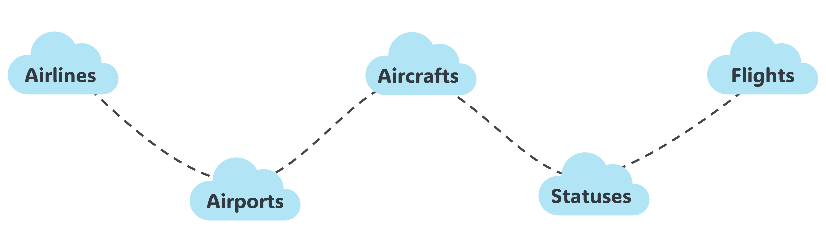
conclusion
• FlightTracker is a clean, well-structured database that connects flights, airlines, airports, aircrafts, and statuses
• database models show clear relationships and normalized data — ready for real queries and simple app integration
• We’re excited to turn this into a working flight info tool!

Slide 7

goodbye
Thank you!!
We are ready for your questions

