Slide 1
Smart curtain opener
Solo innovator project
Peter Kapsiar

Slide 2
Problem
Wanting to improve sleep habits
 | Pros | Cons
curtains closed | Deeper sleep | No natural wake up cue
curtains open | Wake up naturally to sunlight | Too much light pollution from outside

Slide 3
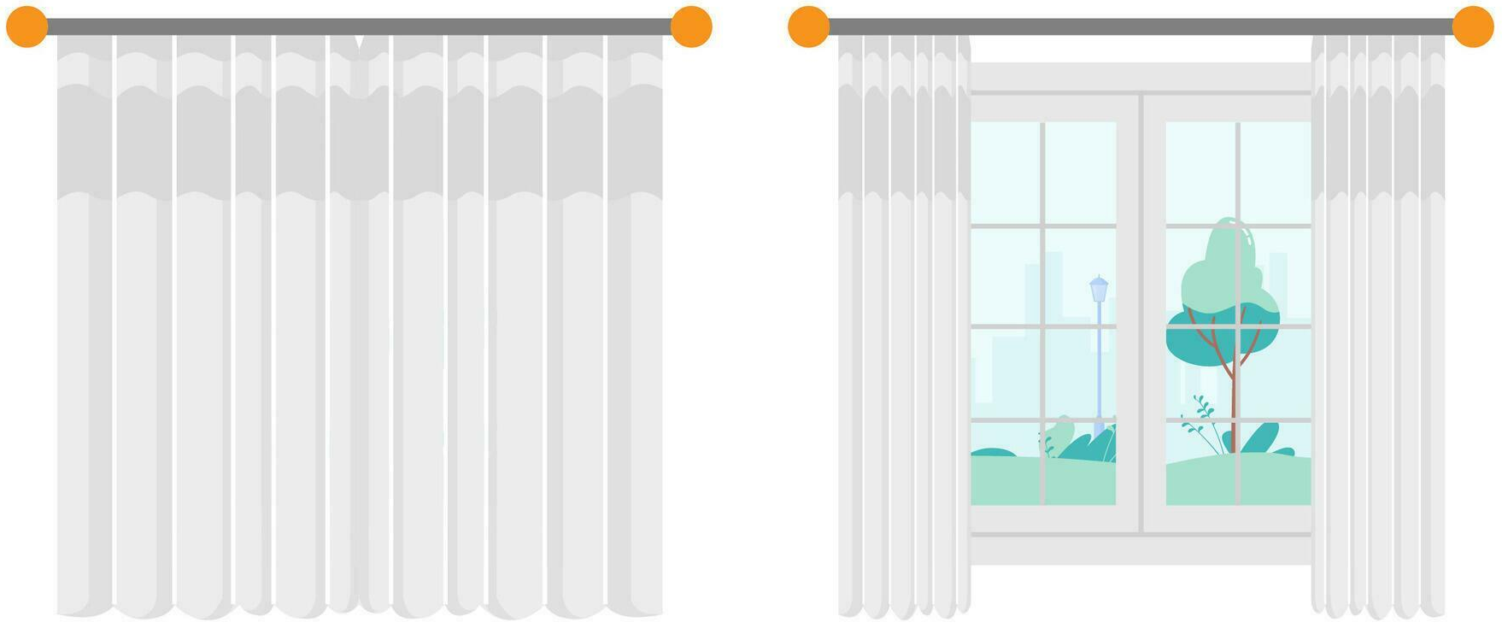
Solution
Automatic opener mechanism
Closing
Opening

Slide 4
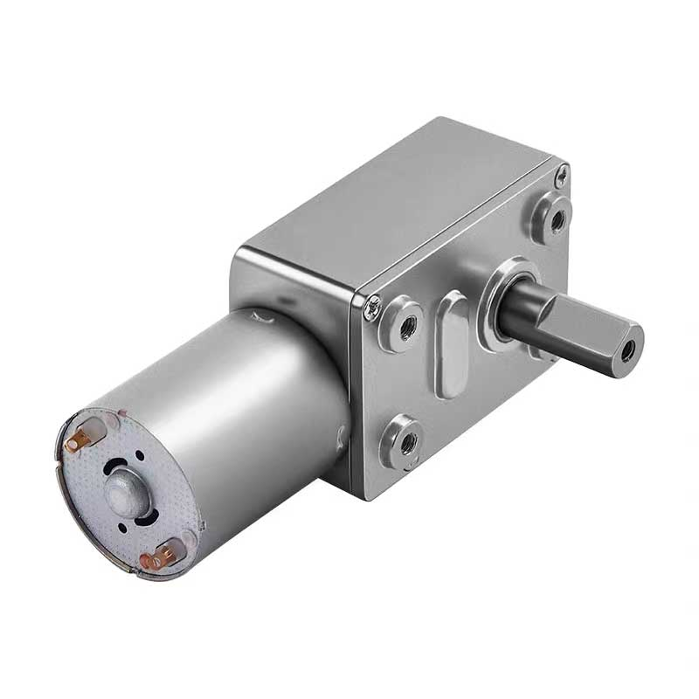
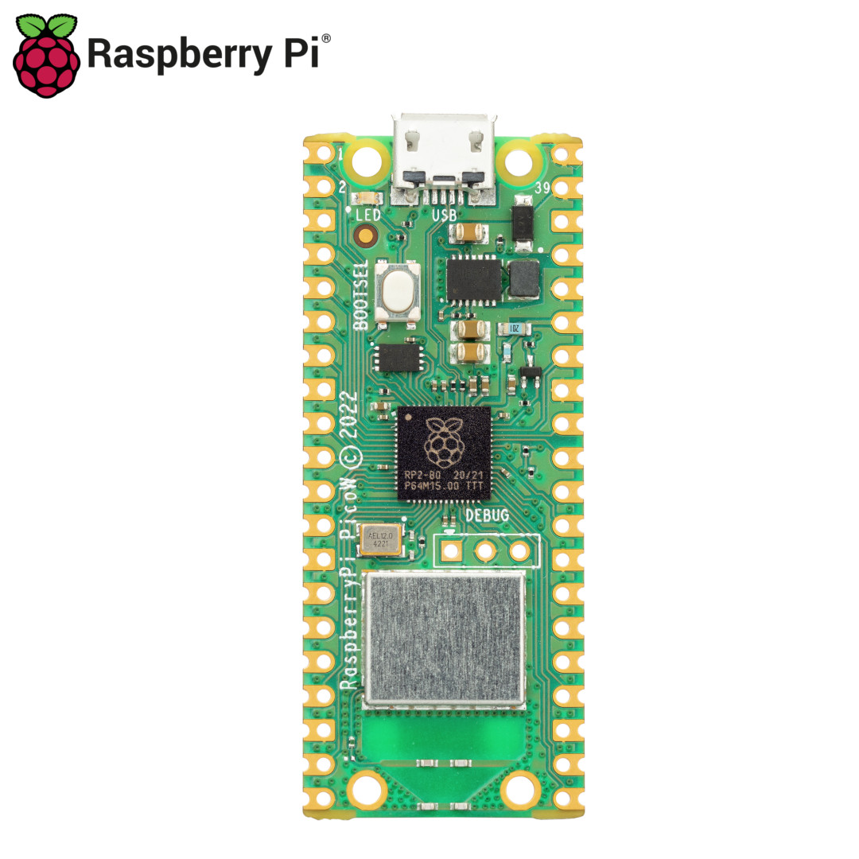
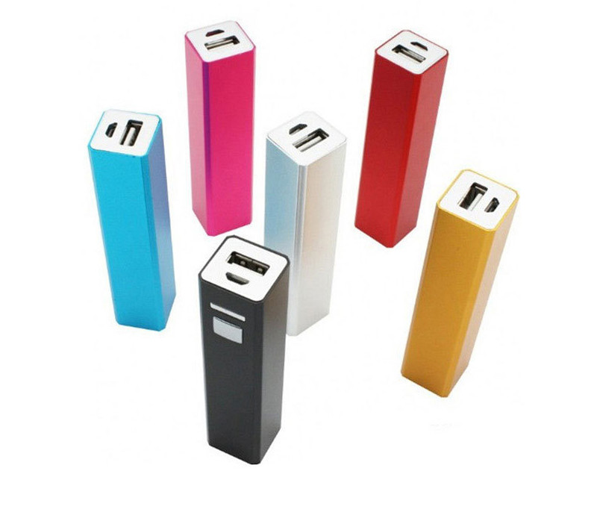
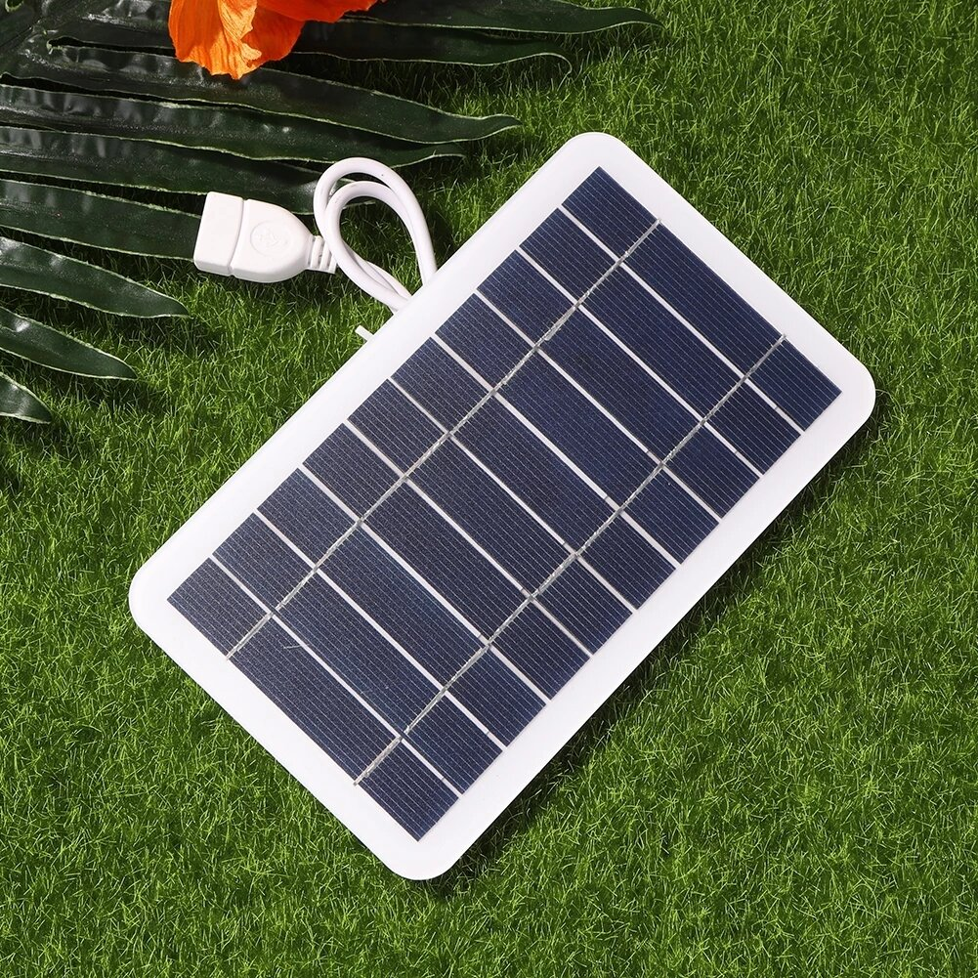
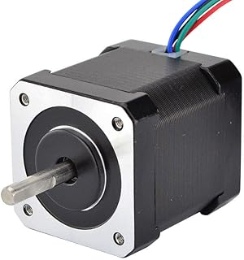
Other components
OR

Slide 5
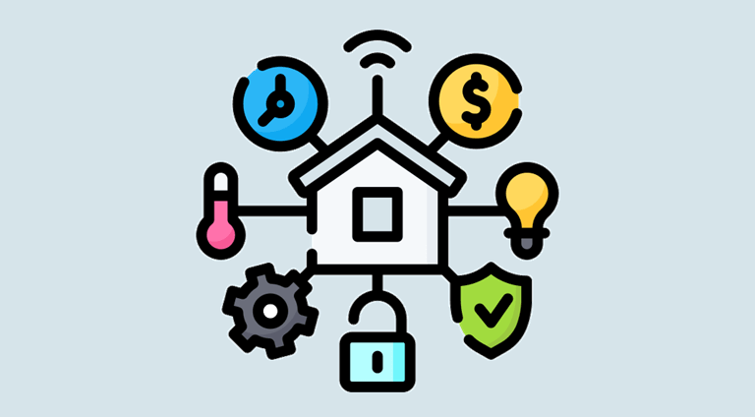
Control
Manual trigger
API
Smart home integration

Slide 6
Thank you

