Slide 1
Spryker - E-commerce and Marketplace Solution

Slide 2
What is Spryker?
Spryker is a modular commerce platform that offers a range of e-commerce and marketplace solutions. It provides a flexible and customizable architecture, empowering businesses to build and scale their online presence.

Slide 3
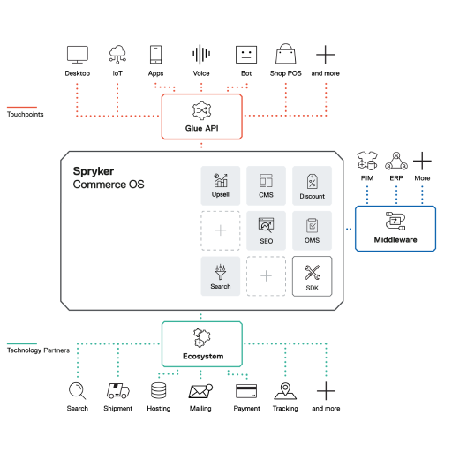
Spryker Architecture

Slide 4
Spryker Modules
Module 1: Description
Module 2: Description
Module 3: Description

Slide 5
E-commerce Capabilities
Capability 1: Description
Capability 2: Description
Capability 3: Description

Slide 6
Marketplace Capabilities
Capability 1: Description
Capability 2: Description
Capability 3: Description

Slide 7
Customization and Flexibility
Customization option 1: Description
Customization option 2: Description
Customization option 3: Description

Slide 8
Integrations and Extensions
Integration 1: Description
Integration 2: Description
Integration 3: Description

Slide 9
Spryker Back Office
Spryker Back Office: Description

Slide 10
Performance and Scalability
Performance: Description
Scalability: Description

Slide 11
Case Studies
Case Study 1: Description
Case Study 2: Description
Case Study 3: Description

Slide 12
Spryker's Professional Services
Service 1: Description
Service 2: Description
Service 3: Description

Slide 13
Spryker Community
Community: Description

Slide 14
Pricing and Licensing
Pricing: Description
Licensing: Description

Slide 15
Conclusion

