Slide 1
Spryker as an eCommerce and Marketplace Solution

Slide 2
About Spryker
Spryker is a leading eCommerce and Marketplace solution that empowers businesses to build and scale their online presence. With its modular and flexible architecture, Spryker offers a comprehensive set of features and functionalities for successful online selling.

Slide 3
Key Features of Spryker
1. Modular Architecture: Spryker's modular architecture allows businesses to customize and extend their online store according to their specific needs.
2. Multi-channel Selling: Spryker supports multi-channel selling, enabling businesses to sell their products across various channels, including web, mobile, and marketplaces.
3. Marketplace Solution: Spryker provides robust marketplace functionality, allowing businesses to create and manage their own online marketplace.
4. Advanced Product Catalog: Spryker offers a powerful product catalog management system, making it easy to manage large catalogs with complex product hierarchies.

Slide 4
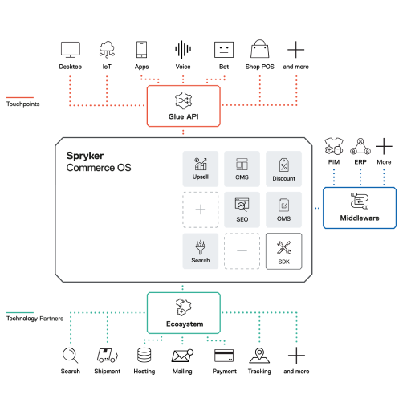
Spryker Architecture

Slide 5
Benefits of Spryker for eCommerce Businesses
1. Flexibility and Scalability: Spryker's modular architecture offers flexibility and scalability, allowing businesses to adapt and grow their online store as their needs evolve.
2. Enhanced Customer Experience: Spryker provides advanced features to deliver a seamless and personalized customer experience, resulting in higher customer satisfaction and repeat purchases.
3. Easy Integration: Spryker seamlessly integrates with various third-party systems and services, making it easy to connect and streamline business operations.
4. Powerful Analytics and Reporting: Spryker offers robust analytics and reporting capabilities, providing businesses with valuable insights to optimize their sales and marketing strategies.

Slide 6
Spryker as a Marketplace Solution
Spryker offers comprehensive marketplace functionality, allowing businesses to create and manage their own online marketplace. With Spryker, businesses can onboard third-party sellers, manage product listings, handle transactions, and ensure a smooth and secure marketplace experience.

Slide 7
Spryker's Integration Capabilities
Spryker integrates seamlessly with various third-party systems and services, including payment gateways, shipping providers, ERP systems, and marketing tools. This integration ecosystem enables businesses to streamline their operations and enhance their overall efficiency.

Slide 8
Spryker's Performance and Scalability
Spryker is built to deliver high performance and scalability. It can handle large product catalogs, high website traffic, and complex business operations without compromising speed and efficiency. This ensures a smooth and reliable online shopping experience for customers.

Slide 9
Spryker's Professional Services
Spryker offers a range of professional services to support businesses throughout their eCommerce journey. These services include consulting, implementation, customization, training, and ongoing support. The Spryker team ensures a successful and seamless implementation of the solution.

Slide 10
Customer Success Stories
Spryker has helped numerous businesses achieve success in their eCommerce journey. Here are a few customer success stories showcasing how Spryker empowered businesses to drive growth, increase sales, and deliver exceptional customer experiences.

Slide 11
Pricing and Licensing
Spryker offers flexible pricing and licensing options tailored to the specific needs of businesses. The pricing model includes licensing fees and additional costs based on the selected features, customization requirements, and professional services.

Slide 12
Conclusion

