Slide 1
Reasons for systems development
AS 1: APPROACHES TO SYSTEMS DEVELOPMENT · TOPIC
Lessons in this topic
AP01 Why develop new systems? Systems, the software crisis and the life cycle
AP02 User needs, time and cost: the feasibility study and the development team

Slide 2

Topic menu
Tap a button to jump straight there. The ☰ Menu button on every slide brings you back here.
Specification map
AP02 User needs, time and cost: the feasibility study and the development team
AP01 Why develop new systems? Systems, the software crisis and the life cycle

Slide 3
Specification map
Lesson | Specification: students should be able to
AP01 | Describe the characteristics of a system and explain how large systems are made up of sub-systems; Understand that a computer system consists of a user interface, processes and data, and explain the factors that affect the choice of user interface; Explain the reasons why an organisation may need to develop a new information system; Explain the impact of the software crisis and the emergence of software engineering; Describe the stages of the systems development life cycle (SDLC), the purpose of each stage and why a structured approach is used
AP02 | Explain the need for software systems that meet the needs of organisations and/or individuals; Explain the main factors affecting systems development: the user needs, time and cost; Describe the purpose of a feasibility study and explain technical, economic, legal, operational and schedule feasibility; Explain the use of a cost–benefit analysis and describe the content of a feasibility report; Describe the roles of the systems analyst, the project manager and the programmer during systems development
☰ Menu
Notes:
Each lesson below is its own section in PowerPoint (View → Slide Sorter shows them). To split this deck by specification point, right-click a section → Move Section, or delete the sections you do not need.

Slide 4
Why develop new systems? Systems, the software crisis and the life cycle
AS 1: APPROACHES TO SYSTEMS DEVELOPMENT · AP01
Learning objectives
Identify the purpose, need and components of a system, and break a large system into sub-systems
Describe the user interface, processes and data of a given computer system and justify a suitable interface
Explain internal and external reasons for developing a new system, applied to a context
Explain the causes and consequences of the software crisis and how software engineering responded
Describe each stage of the life cycle, what it produces and why a structured approach reduces risk
Notes:
Specification: Describe the characteristics of a system and explain how large systems are made up of sub-systems | Understand that a computer system consists of a user interface, processes and data, and explain the factors that affect the choice of user interface | Explain the reasons why an organisation may need to develop a new information system | Explain the impact of the software crisis and the emergence of software engineering | Describe the stages of the systems development life cycle (SDLC), the purpose of each stage and why a structured approach is used

Slide 5
In this lesson
Tap a button to jump straight there. The ☰ Menu button on every slide brings you back here.
The big picture
Why develop a new system?
Stages and their deliverables
What is a system?
Internal and external triggers
Why a structured approach matters
Breaking a large system into sub-systems
The software crisis
Worked example: Lakeland Boat Hire, Fermanagh
What a computer system does
Causes and consequences of the crisis
Exit quiz
Three elements: UI, processes and data
The response: software engineering
↑ Topic menu
Choosing a user interface
The systems development life cycle (SDLC)
Notes:
Lesson menu: each button jumps to that part of the lesson in Slide Show. The ☰ Menu button on each slide returns here.

Slide 6
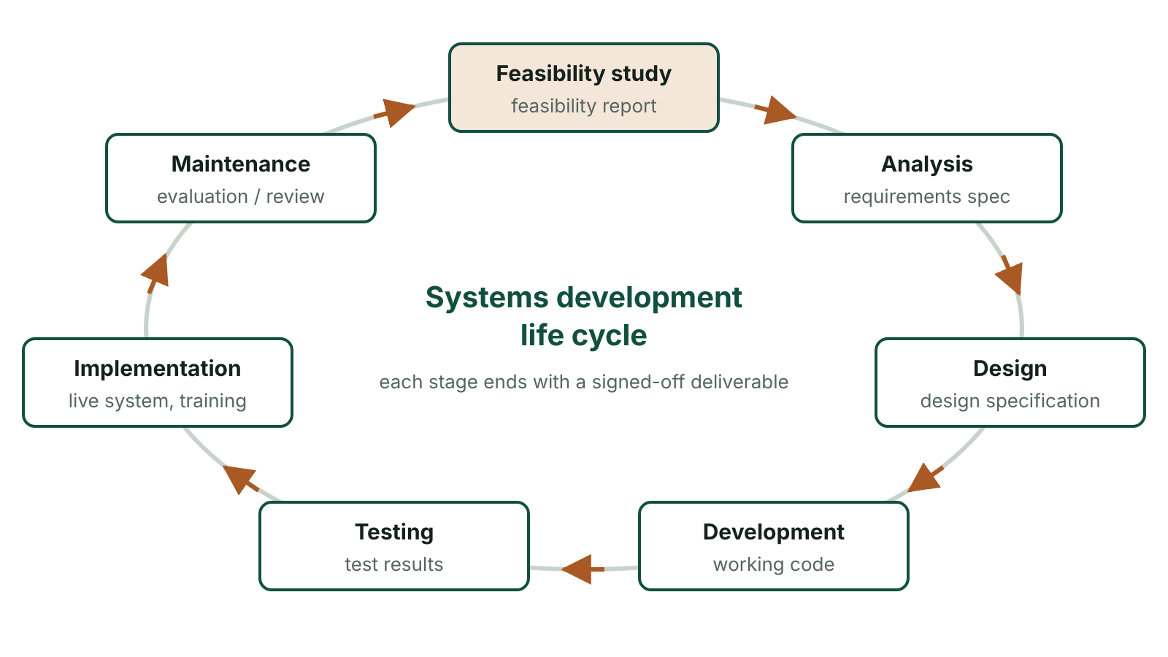
The big picture
The systems development life cycle: seven stages arranged in a cycle, each labelled with its main deliverable
☰ Menu
Notes:
Explain the diagram in your own words before you read on.

Slide 7
What is a system?
A system is a set of interdependent components working together to achieve a goal
Every system has a defined purpose: what it is for
Every system meets a defined need: the problem it solves for an organisation or individual
Every system has components that depend on each other: if one fails, others are affected
Systems may be natural (the water cycle), physical (a road network) or computer-based (online banking)
Systems development normally refers to systems with an element of computer processing
☰ Menu

Slide 8
Breaking a large system into sub-systems
Sub-system of a health trust's computer system | What it does
Patient administration | Registers patients and holds their contact and GP details
Appointments | Books outpatient clinics and sends text reminders
Pharmacy | Records prescriptions and controls drug stock
Theatre scheduling | Allocates operating theatres, surgeons and equipment
Payroll and HR | Pays staff and keeps employment records
Shared links | Appointments reads patient details; pharmacy is linked to the patient record
☰ Menu

Slide 9
What a computer system does
Receives data: raw facts and figures with no context, e.g. 07, 42, 2026-11-03
Processes the data: calculates, sorts, searches, validates or updates it
Stores the data received and any new data generated by processing
Presents processed data as information: data given context and meaning, e.g. a report or alert
Communicates data between related sub-systems, e.g. sales updating stock levels
☰ Menu

Slide 10
Three elements: UI, processes and data
Element | Meaning | Example: school cashless canteen
Data | The raw facts entered by users or generated by processes | Pupil ID, account balance, items bought, prices, top-up payments
User interface (UI) | How users put data in and see the results | Fingerprint or card reader at the till; parent app to top up and view purchases
Processes | The operations that manipulate the data | Identify pupil, check balance is sufficient, deduct cost, record sale, alert parent when balance is low
If it is poor… | Bad data gives unreliable results; a poor UI causes errors and avoidance; poor processing gives wrong or slow results | Wrong price = wrong balance; slow till = long queues at lunch
☰ Menu

Slide 11
Choosing a user interface
The UI is the gateway between the user and the system; usability decides whether people will use it
The choice depends on the application: how much data must be entered and what output is needed
…the environment: noisy, busy, outdoors, moving vehicle, sterile or dirty
…the characteristics of the users: trained staff or the public, age, skills, disabilities, language
Examples: touchscreen self-service kiosk; barcode scanner at a till; voice output in a satnav; keyboard and forms for detailed records
Interfaces evolve: keyboard and mouse → touch, voice, contactless cards, number-plate and face recognition
☰ Menu

Slide 12
Why develop a new system?
The current system cannot cope: more customers, data or transactions than it was built for
New technology creates opportunities, e.g. online booking, mobile apps, cloud hosting or data analytics
Legislation changes, e.g. the UK GDPR or HMRC Making Tax Digital rules change how data is held or reported
Competitive pressure: rivals offer faster, cheaper or more convenient services
The existing (legacy) system is unreliable, unsupported by its supplier or too expensive to maintain
Users' needs have changed: the system no longer serves its purpose or meets its need
☰ Menu

Slide 13
Internal and external triggers
Internal triggers | External triggers
Organisation grows or merges with another | New or changed legislation
Managers need better information for decisions | Competitors introduce new services
Staff errors and duplicated data entry | Customers expect online / mobile access
Old hardware fails or software is no longer supported | New technology becomes affordable
Desire to cut costs, e.g. fewer clerical hours | Suppliers or partners require electronic data exchange
☰ Menu

Slide 14
The software crisis
From the mid-1960s, demand for larger, more complex software grew faster than the industry's ability to build it
Development was informal and unstructured; there were few agreed methods
Projects ran over time and over budget, and many were abandoned
Software was unreliable, of low quality and often did not do what users actually needed
Systems were hard and expensive to maintain
The term was widely used after the 1968 NATO Software Engineering Conference in Germany
☰ Menu

Slide 15
Causes and consequences of the crisis
Cause | Consequence
Little past experience of similar projects to base estimates on | Crude, inaccurate time and cost estimates; deadlines and budgets missed
Unsophisticated development tools | Software took much longer to write
No tools to help find errors early | Faults found late, slow to locate and expensive to fix; costly maintenance
Imprecise methods for capturing requirements | Systems did not meet user requirements
No specialist testers or formal testing process | Low-quality, less robust software reached users
☰ Menu

Slide 16
The response: software engineering
Software engineering: building, and later maintaining, software by following a disciplined, systematic engineering process
Modelled on established engineering disciplines such as civil engineering
Aims: quality software, delivered on time, within budget, that meets user requirements
Led to formal life cycles, requirements specifications, design methods and documentation standards
Also: dedicated testing, better programming languages and tools, project management and estimation techniques
☰ Menu

Slide 17
The systems development life cycle (SDLC)
A structured, staged framework for planning, building and maintaining an information system
Typical stages: feasibility study → analysis → design → development (coding) → testing → implementation → maintenance and evaluation
Each stage has deliverables (documents or products) that are signed off before the next stage starts
Documentation is produced throughout, and the system is handed over to the client at implementation
It is a cycle because evaluation and maintenance eventually show the need for a new system
☰ Menu

Slide 18
Stages and their deliverables (1 of 2)
Stage | Purpose | Main deliverable
Feasibility study | Decide whether the project is worth doing | Feasibility report
Analysis | Investigate the current system and find the requirements | Requirements specification, DFDs
Design | Plan how the new system will meet the requirements | Design specification: inputs, outputs, data, processes, test plan
Development | Build the system: code, database, interfaces | Working software and technical documentation
Testing | Check the system works and meets the requirements | Completed test plan and results
☰ Menu

Slide 19
Stages and their deliverables (2 of 2)
Stage | Purpose | Main deliverable
Implementation | Install, convert data, train users, change over, hand over | Live system, user guide
Maintenance and evaluation | Keep the system working and judge its success | Evaluation / post-implementation review
☰ Menu

Slide 20
Why a structured approach matters
Mistakes in defining requirements or design are cheapest to fix early and very expensive once coded
Skipping feasibility risks spending money on a project that can never pay for itself
Clear milestones make progress easy to monitor and costs easier to control
Documentation at each stage supports testing, training and later maintenance
Sign-off at each stage gives the client control and reduces misunderstandings
Drawback: a strict sequence can be slow and inflexible if requirements change (see AP10)
☰ Menu

Slide 21
Worked example: Lakeland Boat Hire, Fermanagh
Problem: a paper diary causes double bookings and there is no record of which boats need servicing
Purpose: let customers hire boats easily; need: avoid double bookings and lost income as the business grows
Elements: UI = booking web page and staff tablet; processes = check availability, take deposit, flag servicing; data = boats, customers, bookings
Feasibility: an online booking system is affordable and could pay for itself through extra bookings
Analysis: interview the owner, observe the booking desk, inspect the diary and invoices
Design → build → test → install with training for seasonal staff → review after the first summer
☰ Menu

Slide 22
Exit quiz: question 1 of 9
Tap an answer to check it. Presenting? Click to reveal the answer.
A school's cashless canteen uses fingerprint readers at the tills. In the three-element model of a computer system, the fingerprint reader is part of the…
A data
B processes
✗
✗
C user interface
D sub-system boundary
✓
✗
✓ C: user interface – The user interface is how users put data into the system and see results; a fingerprint reader is an input device used to identify the pupil.
☰ Menu

Slide 23
Exit quiz: question 2 of 9
Tap an answer to check it. Presenting? Click to reveal the answer.
Which of these was a cause of the software crisis of the 1960s?
A Too many specialist software testers
B Little past experience on which to base time and cost estimates
✗
✓
C Development tools that were too advanced for programmers
D Users asking for systems that were too small
✗
✗
✓ B: Little past experience on which to base time and cost estimates – With no history of similar projects, estimates were crude and inaccurate, so projects ran late and over budget.
☰ Menu

Slide 24
Exit quiz: question 3 of 9
Tap an answer to check it. Presenting? Click to reveal the answer.
Which stage decides whether a project is worth carrying out?
A Feasibility study
B Analysis
✓
✗
C Design
D Evaluation
✗
✗
✓ A: Feasibility study – The feasibility study produces a recommendation on whether to proceed.
☰ Menu

Slide 25
Exit quiz: question 4 of 9
Tap an answer to check it. Presenting? Click to reveal the answer.
Which is an internal reason for developing a new system?
A A competitor launches an app
B New legislation is passed
✗
✗
C Customers expect online ordering
D Staff re-enter the same data on three forms
✗
✓
✓ D: Staff re-enter the same data on three forms – Duplicated data entry is a problem inside the organisation; the others come from outside.
☰ Menu

Slide 26
Exit quiz: question 5 of 9
Tap an answer to check it. Presenting? Click to reveal the answer.
Which deliverable is produced at the end of analysis?
A Test results
B User guide
✗
✗
C Requirements specification
D Feasibility report
✓
✗
✓ C: Requirements specification – Analysis establishes and documents what the new system must do.
☰ Menu

Slide 27
Exit quiz: question 6 of 9
Tap an answer to check it. Presenting? Click to reveal the answer.
Why does a satnav give directions by voice while the car is moving?
A Voice output is cheaper than a screen
B The driver can keep their eyes on the road
✗
✓
C Touchscreens do not work in cars
D Voice is the only way to show a map
✗
✗
✓ B: The driver can keep their eyes on the road – The environment (driving) means the interface must not distract the user visually.
☰ Menu

Slide 28
Exit quiz: question 7 of 9
Tap an answer to check it. Presenting? Click to reveal the answer.
Software engineering is best defined as…
A a disciplined, systematic engineering process for designing, building and maintaining software
B the repair of computer hardware
✓
✗
C writing code without a design
D the study of computer networks
✗
✗
✓ A: a disciplined, systematic engineering process for designing, building and maintaining software – It applies engineering discipline to software so it is delivered on time, within budget and to requirements.
☰ Menu

Slide 29
Exit quiz: question 8 of 9
Tap an answer to check it. Presenting? Click to reveal the answer.
What is a legacy system?
A A brand-new cloud system
B A test version of a system
✗
✗
C A system left in a will
D An old system still in use, often hard to maintain
✗
✓
✓ D: An old system still in use, often hard to maintain – Legacy systems are outdated but still relied upon, and are a common reason for developing a replacement.
☰ Menu

Slide 30
Exit quiz: question 9 of 9
Tap an answer to check it. Presenting? Click to reveal the answer.
A main disadvantage of a strict sequential life cycle is that…
A there is no documentation
B testing is never done
✗
✗
C it is inflexible when requirements change
D the client cannot sign off stages
✓
✗
✓ C: it is inflexible when requirements change – Going back to earlier stages to accommodate changed requirements is slow and costly.
☰ Menu

Slide 31
Exit quiz answers
Q | Answer | Why
1 | C user interface | The user interface is how users put data into the system and see results; a fingerprint reader is an input device used to identify the pupil.
2 | B Little past experience on which to base time and cost estimates | With no history of similar projects, estimates were crude and inaccurate, so projects ran late and over budget.
3 | A Feasibility study | The feasibility study produces a recommendation on whether to proceed.
4 | D Staff re-enter the same data on three forms | Duplicated data entry is a problem inside the organisation; the others come from outside.
5 | C Requirements specification | Analysis establishes and documents what the new system must do.
6 | B The driver can keep their eyes on the road | The environment (driving) means the interface must not distract the user visually.
7 | A a disciplined, systematic engineering process for designing, building and maintaining software | It applies engineering discipline to software so it is delivered on time, within budget and to requirements.
8 | D An old system still in use, often hard to maintain | Legacy systems are outdated but still relied upon, and are a common reason for developing a replacement.
9 | C it is inflexible when requirements change | Going back to earlier stages to accommodate changed requirements is slow and costly.
☰ Menu

Slide 32
User needs, time and cost: the feasibility study and the development team
AS 1: APPROACHES TO SYSTEMS DEVELOPMENT · AP02
Learning objectives
Explain why a system has to satisfy the organisation as well as its individual users
Explain how user needs, time and cost constrain what a development project can deliver
Apply the five TELOS feasibility criteria to a scenario and carry out a simple payback calculation
Describe what a feasibility report contains and who uses it
Describe the main role and typical duties of the systems analyst, project manager and programmer
Notes:
Specification: Explain the need for software systems that meet the needs of organisations and/or individuals | Explain the main factors affecting systems development: the user needs, time and cost | Describe the purpose of a feasibility study and explain technical, economic, legal, operational and schedule feasibility | Explain the use of a cost–benefit analysis and describe the content of a feasibility report | Describe the roles of the systems analyst, the project manager and the programmer during systems development

Slide 33
In this lesson
Tap a button to jump straight there. The ☰ Menu button on every slide brings you back here.
The big picture
Cost–benefit analysis
Project manager
Whose needs must a system meet?
Worked example: payback period
Programmer
Three factors that affect systems development
The feasibility report
Worked example: Fermanagh & Omagh bin-collection app
Balancing needs, time and cost
Why carry out a feasibility study?
Exit quiz
What is a feasibility study?
The development team: three key roles
↑ Topic menu
TELOS: five kinds of feasibility
Systems analyst
Notes:
Lesson menu: each button jumps to that part of the lesson in Slide Show. The ☰ Menu button on each slide returns here.

Slide 34
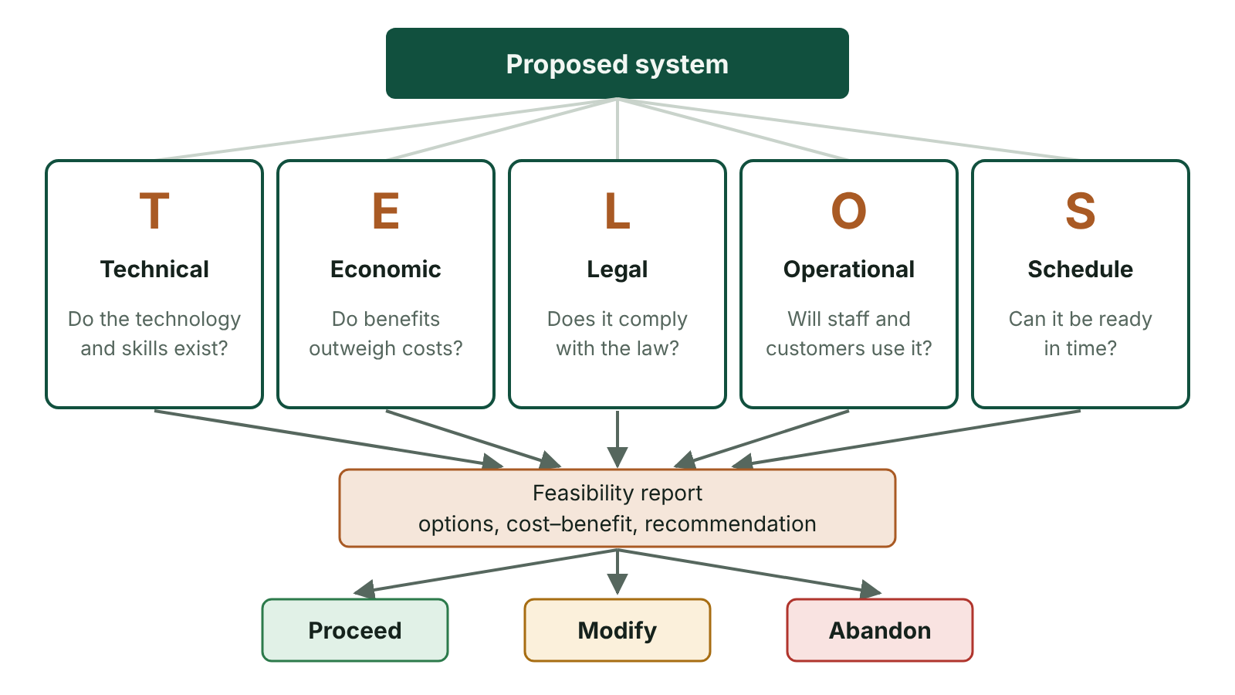
The big picture
A feasibility study tests a proposed system against five TELOS criteria and produces a feasibility report recommending to proceed, modify or abandon
☰ Menu
Notes:
Explain the diagram in your own words before you read on.

Slide 35
Whose needs must a system meet?
The organisation: the system must serve its purpose, e.g. handle thousands of bookings that could never be taken one at a time by phone
The individual users: customers and staff must find it accessible, quick and easy to use
If customers find a booking site confusing they take their business to a competitor, so the system fails its purpose
If staff find it awkward they make errors, use workarounds or avoid it
A successful system meets the needs of both the organisation that runs it and the people who use it
☰ Menu

Slide 36
Three factors that affect systems development
Factor | What it means | Effect on the project
User needs | What the organisation and its users require the system to do, and how they need to interact with it | Defines the scope; requirements must be precise and agreed or the wrong system is built
Time | The date by which the system must be operational | Limits how much can be built; features that cannot be ready in time must be cut or delayed
Cost | The budget available for the project | Limits staff numbers, hardware, software licences, training and testing
☰ Menu

Slide 37
Balancing needs, time and cost
The three factors pull against each other: changing one usually affects the others
More features (user needs) → more time and more cost
A tighter deadline → more staff (cost) or fewer features
A smaller budget → fewer staff, cheaper hardware, or a smaller system
Example: no point specifying a module that takes a year to build if the system must be live in six months
Cutting testing to save time or money risks poor quality, as in the software crisis
☰ Menu

Slide 38
What is a feasibility study?
A preliminary investigation carried out before a project is approved, usually by the systems analyst
Decides whether a proposed system is possible, worthwhile and affordable within the time available
Considers alternative solutions, including improving the current system or doing nothing
Ends with a feasibility report and a recommendation to management: proceed, modify or abandon
☰ Menu

Slide 39
TELOS: five kinds of feasibility
Criterion | Key question | Example consideration
Technical | Does the technology exist and can we use it? | Hardware, software, network capacity, staff technical skills
Economic | Do the benefits outweigh the costs? | Development, hardware, training and running costs v. savings and extra income
Legal | Does it comply with the law? | UK GDPR and Data Protection Act 2018, Computer Misuse Act 1990 (as amended), copyright, equality and accessibility duties
Operational | Will it work in practice and will people use it? | Staff attitudes, working practices, union concerns, user skills, customer acceptance
Schedule | Can it be delivered in the time available? | Deadlines such as the start of the tourist season or a change in the law
☰ Menu

Slide 40
Cost–benefit analysis
Compares the total expected costs of the new system with its expected benefits over a period
One-off costs: development, hardware, software licences, data conversion, initial training
Ongoing costs: maintenance, support, licence renewals, consumables, further training
Tangible benefits can be measured in money, e.g. reduced staffing hours or fewer stock losses
Intangible benefits are hard to measure, e.g. better customer satisfaction or staff morale
The payback period is how long it takes for cumulative benefits to cover cumulative costs
☰ Menu

Slide 41
Worked example: payback period
Item | Year 0 | Year 1 | Year 2 | Year 3
Costs (£) | 40 000 | 5 000 | 5 000 | 5 000
Benefits (£) | 0 | 25 000 | 25 000 | 25 000
Net (£) | −40 000 | +20 000 | +20 000 | +20 000
Cumulative (£) | −40 000 | −20 000 | 0 | +20 000
Result | Cumulative reaches 0 at the end of year 2 | Payback = 2 years
☰ Menu

Slide 42
The feasibility report
Introduction: terms of reference and the problems with the current system
Description of alternative solutions considered (including doing nothing)
TELOS findings for each option, with outline costs and benefits
A justified recommendation, plus an outline plan and estimated timescale
Used by senior management or the client to decide whether to commit money to the project
☰ Menu

Slide 43
Why carry out a feasibility study?
Avoids wasting money on projects that are impossible or will never pay back
Identifies risks early, e.g. legal problems or staff resistance
Forces the organisation to compare alternatives, not just the first idea
Checks the project can be delivered within the time and budget constraints
Limitation: it is based on estimates and itself takes time and money
☰ Menu

Slide 44
The development team: three key roles
Role | Main purpose | Key deliverables
Systems analyst | Identify the user and data processing requirements of the new or modified system | Feasibility report, requirements and system specification
Project manager | Plan, co-ordinate and control the project so it is delivered on time, within budget and meets its objectives | Project plan and schedule, risk register, progress reports
Programmer | Build and test the system to the analyst's design so that it meets the client's needs | Source code, technical and operational documentation, test results
☰ Menu

Slide 45
Systems analyst
Carries out the feasibility study and writes the feasibility report
Liaises with the client and users throughout: the link between the business and the technical team
Fact-finds: interviews, observation, questionnaires and document inspection of any existing system
Analyses the findings to define the user and data processing requirements
Produces the system specification: the detailed proposal for a new, modified or replacement system
☰ Menu

Slide 46
Project manager
Plans the project schedule and splits the work into tasks and sub-tasks
Allocates resources (staff, hardware, software) to each task
Identifies and manages risks, e.g. a key programmer leaving or a supplier delay
Monitors progress against milestones and takes action if tasks slip
Controls the budget so the project finishes by its deadline and does not overspend
Reports progress back to the client and keeps stakeholders satisfied
☰ Menu

Slide 47
Programmer
Writes or amends source code in a high-level language from module specifications, algorithms or flowcharts
Adds meaningful comments so other programmers can maintain the code later
Tests against a test plan, debugs faults and integrates with existing systems
Writes operational documentation and works with the analyst and project manager to meet requirements on time
☰ Menu

Slide 48
Programmer – code
C#
// Module: payback period (spec 4.2 from the analyst)
// Input: one-off cost and yearly net saving in pounds
// Output: number of whole years until costs are recovered
double initialCost = 30000; // development + hardware
double netSavingPerYear = 10000; // savings minus running costs
double cumulative = -initialCost;
int year = 0;
// Add each year's net saving until the total is no longer negative
while (cumulative < 0)
{
year++;
cumulative += netSavingPerYear;
}
Console.WriteLine($"Payback reached in year {year}");
☰ Menu

Slide 49
Worked example: Fermanagh & Omagh bin-collection app
User needs: residents want collection-day reminders and to report missed bins; the council wants fewer phone calls
Time: must be live before the new collection rota starts in April; cost: fixed budget from the council's digital fund
Analyst: interviews customer-services staff, surveys residents, studies call logs; writes feasibility report and specification
Project manager: schedules app, database and notification tasks; tracks budget; reports to councillors monthly
Programmer: codes the rota lookup and reminder modules, comments and tests them, links to the existing address database
TELOS check: GDPR for resident addresses (legal); older residents may prefer phone, so keep it as an option (operational)
☰ Menu

Slide 50
Exit quiz: question 1 of 9
Tap an answer to check it. Presenting? Click to reveal the answer.
Which member of the development team is mainly responsible for identifying the user and data processing requirements of a new system?
A Project manager
B Systems analyst
✗
✓
C Programmer
D Network technician
✗
✗
✓ B: Systems analyst – The systems analyst investigates the current system and defines the requirements and the system specification.
☰ Menu

Slide 51
Exit quiz: question 2 of 9
Tap an answer to check it. Presenting? Click to reveal the answer.
A council system must be live before a new law takes effect in six months. Which factor affecting development does this deadline represent?
A Cost
B User needs
✗
✗
C Time
D Data
✓
✗
✓ C: Time – The time available limits what can be built; a feature taking a year is pointless if the system must be live in six months.
☰ Menu

Slide 52
Exit quiz: question 3 of 9
Tap an answer to check it. Presenting? Click to reveal the answer.
What does the 'O' in TELOS stand for?
A Organisational
B Output
✗
✗
C Optimal
D Operational
✗
✓
✓ D: Operational – Operational feasibility: will it work in practice and be accepted by its users?
☰ Menu

Slide 53
Exit quiz: question 4 of 9
Tap an answer to check it. Presenting? Click to reveal the answer.
Which is a tangible benefit?
A Saving £12 000 a year on paper and postage
B Better company image
✓
✗
C Happier customers
D Improved decision-making
✗
✗
✓ A: Saving £12 000 a year on paper and postage – It can be measured in money.
☰ Menu

Slide 54
Exit quiz: question 5 of 9
Tap an answer to check it. Presenting? Click to reveal the answer.
A system costs £20 000 and gives a net saving of £5 000 a year. What is the payback period?
A 2 years
B 5 years
✗
✗
C 4 years
D 25 years
✓
✗
✓ C: 4 years – 20 000 ÷ 5 000 = 4 years.
☰ Menu

Slide 55
Exit quiz: question 6 of 9
Tap an answer to check it. Presenting? Click to reveal the answer.
Who uses the feasibility report to decide whether to go ahead?
A Management / the client
B End users only
✓
✗
C Testers
D Programmers
✗
✗
✓ A: Management / the client – Management decide whether to fund the project based on the report's recommendation.
☰ Menu

Slide 56
Exit quiz: question 7 of 9
Tap an answer to check it. Presenting? Click to reveal the answer.
Which is a typical duty of a project manager?
A Writing source code from module specifications
B Interviewing users to find requirements
✗
✗
C Splitting the project into tasks and allocating resources
D Adding comments to code
✓
✗
✓ C: Splitting the project into tasks and allocating resources – Planning tasks and allocating staff, hardware and software is a project management duty.
☰ Menu

Slide 57
Exit quiz: question 8 of 9
Tap an answer to check it. Presenting? Click to reveal the answer.
Why does a programmer add meaningful comments to source code?
A To make the program run faster
B To help other programmers understand and maintain the code later
✗
✓
C To encrypt the code
D Because the compiler requires them
✗
✗
✓ B: To help other programmers understand and maintain the code later – Comments are ignored by the compiler but make code easier to modify and maintain.
☰ Menu

Slide 58
Exit quiz: question 9 of 9
Tap an answer to check it. Presenting? Click to reveal the answer.
Checking that a new system complies with the UK GDPR is part of…
A technical feasibility
B schedule feasibility
✗
✗
C economic feasibility
D legal feasibility
✗
✓
✓ D: legal feasibility – Legal feasibility checks compliance with legislation such as data protection law.
☰ Menu

Slide 59
Exit quiz answers
Q | Answer | Why
1 | B Systems analyst | The systems analyst investigates the current system and defines the requirements and the system specification.
2 | C Time | The time available limits what can be built; a feature taking a year is pointless if the system must be live in six months.
3 | D Operational | Operational feasibility: will it work in practice and be accepted by its users?
4 | A Saving £12 000 a year on paper and postage | It can be measured in money.
5 | C 4 years | 20 000 ÷ 5 000 = 4 years.
6 | A Management / the client | Management decide whether to fund the project based on the report's recommendation.
7 | C Splitting the project into tasks and allocating resources | Planning tasks and allocating staff, hardware and software is a project management duty.
8 | B To help other programmers understand and maintain the code later | Comments are ignored by the compiler but make code easier to modify and maintain.
9 | D legal feasibility | Legal feasibility checks compliance with legislation such as data protection law.
☰ Menu

