Slide 1
Object-oriented programming
AS 1: APPROACHES TO SYSTEMS DEVELOPMENT · TOPIC
Lessons in this topic
AP24 Classes, objects and encapsulation
AP25 Inheritance, polymorphism, evaluating OOP and event-driven programming

Slide 2

Topic menu
Tap a button to jump straight there. The ☰ Menu button on every slide brings you back here.
Specification map
AP25 Inheritance, polymorphism, evaluating OOP and event-driven programming
AP24 Classes, objects and encapsulation

Slide 3
Specification map
Lesson | Specification: students should be able to
AP24 | Explain object-oriented programming terminology: class, object, attribute (property), method (behaviour), constructor and instantiation; Explain the purpose of a method's parameter list and return type; Explain encapsulation and its benefits, including private attributes accessed through get and set methods; Write classes in C#, create objects from them and predict the output of object-oriented code; Represent a class using a class diagram, including visibility symbols
AP25 | Explain inheritance using the terms superclass (base class) and subclass (derived class), and represent a class hierarchy in a diagram; Write C# subclasses that inherit from a base class, call the base constructor and add their own attributes and methods; Explain polymorphism and implement it by overriding methods (virtual, abstract and override); Evaluate the object-oriented approach, discussing its advantages and disadvantages; Describe event-driven programming and the use of events, event handlers and controls in a graphical user interface
☰ Menu
Notes:
Each lesson below is its own section in PowerPoint (View → Slide Sorter shows them). To split this deck by specification point, right-click a section → Move Section, or delete the sections you do not need.

Slide 4
Classes, objects and encapsulation
AS 1: APPROACHES TO SYSTEMS DEVELOPMENT · AP24
Learning objectives
Define class, object, attribute, method and constructor, and explain how a class relates to its objects
Explain encapsulation and decide which attributes need get methods, set methods or both
Write a C# class with private attributes, a constructor and methods, then instantiate and use objects
Trace object-oriented code to predict its output
Draw and interpret a class diagram using +, - and # visibility symbols
Notes:
Specification: Explain object-oriented programming terminology: class, object, attribute (property), method (behaviour), constructor and instantiation | Explain the purpose of a method's parameter list and return type | Explain encapsulation and its benefits, including private attributes accessed through get and set methods | Write classes in C#, create objects from them and predict the output of object-oriented code | Represent a class using a class diagram, including visibility symbols

Slide 5
In this lesson
Tap a button to jump straight there. The ☰ Menu button on every slide brings you back here.
The big picture
Encapsulation
Properties: C#'s getters and setters
Object-oriented programming
Get and set methods
Class diagrams
Classes and objects
Worked example: a bike-share Bike class
Exit quiz
Attributes, methods, constructors and properties
Worked example: tracing the Bike program
↑ Topic menu
Worked example: two objects, one class
Protecting state: an Account class
Methods and parameter lists
Several objects, one class
Notes:
Lesson menu: each button jumps to that part of the lesson in Slide Show. The ☰ Menu button on each slide returns here.

Slide 6
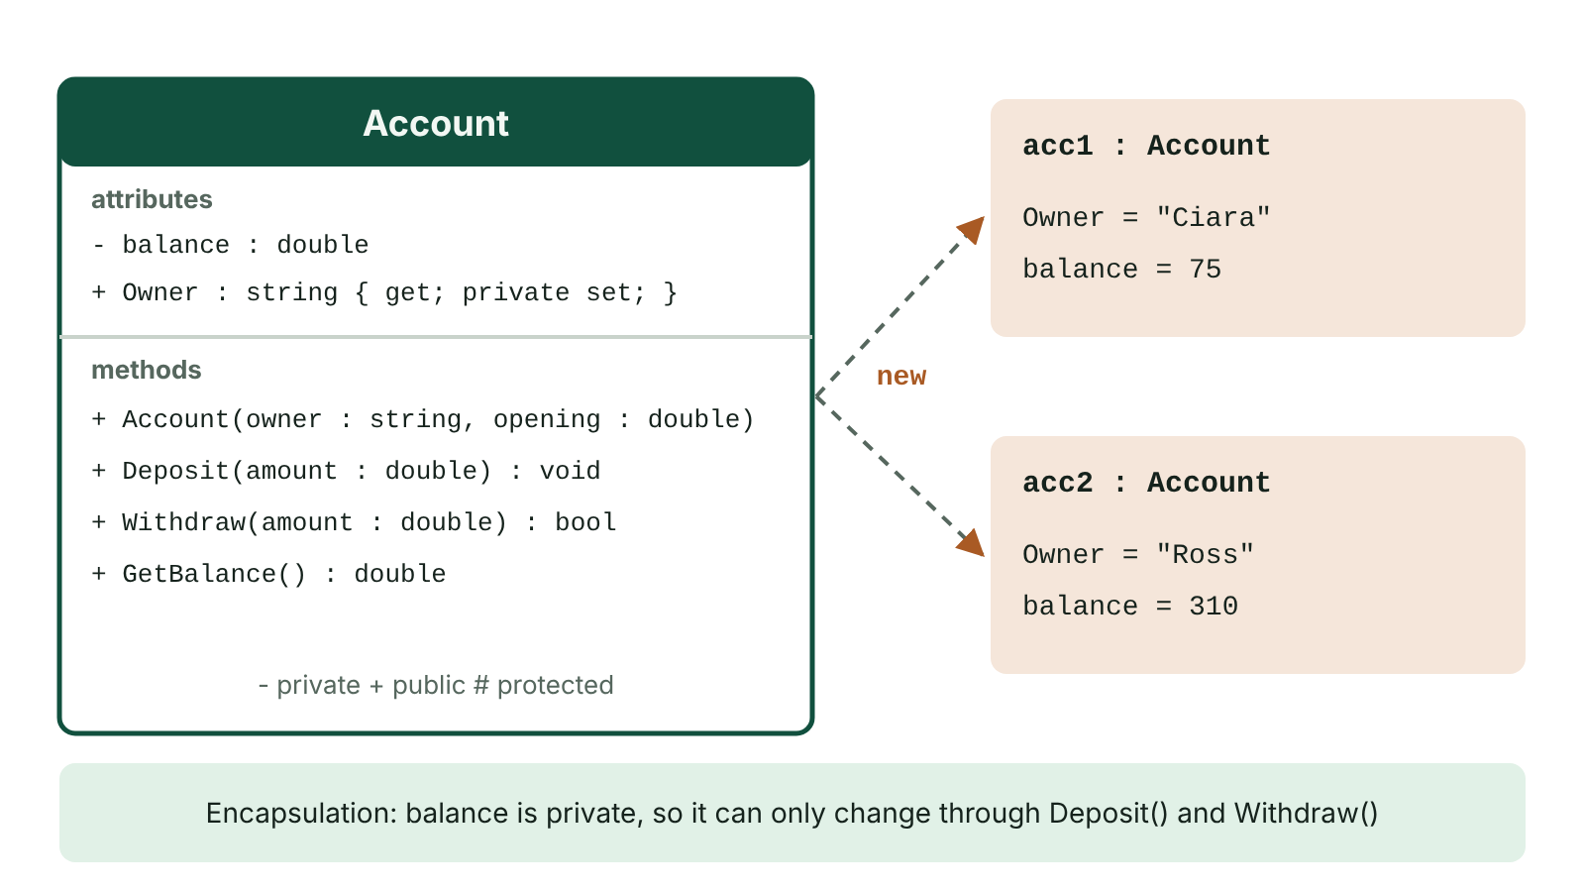
The big picture
Class diagram of an Account class with private attribute and public methods, and two objects instantiated from it with their own state
☰ Menu
Notes:
Explain the diagram in your own words before you read on.

Slide 7
Object-oriented programming
Object-oriented programming (OOP) is a paradigm that builds programs from objects which combine data and the code that acts on that data
Objects are modelled on real-life entities: a pupil, a library book, a hire bike, a bank account
In procedural programming, data and subroutines are kept separate; in OOP each object looks after its own data
The two basic building blocks are classes and objects
C# is an object-oriented language: even a simple console program uses classes such as Console and string
☰ Menu

Slide 8
Classes and objects
A class is a template (blueprint) that defines the attributes and methods every object of that type will have
An object is a specific instance of a class, e.g. class Person, object 'Siobhán Doherty'
Creating an object from a class is called instantiation; C# uses the new keyword
Many objects can be built from one class, each with its own attribute values (its state)
By convention class names start with a capital letter: Bike, Book, Patient
☰ Menu

Slide 9
Attributes, methods, constructors and properties
Term | Meaning | Bike example
Attribute (field) | A variable belonging to an object that holds part of its data; each has a data type | bikeId, dock, battery
Method (behaviour) | A subroutine defined in the class describing an action the object can carry out | Ride(), Report()
Constructor | A special method with the class's name and no return type, run by new to set the starting state | Bike(string id, string startDock, int charge)
Get / set method | Public methods that read (get) or change (set) a private attribute | GetBikeId()
Property (C#) | A member with get and/or set blocks giving controlled access to a private field | public int Age { get; set; }
☰ Menu

Slide 10
Worked example: two objects, one class
Attribute | Data type | Object b1 | Object b2
bikeId | string | "BK101" | "BK102"
dock | string | "City Hall" | "Titanic Quarter"
battery | int | 80 | 35
Methods available | – | Ride(), Report(), GetBikeId() | Ride(), Report(), GetBikeId()
Key idea | – | Own copy of every attribute | Same method code, different state
☰ Menu

Slide 11
Methods and parameter lists
A method header gives the access modifier, return type, name and parameter list: public void SetDock(string newDock)
The parameter list states what extra data the method needs; every call must supply matching arguments, e.g. SetDock("Botanic")
A method that needs nothing extra has an empty parameter list: GetBattery()
void means the method performs an action and returns nothing; int, string, bool etc. mean it returns a value
Methods are called with dot notation: objectName.MethodName(arguments)
☰ Menu

Slide 12
Encapsulation
Encapsulation bundles an object's data and the methods that act on it into one class, and hides the internal details
Attributes are declared private so outside code cannot change them directly
Data can only be read or changed through public methods, so the class controls and validates every change
The internal workings can be changed later without affecting code that uses the class
Related code stays in one place, so programmers using the class need only know its public interface
☰ Menu

Slide 13
Get and set methods
A get method (getter) returns the current value of a private attribute, e.g. GetBikeId()
A set method (setter) takes the new value as a parameter and changes the attribute, e.g. SetPhone(string newPhone)
No setter means read-only: a membership number or National Insurance number should never change once allocated
A setter can validate data, e.g. reject a mark above 100, so the object can never hold invalid values
A setter can also handle side effects, e.g. logging a change of address, so calling code does not have to
☰ Menu

Slide 14
Worked example: a bike-share Bike class
Three private attributes; one constructor; a getter with no matching setter
Ride() checks there is enough charge before changing any data – the object protects its own state
☰ Menu

Slide 15
Worked example: a bike-share Bike class – code
C#
Bike b1 = new Bike("BK101", "City Hall", 80);
Bike b2 = new Bike("BK102", "Titanic Quarter", 35);
b1.Ride(12, "Queen's University");
b2.Ride(40, "City Hall"); // refused: not enough charge
Console.WriteLine(b1.Report()); // BK101 at Queen's University, battery 68%
Console.WriteLine(b2.Report()); // BK102 at Titanic Quarter, battery 35%
class Bike
{
private string bikeId;
private string dock;
private int battery;
public Bike(string id, string startDock, int charge) { bikeId = id; dock = startDock; battery = charge; }
public string GetBikeId() { return bikeId; } // getter only: ID never changes
public void Ride(int minutes, string endDock)
{
if (minutes > battery) return; // 1% charge per minute
battery -= minutes; dock = endDock;
}
public string Report() { return bikeId + " at " + dock + ", battery " + battery + "%"; }
}
☰ Menu

Slide 16
Worked example: tracing the Bike program (1 of 2)
Statement | b1 (dock, battery) | b2 (dock, battery) | Output
b1 = new Bike("BK101", "City Hall", 80) | City Hall, 80 | –
b2 = new Bike("BK102", "Titanic Quarter", 35) | City Hall, 80 | Titanic Quarter, 35
b1.Ride(12, "Queen's University") | Queen's University, 68 | Titanic Quarter, 35
b2.Ride(40, "City Hall") | Queen's University, 68 | Titanic Quarter, 35 (40 > 35, refused)
WriteLine(b1.Report()) | unchanged | unchanged | BK101 at Queen's University, battery 68%
☰ Menu

Slide 17
Worked example: tracing the Bike program (2 of 2)
Statement | b1 (dock, battery) | b2 (dock, battery) | Output
WriteLine(b2.Report()) | unchanged | unchanged | BK102 at Titanic Quarter, battery 35%
☰ Menu

Slide 18
Protecting state: an Account class
private double balance cannot be altered from outside – only Deposit and Withdraw can change it
Withdraw returns a bool so the caller knows whether it worked
Owner { get; private set; } can be read anywhere but only set inside the class
☰ Menu

Slide 19
Protecting state: an Account class – code
C#
Account acc = new Account("Ciara", 50);
acc.Deposit(25);
if (!acc.Withdraw(100)) Console.WriteLine("Insufficient funds");
Console.WriteLine(acc.Owner + ": £" + acc.GetBalance()); // Ciara: £75
class Account
{
private double balance;
public string Owner { get; private set; }
public Account(string owner, double opening) { Owner = owner; balance = opening; }
public void Deposit(double amount) { if (amount > 0) balance += amount; }
public bool Withdraw(double amount)
{
if (amount <= 0 || amount > balance) return false;
balance -= amount;
return true;
}
public double GetBalance() { return balance; }
}
☰ Menu

Slide 20
Several objects, one class
Each object has its own copy of the instance fields, so changing one object does not affect another
A static field belongs to the class itself and is shared by all objects – here it counts instances
this refers to the current object, used when a parameter has the same name as a field
☰ Menu

Slide 21
Several objects, one class – code
C#
Pupil a = new Pupil("Aoife", 72);
Pupil b = new Pupil("Ben", 58);
a.AddBonus(5);
Console.WriteLine(a.Describe()); // Aoife: 77
Console.WriteLine(b.Describe()); // Ben: 58
Console.WriteLine(Pupil.Count); // 2
class Pupil
{
private string name;
private int mark;
public static int Count = 0;
public Pupil(string name, int mark) { this.name = name; this.mark = mark; Count++; }
public void AddBonus(int extra) { if (mark + extra <= 100) mark += extra; }
public string Describe() { return name + ": " + mark; }
}
☰ Menu

Slide 22
Properties: C#'s getters and setters
A property wraps a private field with a get block and a set block; value is the new value being assigned
The set block can validate: an age of -3 is ignored, so the object keeps a valid age
Leaving out set (or making it private set) gives read-only access from outside the class
☰ Menu

Slide 23
Properties: C#'s getters and setters – code
C#
Ticket t = new Ticket();
t.Age = 15;
t.Age = -3; // rejected by the setter: stays 15
Console.WriteLine(t.Age + " " + t.Price()); // 15 4.5
class Ticket
{
private int age;
public int Age
{
get { return age; }
set { if (value >= 0 && value <= 120) age = value; }
}
public double Price() { return age < 16 ? 4.50 : 7.00; }
}
☰ Menu

Slide 24
Class diagrams
Bike | Notes
- bikeId : string | Attributes compartment: - means private
- dock : string - battery : int | Each attribute is shown with its data type
+ Bike(id : string, startDock : string, charge : int) | Methods compartment: constructor has the class name and no return type
+ GetBikeId() : string | + means public; a getter with no setter makes bikeId read-only
+ Ride(minutes : int, endDock : string) : void | Parameters with types, then the return type
+ Report() : string | # would mean protected (visible to derived classes)
☰ Menu

Slide 25
Exit quiz: question 1 of 8
Tap an answer to check it. Presenting? Click to reveal the answer.
In object-oriented programming, what is the relationship between a class and an object?
A An object is a template from which classes are built
B A class is a template, and an object is a specific instance created from it
✗
✓
C A class and an object are two names for the same thing
D A class stores data while an object stores only methods
✗
✗
✓ B: A class is a template, and an object is a specific instance created from it – The class defines the attributes and methods; each object built from it has its own attribute values.
☰ Menu

Slide 26
Exit quiz: question 2 of 8
Tap an answer to check it. Presenting? Click to reveal the answer.
A Patient class has a private attribute hospitalNumber with a get method but no set method. What is the effect?
A Other code can never see the hospital number
B The program will not compile without a setter
✗
✗
C Other code can read the hospital number but cannot change it
D Any code can change the hospital number directly
✓
✗
✓ C: Other code can read the hospital number but cannot change it – A getter alone makes the attribute read-only from outside the class, which suits identifiers that must never change.
☰ Menu

Slide 27
Exit quiz: question 3 of 8
Tap an answer to check it. Presenting? Click to reveal the answer.
Which keyword is used to create an object in C#?
A class
B static
✗
✗
C void
D new
✗
✓
✓ D: new – new allocates the object and calls its constructor.
☰ Menu

Slide 28
Exit quiz: question 4 of 8
Tap an answer to check it. Presenting? Click to reveal the answer.
In a class diagram, what does '- battery : int' show?
A A private attribute called battery of type integer
B A public method that returns an integer
✓
✗
C A protected attribute
D A constructor parameter
✗
✗
✓ A: A private attribute called battery of type integer – - means private and the data type follows the colon.
☰ Menu

Slide 29
Exit quiz: question 5 of 8
Tap an answer to check it. Presenting? Click to reveal the answer.
Which statement correctly describes a constructor in C#?
A A method that must return void
B A method with the same name as the class and no return type, which initialises a new object
✗
✓
C Any method that changes the value of an attribute
D A method that deletes an object when it is no longer needed
✗
✗
✓ B: A method with the same name as the class and no return type, which initialises a new object – It runs automatically when new is used and sets the object's starting state.
☰ Menu

Slide 30
Exit quiz: question 6 of 8
Tap an answer to check it. Presenting? Click to reveal the answer.
What do the empty brackets in GetBattery() show?
A The method is private
B The method returns nothing
✗
✗
C The method needs no parameters
D The method is a constructor
✓
✗
✓ C: The method needs no parameters – An empty parameter list means no extra information is supplied when the method is called.
☰ Menu

Slide 31
Exit quiz: question 7 of 8
Tap an answer to check it. Presenting? Click to reveal the answer.
Which statement best describes encapsulation?
A Bundling data with the methods that act on it and hiding the data so it is only accessed through those methods
B Creating a new class from an existing one
✓
✗
C Giving several methods the same name
D Storing all data in public variables so it is easy to reach
✗
✗
✓ A: Bundling data with the methods that act on it and hiding the data so it is only accessed through those methods – Encapsulation = data and methods together in a class, with the data hidden (private).
☰ Menu

Slide 32
Exit quiz: question 8 of 8
Tap an answer to check it. Presenting? Click to reveal the answer.
Two Bike objects, b1 and b2, are created from the same class. Which statement is true?
A They share one battery attribute
B Changing b1's dock also changes b2's dock
✗
✗
C Only the first object created can call Ride()
D Each object has its own values for the instance attributes
✗
✓
✓ D: Each object has its own values for the instance attributes – Objects share the class's method code but each holds its own state.
☰ Menu

Slide 33
Exit quiz answers
Q | Answer | Why
1 | B A class is a template, and an object is a specific instance created from it | The class defines the attributes and methods; each object built from it has its own attribute values.
2 | C Other code can read the hospital number but cannot change it | A getter alone makes the attribute read-only from outside the class, which suits identifiers that must never change.
3 | D new | new allocates the object and calls its constructor.
4 | A A private attribute called battery of type integer | - means private and the data type follows the colon.
5 | B A method with the same name as the class and no return type, which initialises a new object | It runs automatically when new is used and sets the object's starting state.
6 | C The method needs no parameters | An empty parameter list means no extra information is supplied when the method is called.
7 | A Bundling data with the methods that act on it and hiding the data so it is only accessed through those methods | Encapsulation = data and methods together in a class, with the data hidden (private).
8 | D Each object has its own values for the instance attributes | Objects share the class's method code but each holds its own state.
☰ Menu

Slide 34
Inheritance, polymorphism, evaluating OOP and event-driven programming
AS 1: APPROACHES TO SYSTEMS DEVELOPMENT · AP25
Learning objectives
Explain inheritance and work out which attributes and methods a subclass object has
Write a C# subclass that calls the base constructor, adds members and overrides a virtual method
Explain how polymorphism lets one method call behave differently for different objects
Evaluate the usefulness of object-oriented programming for a given application
Describe how event-driven GUI programs respond to events using handlers and controls
Notes:
Specification: Explain inheritance using the terms superclass (base class) and subclass (derived class), and represent a class hierarchy in a diagram | Write C# subclasses that inherit from a base class, call the base constructor and add their own attributes and methods | Explain polymorphism and implement it by overriding methods (virtual, abstract and override) | Evaluate the object-oriented approach, discussing its advantages and disadvantages | Describe event-driven programming and the use of events, event handlers and controls in a graphical user interface

Slide 35
In this lesson
Tap a button to jump straight there. The ☰ Menu button on every slide brings you back here.
The big picture
Abstract classes
Event-driven programming
Inheritance
Polymorphism with virtual and override
GUI controls
Inheritance terms
Overriding and overloading
An event handler (Windows Forms)
Worked example: a GAA club membership system
Advantages and disadvantages of OOP
Exit quiz
Worked example: the club's class hierarchy
Evaluating OOP for an application
↑ Topic menu
Notes:
Lesson menu: each button jumps to that part of the lesson in Slide Show. The ☰ Menu button on each slide returns here.

Slide 36
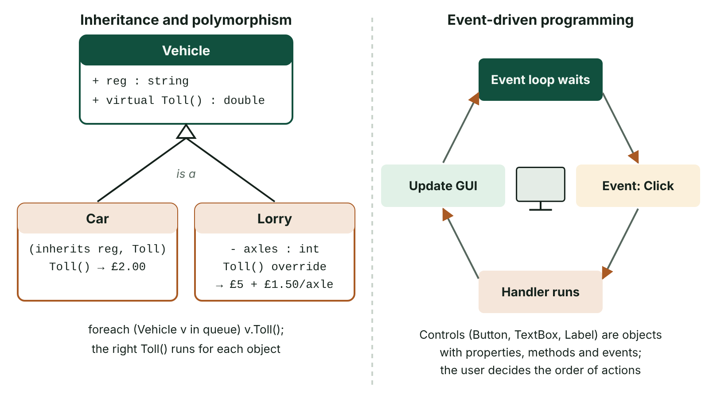
The big picture
Inheritance hierarchy with Car and Lorry deriving from Vehicle and Lorry overriding Toll, beside an event-driven cycle of event loop, event, handler and update
☰ Menu
Notes:
Explain the diagram in your own words before you read on.

Slide 37
Inheritance
Inheritance lets a new, more specialised class take on the attributes and methods of an existing, more general class
The general class is the superclass (base or parent class); the specialised class is the subclass (derived or child class)
The subclass usually adds attributes and methods of its own and may redefine (override) inherited behaviour
It models an 'is a' relationship: a Junior is a Member; a Bus is a Vehicle
Common code is written and tested once in the superclass, then reused by every subclass
☰ Menu

Slide 38
Inheritance terms
Term | Meaning | C# example
Superclass / base class | The general class whose members are inherited | class Member
Subclass / derived class | A specialised class that inherits from the base class | class Junior : Member
protected | Accessible inside the class and its subclasses, hidden from other code (# in a diagram) | protected string name;
Base constructor call | The subclass constructor passes values up to the superclass's constructor | : base(no, n)
Class hierarchy | Tree of classes with the most general at the top | Member → Junior, Adult
☰ Menu

Slide 39
Worked example: a GAA club membership system
Junior inherits memberNo, name, GetMemberNo() and GetName() from Member, and adds guardianPhone and Contact()
Private memberNo is inherited but can only be reached through GetMemberNo(); protected name can be used directly in Junior
Fee() is virtual in Member (adult fee £120) and overridden in Junior (£40)
☰ Menu

Slide 40
Worked example: a GAA club membership system – code
C#
Junior j = new Junior(101, "Orla", "07700 900123");
Console.WriteLine(j.GetName() + " " + j.GetMemberNo()); // Orla 101 (inherited)
Console.WriteLine(j.Fee()); // 40 (overridden)
Console.WriteLine(j.Contact()); // Orla, guardian 07700 900123
class Member
{
private int memberNo;
protected string name;
public Member(int no, string n) { memberNo = no; name = n; }
public int GetMemberNo() { return memberNo; }
public string GetName() { return name; }
public virtual double Fee() { return 120; }
}
class Junior : Member
{
private string guardianPhone;
public Junior(int no, string n, string phone) : base(no, n) { guardianPhone = phone; }
public string Contact() { return name + ", guardian " + guardianPhone; }
public override double Fee() { return 40; }
}
☰ Menu

Slide 41
Worked example: the club's class hierarchy
Class | Own attributes | Own methods | Total attributes
Member (superclass) | - memberNo : int, # name : string | + GetMemberNo() : int, + GetName() : string, + Fee() : double | 2
Junior (subclass) | - guardianPhone : string | + Contact() : string, + Fee() : double (override) | 3 (2 inherited + 1)
Adult (subclass) | - playing : bool, - occupation : string | + IsPlaying() : bool | 4 (2 inherited + 2)
Diagram rule | Subclass boxes sit below the superclass | A line with a hollow arrowhead points up to the superclass | Attributes accumulate going down
☰ Menu

Slide 42
Abstract classes
An abstract class cannot be instantiated: every object must be created from one of its subclasses
An abstract method has a header but no body; each subclass must override it
Useful when the superclass is only a general idea, e.g. every ticket sold is either an Adult or a Child ticket
☰ Menu

Slide 43
Abstract classes – code
C#
using System.Collections.Generic;
// Ticket t = new Ticket(); would not compile: Ticket is abstract
List<Ticket> sales = new List<Ticket> { new Adult(), new Child(), new Child() };
double total = 0;
foreach (Ticket t in sales) total += t.Price();
Console.WriteLine("Total: £" + total.ToString("F2")); // Total: £17.00
abstract class Ticket
{
public abstract double Price(); // no body: every subclass must override it
}
class Adult : Ticket { public override double Price() { return 8.00; } }
class Child : Ticket { public override double Price() { return 4.50; } }
☰ Menu

Slide 44
Polymorphism with virtual and override
Polymorphism ('many forms') means the same method call behaves differently depending on the class of the object
The base class marks a method virtual (or abstract); a subclass provides its own version with override
A List<Vehicle> can hold Cars and Lorries; calling Toll() on each runs the correct version at run time
☰ Menu

Slide 45
Polymorphism with virtual and override – code
C#
using System.Collections.Generic;
List<Vehicle> queue = new List<Vehicle>();
queue.Add(new Car("LGZ 1234"));
queue.Add(new Lorry("AXI 987", 3));
foreach (Vehicle v in queue)
Console.WriteLine(v.reg + ": £" + v.Toll().ToString("F2"));
// LGZ 1234: £2.00
// AXI 987: £9.50
class Vehicle
{
public string reg;
public virtual double Toll() { return 2.00; }
}
class Car : Vehicle { public Car(string r) { reg = r; } }
class Lorry : Vehicle
{
private int axles;
public Lorry(string r, int a) { reg = r; axles = a; }
public override double Toll() { return 5.00 + axles * 1.50; }
}
☰ Menu

Slide 46
Overriding and overloading
 | Overriding | Overloading
What | A subclass redefines an inherited method with the same name and parameters | Several methods in one class share a name but have different parameter lists
When decided | At run time, from the object's actual class | At compile time, from the arguments given
C# keywords | virtual or abstract in the base, override in the subclass | None needed
Example | Lorry.Toll() replaces Vehicle.Toll() | Area(double r) and Area(double w, double h)
☰ Menu

Slide 47
Advantages and disadvantages of OOP (1 of 2)
Advantages | Disadvantages
More accurate modelling: classes mirror real-world entities and their behaviour | Not suited to every problem: abstract or purely computational tasks do not map naturally onto objects
Code reuse: subclasses inherit attributes and methods; class libraries are reused across projects | Larger, more complex designs that take longer to plan and learn
Less testing: only new or overridden methods in a subclass need fresh testing | Can use more memory and processing than a simple procedural program
Encapsulation protects data and reduces unintended side effects | Deep inheritance hierarchies are hard to follow; a change to a base class affects every subclass
Modular: classes developed and tested independently by different team members | Overkill for small, simple programs
☰ Menu

Slide 48
Advantages and disadvantages of OOP (2 of 2)
Advantages | Disadvantages
Easier maintenance: internals of a class change without affecting code that uses it | Poor class design early on is costly to fix later
☰ Menu

Slide 49
Evaluating OOP for an application
OOP is strongest where the problem contains many interacting things with state: games, simulations, CAD/CAM and engineering design, GUIs
Large team projects benefit from classes with clear interfaces that can be built and tested separately
For a short script or a straightforward batch process, such as totalling a file of figures, a procedural approach can be quicker and just as clear
Most modern languages (C#, Java, Python) support both styles, so the choice is about fit, not availability
An evaluation should weigh both sides against the specific context and reach a justified conclusion
☰ Menu

Slide 50
Event-driven programming
In an event-driven program, the flow is determined by events: user actions (click, key press), system events (timer tick, file arrives) or messages
The program waits in an event loop; when an event occurs, the matching event handler (a subroutine) runs
Event handlers are attached to controls, such as btnCalculate.Click
Contrast with a sequential procedural program, where the program decides the order of steps from start to finish
Used for GUIs, games, mobile apps and embedded systems such as alarm sensors
☰ Menu

Slide 51
GUI controls
Control | Use | Typical event
Button | Start an action | Click
TextBox | Enter or display text | TextChanged, KeyPress
Label | Display fixed text or results | (rarely handled)
CheckBox / RadioButton | Yes/no option / one choice from a group | CheckedChanged
ComboBox / ListBox | Choose from a list | SelectedIndexChanged
Timer | Run code at regular intervals | Tick
☰ Menu

Slide 52
An event handler (Windows Forms)
Visual Studio generates the handler when a control is double-clicked in the form designer
Controls are objects: they have properties (Text, Enabled, Visible), methods and events – GUIs are built with OOP
This code needs a Windows Forms project, so it cannot run in the hub's console interpreter
☰ Menu

Slide 53
An event handler (Windows Forms) – code
PSEUDOCODE
// C# Windows Forms – runs in a form, not the console
private void btnCalculate_Click(object sender, EventArgs e)
{
if (int.TryParse(txtHours.Text, out int hours))
{
lblCost.Text = "Cost: £" + (hours * 12);
}
else
{
lblCost.Text = "Enter a whole number of hours";
}
}
☰ Menu

Slide 54
Exit quiz: question 1 of 8
Tap an answer to check it. Presenting? Click to reveal the answer.
What is meant by inheritance in object-oriented programming?
A Hiding an object's data so it can only be changed through methods
B A new, more specialised class taking on the attributes and methods of an existing class
✗
✓
C Several methods in one class sharing the same name
D Creating an object from a class using new
✗
✗
✓ B: A new, more specialised class taking on the attributes and methods of an existing class – The subclass inherits from the superclass and can add or modify members. The other options describe encapsulation, overloading and instantiation.
☰ Menu

Slide 55
Exit quiz: question 2 of 8
Tap an answer to check it. Presenting? Click to reveal the answer.
A Smartwatch subclass inherits three attributes from a Device superclass and adds heartRateSensor and strapSize. How many attributes does a Smartwatch object have?
A 2
B 3
✗
✗
C 5
D 6
✓
✗
✓ C: 5 – Attributes accumulate down the hierarchy: 3 inherited + 2 of its own = 5.
☰ Menu

Slide 56
Exit quiz: question 3 of 8
Tap an answer to check it. Presenting? Click to reveal the answer.
Which statement shows Lorry inheriting from Vehicle in C#?
A class Vehicle : Lorry
B class Lorry extends Vehicle
✗
✗
C class Lorry inherits Vehicle
D class Lorry : Vehicle
✗
✓
✓ D: class Lorry : Vehicle – C# uses a colon after the subclass name; extends is Java.
☰ Menu

Slide 57
Exit quiz: question 4 of 8
Tap an answer to check it. Presenting? Click to reveal the answer.
Which keyword allows a base-class method to be overridden but does not force it?
A virtual
B static
✓
✗
C private
D abstract
✗
✗
✓ A: virtual – virtual allows overriding; abstract forces every subclass to provide an override.
☰ Menu

Slide 58
Exit quiz: question 5 of 8
Tap an answer to check it. Presenting? Click to reveal the answer.
What is polymorphism?
A Creating many objects from one class
B Hiding data in a class
✗
✗
C The same method call behaving differently depending on the object's class
D Having several constructors
✓
✗
✓ C: The same method call behaving differently depending on the object's class – 'Many forms' of one method, chosen at run time from the object's actual class.
☰ Menu

Slide 59
Exit quiz: question 6 of 8
Tap an answer to check it. Presenting? Click to reveal the answer.
A credit union system has an Account superclass, and every real account is either a SavingsAccount or a LoanAccount. Why might Account be declared abstract?
A So that its attributes are public
B So that every object must be created as a specific type of account, such as SavingsAccount or LoanAccount
✗
✓
C So that it runs faster
D So that subclasses cannot inherit its methods
✗
✗
✓ B: So that every object must be created as a specific type of account, such as SavingsAccount or LoanAccount – An abstract class cannot be instantiated, so only its concrete subclasses can be used to create objects.
☰ Menu

Slide 60
Exit quiz: question 7 of 8
Tap an answer to check it. Presenting? Click to reveal the answer.
Which is a disadvantage of the object-oriented approach?
A Code reuse through inheritance
B More accurate modelling of real-world entities
✗
✗
C Easier maintenance
D It does not suit very abstract problems that have no obvious real-world objects
✗
✓
✓ D: It does not suit very abstract problems that have no obvious real-world objects – The other three are advantages.
☰ Menu

Slide 61
Exit quiz: question 8 of 8
Tap an answer to check it. Presenting? Click to reveal the answer.
Which is an example of an event?
A A button being clicked
B A variable being declared
✓
✗
C A class being written
D A constant being defined
✗
✗
✓ A: A button being clicked – Events are actions or occurrences detected by the running program.
☰ Menu

Slide 62
Exit quiz answers
Q | Answer | Why
1 | B A new, more specialised class taking on the attributes and methods of an existing class | The subclass inherits from the superclass and can add or modify members. The other options describe encapsulation, overloading and instantiation.
2 | C 5 | Attributes accumulate down the hierarchy: 3 inherited + 2 of its own = 5.
3 | D class Lorry : Vehicle | C# uses a colon after the subclass name; extends is Java.
4 | A virtual | virtual allows overriding; abstract forces every subclass to provide an override.
5 | C The same method call behaving differently depending on the object's class | 'Many forms' of one method, chosen at run time from the object's actual class.
6 | B So that every object must be created as a specific type of account, such as SavingsAccount or LoanAccount | An abstract class cannot be instantiated, so only its concrete subclasses can be used to create objects.
7 | D It does not suit very abstract problems that have no obvious real-world objects | The other three are advantages.
8 | A A button being clicked | Events are actions or occurrences detected by the running program.
☰ Menu

