Slide 1
Data representation
AS 2: FUNDAMENTALS OF DIGITAL TECHNOLOGY · TOPIC
Lessons in this topic
FD01 Number systems: bits, bytes, binary, denary, hexadecimal and BCD
FD02 Negative numbers and binary arithmetic
FD03 Real numbers: fixed-point and floating-point
FD04 Character sets and error detection
FD05 Representing images and sound

Slide 2

Topic menu
Tap a button to jump straight there. The ☰ Menu button on every slide brings you back here.
Specification map
FD03 Real numbers: fixed-point and floating-point
FD01 Number systems: bits, bytes, binary, denary, hexadecimal and BCD
FD04 Character sets and error detection
FD02 Negative numbers and binary arithmetic
FD05 Representing images and sound

Slide 3
Specification map (1 of 3)
Lesson | Specification: students should be able to
FD01 | Explain the terms bit, nibble, byte, kilobyte, megabyte, gigabyte and terabyte; Demonstrate that 2ⁿ different values can be represented with n bits; Convert unsigned integers between denary and binary (up to 8 bits), showing working; Convert between binary, denary and hexadecimal and explain why hexadecimal is used; Describe binary-coded decimal (BCD) and its uses
FD02 | Perform binary addition of unsigned integers, showing carries; Represent signed integers using sign and magnitude and explain its limitations; Demonstrate how the two's complement system represents positive and negative numbers using 8 bits; Convert between denary and 8-bit two's complement in both directions; Perform addition and subtraction using two's complement; Explain overflow and recognise when it occurs
☰ Menu

Slide 4
Specification map (2 of 3)
Lesson | Specification: students should be able to
FD03 | Represent real numbers in fixed-point binary and convert between fixed-point and denary; Explain floating-point representation using a two's complement mantissa and exponent; Convert between denary and normalised floating-point binary; Normalise floating-point numbers and explain the purpose of normalisation; Explain the trade-off between range and precision and compare fixed-point with floating-point; Describe rounding errors, overflow and underflow with real numbers
FD04 | Explain what a character set is and why an agreed standard is needed for text to be exchanged between computers; Demonstrate how ASCII, extended ASCII and Unicode are used to represent characters; Compare character sets in terms of the number of characters represented and the storage required; Describe how odd and even parity bits are used to detect transmission errors, and their limitations; Explain the purpose of a check digit and how it differs from a parity bit
☰ Menu

Slide 5
Specification map (3 of 3)
Lesson | Specification: students should be able to
FD05 | Describe how bitmap images are represented using pixels, resolution, colour depth and the RGB colour model; Explain the purpose of metadata stored with an image file; Compare bitmap and vector graphics and select the appropriate type for a task; Describe how sound is digitised by sampling, including sampling rate and sample resolution; Calculate the file sizes of uncompressed images and sound files and convert between units
☰ Menu
Notes:
Each lesson below is its own section in PowerPoint (View → Slide Sorter shows them). To split this deck by specification point, right-click a section → Move Section, or delete the sections you do not need.

Slide 6
Number systems: bits, bytes, binary, denary, hexadecimal and BCD
AS 2: FUNDAMENTALS OF DIGITAL TECHNOLOGY · FD01
Learning objectives
Define the units of storage from bit to terabyte and convert between them using powers of 2
Work out how many values n bits can represent and the minimum number of bits needed for a range
Convert confidently between binary, denary and hexadecimal, showing every step
Represent a denary number in BCD and explain where and why BCD is used
Explain why technicians use hexadecimal instead of binary
Notes:
Specification: Explain the terms bit, nibble, byte, kilobyte, megabyte, gigabyte and terabyte | Demonstrate that 2ⁿ different values can be represented with n bits | Convert unsigned integers between denary and binary (up to 8 bits), showing working | Convert between binary, denary and hexadecimal and explain why hexadecimal is used | Describe binary-coded decimal (BCD) and its uses

Slide 7
In this lesson
Tap a button to jump straight there. The ☰ Menu button on every slide brings you back here.
The big picture
Binary to denary
Binary-coded decimal (BCD)
Why computers use binary
Denary to binary: subtraction method
Worked example: a station clock
Units of storage
Denary to binary: division method
Model chain: one number, four forms
Using the units
Hexadecimal conversions
Exit quiz
How many values can n bits hold?
Why use hexadecimal?
↑ Topic menu
Place value in three bases
Worked example: a website colour
Notes:
Lesson menu: each button jumps to that part of the lesson in Slide Show. The ☰ Menu button on each slide returns here.

Slide 8
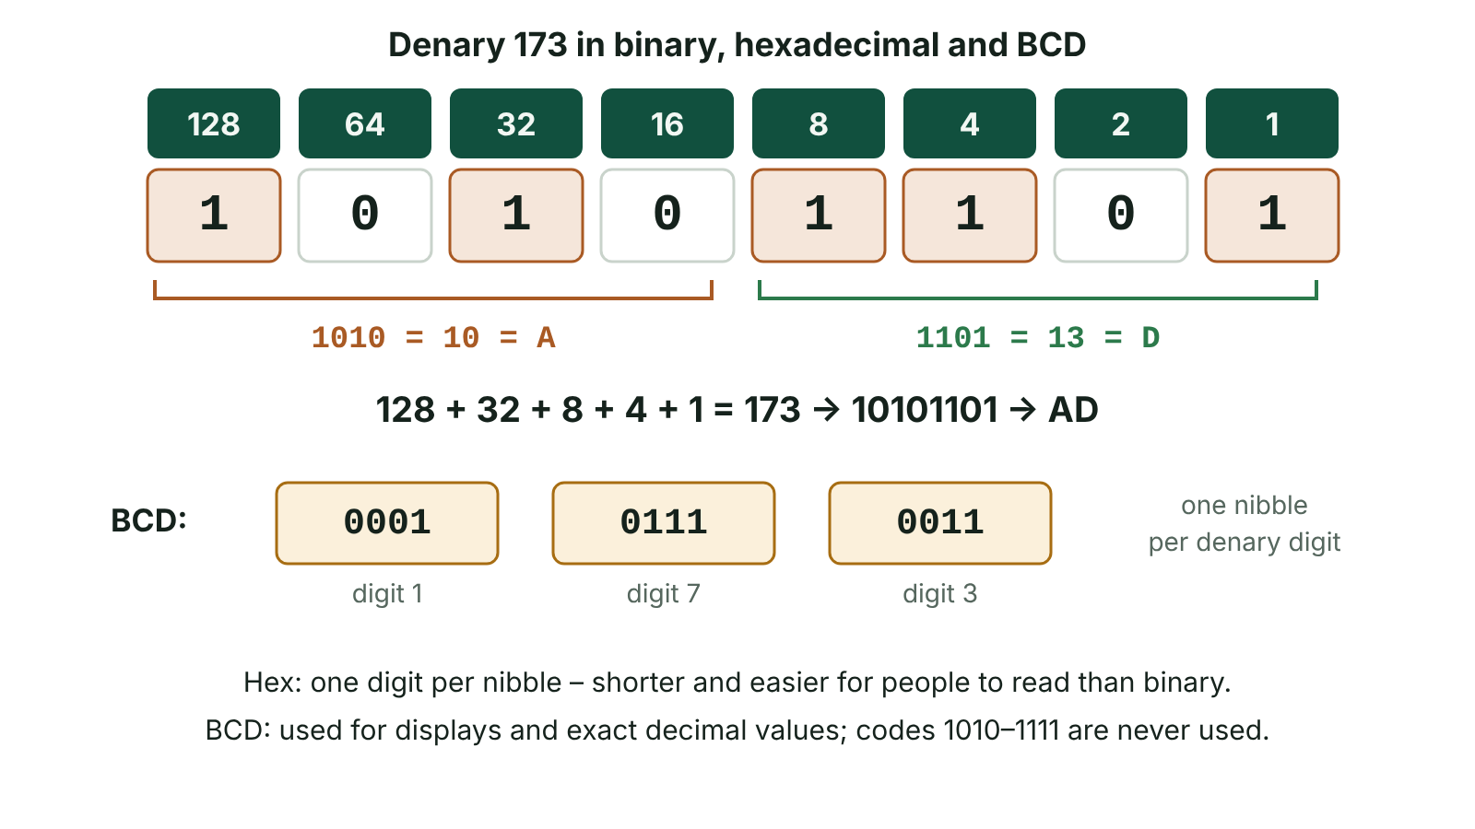
The big picture
173 converted to binary using place values, split into nibbles to give hexadecimal AD, and stored digit by digit in binary-coded decimal
☰ Menu
Notes:
Explain the diagram in your own words before you read on.

Slide 9
Why computers use binary
A processor is built from billions of transistors, and each one is either switched on or off, so data is held using just two states: 1 and 0.
A bit (binary digit) is the smallest unit of data and stores a single 0 or 1.
Bits are grouped: 4 bits make a nibble and 8 bits make a byte. One byte is enough to hold the code for one ASCII character.
Text, numbers, images, sound and program instructions are all stored as patterns of bits; the meaning depends on how the pattern is interpreted.
☰ Menu

Slide 10
Units of storage
Unit | Size | As a power of 2 | Roughly
Byte (B) | 8 bits | 2³ bits | one character
Kilobyte (KB) | 1024 bytes | 2¹⁰ bytes | a thousand bytes
Megabyte (MB) | 1024 KB = 1 048 576 bytes | 2²⁰ bytes | a million bytes
Gigabyte (GB) | 1024 MB = 1 073 741 824 bytes | 2³⁰ bytes | a billion bytes
Terabyte (TB) | 1024 GB = 1 099 511 627 776 bytes | 2⁴⁰ bytes | a trillion bytes
☰ Menu

Slide 11
Using the units
Moving up one unit: divide by 1024. Moving down one unit: multiply by 1024.
Example: a 4 GB memory stick holds 4 × 2³⁰ = 4 294 967 296 bytes – about 4 billion.
Example: how many 512 MB backups fit on that stick? 4 GB = 4 × 1024 = 4096 MB, and 4096 ÷ 512 = 8.
Bits to bytes: divide by 8. A 64 000-bit message is 8000 bytes.
Note: drive makers and the IEC use 1 KB = 1000 bytes (and 1 KiB = 1024 bytes); CCEA mark schemes credit 1 KB = 1024 bytes.
☰ Menu

Slide 12
How many values can n bits hold?
Bits (n) | Different values (2ⁿ) | Unsigned range
1 | 2 | 0 to 1
2 | 4 | 0 to 3
4 | 16 | 0 to 15
6 | 64 | 0 to 63
8 | 256 | 0 to 255
10 | 1024 | 0 to 1023
24 | 16 777 216 | 0 to 16 777 215
☰ Menu

Slide 13
Place value in three bases
Base | Digits used | Column values (right to left) | Example: 237
Denary (base 10) | 0–9 | 1, 10, 100, 1000 (10⁰, 10¹, 10², 10³) | 2×100 + 3×10 + 7×1
Binary (base 2) | 0, 1 | 1, 2, 4, 8, 16, 32, 64, 128 (2⁰ to 2⁷) | 11101101
Hexadecimal (base 16) | 0–9, A–F (A = 10 … F = 15) | 1, 16, 256, 4096 (16⁰ to 16³) | ED = 14×16 + 13
☰ Menu

Slide 14
Binary to denary
Place value | 128 | 64 | 32 | 16 | 8 | 4 | 2 | 1
Binary 10011101 | 1 | 0 | 0 | 1 | 1 | 1 | 0 | 1
Weighting | 128 | 0 | 0 | 16 | 8 | 4 | 0 | 1
Sum of weightings | 128 + 16 + 8 + 4 + 1 |  |  |  |  |  |  | = 157
☰ Menu

Slide 15
Denary to binary: subtraction method
Write the place values 128 to 1. Put a 1 under the largest value that fits, subtract it, and repeat with what is left.
Example 214: 214 − 128 = 86; 86 − 64 = 22; 22 − 16 = 6; 6 − 4 = 2; 2 − 2 = 0.
1s go under 128, 64, 16, 4 and 2; every other column is 0.
Answer: 214 = 11010110. Check: 128 + 64 + 16 + 4 + 2 = 214.
Quick check: an even number always ends in 0 and an odd number always ends in 1.
☰ Menu

Slide 16
Denary to binary: division method
Divide by 2 repeatedly, writing down each remainder, until the quotient is 0.
214 → 107 r0 → 53 r1 → 26 r1 → 13 r0 → 6 r1 → 3 r0 → 1 r1 → 0 r1.
Read the remainders from the last one to the first: 11010110. The code below does exactly this.
☰ Menu

Slide 17
Denary to binary: division method – code
C#
int n = 214;
string bits = "";
while (n > 0)
{
bits = (n % 2) + bits; // remainder becomes the next bit on the left
n = n / 2; // integer division
}
bits = bits.PadLeft(8, '0'); // add leading zeros to make a full byte
Console.WriteLine(bits); // 11010110
Console.WriteLine(Convert.ToInt32(bits, 2)); // back to 214
☰ Menu

Slide 18
Hexadecimal conversions
16 = 2⁴, so one hex digit stands for exactly one nibble. Binary → hex: split into nibbles from the right and convert each.
10110111 → 1011 | 0111 → 11 | 7 → B7.
Hex → denary: first digit × 16, plus the second digit. B7 = 11 × 16 + 7 = 176 + 7 = 183.
Denary → hex: divide by 16; the quotient is the first digit and the remainder the second. 94 ÷ 16 = 5 r 14 → 5E.
Hex → binary: write each digit as 4 bits. 5E → 0101 1110.
☰ Menu

Slide 19
Why use hexadecimal?
It is far shorter than binary – two hex digits per byte – so it is quicker to read, write and remember.
People make fewer copying errors with 'C8' than with '11001000'.
It converts to and from binary much more easily than denary does, because each digit maps to one nibble.
Seen in colour codes (#1A6B53), MAC addresses, memory addresses, error codes and machine-code dumps.
It does not save memory: the computer still stores and processes everything in binary. Hex is purely for humans.
☰ Menu

Slide 20
Worked example: a website colour
Step | Red | Green | Blue
A café in Newry picks the brand colour #1A6B53 | 1A | 6B | 53
Hex → denary (first digit × 16 + second) | 1×16 + 10 = 26 | 6×16 + 11 = 107 | 5×16 + 3 = 83
Hex → binary (one nibble per digit) | 0001 1010 | 0110 1011 | 0101 0011
Bits needed for the whole colour | 8 | 8 | 8 → 24 bits in total
☰ Menu

Slide 21
Binary-coded decimal (BCD)
In BCD each denary digit is coded separately as its own 4-bit nibble.
59 in BCD is 0101 1001 (5 then 9); in pure binary it is 00111011.
Only 0000 to 1001 are used, so 1010 to 1111 are invalid in BCD and some storage is wasted.
Easy to convert digit by digit for display, and decimal values such as money can be held exactly.
Used in digital clocks, calculators, seven-segment displays, electricity meters and some financial systems.
☰ Menu

Slide 22
Worked example: a station clock
Display | Digits | BCD nibbles | Bits
19:45 at a Translink bus station | 1, 9, 4, 5 | 0001 1001 : 0100 0101 | 16
23:58 | 2, 3, 5, 8 | 0010 0011 : 0101 1000 | 16
Same time as minutes since midnight in pure binary | 1185 | 10010100001 | 11
Why the clock uses BCD | Each nibble drives one display digit directly | No conversion needed | Costs 5 extra bits
☰ Menu

Slide 23
Model chain: one number, four forms
Task | Working | Answer
Denary 173 → binary | 128 + 32 + 8 + 4 + 1 | 10101101
Binary 10101101 → hex | 1010 = 10 = A; 1101 = 13 = D | AD
Hex AD → denary | 10 × 16 + 13 | 173
Denary 173 → BCD | 1 | 7 | 3 | 0001 0111 0011
☰ Menu

Slide 24
Exit quiz: question 1 of 9
Tap an answer to check it. Presenting? Click to reveal the answer.
How many different values can be represented with 8 bits?
A 255
B 256
✗
✓
C 128
D 512
✗
✗
✓ B: 256 – 2⁸ = 256 different values, which as unsigned integers run from 0 to 255.
☰ Menu

Slide 25
Exit quiz: question 2 of 9
Tap an answer to check it. Presenting? Click to reveal the answer.
What is the hexadecimal value 3F in denary?
A 48
B 36
✗
✗
C 315
D 63
✗
✓
✓ D: 63 – 3 × 16 + 15 = 48 + 15 = 63.
☰ Menu

Slide 26
Exit quiz: question 3 of 9
Tap an answer to check it. Presenting? Click to reveal the answer.
What is the binary number 11010010 in hexadecimal?
A D2
B C2
✓
✗
C 2D
D B2
✗
✗
✓ A: D2 – Split into nibbles from the right: 1101 = 13 = D and 0010 = 2, giving D2.
☰ Menu

Slide 27
Exit quiz: question 4 of 9
Tap an answer to check it. Presenting? Click to reveal the answer.
Which is the BCD representation of 82?
A 01010010
B 1000 0001
✗
✗
C 1000 0010
D 0101 0010
✓
✗
✓ C: 1000 0010 – Each digit is coded separately: 8 = 1000 and 2 = 0010.
☰ Menu

Slide 28
Exit quiz: question 5 of 9
Tap an answer to check it. Presenting? Click to reveal the answer.
Which of these is NOT a common use of hexadecimal?
A HTML colour codes
B MAC addresses
✗
✗
C Memory addresses in error dumps
D Storing text in RAM
✗
✓
✓ D: Storing text in RAM – Text is stored in binary using a character set; hex is only a human-readable notation for viewing values.
☰ Menu

Slide 29
Exit quiz: question 6 of 9
Tap an answer to check it. Presenting? Click to reveal the answer.
What is the minimum number of bits needed to store 300 as an unsigned integer?
A 8
B 9
✗
✓
C 10
D 16
✗
✗
✓ B: 9 – 2⁸ = 256 is too small; 2⁹ = 512 is enough.
☰ Menu

Slide 30
Exit quiz: question 7 of 9
Tap an answer to check it. Presenting? Click to reveal the answer.
Using the definition credited by CCEA, how many bytes are in a kilobyte?
A 1024
B 1000
✓
✗
C 8
D 1 048 576
✗
✗
✓ A: 1024 – A kilobyte is 2¹⁰ = 1024 bytes; 1 048 576 bytes is a megabyte.
☰ Menu

Slide 31
Exit quiz: question 8 of 9
Tap an answer to check it. Presenting? Click to reveal the answer.
A file is 2 MB. How many kilobytes is that?
A 2000
B 2048
✗
✓
C 1024
D 16
✗
✗
✓ B: 2048 – Moving down one unit means multiplying by 1024: 2 × 1024 = 2048 KB.
☰ Menu

Slide 32
Exit quiz: question 9 of 9
Tap an answer to check it. Presenting? Click to reveal the answer.
What is 214 in 8-bit binary?
A 11010110
B 11010101
✓
✗
C 10110110
D 11100110
✗
✗
✓ A: 11010110 – 128 + 64 + 16 + 4 + 2 = 214, giving 11010110.
☰ Menu

Slide 33
Exit quiz answers
Q | Answer | Why
1 | B 256 | 2⁸ = 256 different values, which as unsigned integers run from 0 to 255.
2 | D 63 | 3 × 16 + 15 = 48 + 15 = 63.
3 | A D2 | Split into nibbles from the right: 1101 = 13 = D and 0010 = 2, giving D2.
4 | C 1000 0010 | Each digit is coded separately: 8 = 1000 and 2 = 0010.
5 | D Storing text in RAM | Text is stored in binary using a character set; hex is only a human-readable notation for viewing values.
6 | B 9 | 2⁸ = 256 is too small; 2⁹ = 512 is enough.
7 | A 1024 | A kilobyte is 2¹⁰ = 1024 bytes; 1 048 576 bytes is a megabyte.
8 | B 2048 | Moving down one unit means multiplying by 1024: 2 × 1024 = 2048 KB.
9 | A 11010110 | 128 + 64 + 16 + 4 + 2 = 214, giving 11010110.
☰ Menu

Slide 34
Negative numbers and binary arithmetic
AS 2: FUNDAMENTALS OF DIGITAL TECHNOLOGY · FD02
Learning objectives
Add binary numbers using the four addition rules and show the carries
Represent negative integers in sign and magnitude and in two's complement, and state the range of each
Convert between denary and 8-bit two's complement, checking each answer
Subtract by adding the two's complement and explain why the final carry is discarded
Identify overflow in unsigned and signed arithmetic and explain its consequences
Notes:
Specification: Perform binary addition of unsigned integers, showing carries | Represent signed integers using sign and magnitude and explain its limitations | Demonstrate how the two's complement system represents positive and negative numbers using 8 bits | Convert between denary and 8-bit two's complement in both directions | Perform addition and subtraction using two's complement | Explain overflow and recognise when it occurs

Slide 35
In this lesson
Tap a button to jump straight there. The ☰ Menu button on every slide brings you back here.
The big picture
Denary to two's complement
Consequences of overflow
Binary addition rules
Two's complement to denary
Comparing the two methods
Worked example: adding scores
Worked example: a frosty morning
Common errors to avoid
Sign and magnitude
Subtraction: add the negative
Exit quiz
Two's complement: the idea
Overflow
↑ Topic menu
Notes:
Lesson menu: each button jumps to that part of the lesson in Slide Show. The ☰ Menu button on each slide returns here.

Slide 36
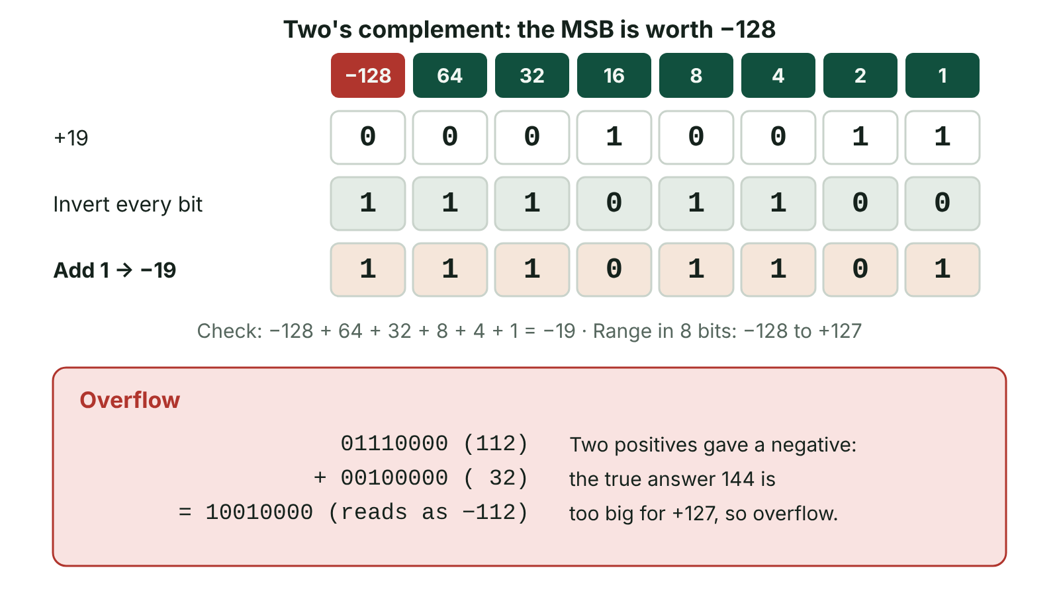
The big picture
Forming -19 in 8-bit two's complement by inverting the bits of +19 and adding 1, and an example of overflow when two positive numbers give a negative result
☰ Menu
Notes:
Explain the diagram in your own words before you read on.

Slide 37
Binary addition rules
Sum | Result bit | Carry to next column | Denary check
0 + 0 | 0 | 0 | 0
0 + 1 or 1 + 0 | 1 | 0 | 1
1 + 1 | 0 | 1 | 2 = 10
1 + 1 + 1 (with a carry in) | 1 | 1 | 3 = 11
☰ Menu

Slide 38
Worked example: adding scores
An Ulster Schools quiz team scores 91 in round one and 54 in round two. Add them in 8-bit binary.
01011011 (91) + 00110110 (54)
Work right to left: 1+0=1; 1+1=0 c1; 0+1+1=0 c1; 1+0+1=0 c1; 1+1+1=1 c1; 0+1+1=0 c1; 1+0+1=0 c1; 0+0+1=1.
Result: 10010001. Check: 128 + 16 + 1 = 145 = 91 + 54.
Write the carries in a row under the sum – they often earn a method mark.
☰ Menu

Slide 39
Sign and magnitude
The MSB is a sign bit (0 = positive, 1 = negative); the remaining bits give the size (magnitude).
+19 = 00010011 and −19 = 10010011 in 8 bits.
8-bit range: −127 to +127. In general, n bits give −(2ⁿ⁻¹ − 1) to +(2ⁿ⁻¹ − 1).
Problem 1: there are two zeros, 00000000 (+0) and 10000000 (−0), which wastes a pattern and complicates comparisons.
Problem 2: ordinary addition fails. 5 + (−3): 00000101 + 10000011 = 10001000, which reads as −8, not +2.
☰ Menu

Slide 40
Two's complement: the idea
Place value | −128 | 64 | 32 | 16 | 8 | 4 | 2 | 1
+5 | 0 | 0 | 0 | 0 | 0 | 1 | 0 | 1
−1 | 1 | 1 | 1 | 1 | 1 | 1 | 1 | 1
−71 | 1 | 0 | 1 | 1 | 1 | 0 | 0 | 1
−128 (most negative) | 1 | 0 | 0 | 0 | 0 | 0 | 0 | 0
+127 (most positive) | 0 | 1 | 1 | 1 | 1 | 1 | 1 | 1
☰ Menu

Slide 41
Denary to two's complement
1. Write the positive value in binary. 2. Pad with leading zeros to 8 bits. 3. Invert every bit. 4. Add 1.
Example −82: 82 = 1010010 → 01010010 → invert 10101101 → add 1 → 10101110.
Check with place values: −128 + 32 + 8 + 4 + 2 = −82.
Second check: 01010010 + 10101110 = 1 00000000; ignore the carry out and the answer is 0, as x + (−x) should be.
Shortcut: from the right, copy bits up to and including the first 1, then invert all the bits to its left.
☰ Menu

Slide 42
Two's complement to denary
If the MSB is 0, convert as normal unsigned binary.
If the MSB is 1, the number is negative: add −128 to the place values of the other 1s.
Example 10111001: −128 + 32 + 16 + 8 + 1 = −71.
Alternative: invert and add 1 to find the magnitude. 10111001 → 01000110 → 01000111 = 71, so the value is −71.
☰ Menu

Slide 43
Two's complement to denary – code
C#
byte raw = 0b1011_1001; // the stored 8 bits
sbyte value = unchecked((sbyte)raw); // read them as two's complement
Console.WriteLine(raw); // 185 if read as unsigned
Console.WriteLine(value); // -71 if read as signed
☰ Menu

Slide 44
Worked example: a frosty morning
Step | Working | Bits
A weather station near Enniskillen logs −6 °C | 6 = 00000110 → invert 11111001 → add 1 | 11111010
By midday it is 9 degrees warmer | +9 | 00001001
Add | 11111010 + 00001001 | 1 00000011
Discard the carry out of the MSB | 8-bit result | 00000011
Check | −6 + 9 | +3 °C
☰ Menu

Slide 45
Subtraction: add the negative
A − B is worked out as A + (two's complement of B), so the CPU needs only an adder circuit.
45 − 19: 00101101 + 11101101 = 1 00011010. Discard the carry: 00011010 = 26.
38 − 52: 00100110 + 11001100 = 11110010 (no carry). −128 + 64 + 32 + 16 + 2 = −14.
A carry out of the MSB in two's complement is simply discarded; on its own it does not mean the answer is wrong.
☰ Menu

Slide 46
Subtraction: add the negative – code
C#
int a = 45, b = 19;
int negB = (~b + 1) & 0xFF; // invert, add 1, keep 8 bits
int sum = (a + negB) & 0xFF; // add, then discard the carry out
Console.WriteLine(Convert.ToString(negB, 2)); // 11101101
Console.WriteLine(sum); // 26
☰ Menu

Slide 47
Overflow
Overflow: the result of a calculation is too large (or too negative) to fit in the bits available.
Unsigned: a carry out of the MSB means overflow. 200 + 100 = 300 > 255; the 8-bit result 00101100 reads as 44.
Two's complement: two positives giving a negative, or two negatives giving a positive, means overflow.
100 + 50: 01100100 + 00110010 = 10010110, which reads as −106 because 150 > 127.
−100 + (−50): 10011100 + 11001110 = 1 01101010, which reads as +106 because −150 < −128.
Adding a positive and a negative can never overflow.
☰ Menu

Slide 48
Consequences of overflow
The processor sets an overflow flag in the status register so that software can detect the error.
If it is ignored, the program carries on with a wrong value, which may give incorrect results, a crash or unsafe behaviour.
Programmers prevent it by choosing a data type with enough bits or by checking results.
The C# below shows the same 8 bits wrapping round silently, and a checked block catching the error instead.
☰ Menu

Slide 49
Consequences of overflow – code
C#
sbyte a = 100, b = 50;
sbyte wrapped = unchecked((sbyte)(a + b));
Console.WriteLine(wrapped); // -106: overflow has happened
try
{
sbyte safe = checked((sbyte)(a + b));
Console.WriteLine(safe);
}
catch (OverflowException)
{
Console.WriteLine("Overflow detected");
}
☰ Menu

Slide 50
Comparing the two methods
 | Sign and magnitude | Two's complement
8-bit range | −127 to +127 | −128 to +127
n-bit range | −(2ⁿ⁻¹ − 1) to +(2ⁿ⁻¹ − 1) | −2ⁿ⁻¹ to +(2ⁿ⁻¹ − 1)
Zero | Two zeros (+0 and −0) | One zero
Arithmetic | Needs special rules for mixed signs | Normal binary addition works
Subtraction | Needs a separate subtractor | Add the two's complement
Reading negatives | Easy for people | Harder for people
☰ Menu

Slide 51
Common errors to avoid
Forgetting to pad to 8 bits before inverting: for −26, pad 11010 to 00011010 first, then invert (11100101) and add 1, giving 11100110.
Inverting but forgetting to add 1 (that gives one's complement, which is out by one).
Treating the MSB as +128 when the question says two's complement.
Calling a discarded carry 'overflow' in two's complement – check the signs instead.
Stating the range as −128 to +128: there is no +128 in 8-bit two's complement.
☰ Menu

Slide 52
Exit quiz: question 1 of 9
Tap an answer to check it. Presenting? Click to reveal the answer.
What denary value does 11110110 represent in 8-bit two's complement?
A −10
B 246
✓
✗
C −118
D −9
✗
✗
✓ A: −10 – −128 + 64 + 32 + 16 + 4 + 2 = −10. The value 246 would be the unsigned reading.
☰ Menu

Slide 53
Exit quiz: question 2 of 9
Tap an answer to check it. Presenting? Click to reveal the answer.
Why is two's complement preferred to sign and magnitude in processors?
A It is easier for people to read
B It uses fewer bits for each number
✗
✗
C Subtraction can be done using the same adder circuit
D It can store real numbers
✓
✗
✓ C: Subtraction can be done using the same adder circuit – A − B becomes A + (−B), so only an adder is needed, and there is a single zero.
☰ Menu

Slide 54
Exit quiz: question 3 of 9
Tap an answer to check it. Presenting? Click to reveal the answer.
What is the range of 8-bit sign and magnitude?
A −128 to +127
B 0 to 255
✗
✗
C −128 to +128
D −127 to +127
✗
✓
✓ D: −127 to +127 – One bit is the sign, so the other 7 bits give 0–127 in each direction.
☰ Menu

Slide 55
Exit quiz: question 4 of 9
Tap an answer to check it. Presenting? Click to reveal the answer.
Which addition overflows in 8-bit two's complement?
A 00010000 + 00010000
B 01100000 + 00110000
✗
✓
C 11110000 + 00000100
D 10000000 + 01111111
✗
✗
✓ B: 01100000 + 00110000 – 96 + 48 = 144, which is greater than 127, so the result appears negative.
☰ Menu

Slide 56
Exit quiz: question 5 of 9
Tap an answer to check it. Presenting? Click to reveal the answer.
What is 1 + 1 + 1 in binary addition?
A 0 carry 1
B 1 carry 0
✗
✗
C 10 carry 1
D 1 carry 1
✗
✓
✓ D: 1 carry 1 – 3 is 11 in binary: write 1 in this column and carry 1.
☰ Menu

Slide 57
Exit quiz: question 6 of 9
Tap an answer to check it. Presenting? Click to reveal the answer.
What is −82 in 8-bit two's complement?
A 11010010
B 10101110
✗
✓
C 10101101
D 01010010
✗
✗
✓ B: 10101110 – 82 = 01010010; invert to 10101101; add 1 to get 10101110.
☰ Menu

Slide 58
Exit quiz: question 7 of 9
Tap an answer to check it. Presenting? Click to reveal the answer.
In the subtraction 45 − 19 using 8-bit two's complement, what happens to the ninth bit produced?
A It is discarded
B It shows overflow has occurred
✓
✗
C It becomes the sign bit
D It is added back to the LSB
✗
✗
✓ A: It is discarded – The carry out of the MSB is discarded; 00011010 = 26 is correct.
☰ Menu

Slide 59
Exit quiz: question 8 of 9
Tap an answer to check it. Presenting? Click to reveal the answer.
What is the unsigned 8-bit result of 200 + 100?
A 300
B 00101100 (44) because of overflow
✗
✓
C 11111111 (255)
D An error with no stored result
✗
✗
✓ B: 00101100 (44) because of overflow – 300 needs 9 bits; only the lower 8 bits, 00101100 = 44, are kept.
☰ Menu

Slide 60
Exit quiz: question 9 of 9
Tap an answer to check it. Presenting? Click to reveal the answer.
How many different values can 8-bit two's complement represent?
A 255
B 127
✗
✗
C 256
D 128
✓
✗
✓ C: 256 – Still 2⁸ = 256 patterns: −128 to +127 inclusive.
☰ Menu

Slide 61
Exit quiz answers
Q | Answer | Why
1 | A −10 | −128 + 64 + 32 + 16 + 4 + 2 = −10. The value 246 would be the unsigned reading.
2 | C Subtraction can be done using the same adder circuit | A − B becomes A + (−B), so only an adder is needed, and there is a single zero.
3 | D −127 to +127 | One bit is the sign, so the other 7 bits give 0–127 in each direction.
4 | B 01100000 + 00110000 | 96 + 48 = 144, which is greater than 127, so the result appears negative.
5 | D 1 carry 1 | 3 is 11 in binary: write 1 in this column and carry 1.
6 | B 10101110 | 82 = 01010010; invert to 10101101; add 1 to get 10101110.
7 | A It is discarded | The carry out of the MSB is discarded; 00011010 = 26 is correct.
8 | B 00101100 (44) because of overflow | 300 needs 9 bits; only the lower 8 bits, 00101100 = 44, are kept.
9 | C 256 | Still 2⁸ = 256 patterns: −128 to +127 inclusive.
☰ Menu

Slide 62
Real numbers: fixed-point and floating-point
AS 2: FUNDAMENTALS OF DIGITAL TECHNOLOGY · FD03
Learning objectives
Convert between denary and fixed-point binary with a given binary point position
Convert floating-point numbers (two's complement mantissa and exponent) to denary and back
Normalise a floating-point number and explain why normalisation is used
Explain how the split of bits between mantissa and exponent affects range and precision
Explain why some real numbers cannot be stored exactly and the effect this has on programs
Notes:
Specification: Represent real numbers in fixed-point binary and convert between fixed-point and denary | Explain floating-point representation using a two's complement mantissa and exponent | Convert between denary and normalised floating-point binary | Normalise floating-point numbers and explain the purpose of normalisation | Explain the trade-off between range and precision and compare fixed-point with floating-point | Describe rounding errors, overflow and underflow with real numbers

Slide 63
In this lesson
Tap a button to jump straight there. The ☰ Menu button on every slide brings you back here.
The big picture
Worked examples: negative mantissa and negative exponent
Errors with real numbers
Storing real numbers
Decoding floating point in C#
Floating point in real systems
Fixed-point binary
Normalisation
Exit quiz
Fixed point: converting and its limits
Worked example: a fitness tracker
↑ Topic menu
Floating point: the idea
Negative denary to floating point
Worked example: positive value
Range versus precision
Notes:
Lesson menu: each button jumps to that part of the lesson in Slide Show. The ☰ Menu button on each slide returns here.

Slide 64
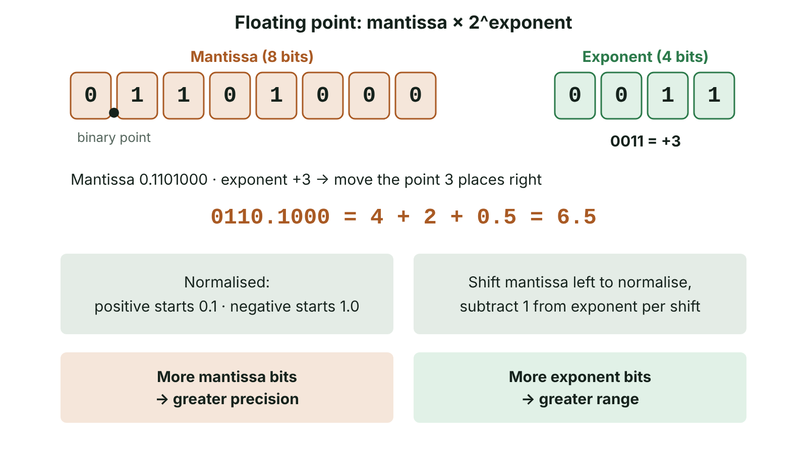
The big picture
A floating-point number with an 8-bit two's complement mantissa and 4-bit exponent; the exponent of 3 moves the binary point three places right to give 6.5
☰ Menu
Notes:
Explain the diagram in your own words before you read on.

Slide 65
Storing real numbers
Real numbers have a fractional part: 6.75 km run, £3.49, 0.0004 seconds, 37.2 °C.
Integers alone cannot hold these, so computers extend place value to the right of a binary point.
Columns after the point are worth ½, ¼, ⅛, 1/16 … (2⁻¹, 2⁻², 2⁻³, 2⁻⁴ …).
Two approaches: fixed point (the point never moves) and floating point (the point moves according to an exponent).
☰ Menu

Slide 66
Fixed-point binary
Place value | 8 | 4 | 2 | 1 | . | ½ | ¼ | ⅛ | 1/16
0110.1010 | 0 | 1 | 1 | 0 | . | 1 | 0 | 1 | 0
Weighting | 0 | 4 | 2 | 0 | . | 0.5 | 0 | 0.125 | 0
Total | 4 + 2 + 0.5 + 0.125 |  |  |  |  |  |  |  | = 6.625
☰ Menu

Slide 67
Fixed point: converting and its limits
Denary → fixed point (4.4): 9.375 = 8 + 1 + 0.25 + 0.125 → 1001.0110.
In 4.4 format the step size (precision) is 1/16 = 0.0625 and the largest unsigned value is 1111.1111 = 15.9375.
Moving the point right increases range but reduces precision; moving it left does the opposite.
Signed fixed point uses two's complement: 1101.1000 = −8 + 4 + 1 + 0.5 = −2.5.
Fast and simple, with the same absolute precision everywhere, but it cannot hold very large and very small values at once.
☰ Menu

Slide 68
Floating point: the idea
Like standard form in science (6.02 × 10²³), but in binary: value = mantissa × 2^exponent.
The mantissa holds the significant bits. It is a two's complement fraction with the binary point just after the sign bit.
The exponent is a two's complement integer saying how many places, and which way, to move the binary point.
Positive exponent: move the point right. Negative exponent: move the point left.
In these examples: 8-bit mantissa then 4-bit exponent, e.g. 0.1101000 0011.
☰ Menu

Slide 69
Worked example: positive value
Step | Working
Given (8-bit mantissa, 4-bit exponent) | 0.1101000 0011
1. Exponent to denary | 0011 = +3
2. Move the binary point 3 places right | 0110.1000
3. Convert using place values | 4 + 2 + 0.5 = 6.5
☰ Menu

Slide 70
Worked examples: negative mantissa and negative exponent
Step | 1.0110000 0010 | 0.1100000 1110
Exponent | 0010 = +2 | 1110 = −8 + 4 + 2 = −2
Move the point | 2 places right: 101.10000 | 2 places left: 0.0011000
Place values | MSB now worth −4 | ¼ column is 0, ⅛ and 1/16 are 1
Value | −4 + 1 + 0.5 = −2.5 | 0.125 + 0.0625 = 0.1875
☰ Menu

Slide 71
Decoding floating point in C#
The program applies the same steps: the mantissa's first bit is worth −1, then ½, ¼, ⅛ …; the exponent's first bit is negative.
Change m and e to check your own answers.
☰ Menu

Slide 72
Decoding floating point in C# – code
C#
string m = "01101000"; // mantissa 0.1101000
string e = "0011"; // exponent
double mant = -(m[0] - '0'); // sign bit is worth -1
for (int i = 1; i < m.Length; i++)
mant += (m[i] - '0') * Math.Pow(2, -i);
int exp = Convert.ToInt32(e, 2);
if (e[0] == '1') exp -= 1 << e.Length; // two's complement exponent
Console.WriteLine(mant * Math.Pow(2, exp)); // 6.5
☰ Menu

Slide 73
Normalisation
A normalised mantissa starts 0.1 (positive) or 1.0 (negative): the first two bits differ.
To normalise, shift the mantissa left until the first two bits differ and subtract 1 from the exponent for each shift.
Positive: 0.0010110 × 2^0110 → shift left 2 → 0.1011000 × 2^0100 (both equal 11).
Negative: 1.1101000 × 2^0011 → shift left 2 → 1.0100000 × 2^0001 (both equal −1.5).
Why: no bits are wasted on repeated leading 0s or 1s, so precision is maximised, and each value has one unique representation.
☰ Menu

Slide 74
Worked example: a fitness tracker
Step | Working
A runner in Belfast logs 6.75 km; store it in normalised form | 6.75 = 4 + 2 + 0.5 + 0.25
1. Write in binary | 110.11
2. Move the point so the number starts 0.1 | 0.11011 × 2³ (point moved 3 places left)
3. Fill the 8-bit mantissa | 0.1101100
4. Exponent 3 in 4-bit two's complement | 0011
Answer (check: 0110.1100 = 6.75) | 0.1101100 0011
☰ Menu

Slide 75
Negative denary to floating point
Example −5.25: first find +5.25 = 101.01 = 0.1010100 × 2³.
Take the two's complement of the mantissa: invert 0.1010100 → 1.0101011, then add 1 → 1.0101100.
The exponent is unchanged: 0011. Answer: 1.0101100 0011.
Check: move the point 3 right → 1010.1100 = −8 + 2 + 0.5 + 0.25 = −5.25.
The result starts 1.0, so it is already normalised.
☰ Menu

Slide 76
Range versus precision (1 of 2)
Choice (total bits fixed) | Effect
More bits in the mantissa | Greater precision (more significant bits), smaller range
More bits in the exponent | Greater range (larger and smaller magnitudes), less precision
8-bit mantissa, 4-bit exponent | Largest value 0.1111111 × 2⁷ = 127; smallest positive normalised 0.1 × 2⁻⁸ ≈ 0.00195
6-bit mantissa, 6-bit exponent | Largest value just under 2³¹ (over 2 billion), but only 5 significant bits
Fixed point | Constant absolute precision; small range; fast
☰ Menu

Slide 77
Range versus precision (2 of 2)
Choice (total bits fixed) | Effect
Floating point | Very wide range; precision relative to size; slower, more complex hardware
☰ Menu

Slide 78
Errors with real numbers
Rounding error: 0.1 is a recurring fraction in binary (0.000110011…), so it is stored approximately.
In 4.4 fixed point, 0.1 rounds to the nearest step, 0000.0010 = 0.125: absolute error 0.025, relative error 25%.
Overflow: the exponent needed is larger than the exponent field can hold. Underflow: the value is too close to zero, so it is stored as 0.
Money is often stored as an integer number of pence, or as a decimal type, to avoid these errors.
☰ Menu

Slide 79
Errors with real numbers – code
C#
double total = 0;
for (int i = 0; i < 10; i++) total = total + 0.1;
Console.WriteLine(total == 1.0); // False
Console.WriteLine(total); // 0.9999999999999999
decimal pounds = 0;
for (int i = 0; i < 10; i++) pounds = pounds + 0.1m;
Console.WriteLine(pounds == 1.0m); // True
☰ Menu

Slide 80
Floating point in real systems
Real processors use the IEEE 754 standard: a 32-bit float has 1 sign bit, 8 exponent bits and 23 mantissa bits; a 64-bit double has 1, 11 and 52.
IEEE 754 stores the sign separately and uses a biased exponent, but the principles of range, precision and normalisation are the same.
In C#, float gives about 7 significant denary digits and double about 15–16; decimal is a base-10 type designed for money.
Games, scientific models and sensors use floating point; tills and banking systems avoid it for currency.
☰ Menu

Slide 81
Exit quiz: question 1 of 9
Tap an answer to check it. Presenting? Click to reveal the answer.
In floating point, what is the main effect of using more bits for the exponent and fewer for the mantissa?
A Greater precision
B Faster processing
✗
✗
C Greater range but less precision
D Fewer rounding errors
✓
✗
✓ C: Greater range but less precision – The exponent controls how far the point can move, so range increases; fewer mantissa bits means less precision.
☰ Menu

Slide 82
Exit quiz: question 2 of 9
Tap an answer to check it. Presenting? Click to reveal the answer.
Why are floating-point numbers normalised?
A To make them positive
B To maximise precision and give a unique representation
✗
✓
C To increase the range of the exponent
D To convert them to fixed point
✗
✗
✓ B: To maximise precision and give a unique representation – Removing redundant leading bits uses the whole mantissa for significant bits, and each value then has only one form.
☰ Menu

Slide 83
Exit quiz: question 3 of 9
Tap an answer to check it. Presenting? Click to reveal the answer.
What is 0.1100000 0010 (8-bit mantissa, 4-bit exponent) in denary?
A 0.75
B 1.5
✗
✗
C 6
D 3
✗
✓
✓ D: 3 – Exponent +2: move the point two places right to get 011.00000 = 3.
☰ Menu

Slide 84
Exit quiz: question 4 of 9
Tap an answer to check it. Presenting? Click to reveal the answer.
Which mantissa is normalised?
A 0.0110000
B 1.1010000
✗
✗
C 0.1010000
D 1.1100000
✓
✗
✓ C: 0.1010000 – The first two bits must differ: positive normalised mantissas start 0.1.
☰ Menu

Slide 85
Exit quiz: question 5 of 9
Tap an answer to check it. Presenting? Click to reveal the answer.
What does 0110.0100 represent in unsigned 4.4 fixed point?
A 6.25
B 6.4
✓
✗
C 6.5
D 100.25
✗
✗
✓ A: 6.25 – 4 + 2 + 0.25 = 6.25.
☰ Menu

Slide 86
Exit quiz: question 6 of 9
Tap an answer to check it. Presenting? Click to reveal the answer.
What is underflow?
A A number too large to store
B A carry out of the MSB
✗
✗
C A rounding error in BCD
D A number too close to zero to represent
✗
✓
✓ D: A number too close to zero to represent – The exponent cannot go negative enough, so the value is stored as zero.
☰ Menu

Slide 87
Exit quiz: question 7 of 9
Tap an answer to check it. Presenting? Click to reveal the answer.
What is 0.1100000 1110 in denary?
A 0.1875
B 0.75
✓
✗
C 3
D −0.25
✗
✗
✓ A: 0.1875 – Exponent 1110 = −2, so move the point two places left: 0.0011 = 0.125 + 0.0625 = 0.1875.
☰ Menu

Slide 88
Exit quiz: question 8 of 9
Tap an answer to check it. Presenting? Click to reveal the answer.
Normalise 0.0010110 0110. What is the new exponent?
A 1000
B 0100
✗
✓
C 0101
D 0110
✗
✗
✓ B: 0100 – The mantissa is shifted left 2 places, so the exponent falls from 6 to 4 (0100).
☰ Menu

Slide 89
Exit quiz: question 9 of 9
Tap an answer to check it. Presenting? Click to reveal the answer.
Why is money often stored as an integer number of pence?
A It uses less memory than any other type
B Values such as £0.10 cannot be stored exactly as binary fractions
✗
✓
C Integers cannot overflow
D Floating point cannot store negative numbers
✗
✗
✓ B: Values such as £0.10 cannot be stored exactly as binary fractions – Binary fractions such as 0.1 recur, causing rounding errors; whole pence are exact.
☰ Menu

Slide 90
Exit quiz answers
Q | Answer | Why
1 | C Greater range but less precision | The exponent controls how far the point can move, so range increases; fewer mantissa bits means less precision.
2 | B To maximise precision and give a unique representation | Removing redundant leading bits uses the whole mantissa for significant bits, and each value then has only one form.
3 | D 3 | Exponent +2: move the point two places right to get 011.00000 = 3.
4 | C 0.1010000 | The first two bits must differ: positive normalised mantissas start 0.1.
5 | A 6.25 | 4 + 2 + 0.25 = 6.25.
6 | D A number too close to zero to represent | The exponent cannot go negative enough, so the value is stored as zero.
7 | A 0.1875 | Exponent 1110 = −2, so move the point two places left: 0.0011 = 0.125 + 0.0625 = 0.1875.
8 | B 0100 | The mantissa is shifted left 2 places, so the exponent falls from 6 to 4 (0100).
9 | B Values such as £0.10 cannot be stored exactly as binary fractions | Binary fractions such as 0.1 recur, causing rounding errors; whole pence are exact.
☰ Menu

Slide 91
Character sets and error detection
AS 2: FUNDAMENTALS OF DIGITAL TECHNOLOGY · FD04
Learning objectives
Explain how a character set maps each character to a unique binary code, and use the ordering of ASCII codes to work out unknown codes
Compare ASCII, extended ASCII and Unicode (UTF-8, UTF-16, UTF-32) in terms of range of characters and bytes needed
Add and check odd or even parity bits and explain why a single parity bit cannot catch every error
Explain how a check digit catches keying errors such as transpositions, and how this differs from parity checking of transmitted data
Notes:
Specification: Explain what a character set is and why an agreed standard is needed for text to be exchanged between computers | Demonstrate how ASCII, extended ASCII and Unicode are used to represent characters | Compare character sets in terms of the number of characters represented and the storage required | Describe how odd and even parity bits are used to detect transmission errors, and their limitations | Explain the purpose of a check digit and how it differs from a parity bit

Slide 92
In this lesson
Tap a button to jump straight there. The ☰ Menu button on every slide brings you back here.
The big picture
Unicode
Check digits: how they differ from parity
Why computers need character sets
Comparing character sets
Worked example: even parity on a whole word
How 7-bit ASCII is organised
Worked example: storing an Irish name
Calculating even parity in C#
Worked example: using the order of codes
Parity bits
Exit quiz
Characters as numbers in C#
Worked example: parity on a ticket machine link
↑ Topic menu
Extended ASCII and code pages
Limits of parity and other checks
Notes:
Lesson menu: each button jumps to that part of the lesson in Slide Show. The ☰ Menu button on each slide returns here.

Slide 93
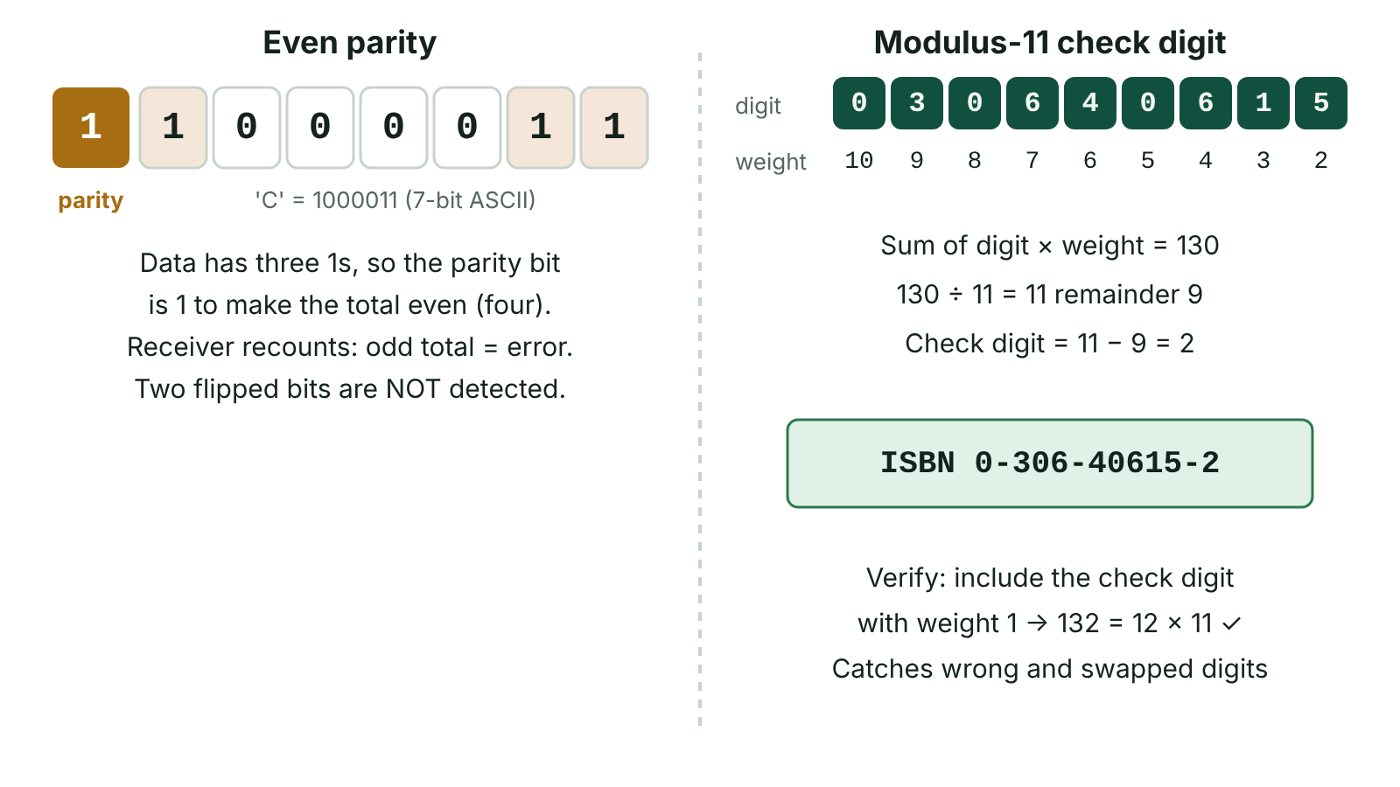
The big picture
An even parity bit added to the ASCII code for C, and a modulus-11 check digit calculation for an ISBN-10
☰ Menu
Notes:
Explain the diagram in your own words before you read on.

Slide 94
Why computers need character sets
Computers can only store binary, so every letter, digit, symbol and space must be stored as a number.
A character set is an agreed list of characters that a system can represent, with a unique binary code for each one.
Sender and receiver must use the same character set, otherwise the same bytes are displayed as the wrong characters.
When you press a key, the keyboard sends a code; it is stored in binary, processed, then turned back into a shape (glyph) on screen.
Character sets also include non-printing control characters, such as carriage return, line feed, tab and escape.
☰ Menu

Slide 95
How 7-bit ASCII is organised
Codes (denary) | Contents | Notes
0 – 31 | Control characters | e.g. 9 = tab, 10 = line feed, 13 = carriage return
32 | Space | The first printable character
48 – 57 | Digits '0' to '9' | '0' is 48, so the digit '7' is 55
65 – 90 | Upper-case 'A' to 'Z' | 'A' is 65 (1000001)
97 – 122 | Lower-case 'a' to 'z' | Each is 32 more than its capital
127 | Delete | Highest code: 7 bits give 2⁷ = 128 codes (0–127)
☰ Menu

Slide 96
Worked example: using the order of codes
Codes run in alphabetical order, which is why text can be sorted by comparing codes.
If 'A' = 65, then 'D' = 65 + 3 = 68 and 'a' = 65 + 32 = 97. In binary, 'A' is 1000001 and 'a' is 1100001: only one bit differs.
The town name 'Erne' is stored as 69, 114, 110, 101, i.e. 01000101 01110010 01101110 01100101: 4 bytes.
A plain text file holding only 'Erne' is therefore 4 bytes; a word-processed file is far larger because it also stores formatting.
The digit '7' is code 55, not the value 7, so joining the text '7' and '1' gives '71', not 8.
☰ Menu

Slide 97
Characters as numbers in C#
In C# a char is stored as a number, so it can be cast to an int to show its code and back again.
Convert.ToString(n, 2) shows the binary pattern; PadLeft adds the leading zeros to make a full byte.
☰ Menu

Slide 98
Characters as numbers in C# – code
C#
char letter = 'A';
int code = letter; // implicit conversion: 65
Console.WriteLine(code);
char lower = (char)(code + 32); // 97 is 'a'
Console.WriteLine(lower);
string bits = Convert.ToString(code, 2).PadLeft(8, '0');
Console.WriteLine(bits); // 01000001
Console.WriteLine("7" + "1"); // text joins: 71
Console.WriteLine('7' - '0'); // 55 - 48 = 7
☰ Menu

Slide 99
Extended ASCII and code pages
ASCII uses only 7 bits of a byte. The spare eighth bit can be used as a parity bit or to double the codes to 2⁸ = 256.
In extended ASCII, codes 0–127 are the same as ASCII (with a leading 0) and codes 128–255 hold accented letters and symbols.
There is no single extended ASCII: different code pages (e.g. ISO 8859-1, Windows-1252) use 128–255 for different characters.
In ISO 8859-1, 'é' is 233; open the file with another code page and a different symbol appears instead.
256 codes are still far too few for languages such as Chinese, Japanese, Arabic or Hindi.
☰ Menu

Slide 100
Unicode
Unicode gives every character in almost every writing system its own code point, written like U+0041 for 'A'.
It has space for over 1.1 million code points; well over 140,000 are assigned, including symbols and emoji.
The first 128 Unicode code points are the same as ASCII, so ASCII text is valid Unicode.
UTF-8 stores each character in 1 to 4 bytes: 1 byte for ASCII characters, 2 for 'é' or 'á', 3 for '€', 4 for most emoji.
UTF-16 uses 2 or 4 bytes per character and UTF-32 always uses 4 bytes. Some textbooks say UTF-8 is 16-bit: it is not.
☰ Menu

Slide 101
Comparing character sets
 | ASCII | Extended ASCII | Unicode
Bits per character | 7 (stored in a byte) | 8 | 8–32 depending on encoding and character
Number of characters | 2⁷ = 128 | 2⁸ = 256 | Over 1.1 million possible code points
Coverage | English letters, digits, punctuation, control codes | Adds accented letters and symbols for one group of languages | Almost all world languages, maths symbols, emoji
Storage | 1 byte per character | 1 byte per character | 1–4 bytes per character (UTF-8)
Main drawback | No accents or other alphabets | Code pages clash between countries | Larger files for non-Latin text
☰ Menu

Slide 102
Worked example: storing an Irish name
Encoding | Bytes for 'Seán Ó Néill' (12 characters) | Reason
7-bit ASCII | Cannot be stored | á, Ó and é are not in ASCII
Extended ASCII (ISO 8859-1) | 12 bytes | 1 byte each; fadas are in codes 128–255
UTF-8 | 15 bytes | 9 ASCII characters × 1 + 3 accented × 2
UTF-16 | 24 bytes | 12 characters × 2 bytes
UTF-32 | 48 bytes | 12 characters × 4 bytes
☰ Menu

Slide 103
Parity bits
A parity bit is one extra bit added to each group of data bits, often making 7-bit ASCII up to a full byte.
Even parity: the parity bit is chosen so the total number of 1s (including the parity bit) is even. Odd parity: the total is odd.
Sender and receiver must agree in advance which type of parity is used, or the check is meaningless.
The receiver counts the 1s in each byte. If the count is wrong for the agreed parity, the byte is corrupt and is re-sent.
In these examples the parity bit is the leftmost (most significant) bit; some systems append it on the right. The count works the same.
☰ Menu

Slide 104
Worked example: parity on a ticket machine link
Stage | Bits | Count of 1s and result
Character 'T' (code 84) | 1010100 | Three 1s
Add even parity bit | 1 1010100 | Parity bit 1 makes four 1s: send 11010100
Received correctly | 11010100 | Four 1s, even: accepted
One bit corrupted | 11000100 | Three 1s, odd: error detected, re-send requested
Two bits corrupted | 11000110 | Four 1s, even: error NOT detected
Same 'T' with odd parity | 01010100 | Parity bit 0 keeps three 1s, odd
☰ Menu

Slide 105
Limits of parity and other checks
Method | How it works | Limitation
Parity bit | Extra bit makes the count of 1s even or odd | Misses an even number of flipped bits; cannot say which bit is wrong
Checksum | A value calculated from a block of data is sent with it and recalculated on arrival | Some combinations of errors can cancel out
Echo check | Receiver sends the data back so the sender can compare it | Doubles the traffic; the error may happen on the return trip
Check digit | Extra digit calculated from the other digits of a code | Shows the code is valid, not that it is the right record
☰ Menu

Slide 106
Check digits: how they differ from parity
A check digit is an extra digit calculated from the other digits of a code number and added to the end, e.g. ISBNs, barcodes and membership numbers.
When the code is keyed in or scanned, the computer recalculates the digit; if the result does not match, the code is rejected.
Parity protects bits while data is transmitted; a check digit protects a whole code number at data entry, catching mistyped and transposed digits.
The Modulus 11 method (weightings from 2 on the right, remainder after dividing by 11, X for 10) is taught and practised in full in FD07.
Like parity, a check digit only detects errors: a valid code can still belong to the wrong customer.
☰ Menu

Slide 107
Worked example: even parity on a whole word
Character | 7-bit ASCII | Number of 1s | Byte sent (parity bit on the left)
E (69) | 1000101 | 3, odd | 11000101
r (114) | 1110010 | 4, even | 01110010
n (110) | 1101110 | 5, odd | 11101110
e (101) | 1100101 | 4, even | 01100101
'n' arrives as 11101010 | Data bits changed | Five 1s in the byte: odd | Error detected; 'n' is re-sent
☰ Menu

Slide 108
Calculating even parity in C#
Each character's code is converted to 7 bits and the 1s are counted.
count % 2 is 0 for an even count, so the parity bit is 0; an odd count needs a parity bit of 1 to make the total even.
☰ Menu

Slide 109
Calculating even parity in C# – code
C#
string word = "Erne";
foreach (char c in word)
{
string bits = Convert.ToString((int)c, 2).PadLeft(7, '0');
int ones = 0;
foreach (char b in bits)
{
if (b == '1') ones++;
}
char parity = (ones % 2 == 0) ? '0' : '1'; // even parity
Console.WriteLine($"{c}: {parity}{bits}");
}
// E: 11000101 r: 01110010 n: 11101110 e: 01100101
☰ Menu

Slide 110
Exit quiz: question 1 of 9
Tap an answer to check it. Presenting? Click to reveal the answer.
How many different characters can 7-bit ASCII represent?
A 64
B 128
✗
✓
C 256
D 65,536
✗
✗
✓ B: 128 – 7 bits give 2⁷ = 128 codes, numbered 0 to 127.
☰ Menu

Slide 111
Exit quiz: question 2 of 9
Tap an answer to check it. Presenting? Click to reveal the answer.
The ASCII code for 'G' is 71. What is the ASCII code for 'g'?
A 71
B 97
✗
✗
C 103
D 135
✓
✗
✓ C: 103 – Lower-case letters are 32 more than their capitals: 71 + 32 = 103.
☰ Menu

Slide 112
Exit quiz: question 3 of 9
Tap an answer to check it. Presenting? Click to reveal the answer.
Which byte is correct if ODD parity is being used?
A 11000011
B 01100110
✗
✗
C 10110101
D 11110000
✓
✗
✓ C: 10110101 – 10110101 has five 1s, an odd number; each of the others has four.
☰ Menu

Slide 113
Exit quiz: question 4 of 9
Tap an answer to check it. Presenting? Click to reveal the answer.
A byte arrives as 11100101 on a link that uses even parity. What should the receiver do?
A Ask for the byte to be sent again
B Accept the byte as correct
✓
✗
C Flip the parity bit to correct it
D Switch to odd parity
✗
✗
✓ A: Ask for the byte to be sent again – 11100101 contains five 1s, an odd number, so the byte is corrupt; parity cannot show which bit is wrong, so the byte is re-sent.
☰ Menu

Slide 114
Exit quiz: question 5 of 9
Tap an answer to check it. Presenting? Click to reveal the answer.
Why is UTF-8 described as backwards compatible with ASCII?
A It only uses 7 bits
B It has no control characters
✗
✗
C It adds a parity bit to each byte
D Its first 128 codes are identical to ASCII and each takes one byte
✗
✓
✓ D: Its first 128 codes are identical to ASCII and each takes one byte – Any valid ASCII file is also a valid UTF-8 file.
☰ Menu

Slide 115
Exit quiz: question 6 of 9
Tap an answer to check it. Presenting? Click to reveal the answer.
Which error would a single even parity bit NOT detect?
A Two bits flipped in the same byte
B One data bit flipped
✓
✗
C Three bits flipped in the same byte
D The parity bit itself flipped
✗
✗
✓ A: Two bits flipped in the same byte – An even number of flips leaves the count of 1s even, so the byte still passes the check.
☰ Menu

Slide 116
Exit quiz: question 7 of 9
Tap an answer to check it. Presenting? Click to reveal the answer.
Which error is a check digit designed to catch?
A A bit flipped by interference on a cable
B A virus hidden in an email attachment
✗
✗
C Two digits of a membership number typed in the wrong order
D A file saved in the wrong folder
✓
✗
✓ C: Two digits of a membership number typed in the wrong order – The check digit is recalculated when a code is entered, so mistyped and transposed digits are rejected; bits flipped in transmission are caught by parity or checksums.
☰ Menu

Slide 117
Exit quiz: question 8 of 9
Tap an answer to check it. Presenting? Click to reveal the answer.
How many bytes does the character 'é' take in UTF-8?
A 1
B 2
✗
✓
C 3
D 4
✗
✗
✓ B: 2 – Characters from U+0080 to U+07FF, including accented Latin letters, use two bytes in UTF-8.
☰ Menu

Slide 118
Exit quiz: question 9 of 9
Tap an answer to check it. Presenting? Click to reveal the answer.
What is the main problem with extended ASCII that Unicode solves?
A It cannot store digits
B It uses too many bytes per character
✗
✗
C It cannot store control characters
D Codes 128–255 mean different characters on different code pages
✗
✓
✓ D: Codes 128–255 mean different characters on different code pages – Unicode gives each character one code point used everywhere, so text displays correctly worldwide.
☰ Menu

Slide 119
Exit quiz answers
Q | Answer | Why
1 | B 128 | 7 bits give 2⁷ = 128 codes, numbered 0 to 127.
2 | C 103 | Lower-case letters are 32 more than their capitals: 71 + 32 = 103.
3 | C 10110101 | 10110101 has five 1s, an odd number; each of the others has four.
4 | A Ask for the byte to be sent again | 11100101 contains five 1s, an odd number, so the byte is corrupt; parity cannot show which bit is wrong, so the byte is re-sent.
5 | D Its first 128 codes are identical to ASCII and each takes one byte | Any valid ASCII file is also a valid UTF-8 file.
6 | A Two bits flipped in the same byte | An even number of flips leaves the count of 1s even, so the byte still passes the check.
7 | C Two digits of a membership number typed in the wrong order | The check digit is recalculated when a code is entered, so mistyped and transposed digits are rejected; bits flipped in transmission are caught by parity or checksums.
8 | B 2 | Characters from U+0080 to U+07FF, including accented Latin letters, use two bytes in UTF-8.
9 | D Codes 128–255 mean different characters on different code pages | Unicode gives each character one code point used everywhere, so text displays correctly worldwide.
☰ Menu

Slide 120
Representing images and sound
AS 2: FUNDAMENTALS OF DIGITAL TECHNOLOGY · FD05
Learning objectives
Explain how pixels, resolution and colour depth determine the quality and file size of a bitmap image
Calculate the uncompressed size of an image from its pixel dimensions or from inches and dpi
Compare bitmap and vector graphics and justify which suits a given use
Explain how an ADC samples a sound wave and calculate uncompressed sound file sizes
Notes:
Specification: Describe how bitmap images are represented using pixels, resolution, colour depth and the RGB colour model | Explain the purpose of metadata stored with an image file | Compare bitmap and vector graphics and select the appropriate type for a task | Describe how sound is digitised by sampling, including sampling rate and sample resolution | Calculate the file sizes of uncompressed images and sound files and convert between units

Slide 121
In this lesson
Tap a button to jump straight there. The ☰ Menu button on every slide brings you back here.
The big picture
Calculating image file size
Calculating sound file size
From analogue to digital
Worked example: scanning a photo for a Derry exhibition
Checking file sizes in C#
Bitmap images
Vector graphics
File formats and compression (link forward)
Worked example: a 1-bit 8 × 8 icon
Bitmap or vector?
Exit quiz
Colour depth and RGB
Sampling sound
↑ Topic menu
Metadata
Effect of the sampling settings
Notes:
Lesson menu: each button jumps to that part of the lesson in Slide Show. The ☰ Menu button on each slide returns here.

Slide 122
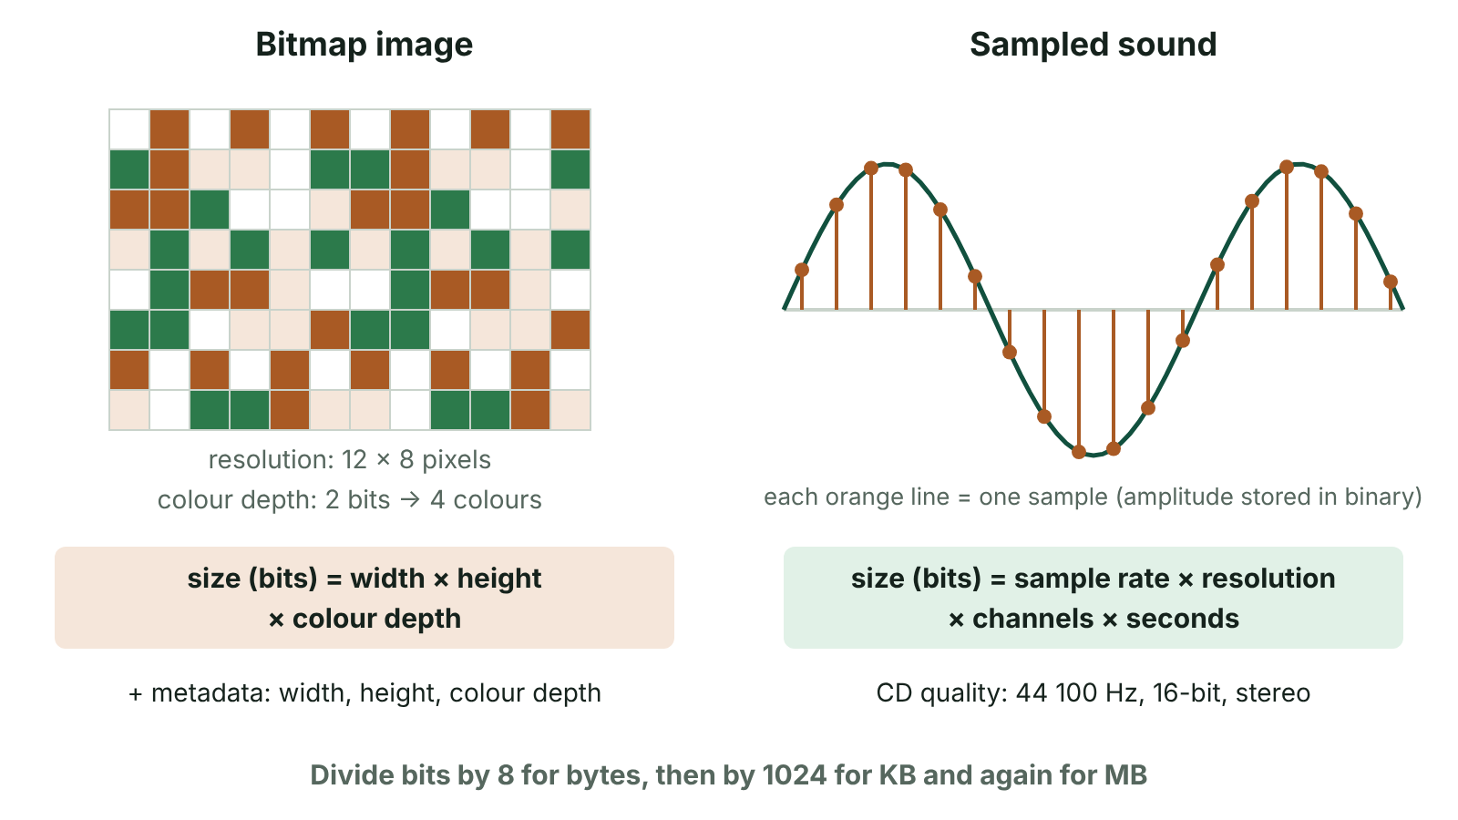
The big picture
A bitmap as a grid of pixels with the image file-size formula, and a sound wave sampled at regular intervals with the sound file-size formula
☰ Menu
Notes:
Explain the diagram in your own words before you read on.

Slide 123
From analogue to digital
Real-world images and sounds are analogue: colours and sound pressure vary continuously.
A computer can only store discrete binary values, so analogue data must be measured and digitised.
Images are split into a grid of pixels and each pixel's colour is stored as a binary number.
Sound is measured (sampled) at regular time intervals and each measurement is stored as a binary number.
In both cases, more detail in the measurements means higher quality but a bigger file.
☰ Menu

Slide 124
Bitmap images
A bitmap is a two-dimensional grid of pixels (picture elements); each pixel holds a single colour.
Resolution is the number of pixels, given as width × height (e.g. 1920 × 1080), or as dots per inch (dpi) for printing.
Typical dpi: around 72 for screen graphics, 150 for desktop printing and 300 or more for commercial print.
More pixels capture finer detail. Enlarging a bitmap beyond its resolution makes the pixels visible: this is pixelation.
Bitmaps suit photographs and scanned images, where colour changes continuously.
☰ Menu

Slide 125
Worked example: a 1-bit 8 × 8 icon
Row | Pixels (1 = black, 0 = white) | Byte
1 | □ □ ■ ■ ■ ■ □ □ | 00111100
2 | □ ■ □ □ □ □ ■ □ | 01000010
3 | ■ □ ■ □ □ ■ □ ■ | 10100101
4 | ■ □ □ □ □ □ □ ■ | 10000001
5 | ■ □ ■ ■ ■ ■ □ ■ | 10111101
Rows 6–8 and size | □■□□□□■□ / □□■■■■□□ / blank | 8 × 8 × 1 bit = 64 bits = 8 bytes
☰ Menu

Slide 126
Colour depth and RGB
Colour depth (bit depth) is the number of bits used for each pixel. n bits give 2ⁿ possible colours.
1 bit = 2 colours; 4 bits = 16; 8 bits = 256; 16 bits = 65,536; 24 bits = 16,777,216 (about 16.8 million).
Screens mix red, green and blue light. 24-bit 'true colour' uses one byte (0–255) for each of R, G and B.
Examples: R255 G0 B0 is pure red; R0 G0 B0 is black; R255 G255 B255 is white.
About 16.8 million colours is roughly as many as the human eye can tell apart, so 24-bit is used for photographs.
Each extra bit per pixel doubles the number of colours and adds one bit for every pixel in the image.
☰ Menu

Slide 127
Metadata
Metadata is data about data. An image file stores it in a header alongside the pixel data.
Essential metadata: width and height in pixels, and colour depth. Without these the bytes cannot be rebuilt into the right grid.
Files may also hold resolution in dpi, file format and compression method, and a colour palette (e.g. GIF).
Cameras and phones add EXIF data: date, time, camera model, exposure settings and often GPS location.
Metadata adds a little to file size; exam calculations usually ignore it unless told otherwise.
Privacy: GPS metadata in a photo posted online can reveal where someone lives, so many sites strip it.
☰ Menu

Slide 128
Calculating image file size
Step | Example: 1024 × 768 pixels, 24-bit colour
Pixels = width × height | 1024 × 768 = 786,432 pixels
Bits = pixels × colour depth | 786,432 × 24 = 18,874,368 bits
Bytes = bits ÷ 8 | 18,874,368 ÷ 8 = 2,359,296 bytes
KB = bytes ÷ 1024 | 2,359,296 ÷ 1024 = 2304 KB
MB = KB ÷ 1024 | 2304 ÷ 1024 = 2.25 MB
☰ Menu

Slide 129
Worked example: scanning a photo for a Derry exhibition
Step | A 6 × 4 inch photo scanned at 200 dpi, 24-bit colour
Width in pixels | 6 × 200 = 1200
Height in pixels | 4 × 200 = 800
Pixels | 1200 × 800 = 960,000
Bytes (24 bits = 3 bytes per pixel) | 960,000 × 3 = 2,880,000 bytes
KB and MB | 2,880,000 ÷ 1024 = 2812.5 KB; ÷ 1024 ≈ 2.75 MB
How many fit on a 32 GB card at 4000 × 3000? | 36,000,000 bytes each; 32 × 1024³ ÷ 36,000,000 ≈ 954.4, so 954 photos
☰ Menu

Slide 130
Vector graphics
A vector graphic is stored as a list of objects (lines, circles, rectangles, curves, text) and their properties.
Properties include coordinates, radius or size, line colour, line width and fill colour.
The image is redrawn from these instructions every time, so it can be scaled to any size without pixelation.
File size depends on the number of objects, not the display size, so simple designs give very small files.
Ideal for logos, icons, fonts, maps, charts and technical drawings. SVG is the standard vector format for the web.
Not suitable for photographs: continuous variations of colour cannot be described efficiently as shapes.
☰ Menu

Slide 131
Bitmap or vector?
 | Bitmap | Vector
What is stored | The colour of every pixel | Objects and their mathematical properties
Enlarging | Pixelates and looks blocky | Stays sharp at any size
File size depends on | Resolution × colour depth | Number and complexity of objects
Best for | Photographs, scans, realistic images | Logos, signs, icons, diagrams, fonts
Editing | Edit individual pixels (e.g. retouching) | Move, resize or recolour whole objects
Example formats | BMP, PNG, GIF, JPEG | SVG, PDF drawings, AI
☰ Menu

Slide 132
Sampling sound
Sound is a pressure wave; a microphone turns it into a continuously varying (analogue) voltage.
An analogue-to-digital converter (ADC) measures the amplitude at regular intervals and stores each sample as a binary number.
Sampling rate: the number of samples per second, in hertz (Hz). CD audio uses 44,100 Hz (44.1 kHz).
Sample resolution (bit depth): bits per sample. CD audio uses 16 bits, giving 65,536 possible amplitude levels.
Nyquist theorem: sample at least twice the highest frequency to be captured. Human hearing reaches about 20 kHz, hence 44.1 kHz.
For playback, a digital-to-analogue converter (DAC) turns the samples back into a voltage for the speaker.
☰ Menu

Slide 133
Effect of the sampling settings
Change | Effect on quality | Effect on file size
Higher sampling rate | Wave measured more often; higher frequencies captured, closer to the original | More samples per second: size rises in proportion
Higher sample resolution | Each amplitude recorded more precisely; less quantisation noise, wider dynamic range | More bits per sample: size rises in proportion
Stereo instead of mono | Separate left and right channels give a sense of direction | Two channels: size doubles
Longer recording | No change in quality | Size rises in proportion to duration
Too low a sampling rate | High notes lost or distorted (aliasing) | Small file
☰ Menu

Slide 134
Calculating sound file size
Step | Example: 3-minute song, 44,100 Hz, 16-bit, stereo
Seconds | 3 × 60 = 180 s
Bits = rate × resolution × channels × seconds | 44,100 × 16 × 2 × 180 = 254,016,000 bits
Bytes = bits ÷ 8 | 31,752,000 bytes
KB = bytes ÷ 1024 | 31,007.8125 KB
MB = KB ÷ 1024 | ≈ 30.3 MB, about 10 MB per minute
Second example: 30 s bus-stop announcement, 16 kHz, 8-bit, mono | 16,000 × 8 × 1 × 30 = 3,840,000 bits = 480,000 bytes = 468.75 KB
☰ Menu

Slide 135
Checking file sizes in C#
The formulas translate directly into code, which is a handy way to check exam working.
Use long (64-bit) for bit counts: a three-minute song is 254,016,000 bits and larger values soon pass the int limit of about 2.1 billion.
☰ Menu

Slide 136
Checking file sizes in C# – code
C#
long width = 1024, height = 768, depth = 24;
long imageBits = width * height * depth;
double imageMB = imageBits / 8.0 / 1024 / 1024;
Console.WriteLine("Image: " + imageMB + " MB"); // 2.25
long rate = 44100, res = 16, channels = 2, secs = 180;
long soundBits = rate * res * channels * secs;
double soundMB = soundBits / 8.0 / 1024 / 1024;
Console.WriteLine("Sound: " + Math.Round(soundMB, 1) + " MB"); // 30.3
☰ Menu

Slide 137
File formats and compression (link forward)
BMP and WAV store data uncompressed, so they give the full sizes calculated in this lesson.
PNG and GIF use lossless compression: the original is rebuilt exactly. GIF limits each image to a palette of 256 colours.
JPEG (images) and MP3 (audio) use lossy compression: detail people are unlikely to notice is discarded, giving much smaller files.
Compression is covered in detail with data file formats; here, focus on why uncompressed files are so large.
☰ Menu

Slide 138
Exit quiz: question 1 of 9
Tap an answer to check it. Presenting? Click to reveal the answer.
How many colours can be represented with a colour depth of 4 bits?
A 4
B 8
✗
✗
C 16
D 256
✓
✗
✓ C: 16 – Each pixel can take 2⁴ = 16 different values, so 16 colours.
☰ Menu

Slide 139
Exit quiz: question 2 of 9
Tap an answer to check it. Presenting? Click to reveal the answer.
What is the uncompressed size of a 100 × 100 pixel image with 24-bit colour?
A 30,000 bytes
B 240,000 bytes
✓
✗
C 10,000 bytes
D 2,400 bytes
✗
✗
✓ A: 30,000 bytes – 10,000 pixels × 24 bits = 240,000 bits; ÷ 8 = 30,000 bytes.
☰ Menu

Slide 140
Exit quiz: question 3 of 9
Tap an answer to check it. Presenting? Click to reveal the answer.
Which term describes the number of bits used to store each sound sample?
A Sampling rate
B Sample resolution
✗
✓
C Number of channels
D Dots per inch
✗
✗
✓ B: Sample resolution – Sample resolution is also called bit depth.
☰ Menu

Slide 141
Exit quiz: question 4 of 9
Tap an answer to check it. Presenting? Click to reveal the answer.
Which is the best reason to store a road sign design as a vector graphic?
A It looks more like a photograph
B It records light and shade more accurately
✗
✗
C It always contains GPS metadata
D It can be printed at any size without losing quality
✗
✓
✓ D: It can be printed at any size without losing quality – Signs are produced at many sizes, and a vector is redrawn sharply at each one.
☰ Menu

Slide 142
Exit quiz: question 5 of 9
Tap an answer to check it. Presenting? Click to reveal the answer.
Which device converts the analogue signal from a microphone into digital samples?
A DAC
B ALU
✗
✗
C ADC
D GPU
✓
✗
✓ C: ADC – An analogue-to-digital converter measures the signal at regular intervals.
☰ Menu

Slide 143
Exit quiz: question 6 of 9
Tap an answer to check it. Presenting? Click to reveal the answer.
A 1-minute mono recording is made at 8,000 Hz with 8-bit samples. What is its size?
A 480,000 bytes
B 64,000 bytes
✓
✗
C 3,840,000 bytes
D 60,000 bytes
✗
✗
✓ A: 480,000 bytes – 8,000 × 8 × 1 × 60 = 3,840,000 bits; ÷ 8 = 480,000 bytes.
☰ Menu

Slide 144
Exit quiz: question 7 of 9
Tap an answer to check it. Presenting? Click to reveal the answer.
Which item of metadata is essential for displaying a bitmap correctly?
A The camera model
B The image width in pixels
✗
✓
C The GPS location
D The date taken
✗
✗
✓ B: The image width in pixels – Width (with height and colour depth) tells software how to arrange the bits into rows of pixels.
☰ Menu

Slide 145
Exit quiz: question 8 of 9
Tap an answer to check it. Presenting? Click to reveal the answer.
Why does CD audio use a sampling rate of 44,100 Hz?
A It is more than twice the highest frequency people can hear
B It gives 65,536 amplitude levels
✓
✗
C It matches the number of pixels on a CD
D It is the maximum an ADC can manage
✗
✗
✓ A: It is more than twice the highest frequency people can hear – Human hearing reaches about 20 kHz; Nyquist requires at least 40 kHz to reproduce it.
☰ Menu

Slide 146
Exit quiz: question 9 of 9
Tap an answer to check it. Presenting? Click to reveal the answer.
A photo is 1200 × 800 pixels with 24-bit colour. What is its size in bytes?
A 960,000
B 23,040,000
✗
✗
C 2,880,000
D 7,680,000
✓
✗
✓ C: 2,880,000 – 960,000 pixels × 3 bytes = 2,880,000 bytes (23,040,000 is the size in bits).
☰ Menu

Slide 147
Exit quiz answers
Q | Answer | Why
1 | C 16 | Each pixel can take 2⁴ = 16 different values, so 16 colours.
2 | A 30,000 bytes | 10,000 pixels × 24 bits = 240,000 bits; ÷ 8 = 30,000 bytes.
3 | B Sample resolution | Sample resolution is also called bit depth.
4 | D It can be printed at any size without losing quality | Signs are produced at many sizes, and a vector is redrawn sharply at each one.
5 | C ADC | An analogue-to-digital converter measures the signal at regular intervals.
6 | A 480,000 bytes | 8,000 × 8 × 1 × 60 = 3,840,000 bits; ÷ 8 = 480,000 bytes.
7 | B The image width in pixels | Width (with height and colour depth) tells software how to arrange the bits into rows of pixels.
8 | A It is more than twice the highest frequency people can hear | Human hearing reaches about 20 kHz; Nyquist requires at least 40 kHz to reproduce it.
9 | C 2,880,000 | 960,000 pixels × 3 bytes = 2,880,000 bytes (23,040,000 is the size in bits).
☰ Menu

