Slide 1
Data and information
AS 2: FUNDAMENTALS OF DIGITAL TECHNOLOGY · TOPIC
Lessons in this topic
FD06 Data, information and knowledge; quality of information; validation and verification
FD07 Check digits, batch totals, data capture and processing methods

Slide 2

Topic menu
Tap a button to jump straight there. The ☰ Menu button on every slide brings you back here.
Specification map
FD07 Check digits, batch totals, data capture and processing methods
FD06 Data, information and knowledge; quality of information; validation and verification

Slide 3
Specification map
Lesson | Specification: students should be able to
FD06 | Distinguish between data, information and knowledge by using examples; Describe how the quality of information is affected by accuracy, relevance, being up to date, completeness, presentation and reliability; Describe and apply the range, type, length, format, presence and lookup validation checks; Explain the purpose of the verification methods double entry and proofreading; Explain the limitations of data validation and data verification
FD07 | Explain the purpose of check digits and calculate and check a Modulus 11 check digit; Explain the purpose of batch totals, control totals and hash totals and apply them to a batch of documents; Describe manual and automated methods of data capture; Describe batch and real-time processing, distinguishing real-time transaction (online) processing from real-time control, and select an appropriate method for a given application; Explain multitasking, multi-user and multithreading in the context of processing
☰ Menu
Notes:
Each lesson below is its own section in PowerPoint (View → Slide Sorter shows them). To split this deck by specification point, right-click a section → Move Section, or delete the sections you do not need.

Slide 4
Data, information and knowledge; quality of information; validation and verification
AS 2: FUNDAMENTALS OF DIGITAL TECHNOLOGY · FD06
Learning objectives
Use one real example to show how raw data becomes information and then knowledge
Evaluate the quality of information using accuracy, relevance, currency, completeness, presentation and reliability
Choose and describe a suitable validation check, with its exact rule, for a given field
Compare validation with verification and explain why neither can guarantee that data is correct
Notes:
Specification: Distinguish between data, information and knowledge by using examples | Describe how the quality of information is affected by accuracy, relevance, being up to date, completeness, presentation and reliability | Describe and apply the range, type, length, format, presence and lookup validation checks | Explain the purpose of the verification methods double entry and proofreading | Explain the limitations of data validation and data verification

Slide 5
In this lesson
Tap a button to jump straight there. The ☰ Menu button on every slide brings you back here.
The big picture
The value of information
Validation or verification?
Data, information, knowledge
Validation
Limitations of validation and verification
From data to information to knowledge
Validation checks and their rules
Exit quiz
Worked example: rugby club fitness testing
Validation in C#
↑ Topic menu
Garbage in, garbage out (GIGO)
Combining checks
Six factors that affect the quality of information
Verification
Notes:
Lesson menu: each button jumps to that part of the lesson in Slide Show. The ☰ Menu button on each slide returns here.

Slide 6
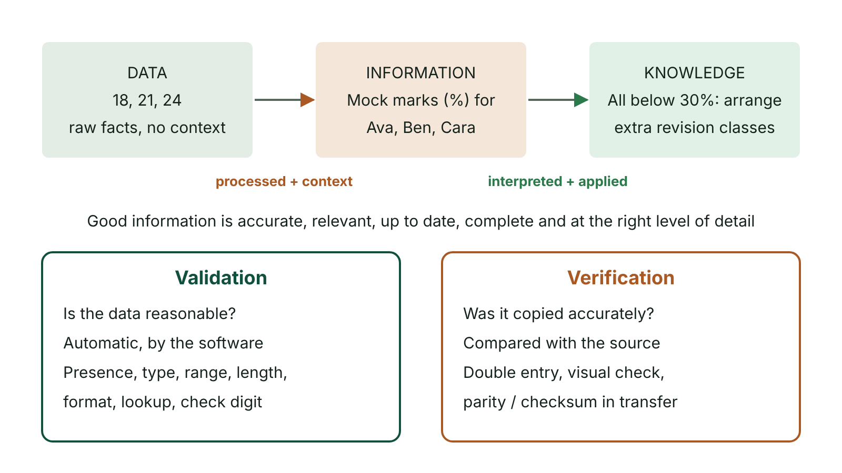
The big picture
Data becomes information when it is processed and given context, and information becomes knowledge when it is interpreted and applied; validation and verification compared
☰ Menu
Notes:
Explain the diagram in your own words before you read on.

Slide 7
Data, information, knowledge
Term | Meaning | Example
Data | Raw facts and figures with no context, so no meaning on their own | BT74 6DQ, 07:42, 14
Information | Data that has been processed and given context so that it has meaning | The 07:42 Translink bus from Enniskillen (BT74) was 14 minutes late
Knowledge | The result of applying a rule (or experience) to information so that an informed decision can be made | Rule: if the bus is more than 10 minutes late, pupils are not marked late. So the pupils on that bus are not marked late
☰ Menu

Slide 8
From data to information to knowledge
Data can be numbers, text, dates, codes, images or sound – anything that can be stored – but without context we cannot tell what it means.
Information = data + context + meaning. Processing (sorting, calculating, labelling, summarising) adds the context.
Knowledge comes from applying a rule, or a set of rules, to information so that a better, informed decision can be made.
The same data can produce different information in different contexts: 120 could be a speed limit, a weight or a mark.
Organisations collect data to produce information that supports decisions at every level, from daily stock orders to long-term plans.
☰ Menu

Slide 9
Worked example: rugby club fitness testing
Level | What the club sees | Why
Data | 11.2 9.6 12.4 | Just numbers – no context
Information | Bleep-test levels for three U16 players: Ciarán 11.2, Josh 9.6, Ellie 12.4 | Labels and context give the numbers meaning
Rule applied | Any player below level 10 joins the extra conditioning group | A rule set by the coach
Knowledge | Josh needs to join the extra conditioning group | The rule turns information into a decision
☰ Menu

Slide 10
Garbage in, garbage out (GIGO)
Information can only be as good as the data it is produced from: poor input gives poor output, however good the system is.
Transcription error: data is mistyped on entry, e.g. 1500 entered instead of 150 tins in a stock system.
Transposition error: two characters swap places, e.g. a patient number 40719 entered as 47019.
Incorrect formulae: a spreadsheet total that misses a row; cross-check totals calculated two different ways.
Biased collection: badly worded or poorly targeted surveys, e.g. only asking people who already use a service.
Bad information can be worse than none, because decisions are made with false confidence.
☰ Menu

Slide 11
Six factors that affect the quality of information (1 of 2)
Factor | Meaning | What goes wrong without it
Accurate | Recorded exactly, free from errors; estimates are flagged | A hospital doses medicine using a wrongly recorded weight
Relevant | Only what this user needs for this purpose | A principal gets 40 pages of raw data instead of a one-page summary
Up to date (current) | Reflects the situation now | A café orders stock using last month's sales, not this week's
Complete | Nothing needed for the decision is missing | A re-order alert gives the product but not the size or pack
Well-presented | Easy to understand; suitable format (chart, map, audio) | A table of 300 bus times when a route map would be clearer
☰ Menu

Slide 12
Six factors that affect the quality of information (2 of 2)
Factor | Meaning | What goes wrong without it
Reliable | From a trustworthy, authoritative, verified source | A rumour on social media is reported as fact
☰ Menu

Slide 13
The value of information
Information has value when it improves decisions, saves cost, improves customer service or gives an advantage over competitors.
Customer data can be used to plan stock, target marketing or personalise services.
Its value falls if it is late, inaccurate, incomplete or equally available to competitors.
Collecting, storing and securing information costs money, so its value must outweigh its cost.
Personal data must be processed lawfully under the UK GDPR and the Data Protection Act 2018.
☰ Menu

Slide 14
Validation
Validation is an automatic check, made by software as data is entered, that the input obeys set rules and is reasonable and sensible.
It rejects impossible or unreasonable data, e.g. an age of -3 or 470.
It does NOT check that data is correct: an age of 34 typed as 43 is still valid.
Validation and verification are two separate procedures; both are used to protect data integrity.
Checks: range, type, length, format, presence, lookup and check digit (check digits are covered in the next lesson).
☰ Menu

Slide 15
Validation checks and their rules
Check | What it tests | Example rule | Rejected
Range | Value lies between a lower and upper limit | Shoe size >= 1 AND <= 15 | 22
Type | Data is the correct data type | Number of tickets is an integer | two
Length | Correct number of characters | Mobile number is exactly 11 characters | 0771234567
Format | Data matches a pattern | School code: 2 letters then 4 digits (LL9999) | 1234AB
Presence | Something has been entered | Email address must not be blank | (empty)
Lookup | Value is in a list or file of valid values | Form class is one of 11A, 11B, 11C | 11Z
☰ Menu

Slide 16
Validation in C#
Each check is a condition; the first failure produces a clear message so the user can correct the input.
int.TryParse performs the type check without crashing on input such as "ten".
Array.IndexOf performs a lookup check against a list of valid values.
☰ Menu

Slide 17
Validation in C# – code
C#
string[] forms = { "11A", "11B", "11C" };
Console.Write("Form class: ");
string form = Console.ReadLine() ?? "";
if (form == "") Console.WriteLine("Presence check failed");
else if (Array.IndexOf(forms, form) == -1) Console.WriteLine("Lookup check failed");
else Console.WriteLine("Form class accepted");
Console.Write("Year group (8-14): ");
string input = Console.ReadLine() ?? "";
if (input == "") Console.WriteLine("Presence check failed");
else if (!int.TryParse(input, out int year)) Console.WriteLine("Type check failed");
else if (year < 8 || year > 14) Console.WriteLine("Range check failed");
else Console.WriteLine("Year group accepted");
☰ Menu

Slide 18
Combining checks
A single check rarely validates a field fully. A format check accepts 45/33/87 as DD/MM/YY although no such date exists.
A date normally needs a format check plus range checks on the day (1–31) and month (1–12) – or a routine that checks the date exists.
Even then, 31/04/2025 passes a 1–31 day check although April has 30 days.
A UK postcode needs a format check (several valid patterns) and a length check (5 to 7 characters without the space).
Choose the check that fits the rule in the question, and state the rule using the actual field and values.
☰ Menu

Slide 19
Verification
Verification checks that data has been entered or copied accurately, so that the copy exactly matches the original source.
Double entry: data is entered twice and the computer compares the two; any difference is flagged (e.g. new passwords, email addresses).
Proofreading (visual check): the entered data is compared by eye with the source document, ideally by a different person.
On-screen confirmation: the user is shown the details and asked 'Is this correct?' before submitting.
Backups and copied files are verified by comparing the copy with the original; transmission uses parity bits and checksums.
☰ Menu

Slide 20
Validation or verification?
Situation | Check | Type
Mark must be 0 to 100 | Range check | Validation
Email typed into two boxes | Double entry | Verification
Postcode matches a pattern such as LL9 9LL | Format check | Validation
Pharmacist compares a printed label with the prescription | Proofreading | Verification
Form tutor must be on the staff list | Lookup check | Validation
Booking summary shown with 'Confirm details?' | On-screen confirmation | Verification
☰ Menu

Slide 21
Limitations of validation and verification
Validation only checks that data is reasonable, not that it is true: a valid but wrong value is accepted.
Verification only checks the copy against the source: if the source document is wrong, the copy is wrong too.
Double entry doubles the input workload and the same mistake can be typed twice.
Proofreading is slow and costly for large volumes and errors are missed when people rush or tire.
Together they reduce errors but can never eliminate them, so important data may need further checks.
☰ Menu

Slide 22
Exit quiz: question 1 of 9
Tap an answer to check it. Presenting? Click to reveal the answer.
A school records the value 14 for a pupil. Which of these turns that data into information?
A Storing 14 as an integer
B Labelling it 'Days absent this term: 14'
✗
✓
C Typing 14 twice to check it
D Rounding 14 to 10
✗
✗
✓ B: Labelling it 'Days absent this term: 14' – Adding context (what the 14 measures) gives the data meaning, which makes it information.
☰ Menu

Slide 23
Exit quiz: question 2 of 9
Tap an answer to check it. Presenting? Click to reveal the answer.
Why would validation NOT detect that a customer's age has been typed as 34 instead of 43?
A Validation only runs on text fields
B Validation only checks data after it has been stored
✗
✗
C 34 is still a sensible, reasonable age, so it passes the rules
D Ages cannot be validated
✓
✗
✓ C: 34 is still a sensible, reasonable age, so it passes the rules – Validation checks reasonableness against rules, not truth; both values are valid ages.
☰ Menu

Slide 24
Exit quiz: question 3 of 9
Tap an answer to check it. Presenting? Click to reveal the answer.
Typing an email address into two boxes so they can be compared is…
A a format check
B a range check
✗
✗
C a lookup check
D verification by double entry
✗
✓
✓ D: verification by double entry – Double entry checks the data has been entered accurately, which is verification.
☰ Menu

Slide 25
Exit quiz: question 4 of 9
Tap an answer to check it. Presenting? Click to reveal the answer.
Which check would ensure that a mobile number contains exactly 11 characters?
A Length check
B Range check
✓
✗
C Presence check
D Lookup check
✗
✗
✓ A: Length check – A length check tests the number of characters entered.
☰ Menu

Slide 26
Exit quiz: question 5 of 9
Tap an answer to check it. Presenting? Click to reveal the answer.
A café uses last month's sales figures to order this week's stock. Which quality factor is lacking?
A Presentation
B Reliability
✗
✗
C Up to date (currency)
D Relevance
✓
✗
✓ C: Up to date (currency) – The figures no longer reflect current sales, so the information is out of date.
☰ Menu

Slide 27
Exit quiz: question 6 of 9
Tap an answer to check it. Presenting? Click to reveal the answer.
A club only accepts membership numbers that exist in its members file. This is a…
A type check
B lookup check
✗
✓
C format check
D proofreading check
✗
✗
✓ B: lookup check – The entry is compared with a file of valid values.
☰ Menu

Slide 28
Exit quiz: question 7 of 9
Tap an answer to check it. Presenting? Click to reveal the answer.
Which statement about verification is true?
A It checks the data matches the original source
B It checks the data is within set limits
✓
✗
C It is always carried out automatically by software
D It guarantees the source document is correct
✗
✗
✓ A: It checks the data matches the original source – Verification compares the entered or copied data with the source; it cannot correct an error in the source.
☰ Menu

Slide 29
Exit quiz: question 8 of 9
Tap an answer to check it. Presenting? Click to reveal the answer.
A news site reports a claim from one unverified social-media post. Which quality factor is most at risk?
A Completeness
B Presentation
✗
✗
C Currency
D Reliability
✗
✓
✓ D: Reliability – Reliable information comes from trustworthy, authoritative sources that have been verified.
☰ Menu

Slide 30
Exit quiz: question 9 of 9
Tap an answer to check it. Presenting? Click to reveal the answer.
What does GIGO mean?
A Good input gives good output
B Poor-quality input data produces poor-quality output information
✗
✓
C Graphics in, graphics out
D Data is processed in the order it arrives
✗
✗
✓ B: Poor-quality input data produces poor-quality output information – Garbage in, garbage out: no system can produce good information from bad data.
☰ Menu

Slide 31
Exit quiz answers
Q | Answer | Why
1 | B Labelling it 'Days absent this term: 14' | Adding context (what the 14 measures) gives the data meaning, which makes it information.
2 | C 34 is still a sensible, reasonable age, so it passes the rules | Validation checks reasonableness against rules, not truth; both values are valid ages.
3 | D verification by double entry | Double entry checks the data has been entered accurately, which is verification.
4 | A Length check | A length check tests the number of characters entered.
5 | C Up to date (currency) | The figures no longer reflect current sales, so the information is out of date.
6 | B lookup check | The entry is compared with a file of valid values.
7 | A It checks the data matches the original source | Verification compares the entered or copied data with the source; it cannot correct an error in the source.
8 | D Reliability | Reliable information comes from trustworthy, authoritative sources that have been verified.
9 | B Poor-quality input data produces poor-quality output information | Garbage in, garbage out: no system can produce good information from bad data.
☰ Menu

Slide 32
Check digits, batch totals, data capture and processing methods
AS 2: FUNDAMENTALS OF DIGITAL TECHNOLOGY · FD07
Learning objectives
Calculate a Modulus 11 check digit and use it to show that a transposition error has been detected
Use batch, control and hash totals to check that every document in a batch has been entered exactly once
Compare manual and automated data capture methods
Describe batch processing, real-time transaction (online) processing and real-time control, and justify which suits a scenario
Notes:
Specification: Explain the purpose of check digits and calculate and check a Modulus 11 check digit | Explain the purpose of batch totals, control totals and hash totals and apply them to a batch of documents | Describe manual and automated methods of data capture | Describe batch and real-time processing, distinguishing real-time transaction (online) processing from real-time control, and select an appropriate method for a given application | Explain multitasking, multi-user and multithreading in the context of processing

Slide 33
In this lesson
Tap a button to jump straight there. The ☰ Menu button on every slide brings you back here.
The big picture
Modulus 11 in C#
Real-time processing: transaction and control
Check digits: purpose
Batch, control and hash totals
Comparing processing methods
The Modulus 11 method
Worked example: youth football club fee forms
Multitasking, multi-user and multithreading
Worked example: patient number 3604
What the totals reveal
Exit quiz
Checking a number and catching a transposition
Data capture methods
↑ Topic menu
When the check digit is X
Batch processing
Notes:
Lesson menu: each button jumps to that part of the lesson in Slide Show. The ☰ Menu button on each slide returns here.

Slide 34
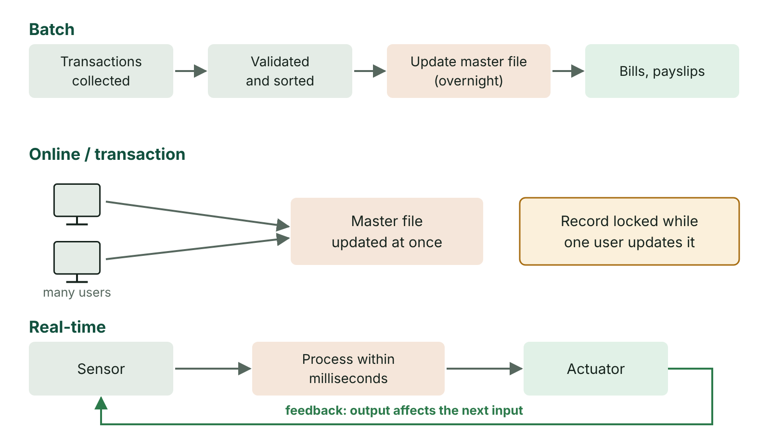
The big picture
Batch processing collects transactions and updates the master file later; transaction processing updates it immediately with record locking; real-time processing uses a feedback loop from sensors
☰ Menu
Notes:
Explain the diagram in your own words before you read on.

Slide 35
Check digits: purpose
A check digit is an extra digit added to the end of a code number, calculated from the other digits.
When the number is entered or scanned, the computer recalculates the check digit and compares it with the one entered.
If they differ, the number has been mistyped or misread and is rejected.
Used on barcodes (EAN-13), ISBNs, bank card numbers and many account and patient numbers.
Modulus 11 detects every single-digit error and every transposition of two digits – it is a validation check.
☰ Menu

Slide 36
The Modulus 11 method
1. Give each digit a weighting: 2 for the rightmost digit, rising by 1 for each digit to the left (n digits: n+1 down to 2).
2. Multiply each digit by its weighting and add the products to get the checksum.
3. Divide the checksum by 11 and find the remainder (checksum MOD 11).
4. Remainder 0 → check digit 0. Remainder 1 → check digit X (stands for 10). Otherwise check digit = 11 − remainder.
5. Append the check digit to the number. Because it may be X, the full code is stored as a string.
The old ISBN-10 book numbers (used until 2007) used this method.
☰ Menu

Slide 37
Worked example: patient number 3604
Step | Working
Weightings | 5 4 3 2
Digits | 3 6 0 4
Products | 15 24 0 8
Checksum | 15 + 24 + 0 + 8 = 47
Remainder | 47 ÷ 11 = 4 remainder 3
Check digit | 11 − 3 = 8, so the full number is 36048
☰ Menu

Slide 38
Checking a number and catching a transposition
 | Correct: 36048 | Transposed: 63048
Weightings | 5 4 3 2 1 | 5 4 3 2 1
Products | 15 + 24 + 0 + 8 + 8 | 30 + 12 + 0 + 8 + 8
Checksum | 55 | 58
55 or 58 MOD 11 | 0 | 3
Result | Remainder 0: accepted | Remainder not 0: error detected
☰ Menu

Slide 39
When the check digit is X
Number 1205: weightings 5, 4, 3, 2 give 5 + 8 + 0 + 10 = 23.
23 ÷ 11 = 2 remainder 1. A remainder of 1 gives X (standing for 10), so the full number is 1205X.
Check: X counts as 10 with weighting 1: 5 + 8 + 0 + 10 + 10 = 33, and 33 MOD 11 = 0, so it is valid.
A check digit only shows the number is consistent; it cannot show it belongs to the right person.
☰ Menu

Slide 40
Modulus 11 in C#
Each character is converted to its digit value with c - '0'.
The weighting starts at Length + 1 and falls by one for each digit.
% gives the remainder after dividing by 11.
C#
string number = "3604";
int weight = number.Length + 1;
int total = 0;
foreach (char c in number)
{
total += (c - '0') * weight;
weight--;
}
int remainder = total % 11;
string check;
if (remainder == 0) check = "0";
else if (remainder == 1) check = "X";
else check = (11 - remainder).ToString();
Console.WriteLine(number + check); // 36048
☰ Menu

Slide 41
Batch, control and hash totals
Used when many paper documents are keyed in as a batch, to check each document has been entered exactly once.
Batch total: the number of documents, counted by hand and compared with the computer's count.
Control total: the sum of a field that has a meaning, e.g. total fees paid or total hours worked.
Hash total: the sum of a field with no meaning, e.g. the total of all member ID numbers.
If the manual total and the computer total differ, a document has been missed, duplicated or mistyped.
Choose a field whose values differ between documents, or the total adds nothing to the batch total.
☰ Menu

Slide 42
Worked example: youth football club fee forms
Member ID | Fee (£)
2041 | 30
1187 | 45
3502 | 30
2876 | 60
1950 | 45
Manual totals | Batch 5 / Control (fees) £210 / Hash (IDs) 11556
☰ Menu

Slide 43
What the totals reveal
Mistake | Batch | Control | Hash | Detected?
None | 5 | 210 | 11556 | All match
Form 3502 missed out | 4 | 180 | 8054 | Yes – and 11556 − 8054 = 3502 names the missing form
3502 missed AND 2041 entered twice | 5 | 210 | 10095 | Only the hash total differs
☰ Menu

Slide 44
Data capture methods (1 of 2)
Method | Example | Strength | Weakness
Manual keying from a form | Paper application form | Cheap, flexible | Slow; transcription errors
Online forms | School trip sign-up | Validation at entry; no re-keying | Needs device and internet
OMR (optical mark recognition) | Multiple-choice answer sheets, lottery slips | Fast and accurate for marks | Only marks, not free text
Barcodes / QR codes | Supermarket tills, parcels | Very fast; check digit validates scan | Damaged codes fail
Card readers (chip, contactless) | Shop payments, library cards | Fast, secure, no typing | Card can be lost or cloned
☰ Menu

Slide 45
Data capture methods (2 of 2)
Method | Example | Strength | Weakness
Sensors / data logging | Weather station on Lough Erne | Continuous, unattended | Needs calibration and power
☰ Menu

Slide 46
Batch processing
Data is collected over a period into a transaction file and processed all at once, later, without human interaction.
The transaction file is validated (including batch totals) and sorted into the same key order as the master file, then used to update it.
Examples: payroll, utility and credit card bills, end-of-day stock re-ordering, overnight bank updates.
Advantages: efficient for large, regular jobs; runs overnight when the system is quiet; easy to schedule and back up.
Disadvantages: the master file is out of date between runs; errors are found only after the run.
☰ Menu

Slide 47
Real-time processing: transaction and control
Real-time processing: each transaction or input is processed as soon as it occurs, so the master file is always up to date.
Real-time transaction (online) processing: the user waits a few seconds for each transaction, e.g. cinema and flight bookings, cash machines, online shopping, password changes.
Record locking stops two users updating the same record at once, preventing double-booking and lost updates.
Real-time control: sensor input is processed within a guaranteed, very short time so the output can affect the next input.
Examples: anti-lock brakes, traffic lights, heart monitors, autopilots. Control systems must be highly reliable, often with duplicated hardware.
☰ Menu

Slide 48
Comparing processing methods
 | Batch | Real-time transaction (online) | Real-time control
When processed | Later, in a group | As each transaction occurs | Immediately, continuously
Master file currency | Out of date between runs | Always current | Always current
User interaction | None during processing | User waits for response | Often none; sensors
Response time | Hours | Seconds | Milliseconds, guaranteed
Example | Monthly payroll | Concert ticket booking | Airbag controller
☰ Menu

Slide 49
Multitasking, multi-user and multithreading
Multitasking: one processor appears to run several programs at once by switching rapidly between them using time slices.
Multi-user: many users share one system's resources at the same time, each with their own session and permissions (e.g. a school file server).
Multithreading: one program is split into threads that run concurrently, e.g. a browser loading images while you scroll.
On a multicore processor, threads can truly run in parallel.
All three rely on the operating system to share processor time, memory and devices fairly and securely.
☰ Menu

Slide 50
Exit quiz: question 1 of 9
Tap an answer to check it. Presenting? Click to reveal the answer.
Using Modulus 11, the checksum for a base number is 47. What is the check digit?
A 3
B 8
✗
✓
C X
D 0
✗
✗
✓ B: 8 – 47 ÷ 11 = 4 remainder 3, and 11 − 3 = 8.
☰ Menu

Slide 51
Exit quiz: question 2 of 9
Tap an answer to check it. Presenting? Click to reveal the answer.
Which application best suits real-time processing?
A Payroll
B Monthly bank statements
✗
✗
C Car airbag deployment
D Exam result processing
✓
✗
✓ C: Car airbag deployment – It must respond within milliseconds, so the output affects what happens next.
☰ Menu

Slide 52
Exit quiz: question 3 of 9
Tap an answer to check it. Presenting? Click to reveal the answer.
The total of all the staff ID numbers on a batch of timesheets is a…
A batch total
B control total
✗
✗
C check digit
D hash total
✗
✓
✓ D: hash total – A total with no meaning is a hash total.
☰ Menu

Slide 53
Exit quiz: question 4 of 9
Tap an answer to check it. Presenting? Click to reveal the answer.
What does record locking prevent?
A Viruses
B Two users updating the same record at once
✗
✓
C Data being deleted by backups
D Unauthorised logins
✗
✗
✓ B: Two users updating the same record at once – It stops lost updates and double-booking.
☰ Menu

Slide 54
Exit quiz: question 5 of 9
Tap an answer to check it. Presenting? Click to reveal the answer.
What are the Modulus 11 weightings for the four-digit base number 9150?
A 5, 4, 3, 2
B 1, 2, 3, 4
✓
✗
C 4, 3, 2, 1
D 2, 3, 4, 5
✗
✗
✓ A: 5, 4, 3, 2 – Weightings start at 2 on the right and rise by 1 to the left.
☰ Menu

Slide 55
Exit quiz: question 6 of 9
Tap an answer to check it. Presenting? Click to reveal the answer.
Which is a feature of batch processing?
A The user waits for each result
B Processing happens without user interaction
✗
✓
C Response in milliseconds
D It relies on record locking
✗
✗
✓ B: Processing happens without user interaction – Batches run unattended, often overnight.
☰ Menu

Slide 56
Exit quiz: question 7 of 9
Tap an answer to check it. Presenting? Click to reveal the answer.
A web browser downloads images while the user scrolls. This is an example of…
A multithreading
B batch processing
✓
✗
C OMR
D multi-user
✗
✗
✓ A: multithreading – One program, several threads running concurrently.
☰ Menu

Slide 57
Exit quiz: question 8 of 9
Tap an answer to check it. Presenting? Click to reveal the answer.
Which data capture method suits a lottery ticket?
A Keying
B Voice input
✗
✗
C OMR
D OCR of handwriting
✓
✗
✓ C: OMR – Players mark boxes in fixed positions, which OMR reads.
☰ Menu

Slide 58
Exit quiz: question 9 of 9
Tap an answer to check it. Presenting? Click to reveal the answer.
Which mistake would a batch total NOT detect?
A One form missed out
B One form entered twice
✗
✗
C One form missed and another entered twice
D Two forms missed out
✓
✗
✓ C: One form missed and another entered twice – The count of forms is unchanged, so the batch total still matches.
☰ Menu

Slide 59
Exit quiz answers
Q | Answer | Why
1 | B 8 | 47 ÷ 11 = 4 remainder 3, and 11 − 3 = 8.
2 | C Car airbag deployment | It must respond within milliseconds, so the output affects what happens next.
3 | D hash total | A total with no meaning is a hash total.
4 | B Two users updating the same record at once | It stops lost updates and double-booking.
5 | A 5, 4, 3, 2 | Weightings start at 2 on the right and rise by 1 to the left.
6 | B Processing happens without user interaction | Batches run unattended, often overnight.
7 | A multithreading | One program, several threads running concurrently.
8 | C OMR | Players mark boxes in fixed positions, which OMR reads.
9 | C One form missed and another entered twice | The count of forms is unchanged, so the batch total still matches.
☰ Menu

