Slide 1
Architecture
AS 2: FUNDAMENTALS OF DIGITAL TECHNOLOGY · TOPIC
Lessons in this topic
FD08 Internal components: CPU, registers, buses, I/O controllers and the Von Neumann architecture
FD09 The fetch–decode–execute cycle, pipelining and processor performance
FD10 Main memory, cache and secondary storage
FD11 Alternative architectures: parallel, multicore, Harvard, RISC and CISC, GPUs

Slide 2

Topic menu
Tap a button to jump straight there. The ☰ Menu button on every slide brings you back here.
Specification map
FD10 Main memory, cache and secondary storage
FD08 Internal components: CPU, registers, buses, I/O controllers and the Von Neumann architecture
FD11 Alternative architectures: parallel, multicore, Harvard, RISC and CISC, GPUs
FD09 The fetch–decode–execute cycle, pipelining and processor performance

Slide 3
Specification map (1 of 3)
Lesson | Specification: students should be able to
FD08 | Describe the internal components of a computer system: processor, clock, main memory, buses, I/O controllers, registers and ports; Describe the tasks performed by the control unit, the arithmetic logic unit (ALU) and the registers; Describe the purpose of the program counter (PC), memory address register (MAR), memory data register (MDR), current instruction register (CIR) and accumulator (ACC); Describe the function and direction of the address, data and control buses; Calculate the maximum addressable memory, or an unknown bus width, from the address bus width, data bus width and memory size; Explain why peripherals are connected through I/O controllers and ports; Describe the Von Neumann (stored-program) architecture and its main limitation
☰ Menu

Slide 4
Specification map (2 of 3)
Lesson | Specification: students should be able to
FD09 | Describe the fetch–execute cycle, including the fetch, decode and execute stages and the roles of the registers and buses; Describe how pipelining overlaps the stages of the cycle, and calculate the time units needed with and without pipelining; Evaluate the factors that influence the speed of processing: processor type (word size, number of cores) and clock speed; Explain how cache size, bus width and the amount of RAM also affect performance; Explain why clock speed alone is not a good measure of performance, and describe benchmark measures such as MIPS and FLOPS; Interpret a computer specification, such as '64-bit 3.2 GHz quad-core'
FD10 | Describe main memory, distinguishing between RAM and ROM, and explain the uses of each; Describe the purpose of cache memory, how a cache controller uses it, and the levels of cache; Explain how virtual memory is used and its effect on performance; Explain the need for secondary storage and the factors that influence the choice of storage device; Describe magnetic, optical and flash (solid-state) secondary storage media, including how data is stored and accessed; Evaluate the use of secondary storage media for common applications
☰ Menu

Slide 5
Specification map (3 of 3)
Lesson | Specification: students should be able to
FD11 | Describe parallel processing and multi-core processors, and explain their benefits and limitations; Compare the Harvard and Von Neumann architectures and identify where each is used; Compare reduced instruction set computers (RISC) and complex instruction set computers (CISC); Describe the use of graphics processing units (GPUs) and other co-processors for graphics and general-purpose parallel processing; Evaluate the choice of processor architecture for a given application
☰ Menu
Notes:
Each lesson below is its own section in PowerPoint (View → Slide Sorter shows them). To split this deck by specification point, right-click a section → Move Section, or delete the sections you do not need.

Slide 6
Internal components: CPU, registers, buses, I/O controllers and the Von Neumann architecture
AS 2: FUNDAMENTALS OF DIGITAL TECHNOLOGY · FD08
Learning objectives
Describe what the control unit, ALU, clock and registers each do
Explain the job of each special-purpose register and each bus, including the direction it carries signals
Calculate maximum addressable memory, or a missing bus width, showing the working in powers of two
Explain why peripherals connect through I/O controllers and ports rather than directly to the system bus
Describe the stored-program concept and the Von Neumann bottleneck
Notes:
Specification: Describe the internal components of a computer system: processor, clock, main memory, buses, I/O controllers, registers and ports | Describe the tasks performed by the control unit, the arithmetic logic unit (ALU) and the registers | Describe the purpose of the program counter (PC), memory address register (MAR), memory data register (MDR), current instruction register (CIR) and accumulator (ACC) | Describe the function and direction of the address, data and control buses | Calculate the maximum addressable memory, or an unknown bus width, from the address bus width, data bus width and memory size | Explain why peripherals are connected through I/O controllers and ports | Describe the Von Neumann (stored-program) architecture and its main limitation

Slide 7
In this lesson
Tap a button to jump straight there. The ☰ Menu button on every slide brings you back here.
The big picture
Registers in action: a short program
Checking the calculation in C#
The Von Neumann (stored-program) model
The system bus
I/O controllers
Inside the case: the motherboard
Reading and writing memory using the buses
Ports and USB
The control unit and the clock
Bus width and addressable memory
Exit quiz
The ALU and registers
Worked example: a till in a Belfast shop
↑ Topic menu
Special-purpose registers
Worked example: finding the address bus width
Notes:
Lesson menu: each button jumps to that part of the lesson in Slide Show. The ☰ Menu button on each slide returns here.

Slide 8
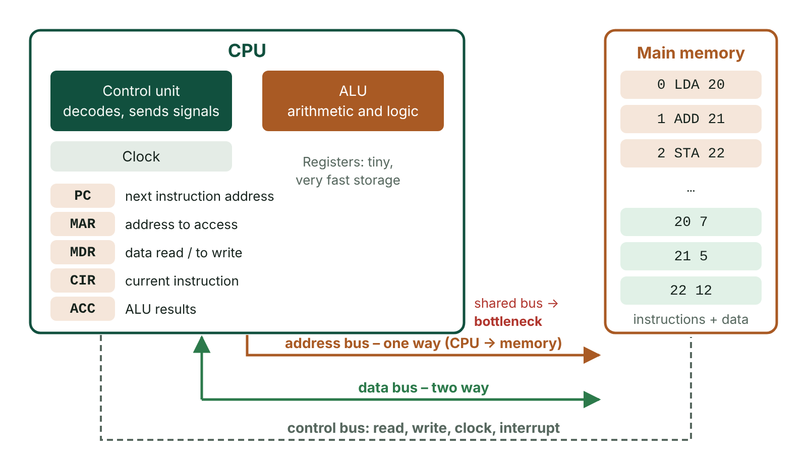
The big picture
The Von Neumann architecture: a CPU containing the control unit, ALU, clock and registers, connected to a single main memory holding instructions and data by the address, data and control buses
☰ Menu
Notes:
Explain the diagram in your own words before you read on.

Slide 9
The Von Neumann (stored-program) model
Program instructions and data are both stored, in binary, in the same main memory – the stored-program concept.
A single processor fetches instructions from memory one at a time and executes them in sequence.
Input devices supply data, output devices present results and secondary storage keeps files when the power is off.
All components communicate over one shared system bus made of address, data and control lines.
Advantage: one general-purpose machine can run any program simply by loading different instructions into memory.
Limitation: instructions and data must take turns on the shared bus – the Von Neumann bottleneck.
☰ Menu

Slide 10
Inside the case: the motherboard
The motherboard is the main printed circuit board that links every internal component.
It holds the CPU socket (with heat sink and fan above), slots for memory modules and connectors for internal drives.
Expansion slots accept extra cards, such as a graphics card, sound card or network card, to add functionality.
Tracks on the board form the buses; I/O controllers and external ports are built in along the edge.
Memory slots mean RAM can be upgraded later without replacing the whole computer.
☰ Menu

Slide 11
The control unit and the clock
Task 1: runs the fetch–execute cycle – fetches each instruction from memory, decodes it and directs its execution, using the ALU when needed.
Task 2: sends control signals that coordinate and monitor the hardware so that software commands are carried out in the right order.
Task 3: controls the movement of data into and out of the processor, including input and output.
The clock generates a steady stream of pulses; every action in the processor is timed to these pulses.
Clock speed is measured in hertz (cycles per second), e.g. 3.6 GHz is 3.6 billion cycles per second.
☰ Menu

Slide 12
The ALU and registers
The ALU takes values from registers, performs the operation chosen by the control unit and puts the result back in a register.
Arithmetic operations: add, subtract, multiply, divide (and shifts).
Logical operations: AND, OR, NOT and comparisons such as <, > and =, which make selection and loops possible.
A register is a single, very fast storage location inside the CPU holding data, an instruction or an address.
All data must be loaded into a register before the ALU can process it.
Only machine code and assembly language handle registers directly; a C# compiler generates that code for you.
☰ Menu

Slide 13
Special-purpose registers
Register | What it holds | Remember it by
Program counter (PC) | The address of the next instruction to be fetched; incremented after each fetch | Points to what comes next
Memory address register (MAR) | The address of the memory location about to be read from or written to | Always an address
Memory data register (MDR) | Data or an instruction just read from memory, or waiting to be written to it | Two-way buffer to memory
Current instruction register (CIR) | The instruction currently being decoded and executed | What is happening now
Accumulator (ACC) | The result of calculations and logic carried out by the ALU | Running total
☰ Menu

Slide 14
Registers in action: a short program
Each instruction has an opcode (what to do) and an operand (the address or value to use).
LDA, ADD and STA all use the accumulator as the working register.
Every read or write of address 20, 21 or 22 passes through the MAR (address) and the MDR (data).
☰ Menu

Slide 15
Registers in action: a short program – code
PSEUDOCODE
LDA 20 // ACC <- contents of address 20
ADD 21 // ACC <- ACC + contents of address 21
STA 22 // contents of address 22 <- ACC
HLT // stop
☰ Menu

Slide 16
The system bus
Bus | What it carries | Direction
Address bus | The address of the memory location or I/O device to be used | Unidirectional: CPU to memory/I/O only
Data bus | Data and instructions between CPU, memory and I/O devices | Bidirectional
Control bus | Signals such as memory read, memory write, clock, interrupt request, bus request | Bidirectional overall (each line one way)
☰ Menu

Slide 17
Reading and writing memory using the buses
Read: the CPU puts the address on the address bus (from the MAR) and the control unit sends a read signal on the control bus.
Read: memory places the contents of that location on the data bus and they are copied into the MDR.
Write: the address goes on the address bus and the data to be stored goes on the data bus (from the MDR).
Write: the control unit sends a write signal on the control bus.
Write: memory copies the value from the data bus into the addressed location, overwriting what was there.
☰ Menu

Slide 18
Bus width and addressable memory
Bus width = the number of parallel lines; each line carries one bit.
An address bus with n lines gives 2ⁿ addresses (0 to 2ⁿ − 1). One extra line doubles the number of locations.
Each location holds as many bits as the data bus carries, so: maximum memory (bits) = 2^(address bus width) × data bus width.
Convert: ÷ 8 for bytes, then ÷ 2¹⁰ for KB, ÷ 2²⁰ for MB, ÷ 2³⁰ for GB (binary multiples, as used in this course).
A wider data bus also moves more bits per transfer, so it helps performance.
Most computers have less than the maximum: RAM is costly, most software does not need it and some addresses are used for I/O ports.
☰ Menu

Slide 19
Worked example: a till in a Belfast shop
The till's processor has a 24-bit address bus and a 16-bit data bus. What is its maximum addressable memory?
Locations = 2²⁴ = 16 777 216.
Bits = 2²⁴ × 16 = 2²⁴ × 2⁴ = 2²⁸ bits.
Bytes = 2²⁸ ÷ 2³ = 2²⁵ bytes.
MB = 2²⁵ ÷ 2²⁰ = 2⁵ = 32 MB.
Check the logic: if it needed 64 MB, one more address line (25 bits) would be enough, because each extra line doubles capacity.
☰ Menu

Slide 20
Worked example: finding the address bus width
A library laptop in Derry~Londonderry has 8 GB of RAM and a 64-bit data bus. What address bus width is needed?
Memory in bits = 8 × 2³⁰ × 8 = 2³ × 2³⁰ × 2³ = 2³⁶ bits.
2^(address width) × 64 = 2³⁶, so 2^(address width) × 2⁶ = 2³⁶.
2^(address width) = 2³⁶ ÷ 2⁶ = 2³⁰.
Address bus width = 30 bits.
Tip: write every number as a power of two first; then multiplying means adding indices and dividing means subtracting them.
☰ Menu

Slide 21
Checking the calculation in C#
1L << n shifts a 1 left n places, which is the same as 2ⁿ, stored as a long so it does not overflow.
With a 30-bit address bus and 64-bit data bus the program prints 8 GB, matching the worked example.
Try changing addressBits to 31 and confirm that the answer doubles.
☰ Menu

Slide 22
Checking the calculation in C# – code
C#
int addressBits = 30;
int dataBits = 64;
long locations = 1L << addressBits; // 2^30 locations
long totalBytes = locations * (dataBits / 8); // each location holds 8 bytes
double gigabytes = totalBytes / Math.Pow(2, 30);
Console.WriteLine($"Locations: {locations}");
Console.WriteLine($"Maximum memory: {gigabytes} GB");
☰ Menu

Slide 23
I/O controllers
Peripherals differ in speed, voltage and complexity, so the CPU does not drive them directly.
An I/O controller sits between the system bus and the device; it may be on the motherboard or on an expansion card.
Three parts: an interface to the system bus, electronics that signal to the device, and an I/O port for exchanging data.
Tasks: protocol conversion, voltage conversion, buffering data between fast CPU and slow device, data format conversion.
One controller can manage several devices, and a computer usually has several controllers.
☰ Menu

Slide 24
Ports and USB
A port is the physical connection point where a peripheral's cable plugs into the computer.
Older PCs had a separate dedicated port for each device: keyboard, mouse, printer, monitor and so on.
USB (Universal Serial Bus) is a standard defining cables, connectors and protocols for data and power in one connection.
Each USB generation is faster than the last; USB4 reaches tens of gigabits per second.
Connector shapes include USB-A, micro-USB and the reversible USB-C now used on most phones and laptops.
Connectors for frequently plugged devices are designed for around 10 000 insertions; standard USB-A is rated much lower.
☰ Menu

Slide 25
Exit quiz: question 1 of 9
Tap an answer to check it. Presenting? Click to reveal the answer.
Which register holds the address of the next instruction to be fetched?
A Memory address register (MAR)
B Current instruction register (CIR)
✗
✗
C Program counter (PC)
D Accumulator (ACC)
✓
✗
✓ C: Program counter (PC) – The program counter holds the address of the next instruction and is incremented after each fetch. The MAR holds whichever address is being accessed right now.
☰ Menu

Slide 26
Exit quiz: question 2 of 9
Tap an answer to check it. Presenting? Click to reveal the answer.
A games console's processor has 32 address lines and a 64-bit data bus. What is the most memory it can address?
A 4 GB
B 32 GB
✗
✓
C 64 GB
D 256 GB
✗
✗
✓ B: 32 GB – 2³² × 64 bits = 2³² × 2⁶ = 2³⁸ bits = 2³⁵ bytes = 2⁵ GB = 32 GB.
☰ Menu

Slide 27
Exit quiz: question 3 of 9
Tap an answer to check it. Presenting? Click to reveal the answer.
Which bus carries signals such as 'memory write' and 'interrupt request'?
A Control bus
B Data bus
✓
✗
C Address bus
D Expansion bus
✗
✗
✓ A: Control bus – Command and timing signals travel on the control bus.
☰ Menu

Slide 28
Exit quiz: question 4 of 9
Tap an answer to check it. Presenting? Click to reveal the answer.
How many locations can a 16-bit address bus access?
A 16
B 256
✗
✗
C 32 768
D 65 536
✗
✓
✓ D: 65 536 – 2¹⁶ = 65 536 locations, numbered 0 to 65 535.
☰ Menu

Slide 29
Exit quiz: question 5 of 9
Tap an answer to check it. Presenting? Click to reveal the answer.
What is the Von Neumann bottleneck?
A Running out of RAM
B Instructions and data competing for one shared bus
✗
✓
C The processor overheating
D Having too few registers
✗
✗
✓ B: Instructions and data competing for one shared bus – Because instructions and data share one memory and bus, they cannot be fetched at the same time, so the CPU can be left waiting.
☰ Menu

Slide 30
Exit quiz: question 6 of 9
Tap an answer to check it. Presenting? Click to reveal the answer.
Which register acts as a two-way buffer between the processor and memory?
A CIR
B PC
✗
✗
C MDR
D MAR
✓
✗
✓ C: MDR – The MDR holds data just read from memory or waiting to be written to it.
☰ Menu

Slide 31
Exit quiz: question 7 of 9
Tap an answer to check it. Presenting? Click to reveal the answer.
Which is NOT a task of an I/O controller?
A Voltage conversion
B Decoding program instructions
✗
✓
C Buffering data
D Protocol conversion
✗
✗
✓ B: Decoding program instructions – Decoding instructions is the control unit's job; I/O controllers convert voltages, protocols and data formats and buffer data.
☰ Menu

Slide 32
Exit quiz: question 8 of 9
Tap an answer to check it. Presenting? Click to reveal the answer.
A computer has 16 GB of RAM and a 64-bit data bus. What is the address bus width?
A 31 bits
B 32 bits
✓
✗
C 34 bits
D 28 bits
✗
✗
✓ A: 31 bits – 16 × 2³⁰ × 8 = 2³⁷ bits; 2³⁷ ÷ 2⁶ = 2³¹, so 31 address lines.
☰ Menu

Slide 33
Exit quiz: question 9 of 9
Tap an answer to check it. Presenting? Click to reveal the answer.
Which component decodes instructions?
A ALU
B Clock
✗
✗
C MDR
D Control unit
✗
✓
✓ D: Control unit – The control unit decodes each instruction and issues the signals needed to execute it.
☰ Menu

Slide 34
Exit quiz answers
Q | Answer | Why
1 | C Program counter (PC) | The program counter holds the address of the next instruction and is incremented after each fetch. The MAR holds whichever address is being accessed right now.
2 | B 32 GB | 2³² × 64 bits = 2³² × 2⁶ = 2³⁸ bits = 2³⁵ bytes = 2⁵ GB = 32 GB.
3 | A Control bus | Command and timing signals travel on the control bus.
4 | D 65 536 | 2¹⁶ = 65 536 locations, numbered 0 to 65 535.
5 | B Instructions and data competing for one shared bus | Because instructions and data share one memory and bus, they cannot be fetched at the same time, so the CPU can be left waiting.
6 | C MDR | The MDR holds data just read from memory or waiting to be written to it.
7 | B Decoding program instructions | Decoding instructions is the control unit's job; I/O controllers convert voltages, protocols and data formats and buffer data.
8 | A 31 bits | 16 × 2³⁰ × 8 = 2³⁷ bits; 2³⁷ ÷ 2⁶ = 2³¹, so 31 address lines.
9 | D Control unit | The control unit decodes each instruction and issues the signals needed to execute it.
☰ Menu

Slide 35
The fetch–decode–execute cycle, pipelining and processor performance
AS 2: FUNDAMENTALS OF DIGITAL TECHNOLOGY · FD09
Learning objectives
Describe each stage of the fetch–decode–execute cycle in the correct order, naming the registers and buses used
Draw a pipelining diagram and work out how many time units a set of instructions needs
Explain how clock speed, cores, word size, cache, bus width and RAM affect processing speed, and the limits of each
Interpret a processor specification and justify why clock speed alone does not decide performance
Notes:
Specification: Describe the fetch–execute cycle, including the fetch, decode and execute stages and the roles of the registers and buses | Describe how pipelining overlaps the stages of the cycle, and calculate the time units needed with and without pipelining | Evaluate the factors that influence the speed of processing: processor type (word size, number of cores) and clock speed | Explain how cache size, bus width and the amount of RAM also affect performance | Explain why clock speed alone is not a good measure of performance, and describe benchmark measures such as MIPS and FLOPS | Interpret a computer specification, such as '64-bit 3.2 GHz quad-core'

Slide 36
In this lesson
Tap a button to jump straight there. The ☰ Menu button on every slide brings you back here.
The big picture
Simulating the cycle in C#
Worked example: choosing laptops for an Omagh school
The cycle at a glance
Trace of the simulation
Measuring performance: benchmarks
Stage 1: fetch
Pipelining
Exit quiz
Stage 2: decode
Pipelining diagram: three instructions
↑ Topic menu
Stage 3: execute
Clock speed
Register transfer summary
Processor type: word size and cores
Notes:
Lesson menu: each button jumps to that part of the lesson in Slide Show. The ☰ Menu button on each slide returns here.

Slide 37
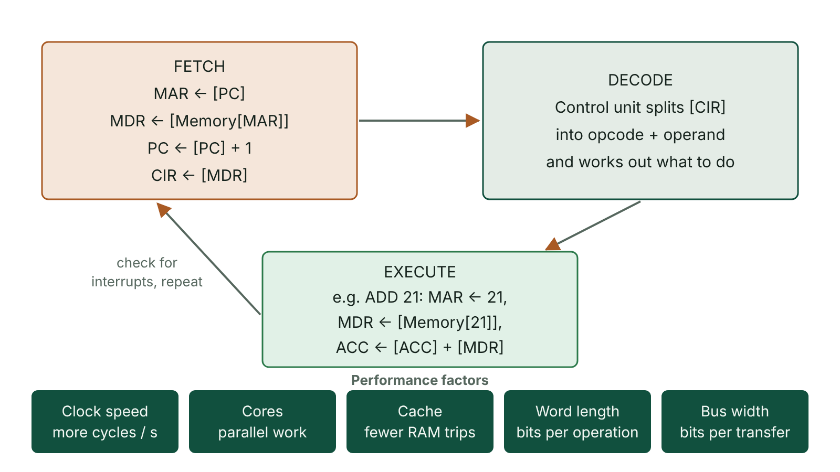
The big picture
The fetch-decode-execute cycle shown as a loop with the register transfers at each stage, and the factors that affect processor performance
☰ Menu
Notes:
Explain the diagram in your own words before you read on.

Slide 38
The cycle at a glance
Before a program runs, the operating system loads its instructions and data from secondary storage into RAM.
The CPU then repeats three stages for every instruction: fetch, decode, execute.
The cycle runs continuously from switch-on to shut-down, billions of times per second.
Despite the common name 'fetch–execute cycle', there are three stages, not two.
Example: when you open a game, its code is copied into RAM and the CPU fetches, decodes and executes it from there.
☰ Menu

Slide 39
Stage 1: fetch
The PC holds the address of the next instruction (at start-up, the address of the first one).
The contents of the PC are copied into the MAR.
The PC is incremented so that it points to the following instruction.
The address in the MAR is put onto the address bus, and the control unit sends a read signal on the control bus.
The instruction at that address travels along the data bus into the MDR.
The instruction is copied from the MDR into the CIR.
☰ Menu

Slide 40
Stage 2: decode
The control unit interprets the instruction held in the CIR.
It splits the instruction into the opcode (the operation, e.g. ADD) and the operand (the data or the address of the data).
Each processor family understands its own instruction set, so machine code for one family will not run on another.
The control unit prepares the registers and circuits needed to carry the instruction out.
☰ Menu

Slide 41
Stage 3: execute
The control unit sends the signals that carry out the instruction.
If the operand is an address, it goes to the MAR and the data comes back through the MDR (or is written out through it).
Arithmetic and logic are performed by the ALU; the result is stored in the accumulator.
A jump/branch instruction loads a new address into the PC, so the next fetch comes from elsewhere in the program.
The cycle then starts again with the next fetch.
☰ Menu

Slide 42
Register transfer summary
Stage | Register transfer | Buses used
Fetch | MAR ← [PC] | Internal
Fetch | PC ← [PC] + 1 | Internal
Fetch | MDR ← [Memory[MAR]] | Address, control (read), data
Fetch | CIR ← [MDR] | Internal
Decode | CU splits [CIR] into opcode and operand | Internal
Execute (ADD 21) | MAR ← 21; MDR ← [Memory[21]]; ACC ← [ACC] + [MDR] | Address, control (read), data
☰ Menu

Slide 43
Simulating the cycle in C#
Each instruction is stored as opcode × 100 + address: 104 means LDA 4, 205 means ADD 5, 306 means STA 6, 0 means HLT.
Each loop pass performs fetch (MAR, MDR, PC, CIR), decode (split the number) and execute.
Trace it: ACC becomes 7, then 12, and 12 is stored in address 6 before the program halts.
☰ Menu

Slide 44
Simulating the cycle in C# – code
C#
int[] memory = { 104, 205, 306, 0, 7, 5, 0 };
int pc = 0, acc = 0;
while (true)
{
int mar = pc; // fetch: MAR <- PC
int mdr = memory[mar]; // MDR <- memory[MAR]
pc++; // PC <- PC + 1
int cir = mdr; // CIR <- MDR
int opcode = cir / 100, operand = cir % 100; // decode
if (opcode == 0) break; // HLT
if (opcode == 1) acc = memory[operand]; // LDA
else if (opcode == 2) acc += memory[operand]; // ADD
else if (opcode == 3) memory[operand] = acc; // STA
Console.WriteLine($"PC={pc} CIR={cir} ACC={acc}");
}
Console.WriteLine($"Address 6 holds {memory[6]}");
☰ Menu

Slide 45
Trace of the simulation
Pass | MAR | CIR (instruction) | PC after fetch | ACC after execute | Memory[6]
1 | 0 | 104 (LDA 4) | 1 | 7 | 0
2 | 1 | 205 (ADD 5) | 2 | 12 | 0
3 | 2 | 306 (STA 6) | 3 | 12 | 12
4 | 3 | 0 (HLT) | 4 | 12 | 12
☰ Menu

Slide 46
Pipelining
Without pipelining, each instruction is fetched, decoded and executed before the next fetch begins: 3 time units each.
With pipelining, the next instruction is fetched while the current one is being decoded, and so on.
Once the pipeline is full, one instruction finishes every time unit.
For n instructions and 3 stages: sequential = 3n units; pipelined = n + 2 units.
4 instructions: 12 units without pipelining, 6 with it. 3 instructions: 9 units versus 5.
A branch can make the instructions already fetched useless, so the pipeline is flushed and some time is lost.
☰ Menu

Slide 47
Pipelining diagram: three instructions
Time unit | Instruction 1 | Instruction 2 | Instruction 3
T1 | Fetch
T2 | Decode | Fetch
T3 | Execute | Decode | Fetch
T4 |  | Execute | Decode
T5 |  |  | Execute
☰ Menu

Slide 48
Clock speed
The clock sends regular pulses; each step of the cycle takes one or more clock cycles.
Clock speed is the number of cycles per second, in hertz: 1 MHz = 10⁶ Hz, 1 GHz = 10⁹ Hz.
Example: 3.2 GHz = 3.2 × 10⁹ = 3 200 000 000 cycles per second; one cycle lasts 1 ÷ 3.2 × 10⁹ s = 0.3125 ns.
A faster clock means more instructions per second, if nothing else is holding the CPU back.
Limit: faster clocks use more power and produce more heat; overheating can damage the chip, so cooling is needed.
Clock speed only compares fairly between similar processors – designs differ in work done per cycle.
☰ Menu

Slide 49
Processor type: word size and cores (1 of 2)
Feature | Effect on performance | Limitation
Word size (32-bit vs 64-bit) | A 64-bit CPU handles 64 bits in one operation and can address far more than the 4 GB limit of 32-bit addressing | Needs a 64-bit operating system and software to benefit
Software compatibility | 32-bit software runs on a 64-bit CPU | Programs compiled for 64-bit cannot run on a 32-bit CPU
Number of cores | Each core runs its own instruction stream, so several threads or programs run at once | Only helps software written in parallel threads; cores share cache and memory
Cache size | More instructions and data kept beside the CPU, so fewer slow RAM accesses | Expensive; gains shrink as cache grows
Data bus width | More bits moved per transfer | Wider buses cost more
☰ Menu

Slide 50
Processor type: word size and cores (2 of 2)
Feature | Effect on performance | Limitation
Amount of RAM | Less swapping to slow secondary storage (virtual memory) | No gain once RAM exceeds what programs need
☰ Menu

Slide 51
Worked example: choosing laptops for an Omagh school
Spec A: 64-bit, 3.0 GHz dual-core, 8 MB cache, 8 GB RAM. Spec B: 64-bit, 2.4 GHz quad-core, 12 MB cache, 16 GB RAM.
64-bit: works with 64-bit words and can use more than 4 GB of RAM.
A runs 3.0 × 10⁹ cycles per second per core; B runs 2.4 × 10⁹, so A is quicker on a single-threaded task.
B has four cores, more cache and twice the RAM, so it copes better with video editing and many open programs.
Verdict for a media studies class: B, because the software is multi-threaded and memory-hungry.
Higher clock speed did not decide the answer – the whole specification and the workload did.
☰ Menu

Slide 52
Measuring performance: benchmarks
Clock speed ignores architecture: instructions per cycle, pipelining, cores and cache all differ between designs.
A benchmark runs a standard set of tasks on different computers and compares the results.
MIPS (millions of instructions per second) measures how quickly general instructions are executed.
FLOPS (floating-point operations per second) measures arithmetic on real numbers – important for science, graphics and AI.
These measure the processor; they say nothing about the speed of the hard disk or network.
☰ Menu

Slide 53
Exit quiz: question 1 of 9
Tap an answer to check it. Presenting? Click to reveal the answer.
In the fetch stage, what happens immediately after the contents of the program counter are copied into the MAR?
A The instruction is decoded
B The PC is incremented to point to the next instruction
✗
✓
C The ALU adds the operand to the accumulator
D The CIR is cleared
✗
✗
✓ B: The PC is incremented to point to the next instruction – The PC is incremented straight away so it is ready for the next cycle, while the address in the MAR is used to read the current instruction.
☰ Menu

Slide 54
Exit quiz: question 2 of 9
Tap an answer to check it. Presenting? Click to reveal the answer.
Why can a 2.8 GHz processor sometimes outperform a 3.4 GHz processor?
A Lower clock speeds always run cooler and so faster
B It may complete more instructions per cycle, or have more cores and cache
✗
✓
C Clock speed is measured differently on each chip
D The 3.4 GHz chip must be 32-bit
✗
✗
✓ B: It may complete more instructions per cycle, or have more cores and cache – Architecture matters: instructions per cycle, cores, cache and pipelining all affect real performance, so clock speed only compares like with like.
☰ Menu

Slide 55
Exit quiz: question 3 of 9
Tap an answer to check it. Presenting? Click to reveal the answer.
Which register receives the instruction from memory via the data bus?
A MAR
B PC
✗
✗
C MDR
D ACC
✓
✗
✓ C: MDR – The data bus delivers the contents of memory into the MDR; it is then copied into the CIR.
☰ Menu

Slide 56
Exit quiz: question 4 of 9
Tap an answer to check it. Presenting? Click to reveal the answer.
A 3.5 GHz processor performs how many cycles per second?
A 3.5 million
B 350 million
✗
✗
C 3.5 billion
D 35 billion
✓
✗
✓ C: 3.5 billion – Giga means 10⁹, so 3.5 × 10⁹ cycles per second.
☰ Menu

Slide 57
Exit quiz: question 5 of 9
Tap an answer to check it. Presenting? Click to reveal the answer.
How many time units do five instructions need with a three-stage pipeline?
A 7
B 5
✓
✗
C 15
D 10
✗
✗
✓ A: 7 – n + 2 = 5 + 2 = 7, compared with 3 × 5 = 15 without pipelining.
☰ Menu

Slide 58
Exit quiz: question 6 of 9
Tap an answer to check it. Presenting? Click to reveal the answer.
During decoding, what is the opcode?
A The address of the next instruction
B The data value used by the instruction
✗
✗
C The register that stores the result
D The part of the instruction that says which operation to perform
✗
✓
✓ D: The part of the instruction that says which operation to perform – The opcode identifies the operation; the operand is the data or address it works on.
☰ Menu

Slide 59
Exit quiz: question 7 of 9
Tap an answer to check it. Presenting? Click to reveal the answer.
Which change would most help a computer that keeps swapping data to virtual memory?
A A faster clock
B More cores
✗
✗
C More RAM
D A wider address bus
✓
✗
✓ C: More RAM – More RAM means less data has to be moved out to slow secondary storage.
☰ Menu

Slide 60
Exit quiz: question 8 of 9
Tap an answer to check it. Presenting? Click to reveal the answer.
What does a jump instruction change during execution?
A The program counter
B The accumulator
✓
✗
C The MDR
D The clock speed
✗
✗
✓ A: The program counter – Loading a new address into the PC makes the next fetch come from a different place in the program.
☰ Menu

Slide 61
Exit quiz: question 9 of 9
Tap an answer to check it. Presenting? Click to reveal the answer.
Which benchmark measure is most relevant for a scientific simulation using real numbers?
A MIPS
B Hz
✗
✗
C Word size
D FLOPS
✗
✓
✓ D: FLOPS – FLOPS counts floating-point (real-number) operations per second.
☰ Menu

Slide 62
Exit quiz answers
Q | Answer | Why
1 | B The PC is incremented to point to the next instruction | The PC is incremented straight away so it is ready for the next cycle, while the address in the MAR is used to read the current instruction.
2 | B It may complete more instructions per cycle, or have more cores and cache | Architecture matters: instructions per cycle, cores, cache and pipelining all affect real performance, so clock speed only compares like with like.
3 | C MDR | The data bus delivers the contents of memory into the MDR; it is then copied into the CIR.
4 | C 3.5 billion | Giga means 10⁹, so 3.5 × 10⁹ cycles per second.
5 | A 7 | n + 2 = 5 + 2 = 7, compared with 3 × 5 = 15 without pipelining.
6 | D The part of the instruction that says which operation to perform | The opcode identifies the operation; the operand is the data or address it works on.
7 | C More RAM | More RAM means less data has to be moved out to slow secondary storage.
8 | A The program counter | Loading a new address into the PC makes the next fetch come from a different place in the program.
9 | D FLOPS | FLOPS counts floating-point (real-number) operations per second.
☰ Menu

Slide 63
Main memory, cache and secondary storage
AS 2: FUNDAMENTALS OF DIGITAL TECHNOLOGY · FD10
Learning objectives
Compare RAM, ROM and cache in terms of volatility, speed, size and use
Explain how the cache controller uses cache to reduce waiting time, and how virtual memory works
Explain why secondary storage is needed and describe how magnetic, optical and flash media store data
Recommend and justify a storage medium for a given scenario using speed, capacity, durability, portability, reliability and cost
Notes:
Specification: Describe main memory, distinguishing between RAM and ROM, and explain the uses of each | Describe the purpose of cache memory, how a cache controller uses it, and the levels of cache | Explain how virtual memory is used and its effect on performance | Explain the need for secondary storage and the factors that influence the choice of storage device | Describe magnetic, optical and flash (solid-state) secondary storage media, including how data is stored and accessed | Evaluate the use of secondary storage media for common applications

Slide 64
In this lesson
Tap a button to jump straight there. The ☰ Menu button on every slide brings you back here.
The big picture
Virtual memory
Comparing secondary storage
Main memory: RAM and ROM
Why we need secondary storage
Worked example: storage for a Fermanagh vet practice
Why main memory matters
Magnetic storage: hard disks
Exit quiz
Cache memory
Writing to a hard disk, and magnetic tape
↑ Topic menu
How the CPU uses cache
Optical storage
The memory hierarchy
Flash (solid-state) storage
Notes:
Lesson menu: each button jumps to that part of the lesson in Slide Show. The ☰ Menu button on each slide returns here.

Slide 65
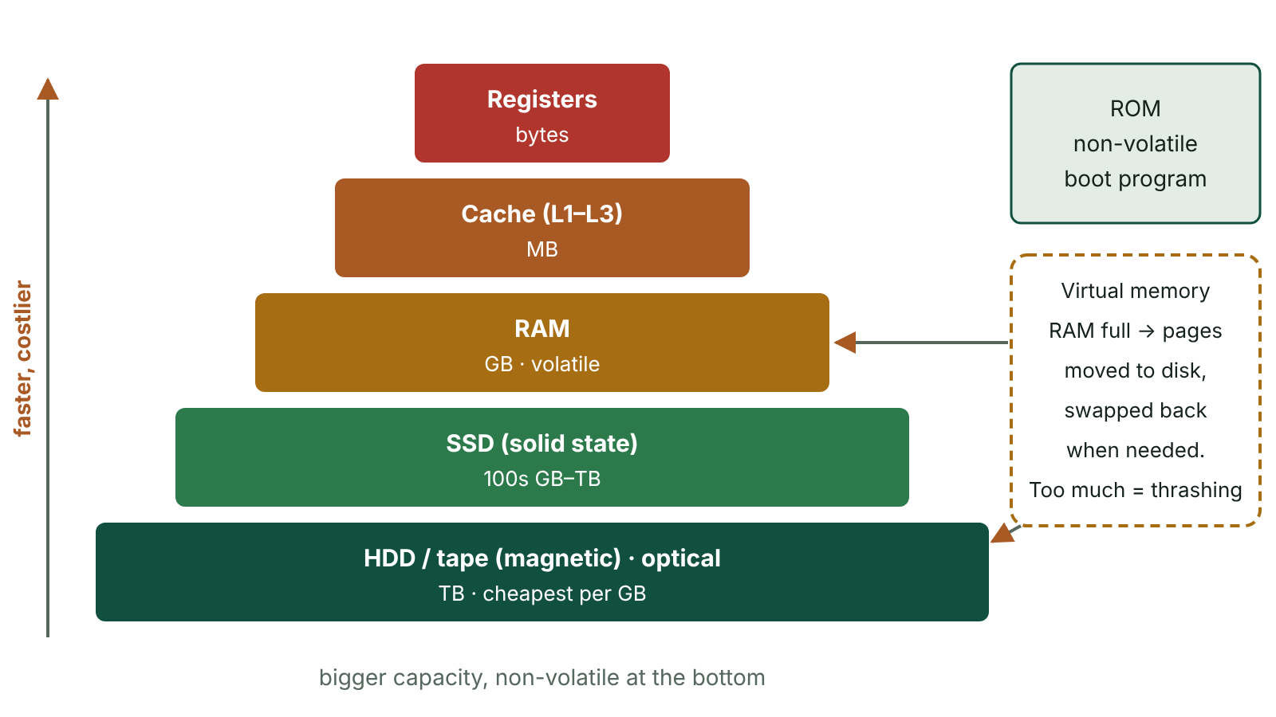
The big picture
The memory hierarchy from registers to magnetic and optical storage: faster and more expensive at the top, larger at the bottom, with virtual memory linking RAM and secondary storage
☰ Menu
Notes:
Explain the diagram in your own words before you read on.

Slide 66
Main memory: RAM and ROM
 | RAM | ROM
Volatile? | Yes – contents lost when power is off | No – contents kept without power
Read/write? | Read and write | Read only in normal use; contents fixed when made
Holds | Operating system, programs and data currently in use | Fixed start-up firmware (bootstrap loader), embedded programs
Typical size | Gigabytes (e.g. 8–32 GB in a PC) | Small – megabytes
Example use | A Word document being edited | Program controlling a dishwasher or microwave
☰ Menu

Slide 67
Why main memory matters
Main memory (immediate access store) is the storage the processor can address directly.
Programs and data are copied from secondary storage into RAM because secondary storage is far too slow to run from.
At power-on RAM is empty, so the instructions that start the computer must be held in non-volatile ROM.
More RAM lets more programs and data stay in memory at once, so the computer responds faster.
RAM modules plug into slots on the motherboard, so memory can usually be upgraded.
☰ Menu

Slide 68
Cache memory
RAM is fast compared with a disk, but still too slow to keep up with the processor.
Cache is a small amount of very fast (and expensive) memory on or beside the CPU.
Task 1: holds instructions and data that are used frequently.
Task 2: reads ahead – the cache controller predicts which addresses are needed next and pre-fetches them.
Prediction works well for program code, because the next instruction is usually in the next address.
More cache means less waiting, but a more expensive processor.
☰ Menu

Slide 69
How the CPU uses cache
1. The CPU checks whether the data or instruction it needs is already in the cache.
2. Cache hit: the cache controller predicted correctly, so the item is supplied from cache straight away.
3. Cache miss: the item is fetched from RAM and copied into the cache before it is processed.
4. The cache controller may then pre-fetch the neighbouring addresses, expecting them to be needed soon.
Levels: L1 is smallest and fastest, inside each core; L2 is larger; L3 is larger still and shared between cores.
☰ Menu

Slide 70
The memory hierarchy
Level | Speed | Capacity | Cost per GB | Volatile?
Registers | Fastest | Bytes | Highest | Yes
L1 / L2 / L3 cache | Very fast | KB to MB | Very high | Yes
RAM | Fast | GB | High | Yes
SSD (flash) | Medium–fast | Hundreds of GB to TB | Medium | No
Hard disk | Slower | TB | Low | No
Magnetic tape | Slowest (serial) | Tens of TB per cartridge | Lowest | No
☰ Menu

Slide 71
Virtual memory
When RAM is full, the operating system uses part of secondary storage as an extension of RAM.
Memory is divided into pages; pages not currently needed are moved out to the disk to free RAM.
When a page on the disk is needed again it is swapped back in, and another page may be moved out.
Advantage: more or larger programs can be open than physical RAM alone allows.
Disadvantage: secondary storage is far slower than RAM, so the computer slows down.
Disk thrashing: so much swapping that the computer spends more time moving pages than processing. Fix: add RAM.
☰ Menu

Slide 72
Why we need secondary storage
RAM is volatile, so anything needed after shut-down must be saved to non-volatile secondary storage.
Capacity: far more space than RAM for the operating system, applications and files.
Portability: removable media let data be carried between computers.
Security: copies can be kept as backups, including off-site in case of fire or theft.
Internal storage (inside the case) is faster as it connects directly to the motherboard; external storage, usually via USB, is portable.
☰ Menu

Slide 73
Magnetic storage: hard disks
One or more rigid platters coated in magnetic material, mounted on a spindle in a sealed case.
Each surface is divided into concentric tracks, and each track into sectors.
Platters spin at thousands of revolutions per minute; read/write heads on an actuator arm move across them.
Bits are stored as tiny regions magnetised in one of two directions, representing 0 and 1.
Direct access, very large capacity (many TB) and low cost per GB – but moving parts can be damaged by knocks.
Floppy disks used the same idea on a flexible disc; they held only 1.44 MB and are now obsolete.
☰ Menu

Slide 74
Writing to a hard disk, and magnetic tape
The operating system checks its file system table to find free space for the file.
The data is passed to the disk controller while the platters spin.
The actuator arm moves the head to the correct track; when the required sector passes under it, the data is written.
Magnetic tape stores data serially: to reach a file the tape must wind past everything before it.
Tape is very cheap per GB with huge capacity, so large organisations use it for archives and backups.
Tape is unsuitable when individual files must be found quickly.
☰ Menu

Slide 75
Optical storage
A laser burns or alters marks (pits) on the reflective layer of a spinning disc; a weaker laser reads the reflections back.
CD about 650–700 MB; DVD 4.7 GB (about 8.5 GB dual-layer); Blu-ray 25 GB per layer, up to 128 GB with four layers.
-ROM: written at manufacture, read only. -R: recordable once by the user. -RW: can be erased and rewritten many times.
Direct access, cheap and light, easy to post – but slower than hard disks and flash, and easily scratched.
Blu-ray has a hard coating that resists scratches; it is used for HD films and games.
Writing requires a drive that can record ('burn') discs; a read-only drive cannot back up to disc.
☰ Menu

Slide 76
Flash (solid-state) storage
Data is held as electrical charges trapped in semiconductor memory cells – non-volatile, with no moving parts.
USB memory sticks and memory cards (SD, microSD) are small, light, robust and portable.
Reading a USB stick: a driver is loaded, the stick's file table is read, the computer sends the address and the stick returns the data.
SSDs replace hard disks inside computers: faster access, less power, silent, shock resistant, smaller.
Drawbacks: higher cost per GB than a hard disk and a limited number of write cycles per cell.
SSDs are now the usual main drive in laptops and many desktops.
☰ Menu

Slide 77
Comparing secondary storage
Factor | Hard disk | Tape | Optical | Flash / SSD
Access | Direct | Serial | Direct | Direct
Speed | Fast | Slow to find data | Slow | Fastest
Capacity | Very high | Very high | Low | High
Cost per GB | Low | Very low | Low | Higher
Durability | Moving parts; damaged by knocks | Wears with repeated rewriting | Scratches easily | Robust; limited write cycles
Portability | External models portable | Cartridges can be stored off-site | Very portable, easy to post | Very portable
☰ Menu

Slide 78
Worked example: storage for a Fermanagh vet practice
Archive 8 TB of old patient records kept for legal reasons: magnetic tape – huge capacity at the lowest cost, and speed of access is not important.
Run the booking system on the reception PC: SSD – fastest access, so records open instantly.
Take X-ray images to a specialist at a weekly clinic: encrypted USB flash drive – small, robust, rewritable, no moving parts.
Send a 300 MB welcome video to new clients by post: DVD-R – cheap, flat, written once so it cannot be altered.
Each choice is linked to the scenario's main need: capacity, speed, portability or cost.
☰ Menu

Slide 79
Exit quiz: question 1 of 9
Tap an answer to check it. Presenting? Click to reveal the answer.
Why must the instructions that start a PC be held in ROM rather than RAM?
A ROM is faster than RAM
B RAM is empty when the computer is switched on, but ROM keeps its contents
✗
✓
C ROM has a larger capacity than RAM
D RAM cannot hold program instructions
✗
✗
✓ B: RAM is empty when the computer is switched on, but ROM keeps its contents – RAM is volatile, so at power-on there is nothing in it; non-volatile ROM still holds the start-up firmware.
☰ Menu

Slide 80
Exit quiz: question 2 of 9
Tap an answer to check it. Presenting? Click to reveal the answer.
A delivery company's drivers record signatures on handheld devices that are often dropped. Which storage is most suitable?
A Hard disk drive
B Magnetic tape
✗
✗
C Flash memory
D DVD-RW
✓
✗
✓ C: Flash memory – Flash memory has no moving parts, so it survives knocks, and it is small and uses little power.
☰ Menu

Slide 81
Exit quiz: question 3 of 9
Tap an answer to check it. Presenting? Click to reveal the answer.
What is disk thrashing?
A Defragmenting a disk
B Excessive swapping of pages between RAM and disk
✗
✓
C A crashed hard disk head
D Formatting a disk
✗
✗
✓ B: Excessive swapping of pages between RAM and disk – The system spends more time swapping pages than processing, so it becomes very slow.
☰ Menu

Slide 82
Exit quiz: question 4 of 9
Tap an answer to check it. Presenting? Click to reveal the answer.
Which storage is best for distributing a film to thousands of customers cheaply?
A SSD
B Magnetic tape
✗
✗
C Hard disk
D Optical disc
✗
✓
✓ D: Optical disc – Optical discs are cheap to mass-produce, light to post and can be made read-only.
☰ Menu

Slide 83
Exit quiz: question 5 of 9
Tap an answer to check it. Presenting? Click to reveal the answer.
Which is fastest?
A RAM
B L1 cache
✗
✓
C SSD
D Hard disk
✗
✗
✓ B: L1 cache – Level 1 cache is inside the core and is faster than RAM and any secondary storage.
☰ Menu

Slide 84
Exit quiz: question 6 of 9
Tap an answer to check it. Presenting? Click to reveal the answer.
What does it mean when the cache controller 'reads ahead'?
A It deletes data the CPU has finished with
B It pre-fetches the data it predicts will be needed next
✗
✓
C It copies the cache to secondary storage
D It reads the next file from the hard disk
✗
✗
✓ B: It pre-fetches the data it predicts will be needed next – It predicts likely addresses, often the next ones in sequence, and loads them into cache before they are requested.
☰ Menu

Slide 85
Exit quiz: question 7 of 9
Tap an answer to check it. Presenting? Click to reveal the answer.
Which is a disadvantage of SSDs compared with hard disks?
A Higher cost per gigabyte
B Moving parts
✓
✗
C Slower access
D Higher power use
✗
✗
✓ A: Higher cost per gigabyte – SSDs cost more per GB; they are faster, use less power and have no moving parts.
☰ Menu

Slide 86
Exit quiz: question 8 of 9
Tap an answer to check it. Presenting? Click to reveal the answer.
Which medium is most suitable for archiving 50 TB of records that are rarely accessed?
A USB flash drive
B Blu-ray disc
✗
✗
C SSD
D Magnetic tape
✗
✓
✓ D: Magnetic tape – Tape offers huge capacity at the lowest cost per GB; slow serial access does not matter for rarely used archives.
☰ Menu

Slide 87
Exit quiz: question 9 of 9
Tap an answer to check it. Presenting? Click to reveal the answer.
On a hard disk, what are tracks?
A Concentric circles on each platter surface
B Pie-shaped wedges of a disc
✓
✗
C The arms that hold the heads
D The cables to the motherboard
✗
✗
✓ A: Concentric circles on each platter surface – Tracks are concentric circles; each is divided into sectors.
☰ Menu

Slide 88
Exit quiz answers
Q | Answer | Why
1 | B RAM is empty when the computer is switched on, but ROM keeps its contents | RAM is volatile, so at power-on there is nothing in it; non-volatile ROM still holds the start-up firmware.
2 | C Flash memory | Flash memory has no moving parts, so it survives knocks, and it is small and uses little power.
3 | B Excessive swapping of pages between RAM and disk | The system spends more time swapping pages than processing, so it becomes very slow.
4 | D Optical disc | Optical discs are cheap to mass-produce, light to post and can be made read-only.
5 | B L1 cache | Level 1 cache is inside the core and is faster than RAM and any secondary storage.
6 | B It pre-fetches the data it predicts will be needed next | It predicts likely addresses, often the next ones in sequence, and loads them into cache before they are requested.
7 | A Higher cost per gigabyte | SSDs cost more per GB; they are faster, use less power and have no moving parts.
8 | D Magnetic tape | Tape offers huge capacity at the lowest cost per GB; slow serial access does not matter for rarely used archives.
9 | A Concentric circles on each platter surface | Tracks are concentric circles; each is divided into sectors.
☰ Menu

Slide 89
Alternative architectures: parallel, multicore, Harvard, RISC and CISC, GPUs
AS 2: FUNDAMENTALS OF DIGITAL TECHNOLOGY · FD11
Learning objectives
Explain how parallel processing and multi-core processors increase throughput and why the gains are limited
Compare Harvard and Von Neumann architectures, giving typical uses of each
Compare RISC and CISC processors and link their features to power use, pipelining and program size
Explain why GPUs suit graphics, machine learning and other highly parallel tasks, and choose an architecture for a scenario
Notes:
Specification: Describe parallel processing and multi-core processors, and explain their benefits and limitations | Compare the Harvard and Von Neumann architectures and identify where each is used | Compare reduced instruction set computers (RISC) and complex instruction set computers (CISC) | Describe the use of graphics processing units (GPUs) and other co-processors for graphics and general-purpose parallel processing | Evaluate the choice of processor architecture for a given application

Slide 90
In this lesson
Tap a button to jump straight there. The ☰ Menu button on every slide brings you back here.
The big picture
Harvard versus Von Neumann
CPU versus GPU
Why look beyond Von Neumann?
Harvard in practice: embedded systems
Choosing an architecture
Parallel processing
RISC and CISC
Exit quiz
Multi-core processors
One task, two instruction sets
↑ Topic menu
Worked example: how much faster with more cores?
Why RISC suits phones and CISC suited PCs
Splitting work across threads in C#
Graphics processing units (GPUs)
Notes:
Lesson menu: each button jumps to that part of the lesson in Slide Show. The ☰ Menu button on each slide returns here.

Slide 91
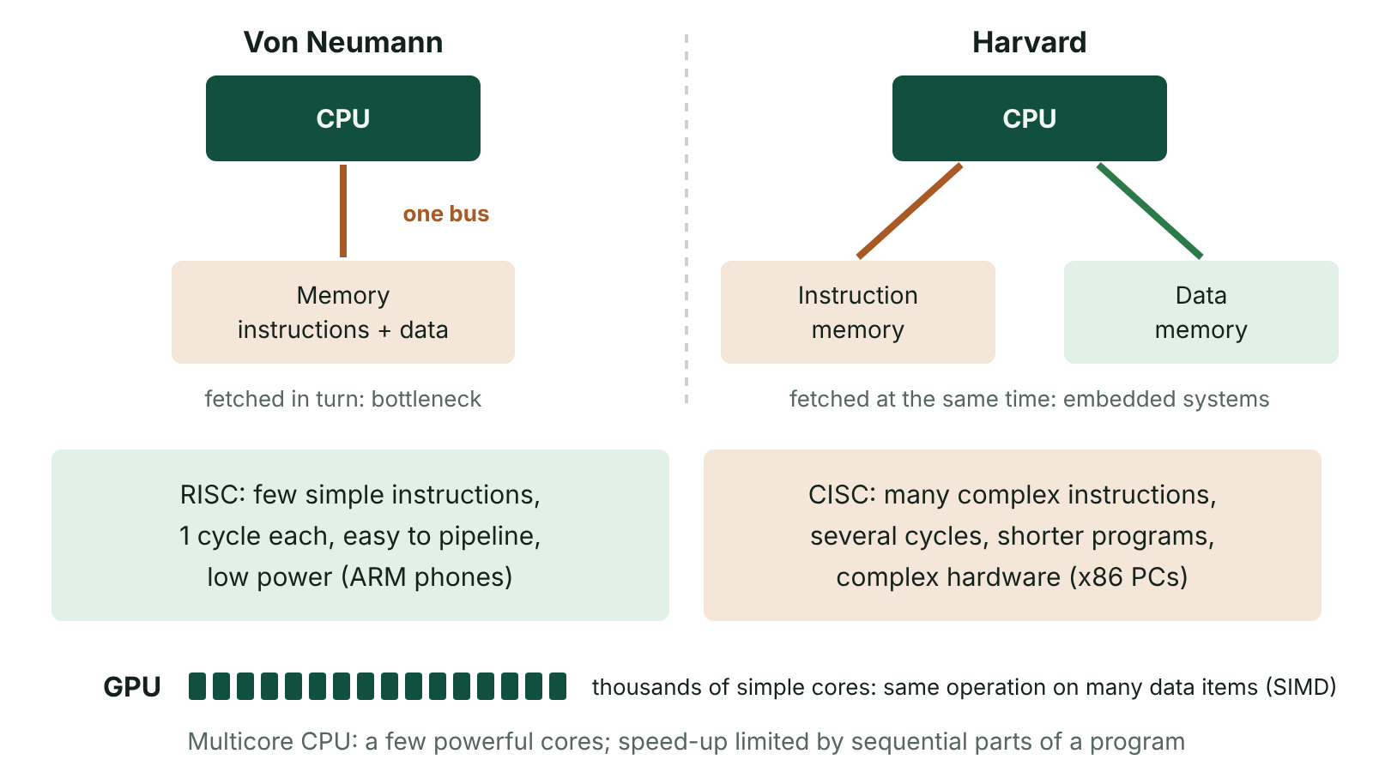
The big picture
Von Neumann architecture with one shared memory and bus compared with Harvard architecture with separate instruction and data memories, plus RISC and CISC and GPU summaries
☰ Menu
Notes:
Explain the diagram in your own words before you read on.

Slide 92
Why look beyond Von Neumann?
A basic Von Neumann machine has one processor that fetches and executes one instruction at a time over one shared bus.
Raising clock speed further is limited by heat and power use.
Designers instead increase the work done per second in other ways.
Do more at once: parallel processing, multi-core chips and GPUs.
Remove the shared-bus bottleneck: the Harvard architecture.
Simplify instructions so they pipeline well: RISC.
☰ Menu

Slide 93
Parallel processing
Parallel processing uses two or more processors or cores to work on different parts of a task at the same time.
The task is split into independent threads; results are combined at the end.
Works well when the parts do not depend on each other: rendering separate frames, serving many web users, processing many images.
Sequential tasks gain nothing: if step 2 needs the answer from step 1, they cannot run together.
Overheads: dividing the work, coordinating cores and combining results all take time.
Software and operating systems must be written specially to use parallelism.
☰ Menu

Slide 94
Multi-core processors
A multi-core processor has two or more complete cores on one chip: dual-core, quad-core, octa-core and beyond.
Each core has its own control unit, ALU, registers and L1 cache; L3 cache is usually shared.
The operating system schedules different programs or threads on different cores.
Benefits: better multitasking and faster multi-threaded software without a higher clock speed, so less heat per unit of work.
Limits: single-threaded programs use only one core; cores compete for shared cache, memory and bus.
☰ Menu

Slide 95
Worked example: how much faster with more cores?
A photo-processing job for a Lisburn wedding photographer takes 100 s on one core; 80 s of it can run in parallel, 20 s cannot.
On 4 cores: 20 s + 80 ÷ 4 = 20 + 20 = 40 s, a speed-up of 100 ÷ 40 = 2.5 times.
On 8 cores: 20 + 80 ÷ 8 = 20 + 10 = 30 s, a speed-up of 100 ÷ 30 ≈ 3.3 times.
However many cores are added, it can never take less than the 20 s sequential part, so the speed-up is limited to 5 times.
Doubling cores from 4 to 8 saved only 10 s: the sequential part limits the gain (and real overheads make it worse).
☰ Menu

Slide 96
Splitting work across threads in C#
Parallel.For shares the loop's iterations between the available cores.
This works because each image can be processed independently of the others.
If each step depended on the previous one, the work could not be split like this.
☰ Menu

Slide 97
Splitting work across threads in C# – code
C#
using System.Threading.Tasks;
int[] brightness = new int[8];
// Each image is processed on whichever core is free
Parallel.For(0, brightness.Length, i =>
{
brightness[i] = (i + 1) * 10; // stand-in for slow image processing
});
Console.WriteLine($"Cores available: {Environment.ProcessorCount}");
Console.WriteLine(string.Join(", ", brightness));
☰ Menu

Slide 98
Harvard versus Von Neumann
 | Von Neumann | Harvard
Memory | One memory holds both instructions and data | Separate memories for instructions and for data
Buses | One shared set of buses | Separate buses for instructions and data
Fetching | Instruction and data fetched one after the other | Instruction and data can be fetched at the same time
Benefits | Simpler and cheaper; memory used flexibly for either | Faster; each memory can differ in size, word length and type (e.g. program in flash, data in RAM)
Drawbacks | Von Neumann bottleneck | More complex; unused instruction memory cannot be used for data
Typical use | General-purpose PCs, laptops, servers | Embedded systems, microcontrollers, digital signal processors
☰ Menu

Slide 99
Harvard in practice: embedded systems
An embedded system is a computer built into a larger device to do one dedicated job.
Examples: a central heating controller, a car's anti-lock brakes, a contactless card reader, a smart meter.
The fixed program sits in non-volatile instruction memory; a small RAM holds sensor readings and variables.
Fetching instructions and data together gives quick, predictable response times.
Modern PCs are hybrids: Von Neumann main memory, but separate L1 caches for instructions and data inside each core.
☰ Menu

Slide 100
RISC and CISC (1 of 2)
 | RISC | CISC
Instruction set | Small set of simple instructions | Large set including complex, multi-step instructions
Clock cycles | Most instructions take one cycle | Complex instructions take several cycles
Instruction format | Fixed length | Variable length
Program length | More instructions in compiled code; compiler does more work | Fewer instructions; one may do several operations
Hardware | Simpler circuitry, more general registers, easy to pipeline, lower power | More complex circuitry, harder to pipeline, more power
☰ Menu

Slide 101
RISC and CISC (2 of 2)
 | RISC | CISC
Examples | ARM chips in phones, tablets, many laptops, Raspberry Pi | Intel and AMD x86 in most desktop PCs
☰ Menu

Slide 102
One task, two instruction sets
Task: multiply the values at addresses 20 and 21 and store the result in 22.
CISC: one complex instruction can read memory, multiply and write back, taking several clock cycles.
RISC: only load and store instructions touch memory; arithmetic works on registers, each step taking about one cycle.
The RISC version has more instructions, but each is simple, fixed length and easy to pipeline.
☰ Menu

Slide 103
One task, two instruction sets – code
PSEUDOCODE
// CISC style
MULT 22, 20, 21 // memory[22] <- memory[20] * memory[21]
// RISC style
LOAD R1, 20 // R1 <- memory[20]
LOAD R2, 21 // R2 <- memory[21]
MUL R3, R1, R2 // R3 <- R1 * R2
STORE R3, 22 // memory[22] <- R3
☰ Menu

Slide 104
Why RISC suits phones and CISC suited PCs
Simpler circuits need fewer transistors, so a RISC chip uses less power and produces less heat: longer battery life, no fan.
Fixed-length, single-cycle instructions keep a pipeline flowing smoothly.
CISC was designed when memory was expensive: fewer, more powerful instructions meant smaller programs.
Backward compatibility keeps x86 in PCs: decades of Windows software expects it.
The gap has narrowed: modern x86 chips convert complex instructions into simple RISC-like steps internally, and ARM chips now power many laptops.
☰ Menu

Slide 105
Graphics processing units (GPUs)
A GPU contains hundreds or thousands of simple cores designed to perform the same operation on many data items at once.
This is SIMD – single instruction, multiple data.
Graphics suits this: every pixel or vertex in a frame needs the same calculation.
General-purpose uses: machine learning, video encoding, scientific modelling and weather forecasting.
Weak at sequential, branching work, so the CPU still runs the operating system and general programs.
A GPU is one kind of co-processor; others include sound processors and the neural engines in phone chips.
☰ Menu

Slide 106
CPU versus GPU
 | CPU | GPU
Cores | A few powerful, complex cores | Hundreds to thousands of simple cores
Best at | Varied, sequential tasks with lots of decisions | The same operation applied to large amounts of data
Control logic and cache per core | Large | Small
Typical work | Operating system, word processing, databases | 3D graphics, video, AI training, simulations
Measure often quoted | Clock speed, cores, benchmark scores | FLOPS (floating-point operations per second)
☰ Menu

Slide 107
Choosing an architecture
Scenario | Suitable design | Reason
Fitness tracker | RISC microcontroller with Harvard-style memory | Very low power, small fixed program, quick response to sensors
Office desktop PC | Multi-core x86 (CISC), Von Neumann main memory | General purpose and runs existing Windows software
Training an AI model | GPU / many-core parallel system | Huge numbers of identical calculations on large data sets
Washing machine controller | Harvard microcontroller | Program in flash, data in small RAM, fetched together
Smartphone | Multi-core ARM (RISC) with built-in GPU | Long battery life, little heat, smooth graphics
☰ Menu

Slide 108
Exit quiz: question 1 of 9
Tap an answer to check it. Presenting? Click to reveal the answer.
Why does a smartphone usually use a RISC processor rather than a CISC one?
A RISC chips have more complex instructions
B RISC chips use simpler circuitry, so they need less power and produce less heat
✗
✓
C RISC chips cannot run apps
D RISC chips use the Von Neumann bottleneck
✗
✗
✓ B: RISC chips use simpler circuitry, so they need less power and produce less heat – Fewer transistors and simple single-cycle instructions mean lower power use and longer battery life.
☰ Menu

Slide 109
Exit quiz: question 2 of 9
Tap an answer to check it. Presenting? Click to reveal the answer.
A task takes 100 s on one core, and 40 s of it must run sequentially. What is the shortest time it could take with unlimited cores?
A 0 s
B 10 s
✗
✗
C 40 s
D 60 s
✓
✗
✓ C: 40 s – Only the 60 s parallel part can shrink; the 40 s sequential part always remains.
☰ Menu

Slide 110
Exit quiz: question 3 of 9
Tap an answer to check it. Presenting? Click to reveal the answer.
Which architecture uses separate memories for instructions and data?
A Von Neumann
B Harvard
✗
✓
C CISC
D Multi-core
✗
✗
✓ B: Harvard – Harvard separates instruction and data memory and buses so both can be accessed at once.
☰ Menu

Slide 111
Exit quiz: question 4 of 9
Tap an answer to check it. Presenting? Click to reveal the answer.
Which is a characteristic of RISC?
A Variable-length complex instructions
B Many cycles per instruction
✗
✗
C Few registers
D Simple instructions that are easy to pipeline
✗
✓
✓ D: Simple instructions that are easy to pipeline – Simple, fixed-length, single-cycle instructions keep a pipeline flowing.
☰ Menu

Slide 112
Exit quiz: question 5 of 9
Tap an answer to check it. Presenting? Click to reveal the answer.
Why are GPUs suited to image rendering?
A They have more cache per core than CPUs
B They use the Harvard architecture
✗
✗
C The same calculation is applied to many pixels in parallel
D They are CISC processors
✓
✗
✓ C: The same calculation is applied to many pixels in parallel – SIMD processing across thousands of cores suits identical per-pixel calculations.
☰ Menu

Slide 113
Exit quiz: question 6 of 9
Tap an answer to check it. Presenting? Click to reveal the answer.
Which device most likely uses a Harvard microcontroller?
A Microwave oven controller
B Web server
✓
✗
C Desktop PC
D Cloud database
✗
✗
✓ A: Microwave oven controller – It is an embedded system with a fixed program and small data memory.
☰ Menu

Slide 114
Exit quiz: question 7 of 9
Tap an answer to check it. Presenting? Click to reveal the answer.
Most desktop PCs use which instruction set approach?
A RISC only
B CISC (x86)
✗
✓
C Harvard
D SIMD
✗
✗
✓ B: CISC (x86) – Intel and AMD x86 processors are CISC.
☰ Menu

Slide 115
Exit quiz: question 8 of 9
Tap an answer to check it. Presenting? Click to reveal the answer.
What is a co-processor?
A A backup CPU used if the main one fails
B A second operating system
✗
✗
C A processor that takes over a specific type of work from the CPU
D A register inside the ALU
✓
✗
✓ C: A processor that takes over a specific type of work from the CPU – Examples include GPUs, sound processors and neural engines.
☰ Menu

Slide 116
Exit quiz: question 9 of 9
Tap an answer to check it. Presenting? Click to reveal the answer.
Which statement about multi-core processors is correct?
A Each core can execute its own stream of instructions at the same time
B All cores must run the same instruction
✓
✗
C Single-threaded programs use every core
D They remove the need for cache
✗
✗
✓ A: Each core can execute its own stream of instructions at the same time – Cores are independent processing units; single-threaded software uses only one of them.
☰ Menu

Slide 117
Exit quiz answers
Q | Answer | Why
1 | B RISC chips use simpler circuitry, so they need less power and produce less heat | Fewer transistors and simple single-cycle instructions mean lower power use and longer battery life.
2 | C 40 s | Only the 60 s parallel part can shrink; the 40 s sequential part always remains.
3 | B Harvard | Harvard separates instruction and data memory and buses so both can be accessed at once.
4 | D Simple instructions that are easy to pipeline | Simple, fixed-length, single-cycle instructions keep a pipeline flowing.
5 | C The same calculation is applied to many pixels in parallel | SIMD processing across thousands of cores suits identical per-pixel calculations.
6 | A Microwave oven controller | It is an embedded system with a fixed program and small data memory.
7 | B CISC (x86) | Intel and AMD x86 processors are CISC.
8 | C A processor that takes over a specific type of work from the CPU | Examples include GPUs, sound processors and neural engines.
9 | A Each core can execute its own stream of instructions at the same time | Cores are independent processing units; single-threaded software uses only one of them.
☰ Menu

