Slide 1
User interface and data compression
AS 2: FUNDAMENTALS OF DIGITAL TECHNOLOGY · TOPIC
Lessons in this topic
FD12 User interfaces and HCI design
FD13 Data compression and file formats

Slide 2

Topic menu
Tap a button to jump straight there. The ☰ Menu button on every slide brings you back here.
Specification map
FD13 Data compression and file formats
FD12 User interfaces and HCI design

Slide 3
Specification map
Lesson | Specification: students should be able to
FD12 | Describe the features of a good user interface; Describe the main features of WIMP (graphical), command line and forms dialogue interfaces; Evaluate WIMP, command line and forms dialogue interfaces for given users and tasks; Describe how text, sound and video can be input using personal computers, laptops, tablets and smartphones; Describe other interfaces (voice, touch, biometric, menu-driven) and principles of HCI design, including accessibility
FD13 | Explain the need for data compression; Distinguish between lossy and lossless compression and give appropriate uses of each; Describe run-length encoding (RLE) and dictionary-based compression and apply them to simple data; Describe how zipping is used to compress data; Evaluate common data file formats: txt, wav, bitmap, JPEG, MPEG and GIF; Calculate uncompressed file sizes and compression ratios
☰ Menu
Notes:
Each lesson below is its own section in PowerPoint (View → Slide Sorter shows them). To split this deck by specification point, right-click a section → Move Section, or delete the sections you do not need.

Slide 4
User interfaces and HCI design
AS 2: FUNDAMENTALS OF DIGITAL TECHNOLOGY · FD12
Learning objectives
Describe the qualities of a good user interface and apply HCI principles such as consistency and feedback
Compare WIMP, command line and forms dialogue interfaces and justify a choice for given users and contexts
Explain how text, sound and video are input on PCs, laptops, tablets and smartphones
Explain how interfaces can be made accessible to users with a range of needs
Notes:
Specification: Describe the features of a good user interface | Describe the main features of WIMP (graphical), command line and forms dialogue interfaces | Evaluate WIMP, command line and forms dialogue interfaces for given users and tasks | Describe how text, sound and video can be input using personal computers, laptops, tablets and smartphones | Describe other interfaces (voice, touch, biometric, menu-driven) and principles of HCI design, including accessibility

Slide 5
In this lesson
Tap a button to jump straight there. The ☰ Menu button on every slide brings you back here.
The big picture
A tiny command interpreter in C#
HCI design principles
What makes a good user interface?
Forms dialogue interface
Accessibility
Graphical user interface (WIMP)
Comparing the three main interfaces
Worked scenario: choosing an interface
WIMP: advantages and disadvantages
Other interfaces
Exit quiz
Command line interface (CLI)
Inputting text, sound and video
↑ Topic menu
Notes:
Lesson menu: each button jumps to that part of the lesson in Slide Show. The ☰ Menu button on each slide returns here.

Slide 6
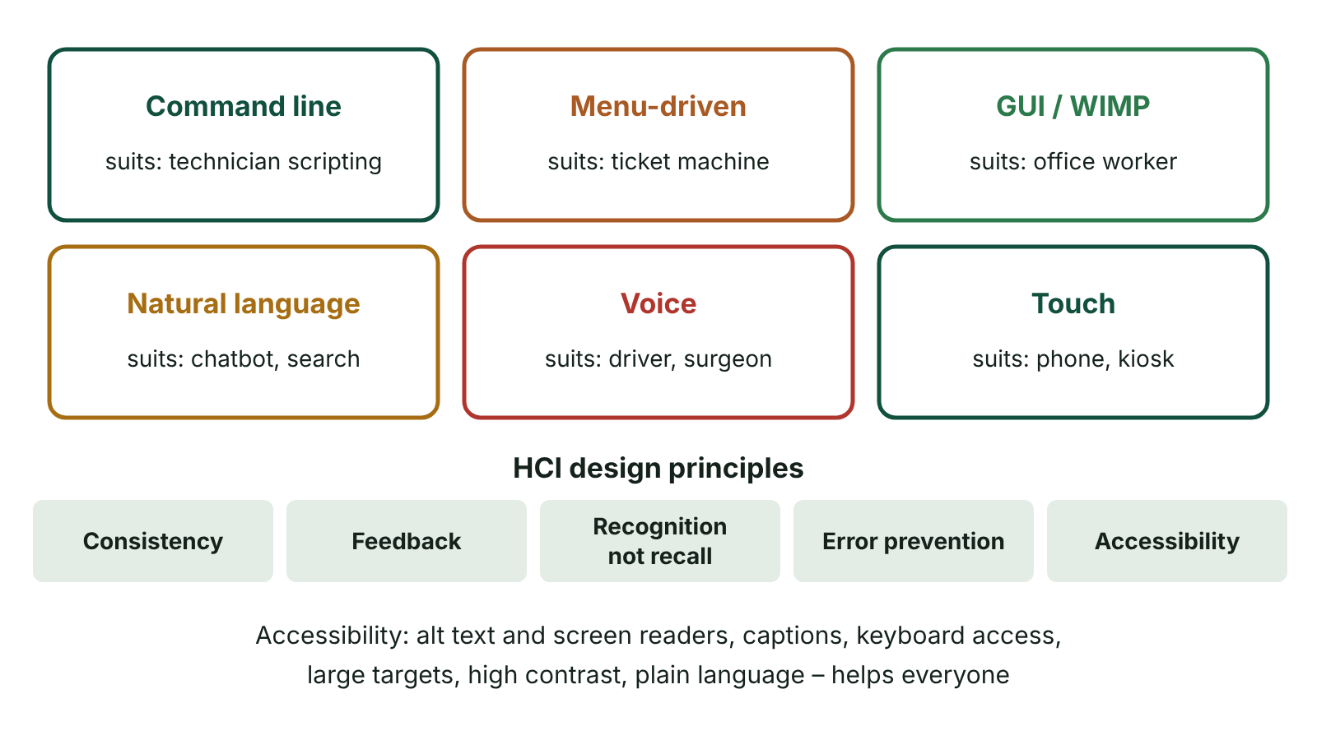
The big picture
Six types of user interface with an example user for each, and the key HCI design principles
☰ Menu
Notes:
Explain the diagram in your own words before you read on.

Slide 7
What makes a good user interface?
The user interface is everything through which a person and a computer exchange information: what they see, hear and touch, and how they give commands.
Simple: clear, uncluttered and easy to learn, balancing functionality against simplicity so nothing is ambiguous.
Intuitive and consistent: controls behave as expected and the same way throughout, so learning transfers to new tasks.
Responsive: keeps up with the user and gives feedback on its status, e.g. a progress bar or spinning icon.
Forgiving: mistakes are easy to reverse (undo, cancel, confirm before delete) and help is available.
Attractive: a pleasing layout, typography and colour scheme improves the user experience.
☰ Menu

Slide 8
Graphical user interface (WIMP)
Windows: rectangular areas of the screen in which applications or documents run, so several can be open at once.
Icons: small pictures representing applications, files, folders or devices.
Menus: lists of options the user chooses from (drop-down, pop-up or ribbon).
Pointer: an arrow moved by a mouse, trackpad or finger to point at and select items.
Used by Windows, macOS, Android and iOS, often combined with touch input.
☰ Menu

Slide 9
WIMP: advantages and disadvantages
Advantages | Disadvantages
Intuitive: users recognise options rather than recall commands | Needs more RAM than other interfaces
Easy to navigate with little training | Uses more storage space
Easy to move data between applications (copy and paste, drag and drop) | Needs a more powerful processor and a good display
Help for novices and shortcut keys for experts | Takes programmers longer to develop
WYSIWYG: see the result before printing | Repetitive tasks can be slow with mouse clicks
☰ Menu

Slide 10
Command line interface (CLI)
The user types text commands at a prompt; the operating system recognises a fixed set of commands with an exact syntax.
Switches (parameters) after the command modify what it does, e.g. dir /s in Windows lists files in all subfolders too.
Advantages: little processing power, memory or display quality needed; very fast for experts; commands can be scripted to automate tasks.
Disadvantages: commands must be learned and typed precisely; few clues for beginners; a mistyped command can delete data.
Used today mainly by network managers, system administrators and programmers.
☰ Menu

Slide 11
A tiny command interpreter in C#
The program only recognises exact commands, just like a real command line.
Try 'list' and then 'List' – the second fails, which shows why CLI users must know the precise syntax.
☰ Menu

Slide 12
A tiny command interpreter in C# – code
C#
string[] files = { "timetable.docx", "rota.xlsx" };
Console.Write("> ");
string command = Console.ReadLine() ?? "";
switch (command)
{
case "list":
foreach (string f in files) Console.WriteLine(f);
break;
case "count":
Console.WriteLine(files.Length + " files");
break;
default:
Console.WriteLine("'" + command + "' is not recognised");
break;
}
☰ Menu

Slide 13
Forms dialogue interface
The user completes a structured form on screen using text boxes, drop-down lists, check boxes and radio buttons.
Common online: booking a holiday, ordering a takeaway, applying for a provisional driving licence.
Advantages: easy for beginners; logical layout; few commands to learn; little processing power; data can be validated as it is entered.
Disadvantages: poorly designed forms are slow; only the options provided can be chosen; tedious for experienced users.
Good forms group related fields, mark compulsory fields, use sensible defaults and give clear error messages.
☰ Menu

Slide 14
Comparing the three main interfaces
 | WIMP / GUI | Command line | Forms dialogue
Ease for beginners | High | Low | High
Speed for experts | Medium | High | Low to medium
Resources needed | High | Low | Low
Flexibility | High | Very high | Limited to options given
Input errors | Few | Many, if mistyped | Reduced by validation
Typical user | General office or home user | Network technician | Member of the public booking online
☰ Menu

Slide 15
Other interfaces
Interface | Advantage | Disadvantage
Menu-driven | Easy to learn; limits choices so fewer errors | Deep menus are slow; restricted options
Voice (dialogue) | Hands-free; faster than typing; helps users with dyslexia or limited mobility | Background noise, accents and homophones (there/their) cause errors; privacy
Touch-sensitive | Very intuitive; no separate keyboard or mouse | Small targets hard to select; screens get dirty or scratched
Biometric | Unique to the person; nothing to forget or lose; hard to forge | Expensive; stored biometric data raises privacy concerns; some features change
Natural language | No commands to learn; flexible | Language is ambiguous and can be misinterpreted
☰ Menu

Slide 16
Inputting text, sound and video
Device | Text | Sound | Video
Desktop PC | Full-size keyboard; scanner with OCR | Plug-in or headset microphone | USB webcam; video capture card
Laptop | Built-in keyboard and trackpad | Built-in microphone array | Built-in webcam
Tablet | On-screen keyboard, stylus handwriting recognition, dictation | Built-in microphones | Front and rear cameras
Smartphone | On-screen keyboard, predictive text, swipe typing, speech-to-text | Microphones, voice notes, voice assistants | High-resolution cameras recording to compressed video
☰ Menu

Slide 17
HCI design principles
Consistency: the same layout, colours, terminology and controls throughout, so users can transfer what they learn.
Feedback: confirm every action (a sound, progress bar or message) so users know what has happened.
Minimise memory load: recognition rather than recall – show options rather than requiring users to remember them.
Error prevention and recovery: confirm destructive actions, validate input, offer undo and clear error messages.
Suit the user: consider age, experience, the task, the environment and the device.
☰ Menu

Slide 18
Accessibility
Visual impairment: screen readers, alt text for images, high contrast, resizable text, colour never the only cue.
Hearing impairment: captions and subtitles, visual alerts instead of sounds.
Motor impairment: keyboard-only navigation, large targets, voice control, switch access.
Cognitive needs: simple language, clear structure, consistent navigation, enough time to complete tasks.
Accessible design benefits everyone and helps organisations meet their duties under disability discrimination law (in Northern Ireland, the Disability Discrimination Act 1995 as amended).
☰ Menu

Slide 19
Worked scenario: choosing an interface
User and task | Best interface | Justification
Network technician configuring 50 switches | Command line | Commands can be scripted and repeated quickly
Visitor paying for parking in Belfast city centre | Menu-driven touch screen | No training, few options, quick
Surgeon checking notes during an operation | Voice | Hands are busy and must stay sterile
Parent booking a Saturday leisure-centre swim | Forms dialogue | Guided, validated input with no commands to learn
Pupil editing a school newsletter | WIMP / GUI | Visual layout, drag and drop, WYSIWYG
Staff unlocking a pharmacy drugs cabinet | Biometric | Identity tied to the person; no shared codes
☰ Menu

Slide 20
Exit quiz: question 1 of 9
Tap an answer to check it. Presenting? Click to reveal the answer.
Why might an experienced programmer prefer a command line interface to a GUI?
A It has more colourful icons
B It is easier for beginners
✗
✗
C Knowing the commands, they can work faster and automate tasks with scripts
D It needs a more powerful processor
✓
✗
✓ C: Knowing the commands, they can work faster and automate tasks with scripts – Experts who know the commands work faster at a CLI and can script repetitive jobs.
☰ Menu

Slide 21
Exit quiz: question 2 of 9
Tap an answer to check it. Presenting? Click to reveal the answer.
What does WIMP stand for?
A Windows, icons, menus, pointer
B Web, internet, mail, protocol
✓
✗
C Wireless, input, memory, processor
D Windows, input, mouse, printer
✗
✗
✓ A: Windows, icons, menus, pointer – These are the four elements of a graphical user interface.
☰ Menu

Slide 22
Exit quiz: question 3 of 9
Tap an answer to check it. Presenting? Click to reveal the answer.
Which is an advantage of a forms dialogue interface?
A It is the fastest interface for experts
B Data can be validated as it is entered
✗
✓
C It offers unlimited options
D It needs no screen
✗
✗
✓ B: Data can be validated as it is entered – Each field can be checked on entry, reducing errors.
☰ Menu

Slide 23
Exit quiz: question 4 of 9
Tap an answer to check it. Presenting? Click to reveal the answer.
Which HCI principle does 'recognition rather than recall' support?
A Feedback
B Consistency
✗
✗
C Error recovery
D Minimising memory load
✗
✓
✓ D: Minimising memory load – Users choose from visible options rather than remembering commands.
☰ Menu

Slide 24
Exit quiz: question 5 of 9
Tap an answer to check it. Presenting? Click to reveal the answer.
Which feature best helps a deaf user watching a training video?
A Alt text
B High contrast
✗
✗
C Captions
D Voice control
✓
✗
✓ C: Captions – Captions present the audio as text.
☰ Menu

Slide 25
Exit quiz: question 6 of 9
Tap an answer to check it. Presenting? Click to reveal the answer.
Which is a drawback of a GUI?
A Hard for beginners
B Requires memorising syntax
✗
✗
C Cannot display images
D Needs more memory and processing power
✗
✓
✓ D: Needs more memory and processing power – Graphics need more RAM, storage and processing.
☰ Menu

Slide 26
Exit quiz: question 7 of 9
Tap an answer to check it. Presenting? Click to reveal the answer.
A spinning wheel appears while a file uploads. Which quality of a good interface does this show?
A Responsive feedback
B Biometric security
✓
✗
C Consistency of colour
D Forgiveness
✗
✗
✓ A: Responsive feedback – The interface tells the user its current status.
☰ Menu

Slide 27
Exit quiz: question 8 of 9
Tap an answer to check it. Presenting? Click to reveal the answer.
Which input method lets a smartphone user enter text without typing?
A Webcam
B Speech-to-text dictation
✗
✓
C Trackpad
D Scanner
✗
✗
✓ B: Speech-to-text dictation – Speech recognition converts spoken words into text.
☰ Menu

Slide 28
Exit quiz: question 9 of 9
Tap an answer to check it. Presenting? Click to reveal the answer.
Which interface is most suitable for a surgeon who must keep their hands sterile?
A Command line
B Forms dialogue
✗
✗
C Voice
D Touch screen
✓
✗
✓ C: Voice – Voice control is hands-free.
☰ Menu

Slide 29
Exit quiz answers
Q | Answer | Why
1 | C Knowing the commands, they can work faster and automate tasks with scripts | Experts who know the commands work faster at a CLI and can script repetitive jobs.
2 | A Windows, icons, menus, pointer | These are the four elements of a graphical user interface.
3 | B Data can be validated as it is entered | Each field can be checked on entry, reducing errors.
4 | D Minimising memory load | Users choose from visible options rather than remembering commands.
5 | C Captions | Captions present the audio as text.
6 | D Needs more memory and processing power | Graphics need more RAM, storage and processing.
7 | A Responsive feedback | The interface tells the user its current status.
8 | B Speech-to-text dictation | Speech recognition converts spoken words into text.
9 | C Voice | Voice control is hands-free.
☰ Menu

Slide 30
Data compression and file formats
AS 2: FUNDAMENTALS OF DIGITAL TECHNOLOGY · FD13
Learning objectives
Explain why data is compressed and compare lossy and lossless compression
Apply run-length encoding and dictionary-based compression to simple examples and calculate the saving
Calculate the size of a bitmap image and a compression ratio
Choose and justify a file format and compression method for a given file and purpose
Notes:
Specification: Explain the need for data compression | Distinguish between lossy and lossless compression and give appropriate uses of each | Describe run-length encoding (RLE) and dictionary-based compression and apply them to simple data | Describe how zipping is used to compress data | Evaluate common data file formats: txt, wav, bitmap, JPEG, MPEG and GIF | Calculate uncompressed file sizes and compression ratios

Slide 31
In this lesson
Tap a button to jump straight there. The ☰ Menu button on every slide brings you back here.
The big picture
Worked example: RLE on a pixel row
Sound and video
Why compress data?
Dictionary-based compression
Choosing a format and method
Worked example: a bitmap photo
Worked example: dictionary compression
Exit quiz
Lossy and lossless
Zipping
↑ Topic menu
How lossy compression decides what to remove
Common file formats
Run-length encoding (RLE)
Images: bitmap, GIF and JPEG
Notes:
Lesson menu: each button jumps to that part of the lesson in Slide Show. The ☰ Menu button on each slide returns here.

Slide 32
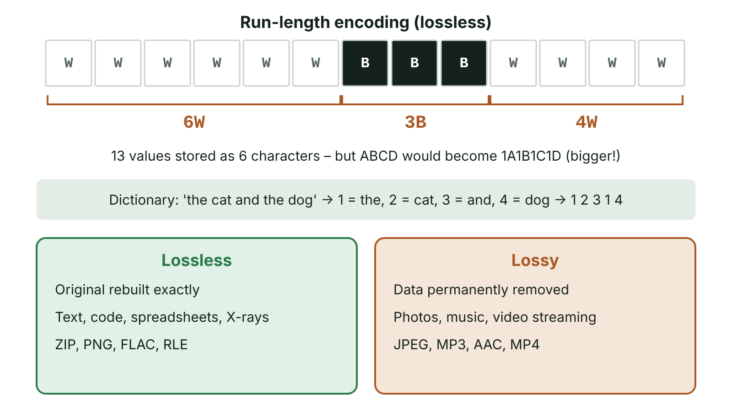
The big picture
Run-length encoding of a row of pixels into 6W 3B 4W, and a comparison of lossless and lossy compression with example formats
☰ Menu
Notes:
Explain the diagram in your own words before you read on.

Slide 33
Why compress data?
Compression encodes data using fewer bits than the original representation.
Most files contain redundancy – the same data repeated – which can be stored more efficiently.
Reason 1: smaller files need less storage space on devices and servers.
Reason 2: smaller files take less time to upload, download or stream, and use less bandwidth.
Cost: compressing and decompressing take processing time, and lossy methods lose quality.
Compression ratio = original size ÷ compressed size (e.g. 12 MB → 3 MB gives 4 : 1).
☰ Menu

Slide 34
Worked example: a bitmap photo
Step | Working
Image | 6 × 4 inch photo of the Giant's Causeway, scanned at 300 dpi, 24-bit colour
Pixels | (6 × 300) × (4 × 300) = 1800 × 1200 = 2 160 000 pixels
Bytes per pixel | 24 bits ÷ 8 = 3 bytes
Bitmap size | 2 160 000 × 3 = 6 480 000 bytes ÷ 1024 ÷ 1024 ≈ 6.18 MB
Saved as JPEG | 540 000 bytes, so ratio = 6 480 000 ÷ 540 000 = 12 : 1
Upload at 8 Mbps | BMP: 6 480 000 × 8 = 51 840 000 bits ÷ 8 000 000 bits/s ≈ 6.5 s; JPEG: 4 320 000 bits ÷ 8 000 000 ≈ 0.5 s
☰ Menu

Slide 35
Lossy and lossless
 | Lossless | Lossy
What happens | Redundancy is removed without losing any data | Data judged less important is permanently removed
Restore original? | Yes, exactly | No – an approximation
Typical saving | Moderate (often about 2 : 1) | Large (10 : 1 or more)
Used for | Text, program code, spreadsheets, medical images | Photos, music, video streaming
Formats | ZIP, PNG, GIF, FLAC | JPEG, MP3, AAC, MPEG-4 video
☰ Menu

Slide 36
How lossy compression decides what to remove
Perceptual coding removes data people are unlikely to notice.
Images (JPEG): fine detail and subtle colour differences are reduced, because the eye is more sensitive to brightness than colour.
Sound (MP3): frequencies outside human hearing, and quiet sounds masked by louder ones, are removed.
Video (MPEG): only the changes between frames are stored rather than every full frame.
Higher compression gives a smaller file but lower quality; repeated lossy saving degrades quality further (generation loss).
☰ Menu

Slide 37
Run-length encoding (RLE)
RLE replaces a run of identical values with a count and one copy of the value.
WWWWWWBBBWWWW (13 characters) → 6W3B4W (6 characters), a ratio of about 2.2 : 1.
Lossless and effective for long runs (simple graphics, icons), but few runs make data larger: ABCD → 1A1B1C1D.
☰ Menu

Slide 38
Run-length encoding (RLE) – code
C#
string data = "WWWWWWBBBWWWW";
string result = "";
int i = 0;
while (i < data.Length)
{
int count = 1;
while (i + count < data.Length && data[i + count] == data[i]) count++;
result = result + count + data[i];
i = i + count;
}
Console.WriteLine(result); // 6W3B4W
☰ Menu

Slide 39
Worked example: RLE on a pixel row
Item | Content
Row of a black-and-white icon (32 pixels) | 8 black, 16 white, 8 black
Uncompressed | BBBBBBBBWWWWWWWWWWWWWWWWBBBBBBBB = 32 characters
RLE | 8B16W8B = 7 characters
Ratio | 32 ÷ 7 ≈ 4.6 : 1
Decompress | Read each count and repeat the value that many times – the original is restored exactly
☰ Menu

Slide 40
Dictionary-based compression
Repeated words or sequences are stored once in a dictionary and each occurrence is replaced by a short token (index).
The dictionary is stored with the file, or rebuilt during decompression, so the original is restored exactly – it is lossless.
Works well on text with repeated words and patterns; more advanced forms (LZ77, LZW) are used in ZIP, GIF and PNG.
Small files may not benefit because the dictionary itself takes space.
☰ Menu

Slide 41
Worked example: dictionary compression
Item | Content
Original (46 characters) | the red bus and the blue bus and the green bus
Dictionary (21 characters) | 1 the, 2 red, 3 bus, 4 and, 5 blue, 6 green
Tokens (11, one byte each) | 1 2 3 4 1 5 3 4 1 6 3
Compressed size | 21 + 11 = 32 bytes (spaces restored between words)
Ratio | 46 ÷ 32 ≈ 1.4 : 1 – longer texts with more repetition save far more
☰ Menu

Slide 42
Zipping
Zipping is a lossless method that compresses one or more files into a single archive with a .zip extension.
Any file type can be zipped, and unzipping restores every file exactly.
Useful for email attachments, archiving old work and sending a whole folder as one file.
Large savings on uncompressed formats such as BMP, WAV and TXT.
Little further saving on JPEG, MP3 or MP4, because they are already compressed.
☰ Menu

Slide 43
Common file formats
Format | Data | Compression | Best for | Drawback
TXT | Plain text | None | Any app can open it; simple data exchange | No formatting
WAV | Audio | None (usually) | High-quality recording and editing | About 10 MB per minute of CD-quality stereo
BMP | Bitmap image | None | Exact pixel data, editing | Very large files
GIF | Image, animation | Lossless, 256-colour palette | Logos, clipart, simple animations | Only 256 colours, poor for photos
JPEG | Image | Lossy, 24-bit colour | Photographs on the web | Loses detail; artefacts at high compression
MPEG (MP4) | Video and audio | Lossy | Streaming and distributing films | Slow to encode; quality loss
☰ Menu

Slide 44
Images: bitmap, GIF and JPEG
A bitmap divides the image into pixels; each stores a colour as a binary number. Colour depth is the bits per pixel.
24-bit colour = 8 bits each for red, green and blue: 2^24 = 16 777 216 colours.
GIF stores 8 bits per pixel, each an index into a palette of 256 colours chosen from the full 24-bit range for that image.
A 600 × 400 image: 24-bit BMP = 720 000 bytes; 8-bit palette version = 240 000 bytes + 768-byte palette, before compression.
JPEG keeps 24-bit colour but discards detail the eye barely notices, so it suits photos with continuous shading.
☰ Menu

Slide 45
Sound and video
WAV stores uncompressed samples: 44 100 samples/s × 16 bits × 2 channels × 60 s ÷ 8 = 10 584 000 bytes ≈ 10.1 MB per minute.
MP3 at 128 kbps: 128 000 × 60 ÷ 8 = 960 000 bytes per minute – a ratio of about 11 : 1.
MPEG-4 (MP4) holds compressed video and audio together in one stream with everything needed for playback.
MPEG encoding is slow but decoding is fast, so it suits video written once and watched many times (BBC iPlayer, YouTube).
Without compression, 1 s of 1920 × 1080 24-bit video at 25 frames/s would be 155 520 000 bytes.
☰ Menu

Slide 46
Choosing a format and method
File | Choice | Reason
C# source code | TXT, zipped if sent | One changed character breaks the program; zip is lossless
Holiday photo for social media | JPEG | Small file; quality loss not noticeable
Club crest with flat colours | GIF (or PNG) | Few colours, sharp edges, lossless
Hospital X-ray | Lossless | Lost detail could affect diagnosis
Podcast recording before editing | WAV | Full quality while editing; compress to MP3 afterwards
School concert video for parents | MP4 | Large saving makes streaming practical
☰ Menu

Slide 47
Exit quiz: question 1 of 9
Tap an answer to check it. Presenting? Click to reveal the answer.
A 6 MB bitmap photo is saved as a 0.5 MB JPEG. What is the compression ratio?
A 3 : 1
B 6 : 1
✗
✗
C 12 : 1
D 1 : 12
✓
✗
✓ C: 12 : 1 – Ratio = original ÷ compressed = 6 ÷ 0.5 = 12, written 12 : 1.
☰ Menu

Slide 48
Exit quiz: question 2 of 9
Tap an answer to check it. Presenting? Click to reveal the answer.
Which file should use lossless compression?
A A holiday photo
B A C# program
✗
✓
C A streamed film
D A podcast
✗
✗
✓ B: A C# program – Every character must be exact or the program will not work.
☰ Menu

Slide 49
Exit quiz: question 3 of 9
Tap an answer to check it. Presenting? Click to reveal the answer.
What is AAAABBBCCD in RLE?
A 4A3B2C1D
B A4B3C2D1
✓
✗
C 4A3B2CD
D ABCD4321
✗
✗
✓ A: 4A3B2C1D – Count then value for each run.
☰ Menu

Slide 50
Exit quiz: question 4 of 9
Tap an answer to check it. Presenting? Click to reveal the answer.
Which format uses lossy compression?
A ZIP
B GIF
✗
✗
C BMP
D JPEG
✗
✓
✓ D: JPEG – JPEG removes fine detail the eye barely notices.
☰ Menu

Slide 51
Exit quiz: question 5 of 9
Tap an answer to check it. Presenting? Click to reveal the answer.
How many colours can 24-bit colour represent?
A 24
B 256
✗
✗
C 65 536
D 16 777 216
✗
✓
✓ D: 16 777 216 – 2^24 = 16 777 216.
☰ Menu

Slide 52
Exit quiz: question 6 of 9
Tap an answer to check it. Presenting? Click to reveal the answer.
Which data compresses best with RLE?
A A photograph of a forest
B Random numbers
✗
✗
C A simple black-and-white icon
D Encrypted data
✓
✗
✓ C: A simple black-and-white icon – Icons have long runs of the same colour.
☰ Menu

Slide 53
Exit quiz: question 7 of 9
Tap an answer to check it. Presenting? Click to reveal the answer.
Why does zipping an MP4 file save very little space?
A MP4 files cannot be zipped
B The MP4 is already compressed
✗
✓
C Zipping is lossy
D Zipping only works on text
✗
✗
✓ B: The MP4 is already compressed – Already-compressed data has little redundancy left to remove.
☰ Menu

Slide 54
Exit quiz: question 8 of 9
Tap an answer to check it. Presenting? Click to reveal the answer.
Which format is best for a logo with five flat colours and sharp edges?
A GIF
B WAV
✓
✗
C JPEG
D TXT
✗
✗
✓ A: GIF – GIF's lossless palette suits few colours and keeps edges sharp.
☰ Menu

Slide 55
Exit quiz: question 9 of 9
Tap an answer to check it. Presenting? Click to reveal the answer.
Why is MPEG well suited to online video services?
A Video is encoded once but decoded and watched many times
B It is lossless
✓
✗
C It stores every frame in full
D It only stores audio
✗
✗
✓ A: Video is encoded once but decoded and watched many times – Encoding is slow but decoding is fast, which suits content watched many times.
☰ Menu

Slide 56
Exit quiz answers
Q | Answer | Why
1 | C 12 : 1 | Ratio = original ÷ compressed = 6 ÷ 0.5 = 12, written 12 : 1.
2 | B A C# program | Every character must be exact or the program will not work.
3 | A 4A3B2C1D | Count then value for each run.
4 | D JPEG | JPEG removes fine detail the eye barely notices.
5 | D 16 777 216 | 2^24 = 16 777 216.
6 | C A simple black-and-white icon | Icons have long runs of the same colour.
7 | B The MP4 is already compressed | Already-compressed data has little redundancy left to remove.
8 | A GIF | GIF's lossless palette suits few colours and keeps edges sharp.
9 | A Video is encoded once but decoded and watched many times | Encoding is slow but decoding is fast, which suits content watched many times.
☰ Menu

