Slide 1
Software
AS 2: FUNDAMENTALS OF DIGITAL TECHNOLOGY · TOPIC
Lessons in this topic
FD14 Operating systems and utility programs
FD15 Translators, application software and processing systems

Slide 2

Topic menu
Tap a button to jump straight there. The ☰ Menu button on every slide brings you back here.
Specification map
FD15 Translators, application software and processing systems
FD14 Operating systems and utility programs

Slide 3
Specification map (1 of 2)
Lesson | Specification: students should be able to
FD14 | Describe the purpose of an operating system and its main components: user interface, application interface, kernel and hardware interface; Describe different types of operating system: single user, multi-user, multiprogramming, multiprocessing, multitasking and multithreading; Explain memory management (paging and segmentation), process scheduling and the handling of interrupts; Describe file management, device management using drivers, and the security functions of an operating system; Explain the need for utility programs; Describe common utility programs: data compression, file backup, archive software and disk defragmenters
☰ Menu

Slide 4
Specification map (2 of 2)
Lesson | Specification: students should be able to
FD15 | Describe the purpose of assemblers, compilers and interpreters, the stages of compilation and the use of intermediate code; Explain what is meant by application software and the difference between generic and special purpose software; Compare the use of custom-built software with off-the-shelf software; Explain how application software can be delivered on different platforms, for example downloaded to a device or accessed using the web; Evaluate different methods of obtaining software: proprietary and open source; Describe batch processing and real-time processing and evaluate their use for common applications; Describe the input, output and processing involved in ATMs, point of sale (POS) terminals and smartphones
☰ Menu
Notes:
Each lesson below is its own section in PowerPoint (View → Slide Sorter shows them). To split this deck by specification point, right-click a section → Move Section, or delete the sections you do not need.

Slide 5
Operating systems and utility programs
AS 2: FUNDAMENTALS OF DIGITAL TECHNOLOGY · FD14
Learning objectives
Explain what an operating system is for and describe the job of each of its main parts
Distinguish single user, multi-user, multiprogramming, multitasking, multiprocessing and multithreading systems
Explain how the OS manages memory, schedules processes and handles interrupts, and trace a round-robin schedule
Explain why utility programs are needed and describe compression, backup, archiving and defragmentation tools
Notes:
Specification: Describe the purpose of an operating system and its main components: user interface, application interface, kernel and hardware interface | Describe different types of operating system: single user, multi-user, multiprogramming, multiprocessing, multitasking and multithreading | Explain memory management (paging and segmentation), process scheduling and the handling of interrupts | Describe file management, device management using drivers, and the security functions of an operating system | Explain the need for utility programs | Describe common utility programs: data compression, file backup, archive software and disk defragmenters

Slide 6
In this lesson
Tap a button to jump straight there. The ☰ Menu button on every slide brings you back here.
The big picture
Multithreading in C#
Utility programs
System software and the operating system
Memory management: paging and segmentation
Disk defragmentation
Inside an operating system
Process scheduling
Worked example: backup and archiving at a Co. Tyrone school
Single user and multi-user operating systems
Worked example: round robin, 2 ms time slice (A needs 5 ms, B 2 ms, C 4 ms)
Exit quiz
Multi-user systems: time-slicing and security
Interrupts
↑ Topic menu
Four ways to run more than one program
Files, devices and security
Notes:
Lesson menu: each button jumps to that part of the lesson in Slide Show. The ☰ Menu button on each slide returns here.

Slide 7
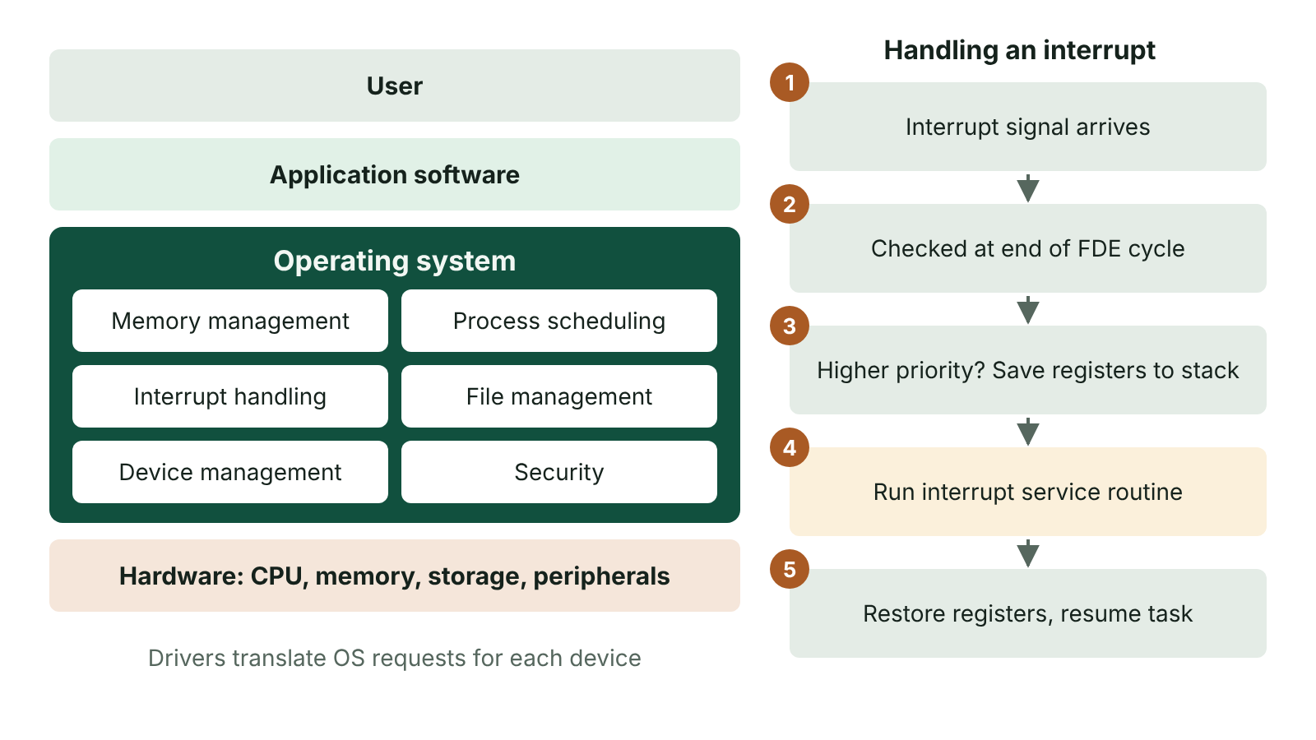
The big picture
The operating system sits between applications and hardware and provides memory management, scheduling, interrupt handling, file and device management and security; an interrupt saves registers, runs the service routine and restores them
☰ Menu
Notes:
Explain the diagram in your own words before you read on.

Slide 8
System software and the operating system
Software divides into system software, which runs the computer itself, and application software, which carries out the user's own tasks.
System software is made up of the operating system (OS) and utility programs.
An OS manages all of the computer's hardware and software resources and is the interface between the hardware, application programs and the user.
It is the first program loaded when the computer is switched on; without it, applications have no way to use the hardware.
An OS is written for a particular processor's instruction set. Examples: Windows, macOS, Linux, Android, iOS.
☰ Menu

Slide 9
Inside an operating system
Part | What it does
User interface | Accepts input from the user and returns output as information, through a command line interface or a graphical user interface (GUI)
Application interface | Provides services that programs can call, and holds a device driver for each device so software can control it
Kernel | The core of the OS: loads and unloads programs in memory and allocates memory, storage and processor time efficiently
Hardware interface | Communicates with the physical components: the CPU, main memory and peripheral devices
☰ Menu

Slide 10
Single user and multi-user operating systems
Type | How it works | Example
Single user, single application | One person runs one program at a time; there is no way to tell users apart | Early PC systems such as MS-DOS; simple embedded controllers
Single user, multitasking | One person can have several programs open; the OS gives each its share of resources and the user switches between them | A Windows laptop downloading a file while the user types an essay
Multi-user | Many users share one computer at the same time, each through their own terminal, each appearing to have the machine to themselves | A mainframe processing a bank's transactions; a Linux server
☰ Menu

Slide 11
Multi-user systems: time-slicing and security
The OS shares processor time between users by time-slicing: each user's task runs for a short slice, then the next task gets a turn.
Slices last only milliseconds, so each user feels as if they have the whole computer to themselves.
Memory, storage and data requests must be allocated so that each user gets enough to work efficiently.
Each user's files and data are protected from other users by accounts, passwords and access rights.
A multi-user OS needs more memory and is far more complex than a single user OS.
☰ Menu

Slide 12
Four ways to run more than one program
Term | Meaning | Key point
Multiprogramming | Several programs are held in main memory but only one executes at a time; when it has to wait (e.g. for I/O) the OS switches to another | Keeps the CPU busy and gives an illusion of parallelism
Multitasking | Several tasks share the CPU and memory; the OS allocates resources and switches between tasks, often by time-slicing | The general form of multiprogramming used on PCs and phones
Multiprocessing | A workload is divided between two or more processors or cores that execute at the same moment | True parallel processing; main benefit is speed
Multithreading | One process runs several threads, each a separate path of execution sharing the process's memory and code | Serves several users or requests without loading extra copies of the program
☰ Menu

Slide 13
Multithreading in C#
A thread is a separate path of execution inside a process, and threads share the same variables.
Here two threads each add 1 to a shared counter 100,000 times, so the correct total is 200,000.
Without the lock, both threads can read the same old value and one update is lost (a race condition), leaving the total below 200,000.
If two threads each hold a resource that the other is waiting for, neither can continue: this is deadlock.
☰ Menu

Slide 14
Multithreading in C# – code
C#
using System;
using System.Threading;
int counter = 0;
object key = new object();
Thread a = new Thread(AddMany);
Thread b = new Thread(AddMany);
a.Start(); b.Start();
a.Join(); b.Join(); // wait for both threads
Console.WriteLine(counter); // 200000
void AddMany()
{
for (int i = 0; i < 100000; i++)
{
lock (key) { counter++; } // one thread at a time
}
}
☰ Menu

Slide 15
Memory management: paging and segmentation
 | Paging | Segmentation
Division | Memory split into fixed-size pages (e.g. 4 KB) | Program split into variable-size logical segments
Based on | Physical size, ignoring program structure | Logical structure, e.g. a subroutine or a data array
Mapping | A page table maps each page to a frame in RAM | A segment table holds each segment's base address and length
Benefit | Pages fit any free frame, so no gaps form between them | Matches program structure; segments can be shared or protected
Drawback | Wasted space in a part-filled last page (internal fragmentation) | Unusable gaps between segments (external fragmentation)
☰ Menu

Slide 16
Process scheduling
The scheduler, part of the kernel, decides which process uses the CPU next and for how long.
Aims: keep the CPU busy, maximise throughput, be fair to every process and respond quickly to interactive users.
Round robin: each process gets a fixed time slice in turn, then rejoins the back of the queue if it is unfinished.
First come, first served runs processes to completion in arrival order; shortest job first runs the shortest process next.
Priority scheduling runs higher-priority processes first, as real-time systems must (e.g. an alarm before a routine log).
☰ Menu

Slide 17
Worked example: round robin, 2 ms time slice (A needs 5 ms, B 2 ms, C 4 ms)
Time (ms) | Running | Time still needed afterwards
0 to 2 | A | A 3, B 2, C 4
2 to 4 | B | B finishes at 4 ms
4 to 6 | C | A 3, C 2
6 to 8 | A | A 1, C 2
8 to 10 | C | C finishes at 10 ms
10 to 11 | A | A finishes at 11 ms (needs only 1 ms of its slice)
☰ Menu

Slide 18
Interrupts
An interrupt is a signal to the processor that an event needs attention: a key press, a printer out of paper, a timer, or a hardware fault.
The CPU checks for interrupts at the end of each fetch–decode–execute cycle.
If the interrupt has a higher priority than the current task, the register contents are saved on the stack.
The matching interrupt service routine (ISR) runs; then the registers are restored and the original task carries on.
Interrupts let the CPU respond to events without wasting time constantly checking (polling) every device.
☰ Menu

Slide 19
Files, devices and security
Function | What the OS does
File management | Organises files into folders; records names, locations and permissions; handles create, open, save and delete
Device management | Uses device drivers to turn general OS requests into device-specific instructions; manages buffers and queues such as print spooling
Security | User accounts and passwords, access rights, encryption, firewall, updates and activity logs
User interface | Provides a GUI or command line through which the user controls the system
☰ Menu

Slide 20
Utility programs
Utility programs are system software that perform specific tasks to manage the computer, its devices or its programs.
They are needed because the OS alone does not keep the system efficient, secure and recoverable; many utilities are now built into the OS.
Data compression: encodes files in fewer bits, saving storage space and reducing transfer times; a means to an end, not a task in itself.
Backup: makes exact copies of files or databases so the originals can be restored after loss, corruption or attack.
Others include antivirus, encryption, disk clean-up and file managers.
☰ Menu

Slide 21
Disk defragmentation
On a magnetic hard disk, a file is saved as a chain of clusters; the file system's table (e.g. the FAT) records which clusters are free.
Deleting a file only marks its clusters as free; the data stays until it is overwritten.
After many saves and deletions, files are scattered in fragments, so the read head must move further and access slows.
A defragmenter moves data so each file occupies contiguous clusters and the free space is gathered together. It can take hours.
SSDs have no moving head, so they should not be defragmented; the OS uses TRIM to manage them instead.
☰ Menu

Slide 22
Worked example: backup and archiving at a Co. Tyrone school
The network manager runs a scheduled backup every night: exact copies of pupil work and the MIS database go to an off-site cloud store.
If ransomware encrypts a shared drive, files are restored from the most recent clean backup.
At the end of each year, departed pupils' folders are archived: many files are combined, compressed and moved to cheaper storage.
The archive stores metadata (file names, lengths, timestamps, access control lists) so every file can be rebuilt exactly.
The manager sets the schedule, location, retention period and who may access archives, and keeps the software needed to unarchive them.
☰ Menu

Slide 23
Exit quiz: question 1 of 9
Tap an answer to check it. Presenting? Click to reveal the answer.
A bank's mainframe lets thousands of staff work at once, each appearing to have the computer to themselves. Which technique makes this possible?
A Defragmentation
B Time-slicing
✗
✓
C Data compression
D Segmentation
✗
✗
✓ B: Time-slicing – Time-slicing gives each user's task a very short turn on the processor in rotation, so every user seems to have exclusive use.
☰ Menu

Slide 24
Exit quiz: question 2 of 9
Tap an answer to check it. Presenting? Click to reveal the answer.
What happens to the contents of the processor's registers when a higher-priority interrupt is serviced?
A They are deleted
B They are sent to the printer
✗
✗
C They are written to the hard disk as a file
D They are saved on the stack and restored afterwards
✗
✓
✓ D: They are saved on the stack and restored afterwards – Saving the registers on the stack lets the interrupted task resume exactly where it stopped once the ISR has finished.
☰ Menu

Slide 25
Exit quiz: question 3 of 9
Tap an answer to check it. Presenting? Click to reveal the answer.
Which term describes several threads running within a single process and sharing its memory?
A Multithreading
B Multiprocessing
✓
✗
C Multiprogramming
D Spooling
✗
✗
✓ A: Multithreading – Each thread is a separate path of execution, but all threads share the process's memory and code.
☰ Menu

Slide 26
Exit quiz: question 4 of 9
Tap an answer to check it. Presenting? Click to reveal the answer.
Which part of the operating system loads programs into memory and allocates processor time?
A User interface
B Hardware interface
✗
✗
C Kernel
D Device driver
✓
✗
✓ C: Kernel – The kernel is the core of the OS that manages memory, storage and processor allocation.
☰ Menu

Slide 27
Exit quiz: question 5 of 9
Tap an answer to check it. Presenting? Click to reveal the answer.
Round robin, 2 ms slices: X needs 3 ms and Y needs 2 ms, X first. When does X finish?
A 2 ms
B 3 ms
✗
✗
C 4 ms
D 5 ms
✗
✓
✓ D: 5 ms – X runs 0–2 ms (1 ms left), Y runs 2–4 ms and finishes, then X runs 4–5 ms and finishes at 5 ms.
☰ Menu

Slide 28
Exit quiz: question 6 of 9
Tap an answer to check it. Presenting? Click to reveal the answer.
What is the main benefit of a multiprocessing system?
A Speed through true parallel processing
B Smaller file sizes
✓
✗
C Fewer interrupts
D No need for drivers
✗
✗
✓ A: Speed through true parallel processing – Work is divided between several processors or cores that execute at the same time.
☰ Menu

Slide 29
Exit quiz: question 7 of 9
Tap an answer to check it. Presenting? Click to reveal the answer.
Which memory management technique divides a program into variable-sized logical units?
A Paging
B Segmentation
✗
✓
C Spooling
D Caching
✗
✗
✓ B: Segmentation – Segments follow the program's logical structure, such as a subroutine or an array, so their sizes vary.
☰ Menu

Slide 30
Exit quiz: question 8 of 9
Tap an answer to check it. Presenting? Click to reveal the answer.
Why does a disk defragmenter speed up file access on a magnetic hard disk?
A It compresses every file
B It deletes unused programs
✗
✗
C It places each file's clusters next to each other
D It adds more RAM
✓
✗
✓ C: It places each file's clusters next to each other – Contiguous clusters mean the read head moves less, so the file is read more quickly.
☰ Menu

Slide 31
Exit quiz: question 9 of 9
Tap an answer to check it. Presenting? Click to reveal the answer.
Which utility combines many files into one file, storing metadata so each can be rebuilt later?
A Disk defragmenter
B Device driver
✗
✗
C Antivirus
D File archiving program
✗
✓
✓ D: File archiving program – An archiver concatenates files, often compresses them, and records names, lengths and attributes for reconstruction.
☰ Menu

Slide 32
Exit quiz answers
Q | Answer | Why
1 | B Time-slicing | Time-slicing gives each user's task a very short turn on the processor in rotation, so every user seems to have exclusive use.
2 | D They are saved on the stack and restored afterwards | Saving the registers on the stack lets the interrupted task resume exactly where it stopped once the ISR has finished.
3 | A Multithreading | Each thread is a separate path of execution, but all threads share the process's memory and code.
4 | C Kernel | The kernel is the core of the OS that manages memory, storage and processor allocation.
5 | D 5 ms | X runs 0–2 ms (1 ms left), Y runs 2–4 ms and finishes, then X runs 4–5 ms and finishes at 5 ms.
6 | A Speed through true parallel processing | Work is divided between several processors or cores that execute at the same time.
7 | B Segmentation | Segments follow the program's logical structure, such as a subroutine or an array, so their sizes vary.
8 | C It places each file's clusters next to each other | Contiguous clusters mean the read head moves less, so the file is read more quickly.
9 | D File archiving program | An archiver concatenates files, often compresses them, and records names, lengths and attributes for reconstruction.
☰ Menu

Slide 33
Translators, application software and processing systems
AS 2: FUNDAMENTALS OF DIGITAL TECHNOLOGY · FD15
Learning objectives
Compare assemblers, compilers and interpreters and put the stages of compilation in order
Explain the differences between generic and special purpose software and weigh up custom-built against off-the-shelf software
Evaluate proprietary and open source software and the ways software is delivered to different platforms
Choose between batch and real-time processing for an application and justify the choice
Identify the input, processing and output of ATMs, POS terminals and smartphones
Notes:
Specification: Describe the purpose of assemblers, compilers and interpreters, the stages of compilation and the use of intermediate code | Explain what is meant by application software and the difference between generic and special purpose software | Compare the use of custom-built software with off-the-shelf software | Explain how application software can be delivered on different platforms, for example downloaded to a device or accessed using the web | Evaluate different methods of obtaining software: proprietary and open source | Describe batch processing and real-time processing and evaluate their use for common applications | Describe the input, output and processing involved in ATMs, point of sale (POS) terminals and smartphones

Slide 34
In this lesson
Tap a button to jump straight there. The ☰ Menu button on every slide brings you back here.
The big picture
Delivering software: download or web
Evaluating batch and real-time processing
Translators: assembler, compiler, interpreter
Proprietary and open source software
ATMs and POS terminals: input, processing, output
Stages of compilation
Worked example: software for a Fermanagh GAA club
Smartphones: input, processing, output
Intermediate code and cross-platform software
Batch processing
Exit quiz
Application software: generic or special purpose
A batch run with a control total (C#)
↑ Topic menu
Custom-built versus off-the-shelf
Real-time processing
Notes:
Lesson menu: each button jumps to that part of the lesson in Slide Show. The ☰ Menu button on each slide returns here.

Slide 35
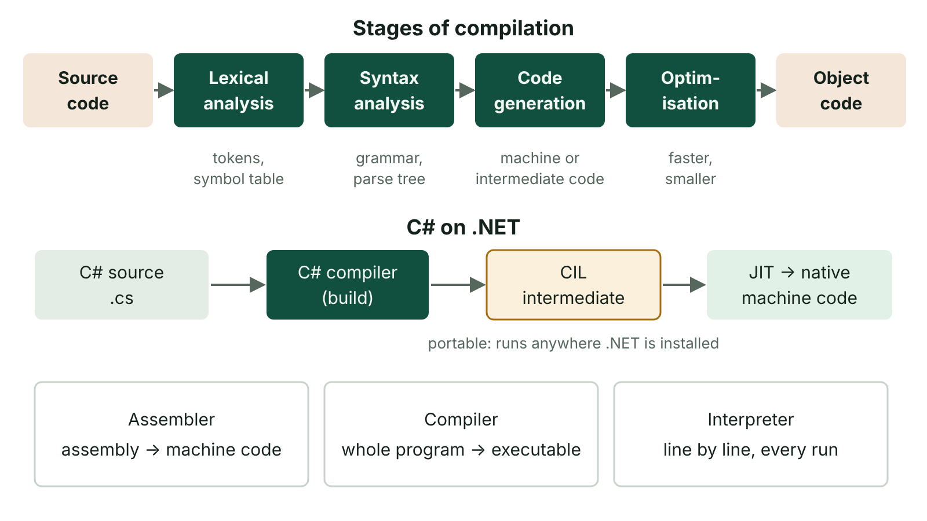
The big picture
The stages of compilation from source code to object code, and how C# is compiled to Common Intermediate Language and then just-in-time compiled to machine code
☰ Menu
Notes:
Explain the diagram in your own words before you read on.

Slide 36
Translators: assembler, compiler, interpreter
 | Assembler | Compiler | Interpreter
Translates | Assembly language mnemonics into machine code, mostly one-to-one | The whole high-level program into object code before it runs | High-level code one statement at a time, executing each as it goes
Output | Executable machine code | An executable that runs without the compiler | No executable; translated again every run
Errors | Reported after assembling | Listed together after compiling | Stops at the first error found
Speed of finished program | Fast | Fast | Slower, as translation happens at run time
Source code hidden? | Yes | Yes, only the executable is distributed | No, the source must be supplied
☰ Menu

Slide 37
Stages of compilation
Stage | What happens
Lexical analysis | Removes white space and comments; splits the code into tokens (keywords, identifiers, operators); builds the symbol table
Syntax analysis | Checks the tokens follow the grammar rules of the language; builds a parse tree; reports syntax errors
Semantic checks | Checks meaning, e.g. that variables are declared and types are compatible
Code generation | Produces object code (machine code or intermediate code) from the parse tree
Optimisation | Improves the code so it runs faster or uses less memory, e.g. removing redundant instructions
☰ Menu

Slide 38
Intermediate code and cross-platform software
A platform is the hardware (processor type) and/or operating system that software runs on; Windows and macOS are different platforms even on the same x86 chips.
Software compiled to machine code for one platform must be rewritten or recompiled for another, because each OS offers a different API.
Java source is compiled to bytecode, machine code for an imaginary processor; each platform has its own Java Virtual Machine (JVM) to run it, so one file works anywhere a JVM exists.
C# compiles to Common Intermediate Language (CIL); the .NET runtime's just-in-time (JIT) compiler turns it into native machine code as it runs.
Web apps are cross-platform in a different way: they run in any modern browser on any OS.
☰ Menu

Slide 39
Application software: generic or special purpose
 | Generic software | Special purpose software
Purpose | Many different tasks without modification | Performs one specific job or meets a unique business need
Examples | Word processor, spreadsheet, presentation software, web browser | Payroll package, GP appointment system, vet's practice manager, a bus fleet tracking system
How produced | Written once and sold off-the-shelf in large numbers | May be bought for a market sector or custom-built for one client
Users | Very wide range of users and organisations | A particular industry or a single organisation
☰ Menu

Slide 40
Custom-built versus off-the-shelf
 | Custom-built (bespoke) | Off-the-shelf
Fit | Does exactly what the organisation needs, optimised for its processes | May lack some needed features and include many unused ones
Cost | Expensive: developers' time paid by one client | Cheaper: development cost spread over many buyers
Time | Long wait while it is analysed, written and tested | Available immediately, though set-up and configuration take time
Testing | Tested by one team; hidden bugs may appear later, e.g. at a date change | Widely used, so most bugs have been found and fixed
Support | Developers on hand to fix problems; little online help | Large user base: forums, tutorials, training courses
☰ Menu

Slide 41
Delivering software: download or web
 | Downloaded and installed | Accessed through the web
How it works | An installation package is downloaded and configures the program for the device; it runs on local resources | Runs on the publisher's servers; the user works through a browser
Device needs | Enough storage, memory and processing power; the correct platform | Little local capability, but a reliable internet connection
Offline use | Yes | Usually no
Updates | User or IT staff must install them | Applied on the server for everyone at once
Typical pricing | One-off licence fee, or a subscription that disables features if not renewed | Renewable subscription, often per user per year
☰ Menu

Slide 42
Proprietary and open source software (1 of 2)
 | Proprietary (closed source) | Open source
Source code | Kept secret; protected by copyright | Supplied with the program; may be studied and changed
Licence | Restricts copying and modification | Allows use, modification and redistribution; copyleft licences (e.g. GPL) require changed versions to stay open
Cost | Usually a fee or subscription; freeware is free but still closed | Usually free; firms may charge for support
Support | Official updates, documentation and technical support | Community forums; paid support for some products
Risks | Locked in to the vendor; support ends if it stops trading | May be less polished, documented or tested; many versions
☰ Menu

Slide 43
Proprietary and open source software (2 of 2)
 | Proprietary (closed source) | Open source
Examples | Windows, Microsoft 365, Adobe Photoshop | Linux, LibreOffice, Firefox, VLC
☰ Menu

Slide 44
Worked example: software for a Fermanagh GAA club
Need 1: letters, fixture lists and accounts. Generic office software suits; a free open source suite or a web-based suite keeps costs low.
Need 2: membership and match-day ticketing. Off-the-shelf web-based club software is ready now, tested and supported for a small subscription.
A bespoke system would fit exactly but cost far more and take months, which a volunteer-run club cannot justify.
Delivered through the web, volunteers can use it on any laptop or phone, and updates happen automatically.
Decision: off-the-shelf, web-delivered software; review if the club's needs become unusual.
☰ Menu

Slide 45
Batch processing
Transactions are collected over a period in a transaction file, then processed together as one batch job at a set time.
The same processing is applied to every record, and once set up the job runs without human intervention.
Often run overnight or off-peak, when the system is less busy.
Validation such as control totals and batch totals checks that no transactions have been lost or added.
The master file is only up to date after the batch has run.
Uses: payroll, utility and credit card bills, end-of-day stock reordering, bank clearing of cheques.
☰ Menu

Slide 46
A batch run with a control total (C#)
The transaction file holds the day's sales; the master file holds stock levels.
Tills counted 22 items, so the control total is 22; the batch is rejected if the transactions do not add up to it.
Here 3 + 10 + 5 + 4 = 22, so the batch runs and prints item 0: 32, item 1: 21, item 2: 50.
☰ Menu

Slide 47
A batch run with a control total (C#) – code
C#
using System;
int[] stock = { 40, 25, 60 }; // master file
(int item, int qty)[] sales = // transaction file
{ (0, 3), (2, 10), (0, 5), (1, 4) };
int controlTotal = 22; // counted at the tills
int sum = 0;
foreach (var s in sales) sum += s.qty;
if (sum != controlTotal)
{
Console.WriteLine("Control total mismatch: batch rejected");
return;
}
foreach (var s in sales) stock[s.item] -= s.qty;
for (int i = 0; i < stock.Length; i++)
Console.WriteLine($"Item {i}: {stock[i]}");
☰ Menu

Slide 48
Real-time processing
Each transaction is processed as soon as it happens, so the master file is always up to date.
Two kinds (also in FD07): real-time transaction (online) processing, e.g. bookings and ATMs, where the user waits seconds, and real-time control, e.g. traffic lights reacting to sensors.
Uses: online orders and stock checks, bank balances after a withdrawal, password changes, traffic lights, heart monitors, seat booking.
Many requests can arrive at once, so scheduling algorithms give priority to the most urgent (a cardiac alarm before a low-battery warning).
Needs constantly available, powerful and often duplicated hardware, so it costs more than batch processing.
☰ Menu

Slide 49
Evaluating batch and real-time processing (1 of 2)
Application | Best method | Reason
Monthly payroll for a council | Batch | Same calculation for every employee, needed only once a month; run off-peak
Electricity or credit card bills | Batch | Readings or transactions collected over a period; one bill per customer
Booking seats at a concert | Real-time | A seat must be removed at once to stop it being sold twice
Cash withdrawal at an ATM | Real-time | Balance must be checked and updated immediately to stop overspending
Hospital patient monitoring | Real-time | Life-critical: alarms must sound within seconds
☰ Menu

Slide 50
Evaluating batch and real-time processing (2 of 2)
Application | Best method | Reason
Overall | Batch: cheap, efficient, controllable | Real-time: up to date and responsive, but costly and complex
☰ Menu

Slide 51
ATMs and POS terminals: input, processing, output
 | ATM | POS terminal with EFTPOS
Input devices | Card reader (chip or contactless), keypad or touchscreen | Barcode scanner, touchscreen, electronic scales, card reader and PIN pad
Input data | Card details, PIN, menu choice, amount | Product codes, weights, quantities, card details, PIN
Processing | Validate PIN with the card issuer's bank, look up account, check balance, deduct amount | Look up price in database, calculate total and weighed prices, update stock, contact bank to authorise payment
Output devices | Screen, cash dispenser, receipt printer | Customer and operator displays, receipt printer, beeps for errors
Processing type | Real-time | Real-time sale; stock reordering may be batch
☰ Menu

Slide 52
Smartphones: input, processing, output
Input: multi-touch screen (taps, swipes, pinches) and on-screen keyboard; microphone for voice assistants; cameras, also used for QR codes and face unlock.
More input: fingerprint sensor; accelerometer and gyroscope for orientation; GPS, compass and barometer; data received over Wi-Fi, 4G and 5G.
Processing: a mobile OS (Android, based on open source Linux, or Apple's iOS) manages resources and runs apps.
One app runs in the foreground; others are mostly suspended in memory to save power, though some still receive notifications.
Output: the touchscreen, speakers or Bluetooth headphones, vibration alerts, and NFC to pay contactlessly at an EFTPOS terminal.
☰ Menu

Slide 53
Exit quiz: question 1 of 9
Tap an answer to check it. Presenting? Click to reveal the answer.
A health trust's payroll is calculated once a month for every employee, overnight and without staff intervention. What type of processing is this?
A Real-time processing
B Interactive processing
✗
✗
C Batch processing
D Multithreading
✓
✗
✓ C: Batch processing – Data is gathered over the month and processed together as one job at a scheduled time, which is batch processing.
☰ Menu

Slide 54
Exit quiz: question 2 of 9
Tap an answer to check it. Presenting? Click to reveal the answer.
Which is the defining feature of open source software?
A Its source code is available and may be modified
B It is always free and never sold
✓
✗
C It has no licence of any kind
D It only runs on Linux
✗
✗
✓ A: Its source code is available and may be modified – Open source software is released with its source code under a licence that allows changes; some open source products are sold or offer paid support.
☰ Menu

Slide 55
Exit quiz: question 3 of 9
Tap an answer to check it. Presenting? Click to reveal the answer.
Which stage of compilation removes comments and splits code into tokens?
A Code generation
B Lexical analysis
✗
✓
C Optimisation
D Syntax analysis
✗
✗
✓ B: Lexical analysis – Lexical analysis is the first stage; it also builds the symbol table.
☰ Menu

Slide 56
Exit quiz: question 4 of 9
Tap an answer to check it. Presenting? Click to reveal the answer.
Which is an advantage of custom-built software over off-the-shelf software?
A It is available immediately
B It is cheaper
✗
✗
C It has large online user forums
D It does exactly what the organisation needs
✗
✓
✓ D: It does exactly what the organisation needs – Bespoke software is written to the client's own requirements, but it costs more and takes longer.
☰ Menu

Slide 57
Exit quiz: question 5 of 9
Tap an answer to check it. Presenting? Click to reveal the answer.
Which application most needs real-time processing?
A Printing quarterly gas bills
B Booking seats on a flight
✗
✓
C Calculating annual tax returns
D Producing monthly bank statements
✗
✗
✓ B: Booking seats on a flight – A seat must be removed immediately once sold, otherwise it could be sold twice.
☰ Menu

Slide 58
Exit quiz: question 6 of 9
Tap an answer to check it. Presenting? Click to reveal the answer.
Which of these happens in the processing stage at an ATM?
A Inserting the card
B Dispensing the cash
✗
✗
C Checking the amount against the account balance
D Printing a receipt
✓
✗
✓ C: Checking the amount against the account balance – Inserting the card is input; dispensing cash and printing are output; the balance check is processing.
☰ Menu

Slide 59
Exit quiz: question 7 of 9
Tap an answer to check it. Presenting? Click to reveal the answer.
Why is a web application described as cross-platform?
A It runs in a browser on any operating system
B It is written in assembly language
✓
✗
C It is installed separately for each device
D It is always open source
✗
✗
✓ A: It runs in a browser on any operating system – Processing is done mostly on the server and the interface runs in a browser, so the OS of the client does not matter.
☰ Menu

Slide 60
Exit quiz: question 8 of 9
Tap an answer to check it. Presenting? Click to reveal the answer.
Which smartphone component lets it pay contactlessly at an EFTPOS terminal?
A Gyroscope
B Barometer
✗
✗
C Fingerprint sensor
D NFC antenna
✗
✓
✓ D: NFC antenna – Near-field communication transfers payment details over a few centimetres.
☰ Menu

Slide 61
Exit quiz: question 9 of 9
Tap an answer to check it. Presenting? Click to reveal the answer.
Which statement about off-the-shelf software is true?
A It is written for one client
B It has usually been widely tested by many users
✗
✓
C It never needs configuring
D It always fits a business exactly
✗
✗
✓ B: It has usually been widely tested by many users – Large numbers of users mean most bugs have been found and fixed, though it may still need setting up and may not fit exactly.
☰ Menu

Slide 62
Exit quiz answers
Q | Answer | Why
1 | C Batch processing | Data is gathered over the month and processed together as one job at a scheduled time, which is batch processing.
2 | A Its source code is available and may be modified | Open source software is released with its source code under a licence that allows changes; some open source products are sold or offer paid support.
3 | B Lexical analysis | Lexical analysis is the first stage; it also builds the symbol table.
4 | D It does exactly what the organisation needs | Bespoke software is written to the client's own requirements, but it costs more and takes longer.
5 | B Booking seats on a flight | A seat must be removed immediately once sold, otherwise it could be sold twice.
6 | C Checking the amount against the account balance | Inserting the card is input; dispensing cash and printing are output; the balance check is processing.
7 | A It runs in a browser on any operating system | Processing is done mostly on the server and the interface runs in a browser, so the OS of the client does not matter.
8 | D NFC antenna | Near-field communication transfers payment details over a few centimetres.
9 | B It has usually been widely tested by many users | Large numbers of users mean most bugs have been found and fixed, though it may still need setting up and may not fit exactly.
☰ Menu

