Slide 1
Web applications
AS 2: FUNDAMENTALS OF DIGITAL TECHNOLOGY · TOPIC
Lessons in this topic
FD16 How the internet and the web work
FD17 Web applications, intranets and web security

Slide 2

Topic menu
Tap a button to jump straight there. The ☰ Menu button on every slide brings you back here.
Specification map
FD17 Web applications, intranets and web security
FD16 How the internet and the web work

Slide 3
Specification map
Lesson | Specification: students should be able to
FD16 | Explain the terms Internet, World Wide Web (WWW), website, web page, web browser, web server, web hosting and internet service provider (ISP); Explain Internet Protocol (IP) addresses and how domain names are organised, including the role of the Domain Name System (DNS); Explain Uniform Resource Locators (URLs), HTTP, HTTPS and File Transfer Protocol (FTP); Explain the use of cookies, sessions and caches with the stateless HTTP protocol; Explain how a search engine works; Describe the role of the ITU and W3C (and the IETF) in agreeing web standards
FD17 | Compare client-side and server-side scripting and describe how dynamic web pages are generated using server-side scripts and databases; Compare web applications with native applications; Describe web-based services: e-services, e-government and portals; Evaluate the use of an intranet by an organisation; Evaluate methods of ensuring security over the internet: encryption (including public and private keys), HTTPS, Secure Sockets Layer (SSL/TLS), digital signatures and digital certificates
☰ Menu
Notes:
Each lesson below is its own section in PowerPoint (View → Slide Sorter shows them). To split this deck by specification point, right-click a section → Move Section, or delete the sections you do not need.

Slide 4
How the internet and the web work
AS 2: FUNDAMENTALS OF DIGITAL TECHNOLOGY · FD16
Learning objectives
Distinguish the Internet from the World Wide Web and explain how websites are connected, hosted and uploaded
Convert an IPv4 address between binary and dotted decimal and break a domain name into its parts
Describe, in order, what happens when a URL is typed into a browser
Explain how cookies, sessions and caches overcome the limits of a stateless protocol
Describe the three parts of a search engine and the bodies that set web standards
Notes:
Specification: Explain the terms Internet, World Wide Web (WWW), website, web page, web browser, web server, web hosting and internet service provider (ISP) | Explain Internet Protocol (IP) addresses and how domain names are organised, including the role of the Domain Name System (DNS) | Explain Uniform Resource Locators (URLs), HTTP, HTTPS and File Transfer Protocol (FTP) | Explain the use of cookies, sessions and caches with the stateless HTTP protocol | Explain how a search engine works | Describe the role of the ITU and W3C (and the IETF) in agreeing web standards

Slide 5
In this lesson
Tap a button to jump straight there. The ☰ Menu button on every slide brings you back here.
The big picture
Taking apart a domain name: www.belfastzoo.co.uk
Web hosting and publishing a site
The Internet and the World Wide Web
URLs
Search engines
Key web terms
From URL to page
Who sets web standards?
IP addresses
HTTP, HTTPS and FTP
Exit quiz
Worked example: writing an IPv4 address
Stateless HTTP: cookies and sessions
↑ Topic menu
Domain names and DNS
Caching
Notes:
Lesson menu: each button jumps to that part of the lesson in Slide Show. The ☰ Menu button on each slide returns here.

Slide 6
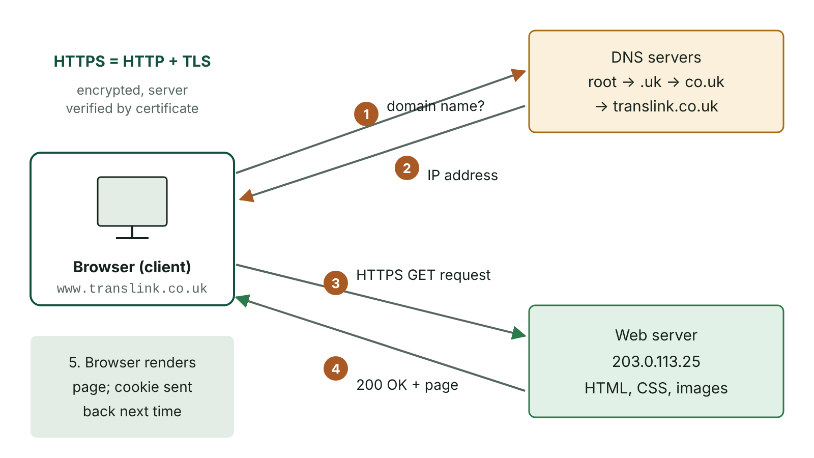
The big picture
Loading a web page: the browser asks DNS for the IP address of the domain name, then sends an HTTPS request to the web server, which returns the page
☰ Menu
Notes:
Explain the diagram in your own words before you read on.

Slide 7
The Internet and the World Wide Web
The Internet is a global network of interconnected networks, so any connected device can communicate with any other: the cables, routers and protocols.
Its rules, TCP/IP, let incompatible early networks such as ARPANET (US), NPL (England) and CYCLADES (France) work together; the NPL network pioneered packet switching.
The World Wide Web is a service that runs on the Internet: an open collection of linked pages, each with a unique address, viewed in a browser.
Tim Berners-Lee proposed the Web at CERN in 1989; CERN made it free for anyone to use in 1993.
Email, online gaming and video calls use the Internet but are not part of the Web.
☰ Menu

Slide 8
Key web terms
Term | Meaning
Web page | A single hypertext document on the Web, viewed in a browser
Website | A set of related web pages sharing a common domain name and served by the same web server
Web browser | Client application that requests pages, receives them and displays them graphically
Web server | Computer and software that stores web content and returns pages in response to HTTP requests
Web hosting | A service that rents space on its servers so others can publish websites
ISP | A company that connects homes and businesses to the Internet through its Point of Presence (POP)
☰ Menu

Slide 9
IP addresses
Every device on the Internet must be uniquely addressable: an IP address is a numeric address for one device.
A dynamic address is assigned each time a device connects; a static address is permanent (useful for servers).
IPv4 uses 32 bits, about 4.3 billion addresses (2^32), which is no longer enough for all devices.
IPv6 uses 128 bits, about 3.4 × 10^38 addresses, written as eight groups of four hexadecimal digits separated by colons.
Example IPv6: 2001:0db8:85a3:0000:0000:8a2e:0370:7334 (leading zeros in a group may be left out).
☰ Menu

Slide 10
Worked example: writing an IPv4 address
Step | Working
32-bit address | 01010110001011111100000100001100
Split into four 8-bit octets | 01010110 . 00101111 . 11000001 . 00001100
Octet 1 | 64 + 16 + 4 + 2 = 86
Octet 2 | 32 + 8 + 4 + 2 + 1 = 47
Octet 3 | 128 + 64 + 1 = 193
Octet 4 | 8 + 4 = 12, so the address is 86.47.193.12
☰ Menu

Slide 11
Domain names and DNS
A domain name is a human-readable name made of labels separated by full stops, which maps to an IP address.
Read from right to left: the last label is the top-level domain (TLD), e.g. .uk, .ie, .com, .org; each label to its left is a sub-domain of the part to its right.
Earlier labels identify the organisation and often the server's purpose, e.g. www for a web server; www is not compulsory.
Some country TLDs have strict rules: a .ie name needs a real connection to the island of Ireland.
The Domain Name System (DNS) is a distributed directory of DNS servers that translates domain names into IP addresses and shares updates when addresses change.
☰ Menu

Slide 12
Taking apart a domain name: www.belfastzoo.co.uk
Part | Meaning
uk | Top-level domain: the United Kingdom country code
co.uk | Second-level domain: UK commercial organisations
belfastzoo.co.uk | The registered domain belonging to the organisation
www.belfastzoo.co.uk | Sub-domain naming the organisation's web server
Other common second levels | ac.uk (universities), gov.uk (government), org.uk (non-profit organisations)
☰ Menu

Slide 13
URLs
Part of URL | Example | Meaning
Protocol | https:// | Rules used to fetch the resource
Domain name | www.translink.co.uk | Name of the web server
Path | /timetables/ | Folder (directory) on the server
File name | metro.html | The page to retrieve
Query (optional) | ?route=12 | Data sent to the server with the request
☰ Menu

Slide 14
From URL to page
1. The browser checks its cache for the page and for the domain's IP address.
2. If needed, it asks a DNS resolver, which queries DNS servers (root, then .uk, then co.uk, then the domain's own server) until the IP address is returned.
3. The browser connects to the web server at that IP address and sends an HTTP GET request; with HTTPS the connection is first encrypted using TLS.
4. The server replies with a status code (200 OK, 404 Not Found) and the HTML of the page.
5. The browser requests the linked CSS, scripts and images, then renders the page on screen.
☰ Menu

Slide 15
HTTP, HTTPS and FTP
 | HTTP | HTTPS | FTP
Purpose | Browser requests and receives web pages | HTTP over an encrypted TLS connection | Transfers any file between computers, e.g. uploading a website to a host
Security | Plain text: readable if intercepted | Encrypted; server identity checked with a digital certificate | Username and password sent unencrypted; SFTP or FTPS secure it
Default port | 80 | 443 | 21
Typical use | Old or internal sites | All public sites, essential for logins and payments | Web developers publishing pages; anonymous FTP for public downloads
☰ Menu

Slide 16
Stateless HTTP: cookies and sessions
HTTP is stateless: each request is independent of all previous ones, which makes it simple to implement and efficient on the network.
But a site such as online banking must remember that a user has already logged in.
A cookie is a small piece of text sent by a website and stored by the browser, then returned with every request to that site.
A session variable is held on the server for the length of the visit; the browser keeps only a session ID, usually in a cookie.
Sessions are more secure because the data stays on the server. Non-essential cookies need consent under UK PECR and UK GDPR.
☰ Menu

Slide 17
Caching
Without caching, logos, menus and pictures that appear on every page would be downloaded again and again.
A cache is temporary storage of web content that is checked before a request goes to the web server.
Browser cache: on the user's device, holding items that user has already fetched.
Proxy cache: a shared server, e.g. in a school, holding content many users request, which saves Internet bandwidth.
Pages that change often, such as live scores, tell the browser not to cache them or to keep them only for a short time.
☰ Menu

Slide 18
Web hosting and publishing a site
An ISP connects you to the Internet; a web host stores your website so others can reach it.
Hosting packages typically include server storage space, a traffic (bandwidth) limit, email addresses and domain name registration.
They often add database support, backups and security, and traffic analysis tools.
Files are uploaded to the host with FTP (or SFTP) after a username and password are authenticated; visitors then view them with HTTP(S).
☰ Menu

Slide 19
Search engines
Component | What it does
Web crawler | Starts from seed pages, follows every link it finds and adds unvisited pages to its list, aiming to visit as much of the Web as possible
Index | Stores what the crawler found on each page (text, images, video, metadata) in a dictionary-like structure linking words to pages
Query engine | Takes the user's search terms, finds matching pages in the index and ranks them so the best appear first
Ranking | Google's PageRank scores a page more highly when many pages link to it, especially highly ranked ones; modern engines combine many signals
Metadata | Data that describes the page but is not visible content, such as its title and description, used in results
☰ Menu

Slide 20
Who sets web standards?
Body | Role
IETF (Internet Engineering Task Force) | Open, volunteer body that develops core Internet standards such as IPv4, IPv6, email and the DNS
ITU (International Telecommunication Union) | UN agency; its ITU-T sector standardises how data is transmitted: telecoms links, encoding of video, sound and images, and digital certificates (X.509)
W3C (World Wide Web Consortium) | Founded by Tim Berners-Lee; agrees standards for web content such as HTML, CSS and web accessibility
Why it matters | Common standards mean any browser on any device can display a page in the same way and any device can talk to any network
☰ Menu

Slide 21
Exit quiz: question 1 of 9
Tap an answer to check it. Presenting? Click to reveal the answer.
When you type a web address into a browser, what does the Domain Name System do?
A Encrypts the page
B Stores the page's images
✗
✗
C Translates the domain name into the server's IP address
D Checks the page for viruses
✓
✗
✓ C: Translates the domain name into the server's IP address – Devices are contacted by IP address, so DNS servers look up the IP address that matches the domain name.
☰ Menu

Slide 22
Exit quiz: question 2 of 9
Tap an answer to check it. Presenting? Click to reveal the answer.
Why does HTTP need cookies or session variables for online banking?
A HTTP cannot carry text
B HTTP is stateless, so the server would not otherwise know the user had logged in
✗
✓
C HTTP only works on intranets
D HTTP deletes pages after viewing
✗
✗
✓ B: HTTP is stateless, so the server would not otherwise know the user had logged in – Each HTTP request is independent, so state such as a successful login must be stored in a cookie or a session variable.
☰ Menu

Slide 23
Exit quiz: question 3 of 9
Tap an answer to check it. Presenting? Click to reveal the answer.
What is 11000001 in denary, as one octet of an IPv4 address?
A 192
B 129
✗
✗
C 65
D 193
✗
✓
✓ D: 193 – 128 + 64 + 1 = 193.
☰ Menu

Slide 24
Exit quiz: question 4 of 9
Tap an answer to check it. Presenting? Click to reveal the answer.
Which protocol would a developer normally use to upload website files to a web host?
A FTP
B HTTP
✓
✗
C DNS
D TLS
✗
✗
✓ A: FTP – FTP (or its secure form, SFTP) transfers files to a server after the user logs in.
☰ Menu

Slide 25
Exit quiz: question 5 of 9
Tap an answer to check it. Presenting? Click to reveal the answer.
How many bits are in an IPv6 address?
A 32
B 128
✗
✓
C 64
D 256
✗
✗
✓ B: 128 – IPv6 uses 128 bits, giving about 3.4 × 10^38 addresses.
☰ Menu

Slide 26
Exit quiz: question 6 of 9
Tap an answer to check it. Presenting? Click to reveal the answer.
Which search engine component follows links from page to page?
A Index
B Query engine
✗
✗
C Web crawler
D Cache
✓
✗
✓ C: Web crawler – The crawler (spider) starts from seed pages and visits every link it finds.
☰ Menu

Slide 27
Exit quiz: question 7 of 9
Tap an answer to check it. Presenting? Click to reveal the answer.
Which organisation agrees the standards for HTML and CSS?
A W3C
B ITU
✓
✗
C ISP
D DNS
✗
✗
✓ A: W3C – The World Wide Web Consortium, founded by Tim Berners-Lee, sets web content standards.
☰ Menu

Slide 28
Exit quiz: question 8 of 9
Tap an answer to check it. Presenting? Click to reveal the answer.
In www.stran.ac.uk, what is stran.ac.uk?
A The top-level domain
B The protocol
✗
✗
C The file name
D A sub-domain of ac.uk
✗
✓
✓ D: A sub-domain of ac.uk – Reading right to left, uk is the TLD, ac.uk sits under uk, and stran.ac.uk sits under ac.uk.
☰ Menu

Slide 29
Exit quiz: question 9 of 9
Tap an answer to check it. Presenting? Click to reveal the answer.
What is the main benefit of a browser cache?
A Pages already fetched can be shown without downloading them again
B It encrypts passwords
✓
✗
C It assigns IP addresses
D It blocks all cookies
✗
✗
✓ A: Pages already fetched can be shown without downloading them again – Reusing stored content reduces network traffic and loading time.
☰ Menu

Slide 30
Exit quiz answers
Q | Answer | Why
1 | C Translates the domain name into the server's IP address | Devices are contacted by IP address, so DNS servers look up the IP address that matches the domain name.
2 | B HTTP is stateless, so the server would not otherwise know the user had logged in | Each HTTP request is independent, so state such as a successful login must be stored in a cookie or a session variable.
3 | D 193 | 128 + 64 + 1 = 193.
4 | A FTP | FTP (or its secure form, SFTP) transfers files to a server after the user logs in.
5 | B 128 | IPv6 uses 128 bits, giving about 3.4 × 10^38 addresses.
6 | C Web crawler | The crawler (spider) starts from seed pages and visits every link it finds.
7 | A W3C | The World Wide Web Consortium, founded by Tim Berners-Lee, sets web content standards.
8 | D A sub-domain of ac.uk | Reading right to left, uk is the TLD, ac.uk sits under uk, and stran.ac.uk sits under ac.uk.
9 | A Pages already fetched can be shown without downloading them again | Reusing stored content reduces network traffic and loading time.
☰ Menu

Slide 31
Web applications, intranets and web security
AS 2: FUNDAMENTALS OF DIGITAL TECHNOLOGY · FD17
Learning objectives
Decide whether a task belongs on the client or the server and explain how a dynamic page is built from a database
Weigh up web apps against native apps for a given purpose
Describe e-services, e-government and portals, and evaluate an intranet for an organisation
Explain how public and private keys, TLS/HTTPS, digital certificates and digital signatures keep data secure over the internet
Notes:
Specification: Compare client-side and server-side scripting and describe how dynamic web pages are generated using server-side scripts and databases | Compare web applications with native applications | Describe web-based services: e-services, e-government and portals | Evaluate the use of an intranet by an organisation | Evaluate methods of ensuring security over the internet: encryption (including public and private keys), HTTPS, Secure Sockets Layer (SSL/TLS), digital signatures and digital certificates

Slide 32
In this lesson
Tap a button to jump straight there. The ☰ Menu button on every slide brings you back here.
The big picture
Web apps versus native apps
SSL/TLS and HTTPS
Static and dynamic pages
E-services and e-government
Digital certificates
Client-side and server-side scripting
Portals
Digital signatures
How a dynamic page is built
Intranets
Exit quiz
Server-side script: building HTML from data (C#)
Worked example: an intranet for a Southern Area hospital
↑ Topic menu
Validation on both sides
Encryption: symmetric and public key
Notes:
Lesson menu: each button jumps to that part of the lesson in Slide Show. The ☰ Menu button on each slide returns here.

Slide 33
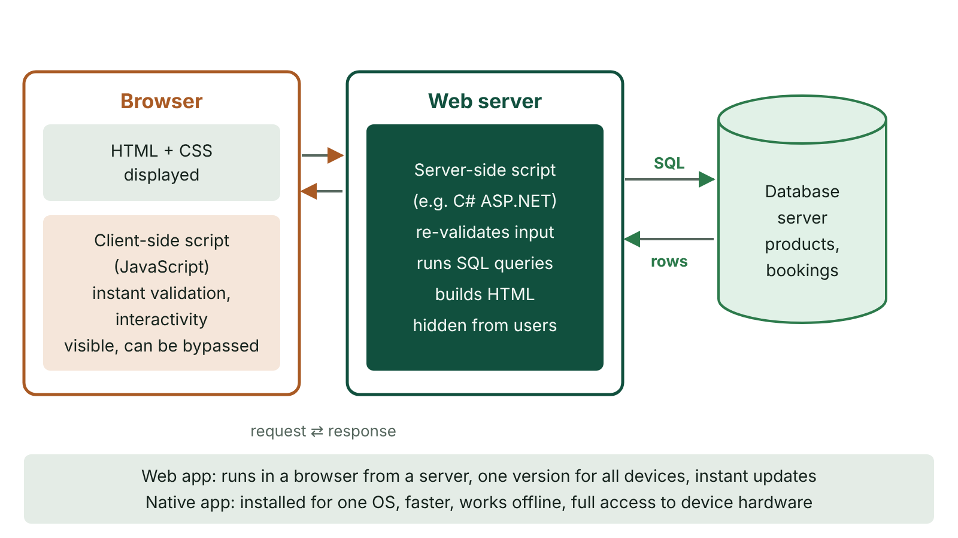
The big picture
A dynamic web page: client-side script runs in the browser, while the server-side script on the web server queries the database server and builds the HTML
☰ Menu
Notes:
Explain the diagram in your own words before you read on.

Slide 34
Static and dynamic pages
 | Static | Dynamic
Content | Fixed HTML, the same for every visitor | Generated when requested; can differ for each user
Stored as | Ready-made HTML files | Scripts plus data held in a database
Updating | Edit the HTML file by hand | Change the data and the pages update automatically
Examples | A simple brochure site for a guest house | Online banking, bus timetables, search results, social media
☰ Menu

Slide 35
Client-side and server-side scripting
 | Client-side | Server-side
Where it runs | In the user's browser, after the page downloads | On the web server, before the page is sent
Typical language | JavaScript | C# (ASP.NET), PHP, Python, JavaScript (Node.js)
Uses | Instant form checks, menus, animations, updating part of a page | Database queries, logins, payments, personalised pages, sending emails
Benefits | Immediate response; less load on the server and network | Code and database hidden from users; works in any browser
Drawbacks | Code visible and can be disabled or altered, so cannot be trusted for security | Every action needs a round trip to the server; more server load
☰ Menu

Slide 36
How a dynamic page is built
Step | Where | What happens
1 | Browser | User submits a form or follows a link carrying a query, e.g. ?club=Armagh
2 | Web server | Server-side script receives and validates the data
3 | Database server | Script runs an SQL query; matching records are returned
4 | Web server | Script builds HTML containing the results and sends it
5 | Browser | Page is displayed; client-side script adds interactivity
☰ Menu

Slide 37
Server-side script: building HTML from data (C#)
On a real site the fixtures would come from a database and the club name from the URL's query string.
The script picks out the matching records and writes HTML, so every club gets its own page from one script.
Output: <ul><li>12 Apr: v Newry</li><li>26 Apr: v Lurgan</li></ul>
☰ Menu

Slide 38
Server-side script: building HTML from data (C#) – code
C#
using System;
using System.Text;
(string Club, string Opponent, string Date)[] fixtures =
{
("Armagh", "Newry", "12 Apr"),
("Omagh", "Strabane", "19 Apr"),
("Armagh", "Lurgan", "26 Apr")
};
string club = "Armagh"; // from ?club=Armagh
var html = new StringBuilder("<ul>");
foreach (var f in fixtures)
if (f.Club == club)
html.Append($"<li>{f.Date}: v {f.Opponent}</li>");
html.Append("</ul>");
Console.WriteLine(html);
☰ Menu

Slide 39
Validation on both sides
Client-side validation gives instant feedback (e.g. 'email address must contain @') and avoids sending unnecessary requests.
Server-side validation is essential because client-side checks can be bypassed by switching off scripts or sending requests directly.
SQL injection: an attacker types SQL into a form field so that it becomes part of the query run on the database.
Defence: parameterised queries keep user input as data, never as SQL commands.
Good practice: validate on the client for usability and on the server for security.
☰ Menu

Slide 40
Web apps versus native apps (1 of 2)
 | Web app | Native app
Runs | In a browser, delivered from a server | Installed on the device's operating system
Platforms | One version works on any device with a browser | Separate versions for iOS, Android, Windows
Updates | Instant: update the server | Users download updates; app store approval may be needed
Performance and hardware | Slower; more limited access to camera, sensors, files | Faster; full access to device features
Offline | Usually needs a connection (progressive web apps can cache) | Works offline
☰ Menu

Slide 41
Web apps versus native apps (2 of 2)
 | Web app | Native app
Distribution | Share a URL | App stores: visibility, but fees and rules
☰ Menu

Slide 42
E-services and e-government
E-services: services delivered electronically, usually online: shopping, banking, insurance, live-chat helpdesks, digital newspapers.
Benefits to customers: convenience, 24/7 access, easy price comparison. To providers: wider customer base, extra channel, more data about customers.
Online-only retailers can save the cost of running physical shops.
E-government: government services delivered electronically, e.g. booking an MOT, renewing a driving licence, filing a tax return, public consultations.
Benefits: faster, cheaper and more efficient than paper. Risk: digital exclusion, so offline routes must remain for people without access or skills.
☰ Menu

Slide 43
Portals
A portal is a website, or single page, giving consistent access to many related services from one place.
Links are often grouped into blocks (portlets) that users can rearrange to suit themselves.
An enterprise portal links to an organisation's services for its staff or clients, often behind a single sign-on.
Examples: a government portal linking to every department's services; a school portal linking to email, timetable, homework and reports.
Benefits: one familiar starting point, less searching, personalised content.
☰ Menu

Slide 44
Intranets
Advantages | Disadvantages
Policies, forms, manuals and directories are online; only the latest version is available | Significant cost to set up and keep up to date; staff may be needed to maintain content
Users log in, so each group sees only what is relevant to them | Personal data held must comply with UK GDPR and the Data Protection Act 2018
Messaging, wikis, blogs and forums improve internal communication | Weak passwords can let intruders reach confidential material, especially with remote access
Online tools for holiday requests, room booking and staff surveys | Heavy dependence: an outage can seriously disrupt work
Less printing and quicker distribution of information | Staff need training and may resist change
☰ Menu

Slide 45
Worked example: an intranet for a Southern Area hospital
Need: 3,000 staff on shifts across several sites must see current clinical guidelines, rotas and policies.
Benefits: one up-to-date version of each guideline replaces printed folders; rotas and leave requests online; ward messages reach night staff.
Role-based log-ins show nurses, doctors and porters different links and protect patient-related pages.
Risks: setup cost, keeping 2,000 documents current, outages during emergencies, and data protection obligations.
Judgement: worthwhile, provided content owners are assigned, MFA is used for remote access and printed fallbacks of critical guidelines are kept.
☰ Menu

Slide 46
Encryption: symmetric and public key
Encryption scrambles plaintext into ciphertext so it is unintelligible to anyone without the key; intercepted data cannot be read.
Symmetric encryption uses the same secret key to encrypt and decrypt. It is fast, but the key must somehow be shared safely.
Public key (asymmetric) encryption uses a mathematically linked pair: data encrypted with one key can only be decrypted with the other.
The public key is shared freely; the private key is kept secret by its owner.
To send Niamh a private message, Conor encrypts it with Niamh's public key; only Niamh's private key can decrypt it.
☰ Menu

Slide 47
SSL/TLS and HTTPS
SSL (Secure Sockets Layer) has been replaced by TLS (Transport Layer Security), though the name SSL is still widely used.
1. The client says hello: the encryption methods it supports and a random value.
2. The server replies with its chosen method, its own random value and its digital certificate containing its public key.
3. The client checks the certificate, then the two sides agree a shared session key, protected by the server's key pair so eavesdroppers cannot learn it.
4. All further data is encrypted symmetrically with the session key. HTTP carried over TLS is HTTPS: padlock icon, port 443.
☰ Menu

Slide 48
Digital certificates
A digital certificate is an electronic document that proves a public key belongs to a particular organisation or website.
It is issued and digitally signed by a trusted certificate authority (CA) after it has checked the owner's identity.
It contains the owner's name and domain, the owner's public key, a serial number, the issuing CA and an expiry date. Never the private key.
Browsers check the CA's signature, the domain name and the expiry date; if any check fails, the user is warned.
Certificates must be renewed regularly, often every year or more frequently.
☰ Menu

Slide 49
Digital signatures
A digital signature proves who sent a document (authenticity) and that it has not been changed (integrity); the sender cannot deny sending it.
Sender: calculates a hash of the document, then encrypts the hash with their own private key. This is the signature, sent with the document.
Receiver: decrypts the signature with the sender's public key, recalculates the hash of the document received, and compares the two.
If the hashes match, the document is genuine and intact; if one character has changed, the hashes differ.
A signature authenticates a document; a certificate authenticates a public key and its owner.
☰ Menu

Slide 50
Exit quiz: question 1 of 9
Tap an answer to check it. Presenting? Click to reveal the answer.
Ciara wants to send a confidential file to Declan using public key encryption. Which key should she use to encrypt it?
A Her own private key
B Declan's private key
✗
✗
C Declan's public key
D Her own public key
✓
✗
✓ C: Declan's public key – Only Declan's private key can decrypt data encrypted with Declan's public key, so only he can read it.
☰ Menu

Slide 51
Exit quiz: question 2 of 9
Tap an answer to check it. Presenting? Click to reveal the answer.
What does a digital signature prove about a document?
A That it was sent over Wi-Fi
B Who sent it and that it has not been altered
✗
✓
C That it contains no viruses
D That it is stored in the cloud
✗
✗
✓ B: Who sent it and that it has not been altered – The signature is a hash encrypted with the sender's private key; checking it confirms authenticity and integrity.
☰ Menu

Slide 52
Exit quiz: question 3 of 9
Tap an answer to check it. Presenting? Click to reveal the answer.
Which task should always be carried out by a server-side script?
A Checking login details against a database
B Highlighting an empty form field as the user types
✓
✗
C Animating a drop-down menu
D Showing a password-strength bar
✗
✗
✓ A: Checking login details against a database – Database access and authentication must happen on the server, where the code and data cannot be seen or changed by users.
☰ Menu

Slide 53
Exit quiz: question 4 of 9
Tap an answer to check it. Presenting? Click to reveal the answer.
Who issues and signs a digital certificate?
A The user's ISP
B The web browser
✗
✗
C The W3C
D A certificate authority
✗
✓
✓ D: A certificate authority – A trusted certificate authority verifies the owner's identity and signs the certificate.
☰ Menu

Slide 54
Exit quiz: question 5 of 9
Tap an answer to check it. Presenting? Click to reveal the answer.
Which is an advantage of a native app over a web app?
A Works on any device with a browser
B Full access to device hardware and works offline
✗
✓
C Updated instantly for all users
D No app store needed
✗
✗
✓ B: Full access to device hardware and works offline – Native apps are installed on the OS, so they can use sensors and storage directly and run without a connection.
☰ Menu

Slide 55
Exit quiz: question 6 of 9
Tap an answer to check it. Presenting? Click to reveal the answer.
Which is a disadvantage of an intranet?
A Staff see only the latest documents
B Information can be targeted to groups
✗
✗
C It costs a lot to set up and keep up to date
D It improves internal communication
✓
✗
✓ C: It costs a lot to set up and keep up to date – Set-up and maintenance costs are significant, and content needs owners to keep it current.
☰ Menu

Slide 56
Exit quiz: question 7 of 9
Tap an answer to check it. Presenting? Click to reveal the answer.
What is HTTPS?
A HTTP sent over an encrypted TLS connection
B A faster version of FTP
✓
✗
C A type of web browser
D A search engine protocol
✗
✗
✓ A: HTTP sent over an encrypted TLS connection – HTTPS carries HTTP requests and responses through TLS, encrypting the data and authenticating the server.
☰ Menu

Slide 57
Exit quiz: question 8 of 9
Tap an answer to check it. Presenting? Click to reveal the answer.
Renewing a driving licence on a government website is an example of what?
A An intranet
B A native app
✗
✗
C Symmetric encryption
D E-government
✗
✓
✓ D: E-government – E-government means a government providing its services electronically, for example through a website.
☰ Menu

Slide 58
Exit quiz: question 9 of 9
Tap an answer to check it. Presenting? Click to reveal the answer.
Why does TLS use public key encryption only to set up the connection?
A Public key encryption cannot encrypt text
B Public key encryption is slow, so a faster symmetric session key encrypts the data
✗
✓
C Browsers do not support symmetric encryption
D It makes certificates unnecessary
✗
✗
✓ B: Public key encryption is slow, so a faster symmetric session key encrypts the data – Asymmetric encryption protects the key exchange; the agreed symmetric key then encrypts the bulk of the data efficiently.
☰ Menu

Slide 59
Exit quiz answers
Q | Answer | Why
1 | C Declan's public key | Only Declan's private key can decrypt data encrypted with Declan's public key, so only he can read it.
2 | B Who sent it and that it has not been altered | The signature is a hash encrypted with the sender's private key; checking it confirms authenticity and integrity.
3 | A Checking login details against a database | Database access and authentication must happen on the server, where the code and data cannot be seen or changed by users.
4 | D A certificate authority | A trusted certificate authority verifies the owner's identity and signs the certificate.
5 | B Full access to device hardware and works offline | Native apps are installed on the OS, so they can use sensors and storage directly and run without a connection.
6 | C It costs a lot to set up and keep up to date | Set-up and maintenance costs are significant, and content needs owners to keep it current.
7 | A HTTP sent over an encrypted TLS connection | HTTPS carries HTTP requests and responses through TLS, encrypting the data and authenticating the server.
8 | D E-government | E-government means a government providing its services electronically, for example through a website.
9 | B Public key encryption is slow, so a faster symmetric session key encrypts the data | Asymmetric encryption protects the key exchange; the agreed symmetric key then encrypts the bulk of the data efficiently.
☰ Menu

