Slide 1
Relational database design
A2 1: INFORMATION SYSTEMS · TOPIC
Lessons in this topic
IS01 Data management: flat files, relational databases and the DBMS
IS02 Entity-relationship modelling
IS03 Normalisation to third normal form
IS04 Data integrity: data dictionary, integrity rules, validation and indexing

Slide 2

Topic menu
Tap a button to jump straight there. The ☰ Menu button on every slide brings you back here.
Specification map
IS03 Normalisation to third normal form
IS01 Data management: flat files, relational databases and the DBMS
IS04 Data integrity: data dictionary, integrity rules, validation and indexing
IS02 Entity-relationship modelling

Slide 3
Specification map
Lesson | Specification: students should be able to
IS01 | Compare flat-file and relational approaches to storing data; Describe the functions of a database management system (DBMS); Explain data independence, data redundancy and data inconsistency
IS02 | Describe entities, attributes and relationships; Explain primary, foreign, composite and candidate keys; Draw and interpret entity-relationship (ER) diagrams showing 1:1, 1:M and M:N relationships; Resolve many-to-many relationships using a link entity
IS03 | Explain the purpose of normalisation; Normalise data from un-normalised form (0NF) to first, second and third normal form; Identify partial and transitive dependencies
IS04 | Describe the purpose and contents of a data dictionary; Explain entity integrity and referential integrity; Describe how validation maintains data integrity; Explain the purpose of indexing and its trade-offs
☰ Menu
Notes:
Each lesson below is its own section in PowerPoint (View → Slide Sorter shows them). To split this deck by specification point, right-click a section → Move Section, or delete the sections you do not need.

Slide 4
Data management: flat files, relational databases and the DBMS
A2 1: INFORMATION SYSTEMS · IS01
Learning objectives
Explain why flat files lead to data redundancy and data inconsistency
Describe at least five functions of a DBMS
Explain what data independence means and why it matters to an organisation
Notes:
Specification: Compare flat-file and relational approaches to storing data | Describe the functions of a database management system (DBMS) | Explain data independence, data redundancy and data inconsistency

Slide 5
In this lesson
Tap a button to jump straight there. The ☰ Menu button on every slide brings you back here.
The big picture
Data independence
Flat-file storage
Flat file vs relational: evaluation
Problems with flat files
Worked example: Erne Leisure Centre
The relational approach
Exit quiz
Functions of a DBMS
↑ Topic menu
Notes:
Lesson menu: each button jumps to that part of the lesson in Slide Show. The ☰ Menu button on each slide returns here.

Slide 6
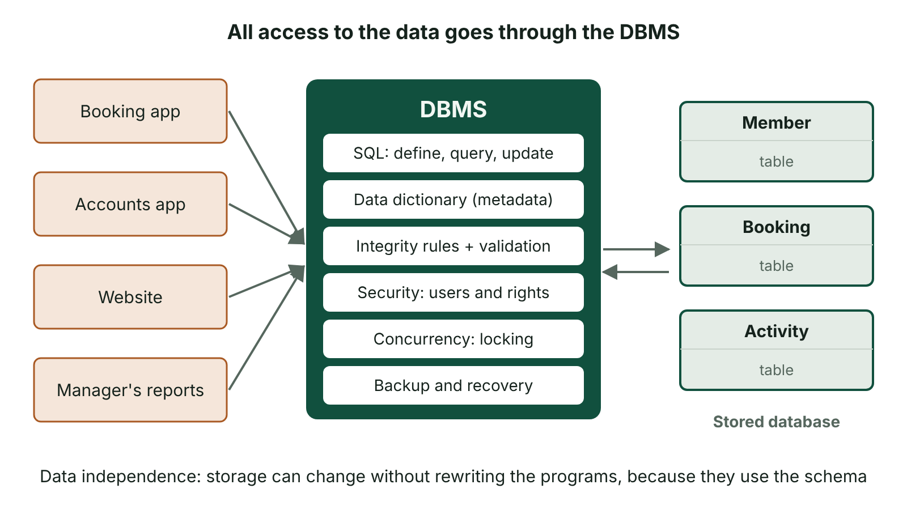
The big picture
Application programs reach the data only through the DBMS, which provides SQL, the data dictionary, integrity, security, concurrency control and backup; this gives data independence
☰ Menu
Notes:
Explain the diagram in your own words before you read on.

Slide 7
Flat-file storage
A flat file stores all data in a single table or file with no links to other files.
Traditional file-based systems gave each department its own files, e.g. Sales and Accounts both keep customer details.
The same data is repeated in many records and many files.
Each application program is written around the exact structure of its own file.
☰ Menu

Slide 8
Problems with flat files
Problem | What it means | Example
Data redundancy | The same data is stored more than once | A member's address on every booking
Data inconsistency | Copies of the same data disagree | Address updated on one booking but not the others
Program-data dependence | Changing a file's structure means rewriting the programs that use it | Adding a mobile number field breaks the booking program
Poor security | Hard to restrict access to parts of a file | Reception can see payment details
Hard to query | Data split across separate files cannot easily be combined | Which members booked squash and also owe fees?
☰ Menu

Slide 9
The relational approach
Data is split into separate tables, each about one entity, e.g. Member, Booking, Activity.
Each table has a primary key; tables are linked by foreign keys.
Each fact is stored once, so redundancy is minimised and updates happen in one place.
Queries join tables back together when a combined view is needed.
Tables are managed by a DBMS rather than by individual application programs.
☰ Menu

Slide 10
Functions of a DBMS
Data storage, retrieval and update through a query language such as SQL.
Maintains the data dictionary (metadata about tables, fields, types and relationships).
Enforces integrity: validation rules, entity and referential integrity.
Security: user accounts, passwords and access rights to tables, views and fields.
Concurrency control (record locking) plus backup and recovery after failure.
☰ Menu

Slide 11
Data independence
Data independence means the way data is physically stored can change without changing the application programs that use it.
Physical data independence: move to a new disk, add an index or change the file organisation – programs are unaffected.
Logical data independence: add a new field or table – existing programs and views still work.
The DBMS achieves this by placing a schema (a description of the data) between programs and the stored data.
Benefit: lower maintenance cost and faster development of new applications.
☰ Menu

Slide 12
Flat file vs relational: evaluation
Criterion | Flat file | Relational database
Redundancy | High | Minimised by normalisation
Consistency | Copies can disagree | Each fact stored once
Set-up | Quick and simple | Needs design: ER model and normalisation
Querying | Limited to one file | SQL joins across many tables
Security and multi-user | Weak | Access rights, locking, transactions
Best for | Small single-user lists | Organisational systems with shared data
☰ Menu

Slide 13
Worked example: Erne Leisure Centre
Flat file: BookingID, Date, Activity, MemberName, Address, Phone – 4000 rows for 600 members.
A member who moves house needs dozens of rows edited; one missed row creates inconsistency.
Relational: Member(MemberID, Name, Address, Phone) and Booking(BookingID, Date, Activity, MemberID).
Now the address is stored once and the change is made in one row.
☰ Menu

Slide 14
Exit quiz: question 1 of 5
Tap an answer to check it. Presenting? Click to reveal the answer.
Which problem occurs when two copies of a customer's address hold different values?
A Data redundancy
B Data inconsistency
✗
✓
C Data independence
D Referential integrity
✗
✗
✓ B: Data inconsistency – Disagreeing copies are inconsistent.
☰ Menu

Slide 15
Exit quiz: question 2 of 5
Tap an answer to check it. Presenting? Click to reveal the answer.
Which is NOT normally a function of a DBMS?
A Enforcing access rights
B Maintaining a data dictionary
✗
✗
C Designing the ER diagram for you
D Backup and recovery
✓
✗
✓ C: Designing the ER diagram for you – The database designer produces the ER model; the DBMS implements and manages it.
☰ Menu

Slide 16
Exit quiz: question 3 of 5
Tap an answer to check it. Presenting? Click to reveal the answer.
Adding an index without changing any application program is an example of…
A logical data independence
B program-data dependence
✗
✗
C physical data independence
D data redundancy
✓
✗
✓ C: physical data independence – Physical storage changed, programs untouched.
☰ Menu

Slide 17
Exit quiz: question 4 of 5
Tap an answer to check it. Presenting? Click to reveal the answer.
In a relational database, tables are linked using…
A foreign keys
B validation rules
✓
✗
C macros
D indexes only
✗
✗
✓ A: foreign keys – A foreign key refers to the primary key of another table.
☰ Menu

Slide 18
Exit quiz: question 5 of 5
Tap an answer to check it. Presenting? Click to reveal the answer.
When is a flat file most appropriate?
A A national bank's accounts
B A hospital patient system
✗
✗
C A small single-user contact list
D An airline booking system
✓
✗
✓ C: A small single-user contact list – Simple, small, single-user data does not need a full DBMS.
☰ Menu

Slide 19
Exit quiz answers
Q | Answer | Why
1 | B Data inconsistency | Disagreeing copies are inconsistent.
2 | C Designing the ER diagram for you | The database designer produces the ER model; the DBMS implements and manages it.
3 | C physical data independence | Physical storage changed, programs untouched.
4 | A foreign keys | A foreign key refers to the primary key of another table.
5 | C A small single-user contact list | Simple, small, single-user data does not need a full DBMS.
☰ Menu

Slide 20
Entity-relationship modelling
A2 1: INFORMATION SYSTEMS · IS02
Learning objectives
Identify entities, attributes and keys from a scenario
Draw an ER diagram using crow's foot notation with the correct degree of each relationship
Resolve a many-to-many relationship using a link entity with a composite key
Notes:
Specification: Describe entities, attributes and relationships | Explain primary, foreign, composite and candidate keys | Draw and interpret entity-relationship (ER) diagrams showing 1:1, 1:M and M:N relationships | Resolve many-to-many relationships using a link entity

Slide 21
In this lesson
Tap a button to jump straight there. The ☰ Menu button on every slide brings you back here.
The big picture
Worked example: resolving M:N
Entities and attributes
Drawing ER diagrams well
Keys
Scenario practice: Lakeland Vets
Degrees of relationship
Exit quiz
Why M:N must be resolved
↑ Topic menu
Notes:
Lesson menu: each button jumps to that part of the lesson in Slide Show. The ☰ Menu button on each slide returns here.

Slide 22
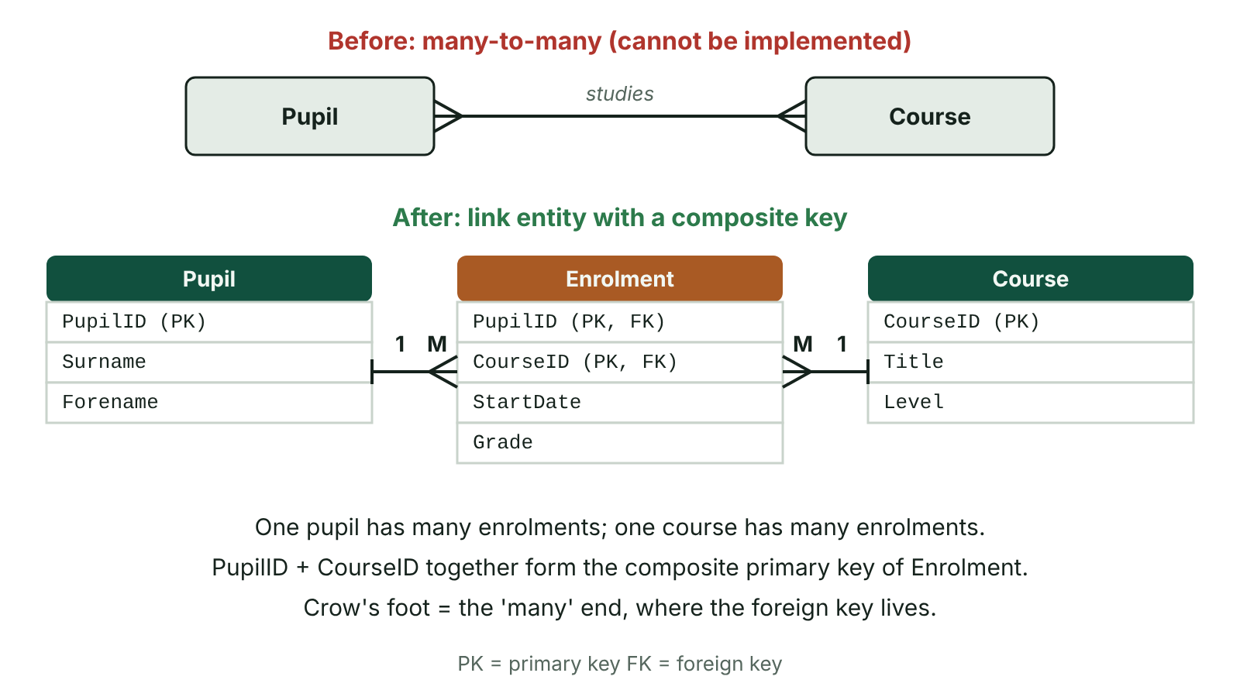
The big picture
A many-to-many relationship between Pupil and Course resolved by an Enrolment link entity with a composite key, giving two one-to-many relationships
☰ Menu
Notes:
Explain the diagram in your own words before you read on.

Slide 23
Entities and attributes
An entity is a thing about which data is stored, e.g. Pupil, Course, Teacher.
An attribute is a property of an entity, e.g. PupilID, Surname, DateOfBirth.
Entity description notation: Pupil(PupilID, Surname, Forename, FormClass) with the primary key underlined.
Each entity becomes a table; each attribute becomes a field; each occurrence becomes a record.
☰ Menu

Slide 24
Keys
Key | Meaning | Example
Primary key | Attribute(s) that uniquely identify each record | PupilID in Pupil
Candidate key | Any attribute that could serve as the primary key | PupilID or C2K username
Foreign key | An attribute that is the primary key of another table, used to link the tables | FormTutorID in Pupil
Composite key | A primary key made from two or more attributes together | (PupilID, CourseID) in Enrolment
Secondary key | A non-unique field used for searching or sorting | Surname
☰ Menu

Slide 25
Degrees of relationship
One-to-one (1:1): one head of department manages one department.
One-to-many (1:M): one form class has many pupils; each pupil is in one form class.
Many-to-many (M:N): a pupil studies many courses and a course has many pupils.
In crow's foot notation the 'many' end of a line has three prongs.
Test each direction: 'One A has how many B? One B has how many A?'
☰ Menu

Slide 26
Why M:N must be resolved
A relational table cannot hold a repeating list of keys in one field (it would not be atomic).
So an M:N relationship cannot be implemented directly.
Create a link (associative) entity between the two entities.
The original M:N becomes two 1:M relationships, with the 'many' ends at the link entity.
The link entity usually has a composite key made of the two foreign keys, and may hold its own attributes such as Grade.
☰ Menu

Slide 27
Worked example: resolving M:N
Before | After
Pupil M ———— N Course | Pupil 1 ——< Enrolment >—— 1 Course
Pupil(PupilID, Surname, Forename) | Pupil(PupilID, Surname, Forename)
Course(CourseID, Title, Level) | Course(CourseID, Title, Level)
(no table can hold the link) | Enrolment(PupilID*, CourseID*, StartDate, Grade)
☰ Menu

Slide 28
Drawing ER diagrams well
Name entities as singular nouns in boxes: Customer, not Customers.
Put the crow's foot at the 'many' end – the end with the foreign key.
Label the relationship with a verb if asked, e.g. Customer 'places' Order.
Check there are no M:N relationships left in a final logical design.
Write the entity descriptions with keys underlined and foreign keys marked with an asterisk.
☰ Menu

Slide 29
Scenario practice: Lakeland Vets
An owner can register many pets; each pet has one owner (1:M).
A pet can have many appointments; each appointment is for one pet (1:M).
A vet sees many pets and a pet may be seen by many vets (M:N), resolved by Appointment.
Entities: Owner(OwnerID, Name, Phone), Pet(PetID, Name, Species, OwnerID*), Vet(VetID, Name), Appointment(ApptID, PetID*, VetID*, Date, Time).
☰ Menu

Slide 30
Exit quiz: question 1 of 5
Tap an answer to check it. Presenting? Click to reveal the answer.
Which relationship needs a link entity?
A One-to-one
B One-to-many
✗
✗
C Many-to-many
D None of these
✓
✗
✓ C: Many-to-many – M:N cannot be implemented directly.
☰ Menu

Slide 31
Exit quiz: question 2 of 5
Tap an answer to check it. Presenting? Click to reveal the answer.
Enrolment(PupilID, CourseID, Grade) uses PupilID and CourseID together as…
A a secondary key
B a composite key
✗
✓
C a candidate attribute
D an index only
✗
✗
✓ B: a composite key – Two fields together make the primary key.
☰ Menu

Slide 32
Exit quiz: question 3 of 5
Tap an answer to check it. Presenting? Click to reveal the answer.
Where is the crow's foot drawn in Customer ——< Order?
A At Customer
B At Order
✗
✓
C At both ends
D Nowhere
✗
✗
✓ B: At Order – One customer places many orders, so the many end is Order.
☰ Menu

Slide 33
Exit quiz: question 4 of 5
Tap an answer to check it. Presenting? Click to reveal the answer.
A head of department manages exactly one department, and each department has one head. This is…
A 1:M
B M:N
✗
✗
C M:1
D 1:1
✗
✓
✓ D: 1:1 – One occurrence relates to one occurrence each way.
☰ Menu

Slide 34
Exit quiz: question 5 of 5
Tap an answer to check it. Presenting? Click to reveal the answer.
Which statement about a foreign key is correct?
A It must be the first field in a table
B It is the primary key of another table
✗
✓
C It cannot contain repeated values
D It is always a composite key
✗
✗
✓ B: It is the primary key of another table – That is what links the tables.
☰ Menu

Slide 35
Exit quiz answers
Q | Answer | Why
1 | C Many-to-many | M:N cannot be implemented directly.
2 | B a composite key | Two fields together make the primary key.
3 | B At Order | One customer places many orders, so the many end is Order.
4 | D 1:1 | One occurrence relates to one occurrence each way.
5 | B It is the primary key of another table | That is what links the tables.
☰ Menu

Slide 36
Normalisation to third normal form
A2 1: INFORMATION SYSTEMS · IS03
Learning objectives
Explain why normalisation is used and the problems (anomalies) it prevents
Take a set of data from 0NF to 3NF, showing each stage
Identify repeating groups, partial dependencies and transitive dependencies
Notes:
Specification: Explain the purpose of normalisation | Normalise data from un-normalised form (0NF) to first, second and third normal form | Identify partial and transitive dependencies

Slide 37
In this lesson
Tap a button to jump straight there. The ☰ Menu button on every slide brings you back here.
The big picture
Third normal form (3NF)
Why normalise?
Final 3NF design
Un-normalised form (0NF)
Checking and evaluating
First normal form (1NF)
Exit quiz
Second normal form (2NF)
↑ Topic menu
Notes:
Lesson menu: each button jumps to that part of the lesson in Slide Show. The ☰ Menu button on each slide returns here.

Slide 38
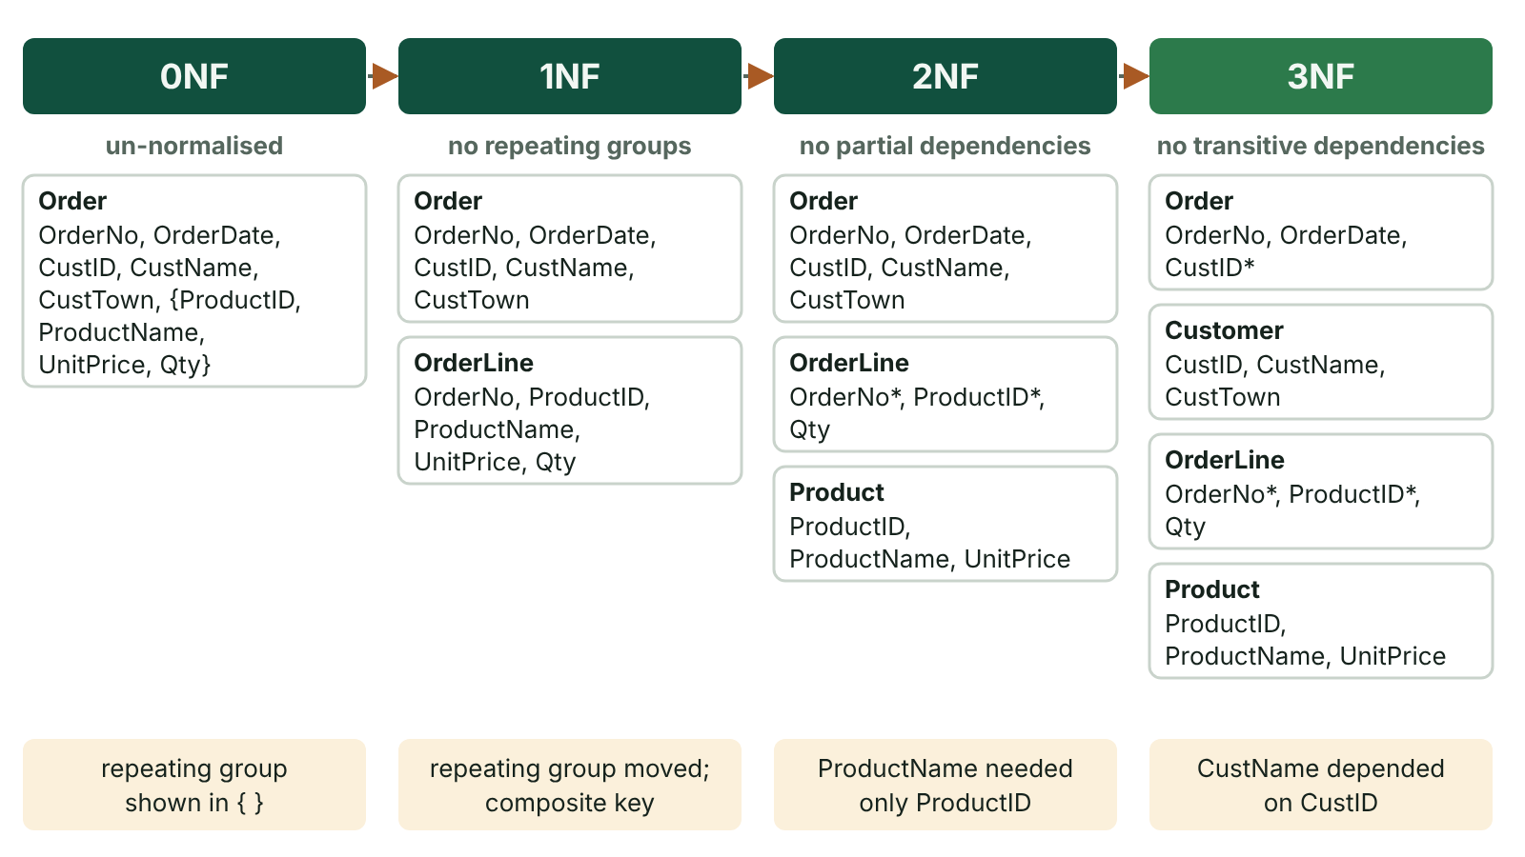
The big picture
Fermanagh Fresh order data normalised from 0NF through 1NF and 2NF to 3NF, showing which dependency is removed at each stage
☰ Menu
Notes:
Explain the diagram in your own words before you read on.

Slide 39
Why normalise?
Normalisation is a formal process of organising attributes into tables to minimise redundancy.
It removes update anomalies: changing a product price in one row but not others.
It removes insertion anomalies: cannot add a new product until someone orders it.
It removes deletion anomalies: deleting the only order for a customer loses the customer's details.
The result: each non-key attribute depends on the key, the whole key and nothing but the key.
☰ Menu

Slide 40
Un-normalised form (0NF)
List every attribute from the source document and choose a key for the whole form.
Identify the repeating group – the attributes that occur several times per key.
Fermanagh Fresh 0NF: Order(OrderNo, OrderDate, CustID, CustName, CustTown, {ProductID, ProductName, UnitPrice, Qty}).
Braces { } show the repeating group: one order has many product lines.
☰ Menu

Slide 41
First normal form (1NF)
Rule: no repeating groups and every attribute is atomic (one value per field).
Move the repeating group into a new table and take the original key with it.
Order(OrderNo, OrderDate, CustID, CustName, CustTown)
OrderLine(OrderNo, ProductID, ProductName, UnitPrice, Qty) – composite key (OrderNo, ProductID).
☰ Menu

Slide 42
Second normal form (2NF)
Rule: in 1NF and no partial dependencies.
A partial dependency is where a non-key attribute depends on only part of a composite key.
In OrderLine, ProductName and UnitPrice depend on ProductID only, not on OrderNo.
Qty depends on both OrderNo and ProductID, so it stays.
OrderLine(OrderNo*, ProductID*, Qty) and Product(ProductID, ProductName, UnitPrice).
☰ Menu

Slide 43
Third normal form (3NF)
Rule: in 2NF and no transitive dependencies.
A transitive dependency is where a non-key attribute depends on another non-key attribute.
In Order, CustName and CustTown depend on CustID, which is not the key.
Order(OrderNo, OrderDate, CustID*) and Customer(CustID, CustName, CustTown).
Tables with a single-field key are automatically in 2NF – check them for 3NF only.
☰ Menu

Slide 44
Final 3NF design
Table | Attributes (key first, * = foreign key)
Customer | CustID, CustName, CustTown
Order | OrderNo, OrderDate, CustID*
Product | ProductID, ProductName, UnitPrice
OrderLine | OrderNo*, ProductID*, Qty (composite key)
☰ Menu

Slide 45
Checking and evaluating
Ask of every non-key attribute: does it depend on the key, the whole key and nothing but the key?
Derived data such as LineTotal = UnitPrice × Qty is normally removed – it can be calculated.
Over-normalisation can mean many joins and slower queries; some data warehouses deliberately denormalise.
Historic prices: if the price at the time of ordering matters, store PriceCharged in OrderLine.
☰ Menu

Slide 46
Exit quiz: question 1 of 5
Tap an answer to check it. Presenting? Click to reveal the answer.
Which form removes repeating groups?
A 1NF
B 2NF
✓
✗
C 3NF
D 0NF
✗
✗
✓ A: 1NF – 1NF requires atomic values and no repeating groups.
☰ Menu

Slide 47
Exit quiz: question 2 of 5
Tap an answer to check it. Presenting? Click to reveal the answer.
OrderLine(OrderNo, ProductID, ProductName, Qty): ProductName depends on ProductID only. This is a…
A transitive dependency
B partial dependency
✗
✓
C repeating group
D full dependency
✗
✗
✓ B: partial dependency – Depends on part of the composite key.
☰ Menu

Slide 48
Exit quiz: question 3 of 5
Tap an answer to check it. Presenting? Click to reveal the answer.
Order(OrderNo, CustID, CustTown): CustTown depends on CustID. Removing this gives…
A 1NF
B 2NF
✗
✗
C 3NF
D 0NF
✓
✗
✓ C: 3NF – It is a transitive dependency, removed at 3NF.
☰ Menu

Slide 49
Exit quiz: question 4 of 5
Tap an answer to check it. Presenting? Click to reveal the answer.
Deleting the only order for a customer also loses the customer's address. This is a…
A update anomaly
B insertion anomaly
✗
✗
C referential anomaly
D deletion anomaly
✗
✓
✓ D: deletion anomaly – Useful data is lost on deletion.
☰ Menu

Slide 50
Exit quiz: question 5 of 5
Tap an answer to check it. Presenting? Click to reveal the answer.
The phrase 'the key, the whole key and nothing but the key' summarises…
A SQL joins
B 3NF
✗
✓
C record locking
D ER diagrams
✗
✗
✓ B: 3NF – Key (1NF), whole key (2NF), nothing but the key (3NF).
☰ Menu

Slide 51
Exit quiz answers
Q | Answer | Why
1 | A 1NF | 1NF requires atomic values and no repeating groups.
2 | B partial dependency | Depends on part of the composite key.
3 | C 3NF | It is a transitive dependency, removed at 3NF.
4 | D deletion anomaly | Useful data is lost on deletion.
5 | B 3NF | Key (1NF), whole key (2NF), nothing but the key (3NF).
☰ Menu

Slide 52
Data integrity: data dictionary, integrity rules, validation and indexing
A2 1: INFORMATION SYSTEMS · IS04
Learning objectives
Describe what a data dictionary stores and who uses it
Explain entity and referential integrity, including cascade update and delete
Evaluate the use of indexes in a relational database
Notes:
Specification: Describe the purpose and contents of a data dictionary | Explain entity integrity and referential integrity | Describe how validation maintains data integrity | Explain the purpose of indexing and its trade-offs

Slide 53
In this lesson
Tap a button to jump straight there. The ☰ Menu button on every slide brings you back here.
The big picture
Validation and verification
What is data integrity?
Indexing
The data dictionary
Putting it together
Entity integrity
Exit quiz
Referential integrity
↑ Topic menu
Notes:
Lesson menu: each button jumps to that part of the lesson in Slide Show. The ☰ Menu button on each slide returns here.

Slide 54
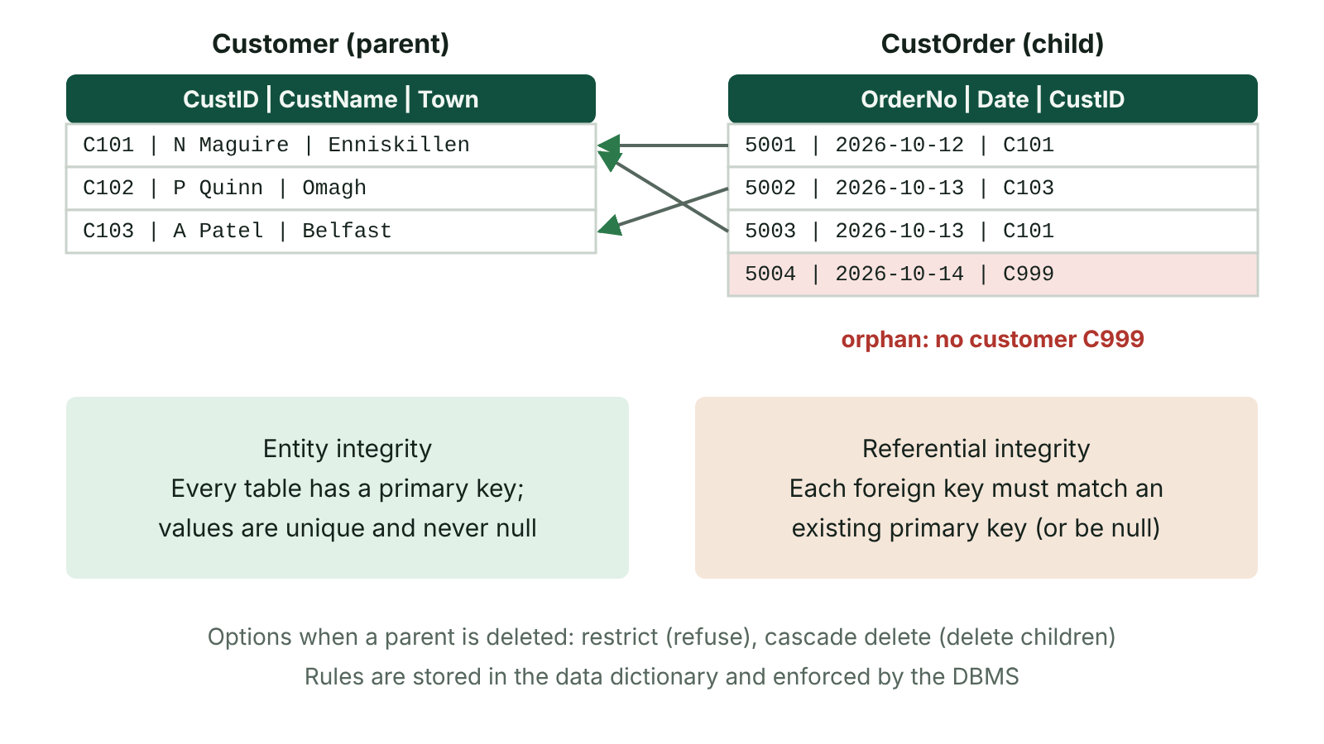
The big picture
Entity integrity requires unique, non-null primary keys; referential integrity requires every foreign key to match a primary key, so an order for missing customer C999 is an orphan record
☰ Menu
Notes:
Explain the diagram in your own words before you read on.

Slide 55
What is data integrity?
Data integrity means data is accurate, complete, consistent and valid throughout its life.
It is threatened by input errors, transmission errors, software bugs, concurrent updates and malicious changes.
A DBMS protects integrity with rules defined in the schema rather than in each program.
Key mechanisms: data dictionary, entity integrity, referential integrity, validation and transactions.
☰ Menu

Slide 56
The data dictionary
Stores (metadata) | Example
Table and field names | Customer.CustTown
Data type and size | VARCHAR(30)
Primary and foreign keys | CustID; Order.CustID references Customer
Validation rules and defaults | Qty > 0; Country default 'UK'
Indexes | Index on Customer.Surname
Users and access rights | Reception: SELECT only on Booking
☰ Menu

Slide 57
Entity integrity
Every table must have a primary key.
The primary key value must be unique for every record.
The primary key must never be null (empty).
The DBMS rejects an INSERT that breaks these rules.
Guarantees each record can be identified and retrieved unambiguously.
☰ Menu

Slide 58
Referential integrity
Every foreign key value must match an existing primary key value in the related table (or be null if allowed).
Prevents orphan records, e.g. an Order for customer C999 who does not exist.
Cascade update: changing a primary key value updates all matching foreign keys automatically.
Cascade delete: deleting a parent record deletes its related child records.
Restrict: the DBMS refuses to delete a parent that still has children.
☰ Menu

Slide 59
Validation and verification
Check | Purpose | Example
Presence | Field is not empty | Surname required
Range | Value within limits | Qty BETWEEN 1 AND 50
Type | Correct data type | Price is numeric
Format / pattern | Matches a pattern | Postcode like BT74 6AA
Lookup | Value in a list or table | Size IN ('S','M','L')
Verification | Checks data matches the source | Double entry of email; visual check
☰ Menu

Slide 60
Indexing
An index is a separate sorted structure (often a B-tree) holding key values and pointers to the records.
The DBMS can find matching rows without scanning the whole table, so searches and joins are faster.
Primary keys are indexed automatically; secondary indexes are added on fields often searched, e.g. Surname.
Trade-off: each index uses extra storage and slows INSERT, UPDATE and DELETE because it must be updated.
Index fields used often in WHERE and JOIN; avoid indexing small tables or rarely queried fields.
☰ Menu

Slide 61
Putting it together
Validation stops wrong values getting in; it cannot guarantee they are correct (a valid but wrong date).
Entity integrity makes every record identifiable.
Referential integrity keeps links between tables meaningful.
The data dictionary records all of these rules centrally so every application obeys them.
☰ Menu

Slide 62
Exit quiz: question 1 of 5
Tap an answer to check it. Presenting? Click to reveal the answer.
Which rule stops two customers having the same CustID?
A Referential integrity
B Entity integrity
✗
✓
C Cascade update
D A format check
✗
✗
✓ B: Entity integrity – Primary keys must be unique and not null.
☰ Menu

Slide 63
Exit quiz: question 2 of 5
Tap an answer to check it. Presenting? Click to reveal the answer.
An Order with CustID C999 exists but there is no customer C999. This breaks…
A entity integrity
B a range check
✗
✗
C referential integrity
D normalisation
✓
✗
✓ C: referential integrity – The foreign key has no matching primary key.
☰ Menu

Slide 64
Exit quiz: question 3 of 5
Tap an answer to check it. Presenting? Click to reveal the answer.
Which is NOT normally stored in a data dictionary?
A Field data types
B Validation rules
✗
✗
C The customers' addresses
D Relationships between tables
✓
✗
✓ C: The customers' addresses – That is data, not metadata.
☰ Menu

Slide 65
Exit quiz: question 4 of 5
Tap an answer to check it. Presenting? Click to reveal the answer.
The main cost of adding many indexes is…
A slower searches
B slower inserts and updates and more storage
✗
✓
C loss of referential integrity
D more redundancy in tables
✗
✗
✓ B: slower inserts and updates and more storage – Each index must be maintained.
☰ Menu

Slide 66
Exit quiz: question 5 of 5
Tap an answer to check it. Presenting? Click to reveal the answer.
'Qty must be between 1 and 50' is a…
A lookup check
B presence check
✗
✗
C format check
D range check
✗
✓
✓ D: range check – Value within limits.
☰ Menu

Slide 67
Exit quiz answers
Q | Answer | Why
1 | B Entity integrity | Primary keys must be unique and not null.
2 | C referential integrity | The foreign key has no matching primary key.
3 | C The customers' addresses | That is data, not metadata.
4 | B slower inserts and updates and more storage | Each index must be maintained.
5 | D range check | Value within limits.
☰ Menu

