Slide 1
SQL and database management
A2 1: INFORMATION SYSTEMS · TOPIC
Lessons in this topic
IS05 SQL data definition and data manipulation
IS06 SQL queries: SELECT, aggregates, grouping and joins
IS07 Multi-user databases: transactions, ACID, locking and distributed databases
IS08 Big data, data warehousing, data mining and analytics

Slide 2

Topic menu
Tap a button to jump straight there. The ☰ Menu button on every slide brings you back here.
Specification map
IS07 Multi-user databases: transactions, ACID, locking and distributed databases
IS05 SQL data definition and data manipulation
IS08 Big data, data warehousing, data mining and analytics
IS06 SQL queries: SELECT, aggregates, grouping and joins

Slide 3
Specification map
Lesson | Specification: students should be able to
IS05 | Use SQL data definition language (DDL) to create tables with data types, primary keys and foreign keys; Use SQL data manipulation language (DML) to insert, update and delete records
IS06 | Write SQL SELECT queries using WHERE, ORDER BY, AND, OR, LIKE and BETWEEN; Use aggregate functions with GROUP BY; Write queries that join two or three tables
IS07 | Explain transactions and the ACID properties; Describe record locking, deadlock and how deadlock is handled; Explain commit and rollback; Compare client–server and distributed databases
IS08 | Describe the characteristics of big data; Explain data warehousing, including extract–transform–load; Describe data mining techniques and the use of analytics in organisations; Discuss privacy issues arising from big data and data mining
☰ Menu
Notes:
Each lesson below is its own section in PowerPoint (View → Slide Sorter shows them). To split this deck by specification point, right-click a section → Move Section, or delete the sections you do not need.

Slide 4
SQL data definition and data manipulation
A2 1: INFORMATION SYSTEMS · IS05
Learning objectives
Write CREATE TABLE statements with suitable data types and constraints
Write INSERT, UPDATE and DELETE statements correctly
Explain the danger of UPDATE and DELETE without a WHERE clause
Notes:
Specification: Use SQL data definition language (DDL) to create tables with data types, primary keys and foreign keys | Use SQL data manipulation language (DML) to insert, update and delete records

Slide 5
In this lesson
Tap a button to jump straight there. The ☰ Menu button on every slide brings you back here.
The big picture
INSERT INTO
SQL: one language, two jobs
UPDATE and DELETE
Common SQL data types
Changing structure: ALTER and DROP
CREATE TABLE with keys
Exit quiz
Composite keys in SQL
↑ Topic menu
Notes:
Lesson menu: each button jumps to that part of the lesson in Slide Show. The ☰ Menu button on each slide returns here.

Slide 6
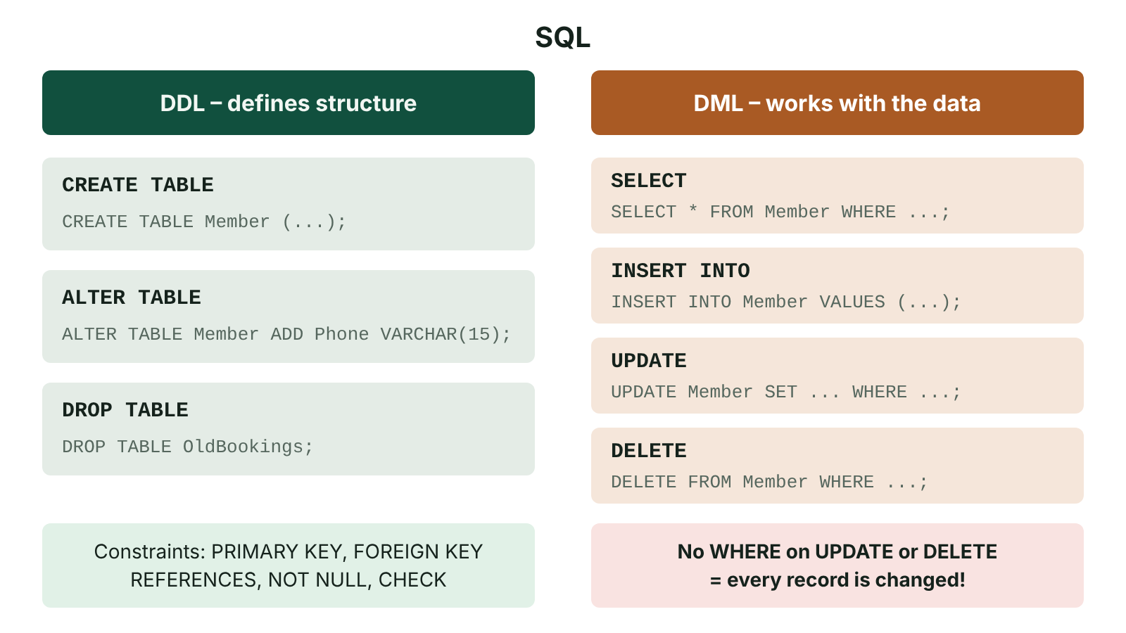
The big picture
SQL split into data definition language for structure and data manipulation language for data, with an example of each command
☰ Menu
Notes:
Explain the diagram in your own words before you read on.

Slide 7
SQL: one language, two jobs
Structured Query Language (SQL) is the standard language for relational databases.
Data definition language (DDL) defines structure: CREATE TABLE, ALTER TABLE, DROP TABLE.
Data manipulation language (DML) works with the data: SELECT, INSERT, UPDATE, DELETE.
SQL is declarative: you say what you want, and the DBMS decides how to get it.
Keywords are written in capitals by convention; statements end with a semicolon.
☰ Menu

Slide 8
Common SQL data types
Data type | Stores | Example field
INT / INTEGER | Whole numbers | Qty INT
DECIMAL(p,s) | Exact decimals, e.g. money | UnitPrice DECIMAL(6,2)
CHAR(n) | Fixed-length text | Postcode CHAR(8)
VARCHAR(n) | Variable-length text up to n | Surname VARCHAR(30)
DATE / DATETIME | Dates and times | OrderDate DATE
BOOLEAN / BIT | True or false | Paid BIT
☰ Menu

Slide 9
CREATE TABLE with keys
Define each field with a name, data type and optional constraints such as NOT NULL.
PRIMARY KEY enforces entity integrity; FOREIGN KEY … REFERENCES enforces referential integrity.
Create parent tables (Customer) before child tables (CustOrder) that refer to them.
☰ Menu

Slide 10
CREATE TABLE with keys – code
PSEUDOCODE
CREATE TABLE Customer (
CustID VARCHAR(6) NOT NULL,
CustName VARCHAR(40) NOT NULL,
CustTown VARCHAR(30),
PRIMARY KEY (CustID)
);
CREATE TABLE CustOrder (
OrderNo INT NOT NULL,
OrderDate DATE NOT NULL,
CustID VARCHAR(6) NOT NULL,
PRIMARY KEY (OrderNo),
FOREIGN KEY (CustID) REFERENCES Customer(CustID)
);
☰ Menu

Slide 11
Composite keys in SQL
A link table lists both fields inside PRIMARY KEY ( , ).
Each part of the composite key is also a foreign key to its own parent table.
A CHECK constraint can add a validation rule.
☰ Menu

Slide 12
Composite keys in SQL – code
PSEUDOCODE
CREATE TABLE OrderLine (
OrderNo INT NOT NULL,
ProductID VARCHAR(5) NOT NULL,
Qty INT NOT NULL CHECK (Qty > 0),
PRIMARY KEY (OrderNo, ProductID),
FOREIGN KEY (OrderNo) REFERENCES CustOrder(OrderNo),
FOREIGN KEY (ProductID) REFERENCES Product(ProductID)
);
☰ Menu

Slide 13
INSERT INTO
Adds a new record; list the fields, then the values in the same order.
Text and dates go in single quotes; numbers do not.
The DBMS rejects the row if it breaks a key, NOT NULL or CHECK rule.
☰ Menu

Slide 14
INSERT INTO – code
PSEUDOCODE
INSERT INTO Customer (CustID, CustName, CustTown)
VALUES ('C101', 'Niamh Maguire', 'Enniskillen');
INSERT INTO CustOrder (OrderNo, OrderDate, CustID)
VALUES (5001, '2026-10-12', 'C101');
☰ Menu

Slide 15
UPDATE and DELETE
UPDATE changes values in existing records; SET lists the changes; WHERE chooses the records.
DELETE removes whole records that match WHERE.
Without WHERE, every record in the table is changed or deleted – a classic and costly mistake.
PSEUDOCODE
UPDATE Product
SET UnitPrice = UnitPrice * 1.05
WHERE Category = 'Veg';
UPDATE Customer
SET CustTown = 'Lisnaskea'
WHERE CustID = 'C101';
DELETE FROM OrderLine
WHERE OrderNo = 5001 AND ProductID = 'P07';
☰ Menu

Slide 16
Changing structure: ALTER and DROP
ALTER TABLE Customer ADD Phone VARCHAR(15); adds a field to an existing table.
DROP TABLE removes the table and all of its data – DDL, not DML.
Referential integrity may stop a DELETE or DROP if child records depend on the parent.
Access to DDL commands is normally restricted to the database administrator.
☰ Menu

Slide 17
Exit quiz: question 1 of 5
Tap an answer to check it. Presenting? Click to reveal the answer.
Which SQL command adds a new record?
A UPDATE
B ALTER
✗
✗
C INSERT INTO
D CREATE
✓
✗
✓ C: INSERT INTO – INSERT INTO … VALUES …
☰ Menu

Slide 18
Exit quiz: question 2 of 5
Tap an answer to check it. Presenting? Click to reveal the answer.
Which data type is most suitable for a price such as 12.49?
A INT
B DECIMAL(6,2)
✗
✓
C CHAR(5)
D BOOLEAN
✗
✗
✓ B: DECIMAL(6,2) – Exact decimal with two decimal places.
☰ Menu

Slide 19
Exit quiz: question 3 of 5
Tap an answer to check it. Presenting? Click to reveal the answer.
What does ALTER TABLE do?
A Changes the structure of an existing table
B Changes values in records
✓
✗
C Deletes a table
D Sorts a table
✗
✗
✓ A: Changes the structure of an existing table – It is DDL that modifies structure.
☰ Menu

Slide 20
Exit quiz: question 4 of 5
Tap an answer to check it. Presenting? Click to reveal the answer.
Which clause of UPDATE says what the new values are?
A WHERE
B VALUES
✗
✗
C FROM
D SET
✗
✓
✓ D: SET – UPDATE table SET field = value WHERE …
☰ Menu

Slide 21
Exit quiz: question 5 of 5
Tap an answer to check it. Presenting? Click to reveal the answer.
Which constraint acts as a presence check?
A CHECK
B NOT NULL
✗
✓
C REFERENCES
D UNIQUE
✗
✗
✓ B: NOT NULL – NOT NULL forbids empty values.
☰ Menu

Slide 22
Exit quiz answers
Q | Answer | Why
1 | C INSERT INTO | INSERT INTO … VALUES …
2 | B DECIMAL(6,2) | Exact decimal with two decimal places.
3 | A Changes the structure of an existing table | It is DDL that modifies structure.
4 | D SET | UPDATE table SET field = value WHERE …
5 | B NOT NULL | NOT NULL forbids empty values.
☰ Menu

Slide 23
SQL queries: SELECT, aggregates, grouping and joins
A2 1: INFORMATION SYSTEMS · IS06
Learning objectives
Write single-table SELECT queries with conditions and sorting
Use COUNT, SUM, AVG, MIN and MAX with GROUP BY and HAVING
Join two or three tables using primary key–foreign key matches
Notes:
Specification: Write SQL SELECT queries using WHERE, ORDER BY, AND, OR, LIKE and BETWEEN | Use aggregate functions with GROUP BY | Write queries that join two or three tables

Slide 24
In this lesson
Tap a button to jump straight there. The ☰ Menu button on every slide brings you back here.
The big picture
Joining two tables
SELECT … FROM … WHERE … ORDER BY
Joining three tables
LIKE, BETWEEN and IN
Common mistakes
Aggregate functions
Exit quiz
GROUP BY and HAVING
↑ Topic menu
Notes:
Lesson menu: each button jumps to that part of the lesson in Slide Show. The ☰ Menu button on each slide returns here.

Slide 25
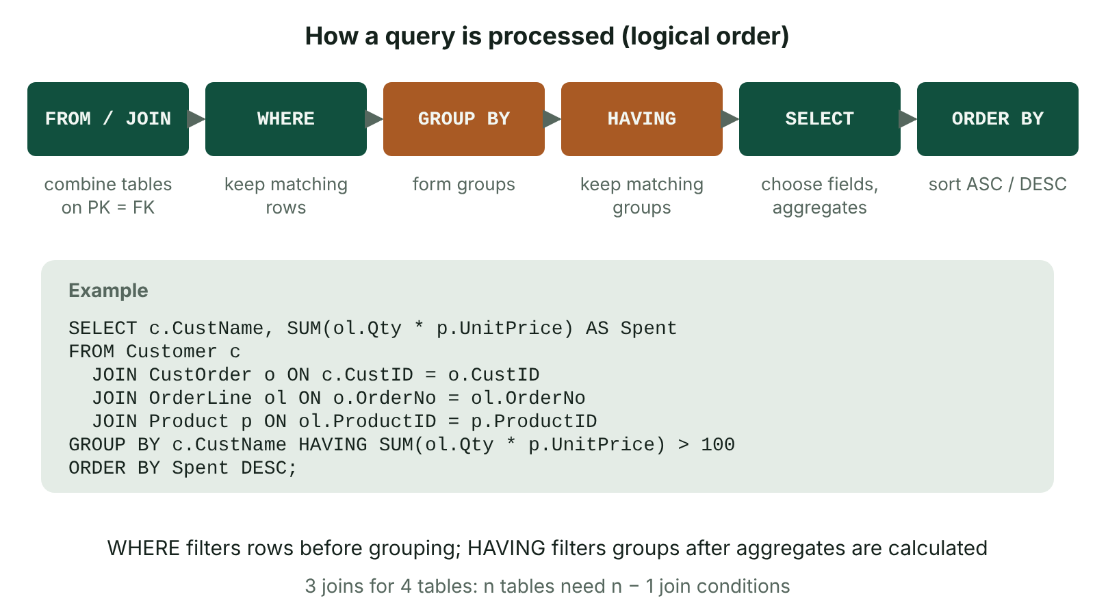
The big picture
The order in which a DBMS logically processes an SQL query: FROM and JOIN, WHERE, GROUP BY, HAVING, SELECT, then ORDER BY
☰ Menu
Notes:
Explain the diagram in your own words before you read on.

Slide 26
SELECT … FROM … WHERE … ORDER BY
SELECT lists the fields to show (* means all fields).
WHERE filters rows; ORDER BY sorts the results ASC (default) or DESC.
Conditions use = <> < > <= >= and combine with AND, OR, NOT and brackets.
☰ Menu

Slide 27
SELECT … FROM … WHERE … ORDER BY – code
PSEUDOCODE
SELECT Surname, Forename, Merits
FROM Pupil
WHERE YearGroup = 13 AND (House = 'Erne' OR House = 'Fermanagh')
ORDER BY Merits DESC, Surname ASC;
☰ Menu

Slide 28
LIKE, BETWEEN and IN
LIKE matches a pattern: % means any number of characters, _ means exactly one.
BETWEEN is inclusive at both ends.
IN tests membership of a list.
☰ Menu

Slide 29
LIKE, BETWEEN and IN – code
PSEUDOCODE
SELECT * FROM Customer
WHERE Postcode LIKE 'BT74%'; -- starts with BT74
SELECT ProductName, UnitPrice FROM Product
WHERE UnitPrice BETWEEN 2.00 AND 5.00; -- 2 and 5 included
SELECT * FROM Pupil
WHERE House IN ('Erne', 'Lough');
☰ Menu

Slide 30
Aggregate functions
Function | Returns | Example
COUNT(*) | Number of rows | SELECT COUNT(*) FROM CustOrder;
SUM(field) | Total of values | SELECT SUM(Qty) FROM OrderLine;
AVG(field) | Mean value | SELECT AVG(UnitPrice) FROM Product;
MIN / MAX(field) | Smallest / largest | SELECT MAX(Merits) FROM Pupil;
☰ Menu

Slide 31
GROUP BY and HAVING
GROUP BY produces one result row per group, e.g. per house.
Every non-aggregated field in SELECT must appear in GROUP BY.
HAVING filters groups after aggregation; WHERE filters rows before.
☰ Menu

Slide 32
GROUP BY and HAVING – code
PSEUDOCODE
SELECT House, COUNT(*) AS Pupils, AVG(Merits) AS AvgMerits
FROM Pupil
WHERE YearGroup >= 12
GROUP BY House
HAVING COUNT(*) > 10
ORDER BY AvgMerits DESC;
☰ Menu

Slide 33
Joining two tables
A join recombines normalised tables by matching a foreign key with its primary key.
Prefix fields with the table name (or an alias) when the name appears in both tables.
The older WHERE-join style gives the same result and is also accepted.
PSEUDOCODE
SELECT c.CustName, o.OrderNo, o.OrderDate
FROM Customer c
INNER JOIN CustOrder o ON c.CustID = o.CustID
WHERE c.CustTown = 'Enniskillen'
ORDER BY o.OrderDate;
-- equivalent WHERE-join style
SELECT Customer.CustName, CustOrder.OrderNo
FROM Customer, CustOrder
WHERE Customer.CustID = CustOrder.CustID;
☰ Menu

Slide 34
Joining three tables
Follow the relationships in the ER diagram: Customer → CustOrder → OrderLine → Product.
Each extra table needs one more join condition (n tables need n − 1 conditions).
Aggregates work across joins: total spent per customer.
☰ Menu

Slide 35
Joining three tables – code
PSEUDOCODE
SELECT c.CustName, SUM(ol.Qty * p.UnitPrice) AS TotalSpent
FROM Customer c
INNER JOIN CustOrder o ON c.CustID = o.CustID
INNER JOIN OrderLine ol ON o.OrderNo = ol.OrderNo
INNER JOIN Product p ON ol.ProductID = p.ProductID
GROUP BY c.CustName
ORDER BY TotalSpent DESC;
☰ Menu

Slide 36
Common mistakes
Forgetting the join condition gives a Cartesian product: every row matched with every row.
Using WHERE with an aggregate (WHERE COUNT(*) > 3) instead of HAVING.
Putting quotes round numbers or leaving them off text and dates.
Ambiguous field names such as CustID without a table prefix.
Writing = with a wildcard: use LIKE 'Mc%' not = 'Mc%'.
☰ Menu

Slide 37
Exit quiz: question 1 of 5
Tap an answer to check it. Presenting? Click to reveal the answer.
Which query finds surnames starting with Mc?
A WHERE Surname = 'Mc%'
B WHERE Surname LIKE 'Mc%'
✗
✓
C WHERE Surname LIKE '%Mc'
D WHERE Surname IN 'Mc'
✗
✗
✓ B: WHERE Surname LIKE 'Mc%' – LIKE with % after the prefix.
☰ Menu

Slide 38
Exit quiz: question 2 of 5
Tap an answer to check it. Presenting? Click to reveal the answer.
Which function returns the number of rows?
A SUM
B AVG
✗
✗
C MAX
D COUNT
✗
✓
✓ D: COUNT – COUNT(*) counts rows.
☰ Menu

Slide 39
Exit quiz: question 3 of 5
Tap an answer to check it. Presenting? Click to reveal the answer.
Which clause produces one result row per house?
A ORDER BY House
B GROUP BY House
✗
✓
C HAVING House
D WHERE House
✗
✗
✓ B: GROUP BY House – GROUP BY creates groups.
☰ Menu

Slide 40
Exit quiz: question 4 of 5
Tap an answer to check it. Presenting? Click to reveal the answer.
Customer and CustOrder are joined on…
A Customer.CustID = CustOrder.CustID
B Customer.CustName = CustOrder.OrderNo
✓
✗
C any field with the same type
D no condition is needed
✗
✗
✓ A: Customer.CustID = CustOrder.CustID – Foreign key matched to primary key.
☰ Menu

Slide 41
Exit quiz: question 5 of 5
Tap an answer to check it. Presenting? Click to reveal the answer.
Which clause order is correct?
A SELECT, WHERE, FROM, ORDER BY
B SELECT, FROM, GROUP BY, WHERE
✗
✗
C SELECT, FROM, WHERE, GROUP BY, HAVING, ORDER BY
D FROM, SELECT, HAVING, WHERE
✓
✗
✓ C: SELECT, FROM, WHERE, GROUP BY, HAVING, ORDER BY – That is the standard order.
☰ Menu

Slide 42
Exit quiz answers
Q | Answer | Why
1 | B WHERE Surname LIKE 'Mc%' | LIKE with % after the prefix.
2 | D COUNT | COUNT(*) counts rows.
3 | B GROUP BY House | GROUP BY creates groups.
4 | A Customer.CustID = CustOrder.CustID | Foreign key matched to primary key.
5 | C SELECT, FROM, WHERE, GROUP BY, HAVING, ORDER BY | That is the standard order.
☰ Menu

Slide 43
Multi-user databases: transactions, ACID, locking and distributed databases
A2 1: INFORMATION SYSTEMS · IS07
Learning objectives
Explain each ACID property with an example
Describe how locking prevents the lost update problem and how deadlock can arise and be resolved
Evaluate client–server and distributed database architectures
Notes:
Specification: Explain transactions and the ACID properties | Describe record locking, deadlock and how deadlock is handled | Explain commit and rollback | Compare client–server and distributed databases

Slide 44
In this lesson
Tap a button to jump straight there. The ☰ Menu button on every slide brings you back here.
The big picture
Deadlock
Transactions
Client–server databases
ACID properties
Distributed databases
The lost update problem
Exit quiz
Record locking
↑ Topic menu
Notes:
Lesson menu: each button jumps to that part of the lesson in Slide Show. The ☰ Menu button on each slide returns here.

Slide 45
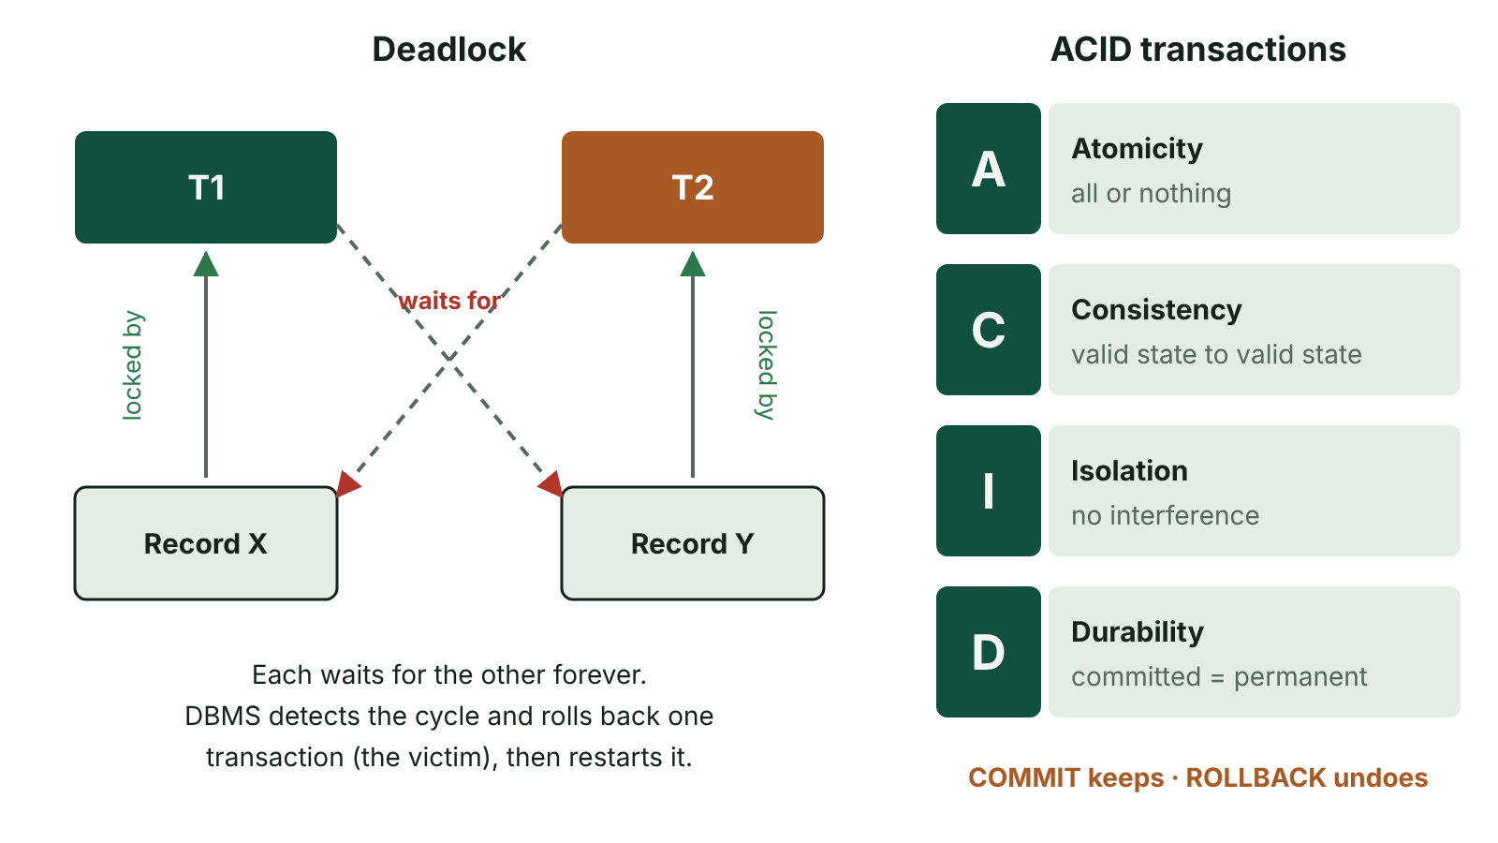
The big picture
Deadlock: transaction T1 holds a lock on record X and waits for Y while T2 holds Y and waits for X; the DBMS rolls one back. ACID properties listed alongside
☰ Menu
Notes:
Explain the diagram in your own words before you read on.

Slide 46
Transactions
A transaction is a group of database operations that must be treated as one single logical unit of work.
Example: transferring £50 from savings to current account = debit one account AND credit the other.
If any step fails, none of the changes should be kept.
COMMIT makes all the changes permanent; ROLLBACK undoes all changes since the transaction began.
☰ Menu

Slide 47
Transactions – code
PSEUDOCODE
BEGIN TRANSACTION;
UPDATE Account SET Balance = Balance - 50 WHERE AccNo = 'S123';
UPDATE Account SET Balance = Balance + 50 WHERE AccNo = 'C123';
COMMIT; -- or ROLLBACK if an error occurred
☰ Menu

Slide 48
ACID properties
Property | Meaning | Bank transfer example
Atomicity | All of the transaction happens or none of it does | Never debit without the credit
Consistency | Takes the database from one valid state to another, obeying all rules | Total money is unchanged; no negative balance if forbidden
Isolation | Concurrent transactions do not interfere; the result is as if they ran one after another | A second withdrawal cannot see a half-finished transfer
Durability | Once committed, changes survive power cuts and crashes | The transfer is still there after a server restart
☰ Menu

Slide 49
The lost update problem
User A reads Balance = 100. User B reads Balance = 100.
A writes 100 − 30 = 70. B writes 100 − 20 = 80.
A's update has been overwritten: the balance should be 50.
Caused by concurrent access without control – breaks isolation.
☰ Menu

Slide 50
Record locking
When a transaction reads a record to update it, the DBMS locks that record.
Other transactions must wait until the lock is released at COMMIT or ROLLBACK.
Shared (read) locks allow many readers; exclusive (write) locks allow one writer only.
Locking at record level allows more concurrency than locking a whole table.
Drawback: users may wait, and locking can cause deadlock.
☰ Menu

Slide 51
Deadlock
Transaction 1 locks record X and waits for record Y.
Transaction 2 locks record Y and waits for record X.
Neither can continue: each waits for the other forever.
The DBMS detects the cycle and chooses a victim to roll back, then restarts it later.
Prevention: lock all records needed at the start, or always lock records in the same order; timestamp ordering is an alternative.
☰ Menu

Slide 52
Client–server databases
The database and DBMS run on a central server; client applications send requests (SQL) over the network.
Only the results are sent back, reducing network traffic compared with sending whole files.
Central control of security, integrity, backup and concurrency.
Drawbacks: server is a single point of failure and a possible bottleneck; needs specialist staff.
☰ Menu

Slide 53
Distributed databases
Feature | Distributed database
Definition | One logical database stored across several sites connected by a network, appearing to users as a single database
Fragmentation | Tables split by rows (e.g. each region's customers) or by columns
Replication | Copies of data held at several sites
Advantages | Local data is fast to access; no single point of failure; scales across sites
Disadvantages | Complex to keep replicas consistent; harder security; distributed transactions need two-phase commit
☰ Menu

Slide 54
Exit quiz: question 1 of 5
Tap an answer to check it. Presenting? Click to reveal the answer.
Which ACID property ensures a debit is never made without its matching credit?
A Isolation
B Durability
✗
✗
C Atomicity
D Consistency
✓
✗
✓ C: Atomicity – All or nothing.
☰ Menu

Slide 55
Exit quiz: question 2 of 5
Tap an answer to check it. Presenting? Click to reveal the answer.
User A's update is overwritten by user B's update. This is the…
A deadlock problem
B lost update problem
✗
✓
C Cartesian product
D update anomaly
✗
✗
✓ B: lost update problem – Concurrent writes without locking.
☰ Menu

Slide 56
Exit quiz: question 3 of 5
Tap an answer to check it. Presenting? Click to reveal the answer.
How does a DBMS usually resolve deadlock?
A Deletes both records
B Rolls back one transaction
✗
✓
C Commits both transactions
D Turns off locking
✗
✗
✓ B: Rolls back one transaction – One victim is aborted and restarted.
☰ Menu

Slide 57
Exit quiz: question 4 of 5
Tap an answer to check it. Presenting? Click to reveal the answer.
Storing copies of the same data at several sites is…
A fragmentation
B normalisation
✗
✗
C indexing
D replication
✗
✓
✓ D: replication – Replication improves availability.
☰ Menu

Slide 58
Exit quiz: question 5 of 5
Tap an answer to check it. Presenting? Click to reveal the answer.
Which statement makes all changes in a transaction permanent?
A COMMIT
B ROLLBACK
✓
✗
C LOCK
D SELECT
✗
✗
✓ A: COMMIT – COMMIT ends the transaction successfully.
☰ Menu

Slide 59
Exit quiz answers
Q | Answer | Why
1 | C Atomicity | All or nothing.
2 | B lost update problem | Concurrent writes without locking.
3 | B Rolls back one transaction | One victim is aborted and restarted.
4 | D replication | Replication improves availability.
5 | A COMMIT | COMMIT ends the transaction successfully.
☰ Menu

Slide 60
Big data, data warehousing, data mining and analytics
A2 1: INFORMATION SYSTEMS · IS08
Learning objectives
Describe big data using volume, velocity, variety, veracity and value
Explain how a data warehouse is built and how it differs from an operational database
Evaluate the benefits of data mining for an organisation against privacy concerns
Notes:
Specification: Describe the characteristics of big data | Explain data warehousing, including extract–transform–load | Describe data mining techniques and the use of analytics in organisations | Discuss privacy issues arising from big data and data mining

Slide 61
In this lesson
Tap a button to jump straight there. The ☰ Menu button on every slide brings you back here.
The big picture
Data mining
What is big data?
Analytics in organisations
The Vs of big data
Privacy and ethical issues
Data warehousing
Exit quiz
Operational database vs data warehouse
↑ Topic menu
Notes:
Lesson menu: each button jumps to that part of the lesson in Slide Show. The ☰ Menu button on each slide returns here.

Slide 62
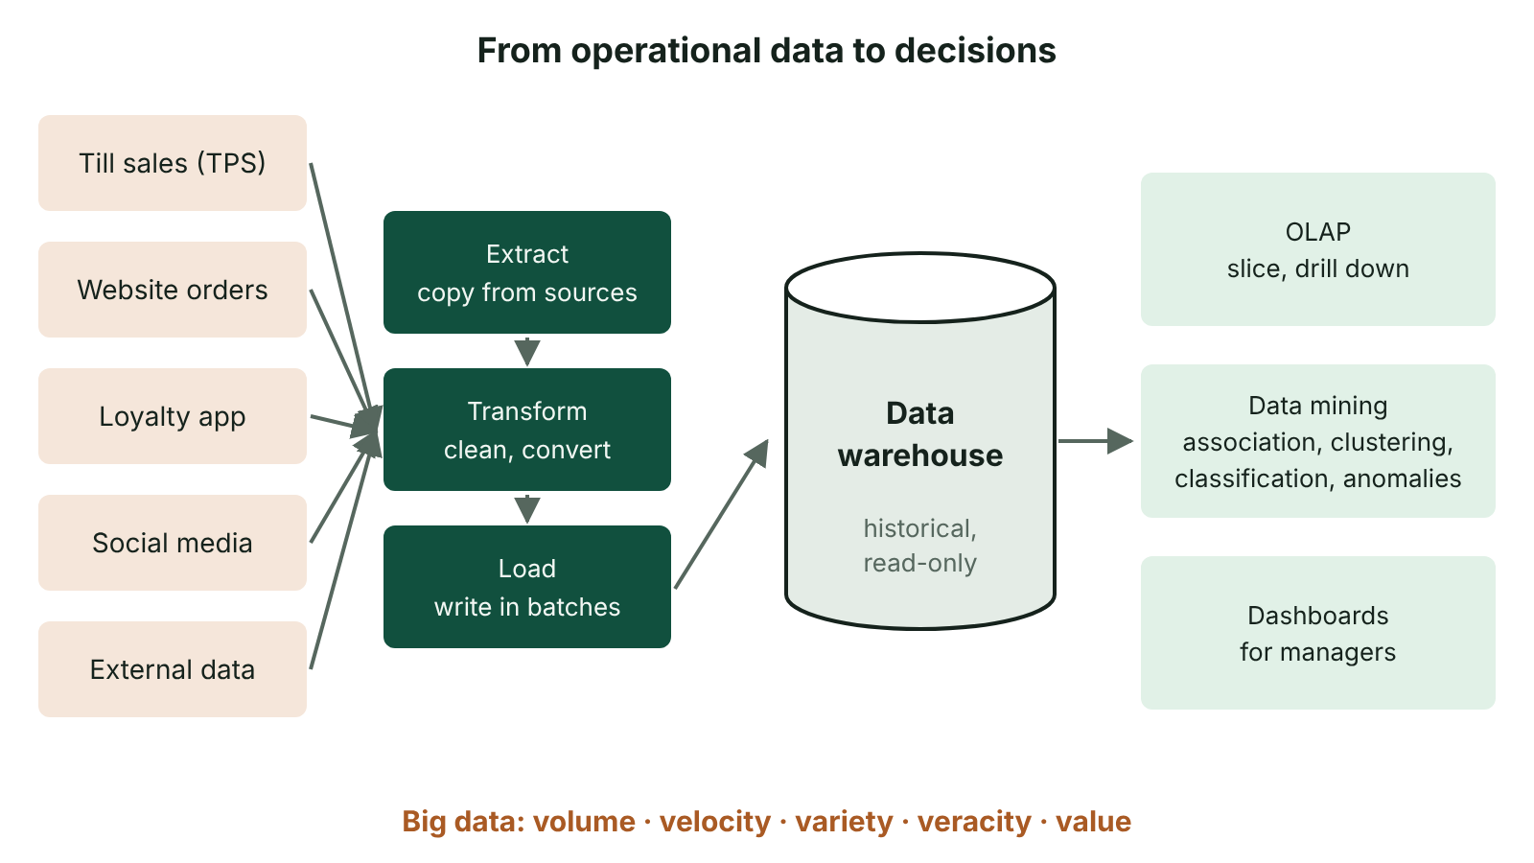
The big picture
Data from operational sources is extracted, transformed and loaded into a data warehouse, then analysed with OLAP and data mining to support decisions
☰ Menu
Notes:
Explain the diagram in your own words before you read on.

Slide 63
What is big data?
Data sets so large, fast-arriving or varied that traditional relational databases and tools cannot process them efficiently.
Sources: social media, sensors and IoT devices, card transactions, web logs, GPS, CCTV.
Often unstructured: text, images, video, audio rather than neat tables.
Processed with distributed storage and parallel processing across many servers, e.g. NoSQL databases.
Value comes from finding patterns that support better decisions.
☰ Menu

Slide 64
The Vs of big data
V | Meaning | Example
Volume | Huge quantity of data (terabytes to petabytes) | Every Translink smart-card tap for years
Velocity | Speed at which data arrives and must be processed | Live sensor readings from wind turbines
Variety | Many types and formats, structured and unstructured | Tweets, photos, transaction records
Veracity | Trustworthiness and accuracy of the data | Fake reviews, faulty sensors
Value | Useful insight that can be gained | Predicting which routes need extra buses
☰ Menu

Slide 65
Data warehousing
A data warehouse is a large store of historical data copied from many operational systems, organised for analysis rather than day-to-day processing.
Built by ETL: extract data from sources, transform it (clean, convert formats, remove duplicates), load it into the warehouse.
Data is subject-oriented, integrated, time-variant (historic) and non-volatile (read-only once loaded).
Often denormalised (e.g. a star schema) so analytical queries need fewer joins.
Analysed with OLAP (online analytical processing): slicing and drilling down by time, place or product.
☰ Menu

Slide 66
Operational database vs data warehouse
Feature | Operational (OLTP) database | Data warehouse
Purpose | Run daily transactions | Analysis and decision-making
Data | Current, changing | Historical, read-only
Design | Normalised to 3NF | Often denormalised
Queries | Many short updates | Few, large, complex reads
Users | Operational staff | Managers and analysts
☰ Menu

Slide 67
Data mining
Data mining is searching large data sets to discover previously unknown patterns, relationships and trends.
Association: customers who buy X also buy Y (market basket analysis).
Classification: assign records to known groups, e.g. likely to default on a loan.
Clustering: find natural groups not known in advance, e.g. customer segments.
Anomaly detection: spot unusual transactions, e.g. card fraud; regression and forecasting predict values.
☰ Menu

Slide 68
Analytics in organisations
Descriptive analytics: what happened? (dashboards and reports).
Predictive analytics: what is likely to happen? (forecasting demand, churn).
Prescriptive analytics: what should we do? (optimise stock levels, pricing).
Benefits: targeted marketing, better stock control, fraud detection, improved services, competitive advantage.
Costs: specialist staff (data scientists), storage and processing power, data quality work.
☰ Menu

Slide 69
Privacy and ethical issues
Data collected for one purpose may be used for another, breaching purpose limitation under UK GDPR.
Combining anonymised data sets can re-identify individuals.
Profiling and automated decisions can be biased or discriminatory.
Large stores of personal data are attractive targets for hackers.
Organisations must be transparent, minimise data, secure it and respect data subjects' rights.
☰ Menu

Slide 70
Exit quiz: question 1 of 5
Tap an answer to check it. Presenting? Click to reveal the answer.
Which V describes the trustworthiness of data?
A Volume
B Velocity
✗
✗
C Veracity
D Variety
✓
✗
✓ C: Veracity – Veracity = accuracy and reliability.
☰ Menu

Slide 71
Exit quiz: question 2 of 5
Tap an answer to check it. Presenting? Click to reveal the answer.
What does the T in ETL stand for?
A Transmit
B Transform
✗
✓
C Transfer
D Test
✗
✗
✓ B: Transform – Data is cleaned and converted.
☰ Menu

Slide 72
Exit quiz: question 3 of 5
Tap an answer to check it. Presenting? Click to reveal the answer.
Finding unusual card transactions that may be fraud is…
A anomaly detection
B association
✓
✗
C normalisation
D replication
✗
✗
✓ A: anomaly detection – Outliers are flagged.
☰ Menu

Slide 73
Exit quiz: question 4 of 5
Tap an answer to check it. Presenting? Click to reveal the answer.
Which is a feature of a data warehouse?
A Current data only
B Fully normalised for updates
✗
✗
C Used for daily order entry
D Historical, integrated data for analysis
✗
✓
✓ D: Historical, integrated data for analysis – Time-variant and integrated.
☰ Menu

Slide 74
Exit quiz: question 5 of 5
Tap an answer to check it. Presenting? Click to reveal the answer.
'What should we do?' is answered by…
A descriptive analytics
B prescriptive analytics
✗
✓
C an index
D a transaction log
✗
✗
✓ B: prescriptive analytics – Prescriptive analytics recommends actions.
☰ Menu

Slide 75
Exit quiz answers
Q | Answer | Why
1 | C Veracity | Veracity = accuracy and reliability.
2 | B Transform | Data is cleaned and converted.
3 | A anomaly detection | Outliers are flagged.
4 | D Historical, integrated data for analysis | Time-variant and integrated.
5 | B prescriptive analytics | Prescriptive analytics recommends actions.
☰ Menu

