Slide 1
Analysis
AS 1: APPROACHES TO SYSTEMS DEVELOPMENT · TOPIC
Lessons in this topic
AP03 Analysis and fact-finding methods
AP04 Stakeholders, requirements and the system specification
AP05 Data flow diagrams

Slide 2

Topic menu
Tap a button to jump straight there. The ☰ Menu button on every slide brings you back here.
Specification map
AP04 Stakeholders, requirements and the system specification
AP03 Analysis and fact-finding methods
AP05 Data flow diagrams

Slide 3
Specification map (1 of 2)
Lesson | Specification: students should be able to
AP03 | Describe the purpose of the analysis (investigation) stage of systems development; Explain the difference between direct and indirect data sources and state a benefit and drawback of each; Describe the four main fact-finding techniques: interviews, questionnaires, observation and document sampling; Evaluate the strengths and weaknesses of each fact-finding technique; Select and justify suitable fact-finding techniques for a given scenario
AP04 | Identify the stakeholders in a systems development project and describe their differing needs; Distinguish between functional and non-functional user requirements; Identify functional and non-functional requirements for systems such as stock control, reservation, payroll and billing; Describe the purpose and contents of the system (requirements) specification produced at the end of analysis; Explain how the role of the specification has changed with the move towards more flexible, Agile approaches
☰ Menu

Slide 4
Specification map (2 of 2)
Lesson | Specification: students should be able to
AP05 | Explain the purpose of a data flow diagram (DFD) and its advantages; Identify and use the standard DFD elements: external entities (sources and sinks), processes, data stores and data flows; Produce a context diagram (Level 0 DFD) for a simple scenario; Produce a Level 1 DFD by exploding a context diagram, maintaining consistency between levels; Interpret DFDs and identify and correct errors using the rules for valid DFDs
☰ Menu
Notes:
Each lesson below is its own section in PowerPoint (View → Slide Sorter shows them). To split this deck by specification point, right-click a section → Move Section, or delete the sections you do not need.

Slide 5
Analysis and fact-finding methods
AS 1: APPROACHES TO SYSTEMS DEVELOPMENT · AP03
Learning objectives
Explain why analysts must fully understand the existing system before a new one is designed
Distinguish direct from indirect data sources using examples
Describe how interviews, questionnaires, observation and document sampling are planned and carried out
Evaluate each technique and justify a combination of methods for a given organisation
Notes:
Specification: Describe the purpose of the analysis (investigation) stage of systems development | Explain the difference between direct and indirect data sources and state a benefit and drawback of each | Describe the four main fact-finding techniques: interviews, questionnaires, observation and document sampling | Evaluate the strengths and weaknesses of each fact-finding technique | Select and justify suitable fact-finding techniques for a given scenario

Slide 6
In this lesson
Tap a button to jump straight there. The ☰ Menu button on every slide brings you back here.
The big picture
Interviews: carrying out and evaluating
Comparing the four techniques
The purpose of analysis
Questionnaires: question types
Worked example: choosing methods
Direct and indirect data sources
Questionnaires: strengths and weaknesses
Triangulation: cross-checking the facts
Worked example: direct or indirect?
Observation
Exit quiz
Interviews: planning
Document sampling
↑ Topic menu
Notes:
Lesson menu: each button jumps to that part of the lesson in Slide Show. The ☰ Menu button on each slide returns here.

Slide 7
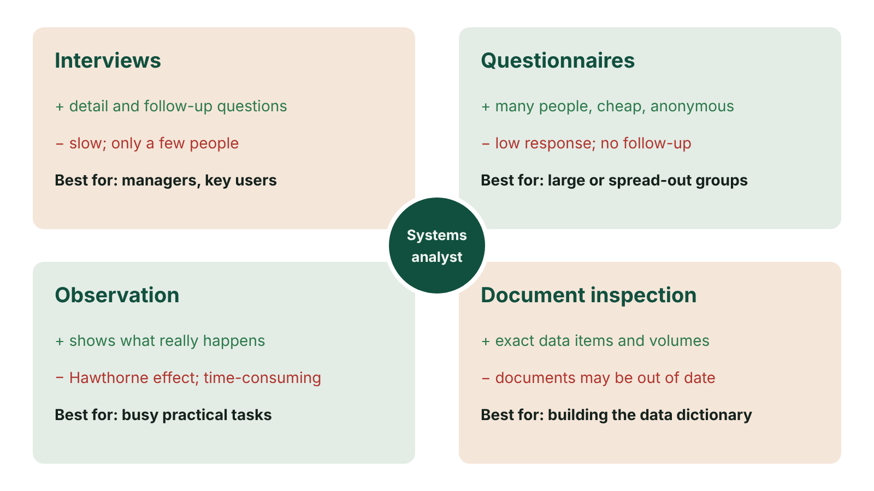
The big picture
The four fact-finding methods with an advantage, a disadvantage and the users each suits, around the systems analyst
☰ Menu
Notes:
Explain the diagram in your own words before you read on.

Slide 8
The purpose of analysis
Analysis (also called investigation) comes before design: the analyst studies the existing system in detail
Goal 1: understand the current system in terms of its inputs, processing, outputs and stored data
Goal 2: identify its strengths, weaknesses and problems, and spot opportunities for new features
Goal 3: establish and agree the user requirements before the project moves on
Mistakes found here are cheap to fix; mistakes found after the system is built are expensive
The analysis stage ends with a documented system (requirements) specification
☰ Menu

Slide 9
Direct and indirect data sources
Direct source: data collected first-hand for this specific purpose, e.g. a questionnaire written for the project
Benefit of direct: the data is targeted at exactly what the analyst needs to know
Drawback of direct: costly and slow, because it must be designed, carried out and analysed
Indirect source: data that already exists and is reused for a purpose it was not collected for, e.g. census figures
Benefit of indirect: cheap and available immediately because someone has already collected it
Drawback of indirect: may not contain exactly what is needed, so it must be filtered or processed first
☰ Menu

Slide 10
Worked example: direct or indirect?
Scenario: a bakery in Enniskillen is deciding whether to open a branch in Omagh | Type | Why
A street survey of Omagh shoppers about how often they buy bread and cakes | Direct | Designed by the bakery for this decision
Population and age figures for Omagh published by NISRA | Indirect | Collected for government planning, reused here
Taste-test feedback cards handed out at an Omagh market stall | Direct | Gathered first-hand for this purpose
The council's list of existing food businesses in the town | Indirect | Collected for licensing and hygiene, not for this
The bakery's own till data showing which products sell best in Enniskillen | Indirect | Collected to record sales, reused to predict demand
☰ Menu

Slide 11
Interviews: planning
Decide exactly what you need to find out: confirm your understanding, fill gaps, or probe an expert's area
Select interviewees carefully (usually managers and experienced users); you cannot interview everyone
Tell each interviewee why they were chosen, the purpose, the format, how long it will take and how answers will be used
Reassure staff who fear the new system may change or remove their job; be sensitive and respectful
Prepare questions aimed at the person's expertise and use a standard response sheet to keep notes consistent
☰ Menu

Slide 12
Interviews: carrying out and evaluating
Structured interview: fixed questions in a set order, easy to compare between interviewees
Unstructured interview: open conversation with follow-up questions where interesting points arise
Taking notes and paraphrasing answers back checks understanding; recording may make people less open
Advantages: rich detail, follow-up questions, can be tailored to the person, users feel involved
Disadvantages: time-consuming, few people covered, interviewees may be nervous or say what they think is wanted
Cross-check answers against other evidence (triangulation) to spot inconsistent or inaccurate responses
☰ Menu

Slide 13
Questionnaires: question types
Input type | How it works | Example (school canteen survey)
Radio buttons | Choose exactly one option from a list | Which year group are you in?
Checkboxes | Tick as many options as apply | Which meals do you usually buy? (breakfast, break, lunch)
Rating scale / slider | Pick a value on a range | Rate the queue time from 1 (poor) to 5 (excellent)
Free text | Type an answer in your own words | What one change would improve the canteen?
Closed questions overall | Fixed answers give quantitative data that software can total and graph | 70% of Year 9 buy lunch daily
Open questions overall | Qualitative data: richer but slower to analyse | Comments about menu choice
☰ Menu

Slide 14
Questionnaires: strengths and weaknesses
Reach large or widely spread groups at low cost; online forms can be analysed automatically
Can be anonymous and completed privately at a convenient time, which may give more honest answers
Consistency checks: ask for age early and date of birth later to filter out careless or false responses
Weaknesses: often a low response rate, and no chance to ask a follow-up question
Questions are fixed in advance; a badly worded or leading question cannot be corrected once sent
Best for: gathering views from many users, e.g. all pupils, all members, all customers
☰ Menu

Slide 15
Observation
The analyst watches, or 'shadows', a representative sample of staff doing their normal work
Records the processes, the data each process needs and the data each process produces, plus timings
Reveals unofficial workarounds that may differ from the written procedures, and may be more efficient
Hawthorne effect: people who know they are watched may behave differently, e.g. following rules more carefully
Reduce this by being unobtrusive, observing several people and observing over a period of time
Less suitable when similar work is done differently at several sites, or for rare tasks such as year-end
☰ Menu

Slide 16
Document sampling
Examine a sample of existing documents: forms, invoices, receipts, orders, reports, procedure manuals
Shows the key users, the data items held and their formats, and how data flows through the organisation
Shows the volume of data processed and the outputs the organisation needs, which helps with design
Can show why the system was created and how it has changed over time
Advantages: objective evidence, does not interrupt staff, a useful first step before interviews
Disadvantages: time-consuming; documents may be incomplete or out of date; shows what is recorded, not why
☰ Menu

Slide 17
Comparing the four techniques
Technique | People reached | Depth of detail | Cost and time | Main risk
Interview | Few | High, with follow-up | High per person | Bias; small sample
Questionnaire | Many | Low to medium | Low per person | Low response rate; no follow-up
Observation | Few | High: real behaviour | High | Hawthorne effect; rare tasks missed
Document sampling | None directly | Medium: data and volumes | Low to medium | Out-of-date or missing documents
☰ Menu

Slide 18
Worked example: choosing methods
Scenario: a health trust with 300 nurses on five hospital sites wants a computerised staff rota system
Document sampling first: study current rotas, leave forms and shift-swap slips to find the data items and volumes
Interview the ward managers who build rotas, because they understand the complex rules in depth
Questionnaire for the 300 nurses: too many and too spread out to interview, and anonymity encourages honesty
Observe a manager building a week's rota to see real workarounds and how long each step takes
Cross-check: if managers say swaps are rare but the forms show dozens a week, investigate further
☰ Menu

Slide 19
Triangulation: cross-checking the facts
No single technique gives a complete or fully reliable picture, so analysts combine several
Triangulation means checking a fact from one source against evidence from another
Example: a driver says they have held a lorry licence for six years, but HR records show they are only 21
Within one questionnaire, related questions can be compared to reject inconsistent responses
Differences between what staff say and what documents or observation show are often where problems lie
☰ Menu

Slide 20
Exit quiz: question 1 of 9
Tap an answer to check it. Presenting? Click to reveal the answer.
A systems analyst wants to watch warehouse staff picking orders to see how they really work. Which problem is most likely?
A Low response rate
B Staff may work differently because they know they are being watched
✗
✓
C Documents may be out of date
D Questions cannot be changed once issued
✗
✗
✓ B: Staff may work differently because they know they are being watched – This is the Hawthorne effect, the main weakness of observation.
☰ Menu

Slide 21
Exit quiz: question 2 of 9
Tap an answer to check it. Presenting? Click to reveal the answer.
Which fact-finding technique is most suitable for collecting the views of 1,200 pupils in a large school?
A Interview each pupil
B Observation
✗
✗
C Online questionnaire
D Document sampling
✓
✗
✓ C: Online questionnaire – A questionnaire reaches large numbers quickly and cheaply, and the results can be analysed automatically.
☰ Menu

Slide 22
Exit quiz: question 3 of 9
Tap an answer to check it. Presenting? Click to reveal the answer.
Which of these is an indirect data source for a newsagent planning a new shop?
A Published population figures for the town
B A street survey the newsagent writes
✓
✗
C Interviews with passers-by
D A taste test of new products
✗
✗
✓ A: Published population figures for the town – The statistics already exist and were collected for another purpose.
☰ Menu

Slide 23
Exit quiz: question 4 of 9
Tap an answer to check it. Presenting? Click to reveal the answer.
Which technique lets the analyst ask follow-up questions?
A Questionnaire
B Document sampling
✗
✗
C Observation
D Interview
✗
✓
✓ D: Interview – The interviewer can respond immediately to an answer and probe further.
☰ Menu

Slide 24
Exit quiz: question 5 of 9
Tap an answer to check it. Presenting? Click to reveal the answer.
Which questionnaire input type allows several answers to be selected?
A Radio buttons
B Checkboxes
✗
✓
C Slider
D Drop-down list with one choice
✗
✗
✓ B: Checkboxes – Checkboxes are independent, so any number can be ticked.
☰ Menu

Slide 25
Exit quiz: question 6 of 9
Tap an answer to check it. Presenting? Click to reveal the answer.
Which technique is best for finding the exact data items recorded on an existing order form?
A Document sampling
B Questionnaire
✓
✗
C Interview
D Observation
✗
✗
✓ A: Document sampling – Inspecting the form shows its fields, formats and volumes directly.
☰ Menu

Slide 26
Exit quiz: question 7 of 9
Tap an answer to check it. Presenting? Click to reveal the answer.
An interviewee says she has driven lorries for six years, but HR records show she is 21. Checking one source against another like this is called…
A validation
B verification by double entry
✗
✗
C normalisation
D triangulation
✗
✓
✓ D: triangulation – Triangulation cross-checks facts from different sources to test reliability.
☰ Menu

Slide 27
Exit quiz: question 8 of 9
Tap an answer to check it. Presenting? Click to reveal the answer.
What is the main drawback of an indirect data source?
A It is always very expensive
B It may not contain exactly the data needed and may need filtering
✗
✓
C It cannot be stored electronically
D It is only available after the system is built
✗
✗
✓ B: It may not contain exactly the data needed and may need filtering – Because it was gathered with another aim in mind, it may not match what is now needed.
☰ Menu

Slide 28
Exit quiz: question 9 of 9
Tap an answer to check it. Presenting? Click to reveal the answer.
Which is NOT a purpose of the analysis stage?
A Understand the inputs, processes and outputs of the current system
B Identify weaknesses of the current system
✗
✗
C Write and test the program code
D Agree the user requirements
✓
✗
✓ C: Write and test the program code – Coding and testing happen later, in development and testing.
☰ Menu

Slide 29
Exit quiz answers
Q | Answer | Why
1 | B Staff may work differently because they know they are being watched | This is the Hawthorne effect, the main weakness of observation.
2 | C Online questionnaire | A questionnaire reaches large numbers quickly and cheaply, and the results can be analysed automatically.
3 | A Published population figures for the town | The statistics already exist and were collected for another purpose.
4 | D Interview | The interviewer can respond immediately to an answer and probe further.
5 | B Checkboxes | Checkboxes are independent, so any number can be ticked.
6 | A Document sampling | Inspecting the form shows its fields, formats and volumes directly.
7 | D triangulation | Triangulation cross-checks facts from different sources to test reliability.
8 | B It may not contain exactly the data needed and may need filtering | Because it was gathered with another aim in mind, it may not match what is now needed.
9 | C Write and test the program code | Coding and testing happen later, in development and testing.
☰ Menu

Slide 30
Stakeholders, requirements and the system specification
AS 1: APPROACHES TO SYSTEMS DEVELOPMENT · AP04
Learning objectives
Identify internal and external stakeholders and explain what each needs from a system
Distinguish functional from non-functional requirements and classify given examples
Write clear, measurable requirements for stock control, reservation, payroll and billing systems from a stated perspective
Describe what a system specification contains and how it is used throughout the project
Notes:
Specification: Identify the stakeholders in a systems development project and describe their differing needs | Distinguish between functional and non-functional user requirements | Identify functional and non-functional requirements for systems such as stock control, reservation, payroll and billing | Describe the purpose and contents of the system (requirements) specification produced at the end of analysis | Explain how the role of the specification has changed with the move towards more flexible, Agile approaches

Slide 31
In this lesson
Tap a button to jump straight there. The ☰ Menu button on every slide brings you back here.
The big picture
Worked example: stock control (hardware merchant, Newry)
The system specification
Stakeholders
Worked example: reservation (ferry company, two perspectives)
Specification as a contract: then and now
From fact-finding to requirements
Payroll and billing requirements
Common pitfalls
Functional requirements
Writing good requirements
Exit quiz
Non-functional requirements
Classify it: functional or non-functional?
↑ Topic menu
Notes:
Lesson menu: each button jumps to that part of the lesson in Slide Show. The ☰ Menu button on each slide returns here.

Slide 32
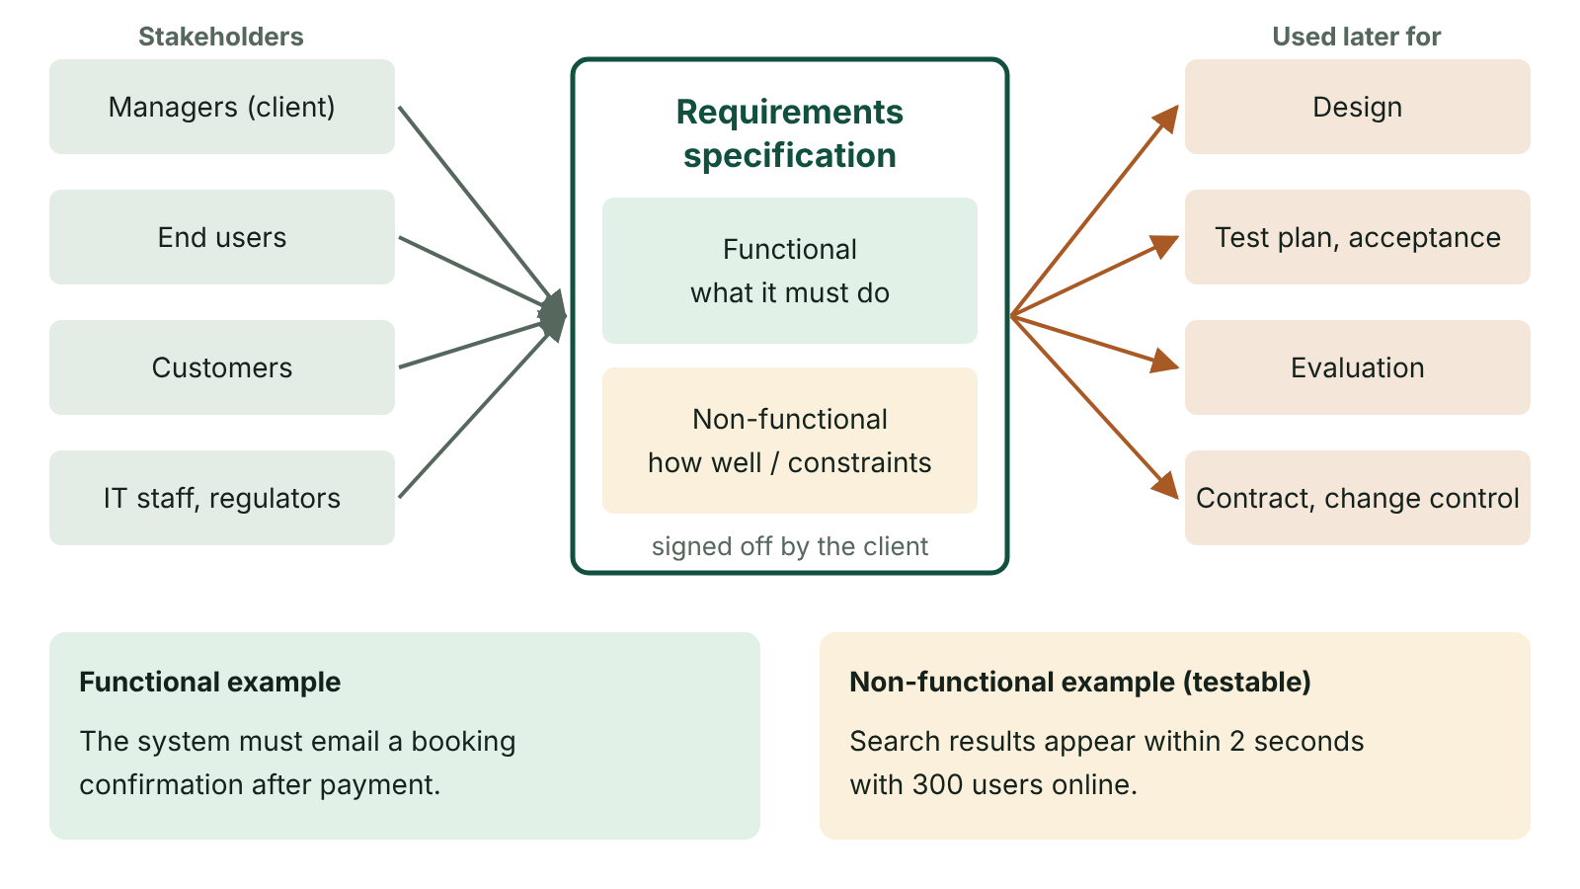
The big picture
Stakeholders supply requirements to the requirements specification, which is then used for design, testing, evaluation and as a contract
☰ Menu
Notes:
Explain the diagram in your own words before you read on.

Slide 33
Stakeholders
A stakeholder is any person or group with an interest in a system or affected by it
Internal: the client or senior managers who commission and pay, the end users who operate it, the IT staff who support it
External: customers, suppliers, shareholders, and regulators such as the Information Commission (formerly the ICO) or HMRC
Stakeholders often want different things: managers want reports, users want speed, customers want convenience
The analyst must identify, record and balance these needs; involving users early reduces resistance to change
☰ Menu

Slide 34
From fact-finding to requirements
After fact-finding, the analyst turns the evidence into a list of user requirements
Requirements are agreed with the client and written up in the system specification
Each requirement is either functional (what the system does) or non-functional (how well, or under what conditions)
Requirements should be stated from a clear perspective: what the organisation needs is not always what customers need
Every requirement should later be testable, so that the finished system can be checked against it
☰ Menu

Slide 35
Functional requirements
Describe what the system must do or allow: its functions, inputs, processing and outputs
Usually written as 'The system must/should allow…' or 'The system must produce…'
Example: 'The system must allow authorised finance staff to create and print invoices.'
Example: 'The system must alert the manager when stock of an item falls to its reorder level.'
Example: 'The system must allow staff to back up transactions on demand as well as automatically.'
☰ Menu

Slide 36
Non-functional requirements
Describe conditions or constraints on how the system behaves, not the behaviour itself
They specify the quality attributes used to judge the system
Performance: response times, throughput, processor and memory use, e.g. 'search results within 2 seconds'
Availability and reliability: e.g. 'available 24/7 apart from a weekly 1-hour maintenance window'
Security: who has access, priorities, password rules, backup frequency
Others: usability, accessibility, capacity (simultaneous users), maintainability, legal compliance
☰ Menu

Slide 37
Worked example: stock control (hardware merchant, Newry)
Functional: the system must… | Non-functional: the system must…
record current stock levels of every item, including items on order | show stock figures that are accurate to the latest transaction
record the date each batch arrives so oldest stock is sold first (FIFO) | be available during all trading hours
alert staff when any item reaches its reorder level | be accessible only to staff with a valid login
produce reports such as slow-moving stock and weekly sales | be backed up automatically every night
generate purchase orders for suppliers | support at least 10 users at the same time
☰ Menu

Slide 38
Worked example: reservation (ferry company, two perspectives) (1 of 2)
Perspective | Functional | Non-functional
Ferry company | Show sailings that match the customer's date, route and vehicle | Restrict booking-management screens to authorised staff
Ferry company | Raise fares automatically as a sailing nears capacity | Handle many simultaneous bookings without double-selling space
Ferry company | Keep a booking history for each registered member | Be backed up daily
Customer | Choose a cabin or seat and pay by card | Confirm a booking within a few seconds
Customer | Receive a confirmation email with booking reference | Keep card and personal data secure
☰ Menu

Slide 39
Worked example: reservation (ferry company, two perspectives) (2 of 2)
Perspective | Functional | Non-functional
Customer | Log in to amend or cancel a booking | Work on a mobile phone and meet accessibility standards
☰ Menu

Slide 40
Payroll and billing requirements (1 of 2)
System | Functional examples | Non-functional examples
Payroll | Add, edit and remove employees | Only payroll staff can view salary data
Payroll | Enter hours worked and calculate gross pay, tax, National Insurance and net pay | Complete the monthly pay run within one hour
Payroll | Produce payslips and send pay details to HMRC | Comply with UK GDPR and current tax rules
Billing | Calculate each customer's bill from usage and tariff, adding VAT | Produce all monthly bills overnight
Billing | Send bills by email or post and record payments received | Calculations must be 100% accurate
☰ Menu

Slide 41
Payroll and billing requirements (2 of 2)
System | Functional examples | Non-functional examples
Billing | Send reminders for unpaid bills after 30 days | Card payments processed securely to industry standards
☰ Menu

Slide 42
Writing good requirements
Specific and measurable so it can be tested: not 'fast' but 'loads in under 3 seconds with 200 users'
Bad: 'The system should be user friendly.' Better: 'A new receptionist can make a booking after 20 minutes' training.'
Unambiguous and traceable to the stakeholder who asked for it
Prioritised, e.g. MoSCoW: Must have, Should have, Could have, Won't have this time
Testable requirements become acceptance criteria and drive the test plan
☰ Menu

Slide 43
Classify it: functional or non-functional?
Requirement (GP surgery appointments system) | Type
Patients can book an appointment online | Functional
Reception can print the day's appointment list for each doctor | Functional
The system sends an SMS reminder the day before | Functional
Pages load within 3 seconds at peak times on Monday mornings | Non-functional (performance)
Patient records are visible only to clinical staff | Non-functional (security)
The online booking service is available 99.5% of the time | Non-functional (availability)
☰ Menu

Slide 44
The system specification
The document produced at the end of analysis, setting out precisely what the client expects the system to do
Contents: scope and objectives, summary of the current system and its problems, stakeholders
Also: functional and non-functional requirements, data requirements, DFDs, constraints such as budget, hardware and timescale
Includes a schedule for development and is signed off by the client
Used later to guide design, to write the test plan and to evaluate the finished system
☰ Menu

Slide 45
Specification as a contract: then and now
Traditionally the specification formed the basis of a binding contract between client and supplier
Two-way: the client could not later demand extra features; the supplier had to deliver what was specified
Changes meant penalties or extra charges, so wording had to be precise and understood by both sides
This suited a small number of suppliers who could plan staff and timescales well in advance
Today there are many more suppliers and Agile methods are common, so specifications are less rigid
Modern specifications build in ways to change requirements, e.g. change control and regular reprioritisation
☰ Menu

Slide 46
Common pitfalls
Giving hardware as a requirement ('a laser printer') instead of what the system must do or achieve
Mixing up types: 'The system must back up data' is functional; 'back up every night' adds a non-functional condition
Vague qualities ('quick', 'secure', 'easy') without a measure or detail
Ignoring the stated perspective: the question may ask for the organisation's needs, not the customer's
Generic answers not linked to the scenario's system, e.g. a payroll answer that mentions stock
☰ Menu

Slide 47
Exit quiz: question 1 of 9
Tap an answer to check it. Presenting? Click to reveal the answer.
A cinema is developing a new online booking system. Which of these is a non-functional requirement?
A Customers can choose their seats
B The system prints a ticket
✗
✗
C Booking pages load within 2 seconds when 1,000 users are online
D Staff can add new film showings
✓
✗
✓ C: Booking pages load within 2 seconds when 1,000 users are online – It sets a performance standard rather than describing a function.
☰ Menu

Slide 48
Exit quiz: question 2 of 9
Tap an answer to check it. Presenting? Click to reveal the answer.
What is the main document produced at the end of the analysis stage?
A The test plan
B The user guide
✗
✗
C The source code
D The system specification
✗
✓
✓ D: The system specification – It records the agreed requirements, scope and constraints.
☰ Menu

Slide 49
Exit quiz: question 3 of 9
Tap an answer to check it. Presenting? Click to reveal the answer.
Which is a functional requirement of a payroll system?
A Calculate each employee's net pay
B Only payroll staff can log in
✓
✗
C Back up every night
D Run on the existing network
✗
✗
✓ A: Calculate each employee's net pay – It describes something the system must do.
☰ Menu

Slide 50
Exit quiz: question 4 of 9
Tap an answer to check it. Presenting? Click to reveal the answer.
Which is the best-written requirement?
A The system should be quick
B The system should look good
✗
✗
C Staff can log in
D A member can book a class in no more than three clicks
✗
✓
✓ D: A member can book a class in no more than three clicks – It is specific and measurable, so it can be tested.
☰ Menu

Slide 51
Exit quiz: question 5 of 9
Tap an answer to check it. Presenting? Click to reveal the answer.
MoSCoW is used to…
A test code
B prioritise requirements
✗
✓
C draw DFDs
D estimate payback
✗
✗
✓ B: prioritise requirements – It sorts requirements into Must, Should, Could and Won't have this time.
☰ Menu

Slide 52
Exit quiz: question 6 of 9
Tap an answer to check it. Presenting? Click to reveal the answer.
Which group are the end users of a hospital's ward system?
A The nurses and doctors who use it daily
B The hospital's shareholders
✓
✗
C The software developers
D The Information Commission
✗
✗
✓ A: The nurses and doctors who use it daily – End users interact with the system directly in their work.
☰ Menu

Slide 53
Exit quiz: question 7 of 9
Tap an answer to check it. Presenting? Click to reveal the answer.
Why were system specifications traditionally written very precisely?
A They were published to the public
B They formed the basis of a contract, and changes led to penalties or extra charges
✗
✓
C They were used as user manuals
D They replaced testing
✗
✗
✓ B: They formed the basis of a contract, and changes led to penalties or extra charges – Both sides had to understand exactly what was agreed.
☰ Menu

Slide 54
Exit quiz: question 8 of 9
Tap an answer to check it. Presenting? Click to reveal the answer.
Which of these is a non-functional requirement for a stock control system?
A Alert staff when stock reaches the reorder level
B Produce a slow-moving stock report
✗
✗
C Allow only warehouse staff to change stock levels
D Record goods received
✓
✗
✓ C: Allow only warehouse staff to change stock levels – Access restrictions are a security condition, not a function.
☰ Menu

Slide 55
Exit quiz: question 9 of 9
Tap an answer to check it. Presenting? Click to reveal the answer.
A question asks for requirements 'from the airline's perspective'. Which answer fits best?
A Choose a seat on the plane
B Monitor current bookings on every flight
✗
✓
C Receive a confirmation email
D Pay by debit card
✗
✗
✓ B: Monitor current bookings on every flight – Monitoring bookings meets the airline's needs; the others are what customers want.
☰ Menu

Slide 56
Exit quiz answers
Q | Answer | Why
1 | C Booking pages load within 2 seconds when 1,000 users are online | It sets a performance standard rather than describing a function.
2 | D The system specification | It records the agreed requirements, scope and constraints.
3 | A Calculate each employee's net pay | It describes something the system must do.
4 | D A member can book a class in no more than three clicks | It is specific and measurable, so it can be tested.
5 | B prioritise requirements | It sorts requirements into Must, Should, Could and Won't have this time.
6 | A The nurses and doctors who use it daily | End users interact with the system directly in their work.
7 | B They formed the basis of a contract, and changes led to penalties or extra charges | Both sides had to understand exactly what was agreed.
8 | C Allow only warehouse staff to change stock levels | Access restrictions are a security condition, not a function.
9 | B Monitor current bookings on every flight | Monitoring bookings meets the airline's needs; the others are what customers want.
☰ Menu

Slide 57
Data flow diagrams
AS 1: APPROACHES TO SYSTEMS DEVELOPMENT · AP05
Learning objectives
Explain why DFDs are used during analysis and who benefits from them
Name, draw and identify each DFD element, including duplicated entities
Draw a context diagram and a balanced Level 1 DFD from a written scenario
Spot errors in a DFD and explain how to correct them
Notes:
Specification: Explain the purpose of a data flow diagram (DFD) and its advantages | Identify and use the standard DFD elements: external entities (sources and sinks), processes, data stores and data flows | Produce a context diagram (Level 0 DFD) for a simple scenario | Produce a Level 1 DFD by exploding a context diagram, maintaining consistency between levels | Interpret DFDs and identify and correct errors using the rules for valid DFDs

Slide 58
In this lesson
Tap a button to jump straight there. The ☰ Menu button on every slide brings you back here.
The big picture
Context diagram (Level 0)
Spot the error
What is a data flow diagram?
Worked example: bike hire context diagram
How to draw a DFD from a scenario
Purpose and advantages of DFDs
Level 1 DFD: exploding the process
Exit quiz
The DFD elements (CCEA textbook notation)
Worked example: bike hire Level 1 flows
↑ Topic menu
Sources, sinks and the system boundary
Checking the worked example balances
Levels and granularity
Rules for valid DFDs
Notes:
Lesson menu: each button jumps to that part of the lesson in Slide Show. The ☰ Menu button on each slide returns here.

Slide 59
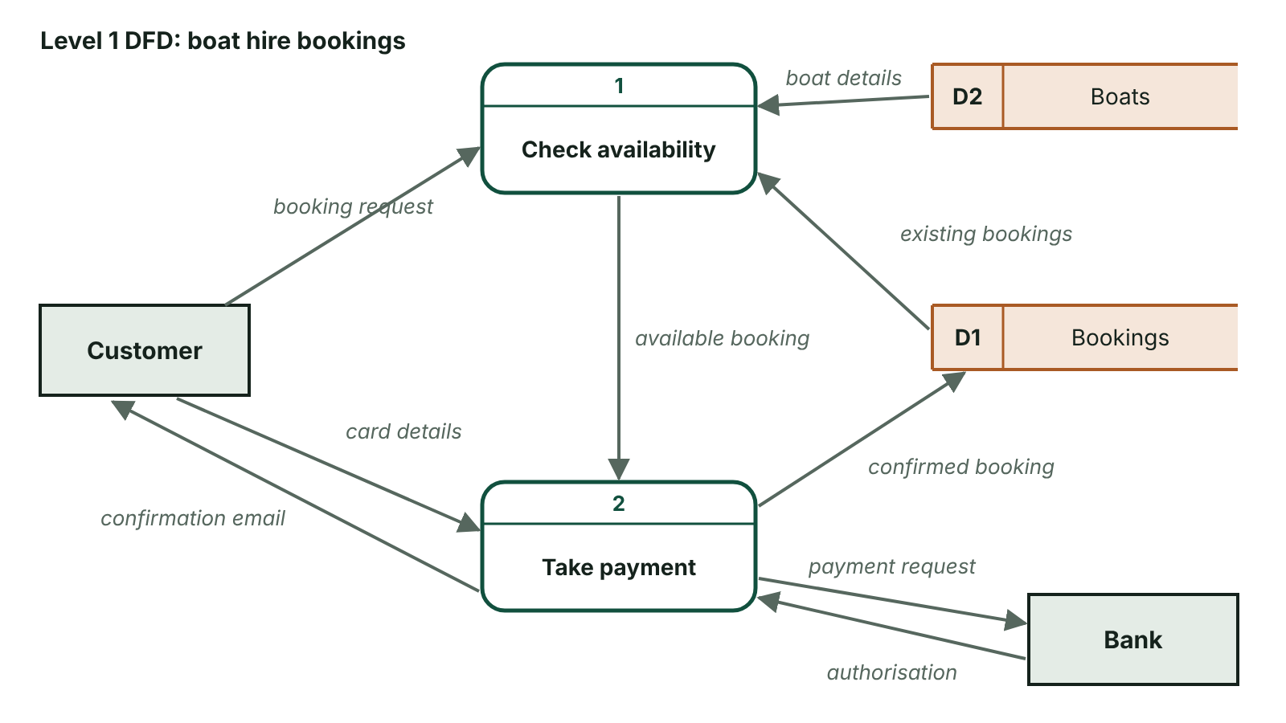
The big picture
A level 1 data flow diagram for a boat hire booking system with external entities, numbered processes, data stores and labelled data flows
☰ Menu
Notes:
Explain the diagram in your own words before you read on.

Slide 60
What is a data flow diagram?
A diagram that models how data moves through a system: where it comes from, how it is processed, where it is stored and where it goes
Data enters from outside, processes act on it, and new data flows back out
Shows data, not the order of events or decisions, so it is not a flowchart
Used during analysis to model the current system and agree the requirements for the new one
Uses only a few symbols, so users with little technical knowledge can understand and check it
☰ Menu

Slide 61
Purpose and advantages of DFDs
Give a clear visual (graphical) representation of a system
Show the system at different levels of detail, from an overview down to sub-systems
Show how the system interacts with external entities and define its boundary
Identify the processes and data stores the new system will need
Create a shared, agreed understanding between analyst, client and users
Help reveal bottlenecks, duplicated work and problem data flows in the current system
☰ Menu

Slide 62
The DFD elements (CCEA textbook notation) (1 of 2)
Element | Drawn as | Meaning | Example
External entity (source or sink) | Ellipse with its name | Person, organisation or system outside the boundary that supplies or receives data | Customer, Supplier, HMRC
Duplicated external entity | Ellipse with a short diagonal line | The same entity drawn again to avoid crossing lines | Customer shown twice
Process | Rectangle with a numbered strip at the top | An action that transforms input data into output data | 1.0 Validate order
Data store | Open-ended rectangle with an ID box (D1, D2…) | Data held for later use, such as a file or table | D1 Stock file
☰ Menu

Slide 63
The DFD elements (CCEA textbook notation) (2 of 2)
Element | Drawn as | Meaning | Example
Data flow | Arrow labelled with the data it carries | Data moving between the other elements | Customer order, Invoice
☰ Menu

Slide 64
Sources, sinks and the system boundary
External entities lie outside the system: the system does not control them
A source supplies data to the system, e.g. a customer placing an order
A sink receives data from the system, e.g. a warehouse receiving dispatch details
Many entities are both: a customer sends an order (source) and receives an invoice (sink)
Other notations draw entities as squares and processes as rounded rectangles; label your diagram clearly whichever you use
☰ Menu

Slide 65
Levels and granularity
DFDs can be drawn with coarse or fine granularity (level of detail)
Context diagram (Level 0): the whole system as one process, giving a high-level overview
Level 1: the single process is exploded into its main sub-processes, numbered 1.0, 2.0, 3.0…
Level 2 and below explode a Level 1 process further (e.g. 2.1, 2.2); CCEA AS requires only Level 0 and Level 1
Each lower level shows part or all of the level above in more detail, and must stay consistent with it
☰ Menu

Slide 66
Context diagram (Level 0)
Exactly one process, representing the whole system, usually numbered 0
All the external entities that the system exchanges data with
Every data flow between those entities and the system, each labelled
Data stores are normally left out (use them very sparingly at this level)
Defines the scope and boundary of the system; most useful for managers wanting an overview
☰ Menu

Slide 67
Worked example: bike hire context diagram
Scenario: Mourne Bike Hire takes online bookings | Data flow | Direction
Customer → 0 Bike Hire System | Hire request | Into system
Customer → 0 Bike Hire System | Card details | Into system
0 Bike Hire System → Customer | Unavailable message / Hire confirmation | Out of system
0 Bike Hire System → Card Payment Provider | Payment request | Out of system
Card Payment Provider → 0 Bike Hire System | Payment authorisation | Into system
0 Bike Hire System → Manager | Weekly hire report | Out of system
☰ Menu

Slide 68
Level 1 DFD: exploding the process
Replace the single process with the main sub-processes, each with a number and a verb-phrase name
Add the data stores the processes need (D1, D2…) and the flows to and from them
Add flows between processes where one passes data to the next
Keep the same external entities: they are outside the system so they do not change
Balancing: every flow into or out of the system at Level 0 must appear at Level 1, with the same name
☰ Menu

Slide 69
Worked example: bike hire Level 1 flows (1 of 2)
From | Data flow | To
Customer | Hire request | 1.0 Check availability
D1 Bikes file | Bike availability | 1.0 Check availability
1.0 Check availability | Unavailable message | Customer
1.0 Check availability | Available hire details | 2.0 Process payment
Customer / Card Payment Provider | Card details / Payment authorisation | 2.0 Process payment
2.0 Process payment | Payment request / Hire confirmation / Hire record / Bike status | Card Payment Provider / Customer / D2 Hires file / D1 Bikes file
☰ Menu

Slide 70
Worked example: bike hire Level 1 flows (2 of 2)
From | Data flow | To
D2 Hires file → 3.0 Produce report | Hire details → Weekly hire report | 3.0 Produce report → Manager
☰ Menu

Slide 71
Checking the worked example balances
Same three entities at both levels: Customer, Card Payment Provider, Manager
All seven external flows from the context diagram reappear at Level 1 with identical labels
New at Level 1: processes 1.0, 2.0, 3.0, stores D1 and D2, and internal flows between them
Each process has at least one input and one output; each store is both written to and read from
Not shown: credit checks, cancellations, adding new bikes; a real system would need more processes
☰ Menu

Slide 72
Rules for valid DFDs
Every data flow must start or end at a process: no entity-to-entity, store-to-store or entity-to-store flows
Every process must have at least one input and at least one output
Every data store should have data flowing in (written) and out (read) somewhere in the system
Label every flow with a noun phrase naming the data, e.g. 'Order details', not 'send'
Name processes with a verb phrase, e.g. 'Check availability'; number processes and stores uniquely
☰ Menu

Slide 73
Spot the error (1 of 2)
Error seen on a DFD | Rule broken | Correction
Customer → D1 Orders, labelled 'Order' | Data cannot pass from an entity straight to a store | Route it through a process, e.g. 1.0 Record order
D1 Stock → D2 Reorders | Data cannot flow store to store | Insert a process, e.g. 3.0 Check reorder levels
Process 2.0 has inputs but no outputs | A process must transform data and output something | Add the missing output flow
An unlabelled arrow | Every flow must name the data it carries | Label it, e.g. 'Payment details'
Level 1 omits 'Invoice' shown at Level 0 | Levels do not balance | Add the Invoice flow from the relevant Level 1 process
☰ Menu

Slide 74
Spot the error (2 of 2)
Error seen on a DFD | Rule broken | Correction
Process named 'Customer' | Processes are actions | Rename with a verb, e.g. 'Register customer'
☰ Menu

Slide 75
How to draw a DFD from a scenario
Read the scenario twice; underline people and organisations outside the system (entities)
Circle verbs describing actions on data (processes) and nouns for stored records (data stores)
Draw the context diagram first: one process, all entities, all external flows
Explode into 2–4 processes, add stores and internal flows, then check balancing and every rule
Use the scenario's own names for entities and data; neat, labelled diagrams earn the marks
☰ Menu

Slide 76
Exit quiz: question 1 of 9
Tap an answer to check it. Presenting? Click to reveal the answer.
In a DFD for a garage's booking system, a car owner sends booking requests and receives confirmations. What is the car owner?
A A process
B A data store
✗
✗
C An external entity that is both a source and a sink
D A data flow
✓
✗
✓ C: An external entity that is both a source and a sink – They are outside the system, supplying data (source) and receiving data (sink).
☰ Menu

Slide 77
Exit quiz: question 2 of 9
Tap an answer to check it. Presenting? Click to reveal the answer.
How many processes does a context diagram contain?
A One
B Two
✓
✗
C None
D As many as needed
✗
✗
✓ A: One – The whole system is shown as a single process.
☰ Menu

Slide 78
Exit quiz: question 3 of 9
Tap an answer to check it. Presenting? Click to reveal the answer.
Which flow is invalid?
A Customer → 1.0 Take order
B 1.0 Take order → D1 Orders
✗
✗
C D1 Orders → D2 Stock
D D2 Stock → 2.0 Reorder
✓
✗
✓ C: D1 Orders → D2 Stock – Data cannot pass directly from one data store to another; it must go through a process.
☰ Menu

Slide 79
Exit quiz: question 4 of 9
Tap an answer to check it. Presenting? Click to reveal the answer.
A good name for a process is…
A Orders
B Customer
✗
✗
C Data
D Calculate invoice total
✗
✓
✓ D: Calculate invoice total – Processes are actions, so they are named with a verb phrase.
☰ Menu

Slide 80
Exit quiz: question 5 of 9
Tap an answer to check it. Presenting? Click to reveal the answer.
Breaking the single process of a context diagram into its main sub-processes is described as…
A normalising the diagram
B exploding (decomposing) the process
✗
✓
C balancing the entities
D iterating the flows
✗
✗
✓ B: exploding (decomposing) the process – The single process is exploded into sub-processes.
☰ Menu

Slide 81
Exit quiz: question 6 of 9
Tap an answer to check it. Presenting? Click to reveal the answer.
What does 'balancing' mean for DFDs?
A Each level has the same number of processes
B The external data flows at one level also appear at the next level
✗
✓
C Every store has two flows
D Entities are drawn the same size
✗
✗
✓ B: The external data flows at one level also appear at the next level – Inputs to and outputs from the system must be consistent between levels.
☰ Menu

Slide 82
Exit quiz: question 7 of 9
Tap an answer to check it. Presenting? Click to reveal the answer.
Which element is usually omitted from a context diagram?
A External entities
B Data flows
✗
✗
C The process
D Data stores
✗
✓
✓ D: Data stores – The context diagram defines the boundary, so stores are left out or used very sparingly.
☰ Menu

Slide 83
Exit quiz: question 8 of 9
Tap an answer to check it. Presenting? Click to reveal the answer.
On a Level 1 DFD, what is new compared with the context diagram?
A Sub-processes, data stores and internal flows
B New external entities
✓
✗
C Removal of all flows
D Decisions and loops
✗
✗
✓ A: Sub-processes, data stores and internal flows – Level 1 adds internal detail while keeping the same entities and external flows.
☰ Menu

Slide 84
Exit quiz: question 9 of 9
Tap an answer to check it. Presenting? Click to reveal the answer.
Which of these is a benefit of DFDs mentioned in mark schemes?
A They show the exact program code
B They give a visual representation that non-specialists can understand
✗
✓
C They replace the need for testing
D They show the timing of every event
✗
✗
✓ B: They give a visual representation that non-specialists can understand – Their simple symbols make them easy for clients and users to check.
☰ Menu

Slide 85
Exit quiz answers
Q | Answer | Why
1 | C An external entity that is both a source and a sink | They are outside the system, supplying data (source) and receiving data (sink).
2 | A One | The whole system is shown as a single process.
3 | C D1 Orders → D2 Stock | Data cannot pass directly from one data store to another; it must go through a process.
4 | D Calculate invoice total | Processes are actions, so they are named with a verb phrase.
5 | B exploding (decomposing) the process | The single process is exploded into sub-processes.
6 | B The external data flows at one level also appear at the next level | Inputs to and outputs from the system must be consistent between levels.
7 | D Data stores | The context diagram defines the boundary, so stores are left out or used very sparingly.
8 | A Sub-processes, data stores and internal flows | Level 1 adds internal detail while keeping the same entities and external flows.
9 | B They give a visual representation that non-specialists can understand | Their simple symbols make them easy for clients and users to check.
☰ Menu

