Slide 1
Networks
A2 1: INFORMATION SYSTEMS · TOPIC
Lessons in this topic
IS09 Network types, topologies and hardware
IS10 Layered network models and protocols
IS11 IP addressing, switching and routing
IS12 Data transmission and error control

Slide 2

Topic menu
Tap a button to jump straight there. The ☰ Menu button on every slide brings you back here.
Specification map
IS11 IP addressing, switching and routing
IS09 Network types, topologies and hardware
IS12 Data transmission and error control
IS10 Layered network models and protocols

Slide 3
Specification map
Lesson | Specification: students should be able to
IS09 | Describe LAN, WAN, PAN and MAN networks; Compare bus, star, ring and mesh topologies; Describe the function of network hardware: NIC, switch, router, wireless access point and gateway
IS10 | Explain why layered models are used in networking; Describe the layers of the OSI and TCP/IP models; Describe the purpose of common protocols: HTTP/HTTPS, FTP, SMTP, POP3, IMAP, TCP, UDP, IP, Ethernet and Wi-Fi
IS11 | Describe IPv4 and IPv6 addressing, public and private addresses and the purpose of subnetting; Explain the roles of DHCP and NAT; Compare packet switching and circuit switching; Describe how routing works
IS12 | Compare transmission media; Distinguish bandwidth and bit rate and explain broadband; Compare serial and parallel, simplex, half-duplex and full-duplex, and synchronous and asynchronous transmission; Describe error detection (parity, checksum, CRC) and correction (ARQ)
☰ Menu
Notes:
Each lesson below is its own section in PowerPoint (View → Slide Sorter shows them). To split this deck by specification point, right-click a section → Move Section, or delete the sections you do not need.

Slide 4
Network types, topologies and hardware
A2 1: INFORMATION SYSTEMS · IS09
Learning objectives
Distinguish network types by geographical scale and ownership
Evaluate the four main topologies for a given scenario
Explain the role of each item of network hardware in moving data
Notes:
Specification: Describe LAN, WAN, PAN and MAN networks | Compare bus, star, ring and mesh topologies | Describe the function of network hardware: NIC, switch, router, wireless access point and gateway

Slide 5
In this lesson
Tap a button to jump straight there. The ☰ Menu button on every slide brings you back here.
The big picture
Network hardware
Network types by scale
Hub vs switch vs router
Bus and ring
Applying it: Erne Valley Hotel
Star and mesh
Exit quiz
Topology comparison
↑ Topic menu
Notes:
Lesson menu: each button jumps to that part of the lesson in Slide Show. The ☰ Menu button on each slide returns here.

Slide 6
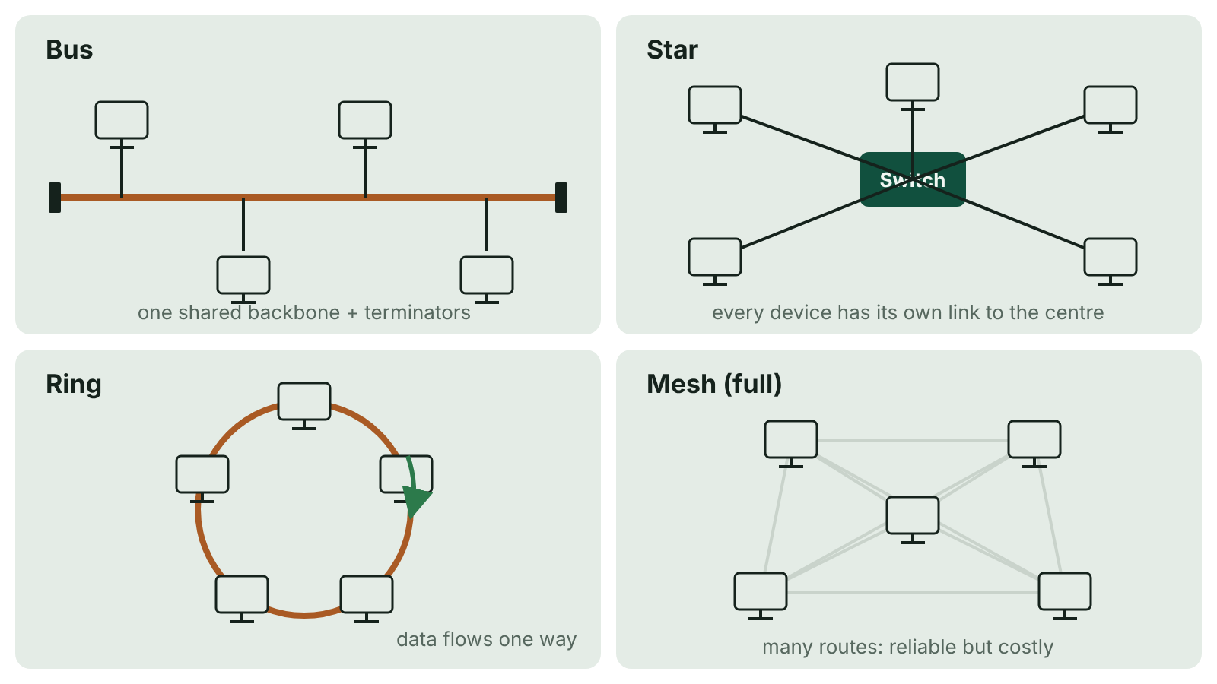
The big picture
The four network topologies: bus with a shared backbone, star with a central switch, ring as a closed loop, and mesh with multiple links
☰ Menu
Notes:
Explain the diagram in your own words before you read on.

Slide 7
Network types by scale
Type | Area covered | Ownership / infrastructure | Example
PAN – personal area network | A few metres around one person | Owned by the user; Bluetooth | Phone, earbuds and smartwatch
LAN – local area network | One site or building | Owned by the organisation | A school network in Enniskillen
MAN – metropolitan area network | A town or city | Often a council, university or provider | A city-wide fibre network linking Belfast council buildings
WAN – wide area network | Countries or the world | Uses leased lines and third-party telecoms links | A bank linking branches; the internet
☰ Menu

Slide 8
Bus and ring
Bus: all devices share a single backbone cable with terminators at each end; only one device can transmit successfully at a time.
Bus: cheap and easy to extend, but collisions increase with traffic and a backbone break stops the network.
Ring: each device connects to two neighbours in a closed loop; data passes in one direction from node to node.
Ring: no collisions and predictable performance, but a single break or failed node can stop the ring (unless dual ring).
Both are now rare in LANs but help explain shared media and token passing.
☰ Menu

Slide 9
Star and mesh
Star: every device has its own cable to a central switch.
Star: a cable fault affects only one device and the switch sends data only to the destination, so performance is good; but the switch is a single point of failure and needs more cable.
Mesh: devices have multiple connections; in a full mesh every node links to every other.
Mesh: many routes, so very reliable and data can be rerouted; but expensive in cabling and configuration.
The internet backbone is a partial mesh; wireless mesh systems extend Wi-Fi in homes.
☰ Menu

Slide 10
Topology comparison
Topology | Reliability | Performance | Cost | Typical use
Bus | Backbone is a single point of failure | Falls with traffic (collisions) | Low | Small, temporary networks
Star | Switch is a single point of failure; cable faults isolated | High, switched | Medium | Almost all modern LANs
Ring | One break can stop it | Predictable, no collisions | Medium | Some legacy and metropolitan fibre rings
Mesh | Very high: alternative routes | High | High | WAN and internet backbones, IoT
☰ Menu

Slide 11
Network hardware
Device | Function
NIC – network interface card | Connects a device to the network; has a unique MAC address; converts data into signals for the medium
Switch | Connects devices in a LAN; learns MAC addresses and forwards frames only to the destination port
Router | Connects different networks; uses IP addresses and routing tables to forward packets along the best route
WAP – wireless access point | Lets wireless devices join a wired LAN using Wi-Fi
Gateway | Connects networks that use different protocols, translating between them
☰ Menu

Slide 12
Hub vs switch vs router
A hub broadcasts every frame to every port, wasting bandwidth and creating collisions.
A switch is intelligent: it uses MAC addresses to send each frame only where it is needed.
A router works with IP addresses and joins networks, e.g. the school LAN to the internet.
A home 'router' usually combines a router, switch, WAP, firewall and modem in one box.
☰ Menu

Slide 13
Applying it: Erne Valley Hotel
Star LAN in each building with a switch per floor; fibre between buildings.
WAPs on each floor for guests and staff, on separate networks for security.
A router connects the LAN to the internet service provider (WAN).
Evaluate: star chosen for fault isolation and performance; cost of cabling is justified.
☰ Menu

Slide 14
Exit quiz: question 1 of 5
Tap an answer to check it. Presenting? Click to reveal the answer.
Which network type covers a city?
A PAN
B LAN
✗
✗
C MAN
D WAN
✓
✗
✓ C: MAN – Metropolitan area network.
☰ Menu

Slide 15
Exit quiz: question 2 of 5
Tap an answer to check it. Presenting? Click to reveal the answer.
Which device lets wireless devices join a wired LAN?
A Wireless access point
B Gateway
✓
✗
C Hub
D Repeater
✗
✗
✓ A: Wireless access point – The WAP bridges Wi-Fi and Ethernet.
☰ Menu

Slide 16
Exit quiz: question 3 of 5
Tap an answer to check it. Presenting? Click to reveal the answer.
In which topology does data travel around a loop from node to node?
A Bus
B Star
✗
✗
C Mesh
D Ring
✗
✓
✓ D: Ring – Ring topology.
☰ Menu

Slide 17
Exit quiz: question 4 of 5
Tap an answer to check it. Presenting? Click to reveal the answer.
What is the main weakness of a star topology?
A Collisions on the backbone
B The central switch is a single point of failure
✗
✓
C It cannot be extended
D No device has a MAC address
✗
✗
✓ B: The central switch is a single point of failure – If the switch fails, all devices lose connection.
☰ Menu

Slide 18
Exit quiz: question 5 of 5
Tap an answer to check it. Presenting? Click to reveal the answer.
Which device translates between networks using different protocols?
A Switch
B NIC
✗
✗
C Gateway
D WAP
✓
✗
✓ C: Gateway – Gateways translate protocols.
☰ Menu

Slide 19
Exit quiz answers
Q | Answer | Why
1 | C MAN | Metropolitan area network.
2 | A Wireless access point | The WAP bridges Wi-Fi and Ethernet.
3 | D Ring | Ring topology.
4 | B The central switch is a single point of failure | If the switch fails, all devices lose connection.
5 | C Gateway | Gateways translate protocols.
☰ Menu

Slide 20
Layered network models and protocols
A2 1: INFORMATION SYSTEMS · IS10
Learning objectives
Explain the benefits of a layered approach to network design
Map the OSI model to the TCP/IP model and place protocols in the correct layer
Compare TCP and UDP and choose an appropriate one for an application
Notes:
Specification: Explain why layered models are used in networking | Describe the layers of the OSI and TCP/IP models | Describe the purpose of common protocols: HTTP/HTTPS, FTP, SMTP, POP3, IMAP, TCP, UDP, IP, Ethernet and Wi-Fi

Slide 21
In this lesson
Tap a button to jump straight there. The ☰ Menu button on every slide brings you back here.
The big picture
TCP vs UDP
Protocols and why layers?
Internet and link layers
OSI and TCP/IP models
Worked example: loading a web page
Encapsulation
Exit quiz
Application-layer protocols
↑ Topic menu
Notes:
Lesson menu: each button jumps to that part of the lesson in Slide Show. The ☰ Menu button on each slide returns here.

Slide 22
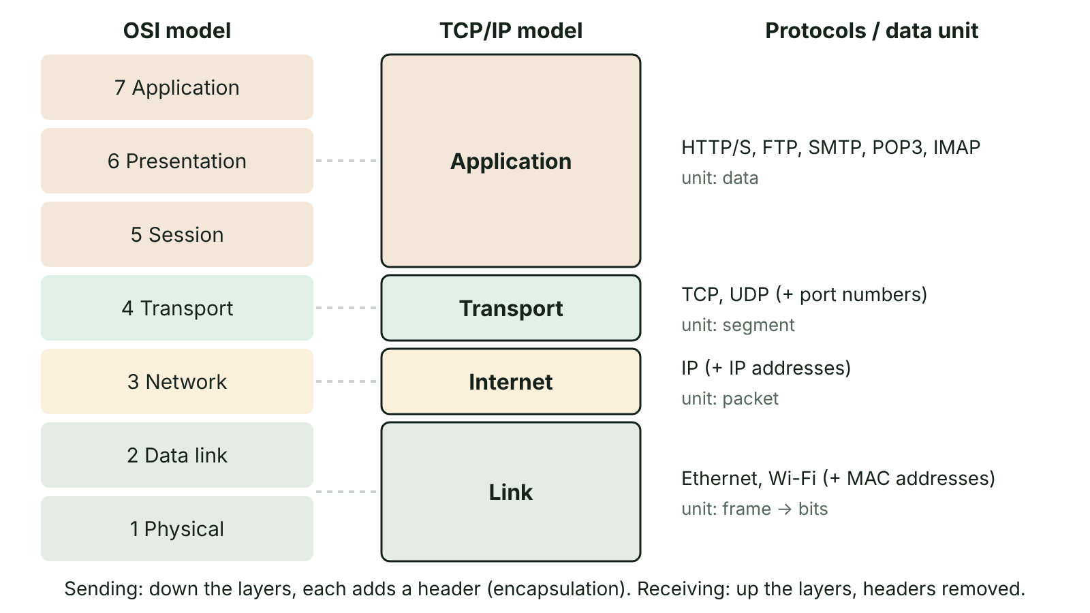
The big picture
The seven OSI layers mapped to the four TCP/IP layers, with example protocols and the header added at each layer during encapsulation
☰ Menu
Notes:
Explain the diagram in your own words before you read on.

Slide 23
Protocols and why layers?
A protocol is a set of rules governing how data is formatted, transmitted and received.
A layered model splits the complex task of communication into layers, each with one job.
Each layer provides a service to the layer above and uses the layer below; layers communicate through standard interfaces.
Benefits: a layer can be changed (e.g. Wi-Fi replaces Ethernet) without affecting the others; easier to design, teach and troubleshoot; manufacturers can build to open standards so equipment interoperates.
Drawback: some overhead, as each layer adds its own header.
☰ Menu

Slide 24
OSI and TCP/IP models
OSI layer | Job | TCP/IP layer
7 Application | Network services to applications | Application
6 Presentation | Data format, encryption, compression | Application
5 Session | Opens, manages and closes sessions | Application
4 Transport | End-to-end delivery, segmentation, ports, reliability | Transport
3 Network | Logical addressing (IP) and routing | Internet
2 Data link | Frames, MAC addresses, error detection on a link | Link (network access)
1 Physical | Bits as signals on cable or radio | Link (network access)
☰ Menu

Slide 25
Encapsulation
On the sending device data moves down the layers; each layer adds a header (and sometimes a trailer).
Application data → transport segment (ports) → network packet (IP addresses) → data link frame (MAC addresses) → bits.
On the receiving device each layer strips its own header and passes the rest up.
Each layer talks logically to the same layer on the other device (peer-to-peer communication).
☰ Menu

Slide 26
Application-layer protocols
Protocol | Purpose | Port
HTTP | Request and transfer web pages between browser and server | 80
HTTPS | HTTP encrypted using TLS, so data cannot be read or altered in transit | 443
FTP | Transfer files between client and server (upload and download) | 20/21
SMTP | Send email from client to server and between mail servers | 25/587
POP3 | Download email to one device, usually deleting it from the server | 110
IMAP | Access email kept on the server, synchronised across devices | 143
☰ Menu

Slide 27
TCP vs UDP
Feature | TCP | UDP
Connection | Connection-oriented (handshake first) | Connectionless
Reliability | Acknowledgements, retransmission of lost segments | No guarantee of delivery
Order | Segments reassembled in order using sequence numbers | May arrive out of order
Speed and overhead | Slower, larger header | Faster, small header
Used for | Web, email, file transfer | Live streaming, online games, VoIP, DNS lookups
☰ Menu

Slide 28
Internet and link layers
IP (Internet Protocol): addresses packets with source and destination IP addresses and routes them across networks; best-effort delivery.
Ethernet: the standard wired LAN protocol; defines frames, MAC addressing and cabling standards.
Wi-Fi (IEEE 802.11): wireless LAN protocol; uses radio frequencies such as 2.4 GHz and 5 GHz.
Together the 'TCP/IP stack' combines TCP or UDP at transport with IP at the internet layer.
☰ Menu

Slide 29
Worked example: loading a web page
Application: browser sends an HTTPS GET request for a page.
Transport: TCP splits it into segments, adds source and destination ports (443) and sequence numbers.
Internet: IP adds source and destination IP addresses to make packets; routers forward them.
Link: Ethernet or Wi-Fi adds MAC addresses to make frames for each hop; bits are sent as signals.
☰ Menu

Slide 30
Exit quiz: question 1 of 5
Tap an answer to check it. Presenting? Click to reveal the answer.
Which protocol sends email between mail servers?
A IMAP
B POP3
✗
✗
C SMTP
D FTP
✓
✗
✓ C: SMTP – Simple Mail Transfer Protocol.
☰ Menu

Slide 31
Exit quiz: question 2 of 5
Tap an answer to check it. Presenting? Click to reveal the answer.
Which OSI layer deals with MAC addresses and frames?
A Data link
B Network
✓
✗
C Transport
D Session
✗
✗
✓ A: Data link – Layer 2.
☰ Menu

Slide 32
Exit quiz: question 3 of 5
Tap an answer to check it. Presenting? Click to reveal the answer.
Live voice calls usually use UDP because…
A it guarantees delivery
B low delay matters more than the odd lost packet
✗
✓
C it encrypts data
D it uses MAC addresses
✗
✗
✓ B: low delay matters more than the odd lost packet – Retransmitting old audio is pointless.
☰ Menu

Slide 33
Exit quiz: question 4 of 5
Tap an answer to check it. Presenting? Click to reveal the answer.
Which TCP/IP layer adds port numbers?
A Link
B Internet
✗
✗
C Application
D Transport
✗
✓
✓ D: Transport – Ports identify the application at each end.
☰ Menu

Slide 34
Exit quiz: question 5 of 5
Tap an answer to check it. Presenting? Click to reveal the answer.
A key benefit of layering is that…
A it removes the need for protocols
B one layer can be changed without affecting the others
✗
✓
C data no longer needs headers
D networks need no hardware
✗
✗
✓ B: one layer can be changed without affecting the others – Layers are independent.
☰ Menu

Slide 35
Exit quiz answers
Q | Answer | Why
1 | C SMTP | Simple Mail Transfer Protocol.
2 | A Data link | Layer 2.
3 | B low delay matters more than the odd lost packet | Retransmitting old audio is pointless.
4 | D Transport | Ports identify the application at each end.
5 | B one layer can be changed without affecting the others | Layers are independent.
☰ Menu

Slide 36
IP addressing, switching and routing
A2 1: INFORMATION SYSTEMS · IS11
Learning objectives
Explain the structure of IPv4 and IPv6 addresses and why IPv6 was introduced
Explain how DHCP, NAT and subnetting are used in an organisation's network
Compare packet and circuit switching and describe how routers forward packets
Notes:
Specification: Describe IPv4 and IPv6 addressing, public and private addresses and the purpose of subnetting | Explain the roles of DHCP and NAT | Compare packet switching and circuit switching | Describe how routing works

Slide 37
In this lesson
Tap a button to jump straight there. The ☰ Menu button on every slide brings you back here.
The big picture
Circuit switching vs packet switching
IPv4 and IPv6
Packets and routing
Public and private addresses
Worked calculation
Subnetting
Exit quiz
DHCP and NAT
↑ Topic menu
Notes:
Lesson menu: each button jumps to that part of the lesson in Slide Show. The ☰ Menu button on each slide returns here.

Slide 38
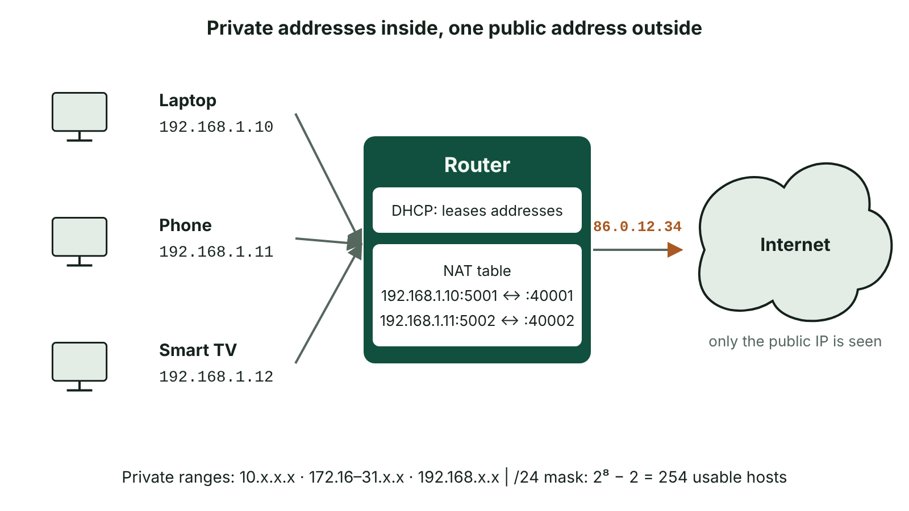
The big picture
A home network where DHCP gives devices private IP addresses and the router uses NAT to share one public IP address with the internet
☰ Menu
Notes:
Explain the diagram in your own words before you read on.

Slide 39
IPv4 and IPv6
Feature | IPv4 | IPv6
Size | 32 bits | 128 bits
Format | Four denary octets, e.g. 192.168.1.20 | Eight groups of four hex digits, e.g. 2001:db8:0:0:0:0:0:1 (shortened 2001:db8::1)
Number of addresses | 2³² ≈ 4.3 billion | 2¹²⁸ ≈ 3.4 × 10³⁸
Why | Original internet standard | IPv4 addresses ran out as devices (phones, IoT) multiplied
☰ Menu

Slide 40
Public and private addresses
Public IP addresses are globally unique and routable on the internet; allocated through ISPs.
Private ranges are reused inside many LANs and are not routed on the internet: 10.0.0.0/8, 172.16.0.0/12, 192.168.0.0/16.
Using private addresses inside organisations conserves scarce public IPv4 addresses.
A device's MAC address identifies its NIC on the local link; its IP address identifies it logically on the network.
☰ Menu

Slide 41
Subnetting
An IP address has a network part and a host part; the subnet mask shows where the split is.
Mask 255.255.255.0 (/24): first 24 bits = network, last 8 bits = host, so 2⁸ − 2 = 254 usable hosts.
Subnetting divides one network into smaller logical networks, e.g. staff, pupils and guests.
Benefits: less broadcast traffic, better security (traffic between subnets passes a router or firewall), easier management.
Hosts on the same subnet communicate directly; others are sent to the default gateway (router).
☰ Menu

Slide 42
DHCP and NAT
Service | What it does | Benefit
DHCP – Dynamic Host Configuration Protocol | Automatically gives a joining device an IP address, subnet mask, default gateway and DNS server, leased for a time | No manual configuration; no duplicate addresses; addresses reused
NAT – network address translation | The router replaces private source addresses with its own public address and tracks connections in a table so replies return to the right device | Many devices share one public IPv4 address; internal addresses are hidden from the internet
☰ Menu

Slide 43
Circuit switching vs packet switching
Feature | Circuit switching | Packet switching
Path | Dedicated path set up for the whole communication | Data split into packets that may take different routes
Resources | Reserved even when silent – wasteful | Links shared by many users – efficient
Delivery | Constant rate, in order, low jitter | Packets may arrive out of order and are reassembled
Failure | Broken link drops the call | Packets rerouted round failures
Example | Traditional landline telephone network | The internet
☰ Menu

Slide 44
Packets and routing
A packet has a header (source and destination IP, sequence number, time to live, protocol) and a payload; a trailer may hold a checksum.
Each router reads the destination IP and looks it up in its routing table to choose the next hop.
Routing tables are updated by routing protocols that share information about routes and congestion.
Time to live (TTL) is reduced at each hop so lost packets are eventually discarded rather than circling forever.
The receiver uses sequence numbers to reassemble packets and requests any that are missing (TCP).
☰ Menu

Slide 45
Worked calculation
A school subnet uses 192.168.10.0 with mask 255.255.255.0.
Host bits = 32 − 24 = 8, so 2⁸ = 256 addresses.
Subtract the network address (.0) and the broadcast address (.255): 254 usable hosts.
If 400 devices must fit, a /23 mask (255.255.254.0) gives 2⁹ − 2 = 510 hosts.
☰ Menu

Slide 46
Exit quiz: question 1 of 5
Tap an answer to check it. Presenting? Click to reveal the answer.
How many usable hosts does a /28 network have?
A 16
B 14
✗
✓
C 28
D 30
✗
✗
✓ B: 14 – 2^4 = 16, minus 2 = 14.
☰ Menu

Slide 47
Exit quiz: question 2 of 5
Tap an answer to check it. Presenting? Click to reveal the answer.
Which service gives a laptop its IP address when it joins the school Wi-Fi?
A NAT
B DNS
✗
✗
C DHCP
D FTP
✓
✗
✓ C: DHCP – DHCP leases addresses.
☰ Menu

Slide 48
Exit quiz: question 3 of 5
Tap an answer to check it. Presenting? Click to reveal the answer.
What is the purpose of the time to live field in a packet?
A To encrypt the packet
B To stop packets circulating forever
✗
✓
C To record the sender's MAC address
D To set the bit rate
✗
✗
✓ B: To stop packets circulating forever – TTL falls at each hop and the packet is discarded at zero.
☰ Menu

Slide 49
Exit quiz: question 4 of 5
Tap an answer to check it. Presenting? Click to reveal the answer.
Which is a feature of circuit switching?
A Dedicated path for the whole call
B Packets take different routes
✓
✗
C Links shared efficiently
D Packets reassembled using sequence numbers
✗
✗
✓ A: Dedicated path for the whole call – The path is reserved.
☰ Menu

Slide 50
Exit quiz: question 5 of 5
Tap an answer to check it. Presenting? Click to reveal the answer.
Which address is public?
A 10.4.2.1
B 172.16.0.9
✗
✗
C 192.168.0.1
D 8.8.8.8
✗
✓
✓ D: 8.8.8.8 – The others are in private ranges.
☰ Menu

Slide 51
Exit quiz answers
Q | Answer | Why
1 | B 14 | 2^4 = 16, minus 2 = 14.
2 | C DHCP | DHCP leases addresses.
3 | B To stop packets circulating forever | TTL falls at each hop and the packet is discarded at zero.
4 | A Dedicated path for the whole call | The path is reserved.
5 | D 8.8.8.8 | The others are in private ranges.
☰ Menu

Slide 52
Data transmission and error control
A2 1: INFORMATION SYSTEMS · IS12
Learning objectives
Compare copper, fibre-optic and wireless media for a given use
Calculate transmission times using bit rate and explain the transmission modes
Apply parity and checksum methods and explain how ARQ corrects errors
Notes:
Specification: Compare transmission media | Distinguish bandwidth and bit rate and explain broadband | Compare serial and parallel, simplex, half-duplex and full-duplex, and synchronous and asynchronous transmission | Describe error detection (parity, checksum, CRC) and correction (ARQ)

Slide 53
In this lesson
Tap a button to jump straight there. The ☰ Menu button on every slide brings you back here.
The big picture
Direction and timing
Transmission media
Error detection
Bandwidth, bit rate and broadband
Error correction: ARQ
Worked calculation
Exit quiz
Serial vs parallel
↑ Topic menu
Notes:
Lesson menu: each button jumps to that part of the lesson in Slide Show. The ☰ Menu button on each slide returns here.

Slide 54
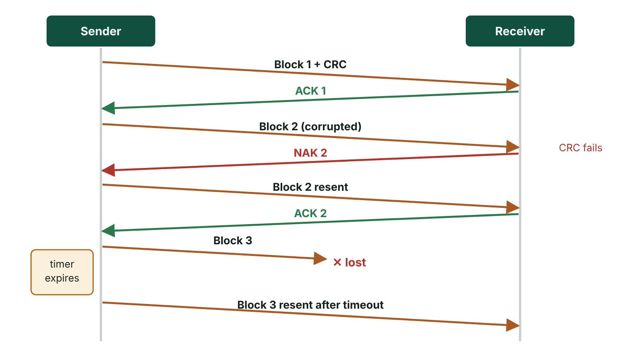
The big picture
Automatic repeat request: block 1 is acknowledged, block 2 arrives with an error and is negatively acknowledged then resent, and block 3 is lost so a timeout triggers retransmission
☰ Menu
Notes:
Explain the diagram in your own words before you read on.

Slide 55
Transmission media
Medium | How data travels | Strengths | Weaknesses
Twisted pair copper (e.g. Cat6) | Electrical signals | Cheap, easy to install | Interference; limited distance (about 100 m per run)
Coaxial copper | Electrical signals, shielded | Less interference than twisted pair | Bulkier; being replaced by fibre
Fibre-optic | Pulses of light | Very high bandwidth, long distances, immune to electrical interference, hard to tap | Expensive, fragile, specialist installation
Wireless (radio, microwave, satellite) | Electromagnetic waves | Mobility, no cables, reaches remote areas | Interference, lower speed over distance, easier to intercept, satellite latency
☰ Menu

Slide 56
Bandwidth, bit rate and broadband
Bandwidth: the range of frequencies a channel can carry, which determines its maximum data capacity; often quoted loosely in bits per second.
Bit rate: the number of bits actually transmitted per second (bps, kbps, Mbps, Gbps).
Higher bandwidth allows a higher maximum bit rate; actual bit rate falls with congestion, distance and interference.
Broadband: a high-capacity connection that carries multiple signals on different frequencies at once over one medium.
Transfer time = file size in bits ÷ bit rate. Remember 1 byte = 8 bits.
☰ Menu

Slide 57
Worked calculation
File: 600 MB. Convert to bits: 600 × 8 = 4800 Mb (megabits).
Bit rate 40 Mbps: time = 4800 ÷ 40 = 120 seconds = 2 minutes.
Using 1 MB = 1024 × 1024 bytes gives about 126 seconds – state which convention you use.
Exam tip: always show the conversion to bits and the units of your answer.
☰ Menu

Slide 58
Serial vs parallel
Feature | Serial | Parallel
Method | Bits sent one after another on one channel | Several bits sent at once on separate wires
Distance | Long distances | Short distances only
Problems | Fewer wires, no skew | Skew (bits arrive at different times) and crosstalk
Examples | USB, SATA, Ethernet, PCIe lanes | Older printer ports; internal buses
☰ Menu

Slide 59
Direction and timing
Mode | Meaning | Example
Simplex | Data in one direction only | Broadcast TV; sensor to controller
Half-duplex | Both directions, but only one at a time | Walkie-talkie
Full-duplex | Both directions at the same time | Phone call; switched Ethernet
Synchronous | Sender and receiver share a clock signal; data sent in continuous blocks | Within a CPU; network links
Asynchronous | No shared clock; each character framed by start and stop bits | Keyboard input to a computer
☰ Menu

Slide 60
Error detection
Parity: an extra bit makes the number of 1s even (even parity) or odd; detects single-bit errors but not two bits flipped.
Example even parity: 1011001 has four 1s, so parity bit 0 → 10110010.
Checksum: a value calculated from the data (e.g. sum of bytes MOD 256) is sent with it; the receiver recalculates and compares.
Cyclic redundancy check (CRC): treats the data as a binary number and divides it by an agreed polynomial; the remainder is sent and checked – detects burst errors very reliably.
Detection tells the receiver something is wrong; it does not fix it.
☰ Menu

Slide 61
Error correction: ARQ
Automatic repeat request (ARQ) uses acknowledgements and timeouts.
The receiver checks each block (e.g. using CRC) and sends a positive acknowledgement (ACK) if correct.
If an error is found, a negative acknowledgement (NAK) is sent, or no ACK is sent.
If the sender receives a NAK or its timer expires before an ACK, it retransmits the block.
Echo checking is a simpler alternative: data is sent back and compared, but doubles traffic.
☰ Menu

Slide 62
Exit quiz: question 1 of 5
Tap an answer to check it. Presenting? Click to reveal the answer.
How long does a 100 MB file take at 50 Mbps (1 MB = 8 Mb)?
A 2 s
B 16 s
✗
✓
C 50 s
D 8 s
✗
✗
✓ B: 16 s – 800 ÷ 50 = 16 s.
☰ Menu

Slide 63
Exit quiz: question 2 of 5
Tap an answer to check it. Presenting? Click to reveal the answer.
Which medium uses pulses of light?
A Coaxial
B Twisted pair
✗
✗
C Fibre-optic
D Microwave
✓
✗
✓ C: Fibre-optic – Fibre carries light.
☰ Menu

Slide 64
Exit quiz: question 3 of 5
Tap an answer to check it. Presenting? Click to reveal the answer.
With odd parity, what is the parity bit for 1100110?
A 1
B 0
✓
✗
C 2
D It cannot be calculated
✗
✗
✓ A: 1 – Four 1s; add 1 to make five (odd).
☰ Menu

Slide 65
Exit quiz: question 4 of 5
Tap an answer to check it. Presenting? Click to reveal the answer.
In ARQ, what does the sender do if no acknowledgement arrives before the timeout?
A Stops sending
B Sends the next block
✗
✗
C Asks the user
D Retransmits the block
✗
✓
✓ D: Retransmits the block – Timeout triggers retransmission.
☰ Menu

Slide 66
Exit quiz: question 5 of 5
Tap an answer to check it. Presenting? Click to reveal the answer.
Which method detects burst errors most reliably?
A Parity bit
B CRC
✗
✓
C Echo by eye
D Simplex
✗
✗
✓ B: CRC – Cyclic redundancy check.
☰ Menu

Slide 67
Exit quiz answers
Q | Answer | Why
1 | B 16 s | 800 ÷ 50 = 16 s.
2 | C Fibre-optic | Fibre carries light.
3 | A 1 | Four 1s; add 1 to make five (odd).
4 | D Retransmits the block | Timeout triggers retransmission.
5 | B CRC | Cyclic redundancy check.
☰ Menu

