Slide 1
Network security and cloud computing
A2 1: INFORMATION SYSTEMS · TOPIC
Lessons in this topic
IS13 Network security: threats, firewalls, encryption and authentication
IS14 Cloud computing and virtualisation

Slide 2

Topic menu
Tap a button to jump straight there. The ☰ Menu button on every slide brings you back here.
Specification map
IS14 Cloud computing and virtualisation
IS13 Network security: threats, firewalls, encryption and authentication

Slide 3
Specification map
Lesson | Specification: students should be able to
IS13 | Describe threats to networks and data; Explain the use of firewalls and proxy servers; Explain symmetric and asymmetric encryption, digital signatures and digital certificates; Describe authentication methods and the use of virtual private networks (VPNs)
IS14 | Describe cloud service models: infrastructure, platform and software as a service; Compare public, private and hybrid cloud deployment; Evaluate the use of cloud computing by organisations; Explain virtualisation and its benefits
☰ Menu
Notes:
Each lesson below is its own section in PowerPoint (View → Slide Sorter shows them). To split this deck by specification point, right-click a section → Move Section, or delete the sections you do not need.

Slide 4
Network security: threats, firewalls, encryption and authentication
A2 1: INFORMATION SYSTEMS · IS13
Learning objectives
Describe common network threats and match each to suitable countermeasures
Explain how symmetric and asymmetric encryption, digital signatures and certificates work together
Evaluate firewalls, proxies, authentication methods and VPNs for an organisation
Notes:
Specification: Describe threats to networks and data | Explain the use of firewalls and proxy servers | Explain symmetric and asymmetric encryption, digital signatures and digital certificates | Describe authentication methods and the use of virtual private networks (VPNs)

Slide 5
In this lesson
Tap a button to jump straight there. The ☰ Menu button on every slide brings you back here.
The big picture
Digital signatures and certificates
Threats to networks
Authentication
Firewalls and proxy servers
Virtual private networks (VPNs)
Symmetric vs asymmetric encryption
Exit quiz
How public key encryption works
↑ Topic menu
Notes:
Lesson menu: each button jumps to that part of the lesson in Slide Show. The ☰ Menu button on each slide returns here.

Slide 6
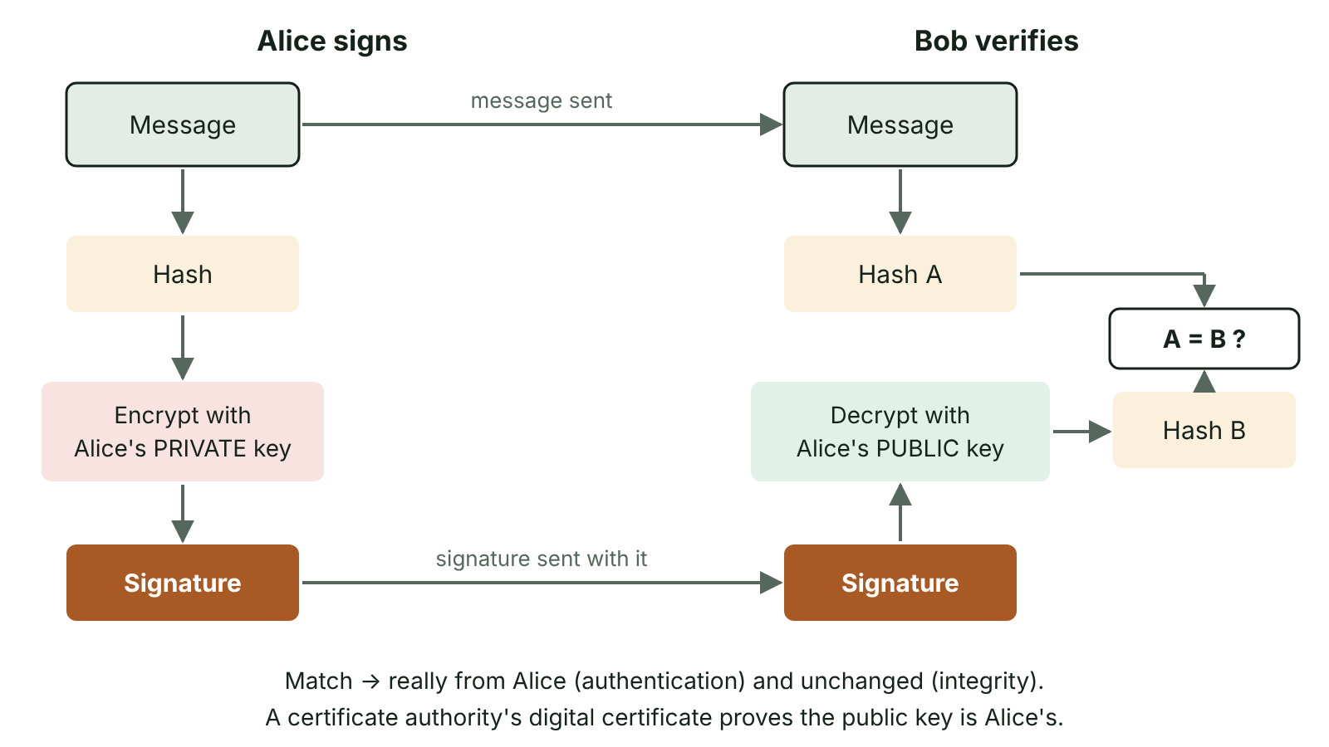
The big picture
Creating a digital signature by hashing a message and encrypting the hash with the sender's private key, and verifying it by decrypting with the sender's public key and comparing hashes
☰ Menu
Notes:
Explain the diagram in your own words before you read on.

Slide 7
Threats to networks
Threat | Description
Malware | Viruses, worms, trojans, ransomware and spyware that damage, encrypt or steal data
Phishing and social engineering | Tricking users into revealing credentials or running malware
Hacking / unauthorised access | Exploiting weak passwords or unpatched vulnerabilities to gain access
Denial of service (DoS/DDoS) | Flooding a server with traffic, often from a botnet, so genuine users cannot get service
Interception (man-in-the-middle) | Capturing or altering data in transit, e.g. on public Wi-Fi
Insider threats | Staff misusing access deliberately or by accident
☰ Menu

Slide 8
Firewalls and proxy servers
A firewall monitors incoming and outgoing traffic and allows or blocks it according to rules (IP addresses, ports, protocols).
Packet-filtering firewalls check headers; stateful firewalls track connections; application firewalls inspect content.
A proxy server sits between users and the internet, making requests on their behalf.
Proxy benefits: hides internal IP addresses, filters web content (e.g. C2k school filtering), caches popular pages to save bandwidth, logs activity.
Neither stops threats that arrive by permitted routes, e.g. a malicious attachment in allowed email.
☰ Menu

Slide 9
Symmetric vs asymmetric encryption
Feature | Symmetric | Asymmetric (public key)
Keys | One shared secret key encrypts and decrypts | A key pair: public key and private key
Speed | Fast – suitable for bulk data | Slow – used for small amounts of data
Key distribution | Problem: the key must be shared securely | Public key can be published openly
Use | Encrypting files, disks and session data | Exchanging session keys, digital signatures
Example | AES | RSA
☰ Menu

Slide 10
How public key encryption works
To send Bob a confidential message, Alice encrypts it with Bob's public key.
Only Bob's private key can decrypt it, and he never shares it.
In HTTPS (TLS) asymmetric encryption is used to agree a symmetric session key; the session data is then encrypted symmetrically for speed.
This combines the security of key exchange with the speed of symmetric encryption.
☰ Menu

Slide 11
Digital signatures and certificates
A digital signature proves who sent a message and that it has not been altered.
Sender hashes the message and encrypts the hash with their private key; this is the signature.
Receiver decrypts the signature with the sender's public key and compares it with their own hash of the message – a match proves authenticity and integrity.
A digital certificate, issued by a trusted certificate authority (CA), binds a public key to an identity (e.g. a bank's domain).
Browsers check the certificate before trusting a site's public key – preventing impostor sites.
☰ Menu

Slide 12
Authentication
Authentication confirms a user's identity: something you know (password, PIN), have (phone, smart card, token) or are (fingerprint, face).
Multi-factor authentication (MFA) combines two or more categories, so a stolen password alone is not enough.
Strong password policies: length, no reuse, account lockout after failed attempts.
Authorisation is different: it decides what an authenticated user may access (access rights).
☰ Menu

Slide 13
Virtual private networks (VPNs)
A VPN creates an encrypted 'tunnel' across a public network such as the internet.
Remote staff connect to the organisation's network as if they were on site.
Data cannot be read if intercepted, e.g. on hotel or café Wi-Fi.
Drawbacks: adds latency, needs configuration and trust in the VPN provider; does not protect a compromised device.
☰ Menu

Slide 14
Exit quiz: question 1 of 5
Tap an answer to check it. Presenting? Click to reveal the answer.
Alice wants to send Bob a secret message. Which key does she encrypt it with?
A Alice's private key
B Bob's public key
✗
✓
C Bob's private key
D Alice's public key
✗
✗
✓ B: Bob's public key – Only Bob's private key can then decrypt it.
☰ Menu

Slide 15
Exit quiz: question 2 of 5
Tap an answer to check it. Presenting? Click to reveal the answer.
Who issues digital certificates?
A Internet service providers
B Web browsers
✗
✗
C Certificate authorities
D Firewalls
✓
✗
✓ C: Certificate authorities – A trusted CA vouches for the key owner.
☰ Menu

Slide 16
Exit quiz: question 3 of 5
Tap an answer to check it. Presenting? Click to reveal the answer.
Flooding a server with traffic from a botnet is…
A phishing
B a DDoS attack
✗
✓
C a man-in-the-middle attack
D spyware
✗
✗
✓ B: a DDoS attack – Distributed denial of service.
☰ Menu

Slide 17
Exit quiz: question 4 of 5
Tap an answer to check it. Presenting? Click to reveal the answer.
A fingerprint scan is authentication by…
A something you know
B something you have
✗
✗
C something you are
D something you share
✓
✗
✓ C: something you are – Biometric factor.
☰ Menu

Slide 18
Exit quiz: question 5 of 5
Tap an answer to check it. Presenting? Click to reveal the answer.
Which is NOT normally a function of a proxy server?
A Caching pages
B Hiding internal IP addresses
✗
✗
C Filtering content
D Issuing digital certificates
✗
✓
✓ D: Issuing digital certificates – CAs issue certificates.
☰ Menu

Slide 19
Exit quiz answers
Q | Answer | Why
1 | B Bob's public key | Only Bob's private key can then decrypt it.
2 | C Certificate authorities | A trusted CA vouches for the key owner.
3 | B a DDoS attack | Distributed denial of service.
4 | C something you are | Biometric factor.
5 | D Issuing digital certificates | CAs issue certificates.
☰ Menu

Slide 20
Cloud computing and virtualisation
A2 1: INFORMATION SYSTEMS · IS14
Learning objectives
Distinguish IaaS, PaaS and SaaS by what the provider and customer each manage
Recommend a public, private or hybrid cloud for a scenario with justification
Explain server virtualisation and evaluate its benefits and drawbacks
Notes:
Specification: Describe cloud service models: infrastructure, platform and software as a service | Compare public, private and hybrid cloud deployment | Evaluate the use of cloud computing by organisations | Explain virtualisation and its benefits

Slide 21
In this lesson
Tap a button to jump straight there. The ☰ Menu button on every slide brings you back here.
The big picture
Drawbacks and risks
What is cloud computing?
Virtualisation
Service models
Evaluating virtualisation
Deployment models
Exit quiz
Benefits of cloud computing
↑ Topic menu
Notes:
Lesson menu: each button jumps to that part of the lesson in Slide Show. The ☰ Menu button on each slide returns here.

Slide 22
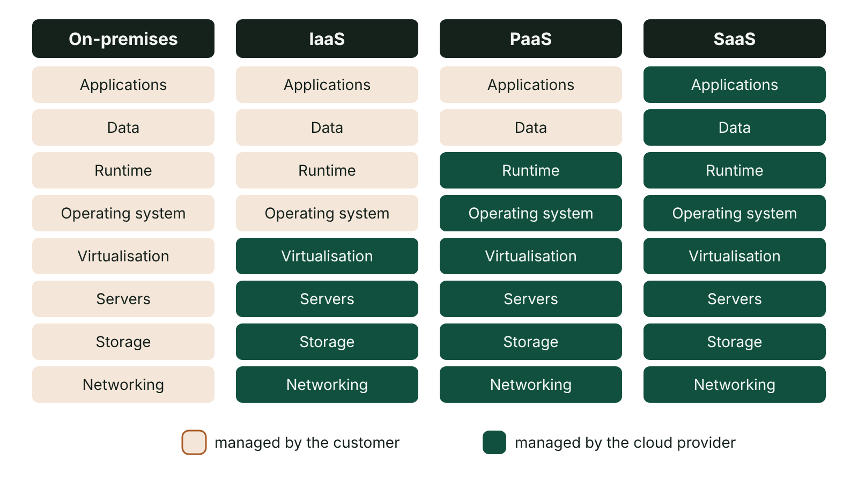
The big picture
Who manages each layer of the computing stack in on-premises, IaaS, PaaS and SaaS models: the customer or the cloud provider
☰ Menu
Notes:
Explain the diagram in your own words before you read on.

Slide 23
What is cloud computing?
Delivery of computing resources – servers, storage, databases, software – over the internet, on demand.
Resources are held in the provider's data centres and shared between many customers.
Pay-as-you-go or subscription instead of buying hardware (operating expenditure rather than capital expenditure).
Key characteristics: on-demand self-service, broad network access, resource pooling, rapid elasticity, measured service.
☰ Menu

Slide 24
Service models
Model | Provider manages | Customer manages | Example
IaaS – infrastructure as a service | Physical servers, storage, networking, virtualisation | Operating system, runtime, applications, data | Renting virtual machines (e.g. Amazon EC2, Azure VMs)
PaaS – platform as a service | Everything up to the OS and runtime/database | Applications and data they develop | Developers deploying a web app to Azure App Service
SaaS – software as a service | The entire application | Only their data and settings | Microsoft 365, Gmail, Google Classroom
☰ Menu

Slide 25
Deployment models
Model | Description | Suits
Public cloud | Infrastructure owned by a provider and shared by many organisations over the internet | Start-ups and variable demand; lowest cost
Private cloud | Cloud infrastructure used by one organisation only, on-site or hosted | Banks, healthcare – strict security or regulatory needs
Hybrid cloud | Combination of private and public, with data and apps moving between them | Sensitive data kept private, public used for peak demand (cloud bursting)
☰ Menu

Slide 26
Benefits of cloud computing
Scalability and elasticity: add or remove capacity quickly, e.g. extra servers for exam results day.
Lower upfront cost; no need to buy, house or power servers.
Access from anywhere on any device; supports remote working and collaboration.
Provider handles maintenance, updates, backups and physical security; disaster recovery across data centres.
Access to advanced services such as AI and big-data analytics without in-house hardware.
☰ Menu

Slide 27
Drawbacks and risks
Depends on a reliable, fast internet connection – a problem in some rural areas.
Security and privacy: data held by a third party; organisations remain responsible under UK GDPR.
Data sovereignty: data may be stored in other countries with different laws.
Less control over downtime, upgrades and changes to service; vendor lock-in makes it hard to switch.
Ongoing subscription costs can exceed the cost of owning hardware over many years.
☰ Menu

Slide 28
Virtualisation
Virtualisation uses software to create virtual versions of hardware: servers, storage, networks or desktops.
A hypervisor allows several virtual machines (VMs), each with its own operating system, to run on one physical server.
Type 1 hypervisors run directly on hardware (data centres); type 2 run on a host operating system (testing on a laptop).
Virtualisation is the technology that makes cloud computing possible: providers pool physical servers and allocate VMs to customers.
☰ Menu

Slide 29
Evaluating virtualisation
Benefits | Drawbacks
Server consolidation: fewer physical servers, lower power, cooling and space costs | Physical server is a single point of failure for all its VMs unless clustered
Fast provisioning: a new VM in minutes | Performance overhead compared with dedicated hardware
Isolation: a crash in one VM does not affect others; safe testing | Licensing and management complexity
Snapshots and migration aid backup and disaster recovery | Specialist skills needed
☰ Menu

Slide 30
Exit quiz: question 1 of 5
Tap an answer to check it. Presenting? Click to reveal the answer.
A developer deploys web app code without managing any servers or operating systems. This is…
A IaaS
B PaaS
✗
✓
C SaaS
D on-premises
✗
✗
✓ B: PaaS – Platform as a service.
☰ Menu

Slide 31
Exit quiz: question 2 of 5
Tap an answer to check it. Presenting? Click to reveal the answer.
Which deployment model is shared by many organisations?
A Public cloud
B Private cloud
✓
✗
C Hybrid cloud
D Intranet
✗
✗
✓ A: Public cloud – Public cloud resources are pooled.
☰ Menu

Slide 32
Exit quiz: question 3 of 5
Tap an answer to check it. Presenting? Click to reveal the answer.
Which is a drawback of cloud computing?
A Scalability
B Access from anywhere
✗
✗
C Dependence on internet connectivity
D No upfront hardware cost
✓
✗
✓ C: Dependence on internet connectivity – No connection means no access.
☰ Menu

Slide 33
Exit quiz: question 4 of 5
Tap an answer to check it. Presenting? Click to reveal the answer.
What does a hypervisor do?
A Encrypts cloud data
B Creates and runs virtual machines
✗
✓
C Assigns IP addresses
D Filters web traffic
✗
✗
✓ B: Creates and runs virtual machines – It manages VMs on a host.
☰ Menu

Slide 34
Exit quiz: question 5 of 5
Tap an answer to check it. Presenting? Click to reveal the answer.
Data stored in another country being subject to that country's laws is an issue of…
A elasticity
B virtualisation
✗
✗
C redundancy
D data sovereignty
✗
✓
✓ D: data sovereignty – Where data physically lives matters legally.
☰ Menu

Slide 35
Exit quiz answers
Q | Answer | Why
1 | B PaaS | Platform as a service.
2 | A Public cloud | Public cloud resources are pooled.
3 | C Dependence on internet connectivity | No connection means no access.
4 | B Creates and runs virtual machines | It manages VMs on a host.
5 | D data sovereignty | Where data physically lives matters legally.
☰ Menu

