Slide 1
Information systems in organisations
A2 1: INFORMATION SYSTEMS · TOPIC
Lessons in this topic
IS15 Types of information system
IS16 Artificial intelligence, machine learning and emerging technologies

Slide 2

Topic menu
Tap a button to jump straight there. The ☰ Menu button on every slide brings you back here.
Specification map
IS16 Artificial intelligence, machine learning and emerging technologies
IS15 Types of information system

Slide 3
Specification map
Lesson | Specification: students should be able to
IS15 | Describe the characteristics and purpose of transaction processing systems (TPS); Describe management information systems (MIS) and decision support systems (DSS); Describe expert systems, including the knowledge base, inference engine and user interface
IS16 | Describe artificial intelligence and machine learning, including supervised, unsupervised and reinforcement learning; Describe emerging technologies including the Internet of Things and robotics; Evaluate the impact of these technologies on organisations
☰ Menu
Notes:
Each lesson below is its own section in PowerPoint (View → Slide Sorter shows them). To split this deck by specification point, right-click a section → Move Section, or delete the sections you do not need.

Slide 4
Types of information system
A2 1: INFORMATION SYSTEMS · IS15
Learning objectives
Match types of information system to the levels of management they serve
Explain how a TPS, MIS and DSS work together using an example organisation
Describe the components of an expert system and evaluate its use
Notes:
Specification: Describe the characteristics and purpose of transaction processing systems (TPS) | Describe management information systems (MIS) and decision support systems (DSS) | Describe expert systems, including the knowledge base, inference engine and user interface

Slide 5
In this lesson
Tap a button to jump straight there. The ☰ Menu button on every slide brings you back here.
The big picture
Expert systems
Information systems and levels of management
Evaluating expert systems
Transaction processing systems
Case study: Lough Erne Hotels group
Management information systems
Exit quiz
Decision support systems
↑ Topic menu
Notes:
Lesson menu: each button jumps to that part of the lesson in Slide Show. The ☰ Menu button on each slide returns here.

Slide 6
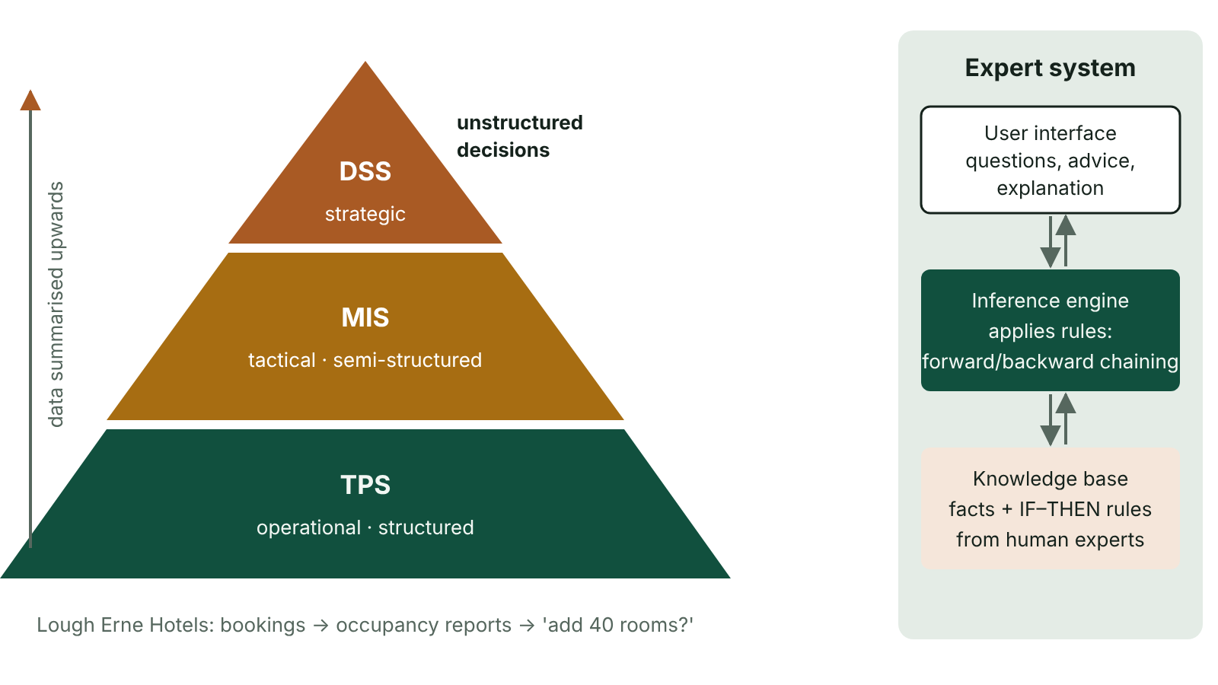
The big picture
The information pyramid: TPS at the operational level, MIS at the tactical level and DSS at the strategic level, with data flowing upwards; and the three components of an expert system
☰ Menu
Notes:
Explain the diagram in your own words before you read on.

Slide 7
Information systems and levels of management
Level | Decisions | Information needed | Typical system
Strategic (directors) | Long-term, unstructured: open a new store? | Summarised, external and internal, forecasts | DSS / executive information system
Tactical (middle managers) | Medium-term, semi-structured: staffing levels next month | Summary reports, exceptions, trends | MIS
Operational (supervisors, staff) | Day-to-day, structured: reorder stock | Detailed, current, internal | TPS
☰ Menu

Slide 8
Transaction processing systems
A TPS records and processes the routine transactions of an organisation: sales, payments, bookings, orders.
Real-time (online) processing updates records immediately, e.g. a cinema seat booking or bank withdrawal.
Batch processing collects transactions and processes them together later, e.g. payroll or utility billing overnight.
Must be fast, reliable, accurate and secure; uses ACID transactions.
The TPS is the main source of data for higher-level systems.
☰ Menu

Slide 9
Management information systems
An MIS takes data from TPSs and produces regular, structured reports for middle managers.
Report types: scheduled (weekly sales by branch), exception (stores below target), on-demand (ad hoc query).
Supports tactical decisions such as staffing, budgeting and stock policy.
Information should be relevant, accurate, timely, complete and appropriately summarised.
Limitation: mostly internal, historic data and fixed reports.
☰ Menu

Slide 10
Decision support systems
A DSS helps managers make semi-structured or unstructured decisions using data, models and interactive tools.
Components: a database (internal and external data), a model base (financial, statistical, forecasting models) and a user interface.
What-if analysis: 'What happens to profit if fuel prices rise 10%?'
Goal seeking: 'What price gives £50 000 profit?' Also scenario comparison and forecasting.
The DSS supports, not replaces, the human decision-maker.
☰ Menu

Slide 11
Expert systems
An expert system emulates the decision-making of a human expert in a narrow domain.
Knowledge base: facts and rules (IF … THEN …) collected from experts by a knowledge engineer.
Inference engine: applies the rules to the facts entered, using forward chaining (from data to conclusion) or backward chaining (from a hypothesis to supporting data).
User interface: asks questions and presents conclusions; an explanation facility shows the reasoning used.
Examples: medical diagnosis support, fault diagnosis in machinery, credit approval, legal advice.
☰ Menu

Slide 12
Evaluating expert systems
Advantages | Disadvantages
Expertise available 24/7 and in many places at once | Lacks common sense and cannot handle situations outside its rules
Consistent answers; does not tire or forget | Expensive and slow to build; knowledge from experts hard to capture
Can preserve knowledge of retiring experts | Must be kept up to date as knowledge changes
Explanation facility supports training | Responsibility unclear if advice is wrong; users may over-trust it
☰ Menu

Slide 13
Case study: Lough Erne Hotels group
TPS: room bookings and restaurant payments recorded in real time; payroll processed in batch.
MIS: weekly occupancy report per hotel and an exception report when occupancy falls below 60%.
DSS: the board models 'what if we add 40 rooms in Enniskillen?' using forecasts and tourism data.
Expert system: front desk tool that recommends room upgrades or flags possibly fraudulent bookings.
☰ Menu

Slide 14
Exit quiz: question 1 of 5
Tap an answer to check it. Presenting? Click to reveal the answer.
A cinema seat booking updated immediately is an example of…
A batch processing
B real-time transaction processing
✗
✓
C a DSS
D an expert system
✗
✗
✓ B: real-time transaction processing – Each transaction processed at once.
☰ Menu

Slide 15
Exit quiz: question 2 of 5
Tap an answer to check it. Presenting? Click to reveal the answer.
Which system produces weekly sales reports for each branch?
A MIS
B TPS
✓
✗
C Expert system
D Hypervisor
✗
✗
✓ A: MIS – Scheduled summary reports are MIS outputs.
☰ Menu

Slide 16
Exit quiz: question 3 of 5
Tap an answer to check it. Presenting? Click to reveal the answer.
'What would profit be if we cut prices by 5%?' uses…
A an exception report
B forward chaining
✗
✗
C the knowledge base
D what-if analysis
✗
✓
✓ D: what-if analysis – A DSS feature.
☰ Menu

Slide 17
Exit quiz: question 4 of 5
Tap an answer to check it. Presenting? Click to reveal the answer.
Which part of an expert system shows how a conclusion was reached?
A Knowledge base
B Explanation facility
✗
✓
C Transaction log
D Model base
✗
✗
✓ B: Explanation facility – It justifies the advice.
☰ Menu

Slide 18
Exit quiz: question 5 of 5
Tap an answer to check it. Presenting? Click to reveal the answer.
Who builds the knowledge base by interviewing experts?
A Database administrator
B Network manager
✗
✗
C Knowledge engineer
D Data subject
✓
✗
✓ C: Knowledge engineer – Knowledge engineers capture expertise.
☰ Menu

Slide 19
Exit quiz answers
Q | Answer | Why
1 | B real-time transaction processing | Each transaction processed at once.
2 | A MIS | Scheduled summary reports are MIS outputs.
3 | D what-if analysis | A DSS feature.
4 | B Explanation facility | It justifies the advice.
5 | C Knowledge engineer | Knowledge engineers capture expertise.
☰ Menu

Slide 20
Artificial intelligence, machine learning and emerging technologies
A2 1: INFORMATION SYSTEMS · IS16
Learning objectives
Explain what artificial intelligence and machine learning are and how a model is trained
Describe the Internet of Things and robotics with organisational examples
Evaluate the benefits and risks of AI and emerging technologies for organisations and employees
Notes:
Specification: Describe artificial intelligence and machine learning, including supervised, unsupervised and reinforcement learning | Describe emerging technologies including the Internet of Things and robotics | Evaluate the impact of these technologies on organisations

Slide 21
In this lesson
Tap a button to jump straight there. The ☰ Menu button on every slide brings you back here.
The big picture
Impact on organisations: benefits
Artificial intelligence
Impact on organisations: risks and issues
Machine learning
Evaluating an AI proposal
Types of machine learning
Exit quiz
Internet of Things and robotics
↑ Topic menu
Notes:
Lesson menu: each button jumps to that part of the lesson in Slide Show. The ☰ Menu button on each slide returns here.

Slide 22
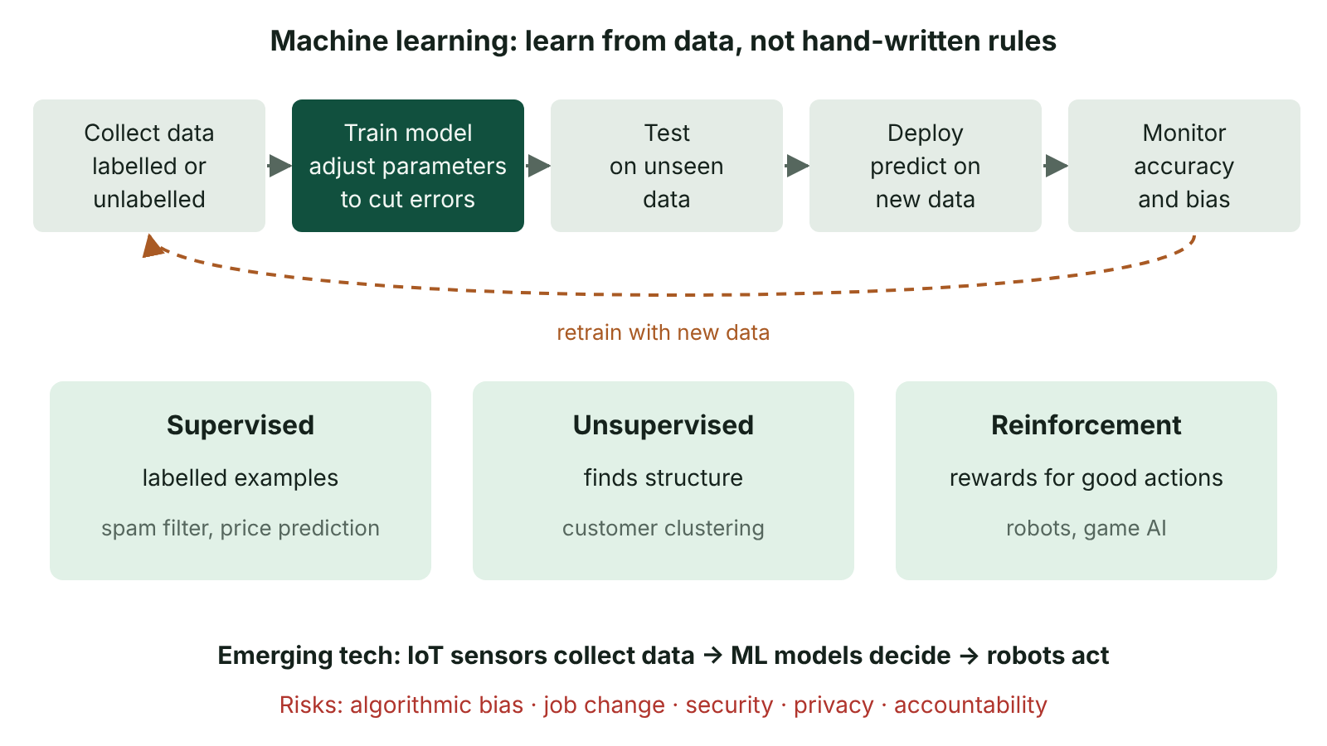
The big picture
The machine learning cycle of training data, training, testing on unseen data, deployment and monitoring, with the three types of learning
☰ Menu
Notes:
Explain the diagram in your own words before you read on.

Slide 23
Artificial intelligence
Artificial intelligence (AI): computer systems that perform tasks normally needing human intelligence – recognising speech and images, understanding language, making decisions.
Narrow AI performs one specific task well (all current AI); general AI would match humans across any task (not yet achieved).
Rule-based AI (expert systems) follows rules written by people; machine learning learns patterns from data.
Generative AI produces new text, images or code from patterns learned from huge training data sets.
☰ Menu

Slide 24
Machine learning
Machine learning (ML): algorithms improve their performance at a task by learning from data rather than being explicitly programmed.
Training: the algorithm is given training data and adjusts the model's parameters to reduce errors.
Testing: the model is evaluated on separate data it has not seen, to check it generalises.
Deployment: the trained model makes predictions on new data.
Neural networks – layers of connected nodes with weighted links – underpin deep learning for images and language.
☰ Menu

Slide 25
Types of machine learning
Type | How it learns | Example
Supervised | From labelled examples (input and correct output) | Emails labelled spam/not spam; predicting house prices
Unsupervised | Finds structure in unlabelled data | Clustering customers into segments
Reinforcement | Trial and error, rewarded for good actions | A robot learning to walk; game-playing AI; optimising traffic lights
☰ Menu

Slide 26
Internet of Things and robotics
Internet of Things (IoT): everyday physical objects with sensors, processors and network connections that collect and exchange data.
Examples: smart meters, wearable health monitors, sensors tracking cattle on Fermanagh farms, smart heating in schools.
Robotics: programmable machines that sense, process and act in the physical world.
Industrial robots in manufacturing; warehouse picking robots; surgical robots; autonomous delivery drones and vehicles.
AI + IoT + robotics combine: sensors feed data to ML models which control robots in real time.
☰ Menu

Slide 27
Impact on organisations: benefits
Automation of repetitive tasks increases productivity and reduces errors.
Better decisions from predictive analytics, e.g. demand forecasting, predictive maintenance from IoT sensor data.
24/7 customer service with chatbots; personalised recommendations increase sales.
Robots work in dangerous environments and with high precision.
New products, services and business models, giving competitive advantage.
☰ Menu

Slide 28
Impact on organisations: risks and issues
Issue | Explanation
Employment | Routine jobs replaced; new jobs need new skills – retraining needed
Algorithmic bias | Models trained on biased data make unfair decisions, e.g. in recruitment or credit
Transparency and accountability | 'Black box' models are hard to explain; who is responsible for errors?
Security | IoT devices often have weak security and can be hijacked into botnets
Privacy | Large amounts of personal data collected and analysed; must comply with UK GDPR
Cost and reliance | High set-up costs, specialist staff, dependence on suppliers and data quality
☰ Menu

Slide 29
Evaluating an AI proposal
What problem does it solve and how will success be measured?
Is there enough good-quality, unbiased training data, and is its use lawful?
Can decisions be explained to customers and regulators? Is a human in the loop?
What are the effects on staff, and how will they be retrained?
Do the benefits outweigh costs and risks? Pilot first, monitor continuously.
☰ Menu

Slide 30
Exit quiz: question 1 of 5
Tap an answer to check it. Presenting? Click to reveal the answer.
Grouping customers into segments without predefined labels is…
A supervised learning
B reinforcement learning
✗
✗
C unsupervised learning
D an expert system
✓
✗
✓ C: unsupervised learning – Clustering of unlabelled data.
☰ Menu

Slide 31
Exit quiz: question 2 of 5
Tap an answer to check it. Presenting? Click to reveal the answer.
Which is an IoT example?
A A spreadsheet
B A smart meter sending readings to the supplier
✗
✓
C A printed report
D A USB stick
✗
✗
✓ B: A smart meter sending readings to the supplier – Connected sensor device.
☰ Menu

Slide 32
Exit quiz: question 3 of 5
Tap an answer to check it. Presenting? Click to reveal the answer.
A recruitment AI rejects more women because past hiring data favoured men. This is…
A overfitting
B data redundancy
✗
✗
C encryption
D algorithmic bias
✗
✓
✓ D: algorithmic bias – Biased training data produces biased output.
☰ Menu

Slide 33
Exit quiz: question 4 of 5
Tap an answer to check it. Presenting? Click to reveal the answer.
What happens during training?
A The model adjusts its parameters to reduce errors on training data
B The model is deleted
✓
✗
C Data is normalised to 3NF
D Users enter rules by hand
✗
✗
✓ A: The model adjusts its parameters to reduce errors on training data – Parameters are tuned.
☰ Menu

Slide 34
Exit quiz: question 5 of 5
Tap an answer to check it. Presenting? Click to reveal the answer.
Which is a likely impact of automation on employment?
A No jobs change
B Routine jobs decline and new skilled jobs appear
✗
✓
C All jobs disappear
D Wages always rise
✗
✗
✓ B: Routine jobs decline and new skilled jobs appear – Jobs shift; retraining is needed.
☰ Menu

Slide 35
Exit quiz answers
Q | Answer | Why
1 | C unsupervised learning | Clustering of unlabelled data.
2 | B A smart meter sending readings to the supplier | Connected sensor device.
3 | D algorithmic bias | Biased training data produces biased output.
4 | A The model adjusts its parameters to reduce errors on training data | Parameters are tuned.
5 | B Routine jobs decline and new skilled jobs appear | Jobs shift; retraining is needed.
☰ Menu

