Slide 1
Legal, ethical and social issues
A2 1: INFORMATION SYSTEMS · TOPIC
Lessons in this topic
IS17 Legislation: data protection, computer misuse, copyright, FOI and RIPA
IS18 Ethical, social and environmental issues

Slide 2

Topic menu
Tap a button to jump straight there. The ☰ Menu button on every slide brings you back here.
Specification map
IS18 Ethical, social and environmental issues
IS17 Legislation: data protection, computer misuse, copyright, FOI and RIPA

Slide 3
Specification map
Lesson | Specification: students should be able to
IS17 | Describe the principles, rights and roles in the Data Protection Act 2018 and UK GDPR; Describe the offences under the Computer Misuse Act 1990; Describe the purpose of the Copyright, Designs and Patents Act 1988, the Freedom of Information Act 2000 and the Regulation of Investigatory Powers Act 2000; Apply legislation to scenarios involving information systems
IS18 | Discuss ethical issues including privacy and surveillance; Discuss social issues including the digital divide, employment and health and safety; Discuss environmental issues including energy use, sustainability and e-waste
☰ Menu
Notes:
Each lesson below is its own section in PowerPoint (View → Slide Sorter shows them). To split this deck by specification point, right-click a section → Move Section, or delete the sections you do not need.

Slide 4
Legislation: data protection, computer misuse, copyright, FOI and RIPA
A2 1: INFORMATION SYSTEMS · IS17
Learning objectives
State and apply the seven data protection principles and the rights of data subjects
Identify which offence under the Computer Misuse Act applies to a scenario
Explain how copyright, freedom of information and investigatory powers legislation affect organisations and individuals
Notes:
Specification: Describe the principles, rights and roles in the Data Protection Act 2018 and UK GDPR | Describe the offences under the Computer Misuse Act 1990 | Describe the purpose of the Copyright, Designs and Patents Act 1988, the Freedom of Information Act 2000 and the Regulation of Investigatory Powers Act 2000 | Apply legislation to scenarios involving information systems

Slide 5
In this lesson
Tap a button to jump straight there. The ☰ Menu button on every slide brings you back here.
The big picture
Copyright, Designs and Patents Act 1988
Data Protection Act 2018 and UK GDPR
Freedom of Information Act 2000
The seven principles
Regulation of Investigatory Powers Act 2000
Rights and roles
Exit quiz
Computer Misuse Act 1990
↑ Topic menu
Notes:
Lesson menu: each button jumps to that part of the lesson in Slide Show. The ☰ Menu button on each slide returns here.

Slide 6
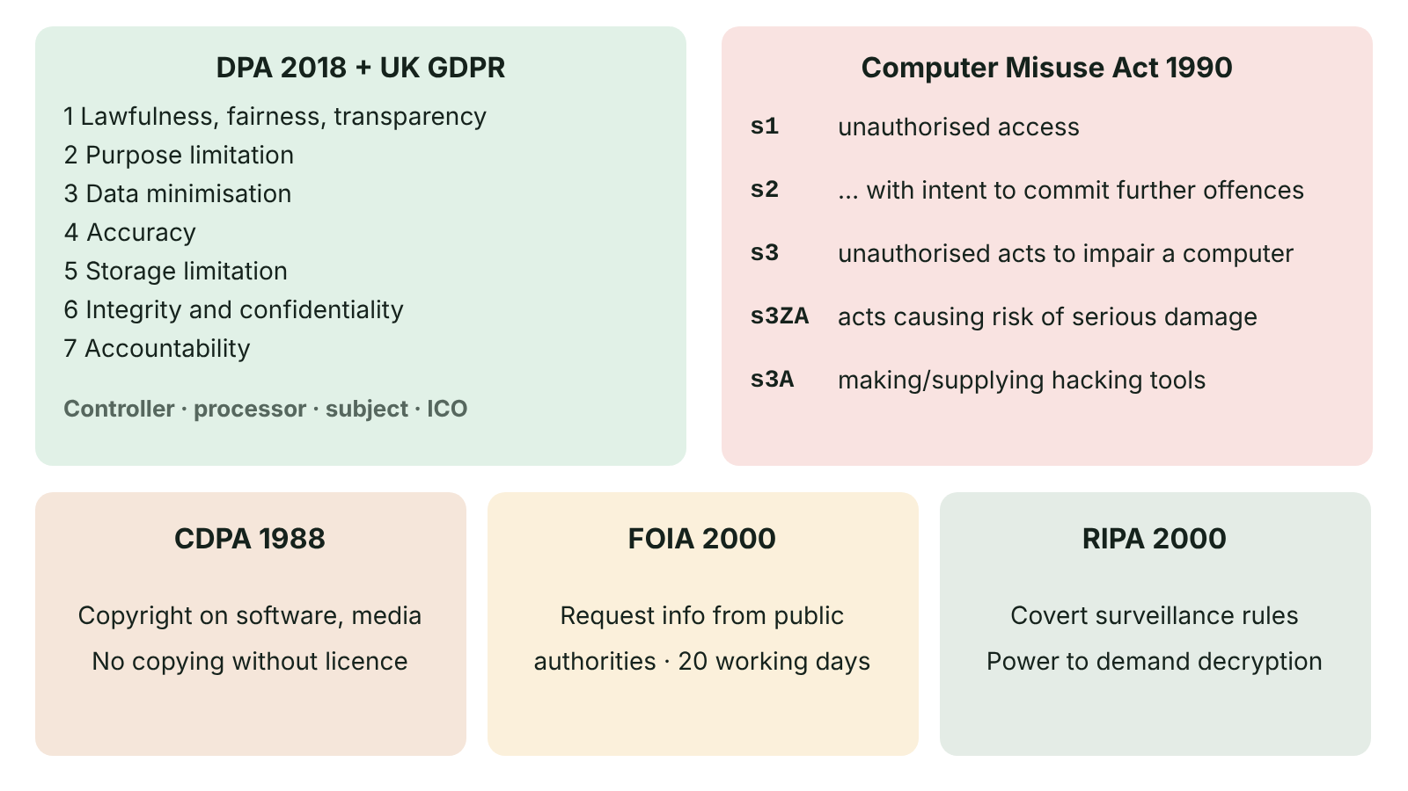
The big picture
Summary of the five Acts: Data Protection Act 2018 and UK GDPR, Computer Misuse Act 1990, Copyright Designs and Patents Act 1988, Freedom of Information Act 2000 and RIPA 2000
☰ Menu
Notes:
Explain the diagram in your own words before you read on.

Slide 7
Data Protection Act 2018 and UK GDPR
The UK GDPR sets the main rules for processing personal data; the Data Protection Act 2018 sits alongside it, adding UK-specific provisions and exemptions.
Both have been amended by the Data (Use and Access) Act 2025, whose changes are being phased in – check current Information Commission guidance.
Personal data: any information relating to an identified or identifiable living person.
Special category data needs extra protection: health, racial or ethnic origin, religion, political opinions, trade union membership, genetics, biometrics, sex life or sexual orientation.
Regulated across the UK, including Northern Ireland, by the Information Commission (formerly the ICO), which can issue fines and enforcement notices.
☰ Menu

Slide 8
The seven principles
Principle | In practice
Lawfulness, fairness and transparency | Have a lawful basis (e.g. consent, contract, legal obligation) and tell people how data is used
Purpose limitation | Collect for specified purposes; do not reuse for incompatible ones
Data minimisation | Only collect what is adequate, relevant and necessary
Accuracy | Keep data accurate and up to date; correct errors
Storage limitation | Keep identifiable data no longer than necessary
Integrity and confidentiality (security) | Protect against unauthorised access, loss or damage
Accountability | The controller must take responsibility and be able to show compliance
☰ Menu

Slide 9
Rights and roles
Rights of the data subject | Roles
Right to be informed; right of access (subject access request) | Data subject: the living individual the data is about
Right to rectification; right to erasure | Data controller: decides why and how data is processed
Right to restrict processing; right to data portability | Data processor: processes data on the controller's behalf, e.g. a cloud provider
Right to object; rights related to automated decision-making and profiling | Data protection officer: monitors compliance; Information Commission (formerly the ICO): regulates and enforces
☰ Menu

Slide 10
Computer Misuse Act 1990
Section | Offence | Example
s1 | Unauthorised access to computer material | Logging in with a friend's password to look at their files
s2 | Unauthorised access with intent to commit or facilitate further offences | Accessing a bank system intending to transfer money
s3 | Unauthorised acts with intent to impair (or recklessness as to impairing) the operation of a computer | Spreading malware; ransomware; DoS attacks; deleting files
s3ZA | Unauthorised acts causing, or creating risk of, serious damage | Attacking a hospital or power network – up to life imprisonment where human welfare or national security is at risk
s3A | Making, supplying or obtaining articles for use in an offence | Selling hacking tools or malware kits
☰ Menu

Slide 11
Copyright, Designs and Patents Act 1988
Copyright protects original works, including software, websites, music, images, video and databases; it arises automatically.
For literary works such as program code, copyright generally lasts for the author's life plus 70 years.
It is illegal to copy, distribute, adapt or rent a work without the owner's permission, e.g. pirating software or using images from the web in a product.
Software is used under a licence (single-user, site, open source, subscription) that sets what the user may do.
Organisations need licence management and staff policies to avoid fines and legal action.
☰ Menu

Slide 12
Freedom of Information Act 2000
Gives anyone the right to request recorded information held by public authorities (councils, schools, health trusts, government departments).
The authority must normally respond within 20 working days, saying whether it holds the information and providing it.
Exemptions apply, e.g. personal data, national security, commercially sensitive information.
Public authorities must also publish information proactively through a publication scheme.
Promotes transparency and accountability; regulated by the ICO. It does not apply to private companies.
☰ Menu

Slide 13
Regulation of Investigatory Powers Act 2000
Regulates how public bodies (police, intelligence services, some councils) carry out surveillance and investigation.
Part II covers covert surveillance and covert human intelligence sources, which must be authorised and proportionate.
Part III gives power to require disclosure of protected (encrypted) data or keys; refusing can be an offence.
Interception of communications and access to communications data are now mainly governed by the Investigatory Powers Act 2016.
Raises debate: national security and crime prevention versus individual privacy.
☰ Menu

Slide 14
Exit quiz: question 1 of 5
Tap an answer to check it. Presenting? Click to reveal the answer.
Keeping applicants' CVs for ten years with no reason breaches…
A accuracy
B storage limitation
✗
✓
C data portability
D purpose limitation only
✗
✗
✓ B: storage limitation – Data must not be kept longer than necessary.
☰ Menu

Slide 15
Exit quiz: question 2 of 5
Tap an answer to check it. Presenting? Click to reveal the answer.
Writing and selling malware kits is an offence under…
A CMA section 3A
B CDPA 1988
✓
✗
C FOIA 2000
D CMA section 1
✗
✗
✓ A: CMA section 3A – Making or supplying articles for use in offences.
☰ Menu

Slide 16
Exit quiz: question 3 of 5
Tap an answer to check it. Presenting? Click to reveal the answer.
A cloud provider storing a school's data on its behalf is a…
A data subject
B data controller
✗
✗
C data processor
D Information Commission
✓
✗
✓ C: data processor – It processes for the controller.
☰ Menu

Slide 17
Exit quiz: question 4 of 5
Tap an answer to check it. Presenting? Click to reveal the answer.
A public authority should normally respond to an FOI request within…
A 5 working days
B 40 calendar days
✗
✗
C 6 months
D 20 working days
✗
✓
✓ D: 20 working days – The standard time limit.
☰ Menu

Slide 18
Exit quiz: question 5 of 5
Tap an answer to check it. Presenting? Click to reveal the answer.
Which Act protects software from being copied without permission?
A Computer Misuse Act 1990
B Copyright, Designs and Patents Act 1988
✗
✓
C Freedom of Information Act 2000
D RIPA 2000
✗
✗
✓ B: Copyright, Designs and Patents Act 1988 – Copyright law.
☰ Menu

Slide 19
Exit quiz answers
Q | Answer | Why
1 | B storage limitation | Data must not be kept longer than necessary.
2 | A CMA section 3A | Making or supplying articles for use in offences.
3 | C data processor | It processes for the controller.
4 | D 20 working days | The standard time limit.
5 | B Copyright, Designs and Patents Act 1988 | Copyright law.
☰ Menu

Slide 20
Ethical, social and environmental issues
A2 1: INFORMATION SYSTEMS · IS18
Learning objectives
Explain privacy and surveillance issues from the viewpoints of different stakeholders
Discuss the causes and effects of the digital divide and the impact of technology on employment and health
Evaluate the environmental impact of digital technology and ways of reducing it
Notes:
Specification: Discuss ethical issues including privacy and surveillance | Discuss social issues including the digital divide, employment and health and safety | Discuss environmental issues including energy use, sustainability and e-waste

Slide 21
In this lesson
Tap a button to jump straight there. The ☰ Menu button on every slide brings you back here.
The big picture
Health and safety
Ethics, law and stakeholders
Environmental issues
Privacy and surveillance
Sustainability: reducing the impact
The digital divide
Exit quiz
Employment
↑ Topic menu
Notes:
Lesson menu: each button jumps to that part of the lesson in Slide Show. The ☰ Menu button on each slide returns here.

Slide 22
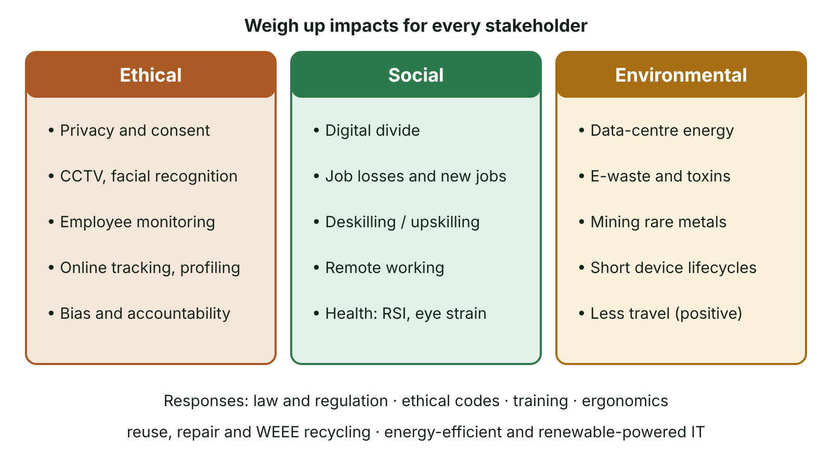
The big picture
Ethical, social and environmental issues of digital technology, each with key concerns and responses
☰ Menu
Notes:
Explain the diagram in your own words before you read on.

Slide 23
Ethics, law and stakeholders
Legal: what the law allows or forbids. Ethical: what is morally right – not everything legal is ethical.
Stakeholders: individuals, employees, organisations, government and society may see the same technology differently.
Ethical frameworks help: consider consequences (harms and benefits), rights (privacy, consent) and fairness.
Professional codes such as the BCS Code of Conduct ask IT professionals to act in the public interest.
☰ Menu

Slide 24
Privacy and surveillance
Technology | Benefit | Concern
CCTV and facial recognition | Deters and detects crime | Mass monitoring; errors and bias in recognition
Employee monitoring (email, keystrokes, location) | Security, productivity, protects firm | Trust, stress, intrusion into private life
Location tracking by apps | Navigation, safety, convenience | Detailed profile of movements sold to advertisers
State interception of communications | National security, serious crime | Proportionality; 'nothing to hide' argument versus right to private life
Cookies and online tracking | Personalised services, free content | Profiling without real understanding or consent
☰ Menu

Slide 25
The digital divide
The digital divide is the gap between those who have access to digital technology and the skills to use it and those who do not.
Causes: cost of devices and broadband, poor rural connectivity, age, disability, lack of skills or confidence.
Effects: exclusion from online services, banking, job applications, education and cheaper online deals.
Global divide between richer and poorer countries; local divide between urban and rural Northern Ireland.
Responses: broadband roll-out schemes, device lending, library and community digital-skills classes, accessible design.
☰ Menu

Slide 26
Employment
Job losses in routine work through automation (e.g. self-service tills, automated warehouses).
New jobs in software, data, cyber security and technical maintenance – need for upskilling and retraining.
Deskilling: some roles become simpler and less skilled as technology does the expert part.
Remote and flexible working: less commuting and wider talent pool, but isolation and blurred work–home boundaries.
Gig economy platforms offer flexibility but often less job security.
☰ Menu

Slide 27
Health and safety
Problem | Cause | Prevention
Repetitive strain injury (RSI) | Repeated keyboard and mouse use | Ergonomic keyboards, wrist rests, regular breaks
Eye strain and headaches | Long periods looking at screens, glare | Anti-glare screens, correct lighting, eye tests, breaks
Back and neck problems | Poor posture, unsuitable chairs | Adjustable chairs and screens, posture training
Stress and mental health | Always-on culture, monitoring, online abuse | Right-to-disconnect policies, workload management, support
☰ Menu

Slide 28
Environmental issues
Manufacturing devices uses energy, water and rare earth metals, often mined in poor conditions.
Data centres and networks use large amounts of electricity for processing and cooling; AI training increases demand.
E-waste: discarded devices contain toxic materials (lead, mercury) and are often exported illegally or sent to landfill.
Short product lifecycles and planned obsolescence increase waste.
Positive effects: video conferencing reduces travel, smart systems cut energy use, remote monitoring improves efficiency.
☰ Menu

Slide 29
Sustainability: reducing the impact
Repair, reuse and refurbish devices; extend replacement cycles.
Recycle through approved schemes under the WEEE (waste electrical and electronic equipment) Regulations.
Use energy-efficient hardware, virtualisation and power-management settings.
Choose cloud providers whose data centres use renewable energy.
Design software and services to be efficient – less processing means less energy.
☰ Menu

Slide 30
Exit quiz: question 1 of 5
Tap an answer to check it. Presenting? Click to reveal the answer.
Which is a cause of the digital divide?
A Fast fibre broadband in every home
B Poor rural connectivity
✗
✓
C Cheap devices for all
D Universal digital skills
✗
✗
✓ B: Poor rural connectivity – Lack of access excludes people.
☰ Menu

Slide 31
Exit quiz: question 2 of 5
Tap an answer to check it. Presenting? Click to reveal the answer.
Recycling electrical equipment in the UK is governed by the…
A WEEE Regulations
B Computer Misuse Act
✓
✗
C FOI Act
D RIPA
✗
✗
✓ A: WEEE Regulations – Waste Electrical and Electronic Equipment Regulations.
☰ Menu

Slide 32
Exit quiz: question 3 of 5
Tap an answer to check it. Presenting? Click to reveal the answer.
Which health problem is linked to repeated mouse use?
A Eye strain
B Hearing loss
✗
✗
C Repetitive strain injury
D Deskilling
✓
✗
✓ C: Repetitive strain injury – RSI affects wrists and hands.
☰ Menu

Slide 33
Exit quiz: question 4 of 5
Tap an answer to check it. Presenting? Click to reveal the answer.
A self-checkout replacing cashiers is an example of…
A upskilling
B digital divide
✗
✗
C e-waste
D automation affecting employment
✗
✓
✓ D: automation affecting employment – Routine jobs are automated.
☰ Menu

Slide 34
Exit quiz: question 5 of 5
Tap an answer to check it. Presenting? Click to reveal the answer.
Which reduces the environmental impact of IT?
A Replacing laptops every year
B Server virtualisation
✗
✓
C Leaving PCs on overnight
D Sending old devices to landfill
✗
✗
✓ B: Server virtualisation – Fewer physical servers use less power.
☰ Menu

Slide 35
Exit quiz answers
Q | Answer | Why
1 | B Poor rural connectivity | Lack of access excludes people.
2 | A WEEE Regulations | Waste Electrical and Electronic Equipment Regulations.
3 | C Repetitive strain injury | RSI affects wrists and hands.
4 | D automation affecting employment | Routine jobs are automated.
5 | B Server virtualisation | Fewer physical servers use less power.
☰ Menu

