Slide 1
System design, development and testing
AS 1: APPROACHES TO SYSTEMS DEVELOPMENT · TOPIC
Lessons in this topic
AP06 System design: storyboarding, prototyping and data design
AP07 Testing and test plans

Slide 2

Topic menu
Tap a button to jump straight there. The ☰ Menu button on every slide brings you back here.
Specification map
AP07 Testing and test plans
AP06 System design: storyboarding, prototyping and data design

Slide 3
Specification map
Lesson | Specification: students should be able to
AP06 | Describe the purpose of systems design, development and testing and the contents of a design document; Describe the use of storyboarding in developing the user interface; Describe the use of prototyping in the design of the user interface and the data model; Describe the design of inputs, outputs and user interfaces, applying principles of human–computer interaction (HCI); Describe the design of data structures and the use of a data dictionary; Explain the role of validation and verification in design and describe common validation checks
AP07 | Explain the importance of testing throughout the development of a system in ensuring system quality; Describe unit and integration testing, including black-box and white-box approaches; Distinguish between system, acceptance, alpha and beta testing; Describe the purpose of a test plan and its main components; Distinguish between normal, boundary (extreme) and erroneous (invalid) test data and select examples for a given rule
☰ Menu
Notes:
Each lesson below is its own section in PowerPoint (View → Slide Sorter shows them). To split this deck by specification point, right-click a section → Move Section, or delete the sections you do not need.

Slide 4
System design: storyboarding, prototyping and data design
AS 1: APPROACHES TO SYSTEMS DEVELOPMENT · AP06
Learning objectives
Describe what the design phase produces and how it leads into development and testing
Explain how storyboards and prototypes are used to get user feedback, with advantages and disadvantages of each
Apply HCI principles to evaluate and design input screens and outputs
Produce a data dictionary entry for a data item, including a precise validation rule
Distinguish between validation and verification with examples
Notes:
Specification: Describe the purpose of systems design, development and testing and the contents of a design document | Describe the use of storyboarding in developing the user interface | Describe the use of prototyping in the design of the user interface and the data model | Describe the design of inputs, outputs and user interfaces, applying principles of human–computer interaction (HCI) | Describe the design of data structures and the use of a data dictionary | Explain the role of validation and verification in design and describe common validation checks

Slide 5
In this lesson
Tap a button to jump straight there. The ☰ Menu button on every slide brings you back here.
The big picture
Storyboarding: pros and cons
Data structures and the data dictionary
Design, development and testing
Prototyping
Validation and verification
What goes in the design document?
Prototyping the interface and the data model
Exit quiz
Storyboarding the user interface
Prototyping: pros and cons
↑ Topic menu
Worked example: canteen pre-order app (version 1)
HCI principles for interface design
Worked example: feedback changes the storyboard
Input and output design
Notes:
Lesson menu: each button jumps to that part of the lesson in Slide Show. The ☰ Menu button on each slide returns here.

Slide 6
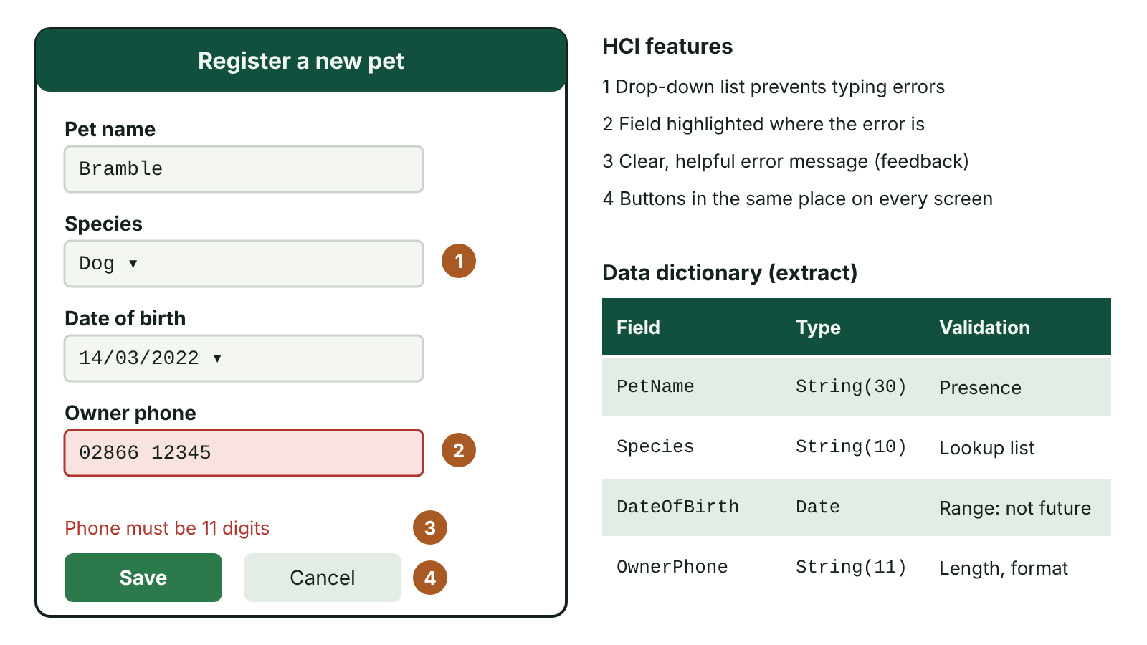
The big picture
An annotated input screen design for registering a pet, with numbered HCI features, beside part of its data dictionary
☰ Menu
Notes:
Explain the diagram in your own words before you read on.

Slide 7
Design, development and testing
Design: a creative stage that plans how the new system will meet the user requirements found during analysis
Design can only start once analysis is complete – the designer must understand what the system is for
Development: programmers turn the design into code, usually as a set of linked modules
Testing: modules are checked on their own and as they are joined, to make sure they match the specification
A good design cuts errors, development time and the cost of later maintenance
☰ Menu

Slide 8
What goes in the design document?
User interface design: screen layouts, menus and navigation between screens
Input design (data to capture and how) and output design, including printed or on-screen reports
Data structures: tables, files, records, arrays and the data dictionary
Validation and verification required for each data item
Algorithms for key processes, security/access levels and an initial test plan
Used by programmers to build, testers to test and maintenance staff to understand the system
☰ Menu

Slide 9
Storyboarding the user interface
Borrowed from film-making, where scenes are planned as a series of sketches before filming
In software, each screen or page is sketched as a frame showing what it contains
Every input and output on each screen is identified
Arrows show navigation: which button or link leads to which screen
Designers walk users through the storyboard to spot awkward routes and missing features early
☰ Menu

Slide 10
Worked example: canteen pre-order app (version 1)
Screen | Inputs | Outputs | Leads to
Log in | Pupil ID, PIN | Error message if wrong | Today’s menu
Today’s menu | Tap a dish | Dishes, prices, allergens | Dish details
Dish details | Quantity, ‘Add to basket’ | Description, price | Basket
Basket | Remove item, ‘Pay’ | Items, total, balance | Confirmation or Today’s menu
Confirmation | ‘Done’ | Order number, collection time | Log in
☰ Menu

Slide 11
Worked example: feedback changes the storyboard
A Year 9 test group in a Newry school walks through the storyboard
Problem 1: adding three dishes means going Menu → Details → Basket → Menu three times
Problem 2: there is no way to see allergens before opening each dish
Change: add a ‘+’ button and allergen icons on the menu screen; Dish details becomes optional
Result: a typical order drops from about 10 taps to 4 – found before any code was written
☰ Menu

Slide 12
Storyboarding: pros and cons
Advantages | Disadvantages
Quick and cheap to produce, even on paper | Not interactive – users cannot click through it like real software
Promotes early communication between designers and users | Gives only limited detail about each screen
Users need no technical knowledge to understand it | Cannot show speed, responsiveness or true usability
Feedback on navigation and functions is gained early | Users may imagine the finished system differently
Changes are cheap because nothing has been built yet | Usually needs a prototype later to judge real usability
☰ Menu

Slide 13
Prototyping
A prototype is an early, incomplete, working model of the software shown to users
Gives users the ‘look and feel’ of the system so they can react to something real
Often has stubs: menu options or buttons that exist but do nothing yet
Little or no validation – it may only work with perfectly correct input
Throw-away prototypes are discarded after feedback; evolutionary prototypes are refined into the final system
Both designers and programmers benefit from feedback before full development starts
☰ Menu

Slide 14
Prototyping the interface and the data model
Interface: try out menu layouts, colour schemes and screen designs and collect users’ opinions
Interface: client and developer check that the prototype meets the agreed requirements
Data model: focus on the inputs needed, the outputs required and the processing between them
Data model: this reveals the tables (entities) and relationships the system needs
Canteen example: Pupil, Dish, Order and OrderLine tables emerge from the inputs and the receipt output
☰ Menu

Slide 15
Prototyping the interface and the data model – code
C#
// Prototype main menu: only option 1 is built
Console.WriteLine("1. View today's menu");
Console.WriteLine("2. Order history");
Console.WriteLine("3. Top up balance");
string choice = Console.ReadLine();
if (choice == "1")
Console.WriteLine("Chicken curry £2.40 | Pasta bake £2.10");
else
Console.WriteLine("Coming soon"); // stub
☰ Menu

Slide 16
Prototyping: pros and cons
Advantages | Disadvantages
Improves the quality of the requirements given to developers | Can be expensive, so developers may resist big changes
Problems, refinements and enhancements are found earlier | Users may accept an early version and better ideas are lost
Users are involved, so feedback is fuller and they feel ownership | Users may focus on appearance and forget accuracy and security
A working model reduces misunderstandings | Too much time can be spent polishing the prototype
Users help shape the interface, giving a better product | Users may expect the real system to be ready very soon
☰ Menu

Slide 17
HCI principles for interface design
Principle | What it means in practice
Consistency | Same layout, colours, button positions and wording on every screen
Feedback | Confirm actions and give clear, helpful error messages
Error prevention | Drop-down lists, date pickers and validation; confirm before deleting
Low memory load | Show options rather than making users remember codes
Accessibility | Good contrast, scalable text, keyboard use, screen-reader labels, not colour alone
Suit the user | Shortcuts for experts; guidance and help for novices
☰ Menu

Slide 18
Input and output design
Input design: decide what data to capture, the method (keyboard, barcode, form, sensor) and the layout
Reduce typing and errors with drop-down lists, option buttons, date pickers and sensible defaults
Output design: decide content, format and medium of screens, reports and documents
Match outputs to the audience, e.g. a summary chart for the principal, a detailed list for the canteen manager
Designs are shown as annotated sketches, wireframes, storyboards or prototypes
☰ Menu

Slide 19
Data structures and the data dictionary
Field | Data type | Length / format | Validation rule | Example
PupilID | String | 6, format LL9999 | Presence; format; unique (primary key) | NW4821
DateOfBirth | Date | dd/mm/yyyy | Range: age 11 to 19 on 1 September | 14/03/2011
Postcode | String | 6–8 characters | Format: starts BT, then 1–2 digits | BT35 6AB
Balance | Currency | 2 d.p. | Range 0.00 to 100.00 | 12.60
FreeMeals | Boolean | 1 | Yes/No only | False
CollectBy | Time | hh:mm | Lookup: 12:40 or 13:20 only | 12:40
☰ Menu

Slide 20
Validation and verification
Validation: automatic checks by the system that data is sensible and obeys rules – it cannot prove data is correct
Checks: presence, type, range, length, format, lookup (list), check digit, consistency (cross-field)
Verification: checks data has been entered or copied accurately, e.g. typing a password twice, proof-reading
Validation rules are decided at design time and recorded in the data dictionary
☰ Menu

Slide 21
Validation and verification – code
C#
Console.Write("Top-up amount (£): ");
string input = Console.ReadLine();
decimal amount;
if (input == "")
Console.WriteLine("Presence check failed: enter an amount");
else if (!decimal.TryParse(input, out amount))
Console.WriteLine("Type check failed: enter a number");
else if (amount < 1 || amount > 50)
Console.WriteLine("Range check failed: £1 to £50 only");
else
Console.WriteLine("Accepted: £" + amount.ToString("0.00"));
☰ Menu

Slide 22
Exit quiz: question 1 of 9
Tap an answer to check it. Presenting? Click to reveal the answer.
A designer sketches every screen of a new app, lists the inputs and outputs on each and draws arrows showing how users move between them. What technique is this?
A Prototyping
B Storyboarding
✗
✓
C Black-box testing
D Data conversion
✗
✗
✓ B: Storyboarding – A storyboard is a sequence of screen sketches showing contents and navigation; it is not a working model.
☰ Menu

Slide 23
Exit quiz: question 2 of 9
Tap an answer to check it. Presenting? Click to reveal the answer.
Which is a disadvantage of prototyping rather than an advantage?
A Problems are found earlier
B Users are more involved
✗
✗
C Users may expect the finished system to be ready very soon
D Misunderstandings are reduced
✓
✗
✓ C: Users may expect the finished system to be ready very soon – Seeing something that looks finished can give users unrealistic expectations of how quickly the real system can be delivered.
☰ Menu

Slide 24
Exit quiz: question 3 of 9
Tap an answer to check it. Presenting? Click to reveal the answer.
In a prototype, a ‘Print report’ button that displays ‘Coming soon’ is an example of a…
A stub
B check digit
✓
✗
C storyboard
D patch
✗
✗
✓ A: stub – A stub is a placeholder for functionality that has not been built yet.
☰ Menu

Slide 25
Exit quiz: question 4 of 9
Tap an answer to check it. Presenting? Click to reveal the answer.
Which check ensures a field has not been left blank?
A Range
B Format
✗
✗
C Type
D Presence
✗
✓
✓ D: Presence – A presence check makes data entry in that field compulsory.
☰ Menu

Slide 26
Exit quiz: question 5 of 9
Tap an answer to check it. Presenting? Click to reveal the answer.
Checking that a follow-up date is after the appointment date is a…
A length check
B consistency (cross-field) check
✗
✓
C check digit
D type check
✗
✗
✓ B: consistency (cross-field) check – It compares the values of two fields with each other.
☰ Menu

Slide 27
Exit quiz: question 6 of 9
Tap an answer to check it. Presenting? Click to reveal the answer.
Which HCI principle is shown by placing the Save button in the same place on every screen?
A Feedback
B Accessibility
✗
✗
C Consistency
D Verification
✓
✗
✓ C: Consistency – Users learn where controls are and can work faster with fewer mistakes.
☰ Menu

Slide 28
Exit quiz: question 7 of 9
Tap an answer to check it. Presenting? Click to reveal the answer.
Proof-reading data on screen against the original paper form is…
A verification
B validation
✓
✗
C normalisation
D encryption
✗
✗
✓ A: verification – It checks the data was copied accurately from the source.
☰ Menu

Slide 29
Exit quiz: question 8 of 9
Tap an answer to check it. Presenting? Click to reveal the answer.
How can prototyping help design the data model?
A It encrypts the tables
B It removes the need for a data dictionary
✗
✗
C It tests the hardware
D Focusing on inputs, outputs and processes reveals the tables and relationships needed
✗
✓
✓ D: Focusing on inputs, outputs and processes reveals the tables and relationships needed – Working out what goes in and comes out shows what data must be stored and how it is related.
☰ Menu

Slide 30
Exit quiz: question 9 of 9
Tap an answer to check it. Presenting? Click to reveal the answer.
Which is a limitation of a storyboard?
A It needs specialist knowledge to read
B It cannot show how responsive the system will be
✗
✓
C It is expensive to produce
D It can only be made after coding
✗
✗
✓ B: It cannot show how responsive the system will be – Sketches cannot convey speed or responsiveness, so usability can only be partly judged.
☰ Menu

Slide 31
Exit quiz answers
Q | Answer | Why
1 | B Storyboarding | A storyboard is a sequence of screen sketches showing contents and navigation; it is not a working model.
2 | C Users may expect the finished system to be ready very soon | Seeing something that looks finished can give users unrealistic expectations of how quickly the real system can be delivered.
3 | A stub | A stub is a placeholder for functionality that has not been built yet.
4 | D Presence | A presence check makes data entry in that field compulsory.
5 | B consistency (cross-field) check | It compares the values of two fields with each other.
6 | C Consistency | Users learn where controls are and can work faster with fewer mistakes.
7 | A verification | It checks the data was copied accurately from the source.
8 | D Focusing on inputs, outputs and processes reveals the tables and relationships needed | Working out what goes in and comes out shows what data must be stored and how it is related.
9 | B It cannot show how responsive the system will be | Sketches cannot convey speed or responsiveness, so usability can only be partly judged.
☰ Menu

Slide 32
Testing and test plans
AS 1: APPROACHES TO SYSTEMS DEVELOPMENT · AP07
Learning objectives
Explain why testing happens at every stage and why unit testing alone is not enough
Describe each stage of testing, who carries it out and where
Compare black-box and white-box testing using an example
Write a test plan with normal, boundary and erroneous data and specific expected outcomes
Notes:
Specification: Explain the importance of testing throughout the development of a system in ensuring system quality | Describe unit and integration testing, including black-box and white-box approaches | Distinguish between system, acceptance, alpha and beta testing | Describe the purpose of a test plan and its main components | Distinguish between normal, boundary (extreme) and erroneous (invalid) test data and select examples for a given rule

Slide 33
In this lesson
Tap a button to jump straight there. The ☰ Menu button on every slide brings you back here.
The big picture
System, alpha and beta testing
Worked example: test plan for the ticket module
Why test – and why all the way through?
Acceptance testing
Finding the bug from a failed test
The stages of testing
What a test plan is for
Exit quiz
Unit testing: black box and white box
Components of a test plan
↑ Topic menu
Worked example: a water bill module
Normal, boundary and erroneous data
Integration testing
Worked example: cinema ticket categories
Notes:
Lesson menu: each button jumps to that part of the lesson in Slide Show. The ☰ Menu button on each slide returns here.

Slide 34
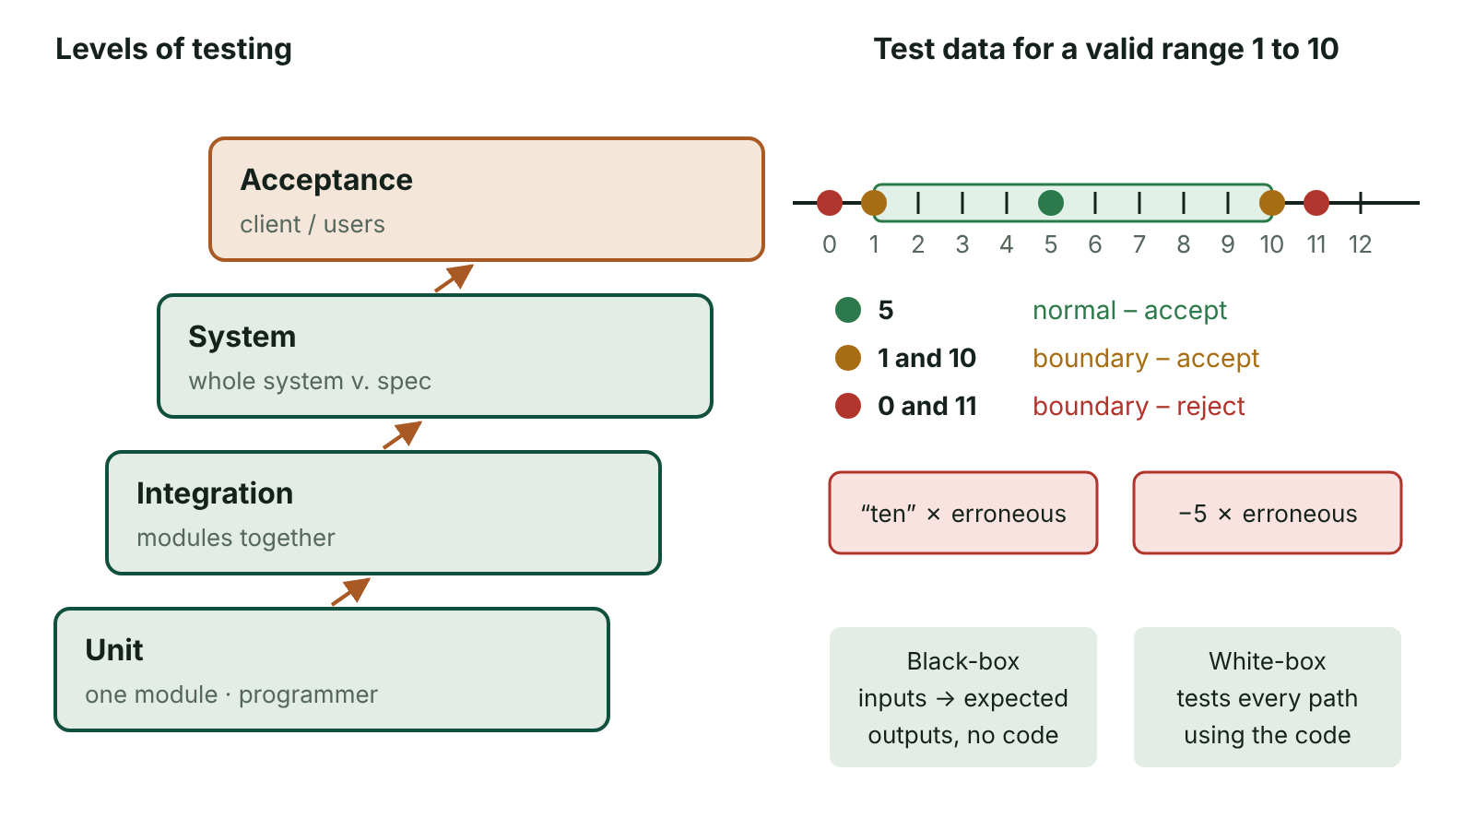
The big picture
Levels of testing from unit to acceptance, and normal, boundary and erroneous test data on a number line for a valid range of 1 to 10
☰ Menu
Notes:
Explain the diagram in your own words before you read on.

Slide 35
Why test – and why all the way through?
To find and remove errors before the system is used for real
To show the system meets the user requirements and the specification
To give the client confidence before they accept and pay for the system
Testing is ongoing: each unit, each join between units, then the whole system
An error found late costs far more to fix than one found early
Testing shows the presence of errors; it can never prove there are none
☰ Menu

Slide 36
The stages of testing
Stage | What is tested | Usually by / where
Unit | Each module or subroutine on its own | Programmer, in-house
Integration | Tested units joined, checking data passes correctly between them | Developer, in-house
System | Whole integrated system against the agreed specification | Developer’s test team, in-house
Alpha | Final in-house phase before handover, following a test plan | Developer’s staff, in-house
Beta | Pre-release version in a realistic setting | Selected external users, without developers present
Acceptance | Live environment, real volumes of data, against the requirements | Client / end users, who then sign off
☰ Menu

Slide 37
Unit testing: black box and white box
 | Black-box (functional) | White-box (structural, ‘glass box’)
Can the tester see the code? | No – only what it should do | Yes – full access to the code
Tests are based on | Inputs and expected outputs from the specification | Paths, branches and loops in the code
Typical tester | Independent or non-technical testers | Programmers
Good at finding | Missing or wrong functions | Errors in particular paths, unreachable code
Techniques | Normal, boundary and erroneous data | Dry runs, trace tables, testing every branch
☰ Menu

Slide 38
Worked example: a water bill module
A council module charges £1.50 per cubic metre (m³) for households, or £1.20 per m³ for businesses using over 100 m³
Black box: enter usage and type, compare the bill with the expected bill – e.g. household 10 m³ → £15.00
White box: the tester sees three branches and writes a test for each one
Branch tests: household 10 → £15.00; business 80 → £120.00; business 200 → £240.00
Boundary at the branch: business 100 → £150.00 and business 101 → £121.20
☰ Menu

Slide 39
Worked example: a water bill module – code
C#
decimal Bill(decimal m3, bool business)
{
if (!business)
return m3 * 1.50m; // branch 1
else if (m3 <= 100)
return m3 * 1.50m; // branch 2
else
return m3 * 1.20m; // branch 3
}
Console.WriteLine(Bill(10, false)); // 15.00
Console.WriteLine(Bill(100, true)); // 150.00
Console.WriteLine(Bill(101, true)); // 121.20
☰ Menu

Slide 40
Integration testing
Units that each work alone may still fail when joined – problems appear at the interfaces
Example: a booking unit stores dates as day/month/year but the billing unit reads month/day/year
So 04/07/2026 (4 July) is read as 7 April – each unit passed its own tests
Fixing it means changing a unit, re-running its unit tests, then integrating again
Prevention: agree data formats early, in the data dictionary
☰ Menu

Slide 41
System, alpha and beta testing
System testing: the complete system checked against its agreed specification – essentially black-box testing of the whole
Alpha testing: the final in-house phase by the developer, including unit, integration and system tests, following a test plan
Small adjustments are still possible once alpha testing ends
Beta testing: a pre-release version given to a group of potential users in a realistic environment
Beta testers work without the developers present and report faults – a form of external user acceptance testing
☰ Menu

Slide 42
Acceptance testing
The final test, after system testing, when the software is ready to hand over
End users try it out in their real working setting, using genuine data at realistic volumes
Checks the system meets their requirements and works with the organisation’s other systems
Users report problems; once these are resolved they sign off the software
Sign-off means the contract is formally complete
☰ Menu

Slide 43
What a test plan is for
Testing is systematic, not random: the plan lists every test before testing starts
Aim: test thoroughly, especially the vulnerable points such as limits and unusual paths
Should cover the requirements, performance against the design, every pathway and every validation routine
Written by the test designer; carried out and completed by the tester
A systems analyst can supply test data (especially boundaries) and check results against the specification
☰ Menu

Slide 44
Components of a test plan (1 of 2)
Column | Content | Completed by
Test number | 1, 2, 3… | Test designer
Part of system | e.g. Ticket-price module, age input | Test designer
What is tested | Type of data and purpose, e.g. ‘Boundary – lowest valid age’ | Test designer
Test data | The exact value(s) to enter | Test designer
Expected outcome | Precise result, e.g. ‘Price £4.00 shown’ | Test designer
Actual outcome | What really happened | Tester
☰ Menu

Slide 45
Components of a test plan (2 of 2)
Column | Content | Completed by
Pass / Fail | PASS if actual = expected, otherwise FAIL | Tester
☰ Menu

Slide 46
Normal, boundary and erroneous data
Normal (valid): typical data that should be accepted and processed, correct in type and format
Boundary (extreme): valid values at the very edges of the range – the most likely place for errors
Erroneous (invalid/exceptional): wrong in type, format or range – it should be rejected with a message
Many testers also test just outside each limit; record these as invalid data that should be rejected
Exam marks rule 0–100 whole numbers: normal 43, 72; boundary 0, 100; erroneous −5, 101, 55.5, ‘sixty’
☰ Menu

Slide 47
Worked example: cinema ticket categories
Category | Age rule | Normal | Boundary
Child | 3 to 15 | 9 | 3 and 15
Adult | 16 to 59 | 34 | 16 and 59
Senior | 60 to 110 | 72 | 60 and 110
Erroneous | Must be rejected | 2, 111, 12.5, ‘ten’, blank | –
☰ Menu

Slide 48
Worked example: test plan for the ticket module
No. | What is tested | Data | Expected outcome | Actual | P/F
1 | Normal – child | 9 | Child ticket £5.50 | Child ticket £5.50 | PASS
2 | Boundary – top of child | 15 | Child ticket £5.50 | Adult ticket £8.50 | FAIL
3 | Boundary – bottom of adult | 16 | Adult ticket £8.50 | Adult ticket £8.50 | PASS
4 | Erroneous – decimal | 12.5 | ‘Enter a whole number’ | ‘Enter a whole number’ | PASS
5 | Erroneous – text | ten | ‘Enter a whole number’ | Program crashed | FAIL
☰ Menu

Slide 49
Finding the bug from a failed test
Test 2 failed: age 15 gave an adult ticket
Cause: the programmer wrote age < 15 instead of age <= 15 (an off-by-one error)
Test 5 failed: int.Parse crashes on text, so int.TryParse is used instead
After fixing, re-run every test, not just the failed ones (regression testing)
☰ Menu

Slide 50
Finding the bug from a failed test – code
C#
Console.Write("Age: ");
int age;
if (!int.TryParse(Console.ReadLine(), out age) || age < 3 || age > 110)
Console.WriteLine("Enter a whole number from 3 to 110");
else if (age <= 15) // was age < 15 – failed test 2
Console.WriteLine("Child ticket £5.50");
else if (age <= 59)
Console.WriteLine("Adult ticket £8.50");
else
Console.WriteLine("Senior ticket £6.00");
☰ Menu

Slide 51
Exit quiz: question 1 of 9
Tap an answer to check it. Presenting? Click to reveal the answer.
Two modules each pass their own tests, but when joined one reads dates as day/month/year and the other as month/day/year. Which stage of testing should find this?
A Unit testing
B Integration testing
✗
✓
C Beta testing
D White-box testing of one module
✗
✗
✓ B: Integration testing – The fault lies at the interface between units, which is exactly what integration testing checks.
☰ Menu

Slide 52
Exit quiz: question 2 of 9
Tap an answer to check it. Presenting? Click to reveal the answer.
A games studio releases a pre-release version to 2 000 volunteer players who play at home and report bugs. This is…
A alpha testing
B acceptance testing
✗
✗
C beta testing
D unit testing
✓
✗
✓ C: beta testing – External potential users test a near-final version in a realistic environment, without developers present.
☰ Menu

Slide 53
Exit quiz: question 3 of 9
Tap an answer to check it. Presenting? Click to reveal the answer.
Testing a single subroutine on its own is…
A unit testing
B system testing
✓
✗
C acceptance testing
D beta testing
✗
✗
✓ A: unit testing – One unit or module is tested in isolation.
☰ Menu

Slide 54
Exit quiz: question 4 of 9
Tap an answer to check it. Presenting? Click to reveal the answer.
Which testing approach designs tests so that every branch of an IF statement is run?
A Black-box
B Beta
✗
✗
C Acceptance
D White-box
✗
✓
✓ D: White-box – White-box testing uses the internal structure of the code.
☰ Menu

Slide 55
Exit quiz: question 5 of 9
Tap an answer to check it. Presenting? Click to reveal the answer.
Valid range 10 to 20 whole numbers. Which is erroneous data?
A 15
B 10
✗
✗
C twelve
D 20
✓
✗
✓ C: twelve – Text in a numeric field is the wrong type, so it should be rejected.
☰ Menu

Slide 56
Exit quiz: question 6 of 9
Tap an answer to check it. Presenting? Click to reveal the answer.
Which test is carried out by end users with real volumes of data, before they sign off the system?
A Acceptance
B Alpha
✓
✗
C Integration
D Unit
✗
✗
✓ A: Acceptance – Acceptance testing is the final test by the client in a live environment.
☰ Menu

Slide 57
Exit quiz: question 7 of 9
Tap an answer to check it. Presenting? Click to reveal the answer.
Grades: Fail 0–39, Pass 40–59. Which pair are both boundary values?
A 20 and 50
B 39 and 40
✗
✓
C 41 and 58
D −1 and 101
✗
✗
✓ B: 39 and 40 – 39 and 40 sit either side of the Fail/Pass edge, where off-by-one errors occur.
☰ Menu

Slide 58
Exit quiz: question 8 of 9
Tap an answer to check it. Presenting? Click to reveal the answer.
Who normally completes the ‘Actual outcome’ and ‘PASS/FAIL’ columns of a test plan?
A The client’s accountant
B The test designer, before testing
✗
✗
C The tester, while carrying out the tests
D The beta testers’ manager
✓
✗
✓ C: The tester, while carrying out the tests – The designer writes the expected outcome in advance; the tester records what actually happened.
☰ Menu

Slide 59
Exit quiz: question 9 of 9
Tap an answer to check it. Presenting? Click to reveal the answer.
System testing checks the complete system against…
A competitors’ products
B the agreed specification
✗
✓
C the old system’s source code
D the hardware warranty
✗
✗
✓ B: the agreed specification – System testing judges whether the integrated system complies with its specification.
☰ Menu

Slide 60
Exit quiz answers
Q | Answer | Why
1 | B Integration testing | The fault lies at the interface between units, which is exactly what integration testing checks.
2 | C beta testing | External potential users test a near-final version in a realistic environment, without developers present.
3 | A unit testing | One unit or module is tested in isolation.
4 | D White-box | White-box testing uses the internal structure of the code.
5 | C twelve | Text in a numeric field is the wrong type, so it should be rejected.
6 | A Acceptance | Acceptance testing is the final test by the client in a live environment.
7 | B 39 and 40 | 39 and 40 sit either side of the Fail/Pass edge, where off-by-one errors occur.
8 | C The tester, while carrying out the tests | The designer writes the expected outcome in advance; the tester records what actually happened.
9 | B the agreed specification | System testing judges whether the integrated system complies with its specification.
☰ Menu

