Slide 1
System implementation
AS 1: APPROACHES TO SYSTEMS DEVELOPMENT · TOPIC
Lessons in this topic
AP08 Implementation: changeover, data conversion and training
AP09 Documentation, maintenance and evaluation

Slide 2

Topic menu
Tap a button to jump straight there. The ☰ Menu button on every slide brings you back here.
Specification map
AP09 Documentation, maintenance and evaluation
AP08 Implementation: changeover, data conversion and training

Slide 3
Specification map
Lesson | Specification: students should be able to
AP08 | Describe the purpose of system implementation and the tasks it involves; Describe and evaluate parallel, direct, pilot and phased changeover; Recommend and justify a changeover method for a given scenario; Explain what is meant by data conversion and describe what it involves; Describe methods of training users and evaluate their suitability
AP09 | Explain why documentation is produced at each stage of system development; Describe user documentation and technical documentation and explain how each is used; Describe the purpose of system maintenance and the reasons it is needed; Describe and evaluate corrective, adaptive and perfective maintenance; Describe the purpose and content of a post-implementation review
☰ Menu
Notes:
Each lesson below is its own section in PowerPoint (View → Slide Sorter shows them). To split this deck by specification point, right-click a section → Move Section, or delete the sections you do not need.

Slide 4
Implementation: changeover, data conversion and training
AS 1: APPROACHES TO SYSTEMS DEVELOPMENT · AP08
Learning objectives
Describe what implementation involves and why it must be planned
Describe the four changeover methods, with a benefit and a drawback of each
Choose and justify the most suitable changeover method for an organisation
Explain data conversion from a paper-based or older computer system
Compare methods of training users
Notes:
Specification: Describe the purpose of system implementation and the tasks it involves | Describe and evaluate parallel, direct, pilot and phased changeover | Recommend and justify a changeover method for a given scenario | Explain what is meant by data conversion and describe what it involves | Describe methods of training users and evaluate their suitability

Slide 5
In this lesson
Tap a button to jump straight there. The ☰ Menu button on every slide brings you back here.
The big picture
Phased changeover
Worked example: a garden centre goes digital
What is implementation?
Comparing changeover methods
Training users
Parallel changeover
Choosing a changeover method
Training and changeover together
Direct changeover
Worked example: which method?
Exit quiz
Pilot changeover
Data conversion
↑ Topic menu
Notes:
Lesson menu: each button jumps to that part of the lesson in Slide Show. The ☰ Menu button on each slide returns here.

Slide 6
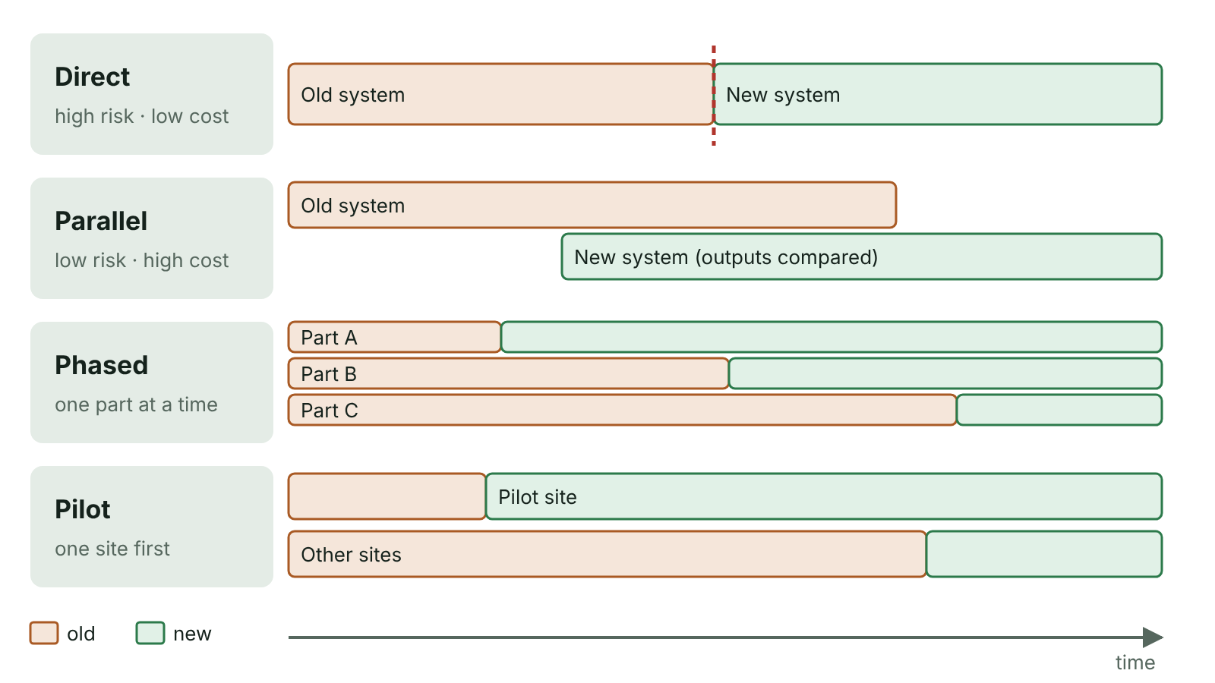
The big picture
Timelines comparing direct, parallel, phased and pilot changeover, showing when the old and new systems are in use
☰ Menu
Notes:
Explain the diagram in your own words before you read on.

Slide 7
What is implementation?
Implementation puts the new system into operation and replaces the old one
Planned while the system is still being developed, not after
Resources must be ready: trained staff, installed hardware, networks and software
Existing data is converted into the new system’s format (data conversion)
Documentation is supplied, and a changeover method is chosen: parallel, direct, pilot or phased
Once live, the system will need ongoing maintenance
☰ Menu

Slide 8
Parallel changeover
Both systems operate at the same time, processing the same transactions
Each transaction is done twice; outputs are compared to prove the new system is correct
When the new system is proven reliable, the old one is switched off
Benefits: very safe – the old system is a backup; staff have time to get used to the new one
Drawbacks: expensive and time-consuming; comparing results takes time; two sets of data may get out of step
☰ Menu

Slide 9
Direct changeover
The ‘big bang’: on a set date the old system stops and the new one starts immediately
No overlap and no duplicated work
Benefits: no work is done twice; all staff switch over together on the same day
Drawbacks: high risk – should the new system break down, returning to the old one may be difficult or impossible
Drawback: there may be a gap when neither system is working
Used when running both is impossible – e.g. Sweden switching from driving on the left to the right in 1967
☰ Menu

Slide 10
Pilot changeover
The whole new system is introduced in one department, branch or site first
Once proven, it is extended to every other site or department
Suits organisations with several similar sections, e.g. bank branches or shops in a chain
Benefits: only one section affected by problems; pilot users can train others
Drawbacks: two systems run in different sections, needing extra resources; data may be hard to share between them
☰ Menu

Slide 11
Phased changeover
The new system is introduced one component at a time, e.g. payroll first, then invoicing, then stock
Each part is made to work satisfactorily before the next is switched on
Suits systems made of separate parts that can be introduced independently
Benefits: staff learn in stages, which is less stressful; a problem affects only one part
Drawbacks: the whole changeover takes a long time; requests for changes to early parts can delay later ones
☰ Menu

Slide 12
Comparing changeover methods
Method | Risk | Cost | Time to finish | NI example
Parallel | Lowest | Highest | Medium | A Lisburn accountancy firm keeps its old payroll running for two months
Direct | Highest | Lowest | Fastest | A small Portrush café swaps its till software overnight
Pilot | Low–medium | Medium | Slow | A credit union tests new software in its Strabane office first
Phased | Medium | Medium | Slowest | A school MIS: attendance first, then reports, then timetabling
☰ Menu

Slide 13
Choosing a changeover method
Organisations want the lowest-risk, most cost-effective method that is actually possible
Pilot is often a good balance where there are several similar sites
Parallel is worth its cost where failure could cause injury or major financial loss
Phased suits systems with distinct parts that can work independently
Direct is high risk – use only when there is no realistic alternative, ideally at a quiet time and with trained staff
Always justify the choice using details from the scenario
☰ Menu

Slide 14
Worked example: which method?
Scenario | Method | Why
A bakery chain sells a new recipe in its Ballymena shop before all shops | Pilot | Whole change, one site first
A pharmacy keeps paper records for six weeks while also using new software | Parallel | Both systems used for the same work
A council moves to a new phone system over one weekend | Direct | Old switched off, new on, no overlap
A hotel adds online booking, then housekeeping, then billing modules | Phased | One component at a time
A pupil keeps a paper planner while also trying a homework app for a month | Parallel | Paper planner is a fallback
☰ Menu

Slide 15
Data conversion
Transferring existing records into the structure and format the new system expects
From paper: create the new database structure, then key in or scan forms, orders and invoices
Entered data must be verified (e.g. proof-reading, double entry) and validated
Large volumes, such as scanned images, can take a long time and many staff
From an older computer system: usually quicker, but may need specialist or bespoke conversion software
Errors in converted data undermine trust in the new system from day one
☰ Menu

Slide 16
Worked example: a garden centre goes digital
A Cookstown garden centre keeps customers in a card index and orders in a diary
Step 1: design tables – Customer, Product, Order – using the data dictionary
Step 2: staff key in about 1 200 customer cards; repeat customers are entered once, not every order
Step 3: verify by proof-reading a sample against the cards; validation catches impossible postcodes
Step 4: phased changeover – customer records first, then orders, then invoicing
☰ Menu

Slide 17
Training users
Method | Advantages | Disadvantages
Classroom / instructor-led | Questions answered; hands-on; consistent | Expensive; staff away from work; fixed pace
One-to-one / on the job | Tailored; learn with real tasks | Slow and costly for many staff
E-learning / video tutorials | Any time, own pace, cheap per person, repeatable | No immediate help; needs motivation
Manuals and online help | Reference later; cheap | Users may not read them
Cascade (train the trainer) | Cheap for large organisations; local experts | Quality may drop at each level
☰ Menu

Slide 18
Training and changeover together
Direct changeover needs everyone fully trained before the switch date
Parallel running gives time to practise, but staff are doing double work
Pilot staff gain experience and can become trainers for the next sites (links to cascade training)
Phased changeover allows training one component at a time
Well-trained staff are more likely to accept the new system rather than resist it
☰ Menu

Slide 19
Exit quiz: question 1 of 9
Tap an answer to check it. Presenting? Click to reveal the answer.
A bank installs a new system but also keeps running its old system for three months, comparing the results of both. Which changeover method is this?
A Direct
B Parallel
✗
✓
C Pilot
D Phased
✗
✗
✓ B: Parallel – Both systems run at the same time on the same work and outputs are compared, so the old system is a fallback.
☰ Menu

Slide 20
Exit quiz: question 2 of 9
Tap an answer to check it. Presenting? Click to reveal the answer.
A council introduces its new planning system in its Omagh office before all its other offices. Which method is this?
A Phased
B Direct
✗
✗
C Pilot
D Parallel
✓
✗
✓ C: Pilot – The whole system is used in one site first, then rolled out to the rest.
☰ Menu

Slide 21
Exit quiz: question 3 of 9
Tap an answer to check it. Presenting? Click to reveal the answer.
Which is a drawback of direct changeover?
A There may be nothing to go back to if the new system fails
B Every transaction must be entered twice
✓
✗
C It takes the longest of all methods
D Two systems run in different branches
✗
✗
✓ A: There may be nothing to go back to if the new system fails – With no overlap, a failure can leave the organisation without a working system.
☰ Menu

Slide 22
Exit quiz: question 4 of 9
Tap an answer to check it. Presenting? Click to reveal the answer.
A leisure centre refurbishes its gym, then its pool, then its reception, finishing each before starting the next. This is most like which changeover method?
A Pilot
B Parallel
✗
✗
C Direct
D Phased
✗
✓
✓ D: Phased – One component is completed before the next is started.
☰ Menu

Slide 23
Exit quiz: question 5 of 9
Tap an answer to check it. Presenting? Click to reveal the answer.
Which is the best description of data conversion?
A Training staff to use the new system
B Transferring existing records into the format the new system expects
✗
✓
C Fixing bugs after the system goes live
D Running two systems together
✗
✗
✓ B: Transferring existing records into the format the new system expects – Data conversion turns old records, paper or electronic, into the new system’s format.
☰ Menu

Slide 24
Exit quiz: question 6 of 9
Tap an answer to check it. Presenting? Click to reveal the answer.
In which situation is parallel running most justified despite its cost?
A A café’s menu display screen
B A school’s lunchtime music playlist
✗
✗
C A payroll system where errors mean staff are paid wrongly
D A personal blog
✓
✗
✓ C: A payroll system where errors mean staff are paid wrongly – When failure would be very costly, keeping the old system as a backup is worth the expense.
☰ Menu

Slide 25
Exit quiz: question 7 of 9
Tap an answer to check it. Presenting? Click to reveal the answer.
Which is a drawback of phased changeover?
A The whole changeover can take a long time
B Everyone changes at once
✓
✗
C No training is possible
D Data never needs converting
✗
✗
✓ A: The whole changeover can take a long time – Introducing components one after another stretches the changeover over a long period.
☰ Menu

Slide 26
Exit quiz: question 8 of 9
Tap an answer to check it. Presenting? Click to reveal the answer.
Training a few staff who then train their colleagues is called…
A e-learning
B beta testing
✗
✗
C cascade training
D parallel training
✓
✗
✓ C: cascade training – Also called train the trainer; it suits large organisations with many sites.
☰ Menu

Slide 27
Exit quiz: question 9 of 9
Tap an answer to check it. Presenting? Click to reveal the answer.
Why was Sweden’s 1967 switch to driving on the right a direct changeover?
A It was the cheapest software option
B Driving on both sides at once was impossible
✗
✓
C It was tested in one town first
D It was introduced one road at a time
✗
✗
✓ B: Driving on both sides at once was impossible – When old and new cannot run together, direct changeover is the only option, so careful planning is essential.
☰ Menu

Slide 28
Exit quiz answers
Q | Answer | Why
1 | B Parallel | Both systems run at the same time on the same work and outputs are compared, so the old system is a fallback.
2 | C Pilot | The whole system is used in one site first, then rolled out to the rest.
3 | A There may be nothing to go back to if the new system fails | With no overlap, a failure can leave the organisation without a working system.
4 | D Phased | One component is completed before the next is started.
5 | B Transferring existing records into the format the new system expects | Data conversion turns old records, paper or electronic, into the new system’s format.
6 | C A payroll system where errors mean staff are paid wrongly | When failure would be very costly, keeping the old system as a backup is worth the expense.
7 | A The whole changeover can take a long time | Introducing components one after another stretches the changeover over a long period.
8 | C cascade training | Also called train the trainer; it suits large organisations with many sites.
9 | B Driving on both sides at once was impossible | When old and new cannot run together, direct changeover is the only option, so careful planning is essential.
☰ Menu

Slide 29
Documentation, maintenance and evaluation
AS 1: APPROACHES TO SYSTEMS DEVELOPMENT · AP09
Learning objectives
Explain why documentation is produced throughout development
Compare user and technical documentation by audience and content
Classify maintenance tasks as corrective, adaptive or perfective and justify the choice
Explain who usually pays for each type of maintenance and what it reveals about the project
Describe how a system is evaluated after implementation
Notes:
Specification: Explain why documentation is produced at each stage of system development | Describe user documentation and technical documentation and explain how each is used | Describe the purpose of system maintenance and the reasons it is needed | Describe and evaluate corrective, adaptive and perfective maintenance | Describe the purpose and content of a post-implementation review

Slide 30
In this lesson
Tap a button to jump straight there. The ☰ Menu button on every slide brings you back here.
The big picture
Annotated code is technical documentation
Worked example: a Belfast gym booking system
Why document every stage?
Why maintenance is always needed
Post-implementation review
User documentation
Corrective maintenance
Evaluation criteria
Technical documentation
Adaptive maintenance
Exit quiz
User or technical?
Perfective maintenance
↑ Topic menu
Notes:
Lesson menu: each button jumps to that part of the lesson in Slide Show. The ☰ Menu button on each slide returns here.

Slide 31
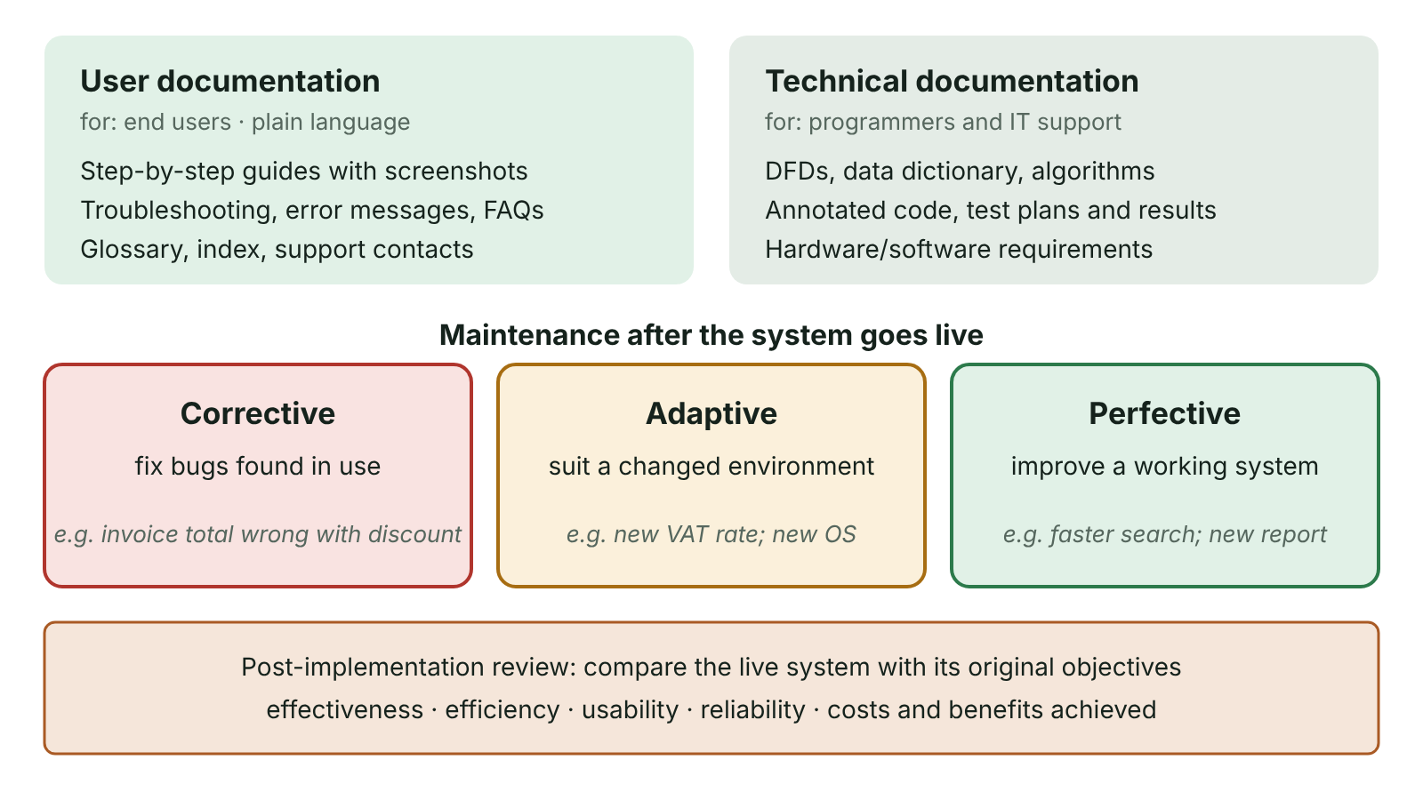
The big picture
User and technical documentation compared, the three types of maintenance with examples, and the post-implementation review
☰ Menu
Notes:
Explain the diagram in your own words before you read on.

Slide 32
Why document every stage?
Each stage’s documents are the starting point for the next stage, e.g. the design document for programmers
They record the work done at each stage
They help maintenance by keeping a record of what was built and every later change
They let new team members take over if staff leave or change role
Two main types for the finished system: user documentation and technical documentation
☰ Menu

Slide 33
User documentation
For the end users of the system, in plain, non-technical language
Overview/introduction to the system; hardware and software requirements; installation instructions
User guide: step-by-step instructions, usually with screenshots, for common tasks
Troubleshooting section, error messages explained, and FAQs
Training materials, plus backup and routine maintenance procedures
Formats: printed manual, online help, context-sensitive help, video tutorials
☰ Menu

Slide 34
Technical documentation
For the system administrator, maintenance programmers and technically skilled users
System specification and user requirements
Data models: DFDs, ER diagrams, data dictionary; input/output design; report specifications; query designs
Program code listings, annotated with comments; algorithms
Test plans, the test data and the outcomes recorded
Detailed hardware and software configuration, e.g. server and network settings
☰ Menu

Slide 35
User or technical?
Item | Type | Who uses it
How to book a class from your phone (with screenshots) | User | Gym members
What to do if ‘Payment declined’ appears | User | Members, reception staff
Entity relationship diagram for Member, Class, Booking | Technical | Maintenance programmers
Annotated source code for the booking module | Technical | Maintenance programmers
How to back up the bookings each night | User | Administrator / office staff
Test plan and results for the payment module | Technical | Developers, testers
☰ Menu

Slide 36
Annotated code is technical documentation
Comments explain the purpose of each module, its parameters and any non-obvious logic
Meaningful identifiers make code self-documenting
Makes corrective, adaptive and perfective maintenance quicker, cheaper and safer
☰ Menu

Slide 37
Annotated code is technical documentation – code
C#
// CalculateFee: returns the monthly fee for a gym member
// Parameters: age in years, isStudent (true if full-time student)
// Rules agreed with client (requirements spec, section 4.2):
// under 18 = £15, student = £20, everyone else = £32
decimal CalculateFee(int age, bool isStudent)
{
if (age < 18) return 15m;
if (isStudent) return 20m;
return 32m;
}
Console.WriteLine(CalculateFee(16, false)); // 15
Console.WriteLine(CalculateFee(21, true)); // 20
☰ Menu

Slide 38
Why maintenance is always needed
System maintenance: any change made to a system during its lifespan after it goes live
An error is found during use that testing missed
The organisation’s business processes change, or the law changes
A security vulnerability is discovered
An improvement is identified, or new hardware or networks can be taken advantage of
Over a system’s life, maintenance often costs more than the original development
☰ Menu

Slide 39
Corrective maintenance
Fixing flaws or weaknesses found after the system is in use, e.g. bugs or a security hole
Most urgent when the system is insecure or cannot do its basic tasks
Often delivered as a software patch, downloaded and often installed automatically
Usually done by the original developers; free if caused by programmer error, otherwise under a maintenance contract
Should decrease over time as errors are found and removed
☰ Menu

Slide 40
Adaptive maintenance
Changing the system because circumstances have changed, so it can still do its job
External changes: a new VAT or tax rate, new legislation, a new operating system
Internal changes: a new discount policy, a new branch, more users at once
Usually paid for by the client, as it adds functionality not in the original specification
Some is inevitable; a lot soon after go-live may mean requirements were poorly analysed
☰ Menu

Slide 41
Perfective maintenance
Improving a system that already works, to make it faster, easier or better
Redesigning input forms to be quicker to use; clearer help or error messages
Keyboard shortcuts for experienced users
Archiving old records so searches run faster
Using larger monitors better, or redesigning the interface for mobile devices
☰ Menu

Slide 42
Worked example: a Belfast gym booking system
Change needed | Type | Why
Booking confirmations are emailed twice to every member | Corrective | The system does not behave as specified
The gym opens a second site in Bangor, so bookings need a site field | Adaptive | Internal circumstances have changed
Data protection law changes how long records may be kept | Adaptive | External change: legislation
Members want to rebook last week’s class with one tap | Perfective | Works already; this improves usability
The class list takes 8 seconds to load; old bookings are archived | Perfective | Improves performance
Members with an apostrophe in their surname cannot log in | Corrective | A bug found during use
☰ Menu

Slide 43
Post-implementation review
A formal evaluation carried out after the system has been in use for some time
Compares the system with the objectives and requirements agreed during analysis
Evidence: user questionnaires and interviews, performance figures, help-desk logs, financial records
Identifies remaining problems and future maintenance needs
Records lessons learned for future projects
☰ Menu

Slide 44
Evaluation criteria
Criterion | Question to ask | Evidence
Effectiveness | Does it meet the requirements? | Requirements checklist, acceptance test results
Efficiency | Is it fast and economical? | Response and processing times, running costs
Usability | Do users find it easy? | Questionnaires, interviews, help-desk calls
Reliability | Does it fail or lose data? | Downtime logs, error reports
Cost–benefit | Were the predicted savings achieved? | Financial records against the feasibility forecast
☰ Menu

Slide 45
Exit quiz: question 1 of 9
Tap an answer to check it. Presenting? Click to reveal the answer.
A system is changed because the government introduces a new rate of VAT. Which type of maintenance is this?
A Corrective
B Perfective
✗
✗
C Adaptive
D Preventive testing
✓
✗
✓ C: Adaptive – The system was correct when built but an external change means it must be adapted.
☰ Menu

Slide 46
Exit quiz: question 2 of 9
Tap an answer to check it. Presenting? Click to reveal the answer.
Who is technical documentation mainly written for?
A Customers of the business
B Administrators and maintenance programmers
✗
✓
C Shareholders
D Beta testers only
✗
✗
✓ B: Administrators and maintenance programmers – It explains how the system works so it can be maintained and extended.
☰ Menu

Slide 47
Exit quiz: question 3 of 9
Tap an answer to check it. Presenting? Click to reveal the answer.
Making a slow report run much faster is…
A perfective maintenance
B corrective maintenance
✓
✗
C adaptive maintenance
D acceptance testing
✗
✗
✓ A: perfective maintenance – It improves a system that already works correctly.
☰ Menu

Slide 48
Exit quiz: question 4 of 9
Tap an answer to check it. Presenting? Click to reveal the answer.
Which item belongs in user documentation?
A Data dictionary
B Annotated code listing
✗
✗
C Test results
D Troubleshooting guide
✗
✓
✓ D: Troubleshooting guide – It helps users solve common problems themselves.
☰ Menu

Slide 49
Exit quiz: question 5 of 9
Tap an answer to check it. Presenting? Click to reveal the answer.
Shortly after go-live, a system crashes whenever a surname contains an apostrophe. The fix is…
A adaptive maintenance
B corrective maintenance
✗
✓
C perfective maintenance
D data conversion
✗
✗
✓ B: corrective maintenance – It is a flaw that should not have been there, so it is corrected.
☰ Menu

Slide 50
Exit quiz: question 6 of 9
Tap an answer to check it. Presenting? Click to reveal the answer.
What is a software patch?
A A small update that fixes or improves a program
B A type of storyboard
✓
✗
C A changeover method
D A user guide
✗
✗
✓ A: A small update that fixes or improves a program – Patches are commonly downloaded and installed automatically to correct flaws.
☰ Menu

Slide 51
Exit quiz: question 7 of 9
Tap an answer to check it. Presenting? Click to reveal the answer.
Which is NOT a reason for producing documentation at each stage?
A To give the following stage something to build on
B To aid maintenance
✗
✗
C To replace the need for testing
D To cope with changes of staff in the team
✓
✗
✓ C: To replace the need for testing – Documentation records and supports work; it never replaces testing.
☰ Menu

Slide 52
Exit quiz: question 8 of 9
Tap an answer to check it. Presenting? Click to reveal the answer.
A post-implementation review compares the system with…
A competitors’ systems
B the source code
✗
✗
C the original objectives and requirements
D the old hardware
✓
✗
✓ C: the original objectives and requirements – It measures whether the project achieved what it set out to do.
☰ Menu

Slide 53
Exit quiz: question 9 of 9
Tap an answer to check it. Presenting? Click to reveal the answer.
Who usually pays for adaptive maintenance?
A The client organisation
B The original programmer personally
✓
✗
C Nobody – it is always free
D The beta testers
✗
✗
✓ A: The client organisation – It adds features beyond what the client originally specified.
☰ Menu

Slide 54
Exit quiz answers
Q | Answer | Why
1 | C Adaptive | The system was correct when built but an external change means it must be adapted.
2 | B Administrators and maintenance programmers | It explains how the system works so it can be maintained and extended.
3 | A perfective maintenance | It improves a system that already works correctly.
4 | D Troubleshooting guide | It helps users solve common problems themselves.
5 | B corrective maintenance | It is a flaw that should not have been there, so it is corrected.
6 | A A small update that fixes or improves a program | Patches are commonly downloaded and installed automatically to correct flaws.
7 | C To replace the need for testing | Documentation records and supports work; it never replaces testing.
8 | C the original objectives and requirements | It measures whether the project achieved what it set out to do.
9 | A The client organisation | It adds features beyond what the client originally specified.
☰ Menu

